Slide 1

Learning about Social Learning in MOOCs:
From Statistical Analysis to Generative Model
Name : MOHAMMED INTISHAR RAHMAN
ID : 20301191

Slide 2

Introduction
"Welcome to the introduction, where we lay the foundation for our exploration into 'Learning about Social Learning in MOOCs.' In this paper, we dive into the intriguing world of Massive Open Online Courses, or MOOCs, and their discussion forums. These forums have become hubs of interaction, learning, and collaboration for students worldwide. The authors of this research paper recognized the importance of understanding the dynamics within these forums to enhance the quality of online education. We'll delve into their insights and findings, shedding light on how these forums shape our learning experiences and how we can make them even more effective."

Slide 3

RESEARCH QUESTIONS
"Now, let's dive into the heart of our investigation with the research questions. Our study focuses on two critical aspects of online learning through MOOC discussion forums:
Forum Participation Decline:
We're exploring why forum activity tends to decline over time despite initial enthusiasm.
Information Overload: We're delving into the challenge of managing the overwhelming number of threads in these forums.
Understanding these questions is crucial as we aim to unlock the potential of online learning platforms and create a more engaging and productive learning environment."

Slide 4

Teaching Staff Participation: We found that active involvement of the teaching staff correlated with increased discussion volume. However, it did not mitigate the decline in participation over time.
DATA ANALYSIS
"Let's delve into our data analysis phase, where we meticulously examined a vast dataset from Coursera. During this phase, we made fascinating observations that shed light on the dynamics of MOOC forums:
Statistical Insights: Through in-depth statistical analysis, we uncovered valuable insights into user behavior and the factors influencing it. These insights provided a foundation for our subsequent investigations."

Slide 5

Graphs and Statistics: On this slide, we present graphs and statistics that vividly illustrate the connection between teaching staff involvement and discussion volume. We quantified how their engagement influences the overall activity within the forum.
TEACHING STAFF PARTICIPATION
"Now, let's focus on the impact of teaching staff participation:
Enhancing Engagement: Our findings suggest that teaching staff participation leads to an increase in forum engagement. However, intriguingly, despite their involvement, we observed a persistent decline in user participation over time. This highlights the complexity of user behavior and the need for deeper insights."

Slide 6
Research Findings: On this slide, we address a crucial issue - the decline in user participation over the course of time. Our extensive analysis revealed a recurring pattern of reduced engagement, which poses challenges to the sustainability of online learning communities.
DECLINE IN PARTICIPATION
"Now, let's delve into the decline of participation over time:
Insights from Analysis: Through our statistical examination, we've identified a distinct trend in MOOC forums where user engagement gradually decreases. Despite active teaching staff participation, this decline persists, indicating the need for innovative strategies to maintain and revitalize user interaction."

Slide 7
Keyword Extraction Algorithm: This algorithm is designed to extract relevant keywords from forum discussions. By considering both background and course-specific training data, it identifies keywords that are highly indicative of course topics. This algorithm aids in summarizing essential course information and identifying key points of focus.
.
PROOF-OF-CONCEPT ALGORITHMS
"Now, let's explore our innovative proof-of-concept algorithms:
Relevance-Ranking Algorithm: Our second algorithm tackles the challenge of ranking discussion threads based on relevance. It assigns weights to keywords extracted using the previous algorithm and computes scores for threads. This enables us to prioritize threads that contain more relevant keywords, ultimately assisting learners in accessing pertinent information effectively."

Slide 8
Process: This algorithm leverages both background and course-dependent training data to extract keywords. By considering surprise weights based on the difference between course-specific and background probabilities, it ranks words and generates a list of relevant keywords.
KEYWORD EXTRACTION ALGORITHM
Benefits: The Keyword Extraction Algorithm enables the identification of course-specific keywords that might not be found in syllabi or traditional methods. This ensures that the extracted keywords align with the actual focus of discussions, offering a more accurate reflection of key topics.

Slide 9
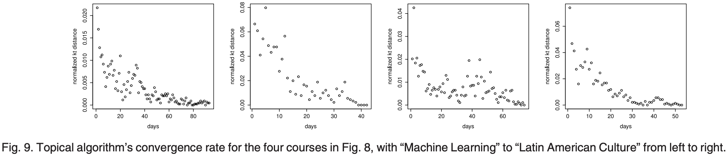
The algorithm was tested on 10 randomly selected high-discussion-volume courses out of 78 options. Courses with at least 15 new threads on 25 days were considered. The algorithm effectively identified keywords in these test courses, revealing meaningful terms not present in syllabi. The convergence rate analysis showed stability in the top-50 keywords within around 10 days. High-inverse document frequency terms were often meaningless, emphasizing the algorithm's ability to capture specific discussion details.
KEYWORD EXTRACTION ALGORITHM

Slide 10
Purpose: The Relevance-Ranking Algorithm is designed to rank discussion threads based on their relevance to the course topics. It assigns weights to keywords and calculates scores for threads, enabling the prioritization of threads that are most aligned with the course content.
RELEVANCE-RANKING ALGORITHM
Functionality: By summing keyword weights and generating scores, this algorithm helps mitigate the problem of information overload. It guides learners toward discussions that are most pertinent to their learning goals, improving the quality of their forum engagement."

Slide 11
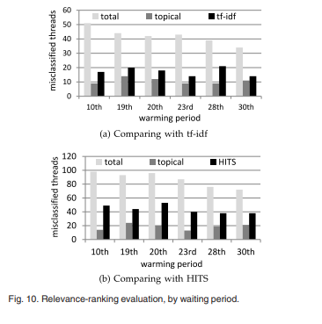
We compare our algorithm with two natural baselines, one term-based and one “random walk”- based. We use tf-idf and Kleinberg HITS-type algorithm respectively. Tf-idf algorithm assigns scores to words in threads and ranks threads based on word scores. Kleinberg HITS-type algorithm measures thread popularity based on user interactions.
The key differences is our algorithm considers all threads in a course, while tf-idf focuses on individual threads. Tf-idf may misweigh non-relevant threads with high idf values (e.g., non-English discussions) and HITS focuses on popularity, not thread relevance
RELEVANCE-RANKING ALGORITHM

Slide 12
Methodology: We employed rigorous evaluations using real-world data. Threads recommended by each algorithm were compared, and human judgments were collected through MTurk to determine relevance.
Positive Results: Our algorithms demonstrated significant improvement over baseline methods in ranking relevant threads. The Keyword Extraction Algorithm successfully identified course-specific keywords, enhancing thread discovery. The Relevance-Ranking Algorithm alleviated information overload, directing learners to threads aligned with their learning needs."
EVALUATION OF ALGORITHMS

Slide 13
Improving Learning: By addressing participation decline and information overload, we aim to create a more engaging and effective learning experience.
Open Research Problems: Our study highlights the need to further investigate methods for sustaining forum participation and leveraging thread rankings for personalized recommendations. These challenges open avenues for future research and innovation in online education."
LARGER GOALS

Slide 14

CONCLUSION
"In conclusion, our research paper has made significant contributions to understanding social learning dynamics in MOOCs:
Insights into Participation: We've uncovered patterns of decline in forum participation over time, shedding light on challenges faced by online learners.
Algorithmic Solutions: Our proof-of-concept algorithms, the Keyword Extraction Algorithm and Relevance-Ranking Algorithm, offer effective ways to address information overload and facilitate personalized learning.
Path to Improvement: By exploring these challenges, we pave the way for enhancing the quality of online education through improved forum engagement and tailored recommendations.

Slide 15

Understanding social learning dynamics is pivotal for transforming the landscape of online education. Our work underscores the need for ongoing research to optimize learning experiences in MOOCs."

