Slide 1
Machine Learning Classifications Of Coronary Artery Disease
Name: Mohammed Intishar Rahman
ID:20301191

Slide 2
Introduction:
Cardiovascular diseases, responsible for a third of global deaths annually, with coronary artery disease (CAD) being the primary cause, prompt intensive efforts in diagnosis, treatment, and prevention. Machine learning (ML) algorithms play a crucial role by leveraging medical datasets to build classification models for CAD detection.
This study focuses on the "heart-disease directory" dataset, comprising 14 features used to train ML models. Three feature selection techniques are employed to identify optimal features for classification. Subsequently, three classification algorithms undergo parameter tuning for enhanced performance. The models are rigorously evaluated and compared to determine their effectiveness in CAD prediction. This research contributes to refining CAD diagnostic models through advanced ML techniques.

Slide 3
Background:
Coronary Artery Disease:
CAD is a cardiac condition marked by the narrowing of coronary arteries, restricting blood flow and diminishing oxygen supply to the heart. This heightened strain on the heart necessitates increased effort to pump blood through constricted passages, potentially leading to heart attacks when arteries are completely obstructed. Fat deposits accumulating in arteries are a common cause, gradually causing narrowing. Lack of physical activity is a significant contributor, with regular exercise proving effective in preventing and rehabilitating from CAD.

Slide 4
Related Work:
Previous studies employing heart-disease directory datasets have primarily focused on predicting CAD presence or absence. Among the four datasets, the Cleveland dataset is preferred due to minimal missing values.
Naïve Bayes, J48 decision trees, and an artificial neural network (ANN) were compared, with Naïve Bayes exhibiting superior performance. Fuzzy logic techniques, testing KNN and decision trees have been utilized and particle swarm optimization and fuzzy expert systems have been used, achieving high CAD classification accuracy. Moreover, an evolutionary fuzzy expert system has been also used on the Cleveland dataset for prediction, incorporating decision trees.
Notably, previous works lacked comprehensive feature selection from the common 14 features and direct comparisons between SVM, KNN, and Naïve Bayes. This study showcases improved results by carefully selecting features and optimizing model parameters, surpassing the performance of SVM, KNN, and Naïve Bayes.

Slide 5
Proposed Algorithms:
Support Vector Machine (SVM):
Supervised ML classifier, adaptable for regression .
Separates data points using hyperplanes in n-dimensional space.
Decision boundary formed by maximizing distance between parallel hyperplanes for linearly separable data.
Non-linear classification achieved using kernels
Naïve Bayes:
Applies Bayes' probability theorem for classification.
Despite oversimplification, effective for certain types of data.
K-Nearest Neighbors (KNN):
Simple supervised ML algorithm for classification and regression.
Classifies based on voting procedure using nearest k examples in multidimensional space.

Slide 6
DATA SET:
The "heart-disease directory" from the "UCI Machine Learning Repository" encompasses four databases dedicated to heart disease diagnosis. Each dataset shares a common set of 75 features and includes one categorical output. Despite the availability of 75 features, only 13 have been utilized in previous research efforts. The dataset chosen for this study is the "Cleveland Clinic Foundation," which contains 303 entries, with only six having missing data. This dataset is favored due to its minimal missing values compared to others. Noteworthy is the renaming of some independent variables to enhance clarity, with these modifications indicated by brackets.
The features include essential health indicators such as age, sex, chest pain type, resting blood pressure, serum cholesterol levels, fasting blood sugar status, resting electrocardiographic results, maximum heart rate achieved during exercise, exercise-induced angina, ST depression induced by exercise relative to rest, slope of the peak exercise ST segment, number of major vessels colored by fluoroscopy, and final diagnosis of heart disease based on angiographic disease status. Each feature is crucial in contributing to a comprehensive understanding of the dataset for the purpose of heart disease prediction.

Slide 7
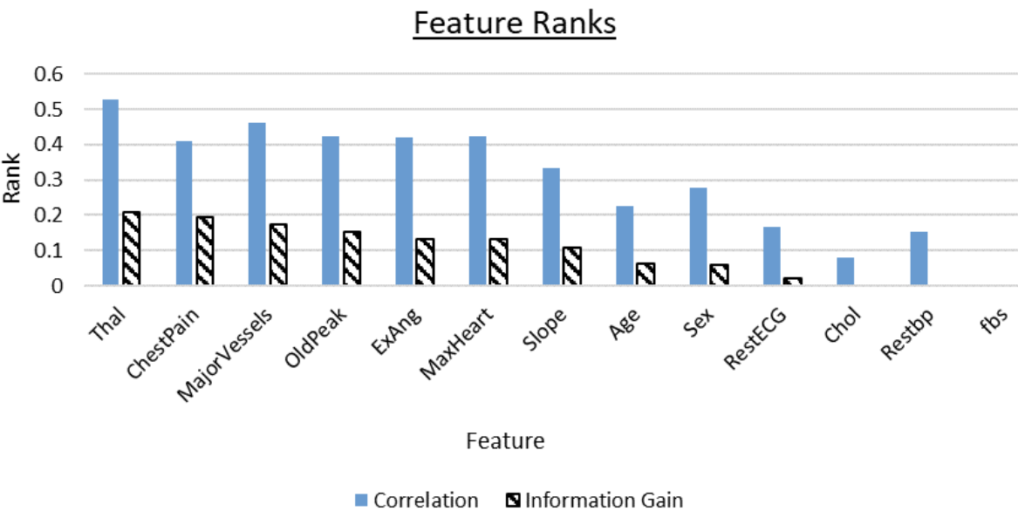
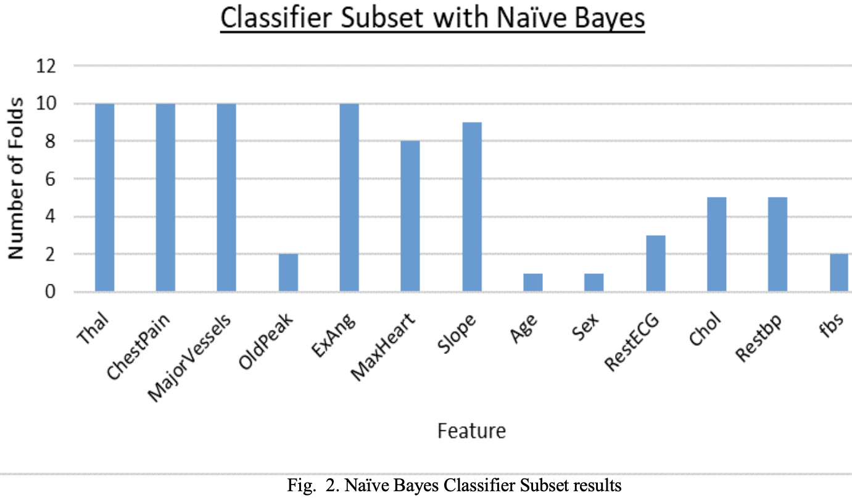
Feature Selection methods:
1. Information Gain evaluator with Ranker search
2. Correlation evaluator with Ranker search
3. Classifier Subset evaluator on Naïve Bayes with Best First search
The results of Ranker search using information gain and correlation and the Classifier Subset using 10-fold cross-validation on Naïve Bayes with a seed of 1 are:

Slide 8
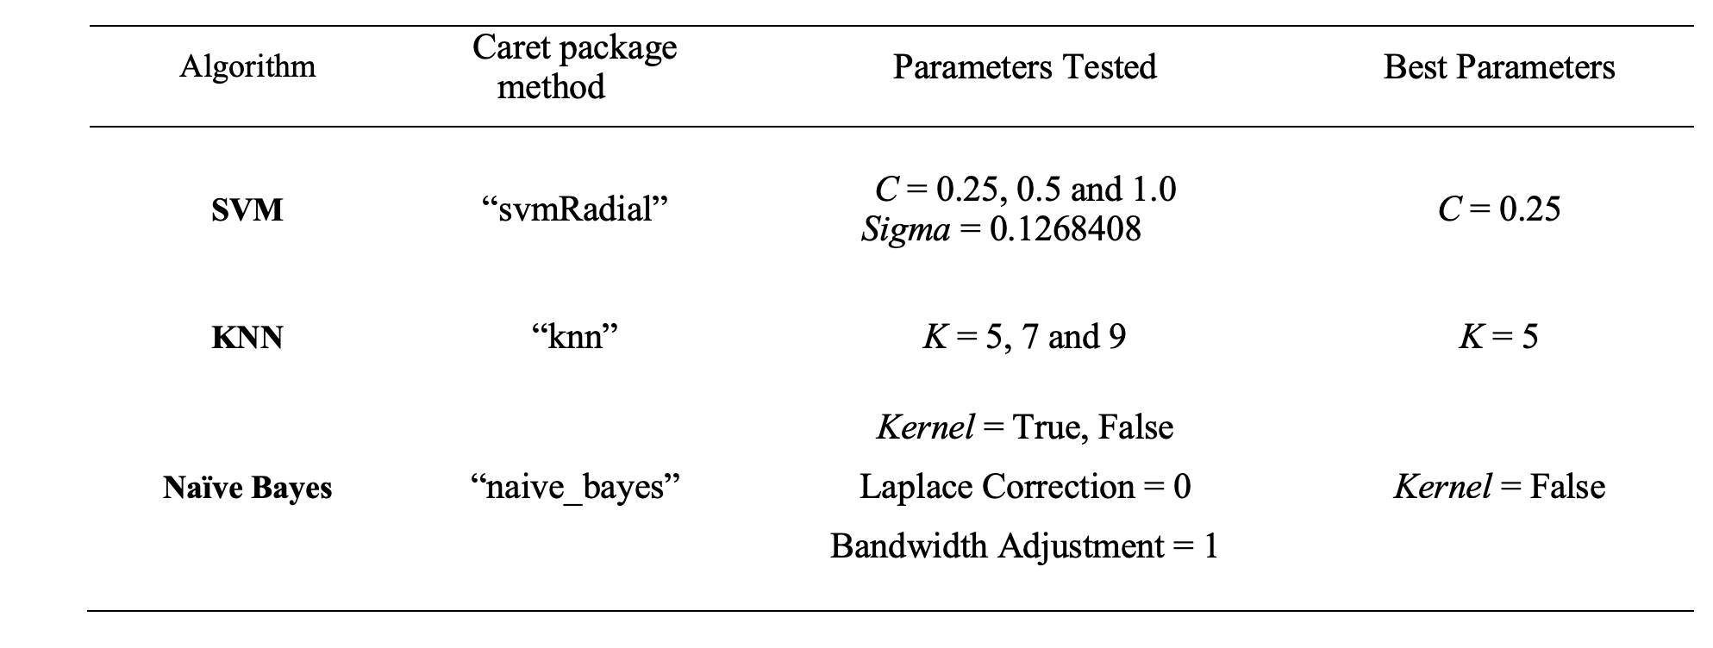
Model Design:
The 'R' programming language was employed for model training, testing, and evaluation. All variables were numeric, except for the output variable, treated as nominal. Leveraging R's 'Caret' package, models were developed using 10-fold cross-validation (randomization seed = 2018). Parameter tuning identified optimal settings for each algorithm, selecting parameters leading to the highest observed accuracy. The final model, based on these parameters, was then trained on the entire dataset, ensuring readiness for new data. The Table outlines the parameters tested for each algorithm and the final parameters chosen.

Slide 9
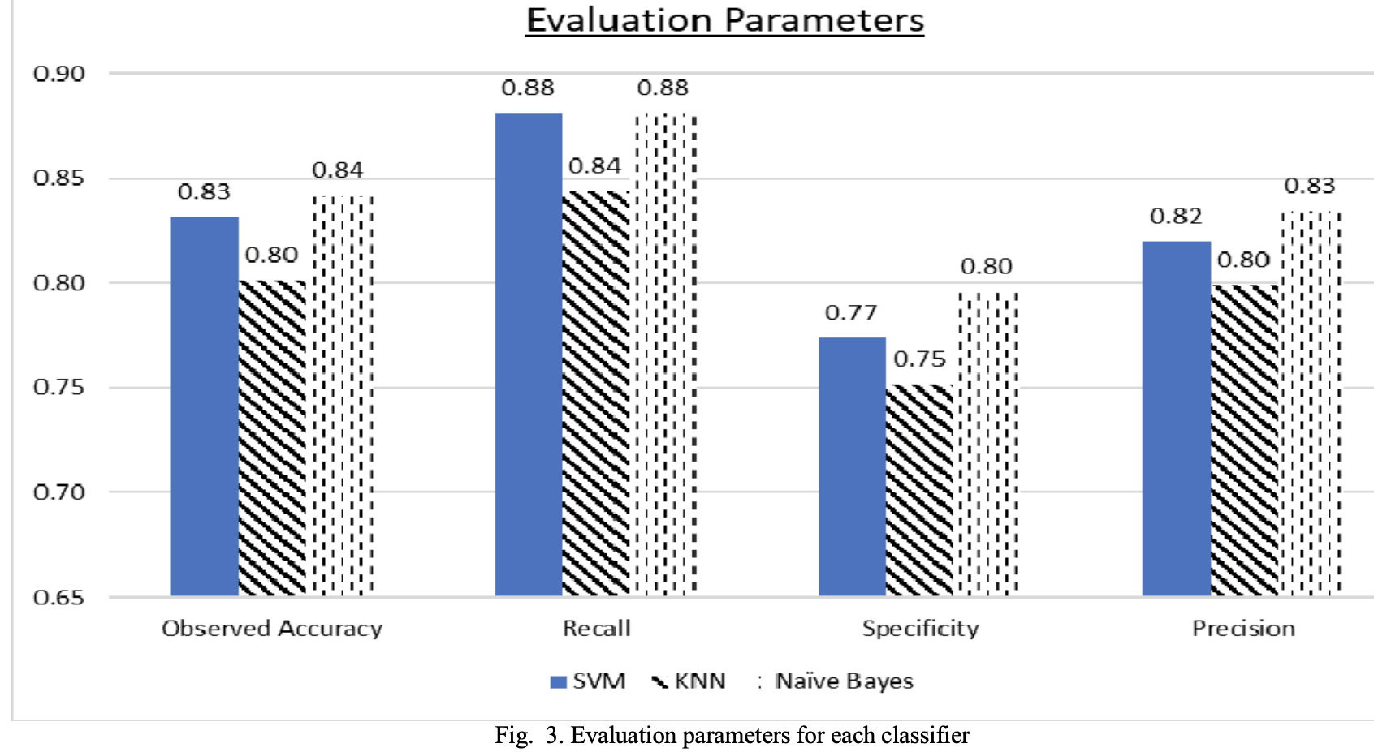
Results:
In medical diagnosis, accurately identifying positive cases is critical, as misdiagnosing a sick person as healthy could be fatal. Therefore, minimizing false negatives and maximizing true positives is essential. This translates to a need for high recall and precision in performance measures. It can be seen both SVM and Naïve Bayes classifiers exhibit equal recall, but Naïve Bayes slightly outperforms in precision. Beyond these crucial measures, Naïve Bayes consistently demonstrates superior performance compared to SVM and KNN. Notably, Naïve Bayes excels in classifying healthy individuals, surpassing both SVM and KNN, despite having the same recall as SVM. KNN on the other hand gives the worst results in all four of the tested performance measures.

Slide 10
Conclusion:
This paper evaluates the performance of three classifiers—SVM, KNN, and Naïve Bayes—for Coronary Artery Disease using Accuracy, Recall, Specificity, and Precision criteria on the Cleveland dataset. Feature selection methods were employed to identify the most relevant features. The findings indicate that the Naïve Bayes classifier surpasses SVM and KNN in performance on the Cleveland dataset.

