Slide 1
CHECKPOINT DATABASE
Zéguina Intissar

Slide 2

DataBase
A database is a set of data stored
in a computer.
This data is usually structured in a way that makes the data easily accessible.

Slide 3
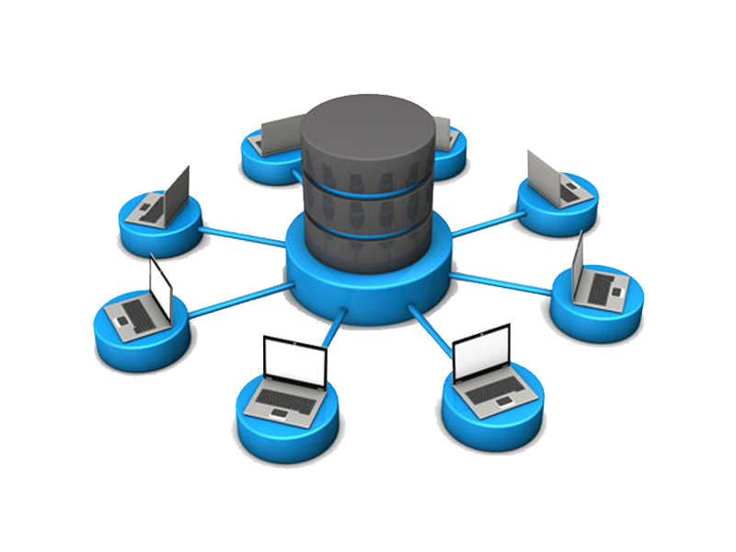
Relational Database?
A relational database is a type of
database.
It uses a structure that allows us to
identify and access data in relation
to another piece of data in the
database.
Often, data in a relational database
is organized into tables.

Slide 4
Popular Relational Database Management Systems

Slide 5

MySQL
MySQL is the most popular open source SQL database.
It is typically used for web application development,
and often accessed using PHP.
The main advantages of MySQL are that it is easy to use,
inexpensive,reliable (has been around since 1995),
and has a large communityof developers who can
help answer questions.
Some of the disadvantages are that it has been known
to suffer frompoor performance when scaling, open
source development has lagged since Oracle has
taken control of MySQL, and it does not include some
advanced features that developers may be used to.

Slide 6

PostgreSQL
PostgreSQL is an open source SQL database
that is not controlled by any corporation.
It is typically used for web application development.
PostgreSQL shares many of the same advantages of
MySQL.
It is easy to use, inexpensive, reliable and has a large
community of developers.
It also provides some additional features such as foreign
key support without requiring complex configuration.
The main disadvantage of PostgreSQL is that it can be
slower in performance than other databases such as
MySQL.
It is also slightly less popular than MySQL.

Slide 7

SQL Server
Microsoft owns SQL Server.
Like Oracle DB, the code is close
sourced.
Large enterprise applications mostly
use SQL Server.
Microsoft offers a free entry-level
version called Express but can
become very expensive as you
scale your application.

Slide 8
comparison between the three RDBMS

Slide 9
Name | Microsoft SQL Server | MySQL | PostgreSQL
Description | Microsofts flagship relational DBMS | Widely used open source RDBMS | Widely used open source RDBMS
Primary database model | Relational DBMS | Relational DBMS | Relational DBMS
Secondary database models | Document store Graph DBMS Spatial DBMS | Document store Spatial DBMS | Document store Spatial DBMS
Website | www.microsoft.com/­en-us/­sql-server | www.mysql.com | www.postgresql.org
Technical documentation | docs.microsoft.com/­en-US/­sql/­sql-server | dev.mysql.com/­doc | www.postgresql.org/­docs
Developer | Microsoft | Oracle | PostgreSQL Global Development Group
Initial release | 1989 | 1995 | 1989
Current release | SQL Server 2019, November 2019 | 8.0.25, May 2021 | 13.3, May 2021
Replication methods | yes, but depending on the SQL-Server Edition | Multi-source replication Source-replica replication | Source-replica replication
MapReduce | no | no | no
Consistency concepts | Immediate Consistency | Immediate Consistency | Immediate Consistency

Slide 10
Name | Microsoft SQL Server | MySQL | PostgreSQL
License | commercial | Open Source | Open Source
Cloud-based only | no | no | no
DBaaS offerings (sponsored links) |  | ScaleGrid for MySQL: Fully managed MySQL hosting on AWS, Azure and DigitalOcean with high availability and SSH access on the #1 multi-cloud DBaaS. | ScaleGrid for PostgreSQL: Fully managed PostgreSQL hosting on AWS, Azure and DigitalOcean with high availability and SSH access on the #1 multi-cloud DBaaS.
Implementation language | C++ | C and C++ | C
ta scheme | yes | yes | yes
Typing | yes | yes | yes
XML support | yes | yes | yes
Secondary indexes | yes | yes | yes
Foreign keys | yes | yes | yes
Transaction concepts | ACID | ACID | ACID
Concurrency | yes | yes | yes
Durability | yes | yes | yes

Slide 11
Name | Microsoft SQL Server | MySQL | PostgreSQL
APIs and other access methods | ADO.NET JDBC ODBC OLE DB Tabular Data Stream (TDS) | ADO.NET JDBC ODBC Proprietary native API | ADO.NET JDBC native C library ODBC streaming API for large objects
Supported programming languages | C# C++ Delphi Go Java JavaScript (Node.js) PHP Python R Ruby Visual Basic | Ada C C# C++ D Delphi Eiffel Erlang Haskell Java JavaScript (Node.js) Objective-C OCaml Perl PHP Python Ruby Scheme Tcl | .Net C C++ Delphi Java JavaScript (Node.js) Perl PHP Python Tcl

