Slide 1
RDBMS
(Relational Database Management System)
Presented by :Toualbia Intissar

Slide 2
Introduction to Databases
Database A database is a set of data stored in a computer. This data is usually structured in a way that makes the data easily accessible.
Relational Database
A relational database is a type of database. It uses a structure that allows us to identify and access data in relation to another piece of data in the database. Often, data in a relational database is organized into tables.
Relational Database Management System (RDBMS)
A relational database management system (RDBMS) is a program that allows you to create, update, and administer a relational database. Most relational database management systems use the SQL language to access the database.

Slide 3
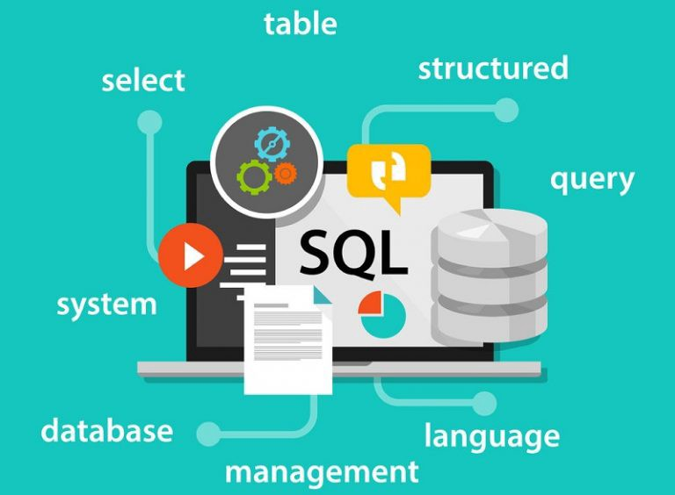
SQL

Slide 4
SQL (Structured Query Language) is a programming language used to communicate with data stored in a relational database management system. SQL syntax is similar to the English language, which makes it relatively easy to write, read, and interpret.
Many RDBMSs use SQL (and variations of SQL) to access the data in tables. For example, SQLite is a relational database management system. SQLite contains a minimal set of SQL commands (which are the same across all RDBMSs). Other RDBMSs may use other variants.
(SQL is often pronounced in one of two ways. You can pronounce it by speaking each letter individually like “S-Q-L”, or pronounce it using the word “sequel”.)

Slide 5
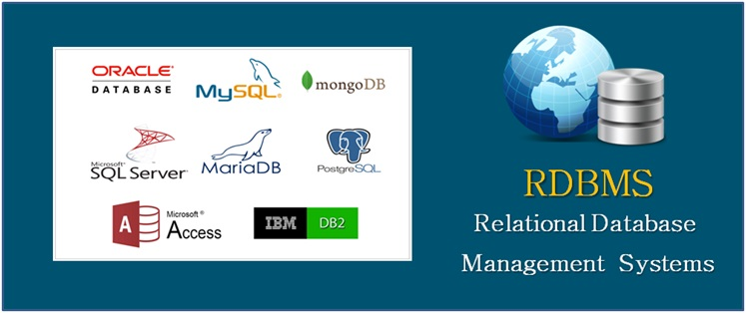
SQL syntax may differ slightly depending on which RDBMS you are using. Popular RDBMSs are :MySQL, PostgreSQL and SQL SERVER .

Slide 6
MySQL
MySQL is an open-source relational database management system. As with other relational databases, MySQL stores data in tables made up of rows and columns. Users can define, manipulate, control, and query data using Structured Query Language, more commonly known as SQL. MySQL’s name is a combination of “My,” the name of MySQL creator Michael Widenius’s daughter, and “SQL”.
A flexible and powerful program, MySQL is the most popular open-source database system in the world. As part of the widely-used LAMP technology stack (which consists of a Linux-based operating system, the Apache web server, a MySQL database, and PHP for processing), it’s used to store and retrieve data in a wide variety of popular applications, websites, and services.

Slide 7
PostgreSQL
PostgreSQL is an open source SQL database that is not controlled by any corporation. It is typically used for web application development.
PostgreSQL shares many of the same advantages of MySQL. It is easy to use, inexpensive, reliable and has a large community of developers. It also provides some additional features such as foreign key support without requiring complex configuration.
The main disadvantage of PostgreSQL is that it can be slower in performance than other databases such as MySQL. It is also slightly less popular than MySQL.

Slide 8
SQL SERVER
SQL Server is a relational database management system, or RDBMS, developed and marketed by Microsoft.
Similar to other RDBMS software, SQL Server is built on top of SQL, a standard programming language for interacting with the relational databases. SQL server is tied to Transact-SQL, or T-SQL, the Microsoft’s implementation of SQL that adds a set of proprietary programming constructs.
SQL Server works exclusively on Windows environment for more than 20 years. In 2016, Microsoft made it available on Linux. SQL Server 2017 became generally available in October 2016 that ran on both Windows and Linux.

Slide 9
Comparison between RDBMS: MySQL, PostgreSQL and SQL SERVER .

Slide 10
 | MySQL | PostgreSQL | SQL server
Developer | Oracle,1995 | PostgreSQL Global Development Group, 1989 | Microsoft, 1989
Implementation language | C/C++ | C | C++
Server operating systems | FreeBSD/Linux/Solaris/Windows | FreeBSD/HP-UX/Linux/NetBSD/OpenBSD/OS X/Solaris/Unix/Windows | Linux Windows
Supported programming languages | Ada/C/C#/C++/D/Delphi Eiffel/Erlang/Haskell/ Java/JavaScript(Node.js)ObjectiveC/OCaml/Perl/PHP/Python/Ruby Scheme/Tcl | .Net/C/C++/Delphi/Java/JavaScript/(Node.js) Perl/PHP/Python/Tcl | C#/C++/Delphi/Go/Java JavaScript (Node.js)/PHP Python/R/Ruby/Visual Basic
Partitioning methods | horizontal partitioning, sharding with MySQL Cluster or MySQL Fabric | partitioning by range, list and (since PostgreSQL 11) by hash | tables can be distributed across several files (horizontal partitioning); sharding through federation
User concepts | Users with fine-grained authorization concept | Fine-grained access rights according to SQL-standard | fine grained access rights according to SQL-standard
APIs and other access methods | ADO.NET/JDBC ODBC/Proprietary native API | ADO.NET/JDBC/native C library/ODBC streaming API for large objects | ADO.NET/JDBC/ODBC OLE DB/Tabular Data Stream (TDS)
Description | Widely used open source RDBMS | Widely used open source RDBMS | Microsofts flagship relational DBMS

