Slide 1

Chapter 1: Introduction
1.1 Overview
1.2 Course Logistics

Slide 2
Chapter 1: Introduction
1.1 Overview
1.2 Course Logistics

Slide 3
Objectives
Define SAS.
Describe the functionality of Base SAS.
Notes:
TAG_AltText:

Slide 4
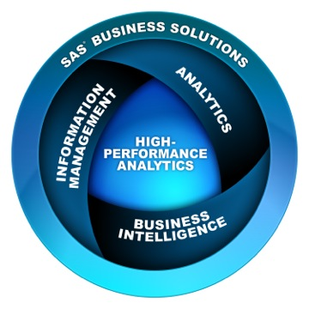

What Is SAS?
SAS is a suite of business solutions and technologies to help organizations solve business problems.
Notes:
TAG_AltText: Graphic describing major solution and technology categories, which are SAS Business Solutions, Analytics, Information Management, Business Intelligence, and High-Performance Analytics

Slide 5
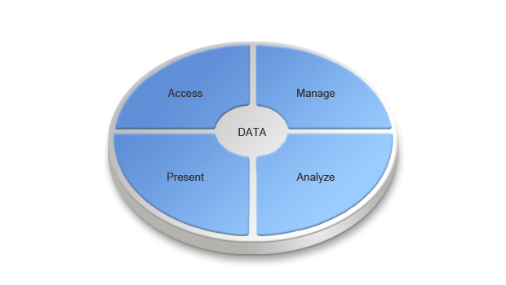
Why Use SAS?
SAS enables you to do the following:
access and manage data across multiple sources
perform analyses and deliver information across your organization
Base SAS is the primary focus of this course.
Notes:
The functionality of SAS is built around the four data-driven tasks common to virtually any application: data access, data management, data analysis, and data presentation.

Slide 6
What Is Base SAS?
Base SAS is the foundation for all SAS software.
Base SAS provides the following:
a highly flexible, highly extensible, fourth-generation programming language
a rich library of encapsulated programming procedures
a choice of programming interfaces
Base SAS
Notes:
TAG_AltText: Graphic describing major solution and technology categories, which are SAS Business Solutions, Analytics, Information Management, Business Intelligence, and High-Performance Analytics

Slide 7
1.01 Multiple Choice Poll
What is your programming experience with SAS?
maintaining programs written by others
writing new programs
no experience
other
Notes:
Type answer here

Slide 8


Slide 9
Chapter 1: Introduction
1.1 Overview
1.2 Course Logistics

Slide 10
Objectives
Describe the data that is used in the course.
Specify the naming convention that is used for the course files.
Define the three levels of exercises.
Explain the extended learning for this course.
Notes:
TAG_AltText:

Slide 11



Orion Star Sports & Outdoors
This course focuses on a fictitious global sports and outdoors retailer that has traditional stores, an online store, and a catalog business.
Notes:
TAG_AltText: “ “

Slide 12













Orion Star Data
Large amounts of data are stored in various formats.
1,000 employees
150,000
orders
90,000 customers
64 suppliers
Notes:
TAG_AltText: Graphics describing that there is data for one thousand employees, one hundred and fifty thousand orders, ninety thousand customers, and sixty-four suppliers

Slide 13



Program Naming Conventions
In this course, you use the structure below to retrieve and save SAS programs.
p104d01x
❶ course ID
❷ chapter #
❸ type a=activity d=demo e=exercise s=solution
❹ item #
❺ placeholder
Programming 1, Chapter 4, Demo 1
Notes:
TAG_AltText: “ “
In this course, we will be using numerous SAS programs. The programs that we use will follow a convention. All the programs start with P1, which stands for Programming 1, and then the next two numbers will correspond to the chapter. At that point, you will see a letter, such as D for demo or E for exercise. Next will be a sequential number taking up two places. There will be a few programs that will also then be followed by a letter such as A or B. Looking at the example on this slide, p104d01 stands for the first demo in Chapter 4. If you see an A in the place of the D, that is an activity, which is a quick task that you will need to perform in a SAS session. It is a mini-exercise. If you see an S, that is a solution. Many of your exercises will consist of a starter program. These starter programs will use the letter E, like p104e01.

Slide 14
Locating Data Files
In this course, macro variable references are used to give a more flexible approach for locating files.
%let path=s:\workshop;
infile "&path\sales.csv";
infile "&path\payroll.dat";
Notes:
TAG_AltText:
Example one shows two statements:
%let location=s:\workshop;
libname orion "&location";
Example two shows one statement:
filename "&location\salesdata.dat";
Example three shows one statement:
infile "&location\payroll.csv";

Slide 15
Three Levels of Exercises
The course is designed to have you complete only one
set of exercises. Select the level that is most appropriate for your skill set.
Level 1 | Provides step-by-step instructions.
Level 2 | Provides less information and guidance.
Challenge | Provides minimal information and guidance. You might need to use SAS Help and documentation.
Notes:
TAG_AltText:
Throughout the course, you will be doing exercises. When we break for exercises, you will have a choice of exercises to try. The exercises are broken into two levels: levels 1 and 2. In some places, we might have also included a challenge exercise that you will probably not have time to complete during the workshop time allotted. However, you can try these on a break or outside of class. These challenge exercises often involve the use of the Help facility.
In general, the recommendation is to do the level 1 exercise and, if there is time, work on level 2 exercises. We will plan to allow enough time for everyone to complete one exercise out of the three levels.
LW: When class is over, you will be able to work on any of the exercises because you have downloaded the data to your PC at C:\SAS_EDUCATION\LWPRG1.
IBT: At the end of class, we will provide you with an access code for the course data so you will be able to work on any of the exercises on your own.
I mentioned that the challenge exercises often involve the use of the Help facility. So, let’s talk about that facility next.

Slide 16

Extending Your Learning
After class, you have access to an extended learning page that was created for this course. The page includes the following:
course data and program files
a PDF file of the course notes
other course-specific resources
Notes:
TAG_AltText: “ “
These pages were built for to extend the customers’ classroom learning experience. Extended learning pages are available for one year following activation, at no charge. For a public class, access codes can be distributed during class. This would be a great time to actually distribute them. If at an onsite, you might not be able to give access during class, but they will be able to access at home, if not at work, after class. ELP access codes will be sent to customers in their “Thank you” letters after class.
Extended learning page materials include
<your course list here>
Possible list of what is included.
course data and program files
course notes
publications and videos relevant to the topics covered in this course.
self-study materials
frequently asked questions
case studies
code examples
links to company-wide resources

