Slide 1

Chapter 2: SAS® Programs
2.1 Introduction to SAS Programs
2.2 Submitting a SAS Program
2.3 SAS Program Syntax
Notes:
TAG_Instructor: In this chapter we’ll explore SAS Programs. We’ll begin by taking a high level look at a program and define its components. Next we’ll see how to submit a program and browse the results. Finally we’ll focus on program syntax.

Slide 2
Chapter 2: SAS® Programs
2.1 Introduction to SAS Programs
2.2 Submitting a SAS Program
2.3 SAS Program Syntax
Notes:
TAG_Instructor: Let’s get started by exploring a simple SAS program.

Slide 3
Objectives
List the components of a SAS program.
Notes:
TAG_Instructor: We’ll look at the components of a SAS program.

Slide 4





SAS Programs
A SAS program is a sequence of one or more steps.
DATA steps typically create SAS data sets.
PROC steps typically process SAS data sets to generate reports and graphs, and to manage data.
DATA Step
PROC Step
Notes:
TAG_Instructor: A SAS program is a sequence of steps. There are only two types of steps in SAS: DATA and PROC steps
DATA steps read from an input source and create a SAS data set.
PROC steps read and process a SAS data set, often generating an output report.

Slide 5
SAS Program Steps
A step is a sequence of SAS statements. This program has a DATA step and a PROC step.
data work.newemps;
infile "&path\newemps.csv" dlm=',';
input First $ Last $ Title $ Salary;
run;
proc print data=work.newemps;
run;
Notes:
TAG_Instructor: A program is a sequence of steps, and a step is a sequence of statements. This program contains the following statements: DATA, INFILE, INPUT, RUN and PROC.
Don’t go into detail about the statements - the purpose of this slide is to introduce the term statement.

Slide 6
Step Boundaries
SAS steps begin with either of the following:
a DATA statement
a PROC statement
SAS detects the end of a step when it encounters one of the following:
a RUN statement (for most steps)
a QUIT statement (for some procedures)
the beginning of another step (DATA statement or PROC statement)
Notes:
TAG_Instructor: Every step has a beginning and ending boundary.
A DATA step begins with a DATA statement and a PROC step begins with a PROC statement.
A step can end in one of several ways.
Most steps end with a RUN statement.
Some PROC steps end with a QUIT statement.
Occasionally a user may omit a RUN or QUIT statement, and the step will end implicitly when the next step begins.

Slide 7
2.01 Short Answer Poll
How many steps are in program p102d01?
data work.newsalesemps;
length First_Name $ 12
Last_Name $ 18 Job_Title $ 25;
infile "&path\newemps.csv" dlm=',';
input First_Name $ Last_Name $
Job_Title $ Salary;
run;
proc print data=work.newsalesemps;
run;
proc means data=work.newsalesemps;
var Salary;
run;
p102d01
Notes:
Type answer here

Slide 8
2.01 Short Answer Poll – Correct Answer
How many steps are in program p102d01? three
data work.newsalesemps;
length First_Name $ 12
Last_Name $ 18 Job_Title $ 25;
infile "&path\newemps.csv" dlm=',';
input First_Name $ Last_Name $
Job_Title $ Salary;
run;
proc print data=work.newsalesemps;
run;
proc means data=work.newsalesemps;
var Salary;
run;
DATA Step
PROC Step
PROC Step
p102d01
Notes:
Type answer here

Slide 9
SAS Program Example
This DATA step creates a temporary SAS data set named work.newsalesemps by reading four fields from a file.
data work.newsalesemps;
length First_Name $ 12
Last_Name $ 18 Job_Title $ 25;
infile "&path\newemps.csv" dlm=',';
input First_Name $ Last_Name $
Job_Title $ Salary;
run;
proc print data=work.newsalesemps;
run;
proc means data=work.newsalesemps;
var Salary;
run;
p102d01
Notes:
TAG_Instructor: Let me briefly explain each step on the next three slides. I want you to have an understanding of what the step is doing, but we aren’t discussing the syntax at this point.
The DATA step is reading four fields from the data file NEWEMPS.CSV, and creating a SAS data set with four variables: First_Name, Last_Name, Job_Title and Salary. The new data set is named work.newsalesemps.

Slide 10
SAS Program Example
This PROC PRINT step lists the work.newsalesemps data set.
data work.newsalesemps;
length First_Name $ 12
Last_Name $ 18 Job_Title $ 25;
infile "&path\newemps.csv" dlm=',';
input First_Name $ Last_Name $
Job_Title $ Salary;
run;
proc print data=work.newsalesemps;
run;
proc means data=work.newsalesemps;
var Salary;
run;
p102d01
Notes:
TAG_Instructor: This PROC PRINT step is listing the data set created in the DATA step. It generates a report.

Slide 11
SAS Program Example
This PROC MEANS step summarizes the Salary variable in the work.newsalesemps data set.
data work.newsalesemps;
length First_Name $ 12
Last_Name $ 18 Job_Title $ 25;
infile "&path\newemps.csv" dlm=',';
input First_Name $ Last_Name $
Job_Title $ Salary;
run;
proc print data=work.newsalesemps;
run;
proc means data=work.newsalesemps;
var Salary;
run;
p102d01
Notes:
TAG_Instructor: This PROC MEANS step is analyzing and summarizing the Salary variable in the work.newsalesemps data set that was just created. It generates a report.

Slide 12


Slide 13
Chapter 2: SAS® Programs
2.1 Introduction to SAS Programs
2.2 Submitting a SAS Program
2.3 SAS Program Syntax

Slide 14
Objectives
Describe various processing modes and SAS interfaces.
Define the three primary tabs or windows used within a SAS interface.
Submit a SAS program to create the course data files.
Submit the SAS program introduced in the previous section.

Slide 15
Processing Modes
The following are two possible processing modes for submitting a SAS program:
 In this course, interactive mode is used to process SAS programs.
Interactive Mode | A SAS program is submitted within a SAS interface for foreground processing
Batch Mode | A SAS program is submitted to the operating environment for background processing
Notes:
With foreground processing, the SAS interface coordinates all the work, so you cannot use your SAS interface to do other work while your program is running.
With background processing, the operating environment coordinates all the work, so you can use your workstation session while your program is running.

Slide 16



SAS Interfaces
There are three possible SAS interfaces for processing a SAS program in interactive mode.
SAS
Windowing
Environment
SAS
Enterprise
Guide
SAS
Studio

Slide 17

SAS Interfaces
Past Present
SAS
Windowing
Environment
SAS
Enterprise
Guide
SAS
Studio

Slide 18
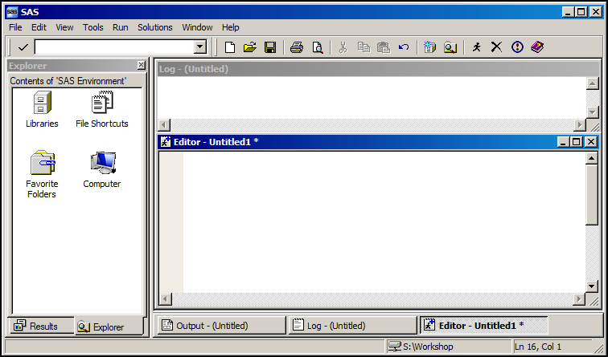
SAS Windowing Environment
The SAS windowing environment is an application that is accessed from different operating environments.
The SAS windowing environment provides a full programming interface that can be used to write, edit, and submit SAS code.

Slide 19
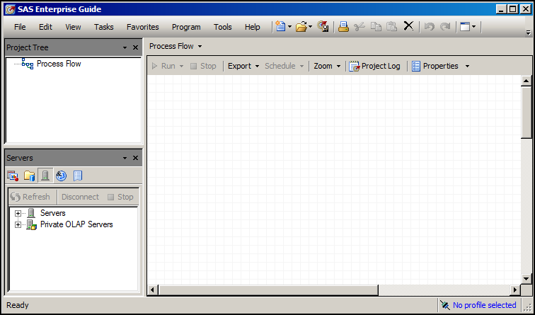
SAS Enterprise Guide
SAS Enterprise Guide is a client application that is accessed from the Windows operating environment.
SAS Enterprise Guide provides the following:
a point-and-click interface with menus and task wizards to generate SAS code
a full programming interface that can be used to write, edit, and submit SAS code

Slide 20
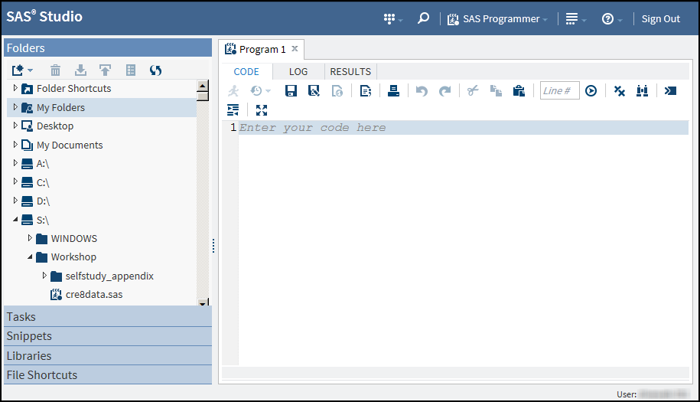
SAS Studio
SAS Studio is a web client that is accessed through an HTML5-compliant web browser.
SAS Studio provides the following:
a point-and-click interface with menus and task wizards to generate SAS code
a full programming interface that can be used to write, edit, and submit SAS code

Slide 21
SAS Interface Tabs or Windows
Regardless of the SAS interface that you choose to use, there are three primary tabs or windows.
Editor | Enter, edit, submit, and save a SAS program
Log | Browse notes, warnings, and errors relating to a submitted SAS program
Results | Browse output from reporting procedures

Slide 22
SAS Interface Tabs or Windows
Each interface uses specific terms to reference these three primary tabs or windows.
Tab | SAS Studio (tabs) | SAS Enterprise Guide (tabs) | SAS Windowing Environment (windows)
Editor | Code | Program | Enhanced or Program Editor
Log | Log | Log | Log
Results | Results | Results | Results Viewer or Output

Slide 23
SAS Interface Tabs or Windows
The following is an example workflow of how a user might use the three primary tabs or windows:
Enter or open a SAS program into the Editor.
Submit the program.
View the log to determine whether any errors occurred in the program.
Debug or modify the program in the Editor.
View the results to explore the output from reporting procedures.

Slide 24





Business Scenario
In this section, the following actions are completed:
Submit a SAS program to create the data files that are needed for the course.
Submit the SAS program introduced in Section 2.1.
cre8data.sas
p102d01.sas

Slide 25
Chapter 2: SAS® Programs
2.1 Introduction to SAS Programs
2.2 Submitting a SAS Program
2.3 SAS Program Syntax
Notes:
TAG_Instructor: SAS program structure is flexible, but there are some rules that must be followed. Lets explore program syntax.

Slide 26
Objectives
Identify the characteristics of SAS statements.
Define SAS syntax rules.
Document a program using comments.
Diagnose and correct a program with errors.
Notes:
TAG_Instructor:

Slide 27

Business Scenario
Well-formatted, clearly documented SAS programs are an industry best practice.
Notes:
TAG_Instructor: Management wants the SAS programmers to write well-formatted, clearly documented code. The programmers need to know the syntax rules for SAS programming statements and comments.

Slide 28
SAS Syntax Rules: Statements
SAS statements
usually begin with an identifying keyword
always end with a semicolon.
data work.newsalesemps;
length First_Name $ 12
Last_Name $ 18 Job_Title $ 25;
infile "&path\newemps.csv" dlm=',';
input First_Name $ Last_Name $
Job_Title $ Salary;
run;
proc print data=work.newsalesemps;
run;
proc means data=work.newsalesemps;
var Salary;
run;
p102d01
Notes:
TAG_Instructor: SAS statements usually begin with a keyword, and always end with a semicolon. The keywords and semicolons are highlighted in this program. Keywords identify the type of statement, and semicolons end the statement.

Slide 29
2.03 Short Answer Poll
How many statements make up this DATA step?
data work.newsalesemps;
length First_Name $ 12
Last_Name $ 18 Job_Title $ 25;
infile "&path\newemps.csv" dlm=',';
input First_Name $ Last_Name $
Job_Title $ Salary;
run;
Notes:
Type answer here

Slide 30
2.03 Short Answer Poll – Correct Answer
How many statements make up this DATA step?
This DATA step has five statements.
data work.newsalesemps;
length First_Name $ 12
Last_Name $ 18 Job_Title $ 25;
infile "&path\newemps.csv" dlm=',';
input First_Name $ Last_Name $
Job_Title $ Salary;
run;
Notes:
Type answer here

Slide 31
SAS Program Structure
SAS code is free format.
This program is syntactically correct but difficult to read.
data work.newsalesemps;
length First_Name $ 12
Last_Name $ 18 Job_Title $ 25;
infile "&path\newemps.csv" dlm=',';
input First_Name $ Last_Name $
Job_Title $ Salary;run;
proc print data=work.newsalesemps; run;
proc means data =work.newsalesemps;
var Salary;run;
p102d02
Notes:
TAG_Instructor: SAS is very flexible about spacing and program structure, but the flexibility can lead to programs that are difficult to read.
You could ask “How many steps are in this program” to stress that it is harder to read. Give them a minute to read the program, then tell them it is the same program as the previous – with 3 steps.

Slide 32
SAS Program Structure
Rules for SAS Statements
Statements can begin and end in any column.
A single statement can span multiple lines.
Several statements can appear on the same line.
Unquoted values can be lowercase, uppercase, or mixed case.
unconventional formatting
data work.newsalesEmps;
length First_Name $ 12
Last_Name $ 18 Job_Title $ 25;
infile "&path\newemps.csv" dlm=',';
input First_Name $ Last_Name $
Job_Title $ Salary;run;
proc print data=work.newsalesemps; run;
proc means data =work.newsalesemps;
var Salary;run;
Notes:
TAG_Instructor: This program uses an unconventional formatting style. It takes advantage of the free-format style SAS permits, but at a cost of being hard to read. Go thru the rules.
Sometimes we like to say that “just because you can does not mean you should.”

Slide 33
Recommended Formatting
Begin each statement on a new line.
Use white space to separate words and steps.
Indent statements within a step.
Indent continued lines in multi-line statements.
data work.newsalesemps;
length First_Name $ 12
Last_Name $ 18 Job_Title $ 25;
infile "&path\newemps.csv" dlm=',';
input First_Name $ Last_Name $
Job_Title $ Salary;
run;
proc print data=work.newsalesemps;
run;
proc means data=work.newsalesemps;
var Salary;
run;
conventional formatting
Notes:
Notes: White space can be blanks, tabs, and new lines. Add them as needed to increase the readability of the code.
TAG_Instructor: Instead we recommend that you use a conventional programming style: add white space to make the program more readable. We also recommend that you begin each statement on a new line, indent statements within a step, and indent continued lines in a multi-line statement.

Slide 34
Program Documentation
You can embed comments in a program as explanatory text.
SAS ignores comments during processing but writes them to the SAS log.
/* create a temporary data set, newsalesemps */
/* from the text file newemps.csv */
data work.newsalesemps;
length First_Name $ 12
Last_Name $ 18 Job_Title $ 25;
*read a comma delimited file;
infile "&path\newemps.csv" dlm=',';
input First_Name $ Last_Name $
Job_Title $ Salary;
run;
/* comment */
* comment statement ;
Notes:
TAG_Instructor: Comments are used to document a program. For example, you can use comments at the beginning of a SAS program to document the purpose of the program, and anywhere in the program to explain segments of code, or mark SAS code as non-executing text. Using comments to mark SAS code as non-executing text is also called commenting out code.

Slide 35
SAS Comments
This program contains four comments.
*----------------------------------------*
| This program creates and uses the |
| data set called work.newsalesemps. |
*----------------------------------------*;
data work.newsalesemps;
length First_Name $ 12 Last_Name $ 18
Job_Title $ 25;
infile "&path\newemps.csv" dlm=',';
input First_Name $ Last_Name $
Job_Title $ Salary /* numeric */;
run;
/*
proc print data=work.newsalesemps;
run;
*/
proc means data=work.newsalesemps;
* var Salary ;
run;
❶
1
❷
❸
❹
p102d03
Notes:
TAG_Instructor: This program contains four comments. The first comment describes the program. The second comment is within a statement. The third comment is commenting out a step. The fourth comment is commenting out a statement.
The comment statement cannot be used inside another statement.

Slide 36
2.04 Short Answer Poll
Open and examine p102a01. Based on the comments, which steps do you think are executed and what output is generated?
Submit the program. Which steps were executed?
Notes:
Type answer here

Slide 37
2.04 Short Answer Poll – Correct Answer
Open and examine p102a01. Based on the comments, which steps do you think are executed and what output is generated?
Submit the program. Which steps were executed?
The DATA step executes and creates an output data set.
The PROC PRINT step executes and produces a report.
The PROC MEANS step is “commented out,” and therefore, does not execute.
Notes:
Type answer here

Slide 39
Business Scenario
Orion Star programmers must be able to identify and correct syntax errors in a SAS program.
Notes:
TAG_Instructor: A good programmer can identify and correct errors in their programs.

Slide 40
Syntax Errors
A syntax error is an error in the spelling or grammar of a SAS statement. SAS finds syntax errors as it compiles each SAS statement, before execution begins.
Examples of syntax errors:
misspelled keywords
unmatched quotation marks
missing semicolons
invalid options
Notes:
TAG_Instructor: A syntax error is reported when a program statement violates the rules of the programming language. Syntax errors are found during the compile phase, before SAS executes the program.
Syntax errors in SAS are typically caused by misspelled keywords, unmatched quotation marks, missing semicolons or invalid options.

Slide 41
2.05 Short Answer Poll
This program includes three syntax errors. One is an invalid option. What are the other two syntax errors?
daat work.newsalesemps;
length First_Name $ 12
Last_Name $ 18 Job_Title $ 25;
infile "&path\newemps.csv" dlm=',';
input First_Name $ Last_Name $
Job_Title $ Salary;
run;
proc print data=work.newsalesemps
run;
proc means data=work.newsalesemps average min;
var Salary;
run;
invalid option
p102d04
Notes:
Type answer here

Slide 42
2.05 Short Answer Poll – Correct Answer
This program includes three syntax errors. One is an invalid option. What are the other two syntax errors?
misspelled keyword
daat work.newsalesemps;
length First_Name $ 12
Last_Name $ 18 Job_Title $ 25;
infile "&path\newemps.csv" dlm=',';
input First_Name $ Last_Name $
Job_Title $ Salary;
run;
proc print data=work.newsalesemps
run;
proc means data=work.newsalesemps average min;
var Salary;
run;
missing semicolon
invalid option
p102d04
Notes:
Type answer here

Slide 43

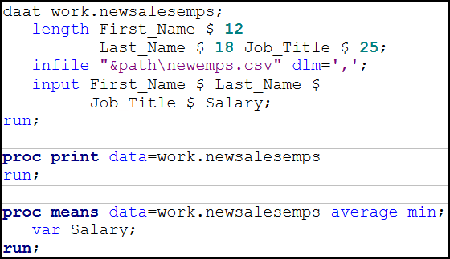


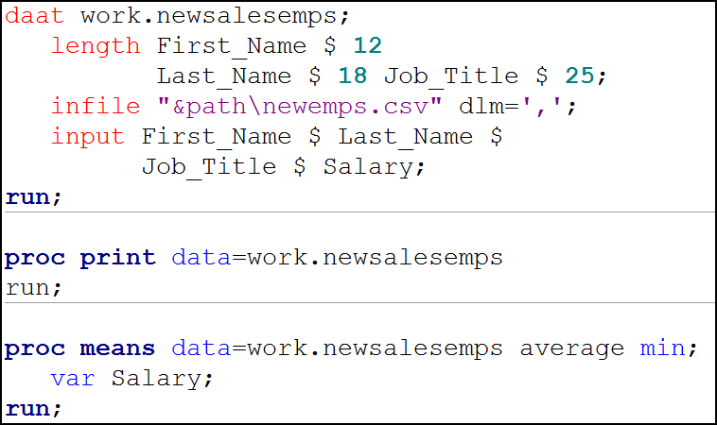
Syntax Errors
Syntax errors in a SAS program can possibly be detected based on the color of the syntax on the Editor tab or in the window.
Notes:
TAG_Instructor: The Enhanced Editor uses the color red to indicate a potential error in your SAS code. Notice that the misspelled word D-A-A-T is displayed in red. This misspelling affects other statements following it since those statements are only permitted in a DATA step, and this is not recognized as such.
The RUN statement in the PROC PRINT step is not the correct font or color, and neither is the work average in the PROC MEANS statement.
Code can also contain logic errors. You learn about logic errors later in this course.

Slide 44

Syntax Errors
When SAS encounters a syntax error, it writes a warning or error message to the log.
You should always check the log to make sure that the program ran successfully, even if output is generated.
WARNING 14-169: Assuming the symbol DATA was misspelled as daat.
ERROR 22-322: Syntax error, expecting one of the following: ;, (,
BLANKLINE, CONTENTS, DATA, DOUBLE, GRANDTOTAL_LABEL,
GRANDTOT_LABEL, GRAND_LABEL, GTOTAL_LABEL,
GTOT_LABEL, HEADING, LABEL, N, NOOBS, NOSUMLABEL,
OBS, ROUND, ROWS, SPLIT, STYLE, SUMLABEL, UNIFORM,
WIDTH.
Notes:
TAG_Instructor: Error messages are written to the SAS log to describe syntax errors. They are displayed in the color red and often identified by a number. Here we see an example of a warning and an error message.

Slide 45


Diagnosing and Correcting Syntax Errors
This demonstration illustrates how to diagnose and correct syntax errors.
p102d04

Slide 46
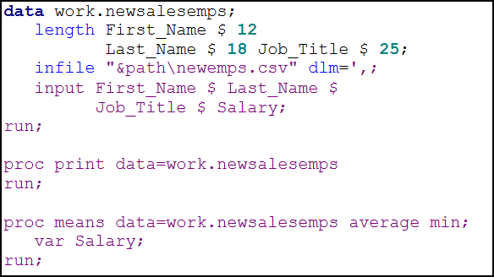
2.06 Short Answer Poll
What is the syntax error in this program?
p102d05
Notes:
Type answer here

Slide 47
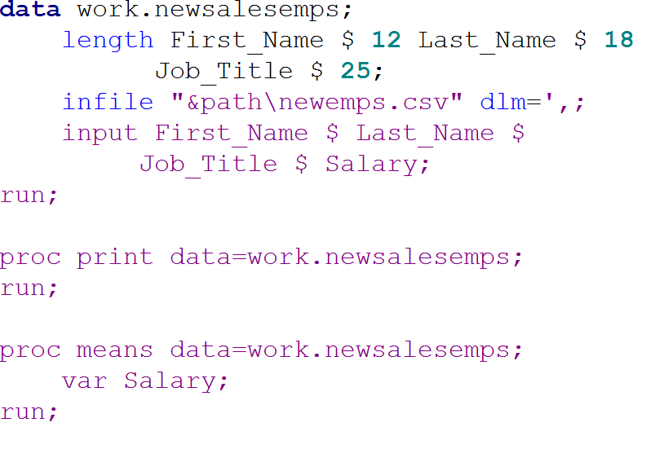
2.06 Short Answer Poll – Correct Answer
What is the syntax error in this program?
The program contains unbalanced quotation marks in the DLM= option in the INFILE statement.
p102d05
Notes:
Type answer here

Slide 48

Notes:
Would like a review of the exercises?
Please answer with your Yes or No seat indicator.

Slide 49
How many step boundaries does this program contain?
four
five
six
seven
data work.staff;
length First_Name $ 12
Last_Name $ 18
Job_Title $ 25;
infile "&path\newemployees.csv"
dlm=',';
input First_Name $ Last_Name$
Job_Title $ Salary;
run;
proc print data=work.staff;
run;
proc means data=work.staff;
var Salary;
run;
Notes:
Correct answer: c
RUN, QUIT, DATA, and PROC statements function as step boundaries, which determine when SAS statements take effect and indicate the end of the current step or the beginning of a new step.

Slide 50
Which of the following is a SAS syntax requirement?
Begin each statement in column one.
Put only one statement on each line.
Separate each step with a line space.
End each statement with a semicolon.
Put a RUN statement after every DATA or PROC step.
Notes:
Correct answer: d
All SAS statements must end with a semicolon, but they are free-format. You can begin or end them anywhere, separate steps with line spaces, and optionally end steps with a RUN statement.

Slide 51
Which of the following steps is typically used to generate reports and graphs?
DATA
PROC
REPORT
RUN
Notes:
Correct answer: b
Feedback: PROC steps are typically used to process SAS data sets (that is, generate reports, graphs, and statistics).

Slide 52
Does this comment contain syntax errors?
No. The comment is correctly specified.
Yes. Every comment line must end with a semicolon.
Yes. The comment text incorrectly begins on line one.
Yes. The comment contains a semicolon, which causes an error message.
/*
Report created for budget
presentation; revised October 15.
*/
proc print data=work.newloan;
run;
Notes:
Correct answer: a
A block comment can contain semicolons and unbalanced quotation marks, can appear anywhere, and doesn’t need a semicolon at the end.

Slide 53
What result would you expect from submitting this step?
an HTML report of the work.newsalesemps data set
an error message in the log
a LISTING report of the work.newsalesemps data set
the creation of the temporary data set work.newsalesemps
proc print data=work.newsalesemps
run;
Notes:
Correct answer: b
There is a missing semicolon following the data set name. When this step runs, SAS will interpret the word RUN as an option in the PROC PRINT statement (because of the missing semicolon). As a result, the PROC PRINT step will not execute and an error message will be displayed in the log.

Slide 54
If you submit a program containing unbalanced quotation marks in SAS Enterprise Guide or SAS Studio, you can simply correct the error and resubmit the program.
True
False
Notes:
Correct answer: a
SAS keeps a running total of the number of quotation marks in your code. In the windowing environment, an odd number of quotation marks would cause the program to hang; you would have to stop the program before adding the missing quotation mark and resubmitting the program. In contrast, SAS Enterprise Guide and SAS Studio automatically adds wrapper code that programmatically balances quotations marks to prevent your program from hanging.

Slide 55
What happens if you submit the following program?
SAS does not execute the step.
SAS assumes that the keyword PROC is misspelled and executes the PROC PRINT step.
porc print data=work.newsalesemps;
run;
Notes:
Correct answer: b
The log will indicate that SAS assumed that the keyword PROC was misspelled, corrected it temporarily, and executed the PROC step.

Slide 56
Suppose you submit a short, simple DATA step. If the active window displays the message DATA step running for a long time, what probably happened?
You misspelled a keyword.
You forgot to end the DATA step with a RUN statement.
You specified an invalid data set option.
Some data values were not appropriate for the SAS statements that you specified.
Notes:
Correct answer: b
Without a RUN statement (or a following DATA or PROC step), the DATA step doesn't execute. Unbalanced quotation marks can also cause the DATA step running message if relatively little code follows the unbalanced quotation mark. The other three problems above generate errors in the Log window.

Slide 57
Suppose that this program contains no errors. What happens when you submit the program in the SAS windowing environment?
Messages appear in the Log window, and the Explorer window moves to the front.
Any HTML output appears in the Output window or a browser window, and any LISTING output appears in the Results Viewer window.
Any HTML output appears in the Results Viewer window or a browser window, and any LISTING output appears in the Output window.
proc print data=work.sales;
run;
Notes:
Correct answer: c
All SAS programs generate log messages. This program creates a PROC PRINT report and moves the Results window to the front. The output appears in the corresponding window (the Output window for LISTING output, or the Results Viewer or browser window for HTML output).

Slide 58
Which of the following is a true statement about SAS output?
SAS Enterprise Guide displays text (LISTING) output by default.
SAS Enterprise Guide displays HTML output by default.
SAS Studio displays SASREPORT output by default.
The SAS windowing environment displays HTML output by default.
Notes:
Correct answer: d
SAS Enterprise Guide creates SASREPORT output by default. SAS Studio creates HTML5 output by default. SAS windowing environment creates HTML output by default starting with SAS 9.3.

