Slide 1

Chapter 1: Introduction
1.1 Introducing the Structured Query Language
1.2 Course Logistics

Slide 2
Chapter 1: Introduction
1.1 Introducing the Structured Query Language
1.2 Course Logistics

Slide 3
Objectives
Describe the historical development of Structured Query Language (SQL).
Explain how SQL is used.

Slide 4


Structured Query Language
Structured Query Language (SQL) is a standardized language originally designed as a relational database query tool.
SQL is currently used in many software products to retrieve and update data.
proc sql;
select Employee_ID
from orion.employee_data
where Salary le 100000;
select Employee_Gender,
avg(Salary)
from orion.employee_data
group by Employee_Gender;
quit;

Slide 5
Structured Query Language: Timeline
1970
1980
1990
2000
1970 – Dr. E. F. Codd of IBM proposes SQL.
1981 – First commercial SQL product is released.
1989 – More than 75 SQL-based systems exist. SAS 6.06 includes
PROC SQL.
To Date – PROC SQL is enhanced
with each new SAS release.

Slide 6
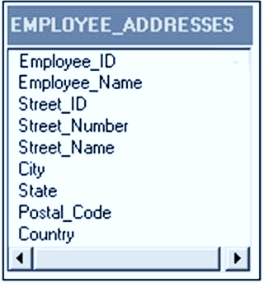
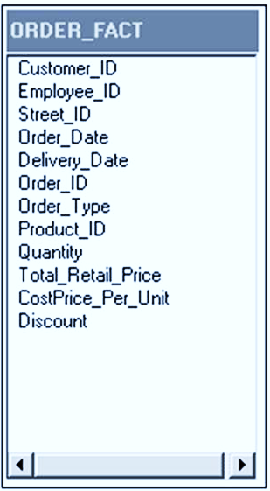
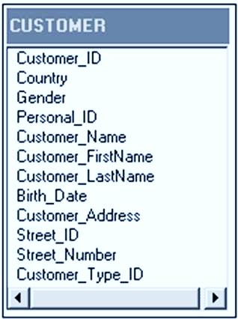
Relational Data

Slide 7

SQL Procedure
The SAS SQL procedure enables the use of SQL in SAS.
Base SAS
PROC SQL
Follows ANSI Standards
Includes
SAS Enhancements

Slide 8


SQL Procedure
What PROC SQL Is | What PROC SQL Is Not
A tool for querying data A tool for data manipulation and management An augmentation to the DATA step | A custom reporting tool A DATA step replacement

Slide 9




SQL Procedure versus Traditional SAS
The SQL procedure can sometimes reproduce the results of multiple DATA and procedure steps with a single query.
PROC SQL
DATA Step
PROC SORT
PROC PRINT

Slide 10







Structured Query Language
Input
Output
Report
SAS Data Set
PROC SQL
DBMS Table
SAS Data View

Slide 11
Terminology
Data Processing | SAS | SQL
File | Data Set | Table
Record | Observation | Row
Field | Variable | Column

Slide 12
1.01 Multiple Choice Poll
Have you worked with PROC SQL?
yes, just maintaining programs
yes, writing some programs
no, not at all
Notes:
Type answer here

Slide 13


Slide 14
Chapter 1: Introduction
1.1 Introducing the Structured Query Language
1.2 Course Logistics

