Slide 1

Predictive Modeling for Employee Turnover
by Avery Tran
STA5737 – UCF MSBA’24

Slide 2

Can we predict employee turnover using data on demographics, job characteristics, and personality traits?
I QUIT!

Slide 3
Employee Turnover
What is it?
The rate at which an employer gains & loses staff
Reflects company health & employee satisfaction
Average tenure: 4.1 years (U.S. BLS, 2022)
Prevalence
Nearly 38% of new hires resign within their first year (Work Institute, 2020)
Young employees, particularly Gen Zers (94%) and Millennials (88%) have searched for a job because of burnout (Limeade, 2020)
Costs
Has cost US industries more than $630 billion (Work Institute, 2020)
Replacement is equivalent to 33% of an employee’s annual salary (Emplify, 2020)

Slide 4
Dataset Variables
1,129 observations
16 variables
Numeric: Age, Stag (Experience Time), Personality Scores (Extraversion, Agreeableness, Conscientiousness, Neuroticism, Openness), Event (Binary: Stayed or Left)
Categorical: Gender, Industry, Profession, Traffic (pipeline employee came to the company), Coach, Head Gender, Greywage, Way (of Transportation)
Dependent Variable: Event

Slide 5
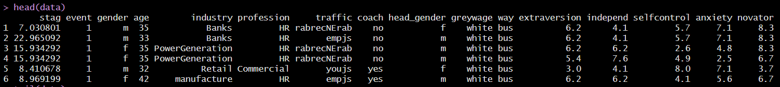
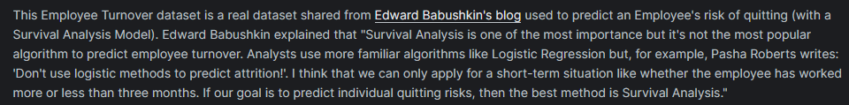
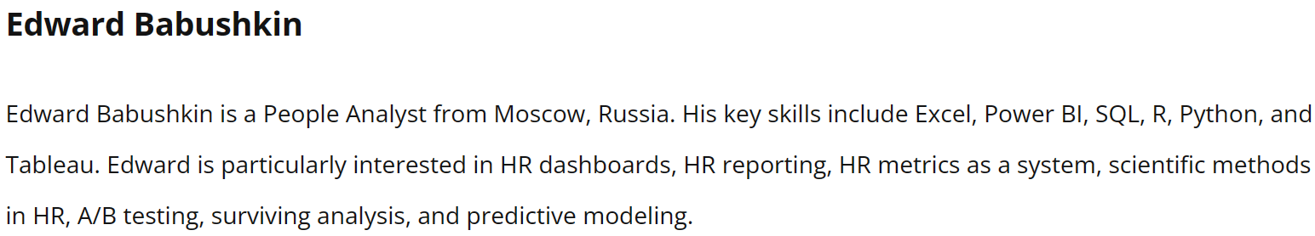

Slide 6
Variables presented
Retained all original variables, as well as an additional log-transformation, for the initial modeling.
Reasoning:
Gender, age, industry, profession, and traffic represent demographic and job-related factors.
Coach and head gender may influence employee experience.
Greywage and transportation mode offer insights into employee circumstances.
Personality scores (‘Big 5’ model) provide psychological insights.

Slide 7
DATA Prep
Checked for NA & blank values to omit from the data if necessary
Renamed Big 5 variables to match the OCEAN scheme
e.g., novator -> openness, selfcontrol -> conscientiousness
Standardized categorical variables
e.g., etc -> other, finan\xf1e -> finance, KA (recruiting agency) -> RA, manage -> management, etc.
Log transformed ‘experience’ to reduce skewness
Added labels ‘Stayed’ & ‘Left’ for the dependent variable’s respective factor levels of 0 & 1 for upcoming visualizations
Made contingency tables for categorical variables to perform chi-squared tests
Industry, Profession, Traffic, and Way returned p-values < 0.05
Industry and Profession have many factor levels, though Way has only 3: bus, car, foot

Slide 8
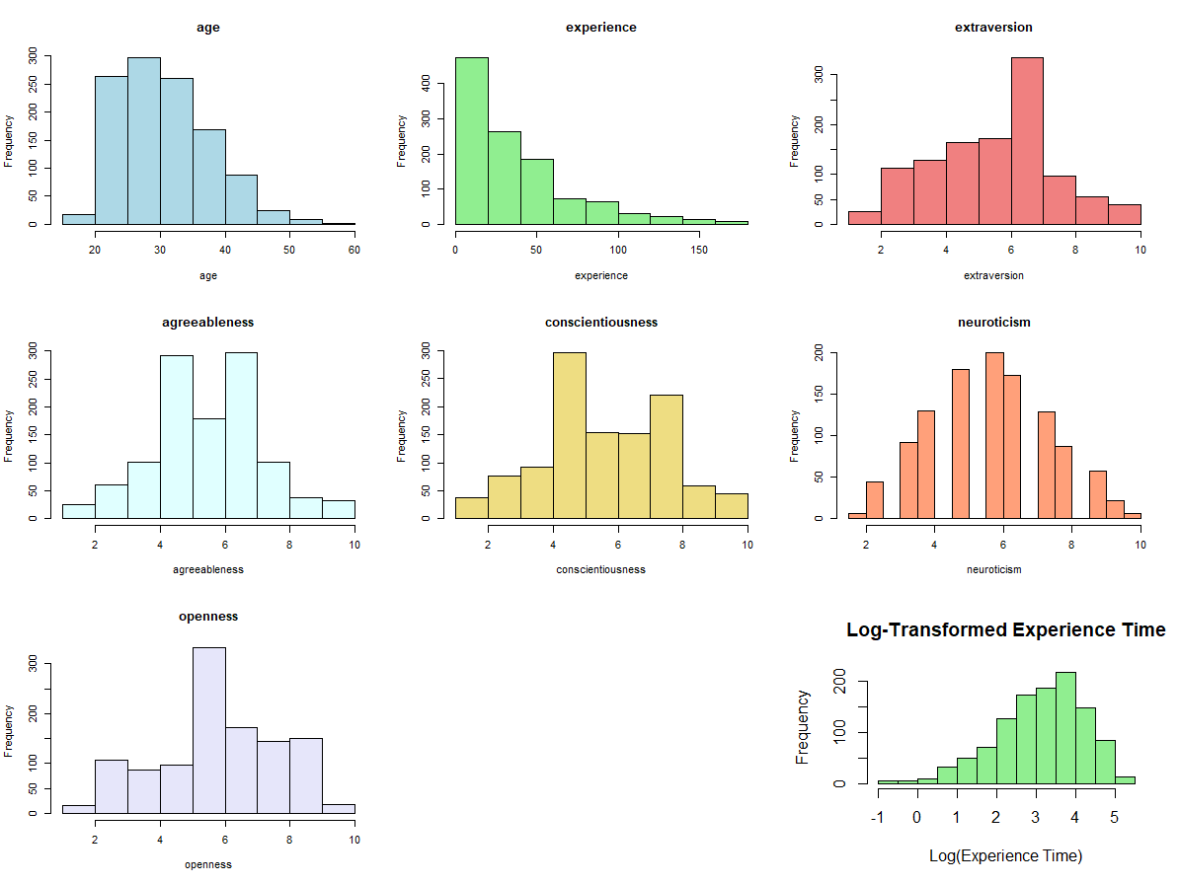
While ‘age’ seems natural to have a right skew, ‘experience’ is worth taking a log-transformation for and seeing if it improves the skewness.

Slide 9
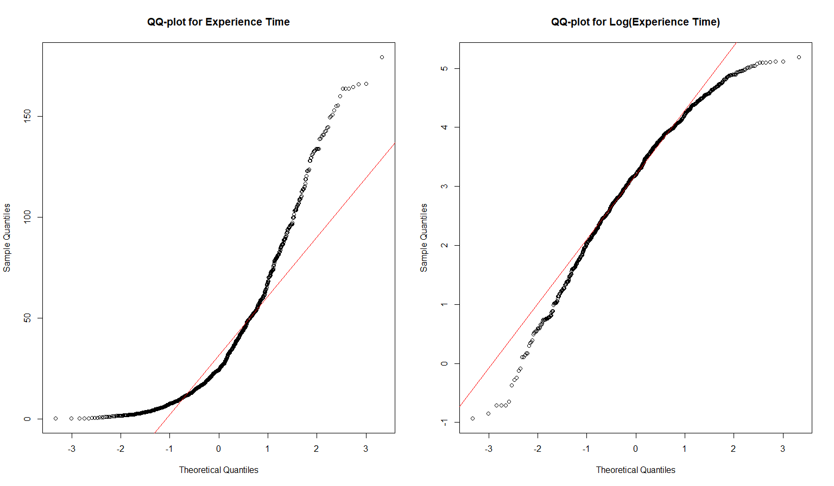
This follows the QQ-line much better now.

Slide 10
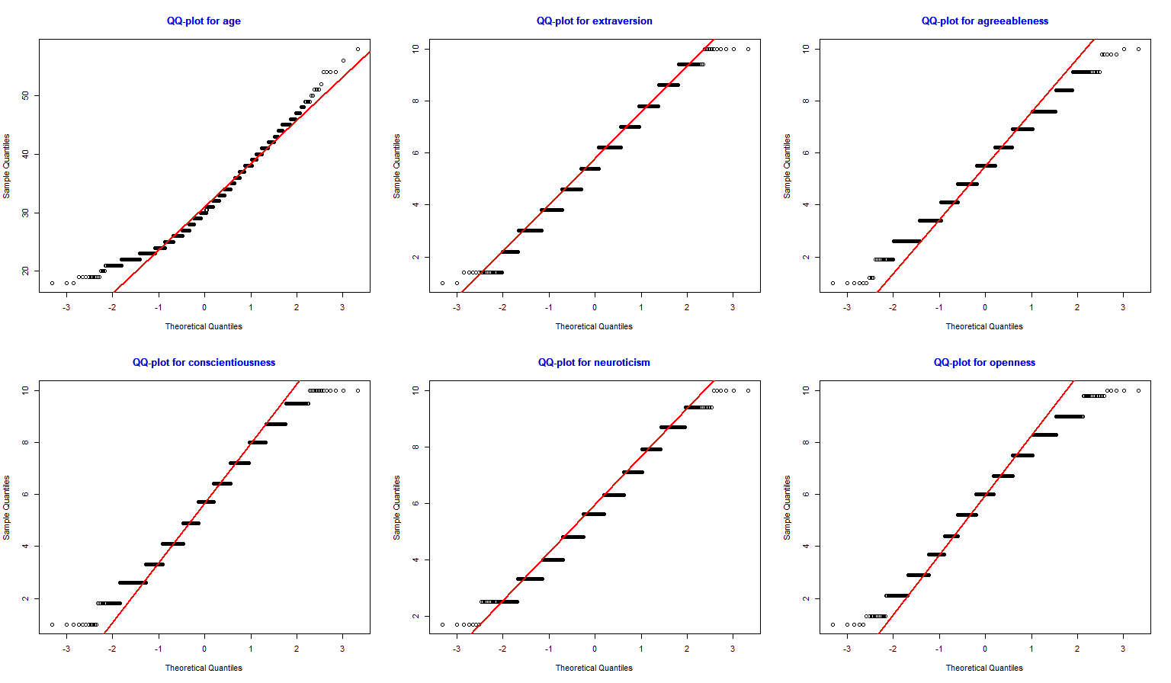
Each variable’s Shapiro-Wilk test results in a p-value less than 0.05, indicating the data is not normally distributed.

Slide 11
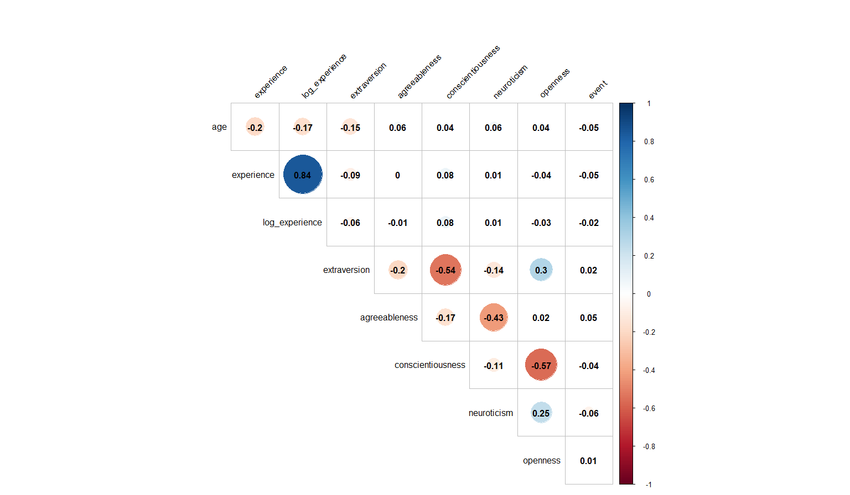
Most variables show little to no correlation of a linear relationship between them.
‘Leaving’ (Event) shows weak correlations with all traits, with a small uptick in turnover linked to higher neuroticism.

Slide 12
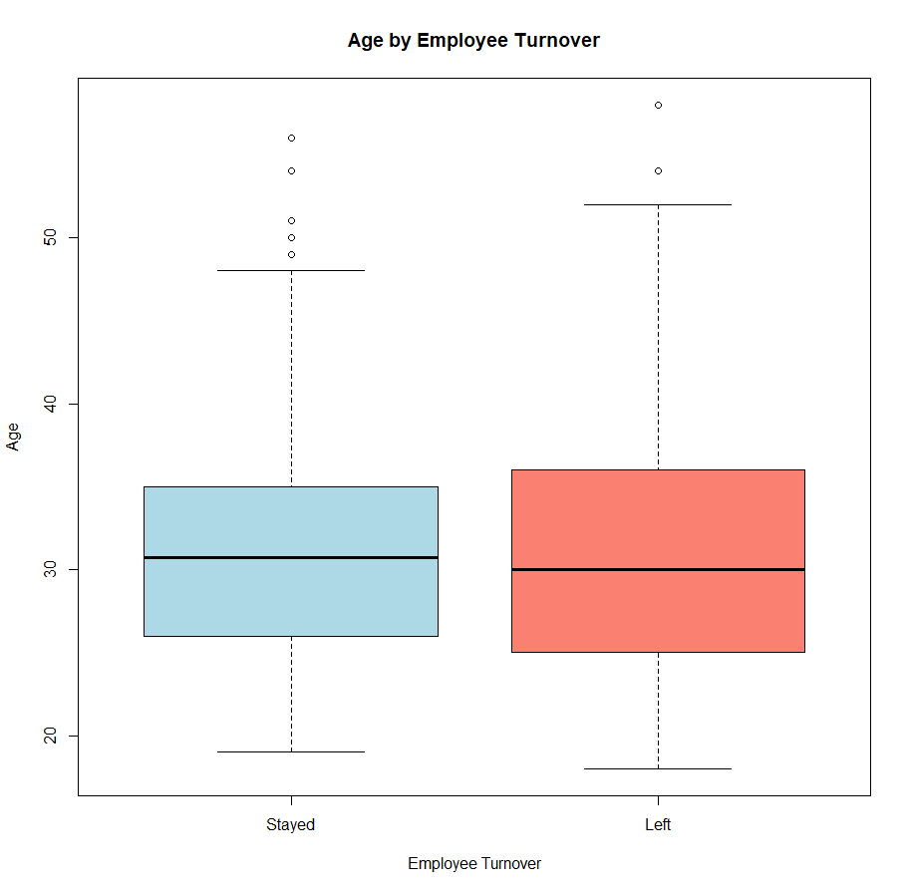
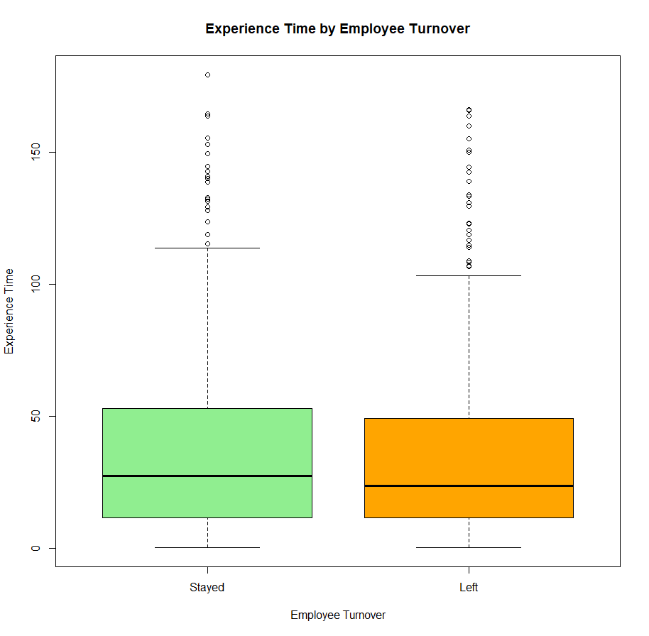
Many outliers, thus individual circumstances can greatly vary despite similar central tendency.
Similar box shapes suggests age and experience time do not significantly differentiate between groups for turnover.

Slide 13
Methodology
Language: R
Libraries: dplyr, corrplot, caret,rpart, randomForest, xgboost, Proc
Train/Test Split: 70:30
Models Used:
Logistic Regression
Appropriate for estimating the probability of a binary outcome; in this case, the ‘event’ variable of whether an employee will Stay or Leave.
Decision Tree
Would offer a clear visualization of how decisions are made, and which variables are most influential at each step in predicting turnover.
Random Forest
Wanted an ensemble method that would be aggregating multiple decision trees to improve predictive performance and control overfitting.
XGBoost
Performs well with classification problems due to its gradient boosting framework.

Slide 14
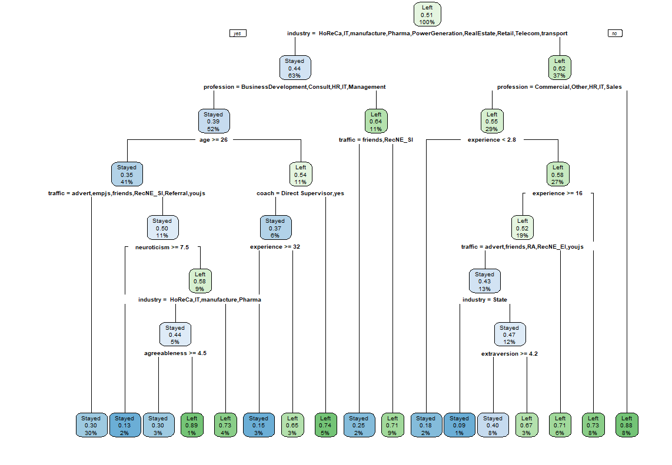
The model indicates Industry and Profession are most significant in predicting whether employees Stay or Leave.
High Traffic and Coach nodes suggest personal relationships and direct management play part in decisions.

Slide 15
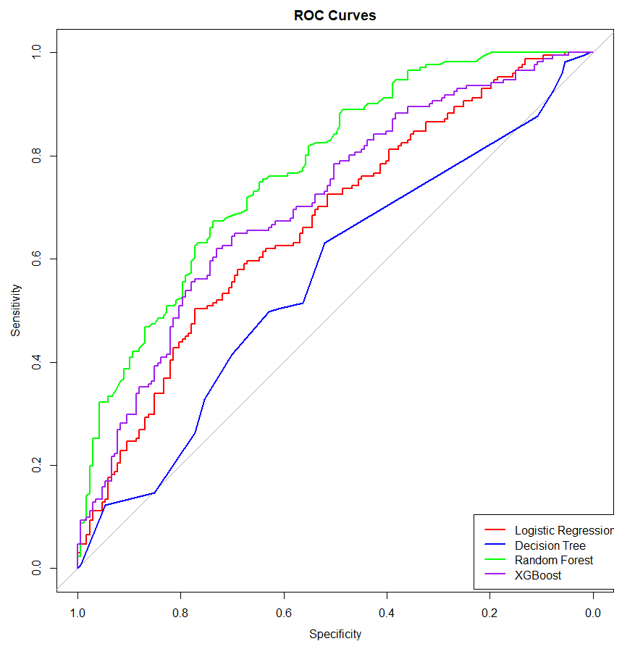




Modeling & Results
Logistic Regression
AUC: 66.82%
Acc: 62.43%
Decision Tree
AUC: 56.22%
Acc: 53.85%
Random Forest
AUC: 77.30%
Acc: 68.05%
XGBoost
AUC: 70.82%
Acc: 64.50%
The Random Forest model is the best performing of the 4.

Slide 16
Model Reduction
Did Feature Importance for the 2 best performing models.
Random Forest: Industry, Experience, Log(Experience), Age, Traffic
XGBoost: Experience, Age, Industry, Traffic, Conscientiousness
Found optimal number of features (N) by testing subsets ranging from 5 to 30, in increments of 5, and evaluating highest model’s AUC and corresponding N value.
N = 5, AUC = 75.99%
N = 10, AUC = 75.52%
N = 15, AUC = 76.82%
Best AUC score is the model with 15 features; however, it is less than 1% better than the model with 5, indicating the more parsimonious model is almost as effective as the complex.
Refit the reduced data for the RF and XGB models, respectively returning AUCs of 75.94% and 71.64%.

Slide 17
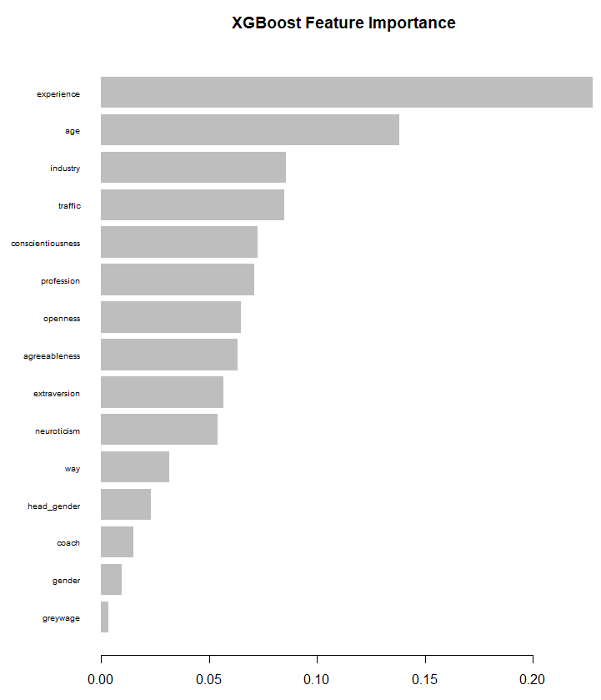
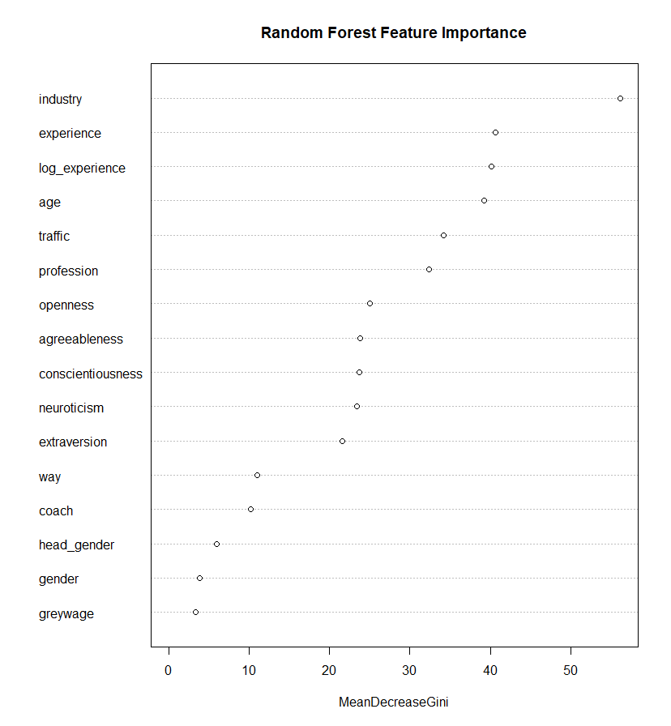
'Experience’ contributes most to the XGBoost model’s predictive accuracy.
'Industry' contributes most to the purity of the RF model's decisions.

Slide 18
Conclusion
Model Comparison: Random Forest outperforms other models, showcasing the highest AUC, indicating superior capability in correctly classifying and ranking the likelihood of employee turnover.
Predictive Power: All models exhibit AUCs above 50%, confirming they all perform better than random chance at predicting binary outcomes (Stay or Leave).
Opportunities:
Cross-validation: To ensure the models' robustness and reliability.
Transformations: Can try transforming more variables, testing for interactions, etc., to further test for potentially better models.
Targeting: Determining which specific rows (i.e., employees) are likely to leave and evaluating their attributes to prevent/address employee turnover.

