Slide 1






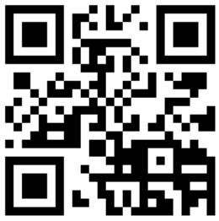
LA LIGA
A MOVEMENT FOR TRUE DEMOCRACY AND JUSTICE
Ideas Belong to Everyone
Knowledge and discoveries should be shared, not sold.
Money Comes from Work
Wealth should come from real effort, not money making more money.
Social Equality for All
No room for discrimination.
Fair Inheritance
Wealth should be shared fairly to all not just family.
No to War
No making or trading weapons.
la-liga.ph

