Slide 1

What is True Democracy?
Explaining Liquid Democracy and How It Can
Improve Our Lives

Slide 2
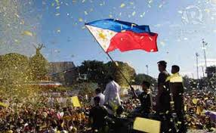
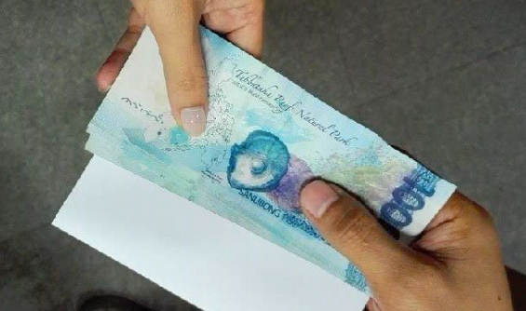
What is Democracy?
It is a system where people have the power to make decisions about their lives.
is it ???

Slide 3
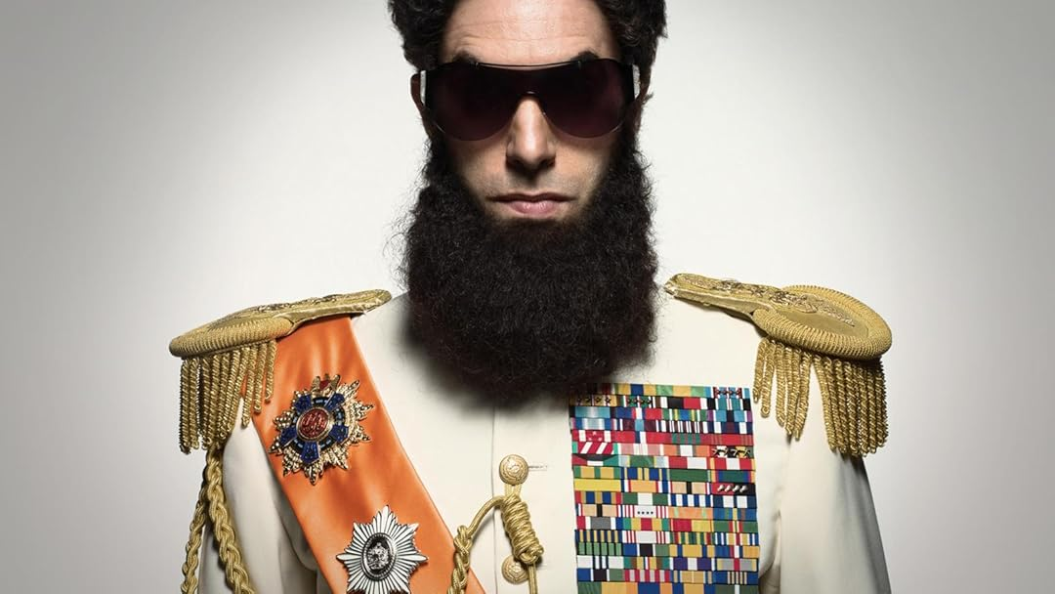
What is Wrong ?
Politicians make their own decisions
We only vote every few years

Slide 4
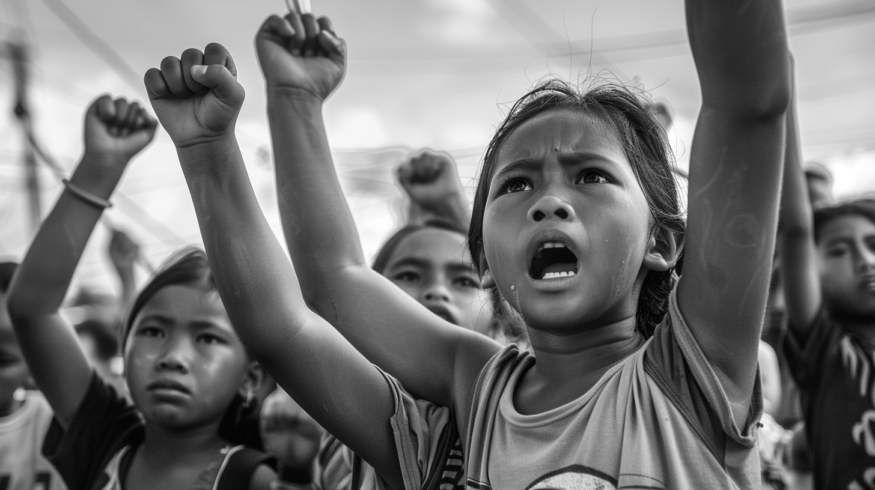
What is Liquid democracy ?
let you vote directly on issues
or delegate to someone you trust on a domain.

Slide 5

Why it is different ?
You can take back your vote anytime !
No one will decide for you if you don’t want to

Slide 6

Join la Liga !
Do you really think this can happen without you ?
la-liga.ph

