Slide 1
Design of a CMOS Integer-16 Charge-Pump PLL
EEE 466 – Analog Integrated Circuit
Jan 2026 Level-4 Term-1 Section G2
Final project Demonstration
Submitted by – Group 03.G2
Tahmid Adib
2106089
Jafrin Rubayet Seme
2106150
Mushfiqur Rahman
2106181
Chayan Paul
2106182

Slide 2
Outline
Summary
Introduction
Design
Implementation
Design Analysis and Evaluation
Individual Contribution
References
Presented by: Group 03.G2

Slide 3
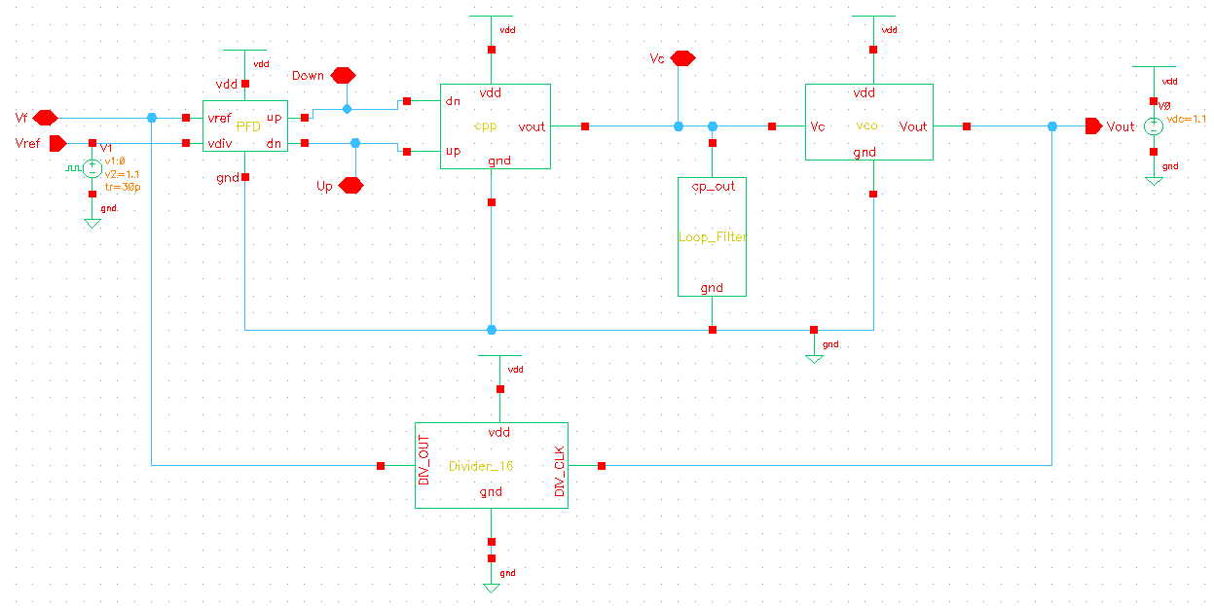
1. Summary
Our designed PLL is a type-II, third-order integer-16 charge-pump loop
Presented by: Group 03.G2

Slide 4
2. Introduction
Digital and RF chips need a GHz clock, but crystal references run at only tens of MHz.
A Phase-Locked Loop (PLL) multiplies the reference up to a high, phase-locked clock.
Our target: a 1.20 GHz clock synthesizer (×16 from 75 MHz)
Transistor-level design in GPDK045 (45 nm), VDD = 1.1 V, with DRC/LVS-clean layout.
f_ref = 75 MHz
PFD
Charge
Pump
Loop
Filter
VCO
f_out = 1.20 GHz
÷16 Divider
75 MHz (feedback)
Presented by: Group 03.G2

Slide 5
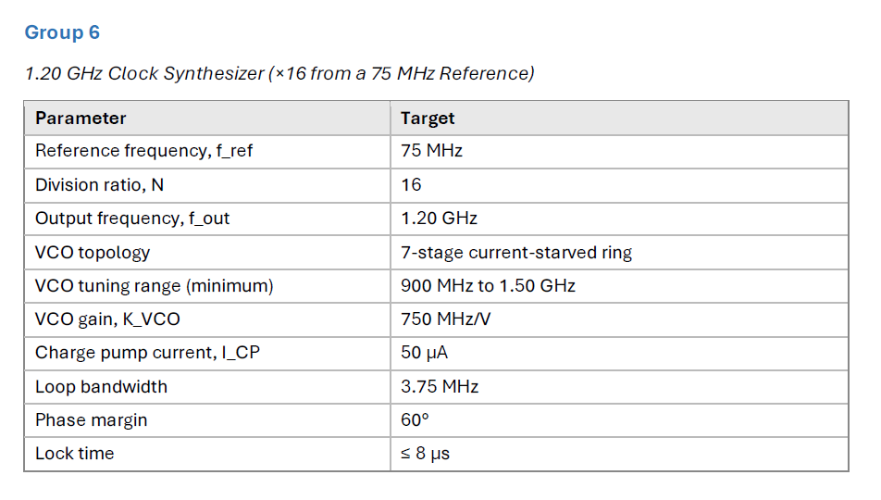
3.1 Design: Problem Formulation
3.1.1 Required Specification
Presented by: Group 03.G2

Slide 6
3.1 Design: Problem Formulation
3.1.2 Formulation of Problem
Phase Frequency Detector – Design a Tri-state PFD (2 D flip-flops + reset), free of dead zone
Charge Pump – Design a switched PMOS (UP) and NMOS (DN) current source with I_CP = 50 µA; UP/DN mismatch ≤ 5 % for Vctrl 0.2–0.9 V
Voltage Controlled Oscillator – Single-ended 7-stage current-starved ring oscillator with frequency range 900 MHz – 1.50 GHz (±25 %), and K_VCO = 750 MHz/V
Frequency Divider – Chain of 4 divide-by-2 D flip-flops (2⁴ = 16)
Loop Filter – passive 2nd-order loop filter
Architecture and loop design approach: [1], [2]
Presented by: Group 03.G2

Slide 7
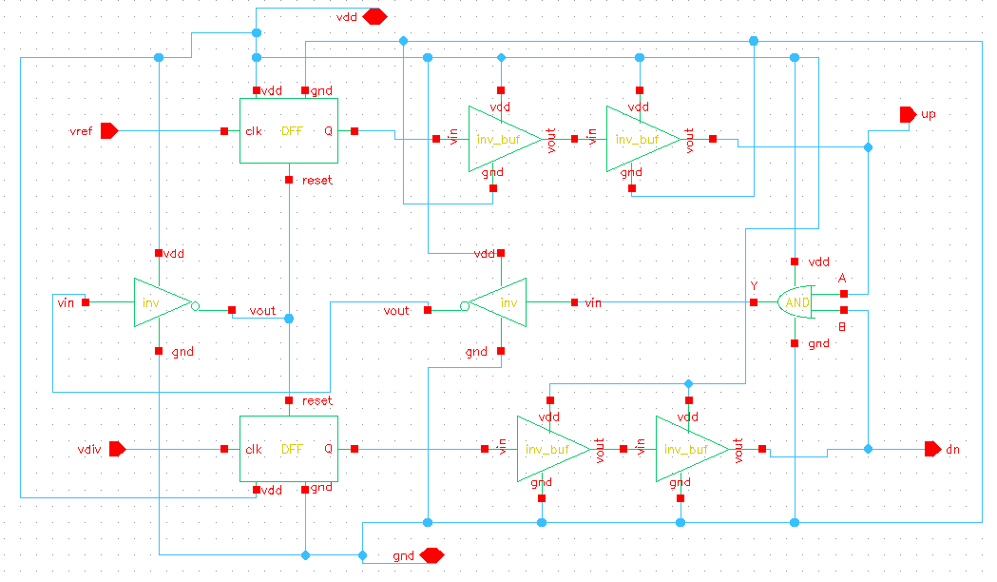
3.2 Design Methods
3.2.1 Phase Frequency Detector (PFD)
Schematic
Presented by: Group 03.G2

Slide 8
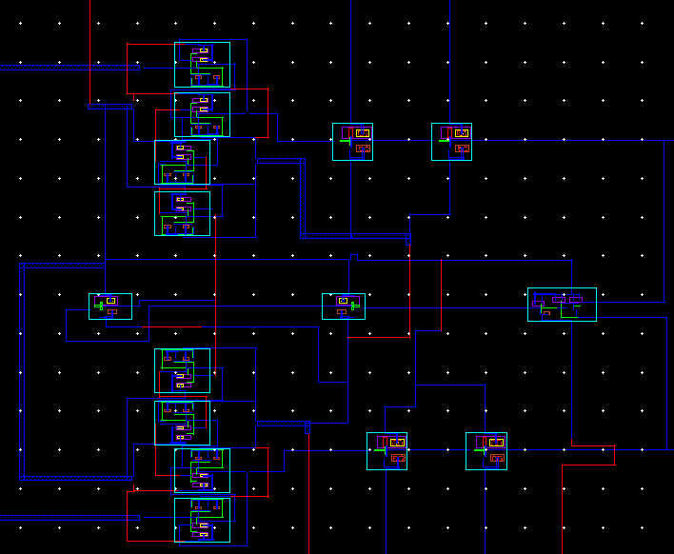
3.2 Design Methods
3.2.1 Phase Frequency Detector (PFD)
Layout
Width – 109 µm
Height – 99.395 µm
Area = 10,834 µm²
= 0.01083 mm²
Presented by: Group 03.G2

Slide 9
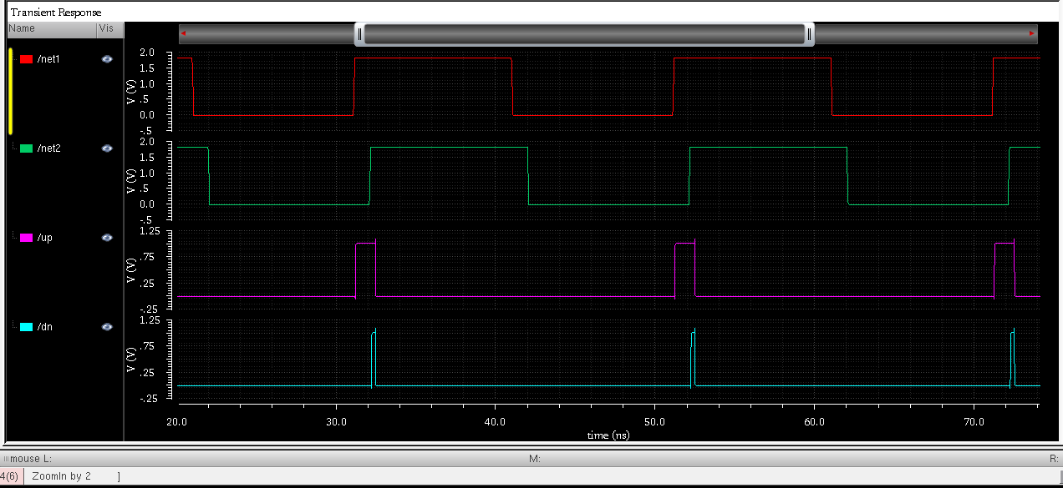
3.2 Design Methods
3.2.1 Phase Frequency Detector (PFD)
Case 1: V_ref leads V_div
UP rises at the V_ref edge and stays high until the V_div edge resets both flip-flops → V_ctrl rises.
Presented by: Group 03.G2

Slide 10
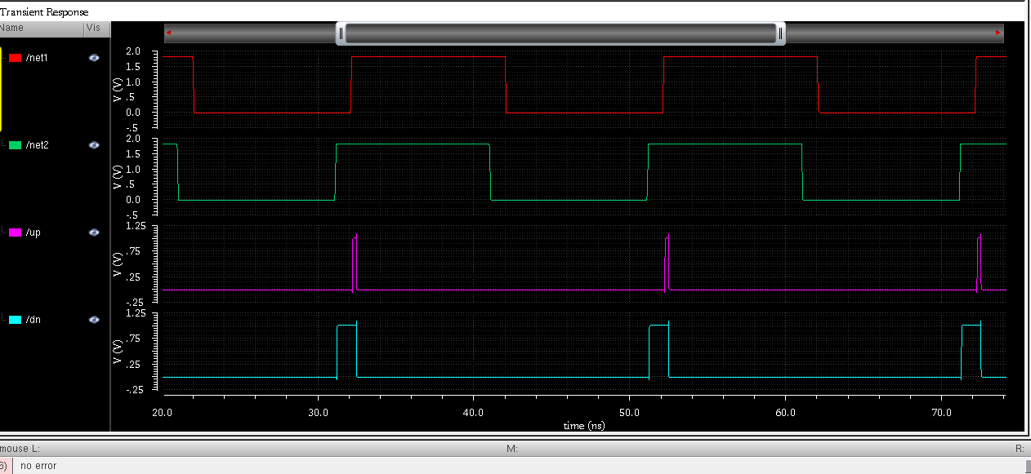
3.2 Design Methods
3.2.1 Phase Frequency Detector (PFD)
Case 2: V_div leads V_ref
DN rises at the V_div edge and stays high until the V_ref edge resets it → V_ctrl falls.
Presented by: Group 03.G2

Slide 11
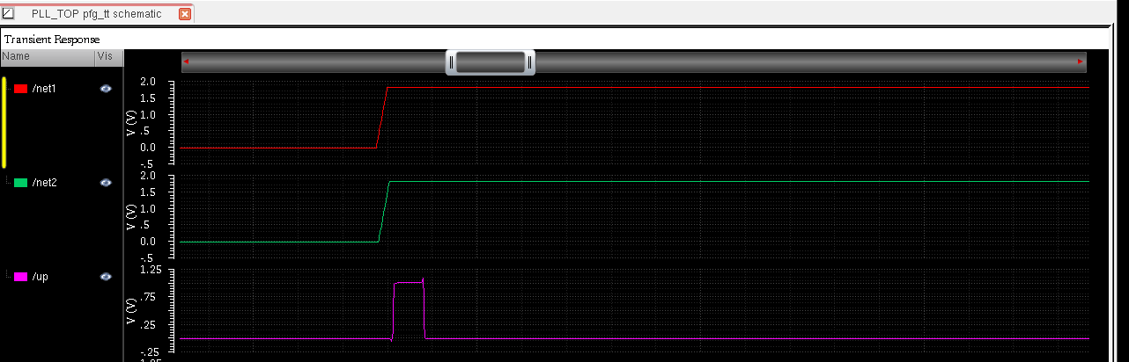
3.2 Design Methods
3.2.1 Phase Frequency Detector (PFD)
Case 3: Dead-zone test (phase error = 20 ps)
Even for a 20 ps phase error UP gives a full pulse (widened by the reset delay) → PFD is free of dead zone.
Presented by: Group 03.G2

Slide 12
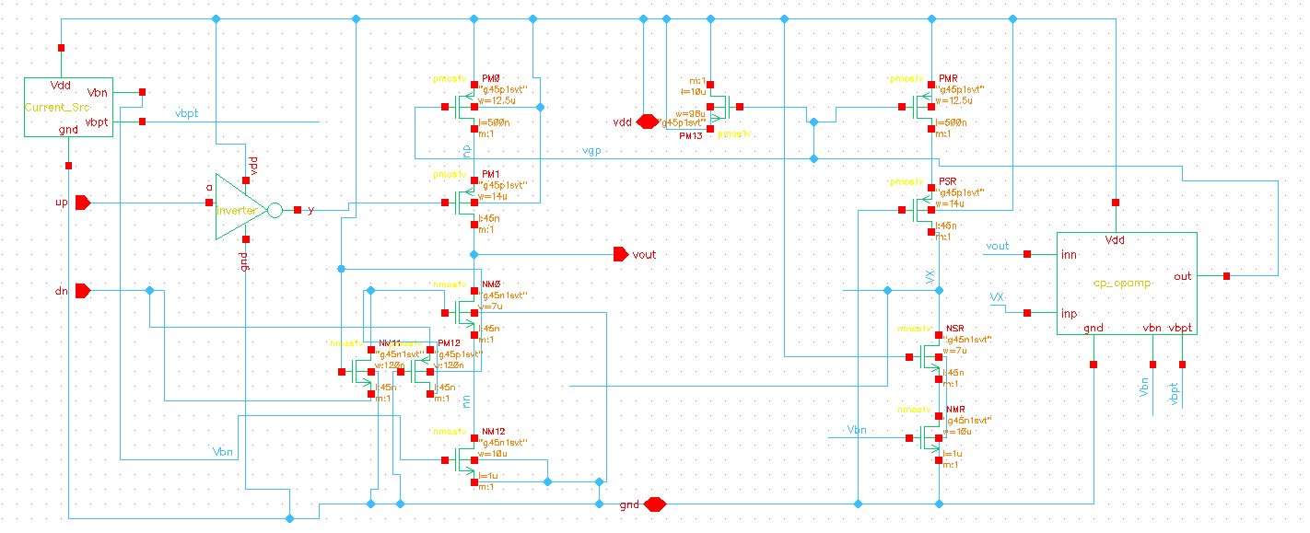
3.2 Design Methods
3.2.2 Charge Pump (CP)
Schematic
Presented by: Group 03.G2

Slide 13
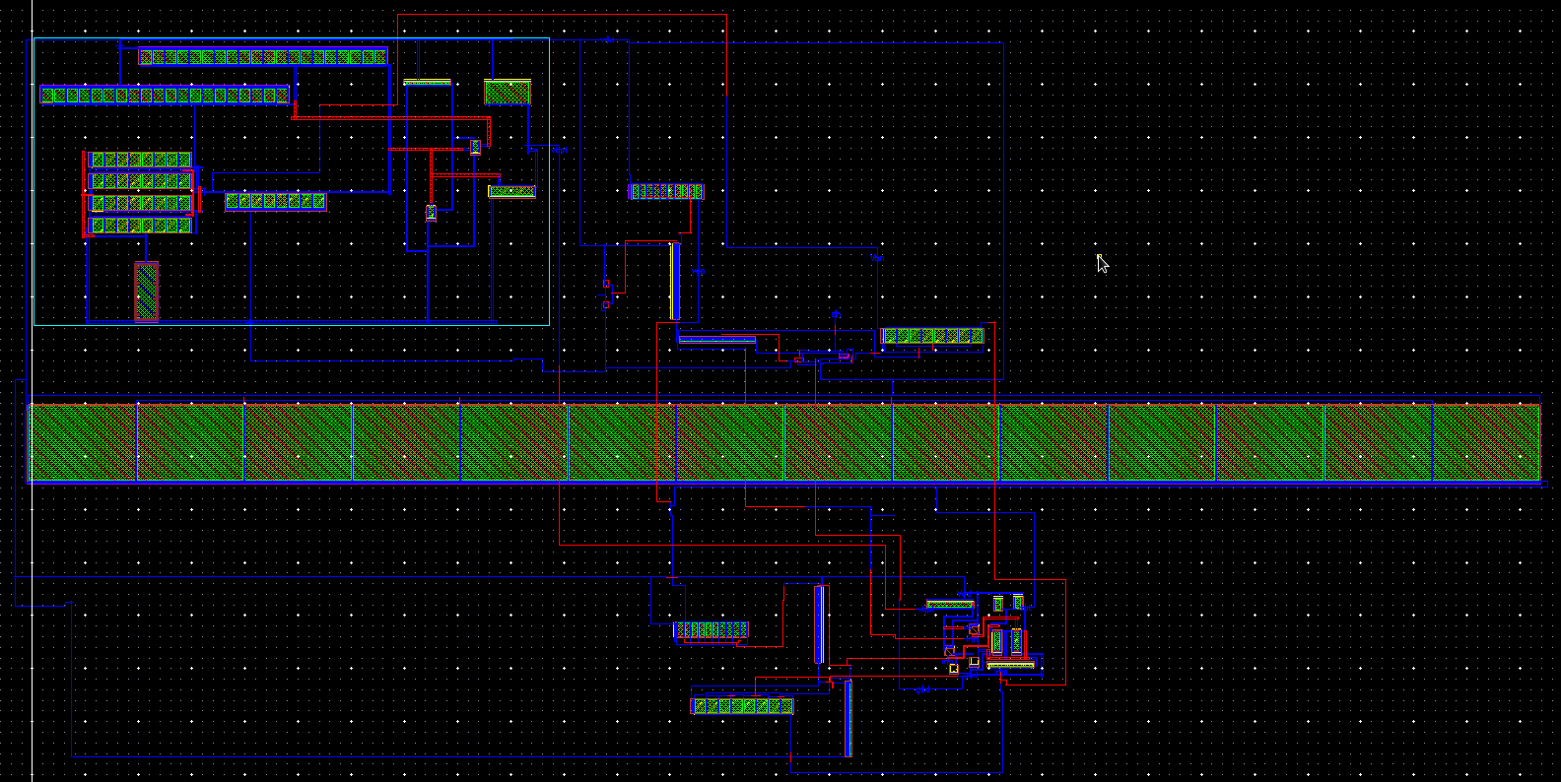
3.2 Design Methods
3.2.2 Charge Pump (CP)
Layout
Width – 144.21 µm Height - 71.32 µm Area = 10,285 µm² = 0.01029 mm²
Presented by: Group 03.G2

Slide 14
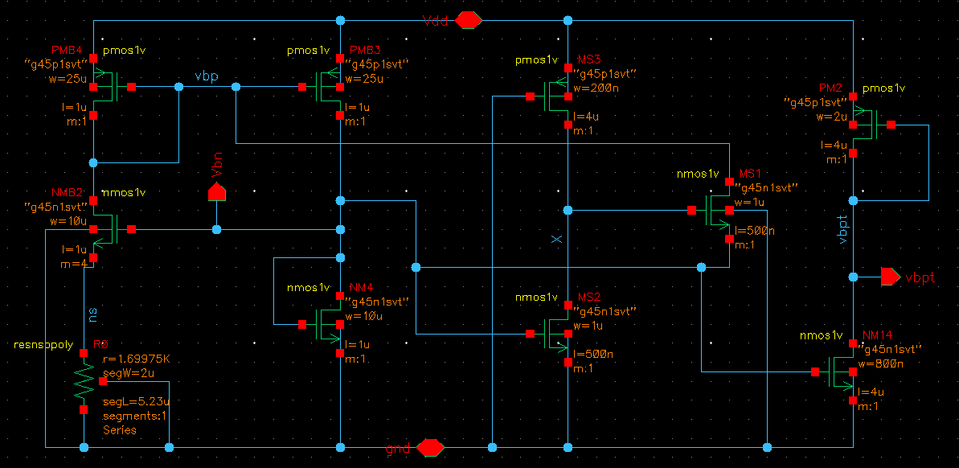
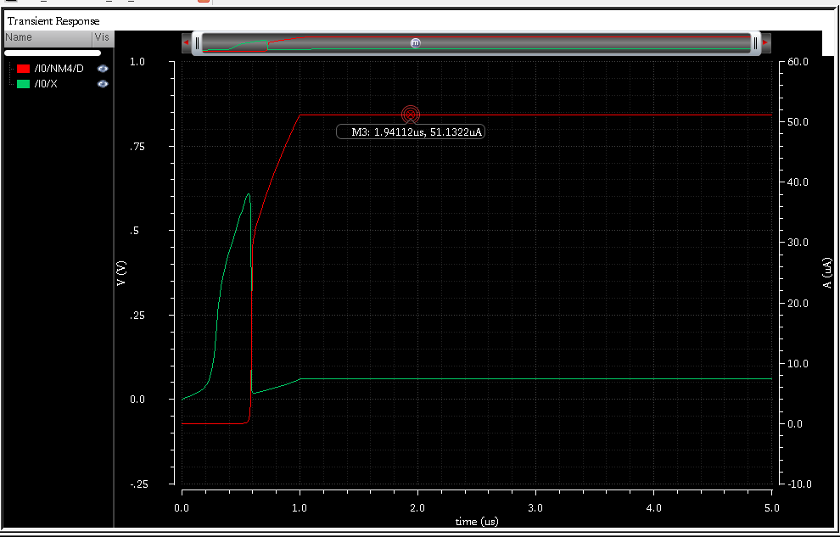
3.2 Design Methods
3.2.2 Charge Pump (CP)
Current source : Beta Multiplier
Presented by: Group 03.G2

Slide 15
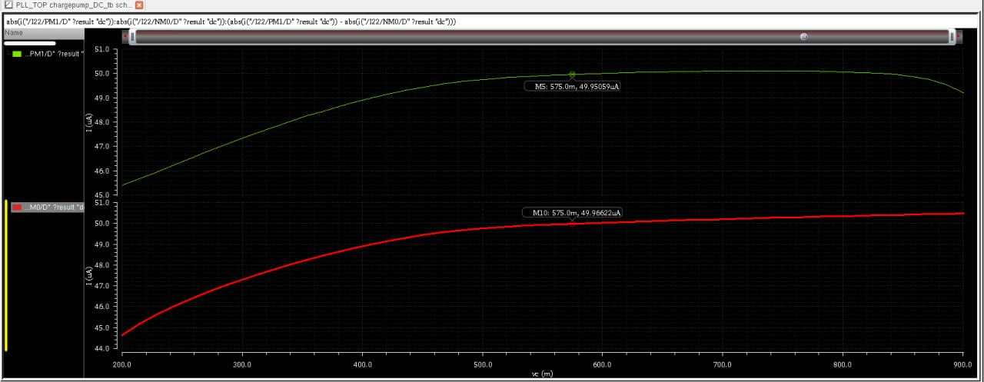
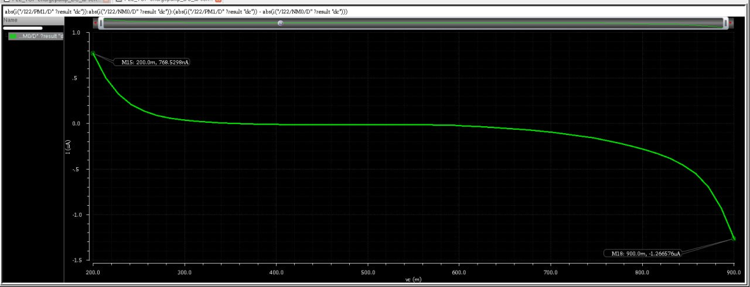
3.2 Design Methods
3.2.2 Charge Pump (CP)
Current Mismatch Plot
Green – Up Current,
Red- Down Current
Presented by: Group 03.G2

Slide 16
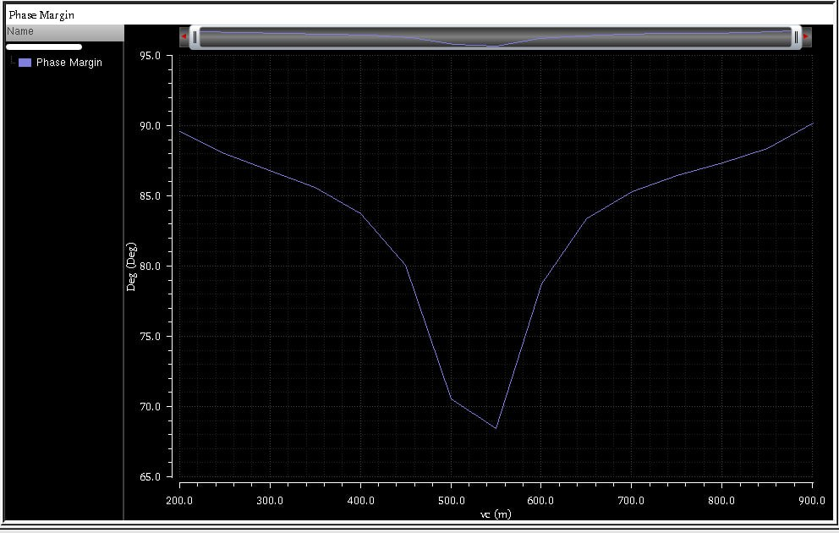
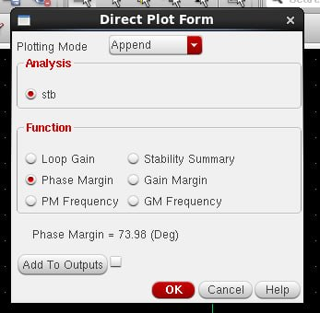
3.2 Design Methods
3.2.2 Charge Pump (CP)
STB analysis of the replica-bias loop: PM > 60° → stable
Parametric STB sweep: stable over the full V_ctrl range (0.2 – 0.9 V)
Presented by: Group 03.G2

Slide 17
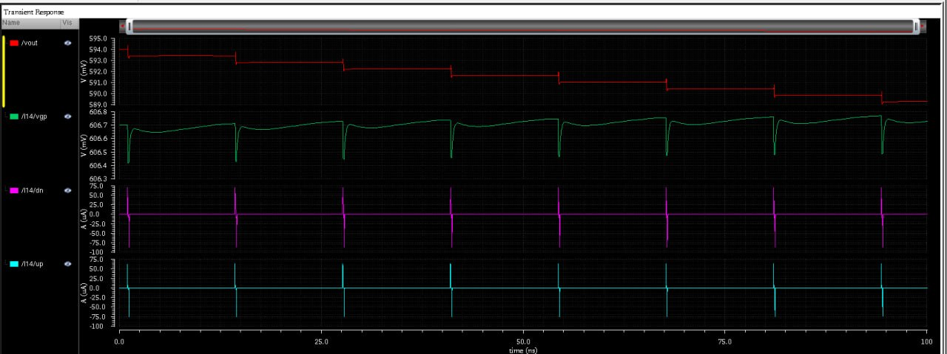
3.2 Design Methods
3.2.2 Charge Pump (CP)
Charge Pump transient analysis
Presented by: Group 03.G2

Slide 18
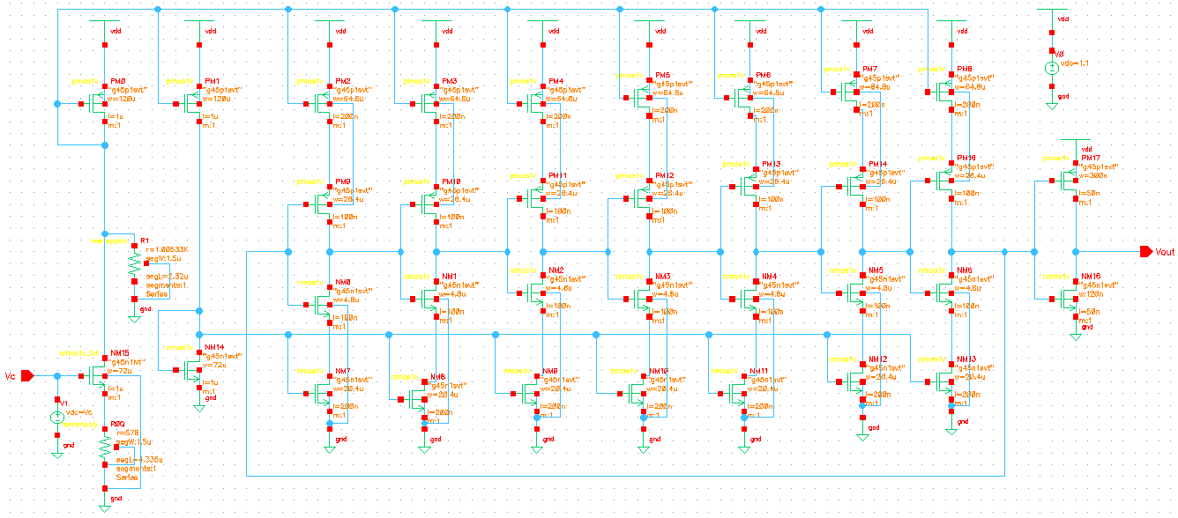
3.2 Design Methods
3.2.3 Voltage-Controlled Oscillator (VCO)
Schematic
Presented by: Group 03.G2

Slide 19
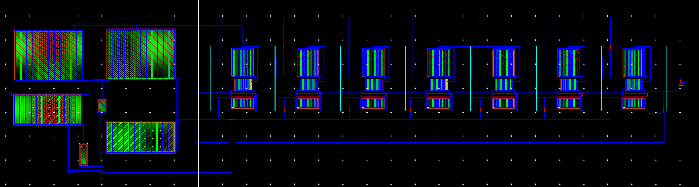
3.2 Design Methods
3.2.3 Voltage-Controlled Oscillator (VCO)
Layout
Width – 139.865 µm
Height – 33.825 µm
Area = 4,731 µm² = 0.004731 mm²
Presented by: Group 03.G2

Slide 20
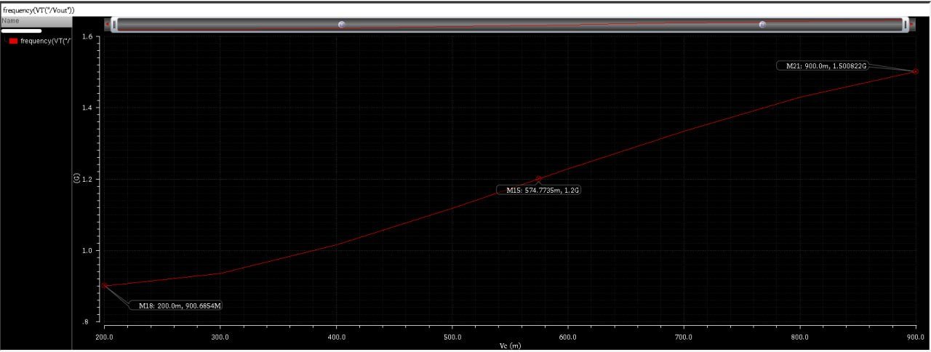
3.2 Design Methods
3.2.3 Voltage-Controlled Oscillator (VCO)
Simulation Result
Frequency Range 900.685 MHz to 1.5 GHz
Presented by: Group 03.G2

Slide 21
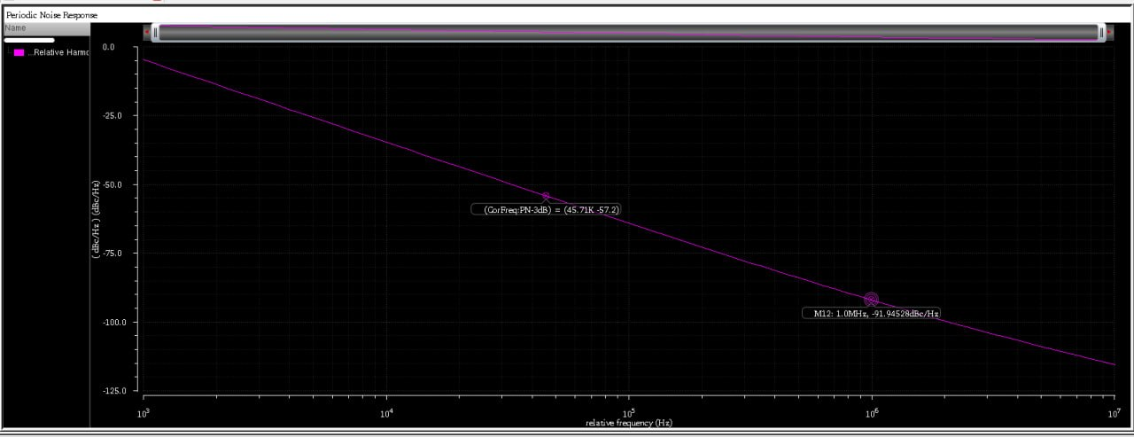
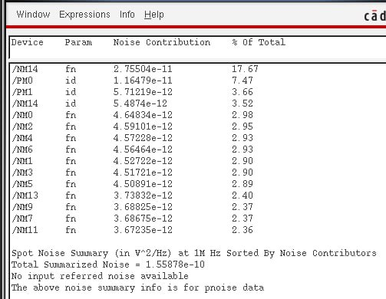
3.2 Design Methods
3.2.3 Voltage-Controlled Oscillator (VCO)
Simulation Result
Phase noise @ 1 MHz offset -91.9452 dBc/Hz
Ring-oscillator phase-noise theory: A. Hajimiri and T. H. Lee [3]
Presented by: Group 03.G2

Slide 22
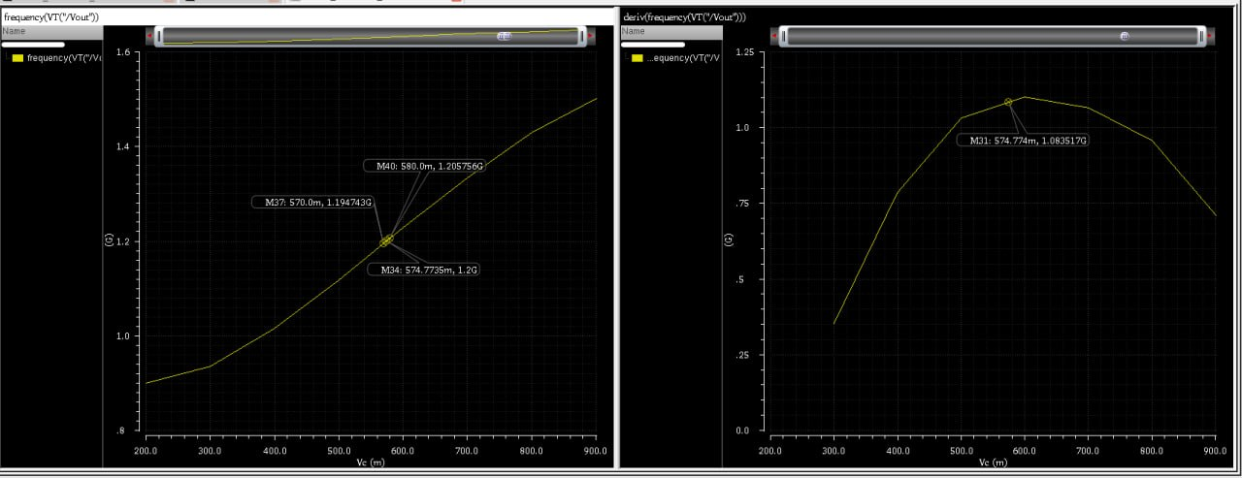

3.2 Design Methods
3.2.3 Voltage-Controlled Oscillator (VCO)
Simulation Result
Kvco Calculation
Kvco = $\frac{∆f}{∆V}=1083.51 MHz/V$
Presented by: Group 03.G2

Slide 23
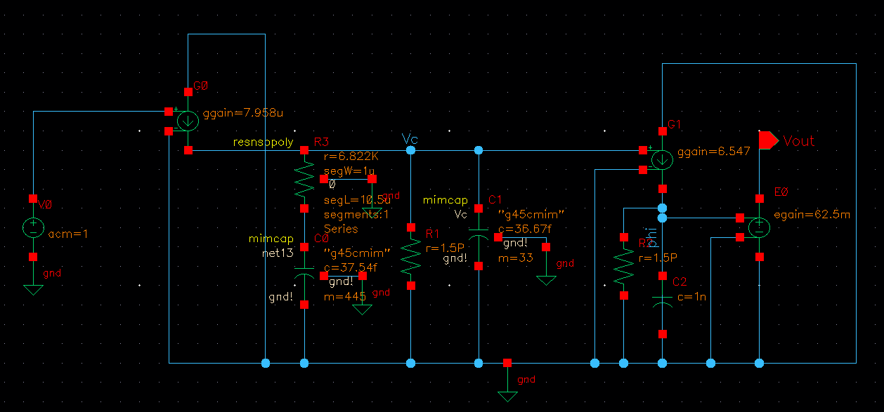
3.2 Design Methods
3.2.4 Linear Loop Model
Source: linear phase-domain CP-PLL model adapted from B. Razavi, Design of Analog CMOS Integrated Circuits, Ch. 16 [1]
Presented by: Group 03.G2

Slide 24
3.2 Design Methods
3.2.4 Loop Filter (LF)
Loop Filter Design (passive 2nd-order: R–C0 series ∥ C1 → 3rd-order loop)
Given: ICP = 50 µA, KVCO = 1.08 GHz/V, N = 16,
fc = 3.75 MHz (ωc = 2.356×10^7 rad/s), PM = 60°
1. Pole at 5×ωc (ripple suppression):
ωp = 5ωc = 1.178×10^8 rad/s → Tp = 8.49 ns
Phase lost = tan⁻¹(1/5) = 11.31°
2. Zero for PM = 60°:
tan⁻¹(ωc/ωz) = 60° + 11.31° = 71.31° → ωc/ωz = 2.956
ωz = 7.97×10^6 rad/s (1.27 MHz) → Tz = 125.5 ns
3. Total capacitance (|L(jωc)| = 1):
Ctot = [ICP·KVCO / (2π·N·ωc²)] · √(1+(ωcTz)²) / √(1+(ωcTp)²)
= 5.967 pF × 3.060 = 18.26 pF
Loop-filter design procedure: [1], [4], [5]
Presented by: Group 03.G2

Slide 25
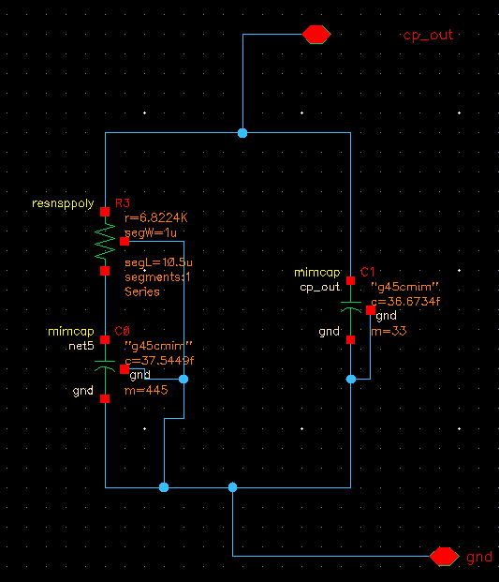
3.2 Design Methods
3.2.4 Loop Filter (LF)
4. Component values:
C1 = Ctot·Tp/Tz = 1.235 pF
C0 = Ctot − C1 = 17.02 pF
R = Tz / C0 = 7.37 kΩ
Implemented (GPDK045):
C0: mimcap, c = 37.54 fF × m = 445 → 16.71 pF
C1: mimcap, c = 36.67 fF × m = 33 → 1.21 pF
R3: resnsppoly, segL = 10.5 µm → 6.82 kΩ
Result (linear model): Loop BW = 3.752 MHz, PM = 60.01°
Schematic
Presented by: Group 03.G2

Slide 26
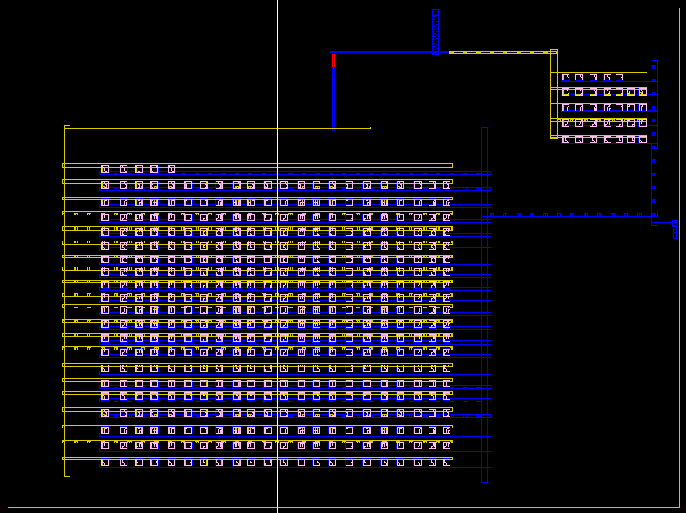
3.2 Design Methods
3.2.4 Loop Filter (LF)
Layout
Width – 513.135 µm
Height – 394.495 µm
Area = 202,429 µm²
= 0.2024 mm²
Presented by: Group 03.G2

Slide 27
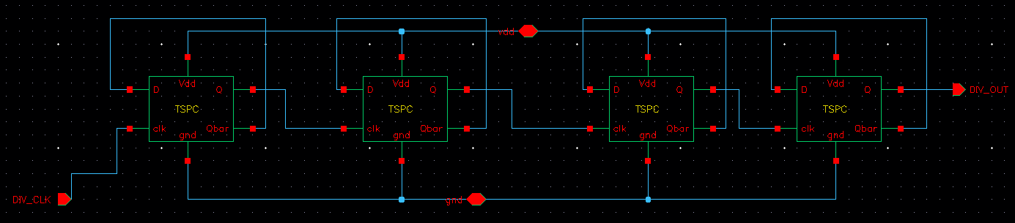
3.2 Design Methods
3.2.5 Frequency Divider (÷16)
Schematic
Presented by: Group 03.G2

Slide 28
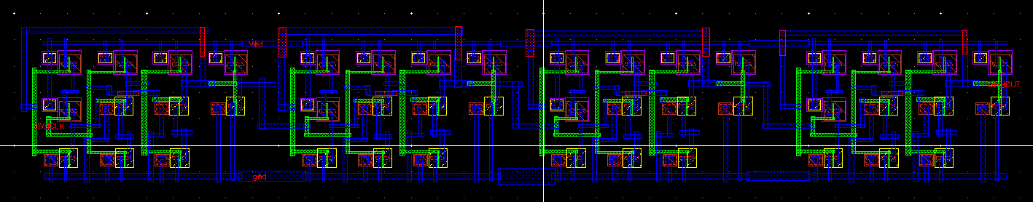
3.2 Design Methods
3.2.5 Frequency Divider (÷16)
Layout
Width – 37.405 µm Height – 5.7 µm Area = 213.2 µm² = 0.0002132 mm²
Presented by: Group 03.G2

Slide 29
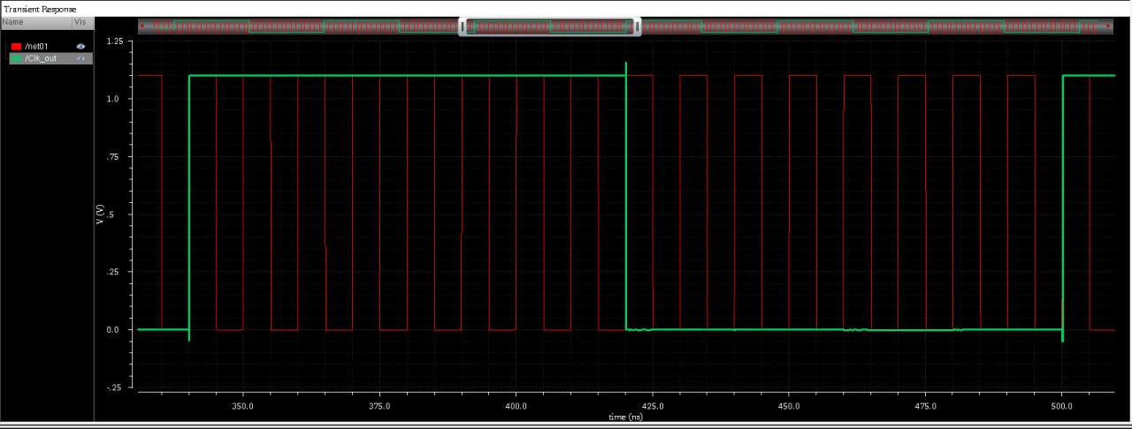
3.2 Design Methods
3.2.5 Frequency Divider (÷16)
Simulation Result
16 cycles of the input wave (red) are equal to 1 cycle of the output wave (green)
Presented by: Group 03.G2

Slide 30
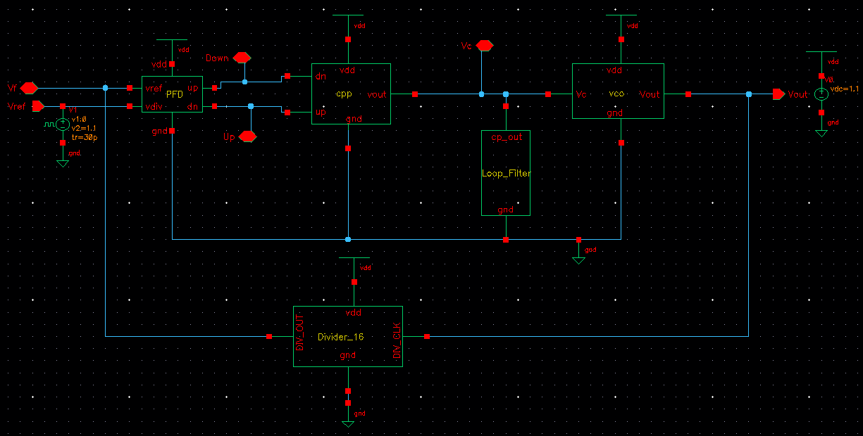
3.3 Design: Final Circuit Diagram
3.3.1 Schematic
Presented by: Group 03.G2

Slide 31
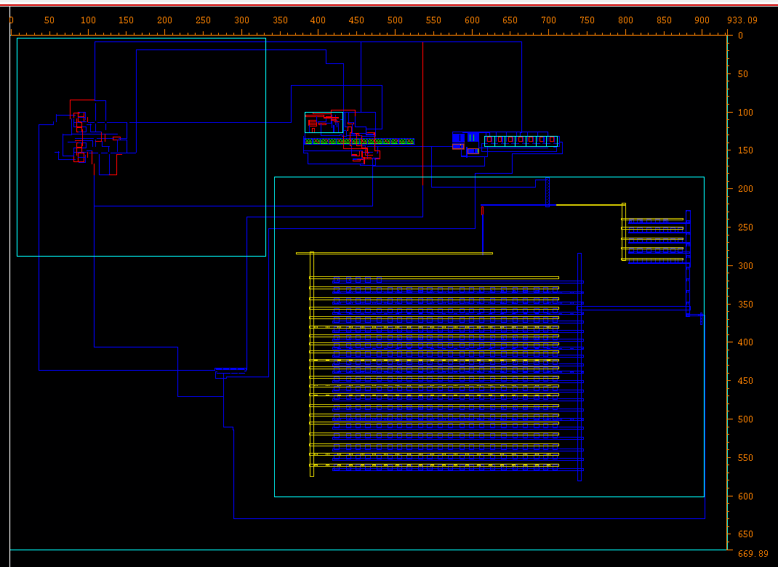
3.3 Design: Final Circuit Diagram
3.3.2 Layout
Width – 933.09 µm
Height – 669.89 µm
Area = 625,068 µm²
= 0.6251 mm²
Layout per GPDK045 rules and the course layout guideline [6], [7]
Presented by: Group 03.G2

Slide 32
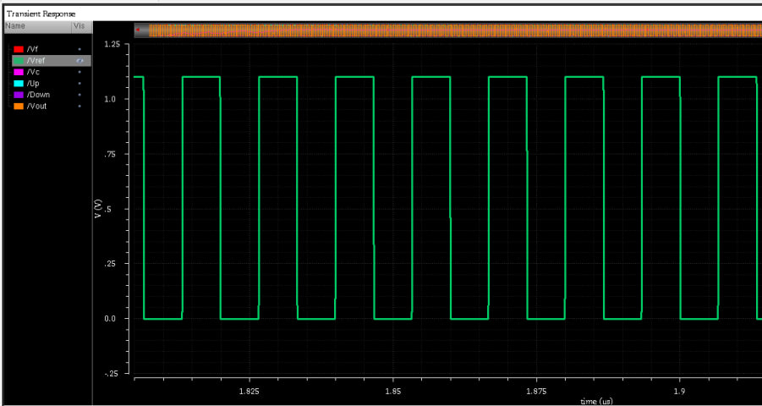
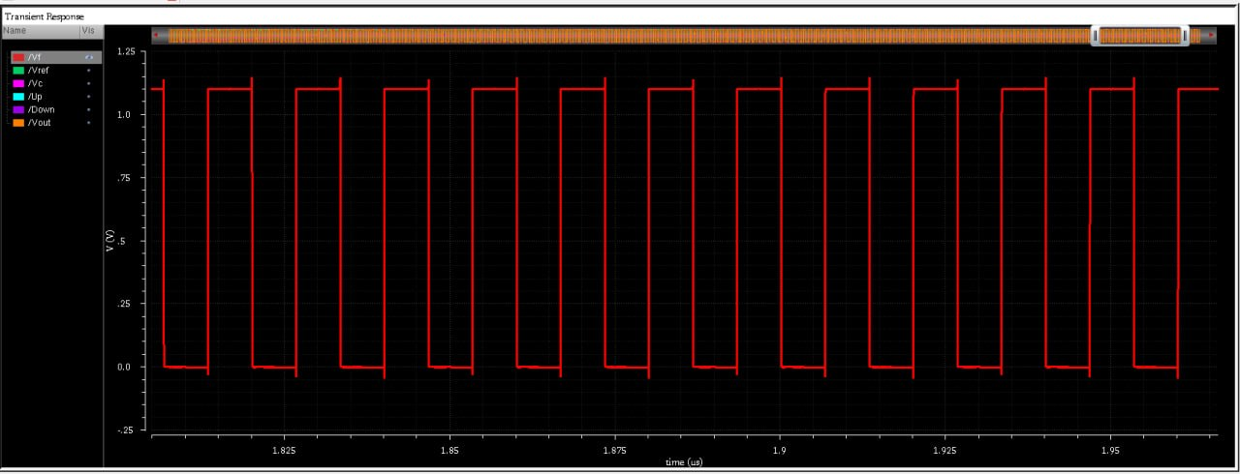
4.1 Implementation: Simulation Results
4.1.1 Divider Output vs Reference Input
Left: ÷16 feedback | Right: 75 MHz reference — same frequency after lock
Presented by: Group 03.G2

Slide 33
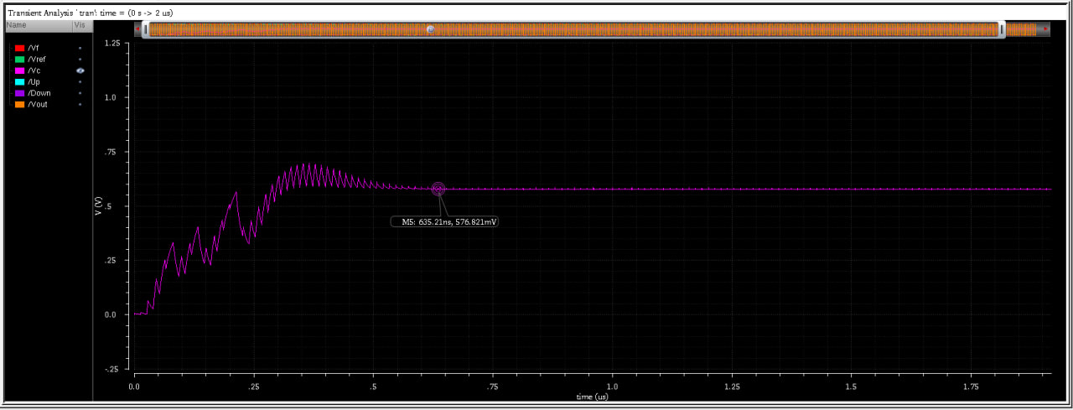
4.1 Implementation: Simulation Results
4.1.2 Control Voltage V_ctrl — Lock Transient
Locks in 520.9 ns (spec ≤ 8 µs) ; V_ctrl at lock = 575.7 mV, ripple = 10.13 mV p-p
Presented by: Group 03.G2

Slide 34
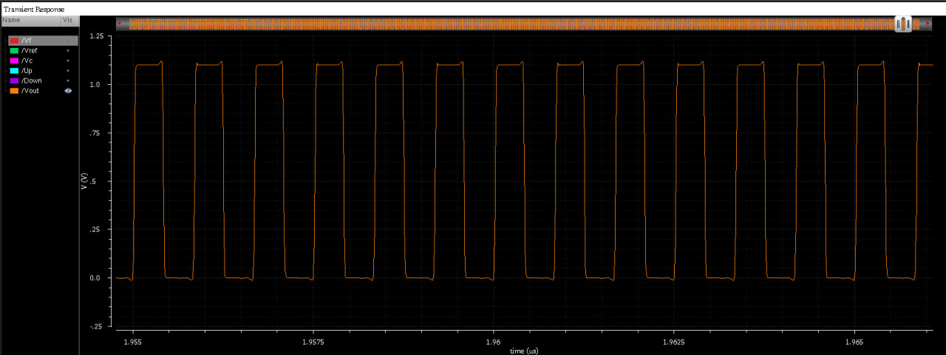
4.1 Implementation: Simulation Results
4.1.3 VCO Output After Lock
f_out = 1.200 GHz (= 16 × 75 MHz)
Presented by: Group 03.G2

Slide 35
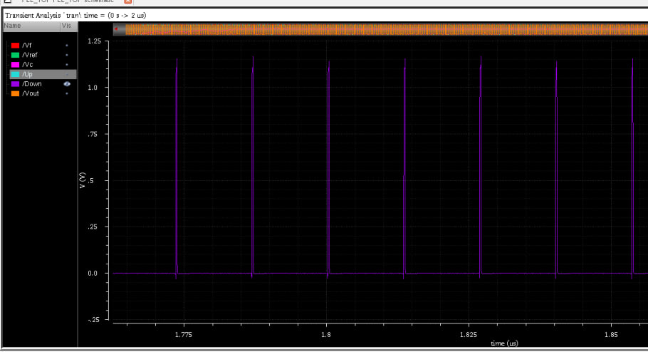
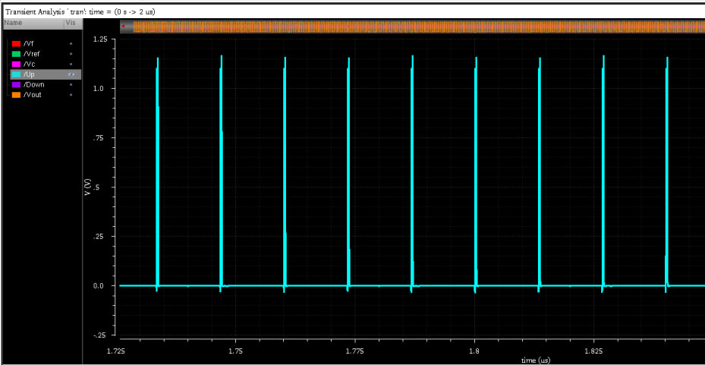
4.1 Implementation: Simulation Results
4.1.4 UP & DN Pulses at Lock
UP & DN pulses at lock
Presented by: Group 03.G2

Slide 36
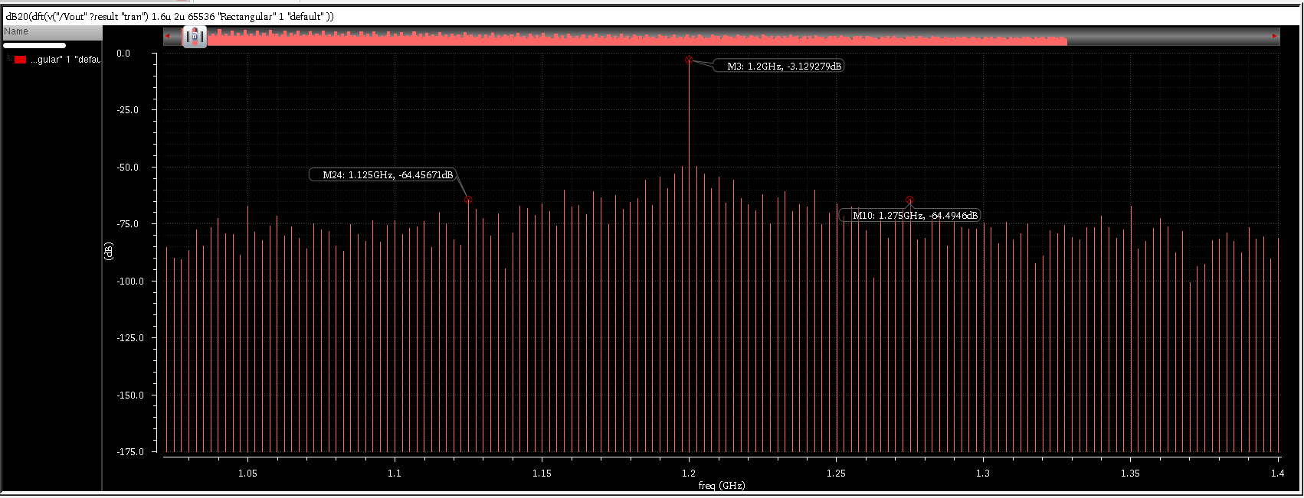
4.1 Implementation: Simulation Results
4.1.5 Reference Spur
Reference spur at f_out ± 75 MHz ≤ −64.5 dBc (spec ≤ −40 dBc )
Presented by: Group 03.G2

Slide 37
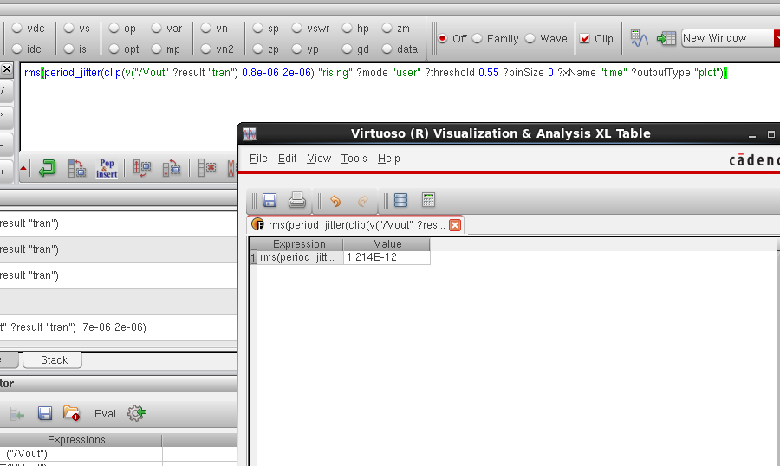
4.1 Implementation: Simulation Results
4.1.6 RMS Period Jitter
RMS period jitter = 1.214 ps (spec ≤ 8 ps )
Presented by: Group 03.G2

Slide 38
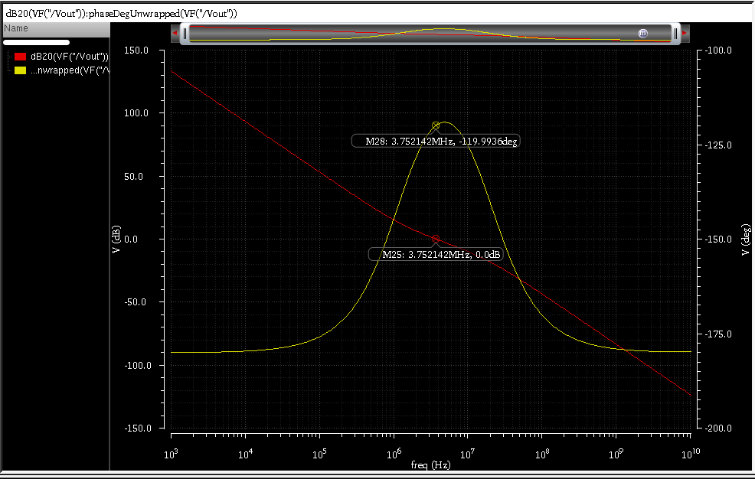
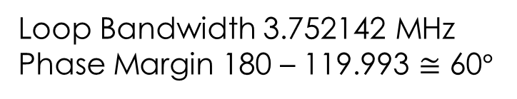
4.1 Implementation: Simulation Results
4.1.7 Loop Bandwidth & Phase Margin
Loop Bandwidth 3.752142 MHz
Phase Margin 180 – 119.993 $≅$ 60$°$
Presented by: Group 03.G2

Slide 39
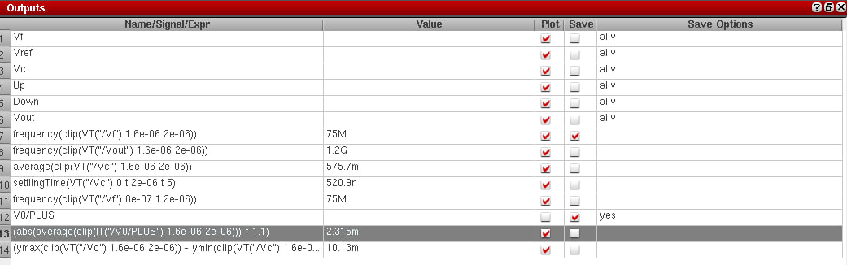
4.1 Implementation: Simulation Results
4.1.9 Power Consumption (after lock)
Power Consumption Calculation (after lock)
P = VDD × |I_avg|
ADE expression:
P = abs(average(clip(IT("/V0/PLUS"), 1.6µs, 2µs))) × 1.1
P = 2.315 mW (Spec: ≤ 5 mW)
Presented by: Group 03.G2

Slide 40
4.2 Layout Area Summary
4. Implementation
Block | W × H (µm) | Area (W × H) | Share
PFD | 109 × 99.395 | 10,834 µm² = 0.01083 mm² | 4.7 %
Charge pump | 144.21 × 71.32 | 10,285 µm² = 0.01029 mm² | 4.5 %
VCO | 139.865 × 33.825 | 4,731 µm² = 0.004731 mm² | 2.1 %
Loop filter | 513.135 × 394.495 | 202,429 µm² = 0.2024 mm² | 88.6 %
Divider (÷16) | 37.405 × 5.7 | 213.2 µm² = 0.0002132 mm² | 0.1 %
Sum of blocks | — | 228,492 µm² = 0.2285 mm² | 100 %
Full PLL layout | 933.09 × 669.89 | 625,068 µm² = 0.6251 mm² | —
Loop filter ≈ 89 % of block area; total PLL = 933.09 µm × 669.89 µm = 625,068 µm² = 0.6251 mm²
Presented by: Group 03.G2

Slide 41
5.1 Major Design Challenges & Solutions
5. Design Analysis and Evaluation
Challenge | Root cause | How it was addressed
K_VCO higher than spec (≈ 1.08 GHz/V vs 750 MHz/V) | 600 MHz span over ~0.7 V V_ctrl forces ≥ 857 MHz/V on average; 750 MHz/V is possible only locally | Loop filter recalculated with the measured K_VCO → BW = 3.75 MHz, PM = 60° restored
Charge-pump UP/DN mismatch | Channel-length modulation in short-L mirrors; limited headroom | Longer-L mirrors, replica-bias CP with error amplifier, beta-multiplier reference → mismatch < 5 % over 0.2–0.9 V
Narrow, non-full-swing PFD pulses (~150 ps, triangular) | Reset path too short for UP/DN to reach full swing | Longer reset-delay cell + output buffers → full-swing ~225 ps pulses
CP polarity bug & divider supply swap | V_ctrl stuck at VDD; divider VDD/GND reversed | Found with block-level testbenches and fixed before integration
Ideal R / C → PDK devices | mimcap and resnsppoly values differ from the ideal R and C | Values re-tuned (C: m = 445 / 33, R: segL) to keep BW and PM
Presented by: Group 03.G2

Slide 42
5.2 Result Comparison: Specified vs Achieved
5. Design Analysis and Evaluation
Group 6 parameter | Specified | Achieved
Reference frequency | 75 MHz | 75 MHz | ✓
Division ratio N | 16 | 16 | ✓
Output frequency | 1.20 GHz | 1.200 GHz | ✓
VCO topology | 7-stage CS ring | 7-stage CS ring | ✓
VCO tuning range | 0.90 – 1.50 GHz | 0.901 – 1.50 GHz | ✓
VCO gain K_VCO | 750 MHz/V | ≈ 1.08 GHz/V | ✗*
CP current I_CP | 50 µA | 50.0 µA | ✓
Loop bandwidth | 3.75 MHz | 3.752 MHz | ✓
Phase margin | 60° | 60.0° | ✓
Lock time | ≤ 8 µs | 0.52 µs | ✓
Common requirement | Specified | Achieved
Supply voltage | 1.1 V | 1.1 V | ✓
PFD dead zone | None | None (20 ps test) | ✓
CP matching, V_ctrl 0.2–0.9 V | ≤ 5 % | < 3 % | ✓
RMS period jitter | ≤ 8 ps | 1.21 ps | ✓
Phase noise @ 1 MHz | ≤ −90 dBc/Hz | −91.9 dBc/Hz | ✓
Reference spur | ≤ −40 dBc | −64.5 dBc | ✓
Total power | ≤ 5 mW | 2.315 mW | ✓
Layout area | — | 625,068 µm² = 0.6251 mm²
* K_VCO: a 600 MHz span over ~0.7 V of V_ctrl needs ≥ 857 MHz/V on average, so 750 MHz/V cannot coexist with the tuning range. The loop filter was recalculated with the measured K_VCO, so BW and PM still meet spec.
Also: V_ctrl at lock = 575.7 mV, ripple = 10.13 mV p-p.
Presented by: Group 03.G2

Slide 43
5.3 Limitations & Unresolved Challenges
5. Design Analysis and Evaluation
K_VCO spec not met directly
750 MHz/V is incompatible with the required tuning range
Compensated at system level via the loop filter
Residual CP charge imbalance
Small UP/DN charge imbalance at lock (~14 fC/cycle)
Acceptable: spur −64.5 dBc vs −40 dBc spec
Loop-filter area
Capacitors dominate: ≈ 0.2024 mm² of the 0.6251 mm² layout
Pre-layout verification only
Results are schematic-level simulations
No post-layout (PEX) or process-corner runs
Presented by: Group 03.G2

Slide 44
6.1 Individual Contribution of Each Member
Block / task | Work done | Member (ID)
Phase-frequency detector | Tri-state DFF PFD, reset-delay cell, output buffers; dead-zone tests; layout | 2106182, 150
Charge pump & bias | Replica-bias CP, error amplifier, beta-multiplier; matching & STB sweeps; layout | 2106089, 150, 181
VCO | 7-stage current-starved ring; tuning range, K_VCO, phase noise; layout | 2106150, 89
Loop filter | Loop-filter calculation, K_VCO-aware rescaling, mimcap / poly-R implementation; layout | 2106181, 182
Frequency divider | 4-stage ÷2 DFF chain; functional verification; layout | 2106181, 89
Top-level integration | PLL_TOP assembly; lock, jitter, spur and power measurements; DRC & LVS | 2106150, 182
Report & presentation | Documentation and slides | ALL
Presented by: Group 03.G2

Slide 45
7. References
[1] B. Razavi, Design of Analog CMOS Integrated Circuits, 2nd ed. New York, NY, USA: McGraw-Hill, 2017, ch. 15–16.
[2] M. K. Jha, "Designing a complete PLL: Type-II, 3rd-order phase-locked loop design," Classical PLL Project Report, Dept. of Electrical Engineering, Indian Institute of Technology Patna, Bihta, India, Sep. 2025.
[3] A. Hajimiri and T. H. Lee, "A general theory of phase noise in electrical oscillators," IEEE J. Solid-State Circuits, vol. 33, no. 2, pp. 179–194, Feb. 1998.
[4] S. Palermo, "ECEN 620: Network Theory – Broadband Circuit Design," lecture notes, Texas A&M University, College Station, TX, USA.
[5] D. Fischette, "Practical phase-locked loop design," tutorial, IEEE Int. Solid-State Circuits Conf. (ISSCC), San Francisco, CA, USA, 2004.
[6] Cadence Design Systems, GPDK045 45 nm Generic Process Design Kit: Reference Manual and DRC Rule Manual. San Jose, CA, USA: Cadence.
[7] Dept. of EEE, BUET, EEE 466 PLL Layout Guideline. Dhaka, Bangladesh, 2026.
Presented by: Group 03.G2

