Slide 1
Chi Square Test

Slide 2
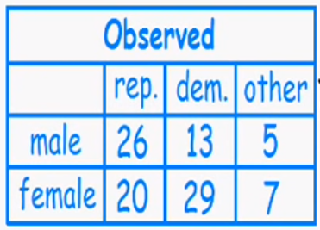
Contingency table
Summarize the relationship between several categorical variables.
A contingency table is a special type of frequency distribution table, where two variables are shown simultaneously
 | Drug A | Drug B
Cured | 60 | 84
Not cured | 138 | 114

Slide 3
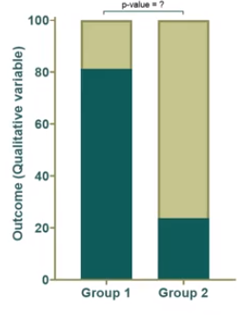
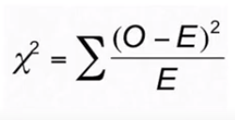

Chi square (Chi²) test and Fisher’s exact test
Assess the significance between two proportion
It is for categorical data
It is comparing the observed frequencies for two or more group with expected frequencies by chance

Slide 4
Calculating Expected Value
 | Drug A | Drug B | Total
Cured | 70 | 40 | 90
Not cured | 30 | 60 | 110
Total | 100 | 100 | 200
Expected | Drug A | Drug B | Total
Cured | 45 | 45 | 90
Not cured | 55 | 55 | 110
Total | 100 | 100 | 200
ExpectedValue(cured,drugA) = 100/200 (gets drug A) * 90 (cured) = 45
ExpectedValue(cured,drugB) = 90/200 (gets cured) * 100 (drug A) = 45
ExpectedValue(Notcured,drugA) = 100/200 (gets drug A) * 110 (drug A) = 55
ExpectedValue(Notcured,drugB) = 110/200 (not cured) * 100 (drug A) = 55

Slide 5
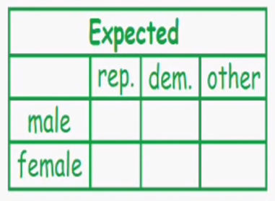
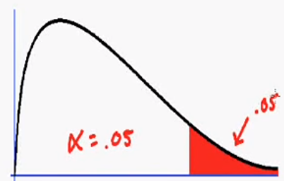
Example
H0: Political party independent upon gender
Ha: Political party dependent upon gender
Is gender related to the political party?
total
44
20.24
18.48
5.28
56
25.76
23.52
6.70
total
46
42
12
100
ExpectedValue (male,Rep) = $\frac{male ∗rep}{total}= \frac{44∗46}{100}=20.24$
ExpectedValue (female,Rep) = $\frac{female ∗rep}{total}= \frac{56∗46}{100}=25.76$

Slide 6
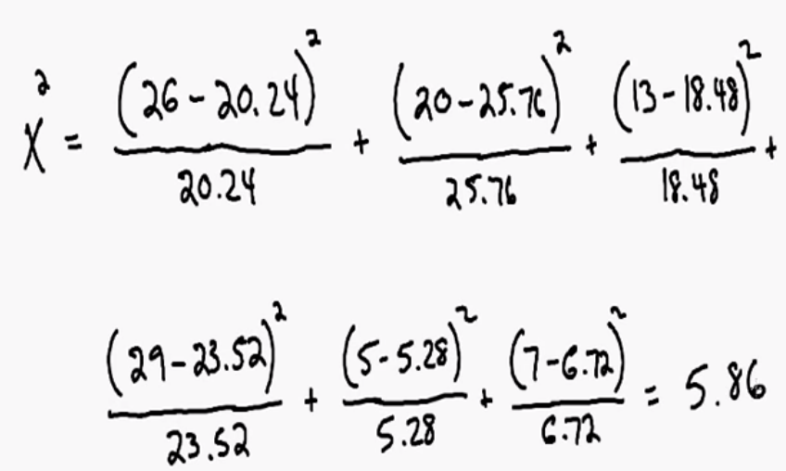
Example
H0: Political party independent upon gender
Ha: Political party dependent upon gender
Is gender related to the political party?
total
44
20.24
18.48
5.28
56
25.76
23.52
6.70
total
46
42
12
100

Slide 7
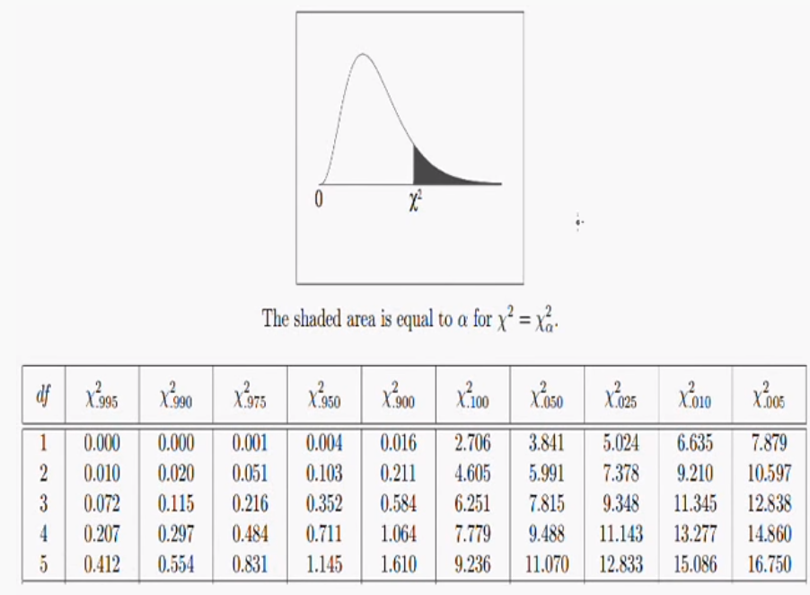
Degree of freedom = (number of row - 1 ) (number of columns -1)
Degree of freedom = (2 - 1 ) (3 -1) = 2

Slide 8
Example
H0: Political party independent upon gender
Ha: Political party dependent upon gender
Is gender related to the political party?
total
P-value is not less than 0.05
44
Fail to reject null hypothesis
20.24
18.48
5.28
56
25.76
23.52
6.70
total
46
42
12
100
5.86
CV = 5.991

Slide 9
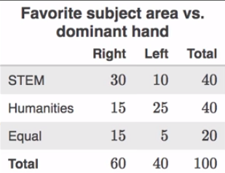
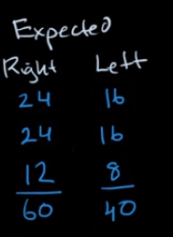
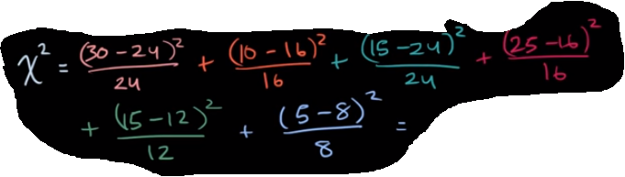
Example
H0: No difference
Ha: There is a difference
Does a dominant hand related to the favorite subject area?
DF = (3 -1) (2-1) = 2

Slide 10
Kahoot time

