Slide 1
P-value

Slide 2
Hypothesis Testing
The goal is to test if there is no difference between the drugs
Hypothesis: There is no difference in recovery times between Drug C and drug D
The hypothesis that there is no difference/signal between things is called Null Hypothesis
We design a significance test to evaluate the strength of the evidence against some null hypothesis (H0​)
The alternative hypothesis (Ha​) is the claim we are trying to find evidence in favor of.

Slide 3
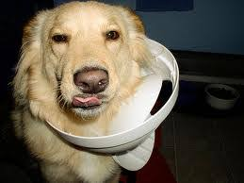

P-value
Null Hypothesis: The dog is innocent
What the world looks like if the dog is innocent
What is the probability that this event happens in that world?
Probability of getting something at least as bad as we got in the world that we constructed (innocent dog)
Lower the p-value, the more surprising the data/evidence is, the more ridiculous our null hypothesis is
Alternative Hypothesis: The dog is guilty
Because the null hypothesis looks ridiculous, we reject it in favor of alternative hypothesis

Slide 4
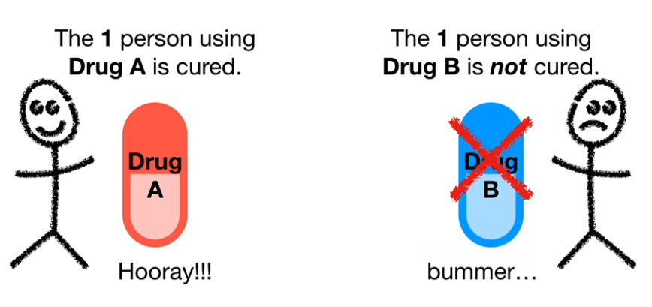
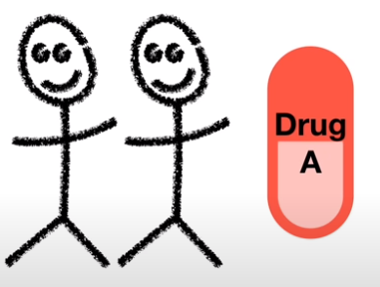
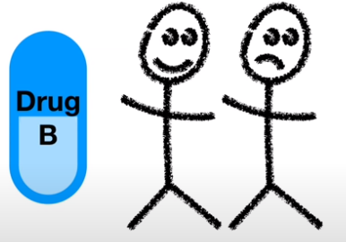
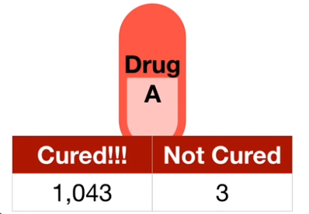
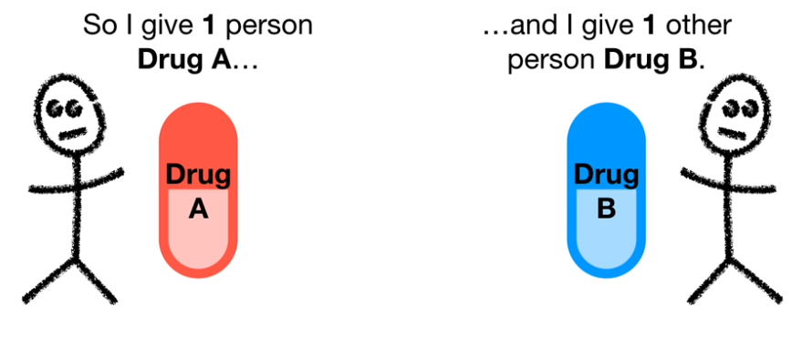
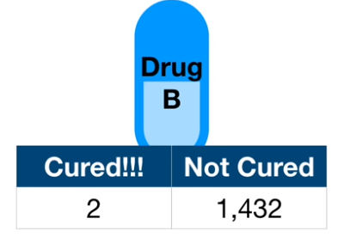
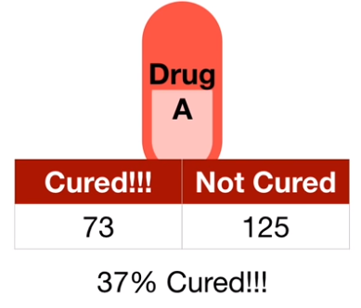
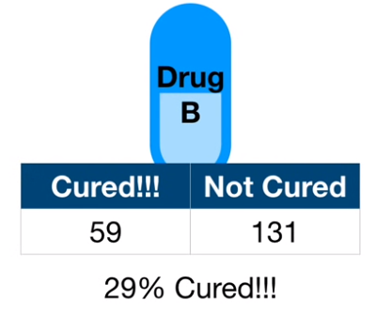
P-value
No, random thing might have happened
Can we say drug A is better than Drug B?
No, random thing might have happened
Yes, It is unrealistic that these result are random chance
How confident are we that drug A is different from drug B?
P-value = 0.24
99.7% Cured
0.001% Cured

Slide 5
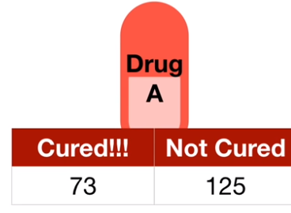
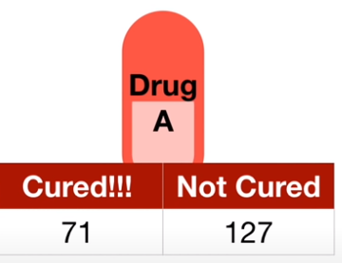
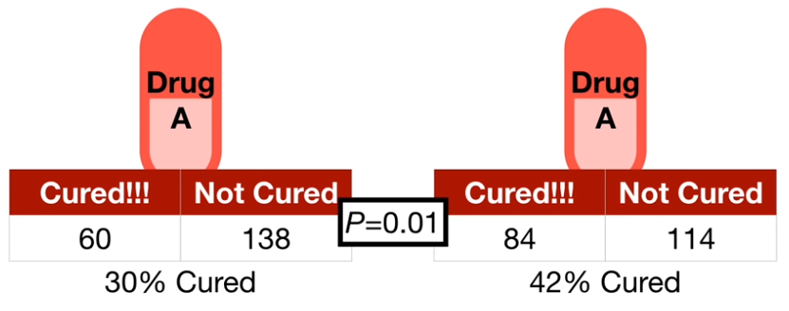
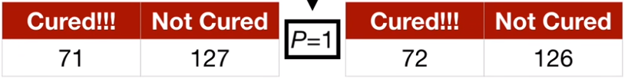
How small does a p-value should be to be confident?
A commonly used threshold is 0.05
It means if there is no difference between drug A and B, and if we did this exact same experiment a bunch of times, then only 5% of those experiments would result in the wrong decision
P-value = 0.9
We fail to see a difference between two groups
These two groups are different
Getting small p-value when
There is no difference:
False Positive (Type I Error)

Slide 6
How small does a p-value should be to be confident?
0.05 threshold for p-values means that 5% of the experiments will generate a p-value smaller than 0.05
If there is no difference between drug A and B, 5% times we do the experiment, we will get a p-value less than 0.05 (False Positive)
The threshold is arbitrary.
P-value = 0.24 -> we are not confident that they are different -> we fail to see the difference
P-value = 0.24

Slide 7
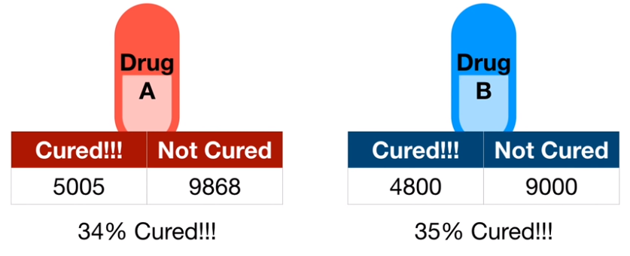
Note
P-value helps us decide if we should reject the Null Hypothesis or not
But it does not tell us how different they are
Small p-value does not imply that the effect size of drug A or B is large
P-value = 0.04
P-value = 0.24

Slide 8


How to calculated P-value?
My Hypothesis: My coin is so special
Null Hypothesis: There is no different between my coin and a normal coin
Let’s calculate the p-value to see if we should reject the null hypothesis
P-values are determined by adding up probabilities

Slide 9
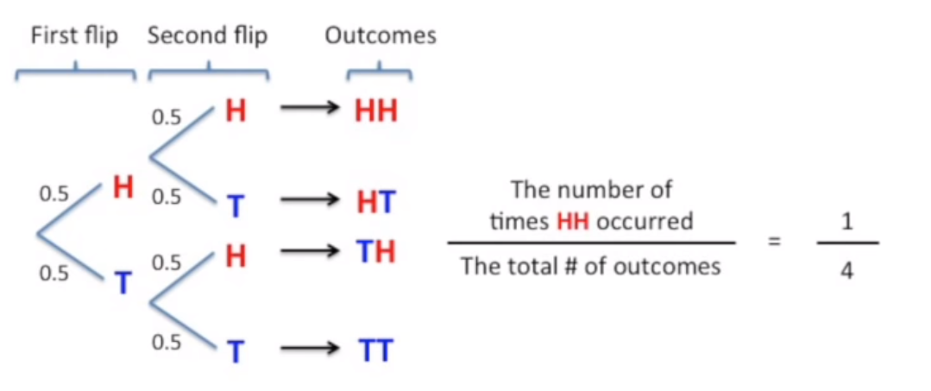
How to calculated P-value?
We flip the coin, we want to calculate what is the p-value of 2 heads?
What is the probability of getting 2 heads?
What is the probability of getting 2 tails?
What is the probability of getting one heads and one tails?
¼ = 0.25
¼ = 0.25
2/4 = 0.5

Slide 10
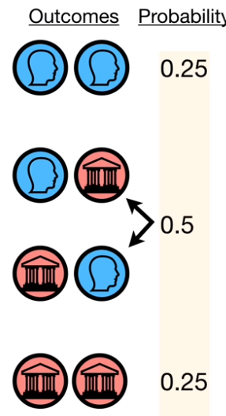
How to calculated P-value?
Although getting 2 heads is special, it is not that special when we know that other things are just as rare.
P-value is composed of three parts:
  The Probability random chance would result in the observation
  The probability of observing something else that is equally rare
  The probability of observing something rarer or more extreme
P-value = 0.25 + 0.25 + 0 = 0.5
Although I got 2 heads, but p-value is not low (< 0.05),
My coin is not different from normal coin
Fail to reject the null hypothesis

Slide 11


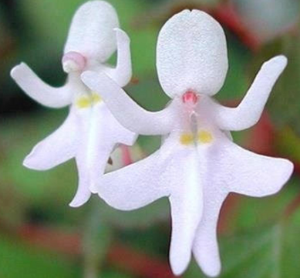




How to calculated P-value?
Although getting 2 heads is special, it is not that special when we know that other things are just as rare.
P-value is composed of three parts:
  The Probability random chance would result in the observation
  The probability of observing something else that is equally rare
  The probability of observing something rarer or more extreme (rare things makes thing less special)
This is the rarest flower
This flower is equally as rare as all of these flowers
There are a lot of flowers that are rarer than this one

Slide 12

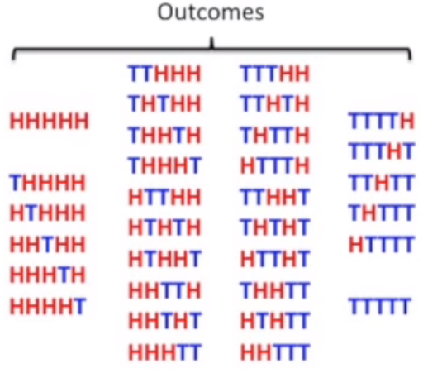
How to calculated P-value?
Is my coin special?
Null Hypothesis: My coin is no different from a normal coin
Let’s calculate P-value
P-value:
  Probability we randomly get 4 head and 1 Tail
  Probability we randomly get something else that is equally rare
  Probability we randomly get something rarer or more extreme
32
5 / 32
5 / 32
2 / 32
P-value = 5/32 + 5/32 + 2/32 = 12/32 = 0.375
P-value is not smaller than 0.05 ,so the data did not
Convince us that our coin is special -> Fail to Reject Null Hypothesis

Slide 13
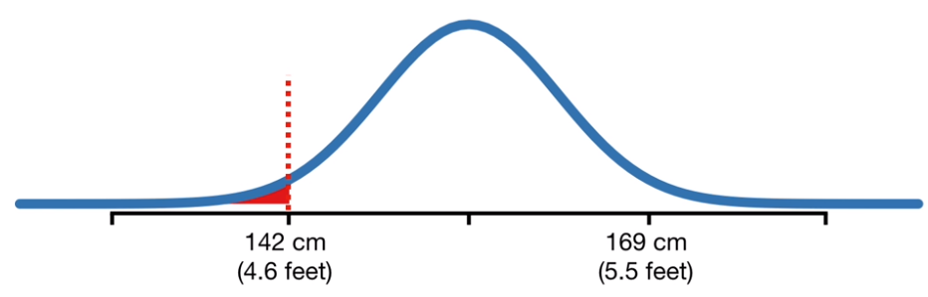
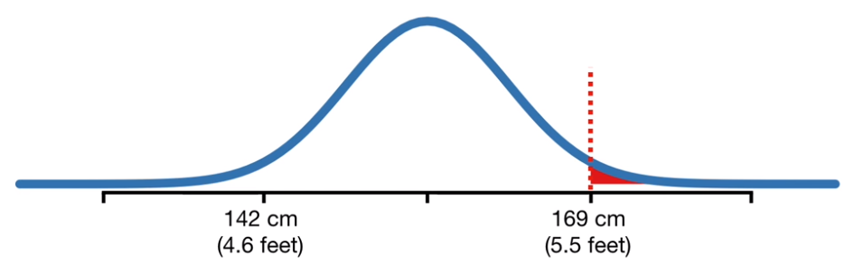
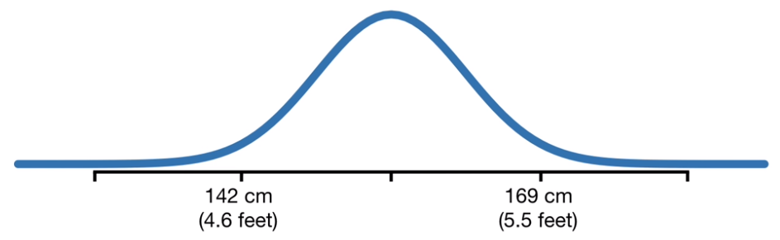
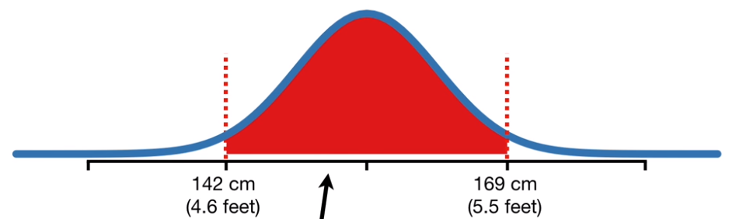
How to calculated P-value for Continuous data?
Height distribution from Brazilian women between 15-49 years old in 1996
The area under the curve represent the probability
2.5% probability that each time we measure a Brazilian woman, their height will be less than 142
2.5% probability that each time we measure a Brazilian woman, their height will be greater than 169
95% of Brazilian women were between 142-169
95% probability that each time we measure a Brazilian woman , their height is 142-169
Null Hypothesis: This person is special from this distribution
It is statistically significant
Adding more extreme/rarer values
P-value for 142 cm given this distribution = 0.025 +
0.025
= 0.05 It is pretty special to see
someone with 142 in this distribution

Slide 14
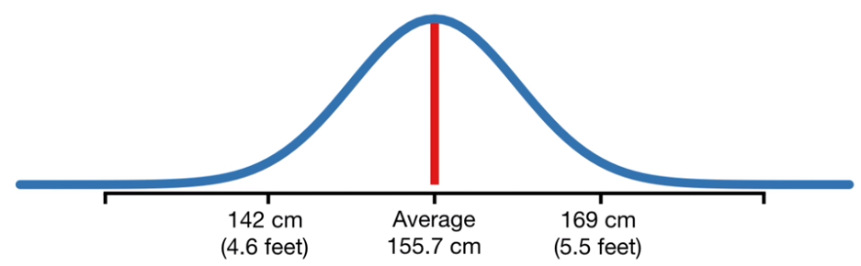
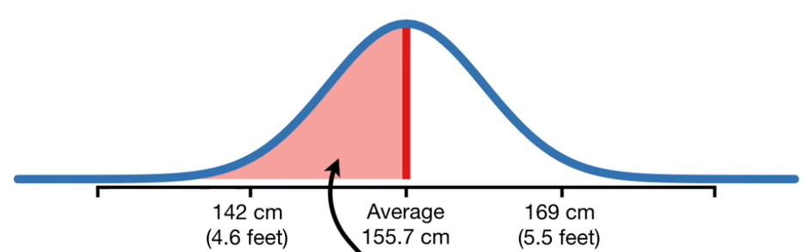
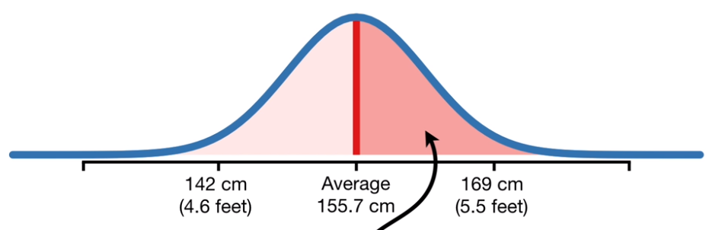
How to calculated P-value?
What is the p-value to find someone between 155.4-156 cm?
P(155.4<h<156) = red area = 0.04
P(h<155.4) = 0.48
P(h>156) = 0.48
Pvalue = 0.04+0.48+0.48 = 1
This is the probability that this happens in random chance
This is the probability of more extreme part
Given this distribution, it is not unusual to measure someone in that range (close to mean)
48%

Slide 15
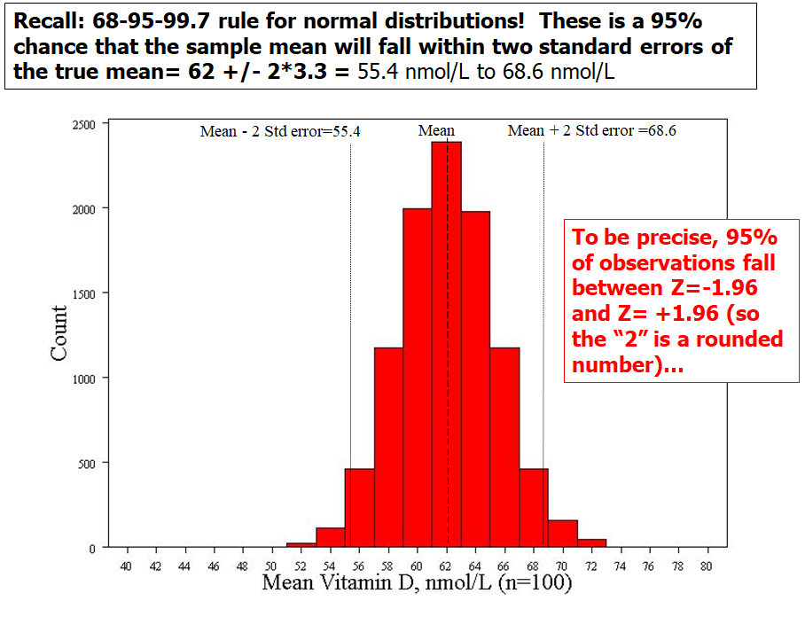
Vitamin D - Confidence Interval

Slide 16
Hypothesis Testing
Research Question: Is the mean vitamin D in middle-aged and older European men lower than 100 nmol/L (the “desirable” level)?
Assume that the mean = 100
  This is called the “null hypothesis”
  Alternative hypothesis: The mean is not 100
Assess the probability of observing what we observed assuming that the null is true
  If that probability is high, then we likely observed what we observed just by chance
  If that probability is low, then our assumption (i,e, the null hypothesis) may have been wrong
  So we will reject the null hypothesis (rather than rejecting our data) => We will say that our observation of a mean less than 100 is statistically significant

Slide 17
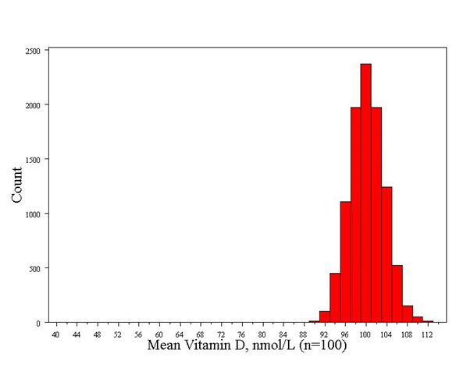
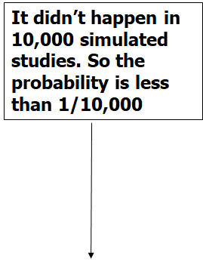

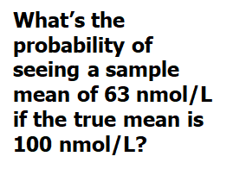
Hypothesis Testing - Simulation
Standard error for the mean: 3.3
Null hypothesis mean: 100
Simulate the distribution for these statistics

Slide 18
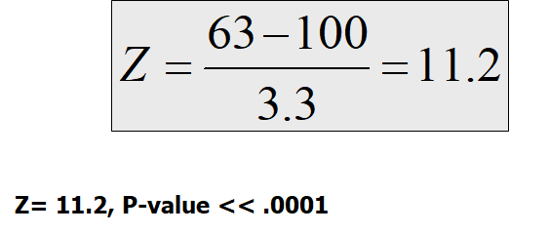
Hypothesis Testing - Parametric
Since we know the probability density function for normal distribution work, we can exactly calculate the probability of seeing an average of 63 nmol/L if the true average weight is 100 (i.e., if our null hypothesis is true)

Slide 19
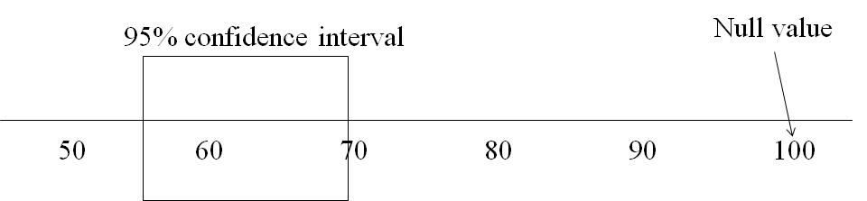
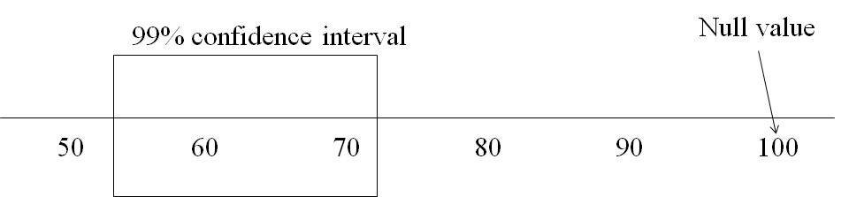
Confidence Intervals vs. Hypothesis Tests
Significance level = 1 – Confidence level
p < 0.05
p < 0.01
A confidence interval is more informative than a p-value
  A p-value can always be derived from the confidence interval
  A confidence interval cannot be derived from a p-value

Slide 20
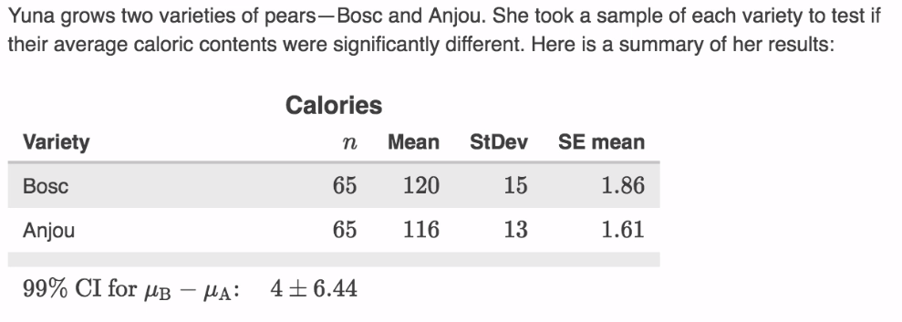


Example (CI and P-value)
0 is in the interval -> nothing surprising happened
P-value > 0.01
Fail to reject null hypothesis
-> Apples are the same in their average caloric content
If we compute this parameter 100 times, 99 times the difference will be in this interval
$$μ_{B}−μ_{A}=0$$
If it did not overlap, we could say this is that 1 in 100 times
P-value < 0.01 -> reject null hypothesis
-> the pears are different on their average caloric

Slide 21
Kahoot time

Slide 22
Comparing Distributions
t-test
F-test
Kolmogorov-Smirnov test

Slide 23
Comparing Distributions
We have two samples
  Different variables, from the same population
  The same variable, from different populations
  Different variables, from different populations?
How different are the two distributions these samples come from?
Probably the most common question in data analysis
  Does a certain treatment reduce the likelihood of acquiring a disease of interest?
  Are women who run the Boston Marathon tend to be younger than men who run the Boston Marathon?
  What are the genes that are differentially expressed in metastatic colon cancer as compared to the primary tumor?
What to compare?
  Means => (Student’s) t-test
  Variances => F-test
  Distributions => Kolmogorv-Smirnov test

Slide 24
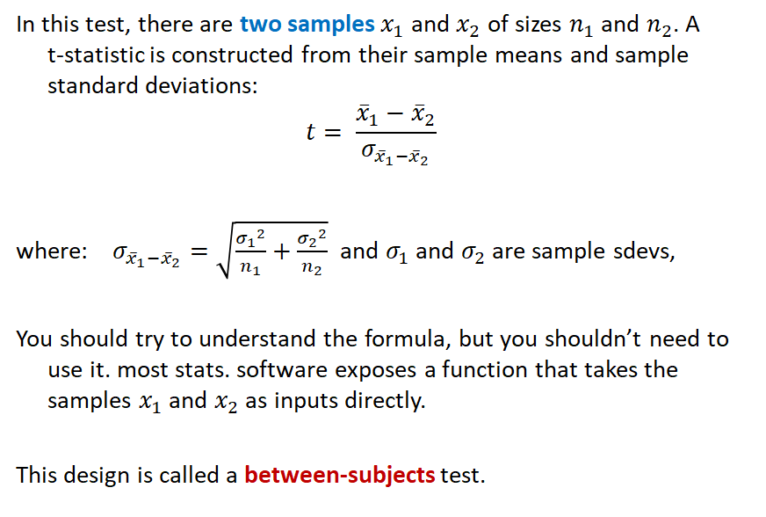
Two Sample t-test

Slide 25
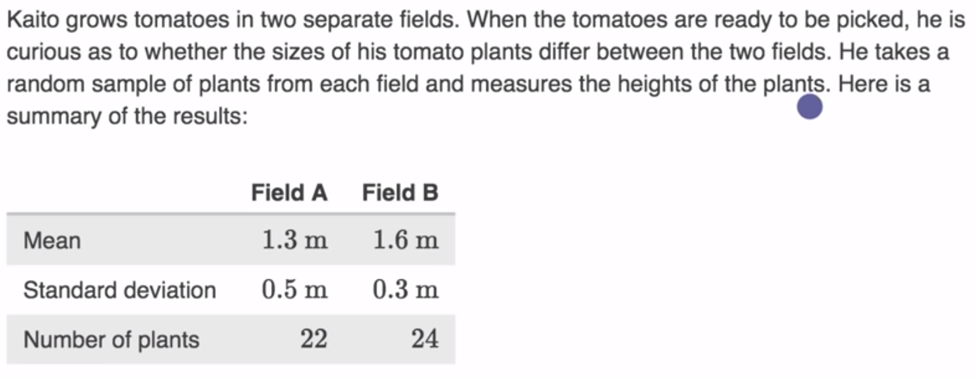

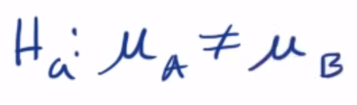
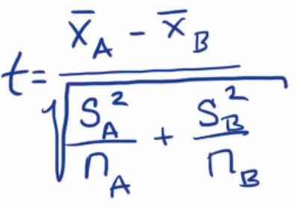
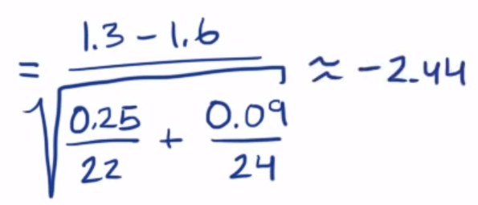
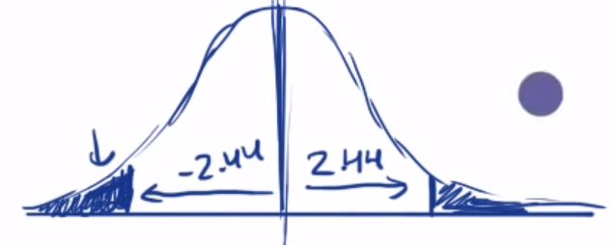

Example
We reject the null hypothesis if the p-value < 0.05

