Slide 1
Introduction to Data Science
Class Time: W 6:30 - 9
Instructor: Marzieh Ayati
Email: Marzieh.ayati@utrgv.edu
Office hours: by appointment or after class

Slide 2
Prerequisites
Required: CSCI 2380; CSCI 3310 (Algorithm and data structure)
Preferred: STAT3337 or equivalent, CSCI 3333, and CSCI 3336. MATH 2318, MATH 2414

Slide 3
Materials
Data and Distributions
Data types, probabilistic representation of data, random variables, descriptive statistics and summarization, visualization of distribution, normalization, transformation
Statistical Inference
Parameters and likelihood, differential analysis, hypothesis testing, statistical significance, permutation test
Assessing the relationship between variables
Distance measures, correlations, mutual information, visualization of the relationship between variables

Slide 4
Supervised and Unsupervised Learning
Hierarchal clustering, K-means clustering, cluster visualization, enrichment analysis, Model fitting, regression, feature selection, LASSO, Ridge regression, cross validation
Dimensionality Reduction
Curse of dimensionality, matrix decomposition, principal component analysis, use of dimensionality reduction in visualization
Networks
Random Walk, Node Embeddings, Community Detection

Slide 5
Text Book
  M. J. Zaki and W. Maiera, Jr. Data Mining and Analysis: Fundamental Concepts and Algorithms. Cambridge University Press, May 2014
  C. O’Neil and R Schutt. Doing Data Science: Straight Talk from Frontline. O’Reilly Media Inc, October 2013

Slide 6
Please note that in this course programming will NOT be taught. You can use the following resources to get familiar with R, Python, or MATLAB:
Learning R: https://www.w3schools.in/r/
Learning Python: https://www.w3schools.com/python/
Learning MATLAB: http://www.math.ucsd.edu/~bdriver/21d-s99/matlab-primer.html
Learning GIT: https://git-scm.com/
Learn how to use Google search / ChatGPT efficiently

Slide 7
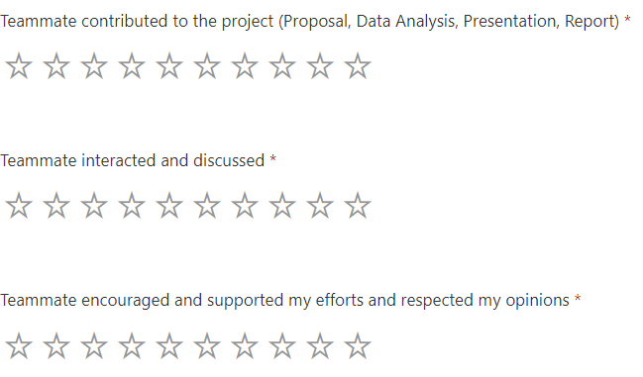
Grading
Participation, Activities, and Quiz (30%)
HomeWorks (20%) [Individually]
  Working with real data
Final Exam (15%) [ Open Book]
  Open book
Project (35%) [ Group of 3, Pre-defined]
  Proposal Presentation
  Final Presentation
  Final Report
  Group Contribution
    Public Github Repository
    Discord group
    Teammate evaluation [final grade of project*average(teammate evaluation)]
A -> 90-100
B -> 80-89
C -> 70-79
D -> 60-69
F -> 0 – 59
Grades may be curved to reflect the overall performance of the class.

Slide 8
Family centered / community centered project
10% bonus if your project involves family or community
For data collection or for impact on family/community
This project is part of a National Science Foundation grant, and it will require you to interview/interact with members of your community or family.
FCSP Demonstration will be on April 18th. You have to create a poster and family members are invited. In the case that none of your group members can attend, you will get 3% of the bonus point.

Slide 9
Use of AI
Students are encouraged to use Artificial Intelligence (AI) tools. However, AI should be used as a tool to support your thinking, not as a substitute for it.
Students are responsible for the accuracy, quality, and integrity of all work they submit
Blindly copying and pasting AI-generated content is not acceptable.
AI SHOULD NOT BE USED IN THE FINAL EXAM. USING AI IN THE FINAL EXAM WILL RESULT IN 0 FOR FINAL EXAM.

Slide 10
Plagiarism
Zero-tolerance policy on plagiarism is enforced. If the homeworks or assignment found to be similar to the available resources online or to other students, you will get 0 for that assignment.
A few students randomly may be selected to come to the office hour to explain their homework. Not showing up results losing the score for that particular assignment.

Slide 11
Question? Suggestion?

Slide 12
You have HomeWorks for this week
Available on BrightSpace:
Join Discord Server (https://discord.gg/YqmE4dHbrp)
Take self-assessment test to help me group you properly

