Slide 1
What is Data?
What is Data Science?

Slide 2
Have you ever worked with data?

Slide 3


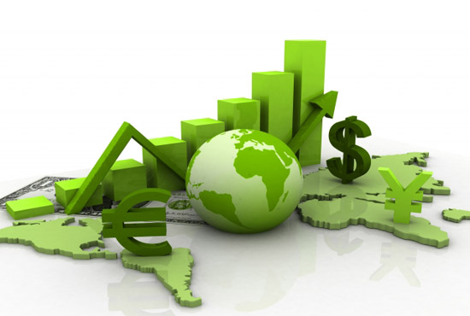

Data All Around
Lots of data is being collected and warehoused
  Web data, e-commerce
  Financial transactions, bank/credit transactions
  Online trading and purchasing
  Social Network

Slide 4
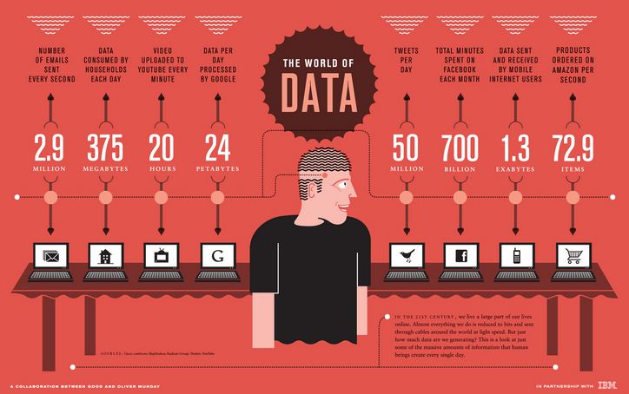
How Much Data Do We have?
Google processes 20 PB a day (2008)
Facebook has 60 TB of daily logs
eBay has 6.5 PB of user data + 50 TB/day (5/2009)
1000 genomes project: 200 TB
Cost of 1 TB of disk: $35
Time to read 1 TB disk: 3 hrs
(100 MB/s)

Slide 5
Big Data
  Big Data is any data that is expensive to manage and hard to extract value from
  Volume
    The size of the data
  Velocity
    The latency of data processing relative to the growing demand for interactivity
  Variety and Complexity
    the diversity of sources, formats, quality, structures.

Slide 6
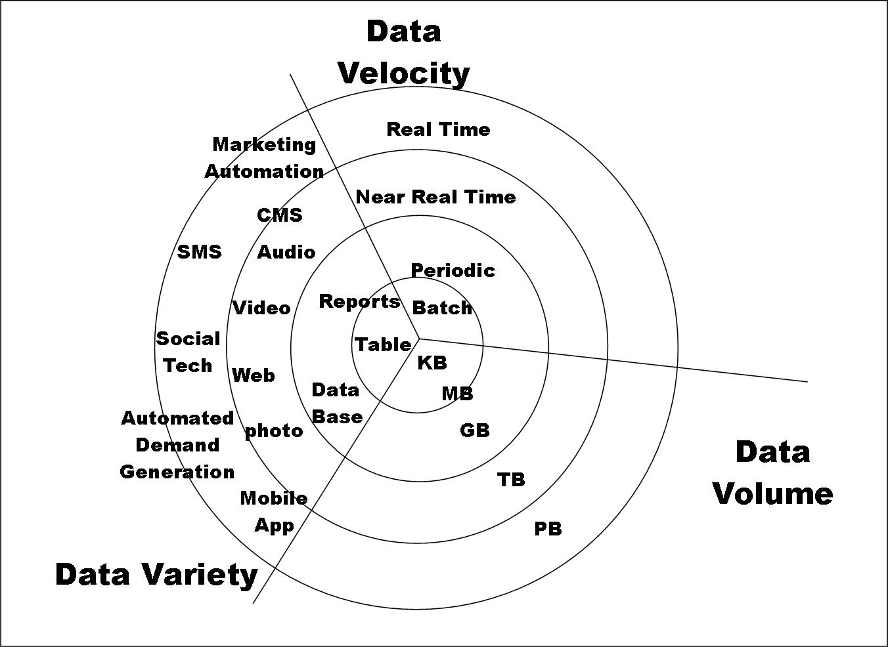
Big Data

Slide 7
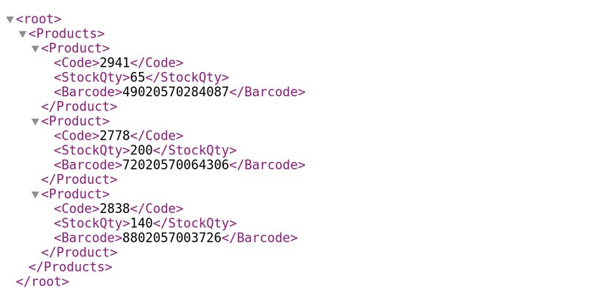
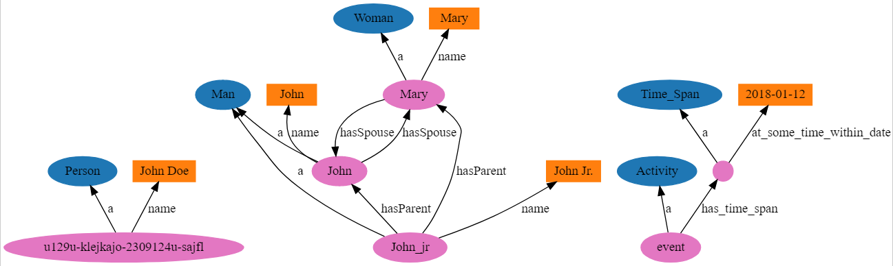
Types of Data We Have
Relational Data (Tables/Transaction/Legacy Data/CVS file)
Text Data (Web)
Semi-structured Data (XML)
Graph Data
Social Network, Semantic Web (RDF), …
Streaming Data
You can afford to scan the data once

Slide 8
What To Do With These Data?
Aggregation and Statistics
  Data warehousing and OLAP
Indexing, Searching, and Querying
  Keyword based search
  Pattern matching (XML/RDF)
Knowledge discovery
  Data Mining
  Statistical Modeling

Slide 9
What is the Clean Data?
Consistency: are observations always entered the same?
Completeness: do you have coverage of the topic?
Usability: machine readability?
Since we use machines to operate on data, machine-readability is a strong criteria.

Slide 10
Issues with Data...
Values are missing (what does the absence of this value means? How to handle?)
Zeros replace missing values (Are zeros really number or just missing data?)
Rows or values are duplicated (why?)
Spelling is inconsistent (Los Angeles, LosAngeles, LA; data entered by human)
Name order or data format is inconsistent (date in Farsi; 10/9/90 or 9/10/90)

Slide 11
Issues with Data…
Categories are badly chosen (definition of rape by FBI is changing over time)
Suspicious values are present (Gene Names in Excel; 7-Mar)
Data are too coarse (You need county data, but you got states data -> privacy)
Sample is not random and is biased (face recognition data biased; genomic data are biased; research on the internet and poorer people don’t use internet as frequent)
Margin of error is too large (the number of Asians living in New York is 1,106,989 ± 3,526 (0.3%). The number of Filipinos is 71,969 ± 3,088 (4.3%). The number of Samoans is 203 ± 144 (71%))
Frame of reference has been manipulated (Crime statistics are often manipulated for political purposes by comparing to a year when crime was very high. This can be expressed either as a change (down 60% since 2004) or via an index (40, where 2004 = 100). In either of these cases, 2004 may or may not be an appropriate year for comparison. It could have been an unusually high crime year.)

Slide 12
Big Data and Data Science
“… the sexy job in the next 10 years will be statisticians,” Hal Varian, Google Chief Economist
The U.S. will need 140,000-190,000 predictive analysts and 1.5 million managers/analysts by 2018. McKinsey Global Institute’s June 2011
New Data Science institutes being created or repurposed – NYU, Columbia, Washington, UCB,...
New degree programs, courses, boot-camps:
  e.g., at Berkeley: Stats, I-School, CS, Astronomy…
  One proposal (elsewhere) for an MS in “Big Data Science”

Slide 13
Why data science? Why now?
Data
  larger amounts of data, easy to produce, collect and store
Compute
  powerful processing units, hardware acceleration, parallelization
Algorithms
  ML frameworks, libraries, improved and more efficient techniques

Slide 14
What is Data Science?
Machine Learning
Wikipedia describes Data Science as:
“a multi-disciplinary field that uses scientific methods, processes, algorithms and systems to extract knowledge and insights from structured and unstructured data.”
MACHINE LEARNING
MATHEMATICS
COMPUTER
SCIENCE
DATA
SCIENCE
STATISTICAL
RESEARCH
DATA
PROCESSING
DOMAIN
EXPERTISE
https://en.wikipedia.org/wiki/Data_science

Slide 15
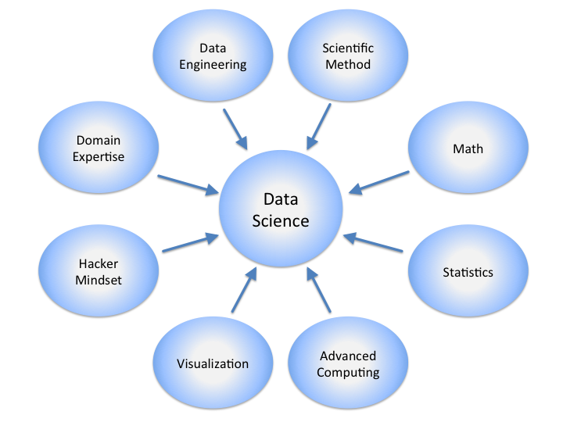
Data Science

Slide 16
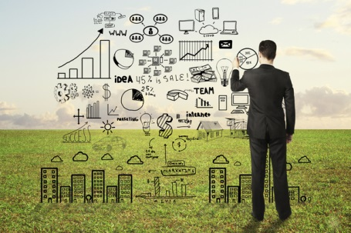
Data Scientists
Data Scientist
  The Sexiest Job of the 21st Century
They find stories, extract knowledge. They are not reporters

Slide 17

Data Scientists
Data scientists are the key to realizing the opportunities presented by big data. They bring structure to it, find compelling patterns in it, and advise executives on the implications for products, processes, and decisions

Slide 18
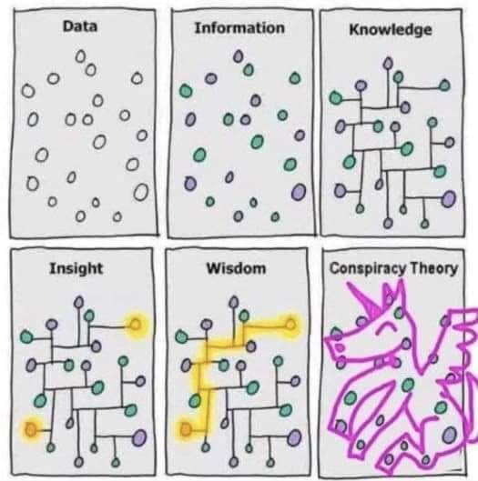

Slide 19
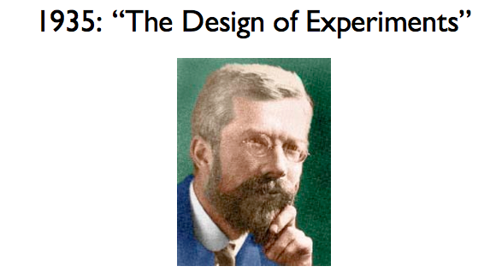
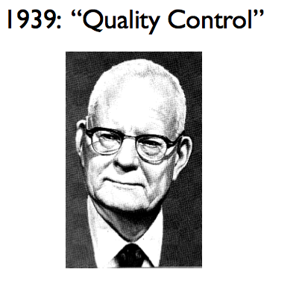
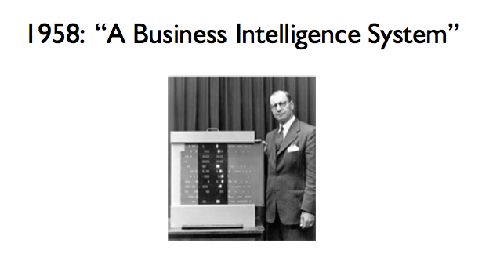
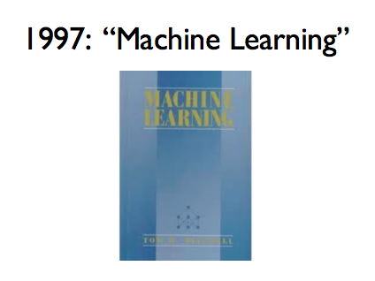
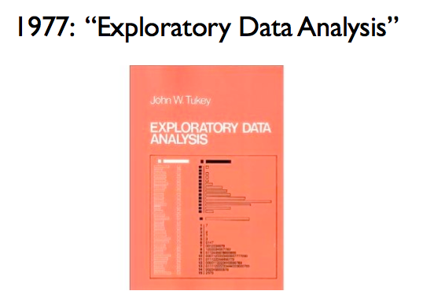
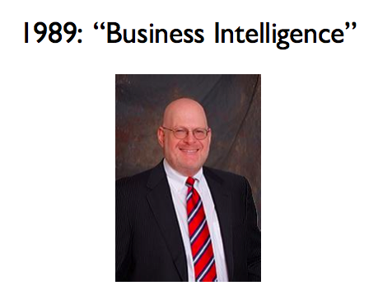
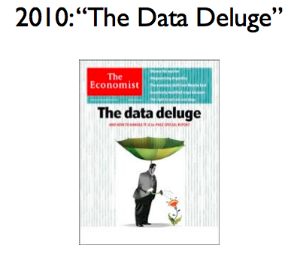
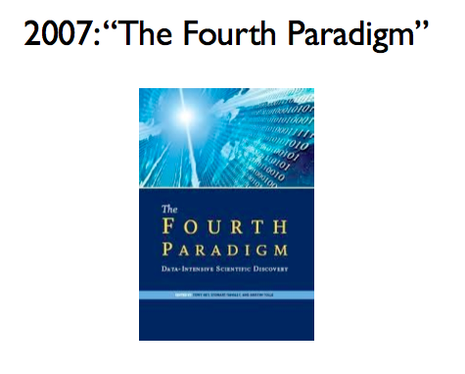
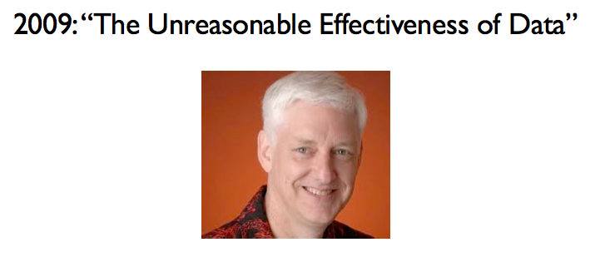
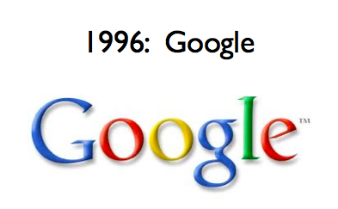
Data Analysis Has Been Around for a While
R.A. Fisher
W.E. Demming
Peter Luhn
Howard
Dresner
Abridged Version of Jeff Hammerbacher’s timeline for CS 194, 2012
Notes:
Fisher: ANOVA, Fisher’s exact test.
Also credited with quote “correlation does not imply causation” – lifetime pipe smoker, he derided papers showing a link between smoking and cancer.
Denning – quality control – statistical sampling
Luhn – indexing, IR principles – use text and data to inform Business Decisions
Tukey – exploratory data analsysi – led to S, S+ and R
Howard Dresner – modern proponent of BI
Tom Mitchell’s ML book – still a best-seller
Fourth Paradigm – data driven science – inspired by Jim Gray’s work.
Peter Norvig – simple models + lots of data > complex models
Data Deluge – exponential growth in data volume

Slide 20
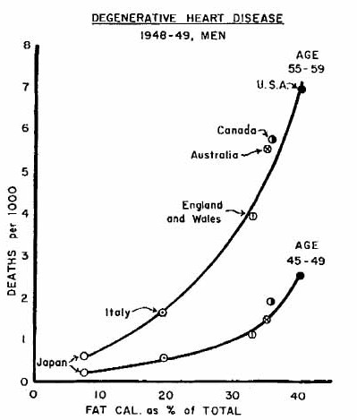
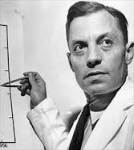
Data makes everything clearer
Seven Countries Study (Ancel Keys, UCB 1925,28)
13,000 subjects total, 5-40 years follow-up.

Slide 21
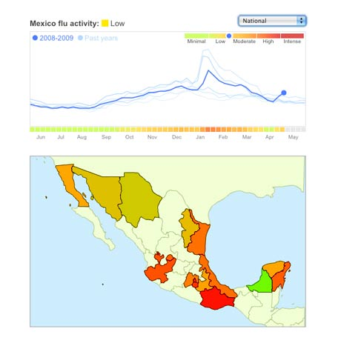
Data Science: Why all the Excitement?
e.g.,
Google Flu Trends:
Detecting outbreaks
two weeks ahead
of CDC data
New models are estimating
which cities are most at risk
for spread of the Ebola virus.

Slide 22
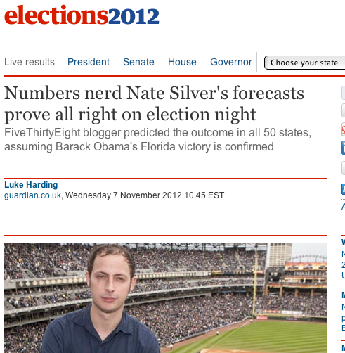
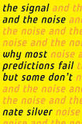
Why the all the Excitement?

Slide 23
Real Life Examples
Companies learn your secrets, shopping patterns, and preferences
  For example, can we know if a woman is pregnant, even if she doesn’t want us to know? Target case study [Lots of people buy lotion, but one of Pole’s colleagues noticed that women on the baby registry were buying larger quantities of unscented lotion around the beginning of their second trimester. Another analyst noted that sometime in the first 20 weeks, pregnant women loaded up on supplements like calcium, magnesium and zinc. Many shoppers purchase soap and cotton balls, but when someone suddenly starts buying lots of scent-free soap and extra-big bags of cotton balls, in addition to hand sanitizers and washcloths, it signals they could be getting close to their delivery date.]
Data Science and election (2012, 2016)
  1 million people installed the Obama Facebook app that gave access to info on “friends”
  We all know about Trump election (Cambridge Analytica)

Slide 24
Data and Election 2012 (cont.)
…that was just one of several ways that Mr. Obama’s campaign operations, some unnoticed by Mr. Romney’s aides in Boston, helped save the president’s candidacy. In Chicago, the campaign recruited a team of behavioral scientists to build an extraordinarily sophisticated database
…that allowed the Obama campaign not only to alter the very nature of the electorate, making it younger and less white, but also to create a portrait of shifting voter allegiances. The power of this operation stunned Mr. Romney’s aides on election night, as they saw voters they never even knew existed turn out in places like Osceola County, Fla.
        New York TImes, Wed Nov 7, 2012

Slide 25
Question? Suggestion?

