Slide 1
Data and Matrix

Slide 2
Variable Types
Variables may be classified into two main types:
  Discrete variable: values are discrete (e.g. year born, T/F)
  Continuous variables: values that are real numbers (e.g. length)

Slide 3
Variable Types
Numeric Attributes: real-valued or integer-valued domain
Interval-scaled:
  There are equal differences between successive points on the scale but the position of zero is arbitrary
  only differences are meaningful, not the ratio e.g., temperature
Ratio-scaled
  The relative magnitudes of scores and the differences between them matter. The position of zero is fixed and meaningful. It is the absence of what is being measured.
  differences and ratios are meaningful e.g, Age, number of customers
Categorical Attributes: set-valued domain composed of a set of symbols
Nominal: only equality is meaningful e.g., domain(Sex) = { M, F}
Ordinal:
  There is an ordering but no implication of equal distance between the different points of the scale.
  both equality (are two values the same?) and inequality (is one value less than another?) are meaningful
  e.g., domain(Education) = { High School, BS, MS, PhD}

Slide 4

More examples…
What is the type of color?
Longitude
How satisfied are you with your instructor? Scale from 1 -5.
Weight
College major
Categorical; Nominal
Numeric; Interval
Categorical; Ordinal
Numeric; Ratio
Categorical; Nominal

Slide 5
Tabular Data
Simplest way to present the data

Slide 6
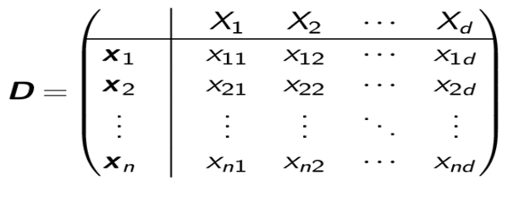

Data Matrix
Data can often be represented or abstracted as an n × d data matrix, with n rows and d columns, given as
Rows: Also called samples, instances, examples, records, transactions, objects, points, feature-vectors, etc. Given as a d -tuple
x_{i} = (x_{i 1}, x_{i 2}, . . . , x_{id} )
Columns: Also called attributes, properties, features, dimensions, variables, fields, etc. Given as an n-tuple
X_{j} = (x_{1j} , x_{2j} , . . . , x_{nj} )
R^{nxd}
$$∈$$

Slide 7
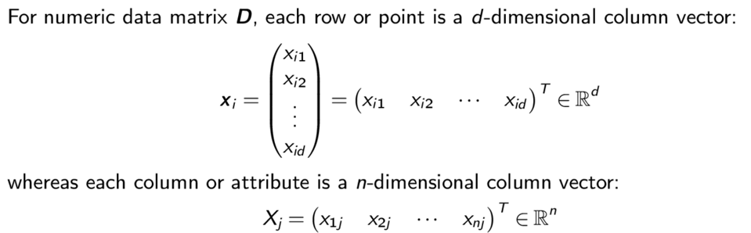
Data: Algebraic view

Slide 8
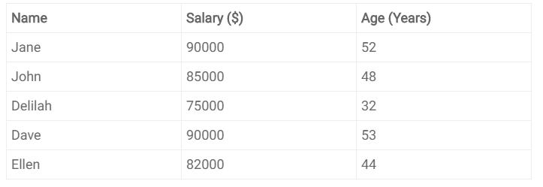
Usually the first column is the identifier of objects
The first row is the descriptor of columns
In this matrix, we have 5 rows and three columns
-> 5 Objects and 2 features

Slide 9
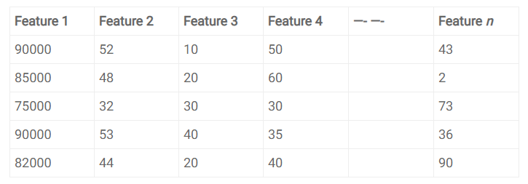
Dimension (Space)
The word “Dimension” in programming is used to count the number of cells.
“Dimension” in data science refers to the mathematical space, such as the Euclidian space.
Number of Dimensions = number of features

Slide 10
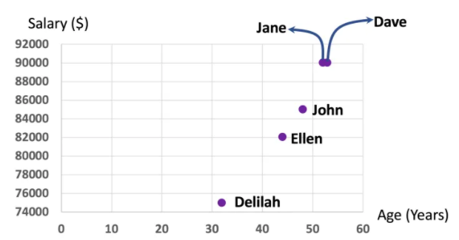
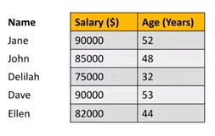
2-dimensional data
Each point in a two-dimensional Euclidean space has two values (x-value and y-value.)

Slide 11
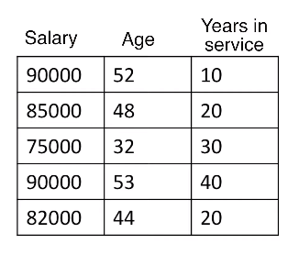
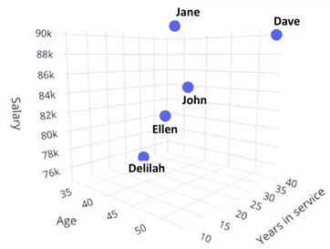
3-dimensional data
In programming, we will say that this table can be stored in a 2-dimensional array of size 5 times 3. That means, it has five rows and three columns.
In data science, this table is called a three-dimensional dataset because it composes a mathematical space of three dimensions.

Slide 12
Note that regardless of the number of features or number of columns, or the number of dimensions, the data table can be stored in a two-dimensional array. That is, even one hundred-dimensional dataset can be kept in a 2D array or in a 2D matrix.
High dimension data:
  High number of objects [ rows]
  High number of dimensions (features) [columns]

Slide 13
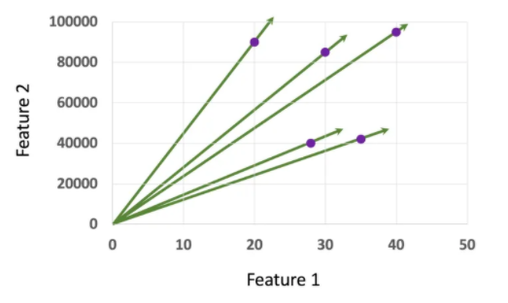
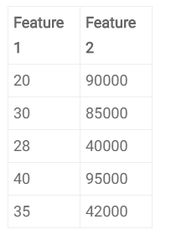
Vector
A vector in data science is no different than a vector in physics.
Each object or a data point of a tabular data is sometimes referred to as a vector.
A point in the space = An object of the data table (row) = A vector

Slide 14
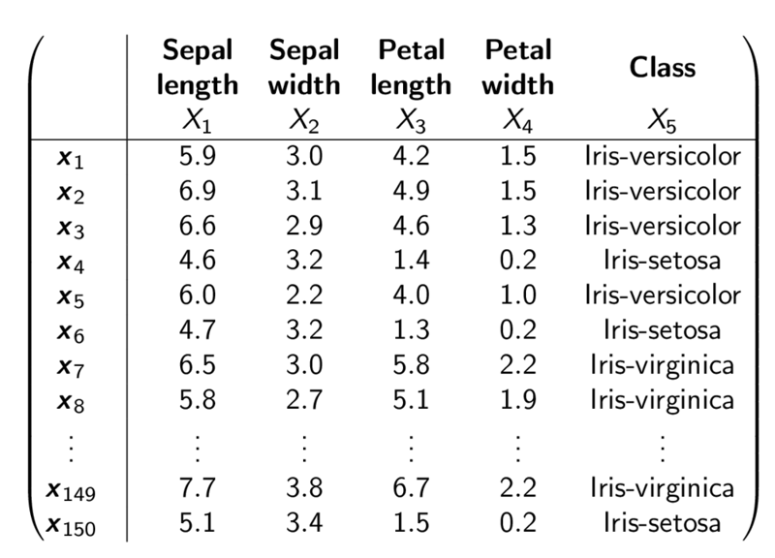
Iris Dataset

Slide 15
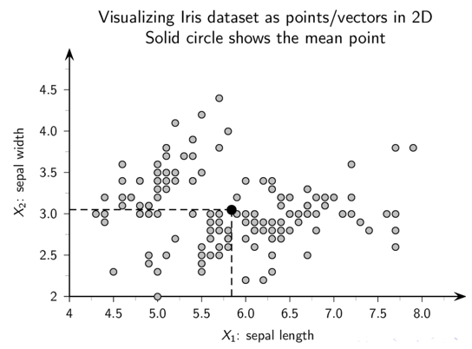

Slide 16


Whatever input you have, we try to convert it to data matrix
  Image, Text, Networks,….
Image 1
Image 2
r1
r1
r2
RGB color | Texture | ….
r2
RGB color | Texture | ….
r1 r2 …..
Image 1
RGB color | Texture | ….
RGB color | Texture | ….
Image 2
RGB color | Texture | ….
RGB color | Texture | ….

Slide 17
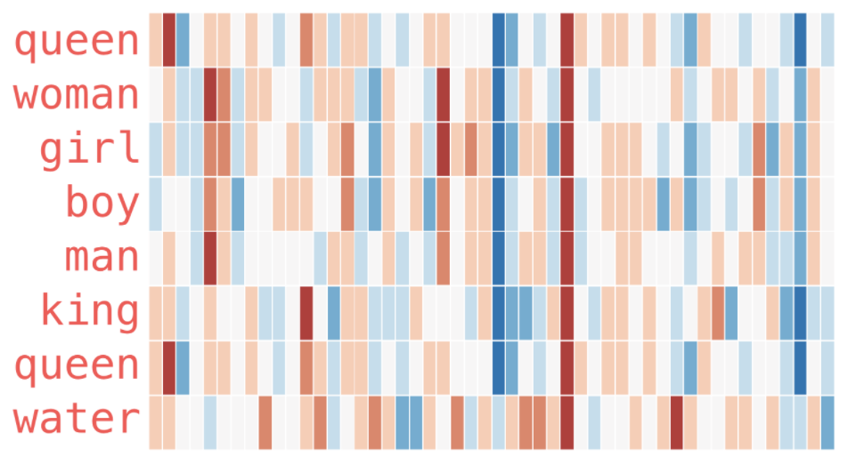
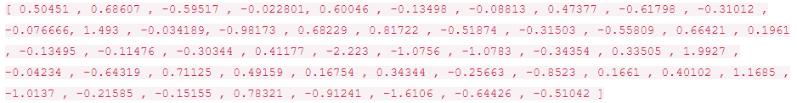
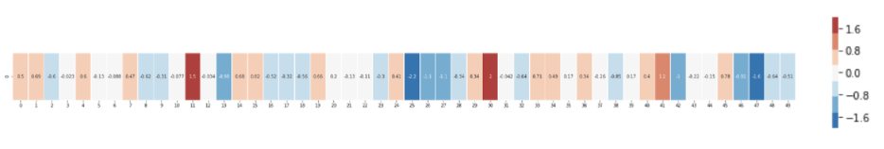
Whatever input you have, we try to convert it to data matrix
  Image, Text, Networks,….
  Text: For each word, create a vector of aggregated global word-word co-occurrence statistics
“King”

Slide 18
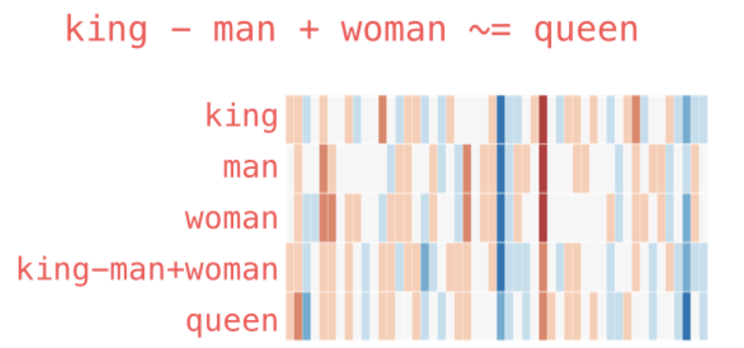

Slide 19
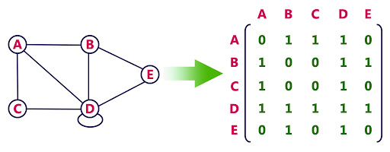
Whatever input you have, we try to convert it to data matrix
  Image, Text, Networks,….

Slide 20
Quiz
Kahoot.com

