Slide 1
Basic Statistics

Slide 2
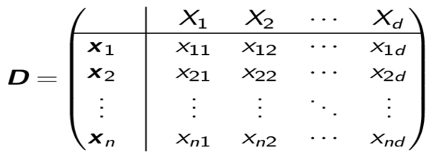

Data Matrix
Data can often be represented or abstracted as an n × d data matrix, with n rows and d columns, given as
Rows: Also called samples, instances, examples, records, transactions, objects, points, feature-vectors, etc. Given as a d -tuple
x_{i} = (x_{i 1}, x_{i 2}, . . . , x_{id} )
Columns: Also called attributes, properties, features, dimensions, variables, fields, etc. Given as an n-tuple
X_{j} = (x_{1j} , x_{2j} , . . . , x_{nj} )
R^{nxd}
$$∈$$

Slide 3
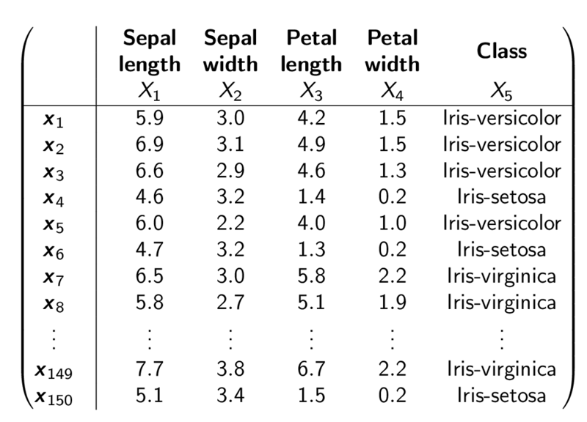
Iris Dataset

Slide 4
Probabilistic View
A random variable X is a function X : O → R, where O is the set of all possible outcomes of the experiment, also called the sample space.
A discrete random variable takes on only a finite or countably infinite number of values, whereas a continuous random variable if it can take on any value in R.
By default, a numeric attribute X_{j} is considered as the identity random variable given as
X (v ) = v for all v ∈ O. Here O = R.

Slide 5
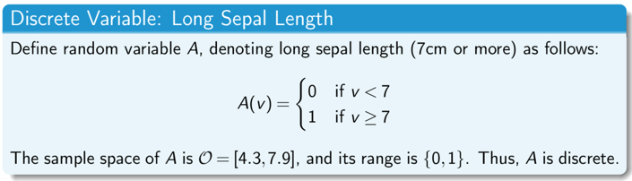
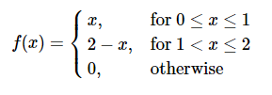
Example for Random Variable
Continuous Random Variable

Slide 6
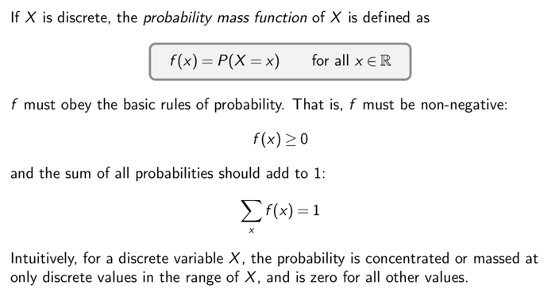
Probability Mass Function

Slide 7
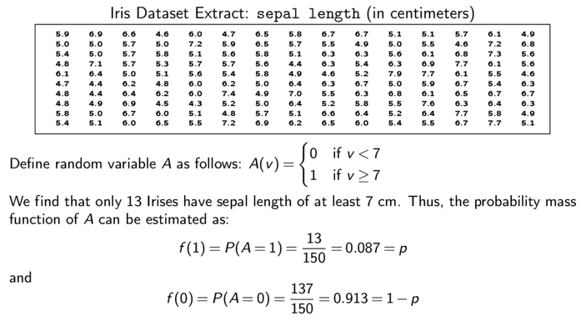
Probability Mass Function For Sepal Length

Slide 8
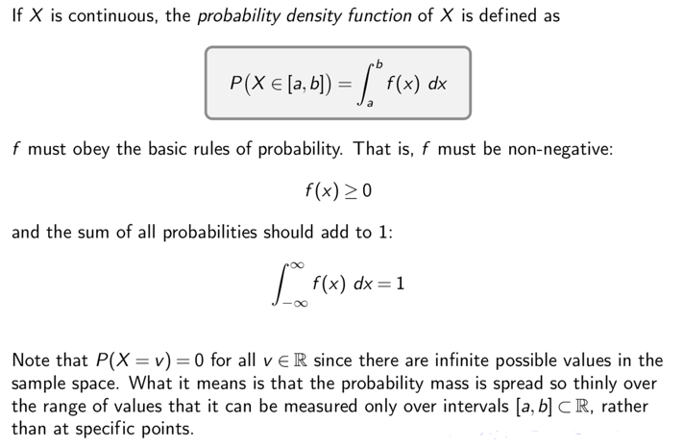
Probability Density Function

Slide 9
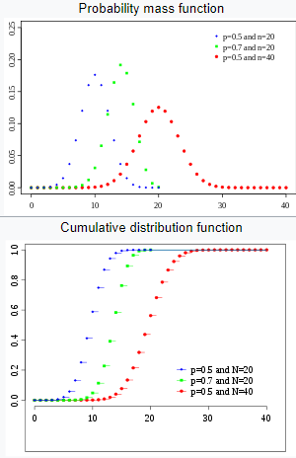
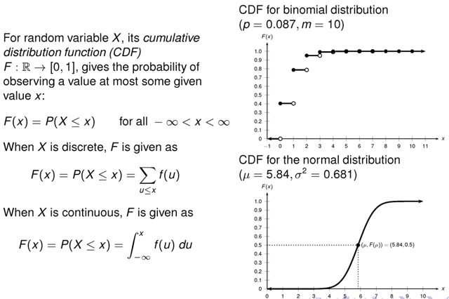
Cumulative Distribution Function (CDF)

Slide 10
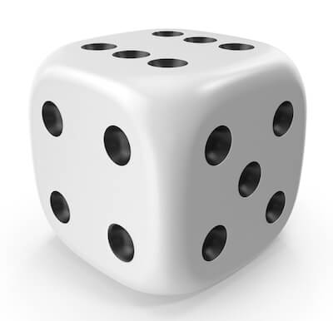
Example for CDF
Rolling a single die
P(X = k) = 1/6 for k = 1,2,...,6
P(X<1) = 0; can not take the values less than 1
P(X ≤ 1) = 1/6
P(X ≤ 2) = 2/6
P(X ≤ 3) = 3/6
P(X ≤ 4) = 4/6
P(X ≤ 5) = 5/6
P(X ≤ 6) = 6/6 = 1
P(X ≤ a (a>6)) ?
=1

Slide 11



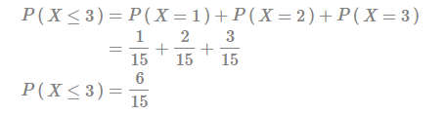

Example for CDF
A discrete random variable X whose probability function is
F(3)?
P(X>3) = 1 – 0.4 = 0.6

Slide 12
Descriptive Statistics

Slide 13
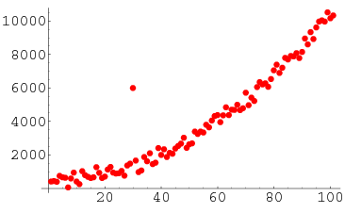
Robustness
We say that a statistic is robust if it is not affected by extreme values (such as outliers)

Slide 14
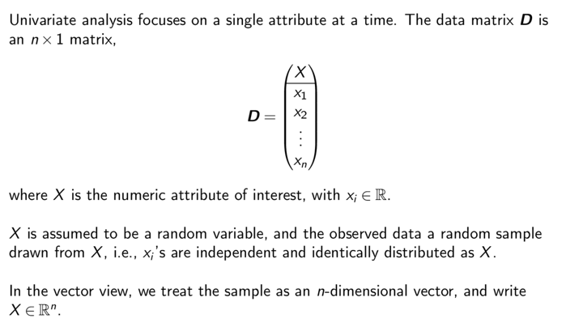
Univariate Analysis

Slide 15
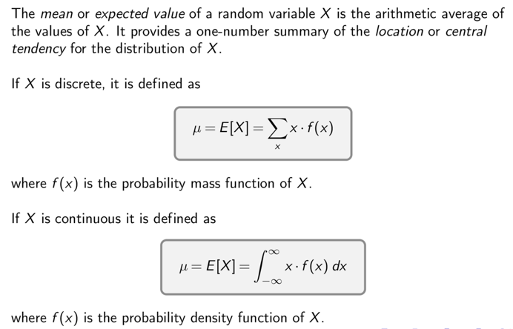
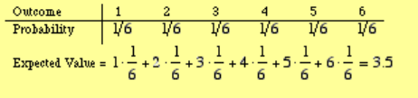
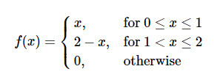

Mean

Slide 16
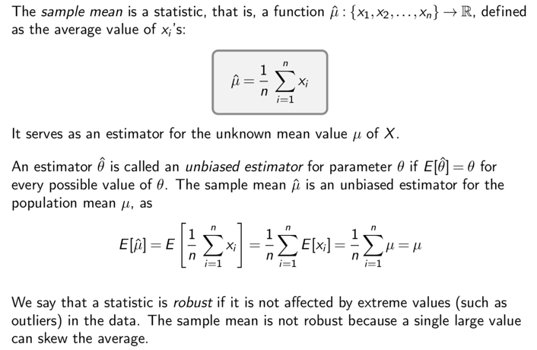
Sample Mean
Is samples mean robust?
No, a single large value can skew the average

Slide 17
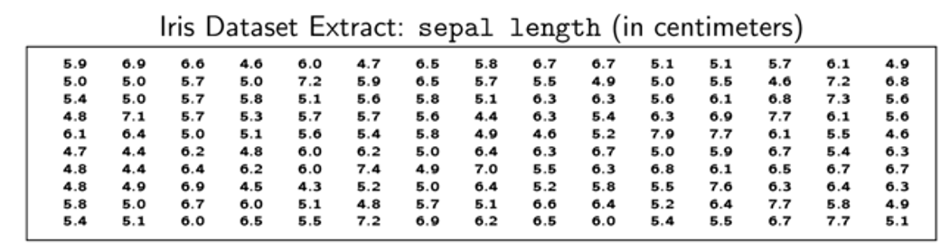
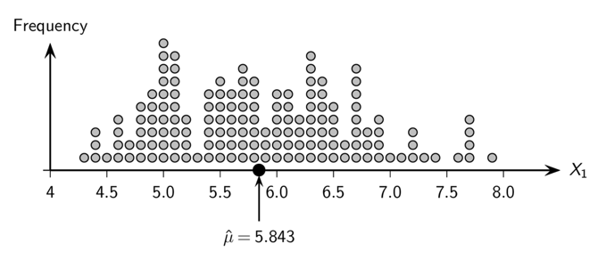
Sample Mean: Iris sepal length

Slide 18
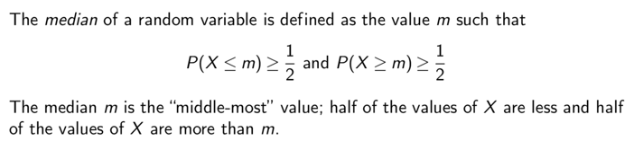
Median
Is Median robust?
Yes, it is not affected very much by extreme values

Slide 19
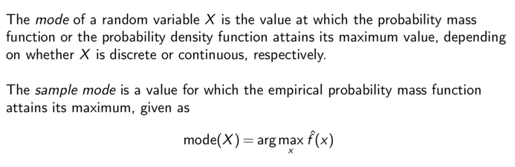
Mode
Is Mode robust?
Yes, it is not affected by extreme values

Slide 20
Range
The value range or simply range of a random variable X is the difference between the maximum and minimum values of X , given as
r = max{X } − min{X }
Is Range robust?
No, it is sensitive to extreme values

Slide 21
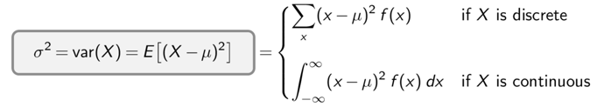
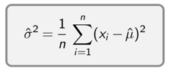

Variances and Standard Deviation
The variance of a random variable X provides a measure of how much the values of X deviate from the mean or expected value of X
The standard deviation σ, is the positive square root of the variance, σ².
The population variance is defined as
and the population standard deviation is

Slide 22
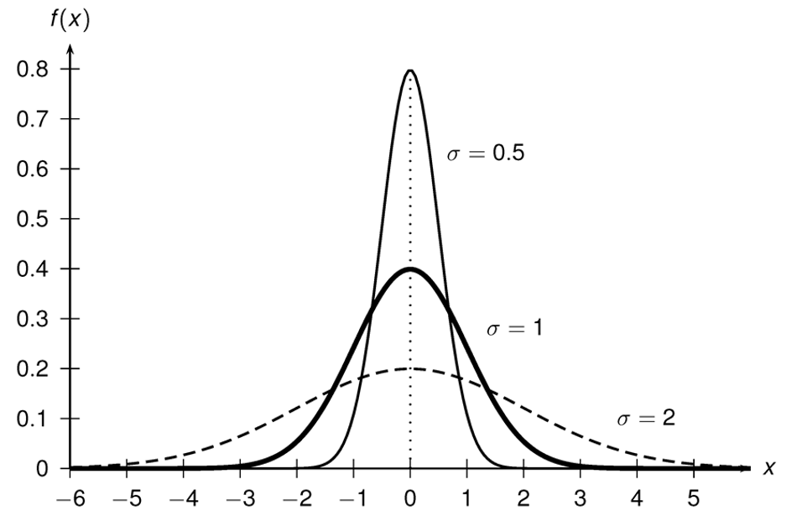
Normal Distribution with mean = 0, different std

Slide 23
Kahoot Quiz

