Slide 1
Basic Statistics and Visualization

Slide 2
Basic stats
Mean : Where is the random variable concentrated?
standard deviation : How the values spread out?
Mode: Most frequent value
Median: What is the value that 50% of the mass on left and 50% on the right
min
max

Slide 3
Percentile and Quantile
Quantiles are the lines that divide the data in equally size groups
Percentile are quantiles that divide the data into 100 equally sized group
The k-th percentile of a set of values divides them so that k % of the values lie below and (100 − k)% of the values lie above.
The 25th percentile is known as the lower quartile.
The 50th percentile is known as the median. (0.5 quantile; 50% quantile)
The 75th percentile is known as the upper quartile.

Slide 4
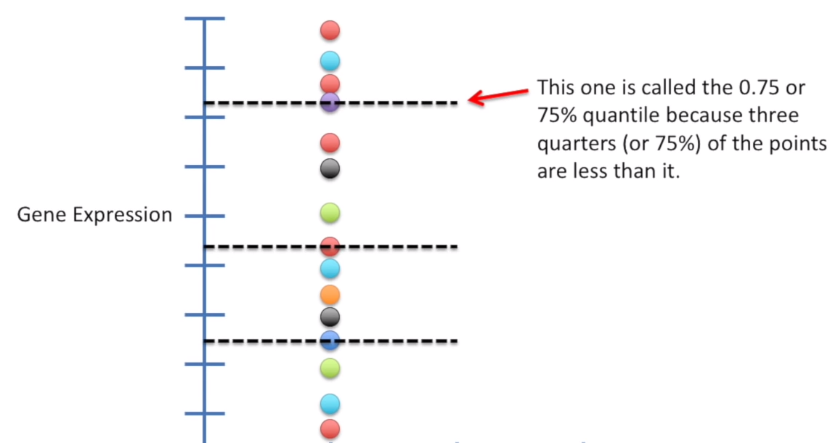

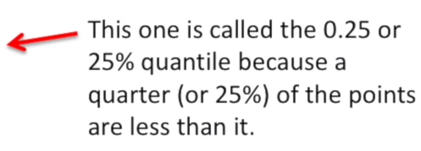
?
0% quantile or
0th percentile
Since no values are less than that

Slide 5
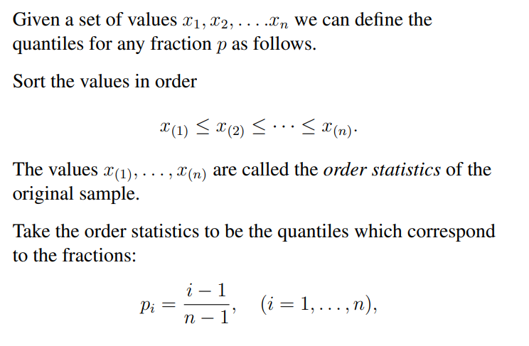
How to compute quantile?

Slide 6
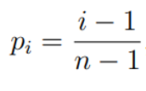
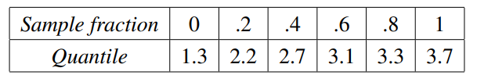
Example
3.3, 2.7, 2.2, 1.3, 3.7, 3.1

Slide 7

Example
What is the 25% quantile of these numbers?
3.7 2.7 3.3 1.3 2.2 3.1
First: sort them: 1.3 2.2 2.7 3.1 3.3 3.7
Associate the ordered values with sample fractions equally spaced from zero to one.
Lower quantile: .75 × 2.2 + .25 × 2.7 = 2.325
i 1 2 3 4 5 6

Slide 8
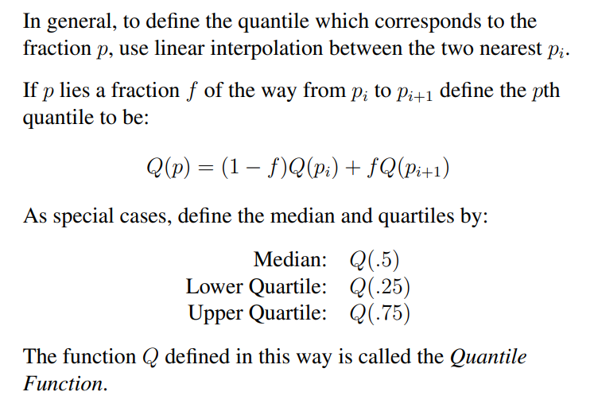
How to compute quantile?

Slide 9
Visualizing Distributions
Statistics are numbers and they are useful, but they do not tell the entire story
Visualization is useful for understanding the distribution of a single variable…
Easier for comparing distributions of multiple variables

Slide 10


Why visualization?

Slide 11
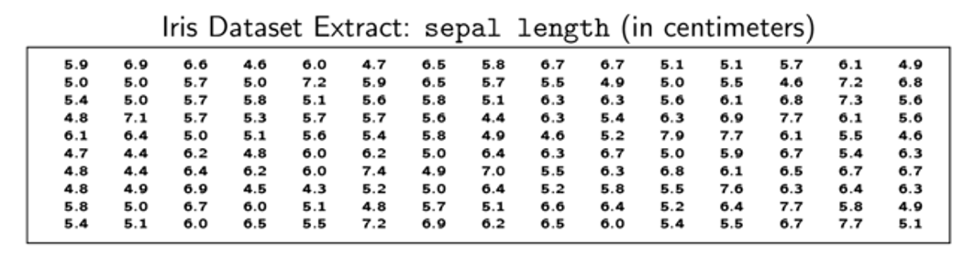
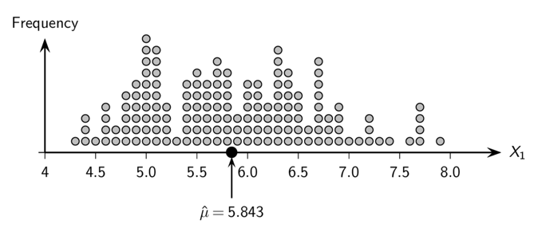
Sample Mean: Iris sepal length

Slide 12
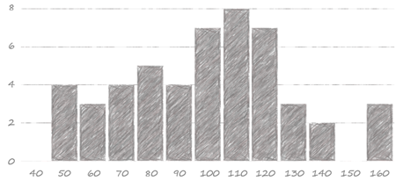
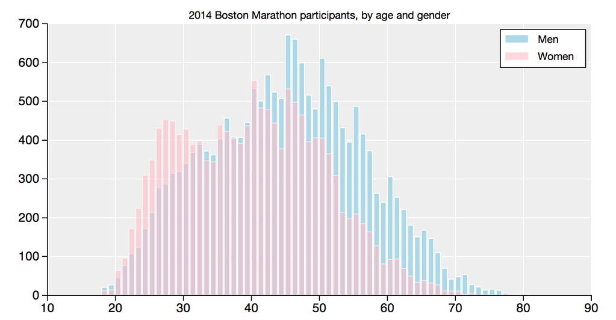
Histogram
An empirical representation of the probability function
Divide data into bins (how to do it?)
X axis: center point of bin
Y axis: number (fraction) of data points in bin
Number
Age
Comparison of age distributions of Boston Marathon participants in 2014 by gender
https://github.com/llimllib/bostonmarathon#user-content-visualizations

Slide 13
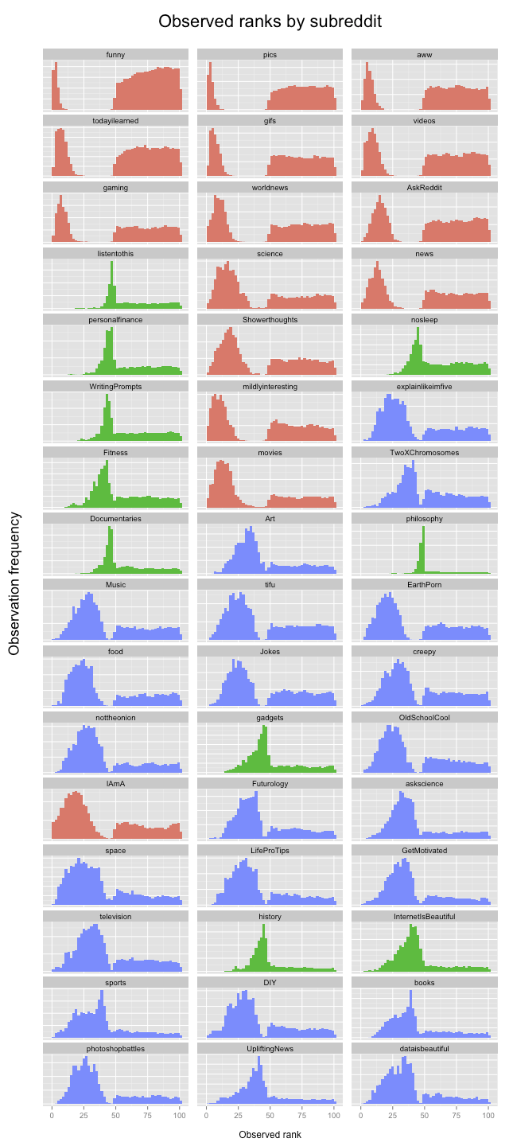
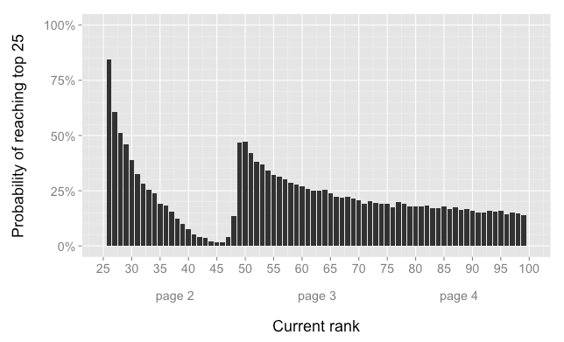
Clustering Histograms Visually
Distribution of Reddit ranks by SubReddit
https://toddwschneider.com/posts/the-reddit-front-page-is-not-a-meritocracy/

Slide 14
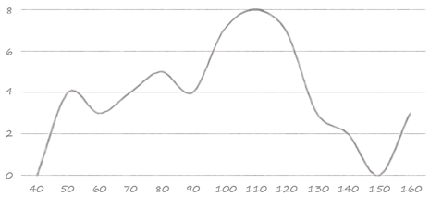
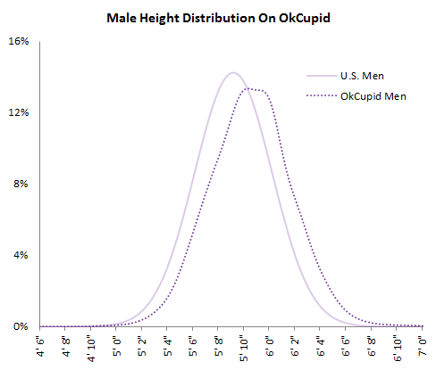
Line Chart
Getting closer to the probability density function
Just use sufficient number of bins so that the curve is smooth enough, while also accurately representing the distribution
Comparison of distributions of men’s height in the US vs. heights reported by men on OkCupid
https://theblog.okcupid.com/the-big-lies-people-tell-in-online-dating-a9e3990d6ae2

Slide 15
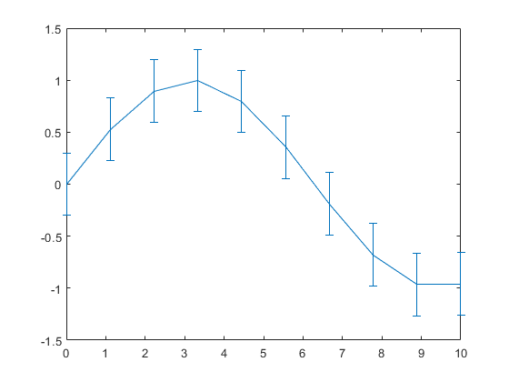
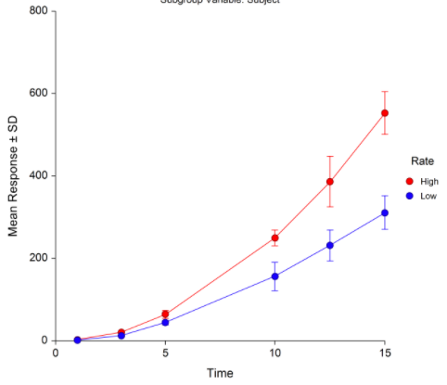
Error Bar
If we are comparing too many categories or distributions as a function of a continuous variable (e.g., by binning), it is useful to display summaries of each distribution side-by-side
Show curve of means by subpopulation, show standard deviation via bars
Sensitive
Resistant
Effect of drug on two groups of patients who are resistant and sensitive to the drug

Slide 16
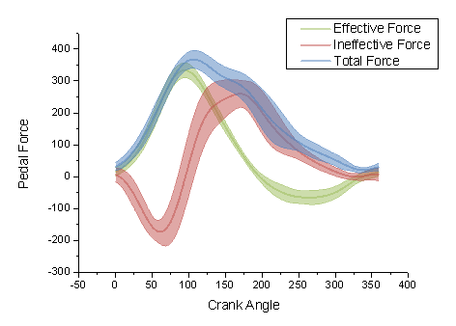
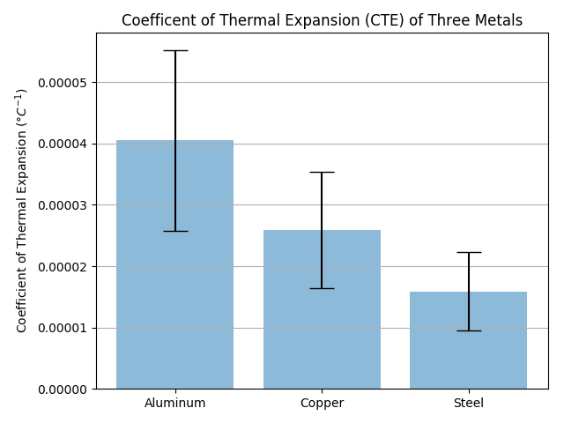
Variations of Error Bar
Error cloud
Bar plot with error bars

Slide 17
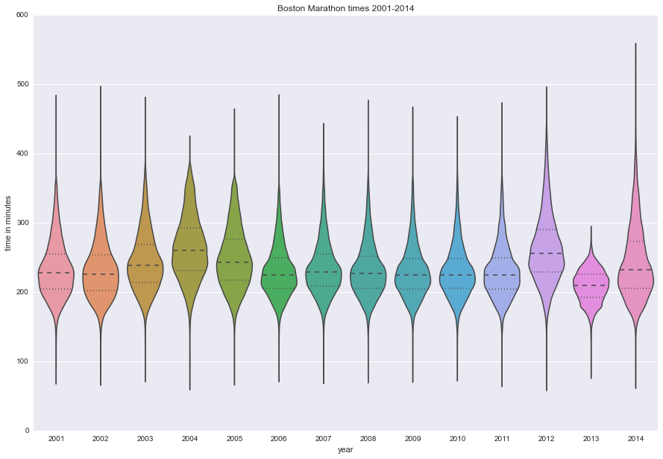
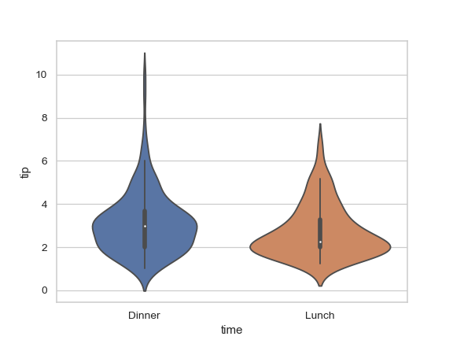
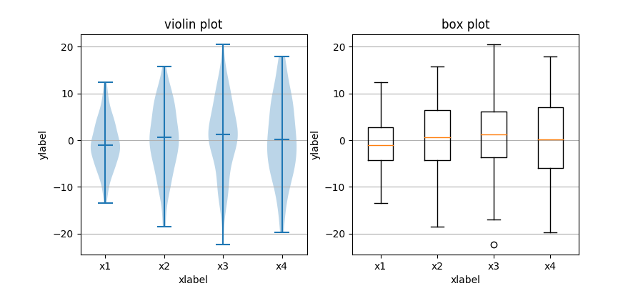
Violin Plot
Distribution of finishing times (in minutes) in Boston Marathon as a function of year
https://github.com/llimllib/bostonmarathon#user-content-visualizations

Slide 18
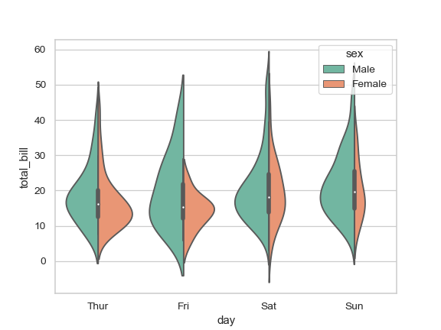
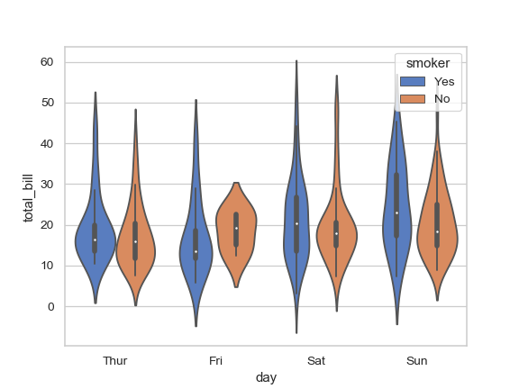

Combined Violin Plot for comparing distributions
https://seaborn.pydata.org/generated/seaborn.violinplot.html

Slide 19
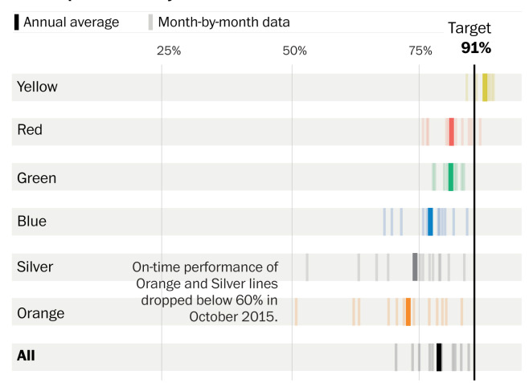
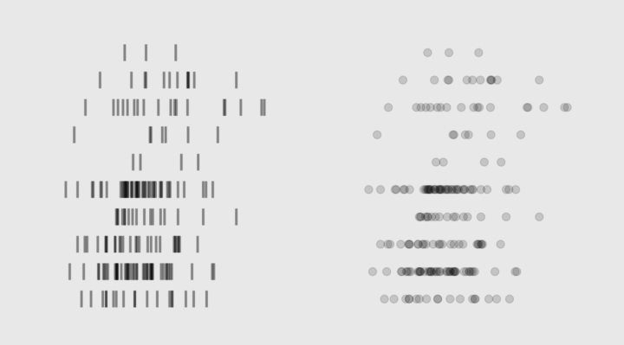
Barcode Chart
Show each data point as a bar on a line
Present each variable in a separate row
When is this useful?
Range is compatible between different variables
A few data points
Not too much space
Each bar shows the monthly average of on-time performance of Washington Metro
Each row displays 12 bars
Annual average is shown by a bold bar
https://postgraphics.tumblr.com/post/143869718338/a-complete-guide-to-the-major-problems-facing

Slide 20
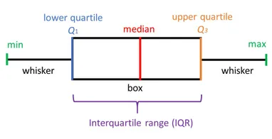
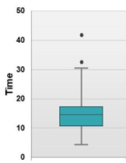
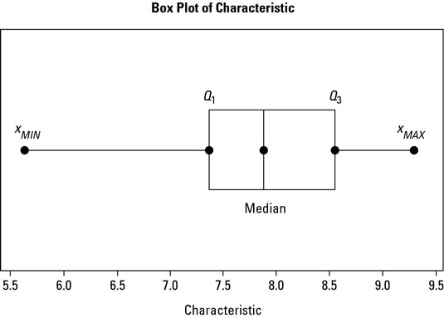
Box Plot
Draw a box from the lower quartile to the upper quartile.
Extend a whisker from the ends of the box to the furthest observation which is no more than 1.5 times inter-quartile range from the box.
Mark any observations beyond this as “outliers.”

Slide 21
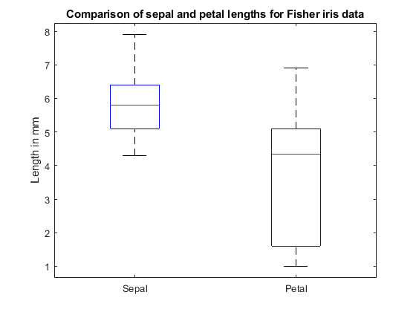
Comparing Samples with Box Plots
The median in Sepal is higher than Petal
The spread of the values in Petal is larger

Slide 22
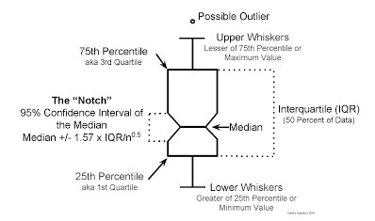
Box Plots with Notch

Slide 23
Confidence Interval
A confidence interval is how much uncertainty there is with any particular statistics.
Confidence intervals are often used with a margin of error.
It tells you how confident you can be that the results from a poll or survey reflect what you would expect to find if it were possible to survey the entire population

Slide 24

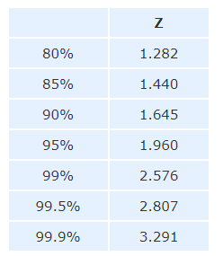
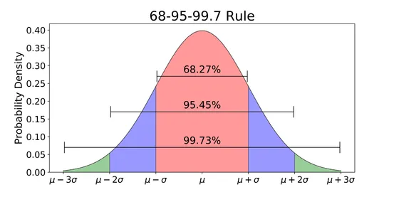
Box Plots with Notch
s: Compute the standard deviation
n: Number of observations
Z: Z-value from the table
X: the value we are computing the CI for
Desired CI
X
Proportion of a standard normal distribution (SND) in percentages.
The probability of randomly selecting a value between -1.96 and +1.96 standard deviations from the mean is 95% . If there is less than a 5% chance of a raw score being selected randomly, then this is a statistically significant result.

Slide 25
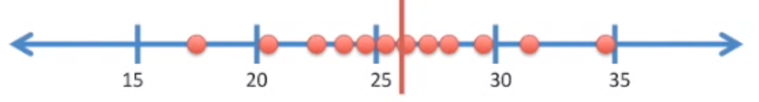

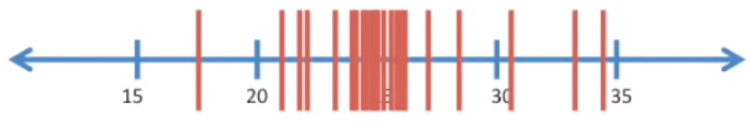
Calculating Confidence Interval: Bootstrapping
Suppose we measure the weight of 12 female mice
Calculate Sample Mean
Bootstrap the samples: Randomly select 12 data point with replacement (duplicate is allowed)
Calculate the mean of random samples
Repeat Bootstrapping >10000 times

Slide 26
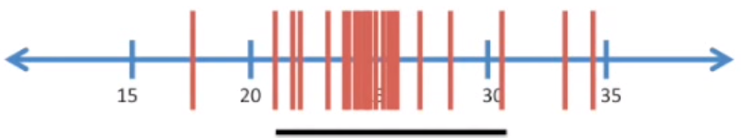
Calculating Confidence Interval: Bootstrapping
95% CI is the interval that covers 95% of the means (the 2.5th percentile as the lower bound and the 97.5th percentile as the upper bound. )
Anything outside of CI occurs less than 5% of the time
  The probability that the true mean will be <20 is less than 5% (p-value < 0.05)
Increasing the sample size, ……………………..Confidence Interval
Higher Standard Deviation, …………………….. Confidence Interval
Narrower
Wider

Slide 27
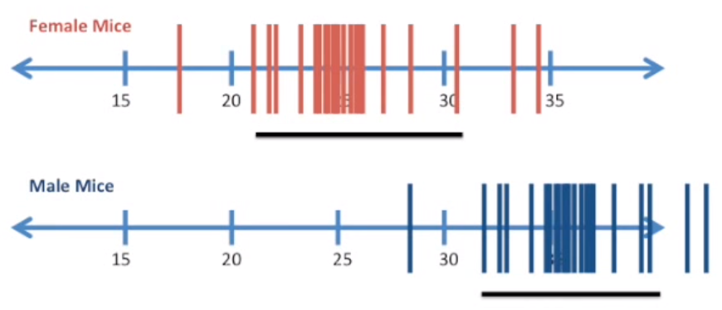
Use Confidence Interval to Compare 2 Samples
Confidence intervals do not overlap, so they are statistically different with p-value < 0.05

Slide 28
Kahoot Quiz

