Slide 1
Data and Distributions

Slide 2
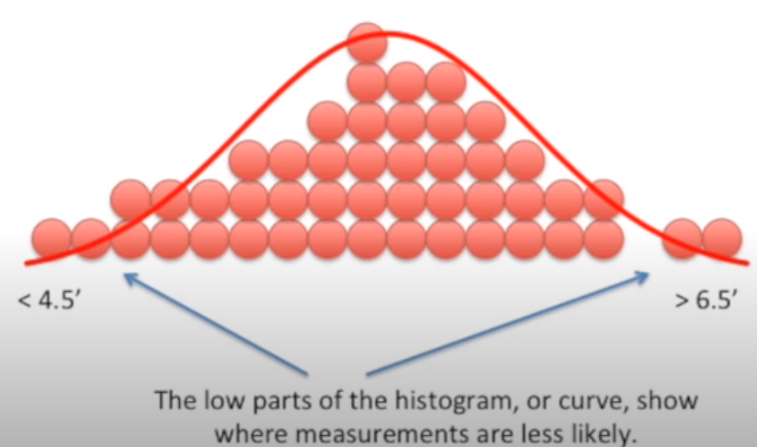
What Is Distribution?
It shows us how the probabilities of measurements are distributed
The tallest part of histogram/curve shows the region where measurements are most likely.

Slide 3
Common Distributions
Continuous
Gaussian/Normal
Uniform
Exponential, Power Law
Discrete
Bernoulli
Binomial

Slide 4
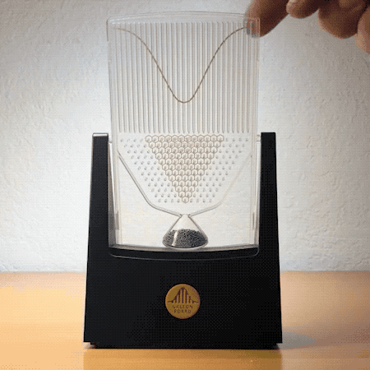
Normal Distribution
Normal Distribution is also called “Gaussian Distribution” or more commonly known as “Bell Curve”
One of the main reasons for the popularity of the Normal Distribution curve is that it occurs very commonly in most of the things we see in nature around us. For example: in finance, like the salary distribution in an office, height, weight, grading, ….

Slide 5
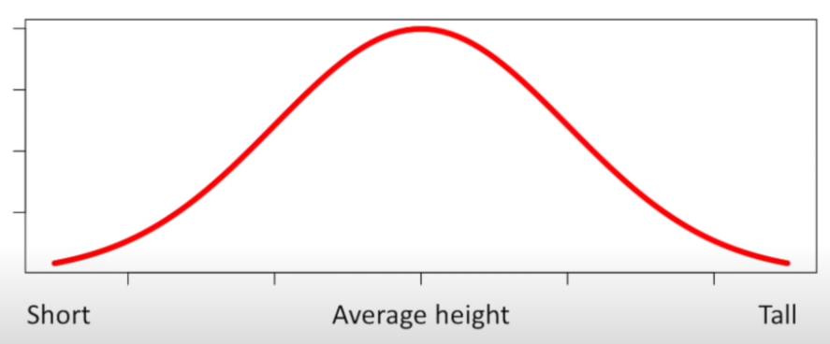
Normal Distribution
Y-axis: Relative probability of observing someone who is really short, really tall, or has an average height
More likely
Less likely

Slide 6
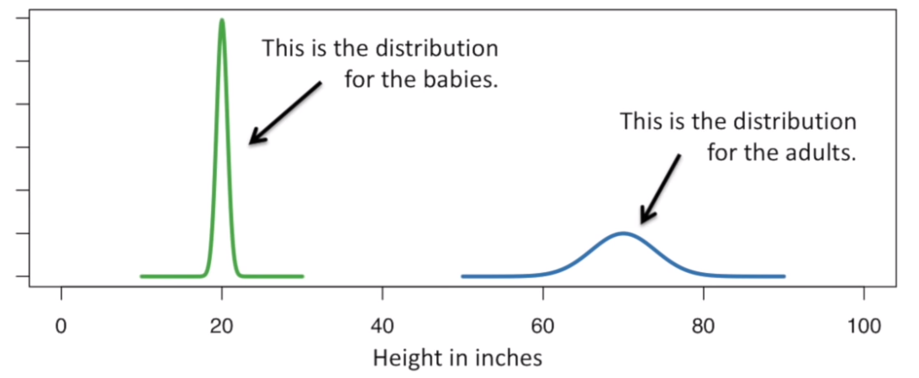
Two normal distributions of the height of male humans
Normal distribution are always centered around the average value
Width of the curve: Standard Deviation
Why the curve for babies height distribution is taller?
There are more possibilities for adult heights

Slide 7
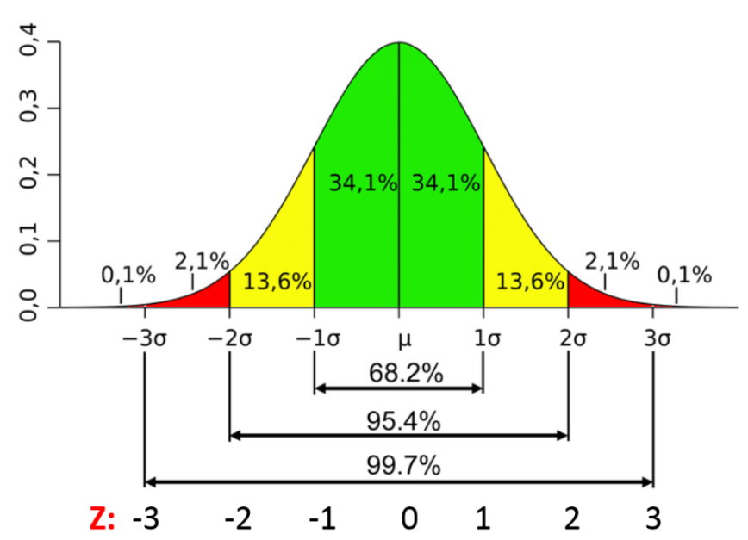
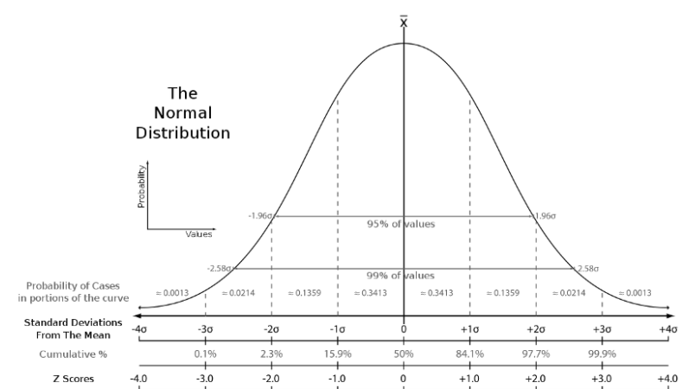
95% of the values fall between +/-2 standard deviation

Slide 8
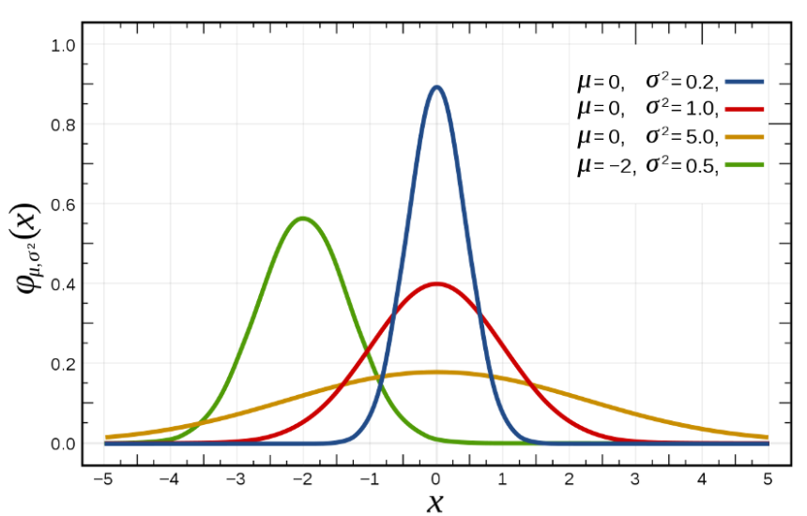
Shifting and Scaling Normal Distribution

Slide 9
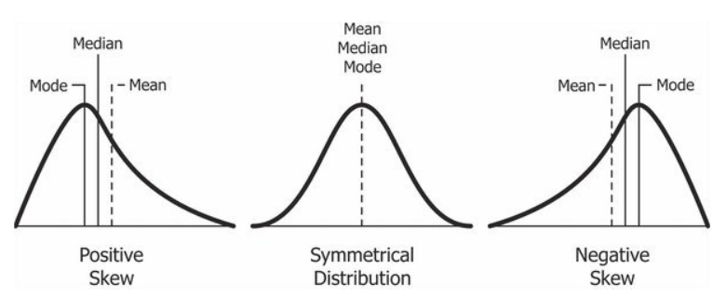
Bending Normal Distribution

Slide 10
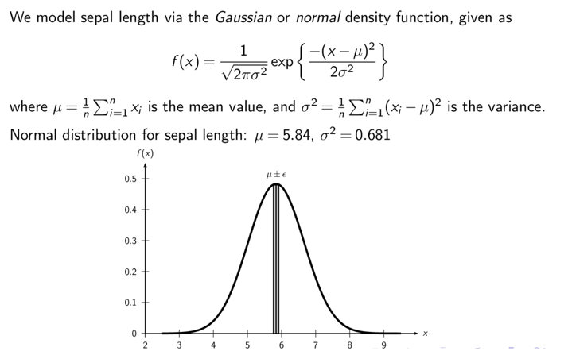
Probability Density Function for Normal Dist.

Slide 11
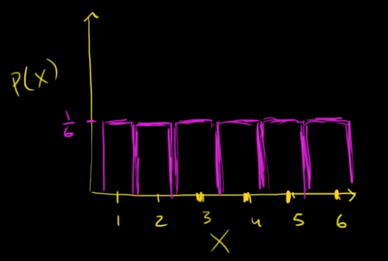
Uniform Distribution
The distribution describes an experiment where there is an arbitrary outcome that lies between certain bounds
Every outcome is equally likely
Rolling a fair 6-sided die P(X=1) = 1/6
Summation of probabilities adds up to 1
Discrete Uniform Distribution

Slide 12
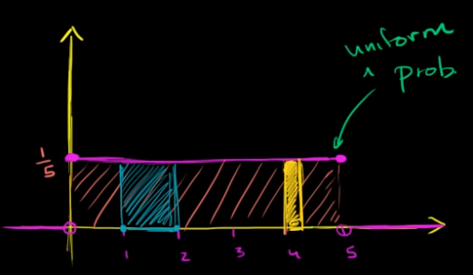
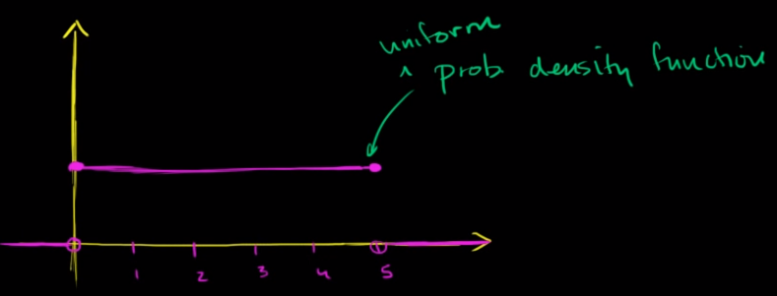
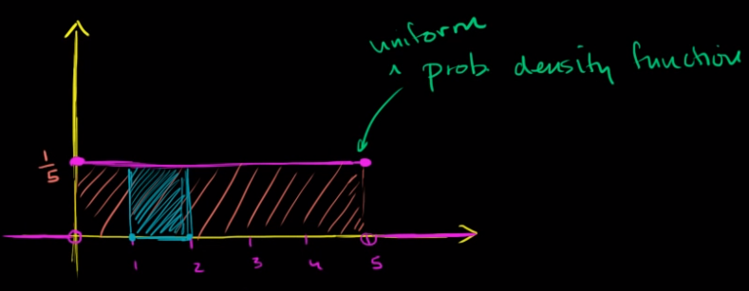
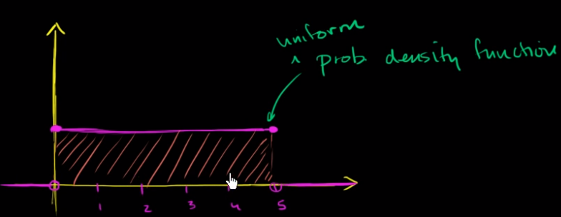
Uniform Distribution Example
X: Continuous Random Variable
P (1 < X < 2) = ?
1 * 1/5 = 1/5
5*X = 1 -> X = 1/5
P( 4 < X < 4 1/3) =
1/3 * 1/5 = 1/15
?
?
1/5
P(X = 4) =
0

Slide 13
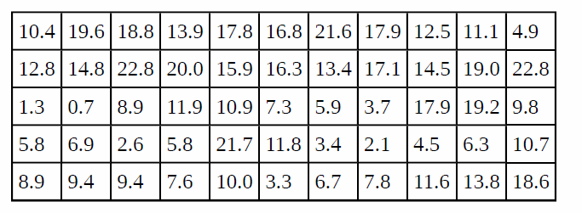
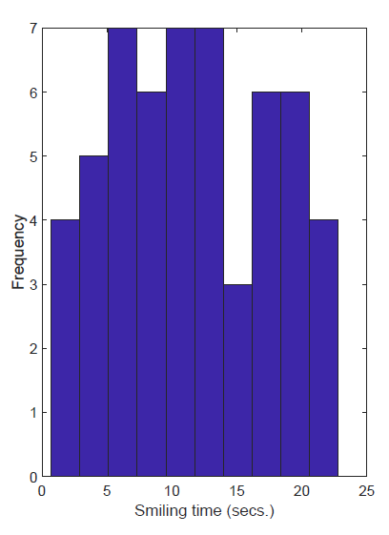
Uniform Distribution Example
Smiling times of an 8-week old baby (in secs.):
Generating Random Numbers

Slide 14
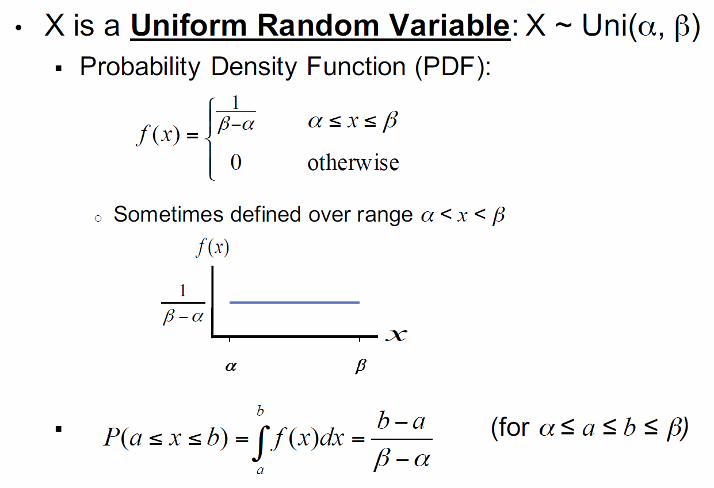


Generalized Mean and Standard Deviation

Slide 15
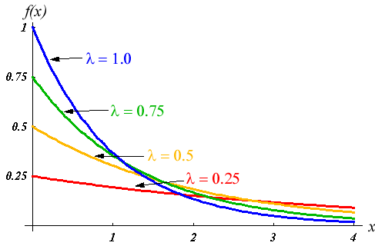
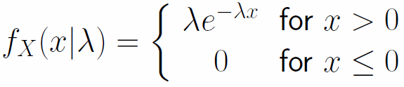
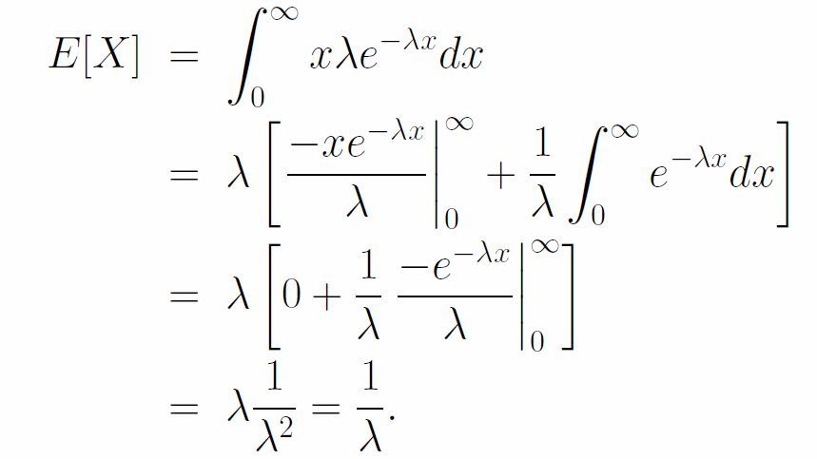
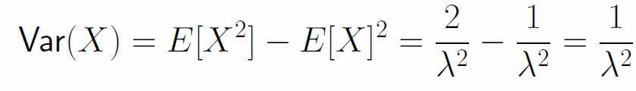
Exponential Distribution
It is often used to model the time elapsed between events.
You are at a store and are waiting for the next customer
Mean
0 < 𝜆 <= 1is a parameter (usually known as the “rate” parameter)

Slide 16

Example
Cumulative Distribution Function
P(X < x) =
A dell laptop last on average for 5 years.
1) What is the probability that a laptop will last less than 3 years?
Mean = 1/ λ -> λ = 1/ 5 = 0.2
$$P\left(X<3\right)=1 −e^{−0.2∗3}=0.4512$$

Slide 17
Example
Imagine you are managing a coffee shop, and customers arrive at your shop randomly throughout the day.
if you have, on average, 10 customers arriving per hour, then λ = 10 customers per hour.
Questions:
- What is the average time a customer has to wait between the arrival of one customer and the next?
Average Waiting Time = 1/λ
Average Waiting Time = 1/10 = 0.1 hours = 6 mins
What is the probability that a customer will arrive within the next 5 minutes (5/60 hours)?
CDF(5/60) = 1 - e^(-10*(5/60)) CDF(5/60) ≈ 0.0801

Slide 18
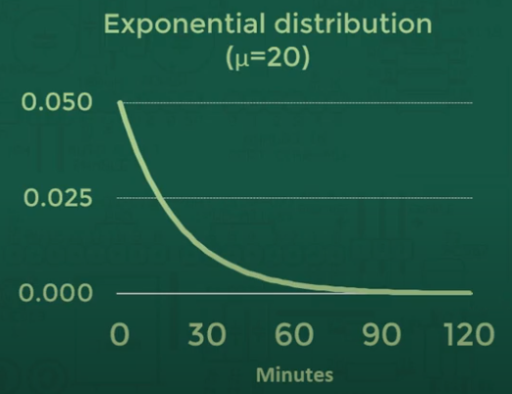

Example
What is the probability that the first visitor lands on the website within the first minute?
$$P\left(0<x<1\right)=0.05$$
What is the probability that the first visitor lands on the website within the second minute?
$$P\left(1<x<2\right)=\left(1−0.05\right)0.05=0.95∗0.05=0.0475$$
$$P\left(2<x<3\right)=\left(1−0.05\right)(1−0.05)0.05={0.95}^{2}∗0.05$$
Miss first minute
Miss second minute

Slide 19
Power Law Distribution
A power law distribution, also known as a Pareto distribution, is a statistical distribution that describes a phenomenon in which a small number of items have significantly more occurrences or higher values than the majority of items.
One of the most well-known real-life examples of a power law distribution is the distribution of wealth in a society, often referred to as the "Pareto principle" or the "80/20 rule." This principle suggests that approximately 80% of the wealth is owned by approximately 20% of the population.

Slide 20

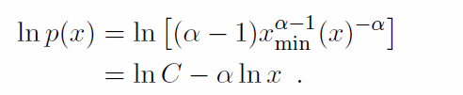
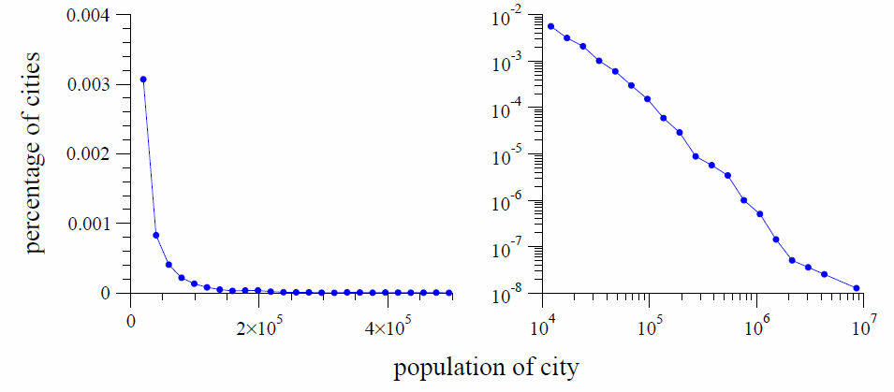
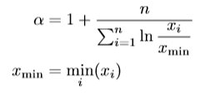
Power-Law Distribution
Encountered quite commonly in real life
The parameter 𝛂 > 1 is known as the power law exponent, x_{min} is the lower-end of the range
Number of cities that have x population or more

Slide 21
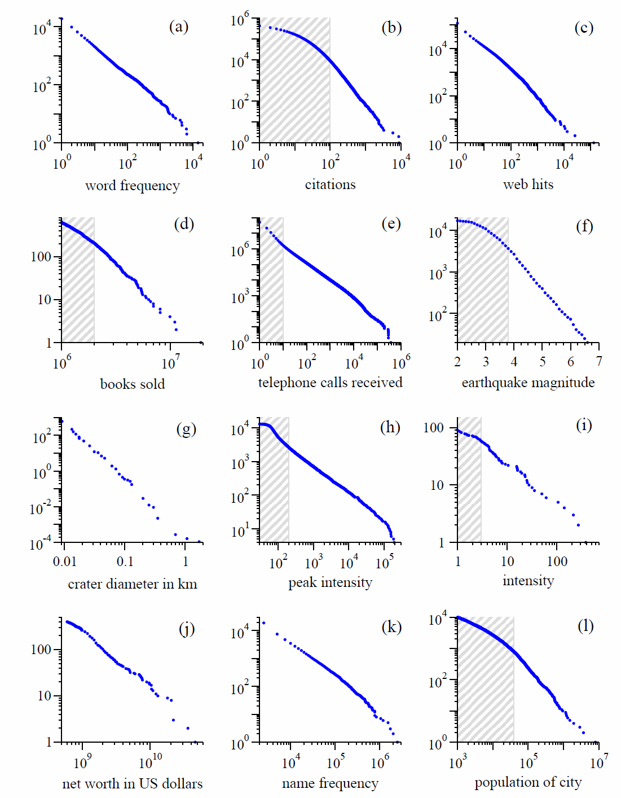
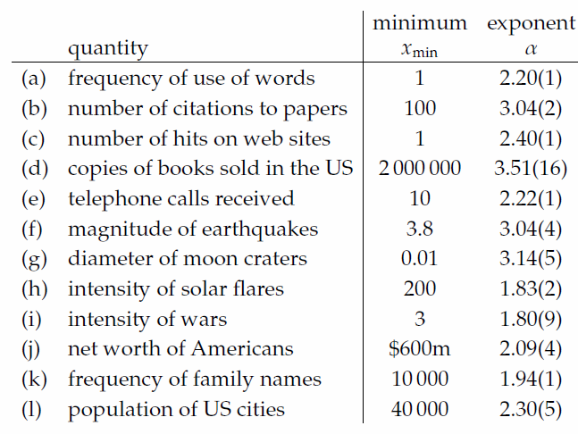
Examples of Power-Law Distribution
Number of words which occur that many times or more
Complementary CDF
Lecture notes of Mark Newman, University of Michigan

Slide 22
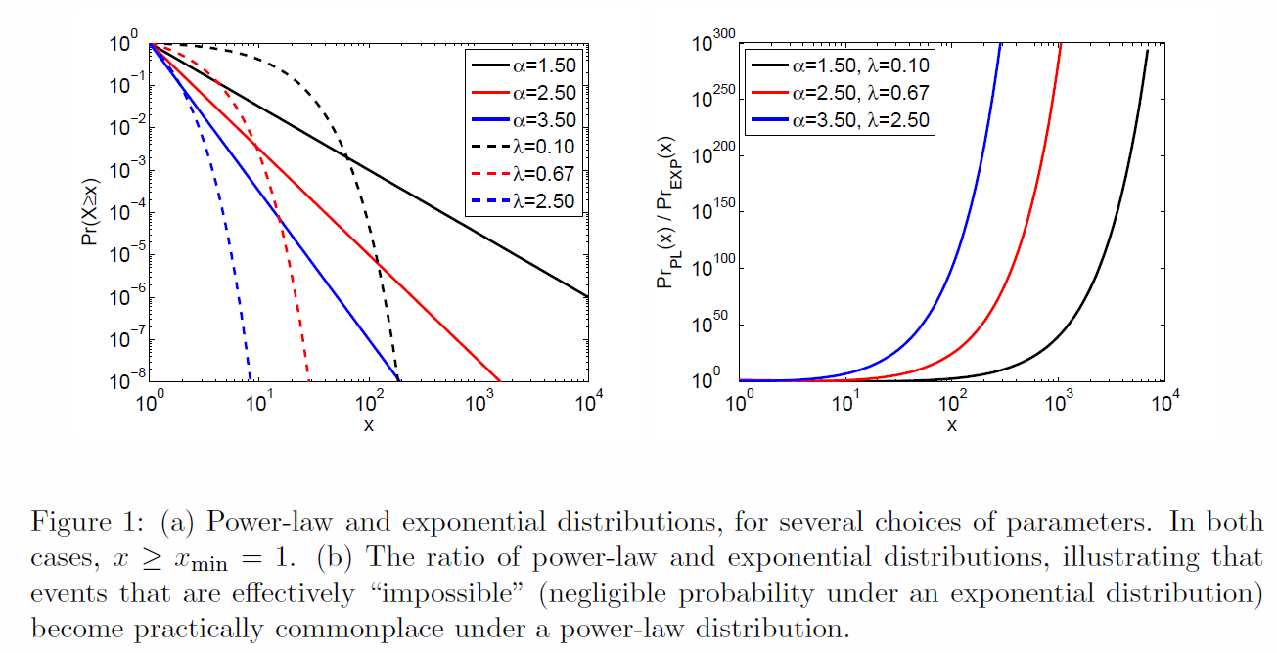
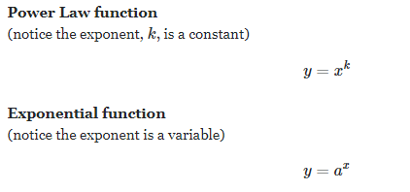
Power-Law vs. Exponential Distribution
Lecture notes of Aaron Clauset, Santa Fe Institute

Slide 23
Bernoulli Distribution
Assume each data point has been mapped to a binary value
Whenever your experiment lead to either success or failure, you can associate success (labeled with 1) a probability p, and failure (labeled with 0) a probability (1-p)
Example:
  Flipping a coin: Head or tail
  Trump or Biden

Slide 24
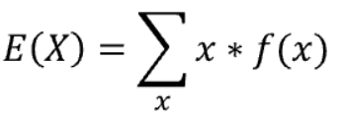

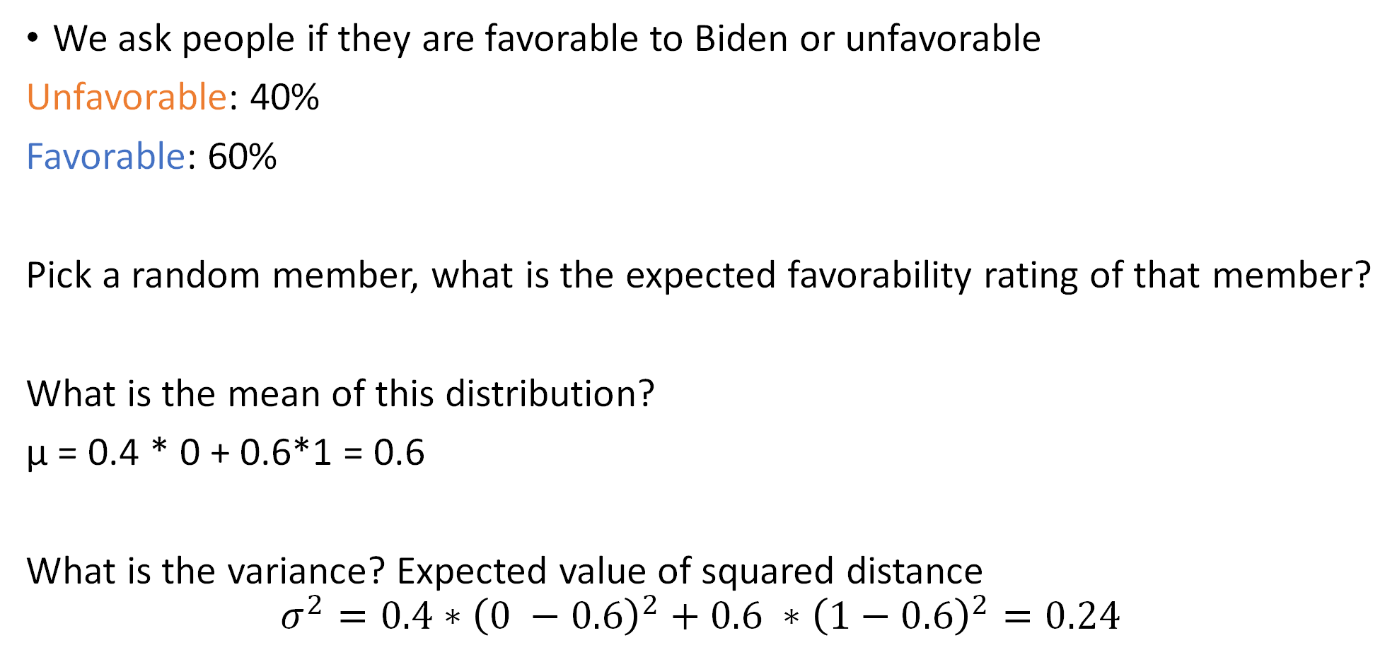
Example
We ask people if they are favorable to Biden or unfavorable
Unfavorable: 40%
Favorable: 60%
Pick a random member, what is the expected favorability rating of that member?
What is the mean of this distribution?
μ = 0.4 * 0 + 0.6*1 = 0.6
What is the variance? Expected value of squared distance
$$σ^{2}=0.4∗{\left(0 −0.6\right)}^{2}+0.6 ∗{\left(1−0.6\right)}^{2}=0.24$$
60%
40%
0 1
0.6
This is not the value that the distribution can take

Slide 25


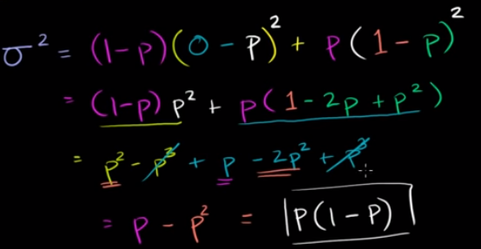

Generalized mean and standard deviation
Probability Mass Function
p
1-p
0 1

Slide 26
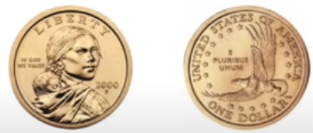
Binomial Distribution
Similar to the Bernoulli but running more than one trial (trials are independent)
X: Number of success after n trials where P(success) for each trial
Example:
  Probability of getting 2 “Tails”” in 5 tosses

Slide 27
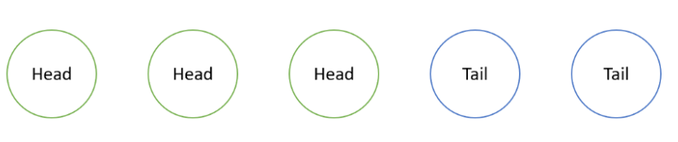
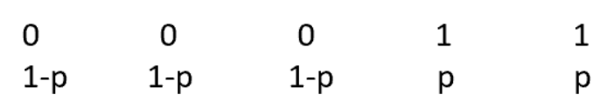
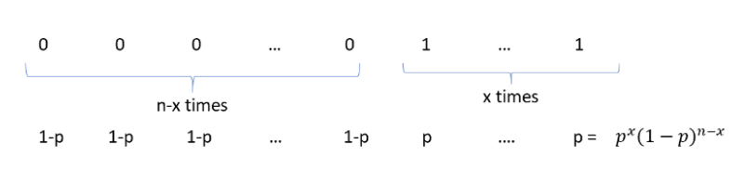
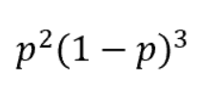
Example
we flipped our coin 5 times and we lost in the first 3 trials, while we won in the last 2. Since we said that success=tail=1 and failure=head=0

Slide 28
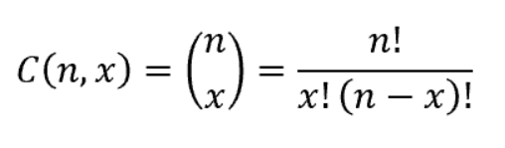
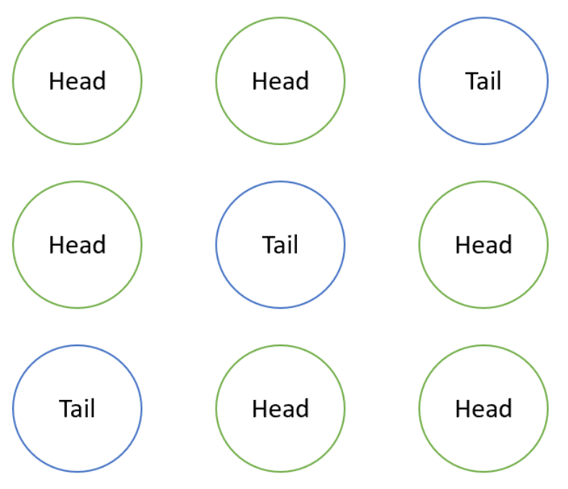
Example
But we don’t care about the order
-> Different combination should be counted
Where n is the number of trials and x is the number of successes of which we want to know the probability of occurrence.

Slide 29



Generalized Mean and Standard Deviation
n is the number of independent Bernoulli random variables
n1 is the number of success
p is the probability of success

Slide 30
Kahoot Time

