Slide 1
Data Distribution and Data Transformation

Slide 2

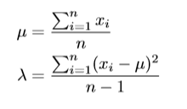
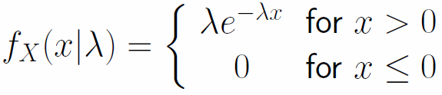

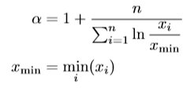



What is the distribution of a given data?
We have to use the given data to identify the parameters for different probability density functions of different distributions
Normal Distribution
Exponential Distribution
Power Law Distribution
Uniform Distribution

Slide 3
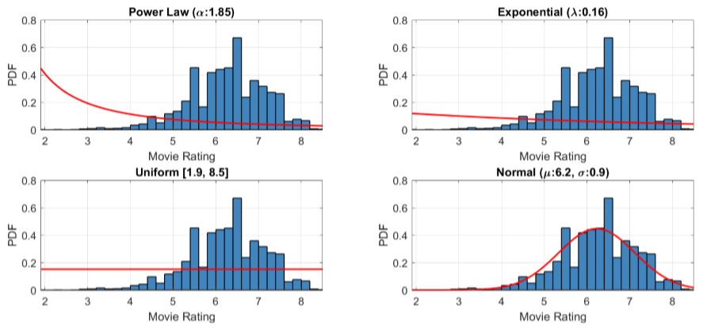
What is the distribution of a given data?
Plot histogram of your data
Plot the hypothetical distribution

Slide 4
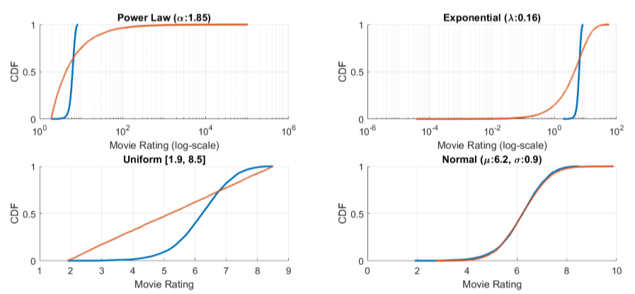
Further Verification
Check the cumulative distribution function

Slide 5
Quantile-Quantile Plot (Q-Q Plot)
Quantile-quantile plots allow us to compare the quantiles of two sets of numbers
It helps to answer if a data comes from a specific distribution
This kind of comparison is much more detailed than a simple comparison of means or medians
The sample sizes do not need to be equal.

Slide 6
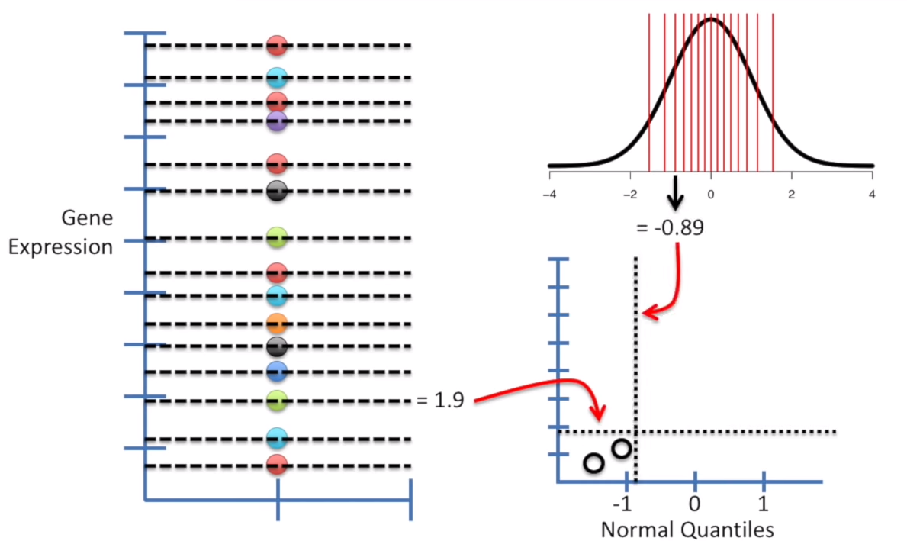
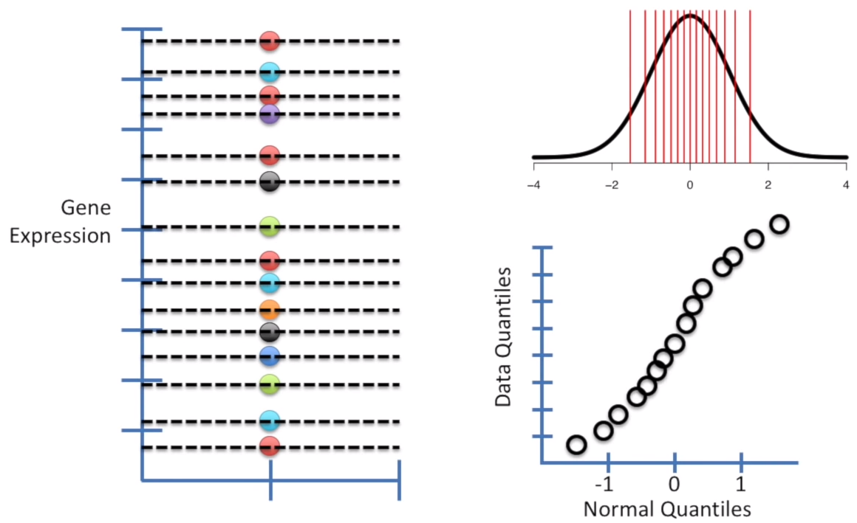
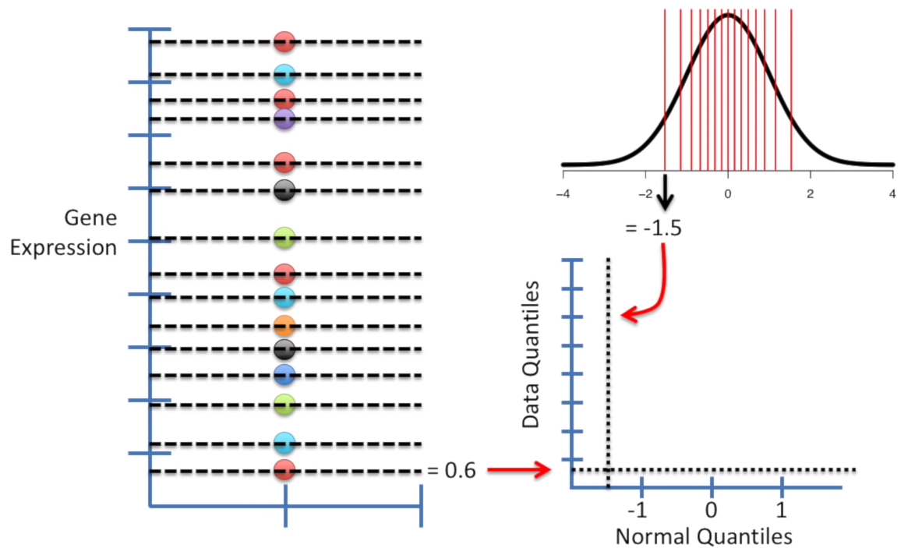
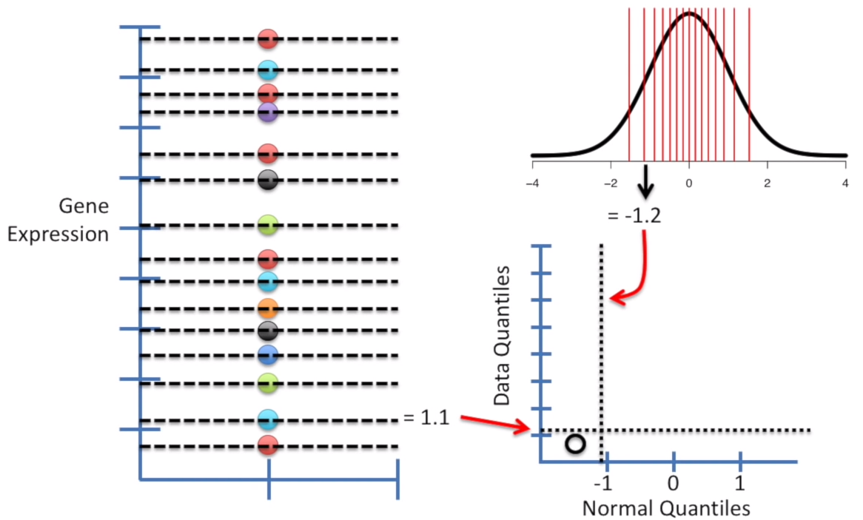
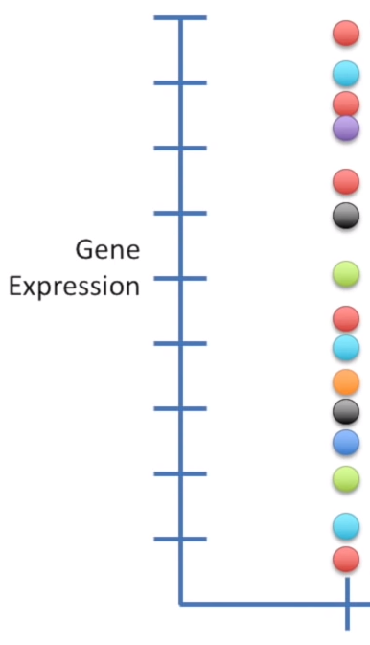
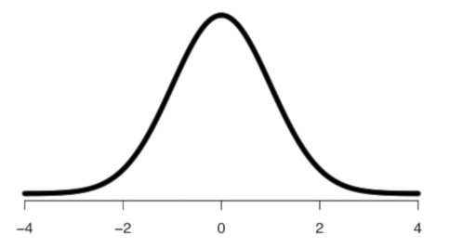
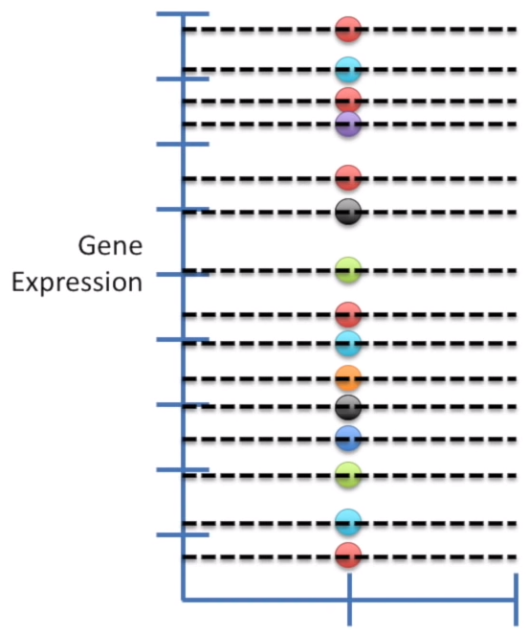
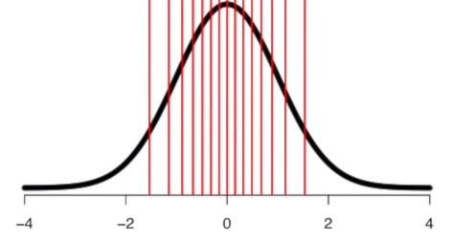
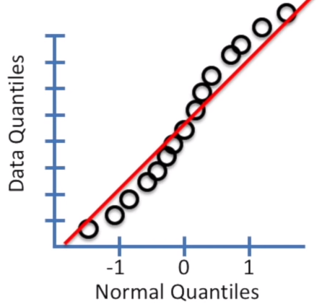
Is this data normally distributed?
Step 1: Give each point its own quantile
Step 2: Get a normal curve
Step 3: Add the same number of quantiles to the curve
Equal sized group in normal curve means equal probability observing a value
Within each group (narrower group in the middle, wider group on the edge)

Slide 7
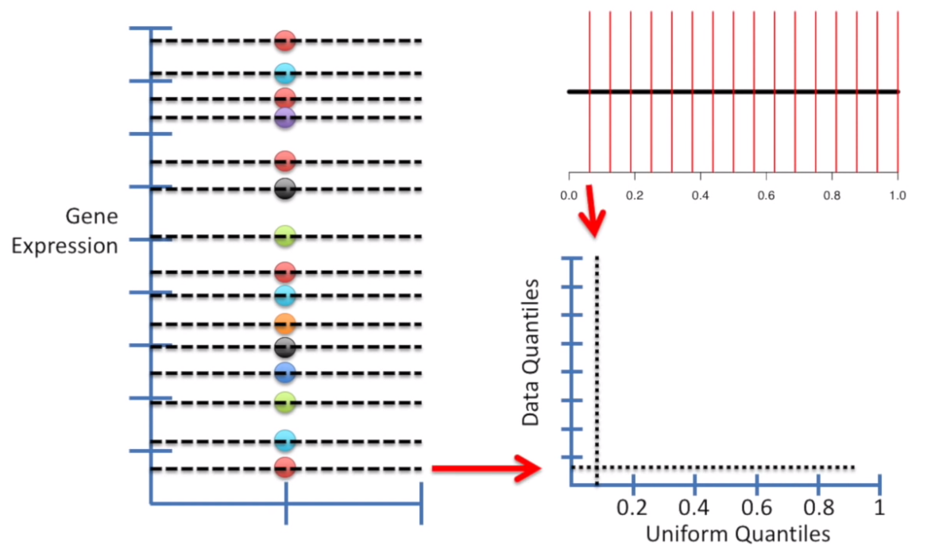
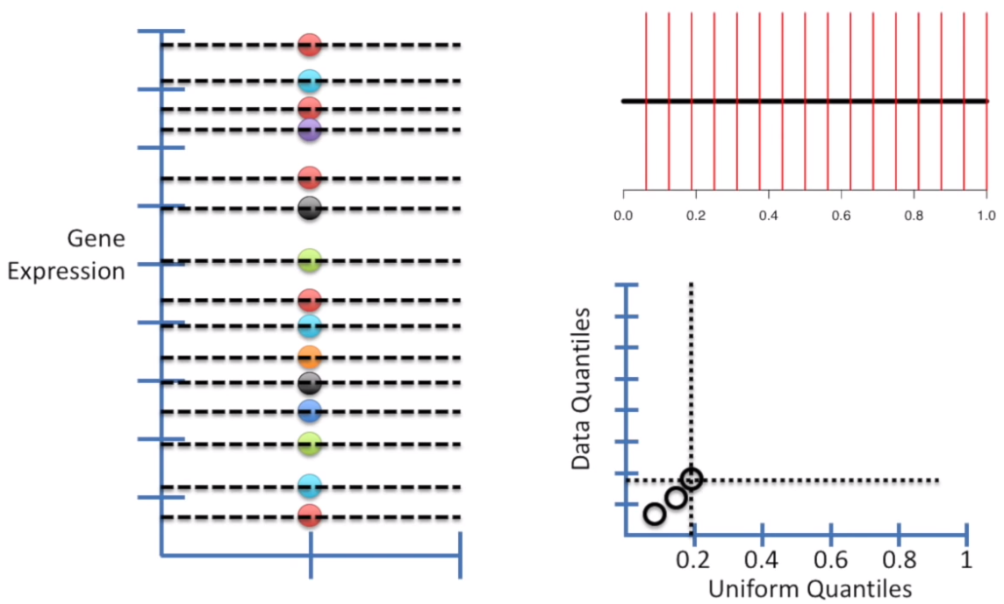
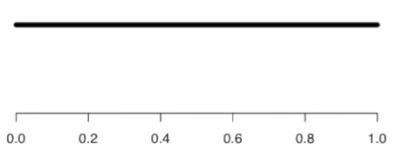
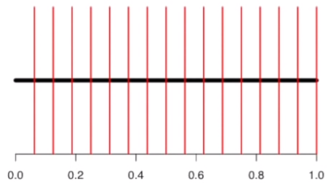
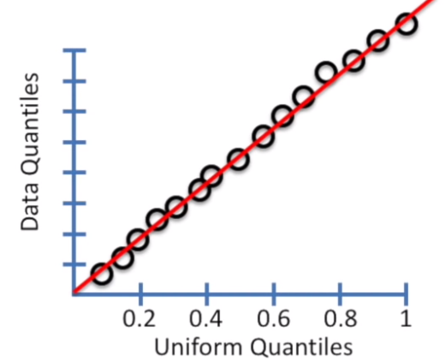
Is this data Uniformly distributed?
Step 1: Give each point its own quantile
Step 2: Get a uniform distribution
Step 3: Add the same number of quantiles to the curve

Slide 8
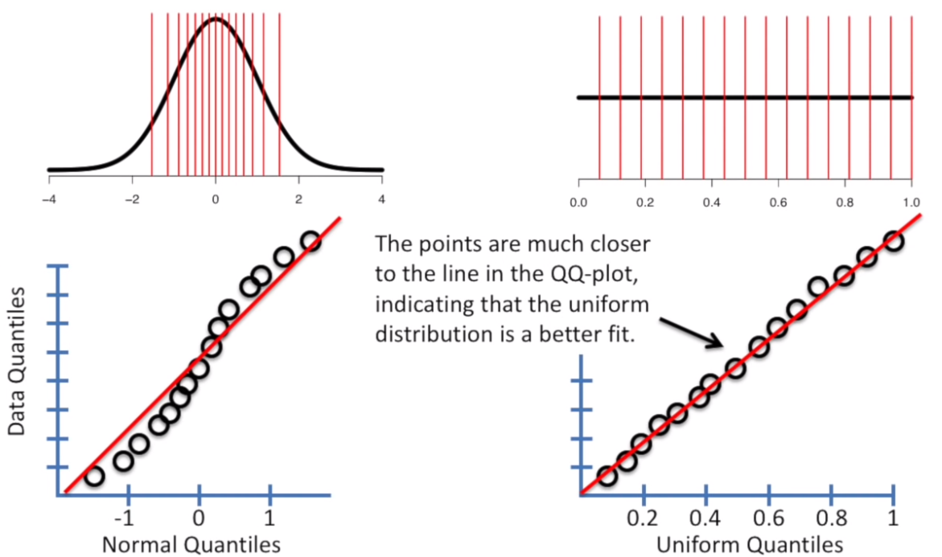

Slide 9
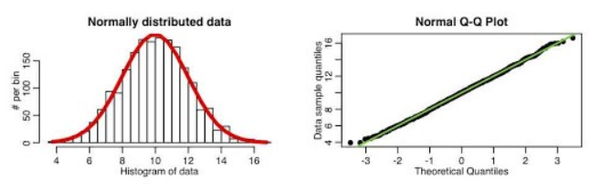
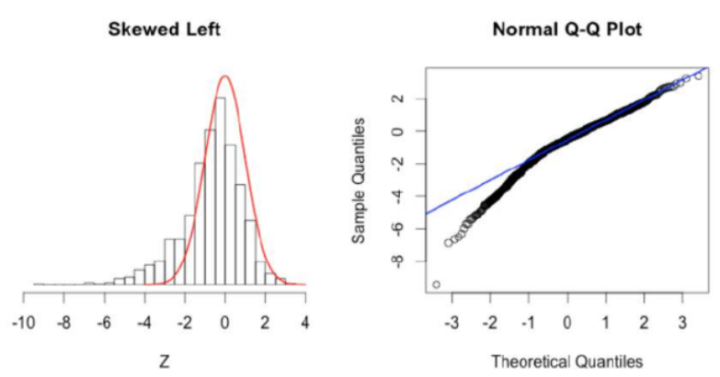
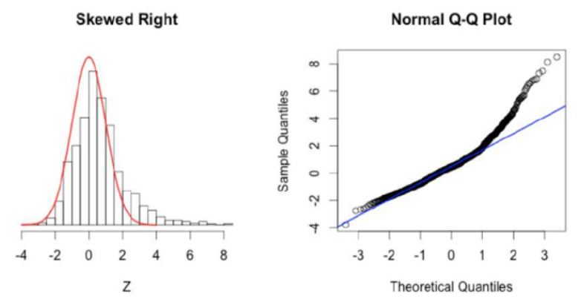

Slide 10
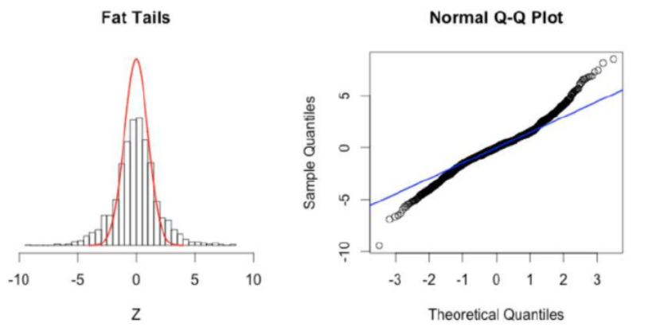
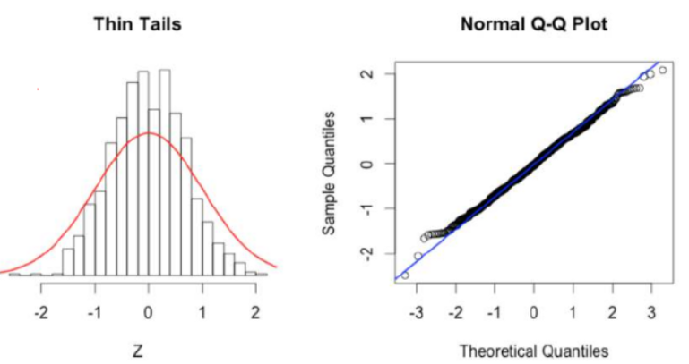

Slide 11
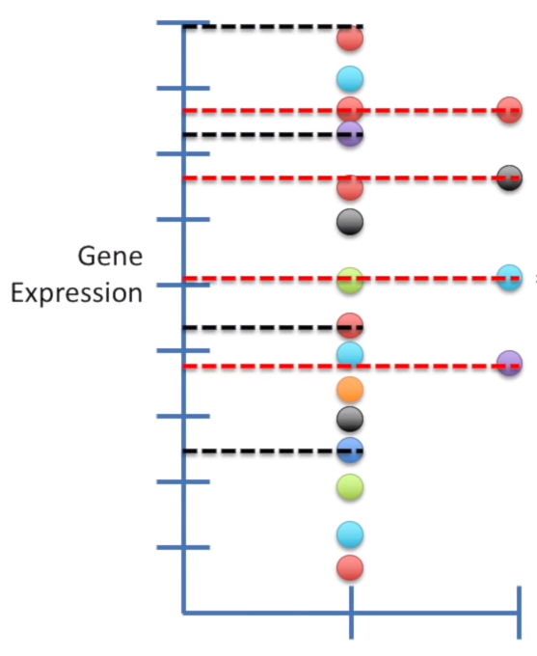
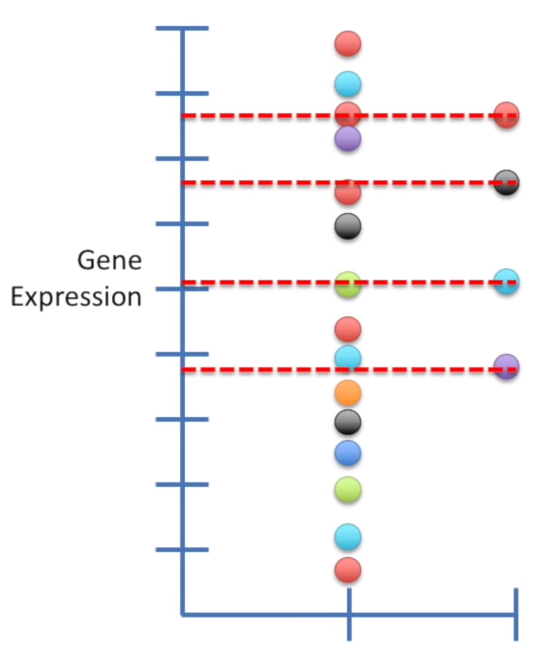
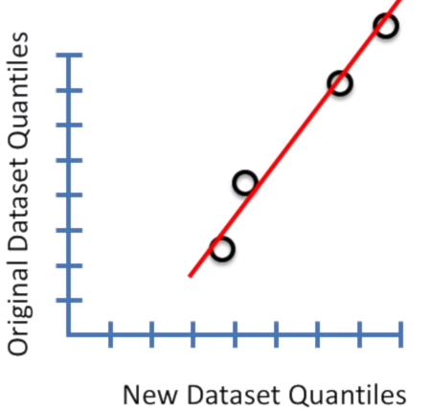
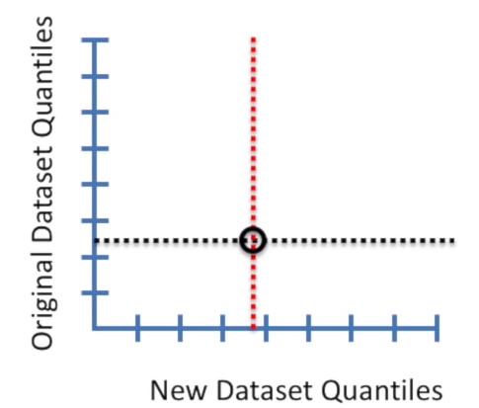
Q-Q Plot: Comparing two datasets

Slide 12
Data Transformation
Discretization/quantization
Normalization
  Centering , Scaling, …
Other transformation
  Logarithmic
  Used to change the shape of distribution

Slide 13




Discretization
Discretization, also called binning, converts numeric attributes into categorical ones.
Equal-Width Intervals: Partition the range of X into k equal-width intervals. The interval width is simply the range of X divided by k:
Thus, the i th interval boundary is given as
Equal-Frequency Intervals: We divide the range of X into intervals that contain (approximately) equal number of points. The intervals are computed from the empirical quantile or inverse cumulative distribution function
We require that each interval contain 1/k of the probability mass; therefore, the interval boundaries are given as follows:

Slide 14
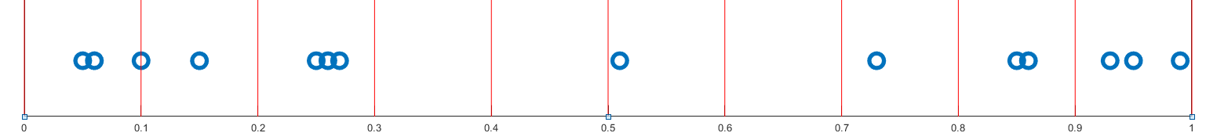
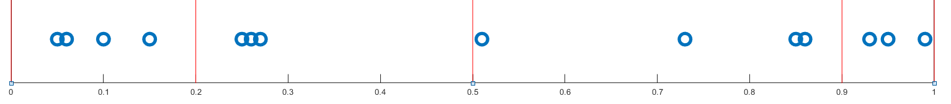
Equal-Width Intervals: Partition the range of X into k equal-width intervals. The interval width is simply the range of X divided by k:
Equal-Frequency Intervals: We divide the range of X into intervals that contain (approximately) equal number of points.

Slide 15
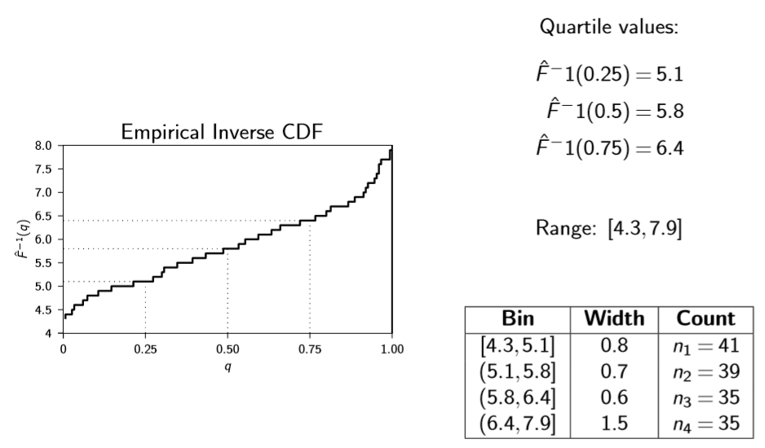
Equal-Frequency Discretization: sepal length (4 bins)

Slide 16
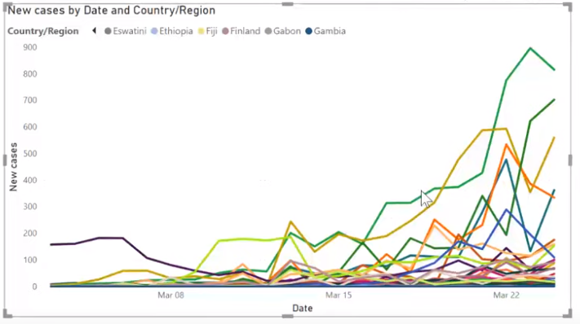
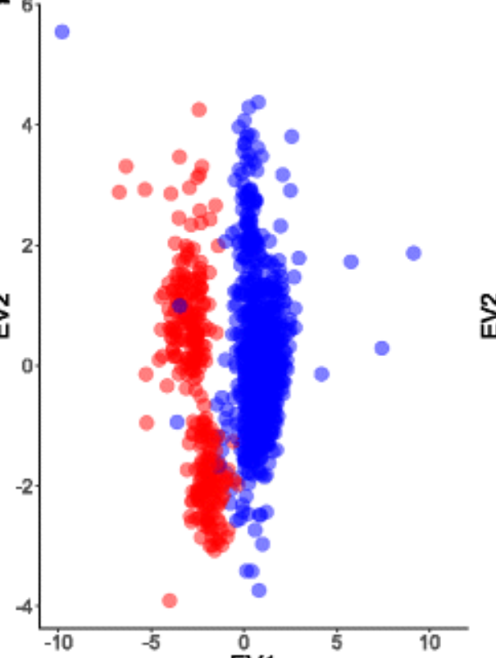
Why Data Normalization?
Every feature has a unit and magnitude
To account for technical differences between experiments
To have a fair comparison
Using machine learning algorithm specially if they are based on Euclidean distance

Slide 17


Data Normalization
If the attribute values are in vastly different scales, then it is necessary to normalize them.
Range Normalization: Let X be an attribute and let x₁, x₂,..., x_{n} be a random sample drawn from X . In range normalization each value is scaled by the sample range rˆ of X :
After transformation the new attribute takes on values in the range [0, 1].
Standard Score Normalization: Also called z -normalization; each value is replaced by its z -score:
where µˆ is the sample mean and σˆ² is the sample variance of X .
After transformation, the new attribute has mean µˆ′ = 0, and standard deviation σˆ′ = 1.

Slide 18
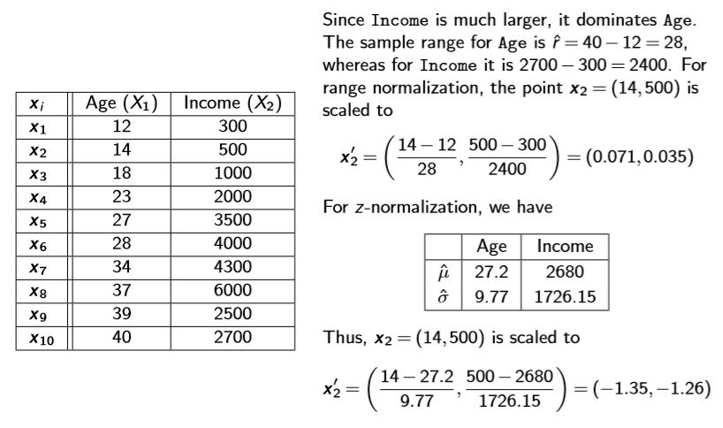
Example
6000
5700
0.035
5700

Slide 19
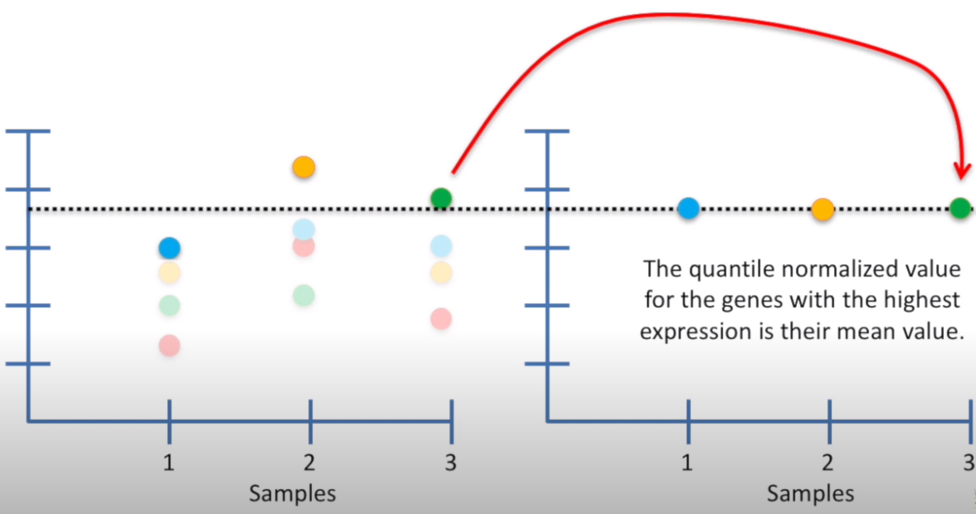
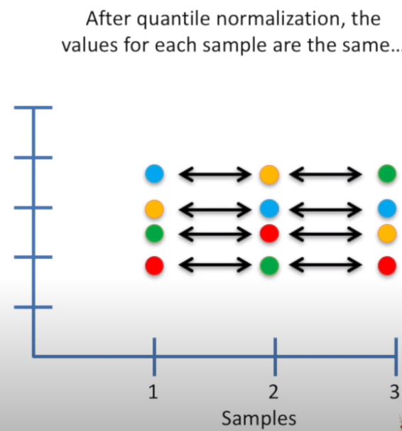
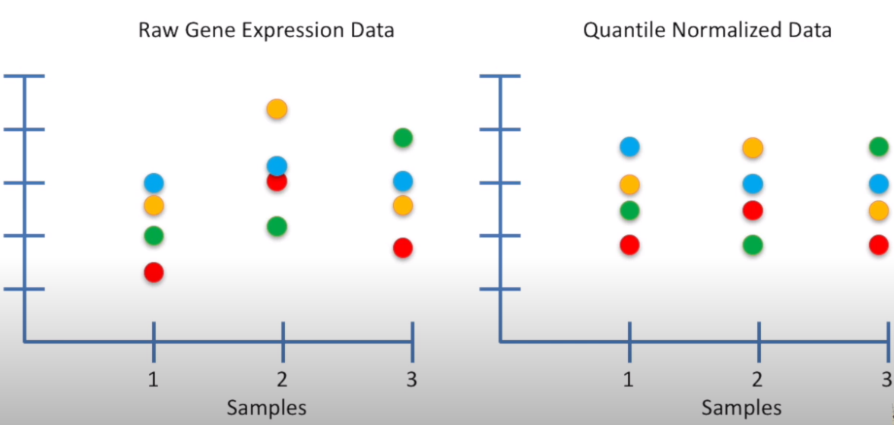
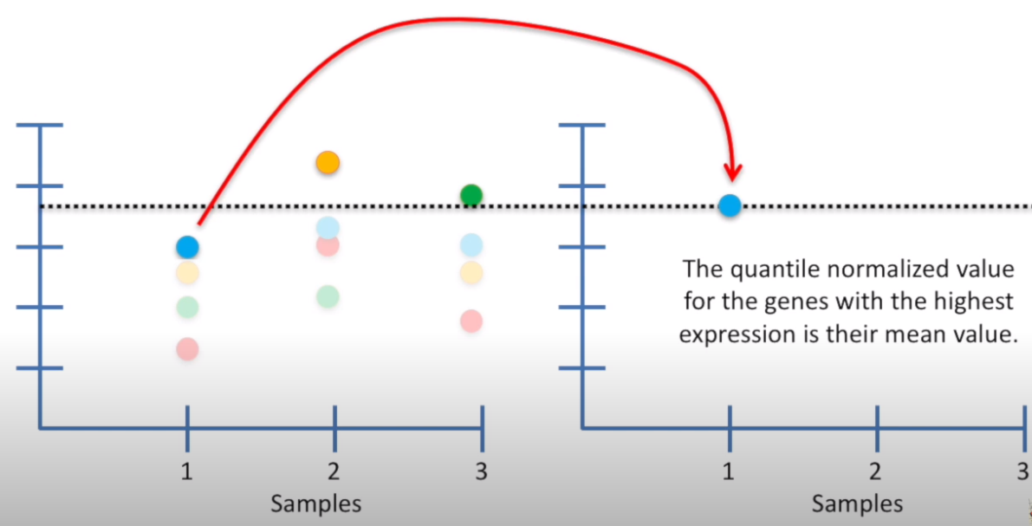
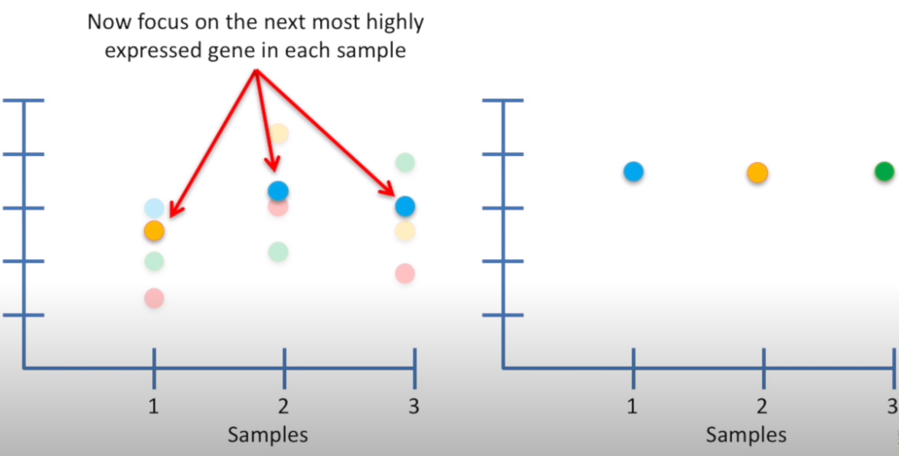
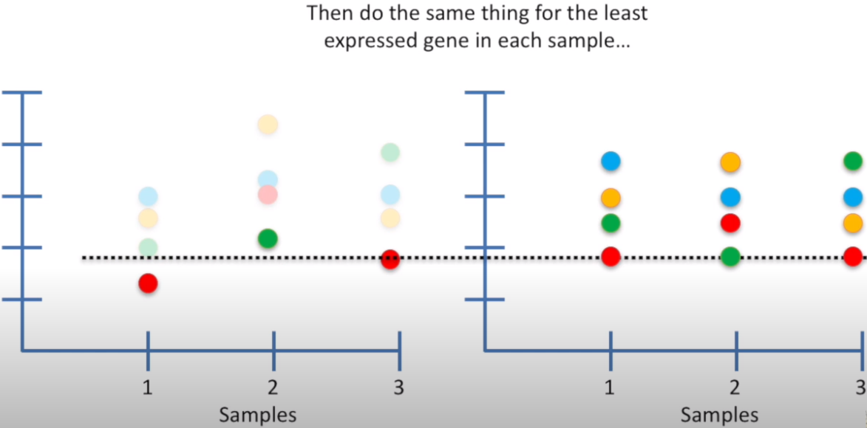
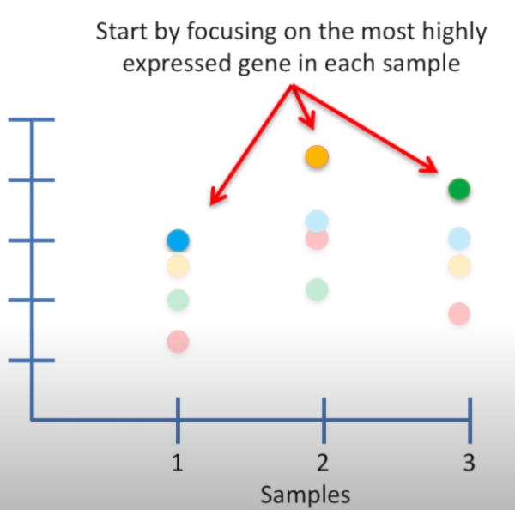
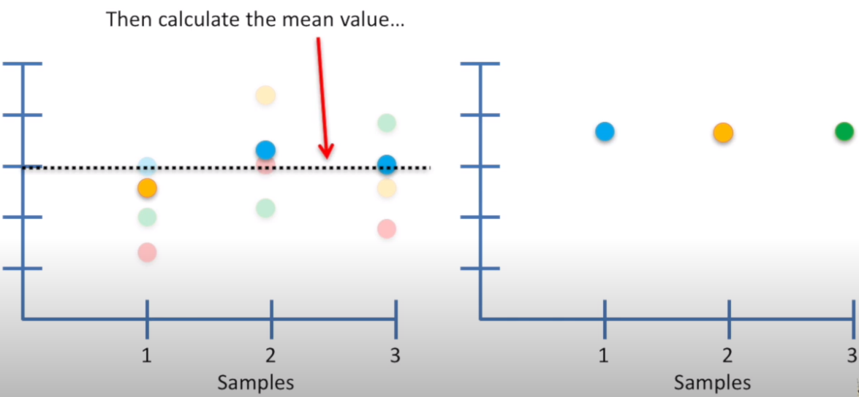
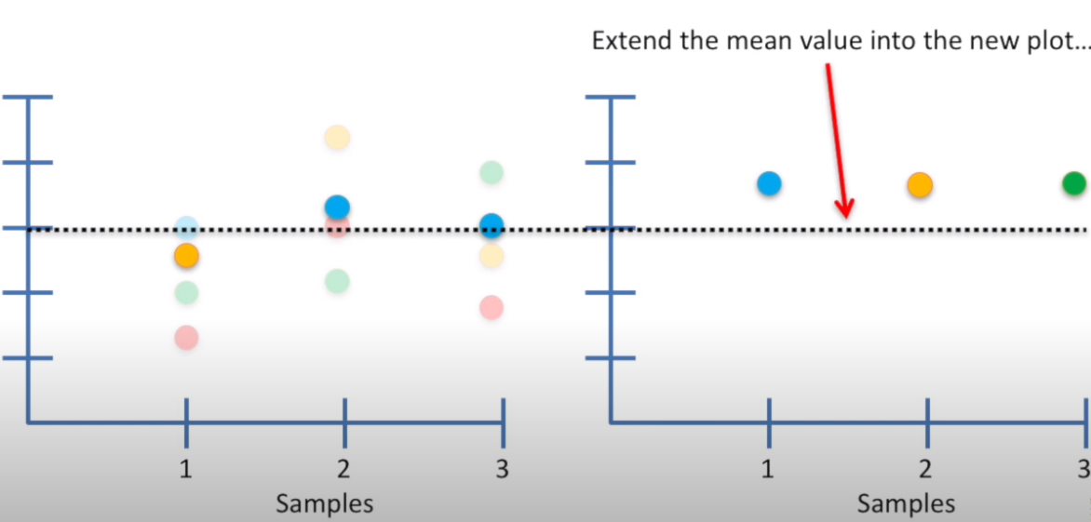
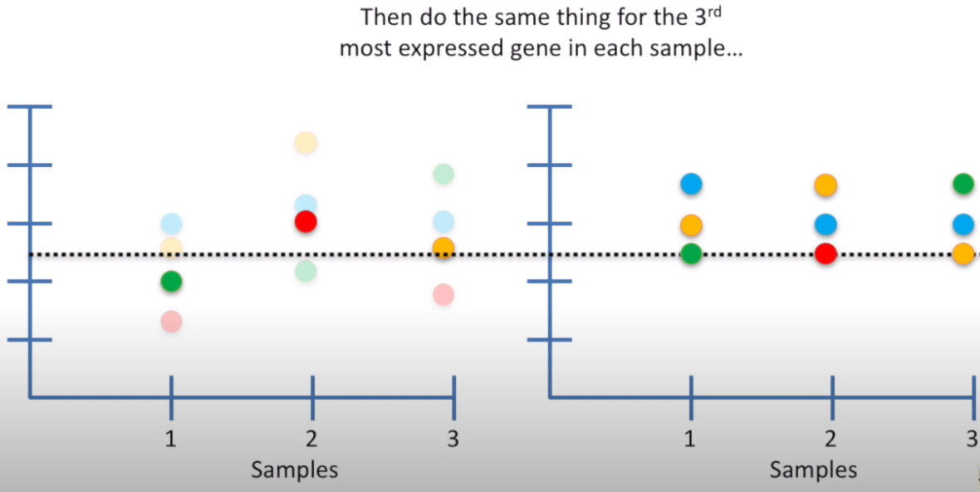
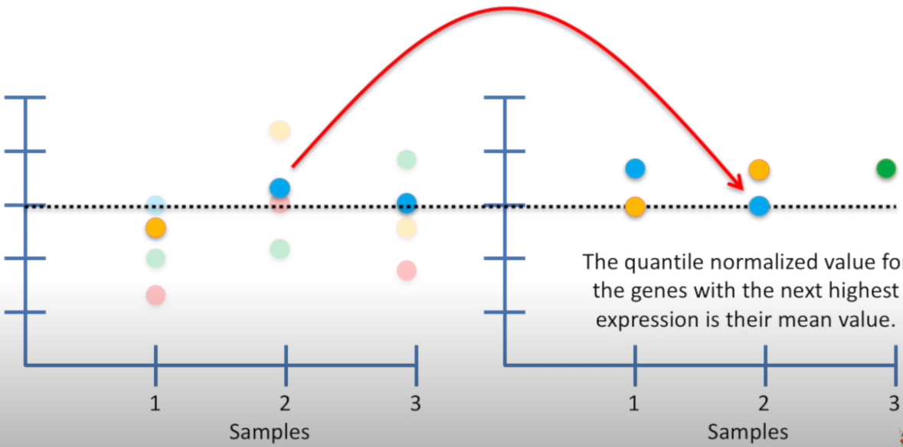
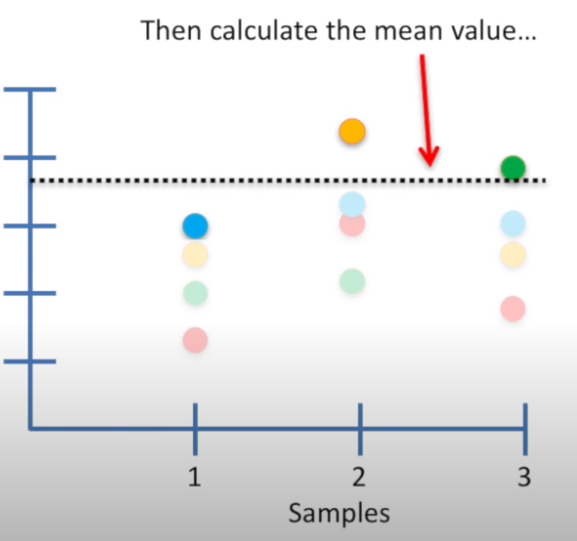
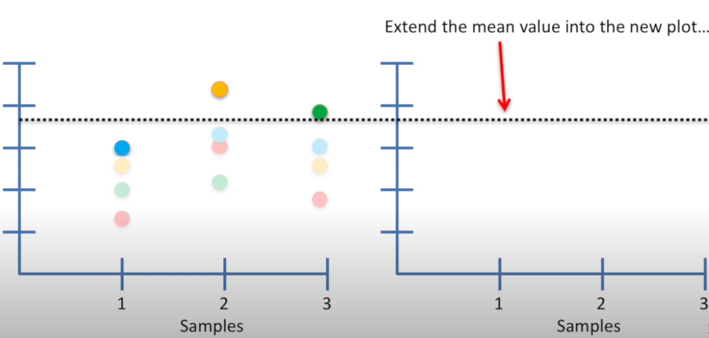
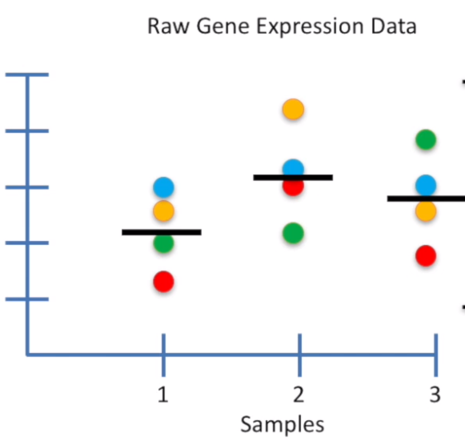
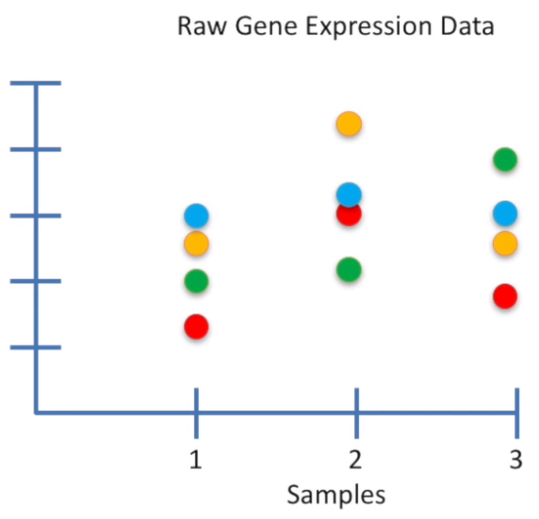


Quantile Normalization

Slide 20

Example

Slide 21

Robust Scaling
Robust scaling uses median and interquartile range (IQR) instead.
The interquartile range (IQR) contains the second and third quartiles, or the middle half of your data set.

Slide 22

Logarithmic Transformation
The log transformation can be used to make highly skewed distributions less skewed.
This can be valuable both for making patterns in the data more interpretable and for helping to meet the assumptions of inferential statistics.

Slide 23
Kahoot Quiz

Slide 24
Handling missing values

Slide 25
Handling Missing Values (NA,N/A, NaN, NAN, Empty)
Drop rows and/or columns with missing values: Remove those rows and/or columns from the dataset.
  Less training data samples and/or less features can lead to overfitting/underfitting
Impute (fill-in) the missing values:
  Average imputation on missing numerical values: Replace with the average value in the column -
  Common point imputation on missing categorical values: Replace with the most common value for that column -
  Placeholder: Assign a common value for missing data location
  Advanced imputation: Predict missing values from complete samples using ML techniques.

Slide 26


