Slide 1
INTRODUCTION TO DATA ANALYSIS
Topic 3: Assessing Pairwise Association
Sources:
Kan et al., Introduction to Data Mining, Chapter 2, 2018.

Slide 2
What is Association?
Algebraic perspective
  Distance or alignment between vectors
  Linearity and/or direction of relationship
Probabilistic perspective
  Statistical dependence (If…then…)

Slide 3
Similarity vs. Dissimilarity
Similarity measure
  Numerical measure of how alike two data objects are
  Is higher when objects are more alike
  Often falls in the range [0,1]
Dissimilarity measure
  Numerical measure of how different two data objects are
  Lower when objects are more alike
  Minimum dissimilarity is often 0
  Upper limit varies

Slide 4
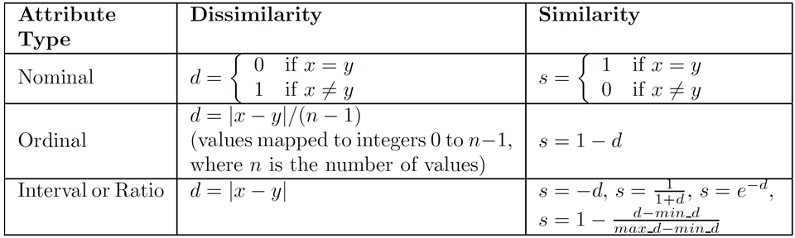
Similarity and Dissimilarity of Single Attributes

Slide 5
Assessing the Association between Vectors
Attributes/Features/Variables
Many data mining and machine learning algorithms work directly on pairwise distance/similarity measures
Data Matrix
Items/Samples/Observations
How are two variables associated?
  Association between pairs of columns
How similar are two items?
  Association between pairs of rows

Slide 6
Outline
Continuous variables
  Distance measures, co-variance, cosine similarity, correlation
Categorical/discrete variables
  contingency analysis, Chi-Square test, Hyper-geometric test, Jaccard index
Information theoretic measures
  Mutual Information => Discrete variables
  Discretization for computation of mutual information
  Maximal Information Coefficient

Slide 7
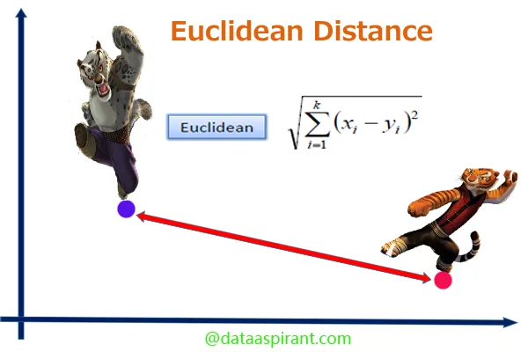
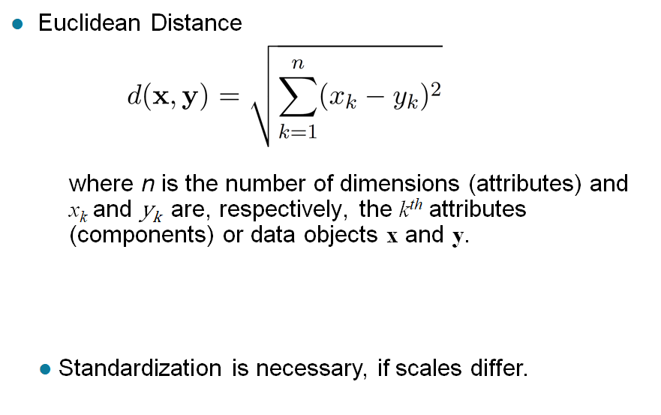
Euclidian Distance

Slide 8


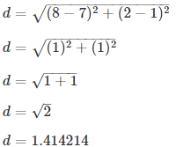
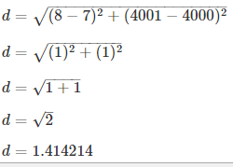
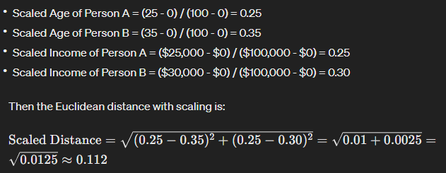
Scaling is important
Standardization is important
The feature with higher values may dominate the whole distance
Person A: Age = 25 years, Income = $25,000
Person B: Age = 35 years, Income = $30,000
the difference in Age contributes almost nothing to the overall distance due to the overwhelming scale of the Income feature.
In this scaled version, both Age and Income contribute more equally to the overall distance, giving a more balanced and meaningful measure of similarity between individuals.

Slide 9
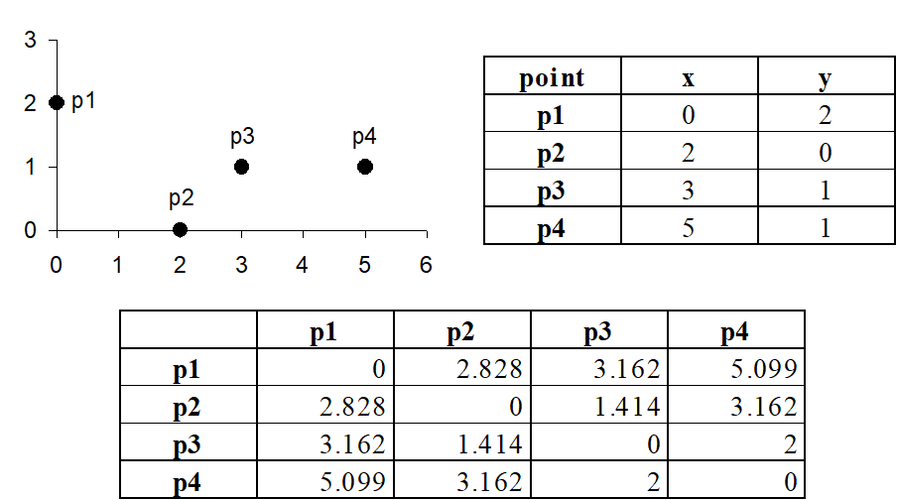
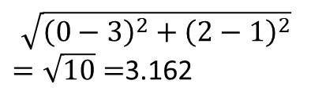
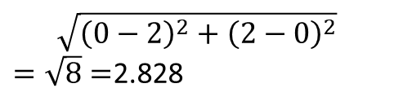
Distance Matrix
$$\sqrt{{\left(0−2\right)}^{2}+{\left(2−0\right)}^{2}}$$
$=\sqrt{8}=$2.828
$$\sqrt{{\left(0−3\right)}^{2}+{\left(2−1\right)}^{2}}$$
$=\sqrt{10}=$3.162

Slide 10
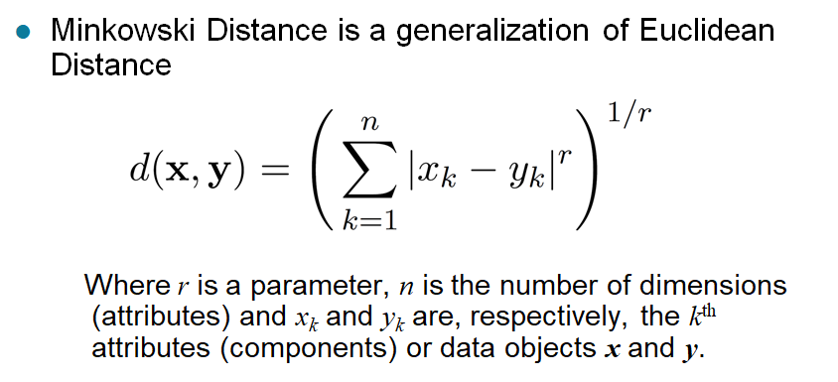
Minkowski Distance

Slide 11
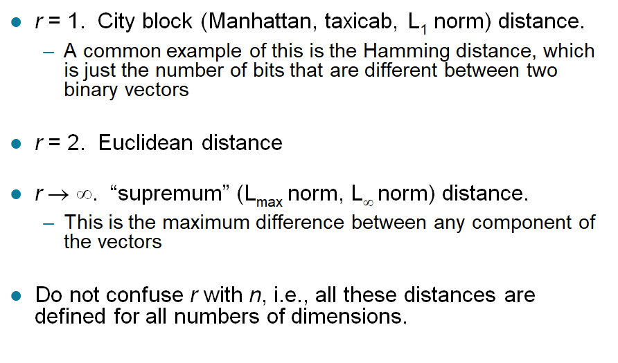
Minkowski Distance: Examples

Slide 12
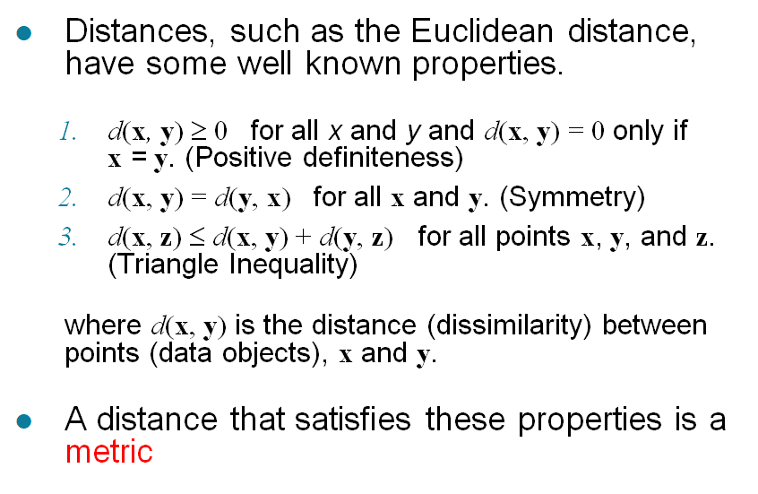
Metrics

Slide 13
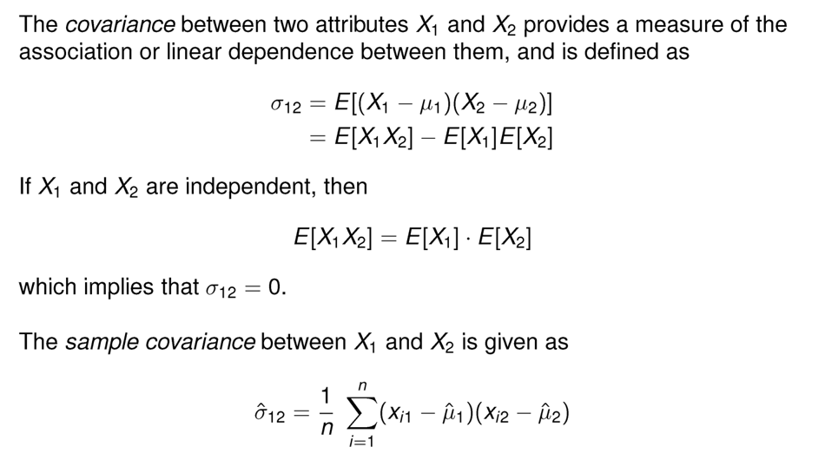
Covariance
-1

Slide 14
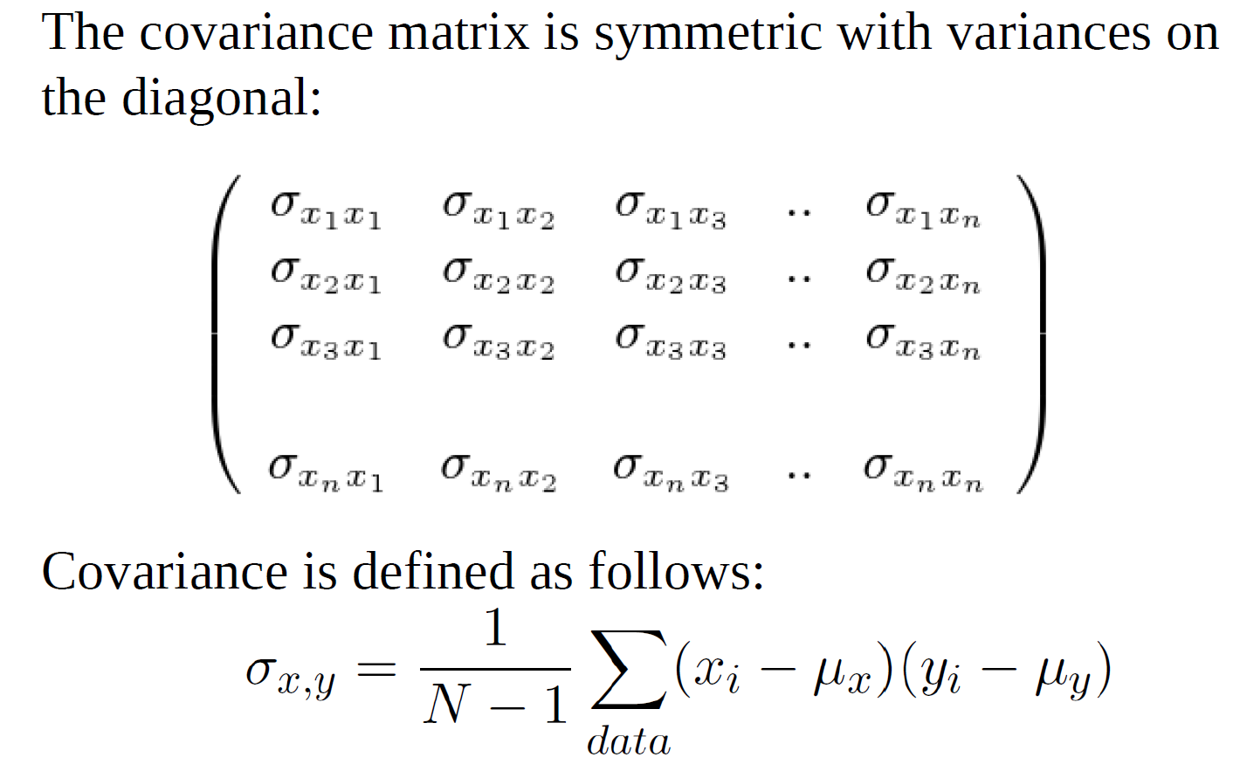
Covariance Matrix

Slide 15
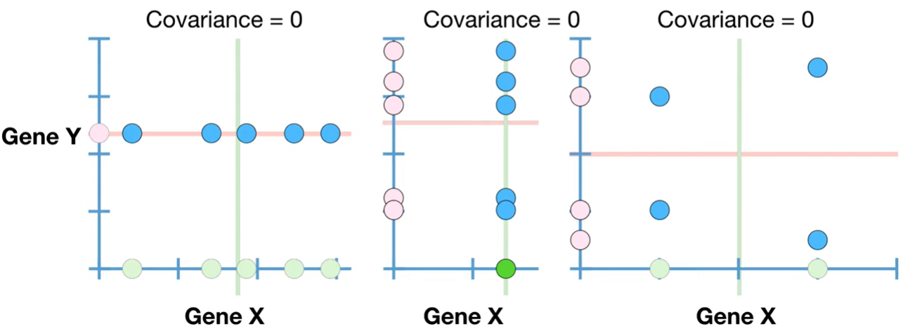
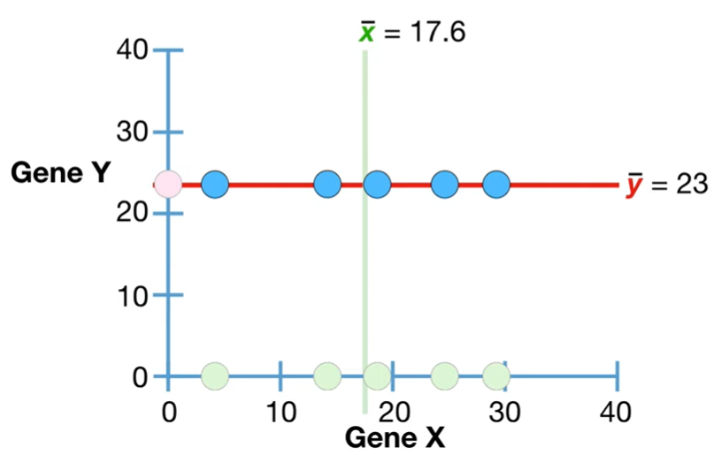
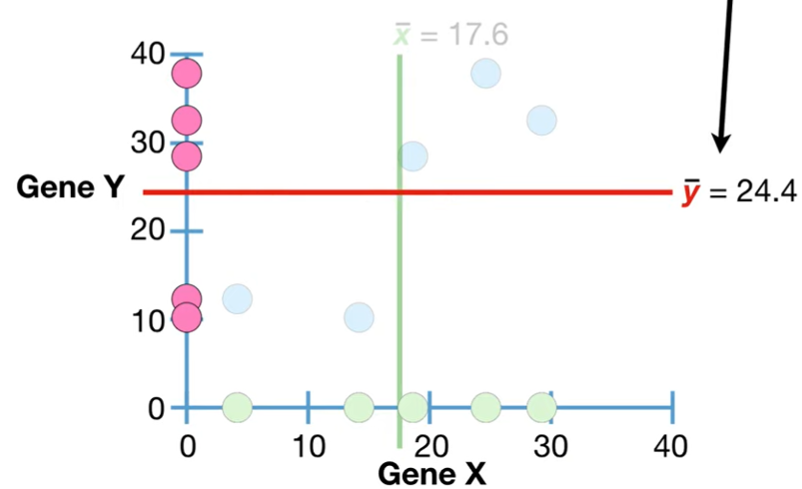
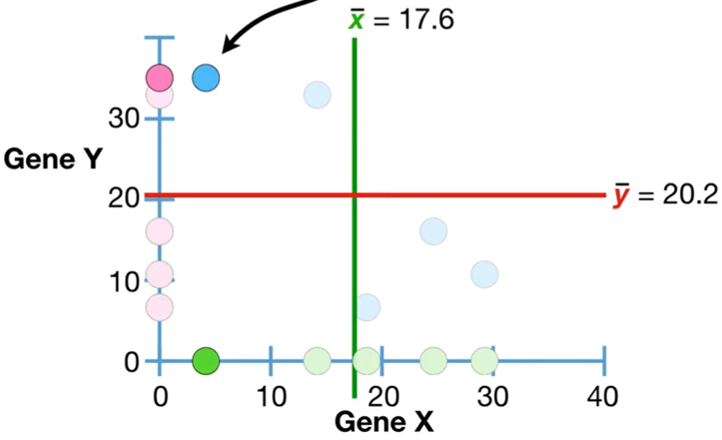
Covariance Values
Positive co-variance means relationship has a positive slope
Negative co-variance means the relationship has a negative slope
Co-variance is zero when there is no relationship between X and Y

Slide 16
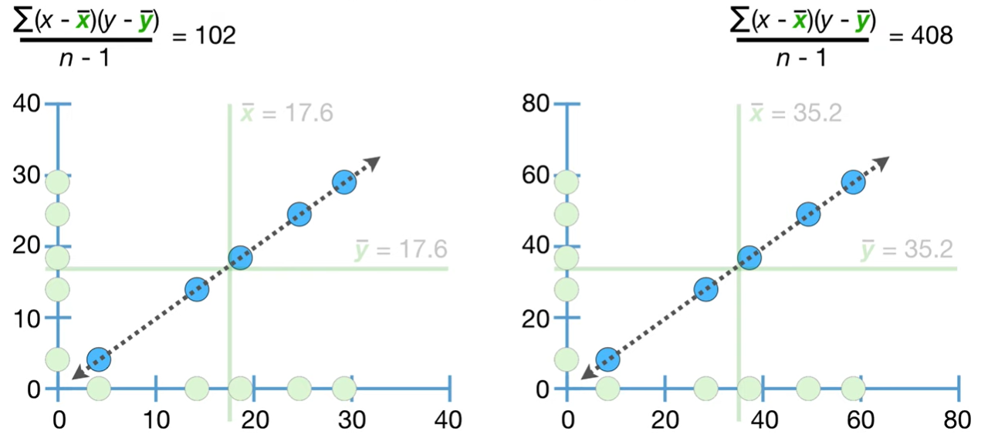
DRAWBACK: Covariance is senstitive to scale
Here, we just double the data
The relationship has not changed but the co-variance value is has changed

Slide 17
Interpretation of Covariance
It is hard to interpret the co-variance value
It doesn’t not tell us if the points are relatively close to the trend line or not
It does not tell us if the slope of the relationship line is steep or not
It just tells us the slope of the relationship is positive, or negative

Slide 18
Consider a dataset with two variables:
the number of hours studied (X) and the score on a test (Y).
If we calculate the covariance of X and Y and find it to be a positive number, this indicates that, generally, students who studied more hours tended to score higher on the test.
If the covariance were negative, it would indicate that students who studied more hours tended to score lower
We cannot say how strong this relationship is

Slide 19
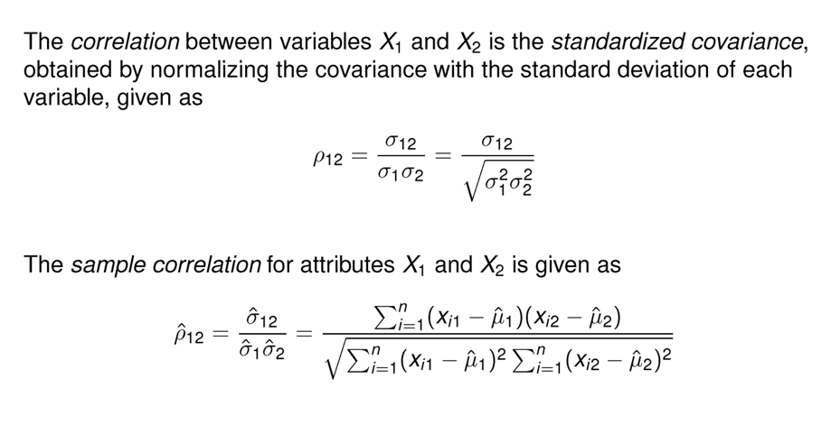
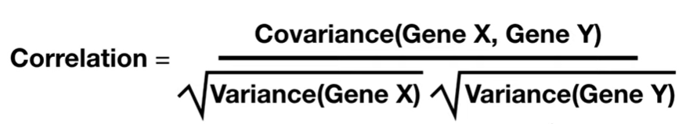
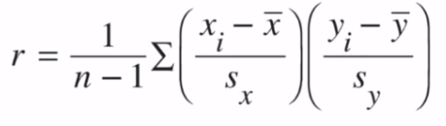
Pearson Correlation
How well a linear model can describe a relationship between two variables. Correlation quantifies the strength of relationships.
How many sample standard deviation it is far from its mean

Slide 20
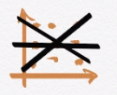
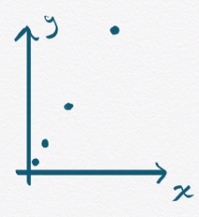
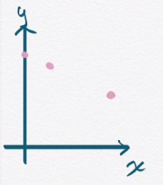
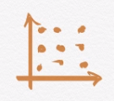
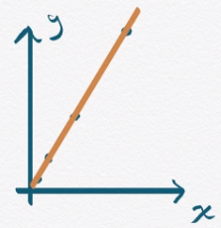
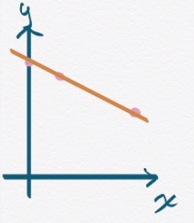
Example
Correlation = 1
Correlation = -1
Correlation = 0

Slide 21
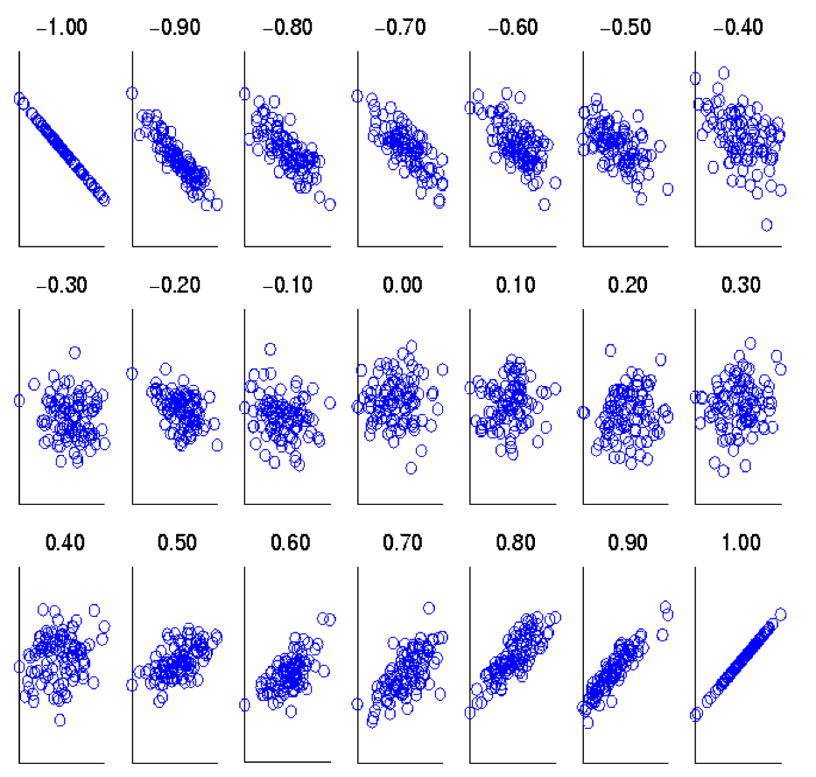
Interpretation of Correlation
Correlation coefficient assesses the linearity of the relationship between two variables
Correlation coefficient is the measure we use to quantify correlation

Slide 22

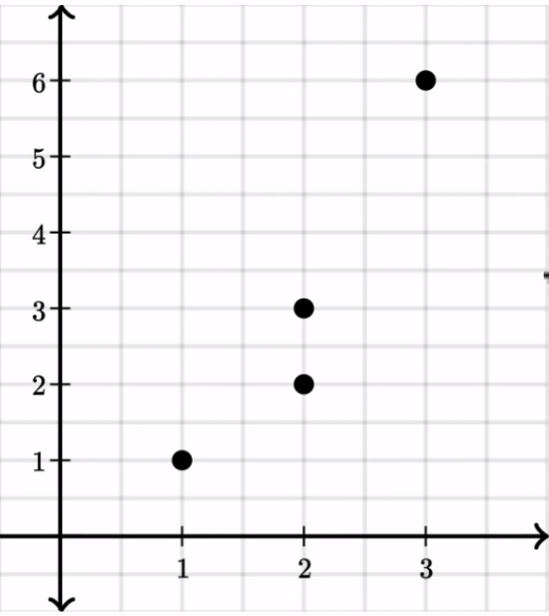

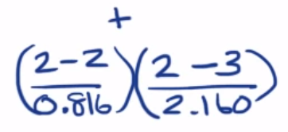
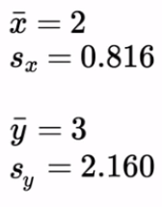

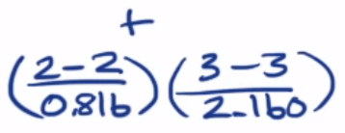

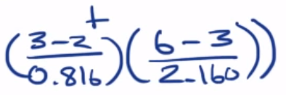
Example
3
= 0.94

Slide 23
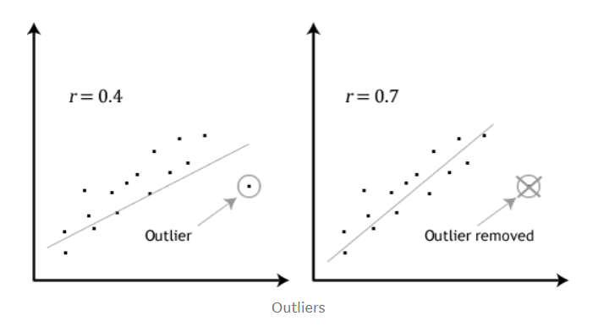
Pearson Correlation Is Sensitive to Outliers

Slide 24
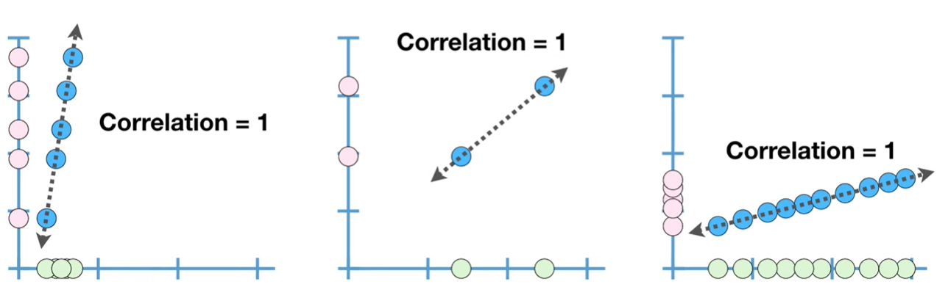
Correlation does not depend on the slope and size of data

Slide 25

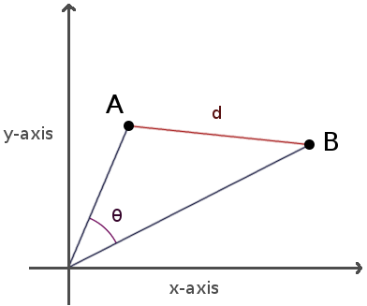
Cosine Similarity
Assess the alignment of the directions of two vectors in multi-dimensional space
  cos( d₁, d₂ ) = <d₁,d₂> / ||d₁|| ||d₂||
    <d₁,d₂> indicates inner product
    || d || is the length of vector d
Cosine similarity is related to Euclidian distance, but it is normalized by nature

Slide 26
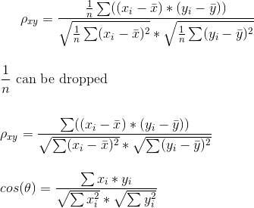
Correlation vs. Cosine Similarity
Correlation coefficient and cosine similarity are identical when the vectors are centered (i.e., their means are 0)

Slide 27
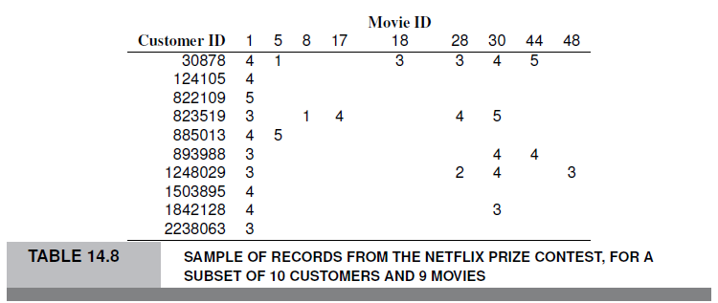
Example – Tiny Netflix subset
Consider users 30878 and 823519

Slide 28


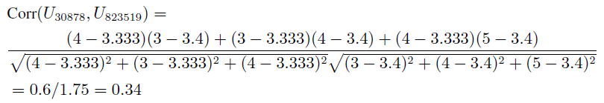
Correlation between users 30878 and 823519
First find average ratings for each user:
Find correlation using departure from avg. ratings for the co-rated movies (movies 1, 28 and 30):

Slide 29
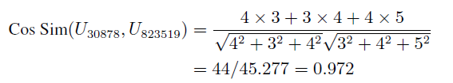
Find cosine similarity for same users
Use raw ratings instead of departures from averages:
Ranges from 0 (no similarity) to 1 (perfect match) since the numbers are ranking/frequencies, it can not be negative.
But cosine similarity could be -1

Slide 30
In text analysis, cosine similarity is preferred, why?
Correlation vs. Cosine Similarity
Data Sparsity: In text data, vectors are usually sparse, meaning that they contain a lot of zeros because most words do not occur in most documents. Cosine similarity is particularly effective for comparing such sparse vectors because it focuses on the angle between vectors, not their magnitude. This makes it well-suited to measuring similarity in high-dimensional, sparse data spaces typical in text analysis.
Normalization: Cosine similarity inherently normalizes for the length of the vectors (documents). This means that it measures the similarity in terms of the orientation of the vectors and not their magnitude, which is beneficial when comparing documents of different lengths.
Non-centrality: Pearson correlation coefficients are centered around the mean, considering the deviation from the average behavior of the dataset. This is ideal for measuring linear relationships where the average is meaningful. However, in text analysis, the absence of a term (which contributes to the zero entries in sparse vectors) does not always carry the same kind of statistical significance as numerical data points around a central mean. Cosine similarity bypasses this by treating the zero entries as absence of terms, focusing instead on the direction where terms exist.

Slide 31
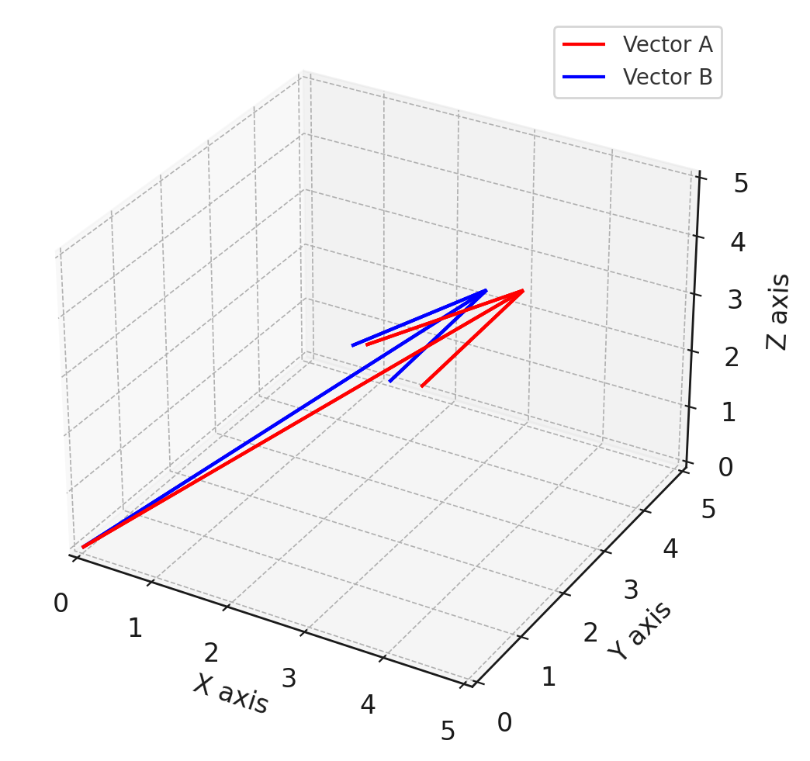
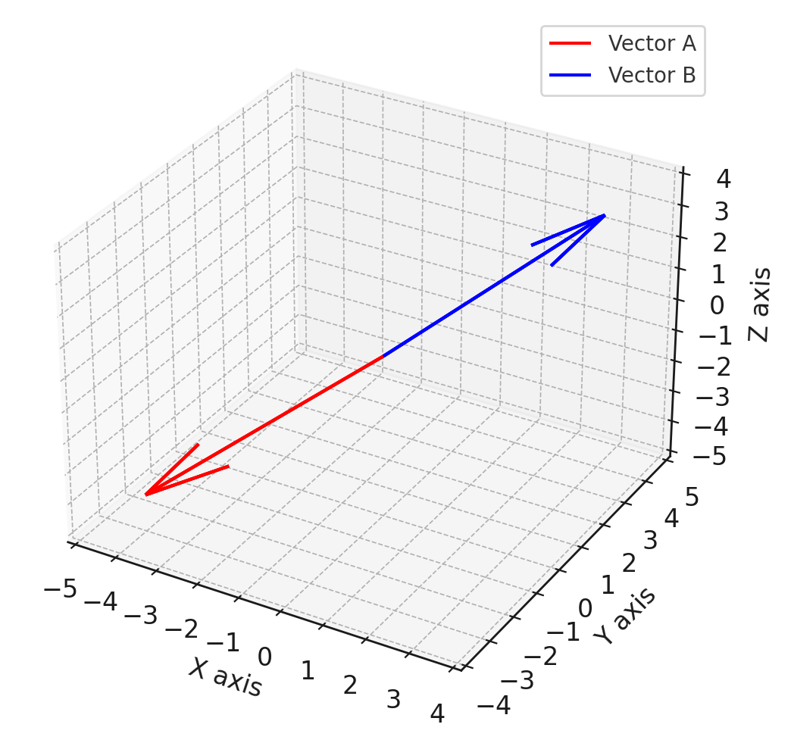
Some Examples
A = [4 , 3 , 4];
B = [3, 4 , 5];
Cosin(A,B) = 0.97
Corr(A,B) = 0
A = [4 , 3 , 4];
B = [3, 4 , 3];
Cosin(A,B) = 0.96
Corr(A,B) = -1
A = [4 , 3 , 40];
B = [3, 4 , 30];
Cosin(A,B) = 0.99
Corr(A,B) = 0.99
A = [-4 , -3 , -4];
B = [3, 4 , 3];
Cosin(A,B) = -0.96
Corr(A,B) = -1

Slide 32
Extensions of Correlation Coefficient
Pearson’s correlation coefficient is vulnerable to outliers
  If two variables have very high values in just one sample, it might dominate to show that the two variables are highly correlated
  Jackknife correlation: Estimate n correlations by taking each dimension (sample) out, take the minimum among them
Pearson’s correlation coefficient is not robust for non-Gaussian distributions
  Spearman’s rank order correlation coefficient: Rank values of each variable, replace each value with its rank
  More robust against outliers
  A lot of loss of information

Slide 33
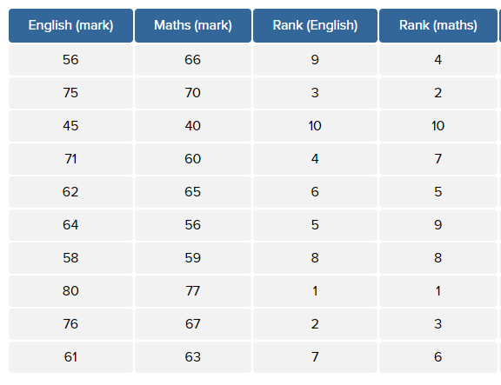
Extensions of Correlation Coefficient
Pearson’s correlation coefficient is not robust for non-Gaussian distributions
  Spearman’s rank order correlation coefficient: Rank values of each variable, replace each value with its rank
  More robust against outliers
  A lot of loss of information

Slide 34
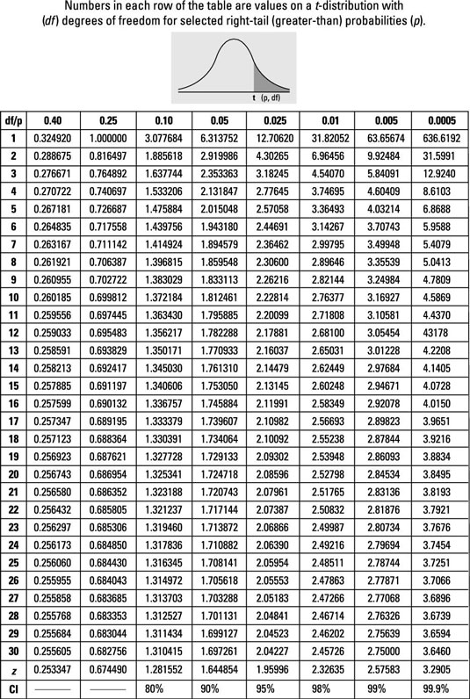

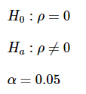
Assessing Statistical Significance of Correlation
Degree of freedom: n-2
Example : r = 0.6631 , n = 11 data points
t = 2.6576
P-value ~= 0.026

Slide 35
Assessing Statistical Significance of Correlation
Degree of freedom: n-2
Example : r = 0.6631 , n = 11 data points
t = 2.6576
t > 1.83 -> p-value < 0.05

Slide 36
Kahoot time

