Slide 1
Entropy and
Mutual Information

Slide 2
Discrete Variables
Can be nominal and ordinal, can take multiple values
  Binary/Bernoulli random variables are a special case since:
    Multi-dimensional binary vectors are equivalent to sets
    Any discrete random variable can be represented by binary random variables
Gender Smoker Cancer
s1 = {v1, v3}
s2 = {v1}
s3 = {v2, v3}
s4 = {v3}
S5 = {v1, v2, v3}
 | v1 | v2 | v3
s1 | 1 | 0 | 1
s2 | 1 | 0 | 0
s3 | 0 | 1 | 1
s4 | 0 | 0 | 1
s5 | 1 | 1 | 1
Observations across a set of binary variables can be represented as sets!

Slide 3
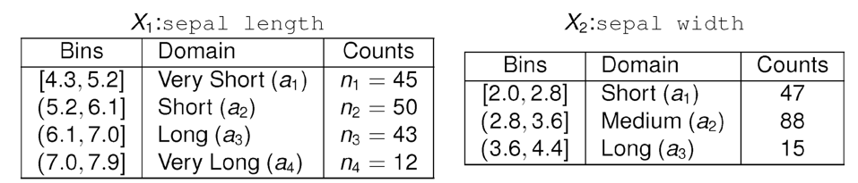
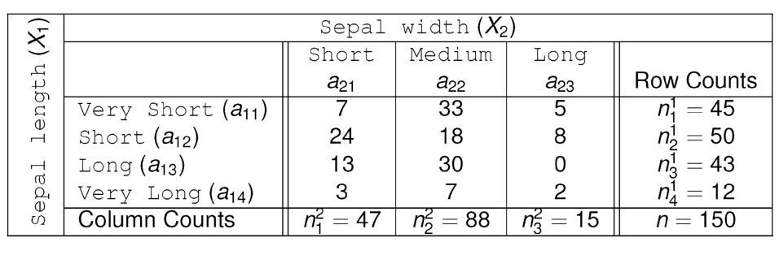
Example

Slide 4
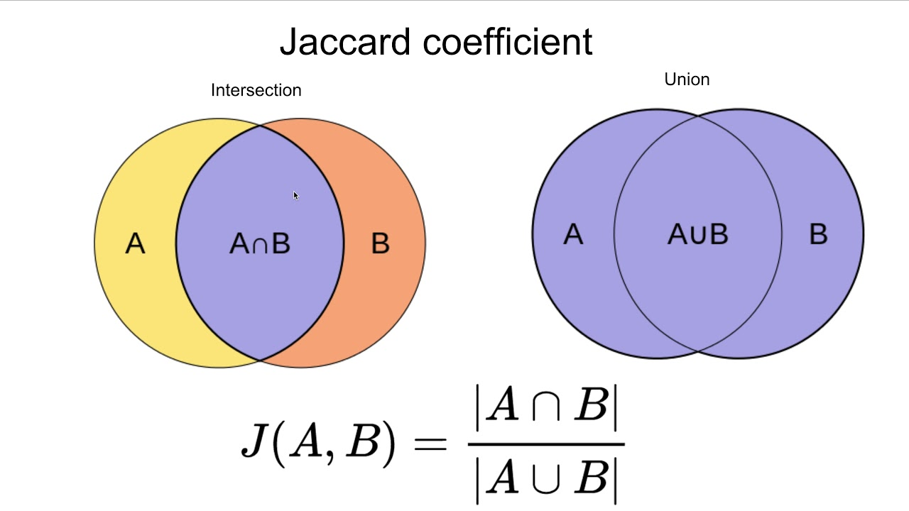
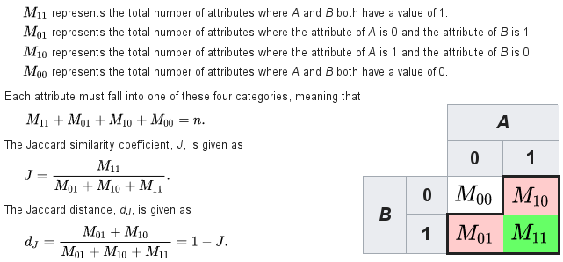
Jaccard Index (a.k.a. Jaccard Coefficient)
Contingency table representation
Set representation

Slide 5
Information Theoretic Measures of Assocation
Information theory was developed in the context of communicating information
  It turned out to be really useful in probabilistic modeling of associations as well
  Mutual information
  Maximal Information Coefficient (MIC)
Information-theoretic measures can naturally handle non-linear relationships
  Thus do not have a notion of “direction of the relationship”
Can be complicated and time intensive to compute

Slide 6
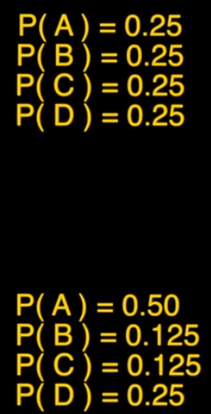
Entropy
Imagine two machines that produce alphabets ABCD
Which machine produce more information?
Shannon rephrase: If you had to predict the next symbol , what is the minimum number of Yes/No questions you would expect to ask?
The most efficient way is to divide the possibilities in half
Machine 1
Machine 2
Is it _____?
Y N

Slide 7
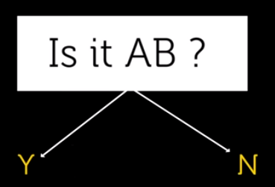


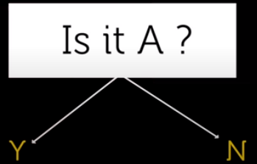
Entropy
Machine 1
Machine 2
The uncertainty of machine 1 is 2 questions per symbol
C

Slide 8
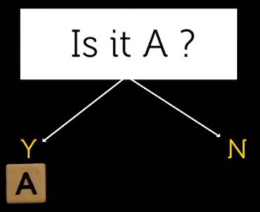


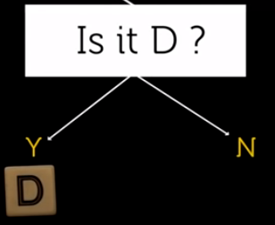


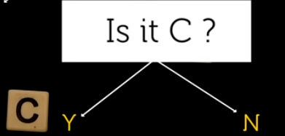
Entropy
Machine 1
Machine 2
# of questions =
$$0.5∗1+0.125∗3+0.125∗3+0.25∗2=1.75$$

Slide 9
Entropy
If you want to guess 100 symbols
Machine 1
Machine 2
2 questions on average
1.75 questions on average
200 questions on average
175 questions on average
In Machine 2 less information is needed
Less surprise
Less uncertainty about its output

Slide 10
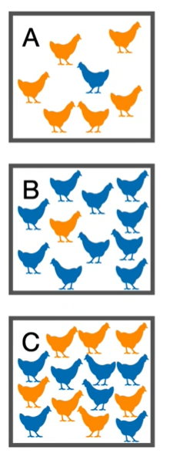
Surprise and Probability
When the probability of picking a blue chicken is low, the surprise is high
When the probability of picking a blue chicken is high, the surprise is low
There is an inverse relationship between probability and surprise

Slide 11
Information of an Event
The intuition behind quantifying information is the idea of measuring how much surprise there is in an event.
Those events that are rare (low probability) are more surprising and therefore have more information than those events that are common (high probability).
Low Probability Event: High Information (surprising).
High Probability Event: Low Information (unsurprising).

Slide 12
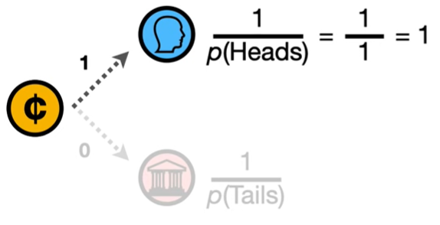
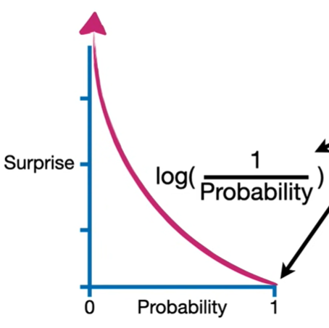
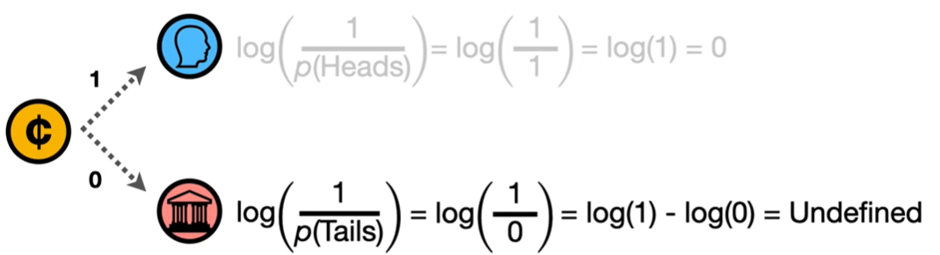
Measuring Surprise
Since there is a reverse relationship between probability and surprise, can we use surprise = 1 / probability?
Suppose you have an unfair coin which always turn to be head after flip
But we wanted the surprise to be 0

Slide 13
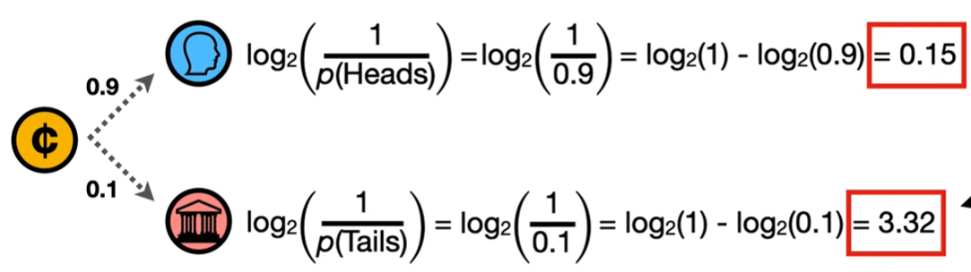
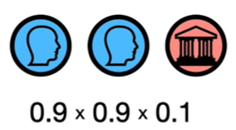
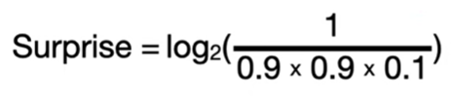

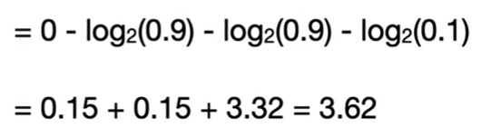
Measuring Surprise

Slide 14
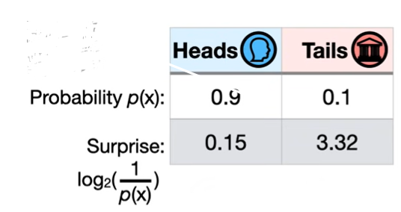
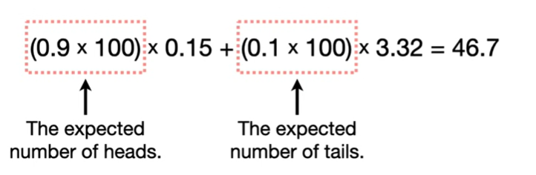
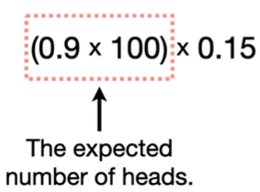
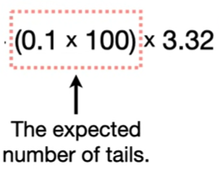
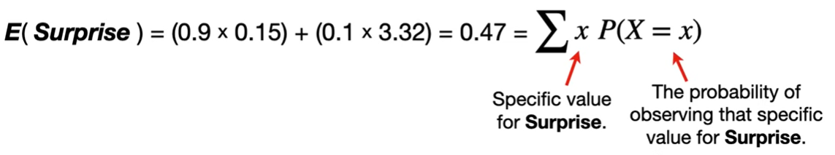
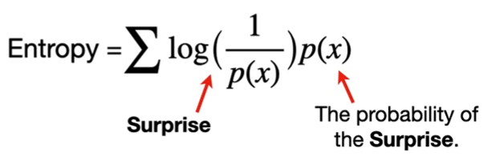
Measuring Surprise
We want to estimate the total surprise after flipping the coin 100 times
If we divide the amount of surprise in 100 flip to 100, we get the average amount of surprise every time we flip the coin
46.7 / 100 = 0.467
How much surprise from getting head in 100 flip
How much surprise from getting tail in 100 flip
This is the Entropy of the coin =
The expected surprise every time we flip the coin = 0.47

Slide 15
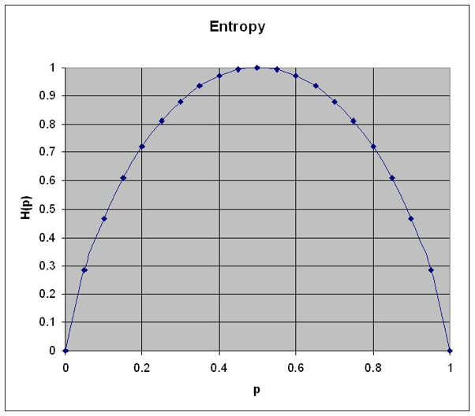
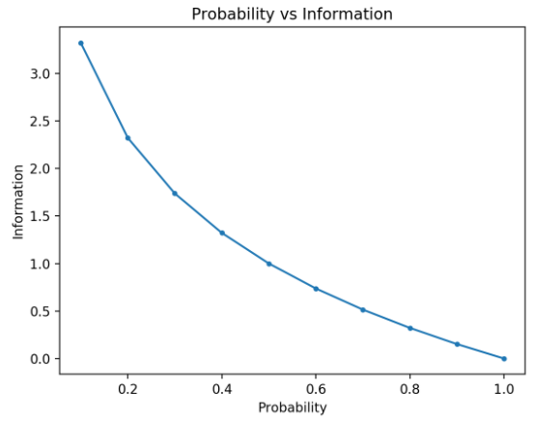
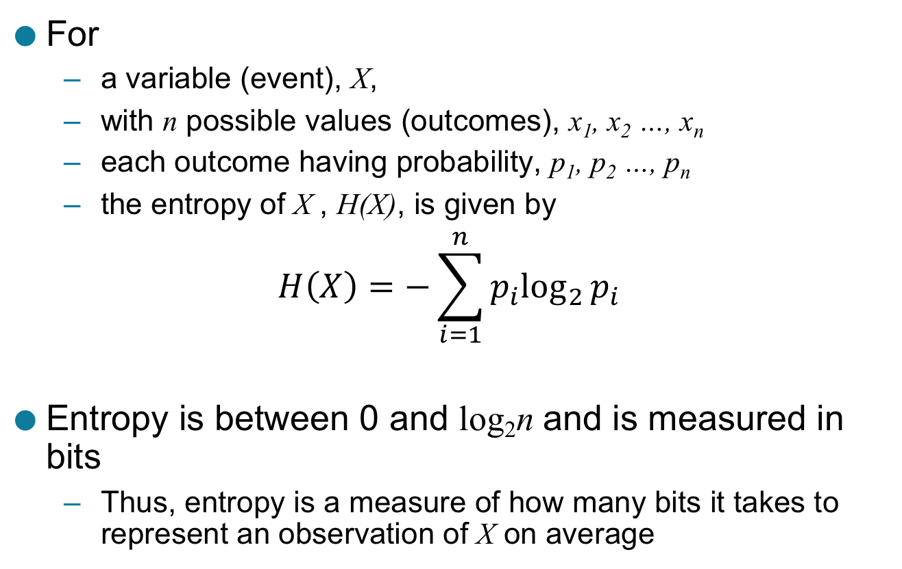
Shannon Entropy
Information
The entropy of a Bernoulli random variable as a function of p
Less uncertainty
We can predict outcome better

Slide 16
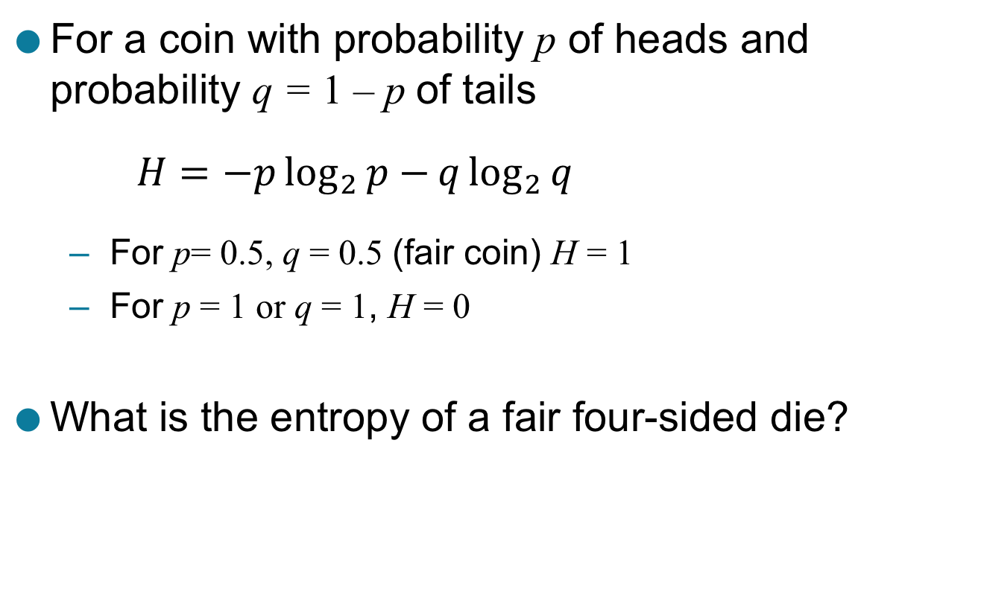
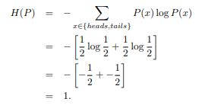
Entropy: Examples

Slide 17
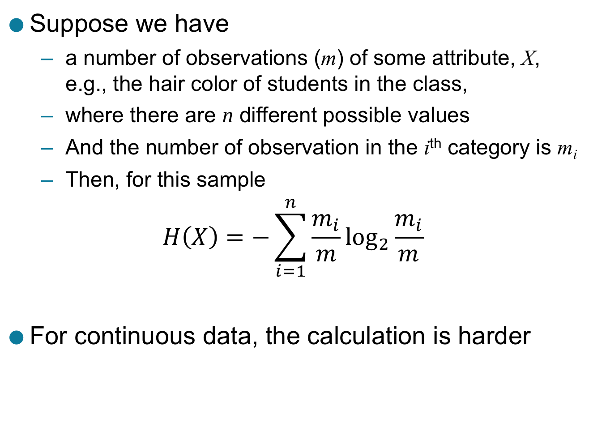
Computing Entropy From A Sample

Slide 18
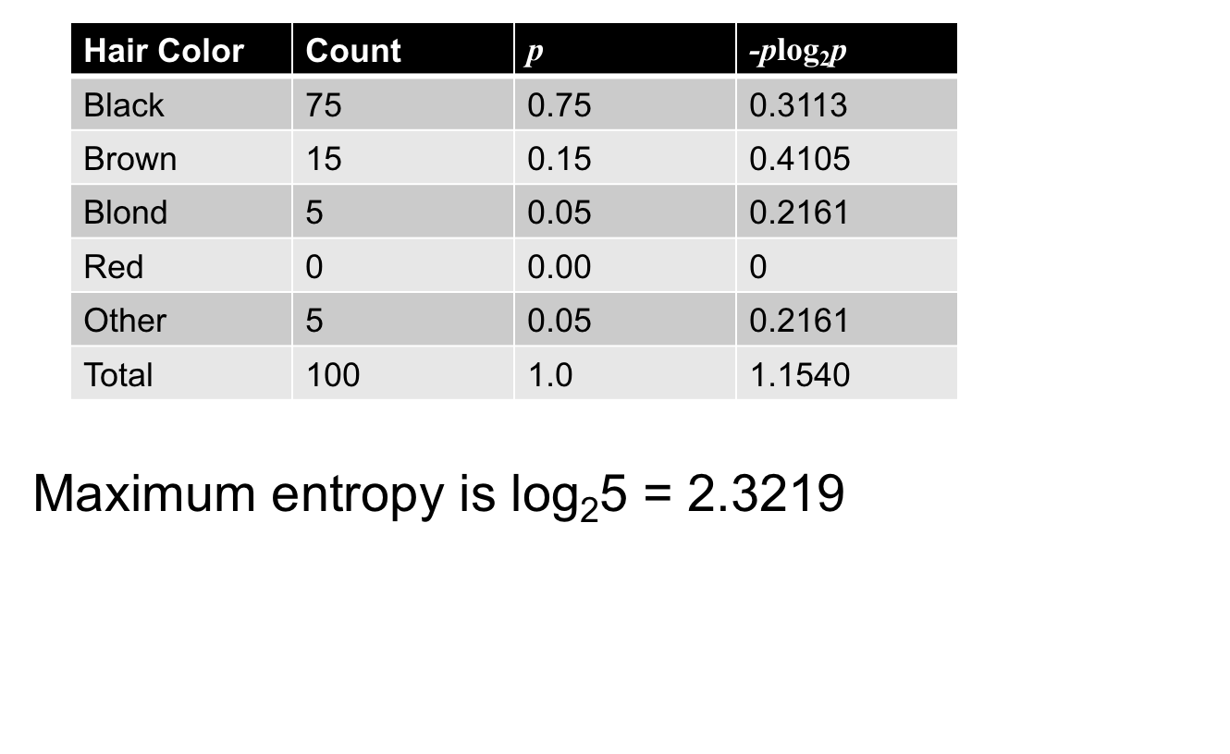
Distribution of Hair Colors

Slide 19
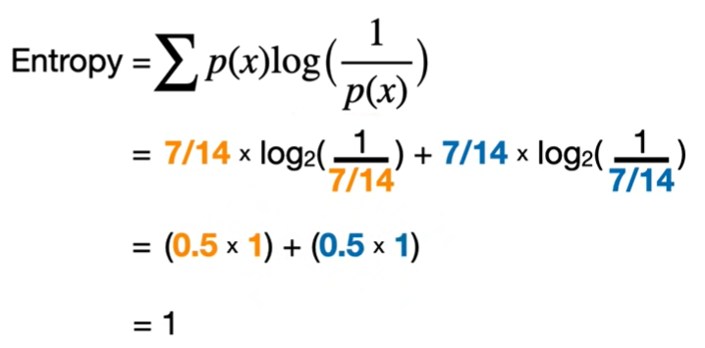
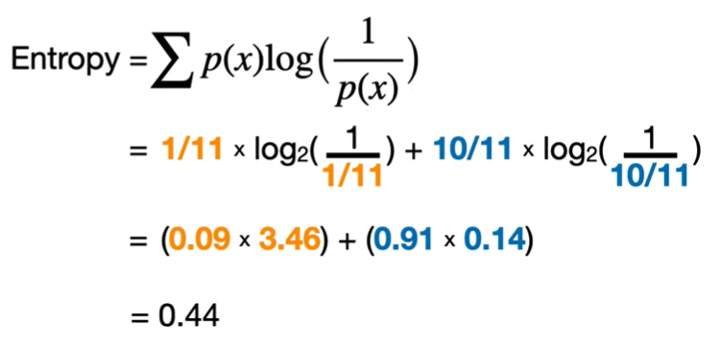
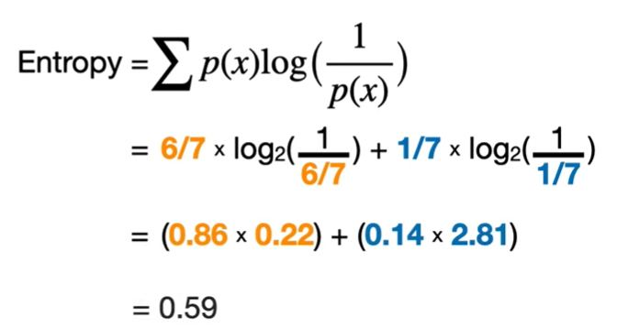
Calculating Entropy
Entropy
0.59
0.44
1
Every time we pick up the chicken, we get moderate surprise
-> We can use entropy to quantify the similarity or difference in number of orange and blue chickens in each area
As we increase the difference in the numbers, we lower the entropy
Surprise associated with picking up a orange chicken is high
But the probability of picking up a orange chicken is low
So the total entropy is closer to the surprise of picking blue chicken
Surprise associated with picking up a orange chicken is low
But the probability of picking up a orange chicken is high
So the total entropy is closer to the surprise of orange chicken

Slide 20

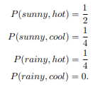


Joint Entropy
It measures the amount of information needed to describe both variables simultaneously. (collective uncertainty)
Let X represent whether it is sunny or rainy in a particular town on a given day. Let Y represent whether it is above 70 degrees or below seventy degrees. Compute the entropy of the joint distribution P(X, Y ) given by

Slide 21
Comparison of Joint Entropy with Individual Entropy
If the joint entropy is significantly lower than the sum of the individual entropies (H(X) + H(Y))
Does it show dependency between variables?
knowing one variable reduces the uncertainty about the other beyond what can be explained by their individual behaviors.
it suggests that there is some degree of association or dependency between X and Y

Slide 22
Mutual Information
Mutual information is a quantity that measures a relationship between two random variables that are sampled simultaneously.
In particular, it measures how much information is communicated, on average, in one random variable about another.
Intuitively, one might ask, how much does one random variable tell me about another?
For example, suppose X represents the roll of a fair 6-sided die, and Y represents whether the roll is even (0 if even, 1 if odd). Clearly, the value of Y tells us something about the value of X and vice versa.
If X represents the roll of one fair die, and Z represents the roll of another fair die, then X and Z share no mutual information. The roll of one die does not contain any information about the outcome of the other die.

Slide 23
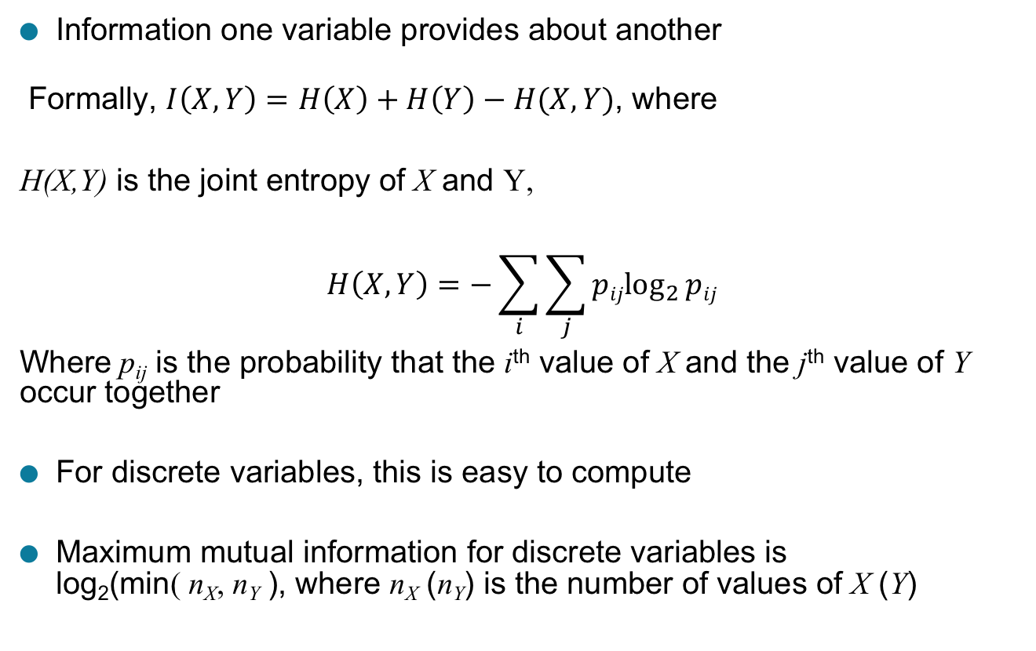

Mutual Information

Slide 24
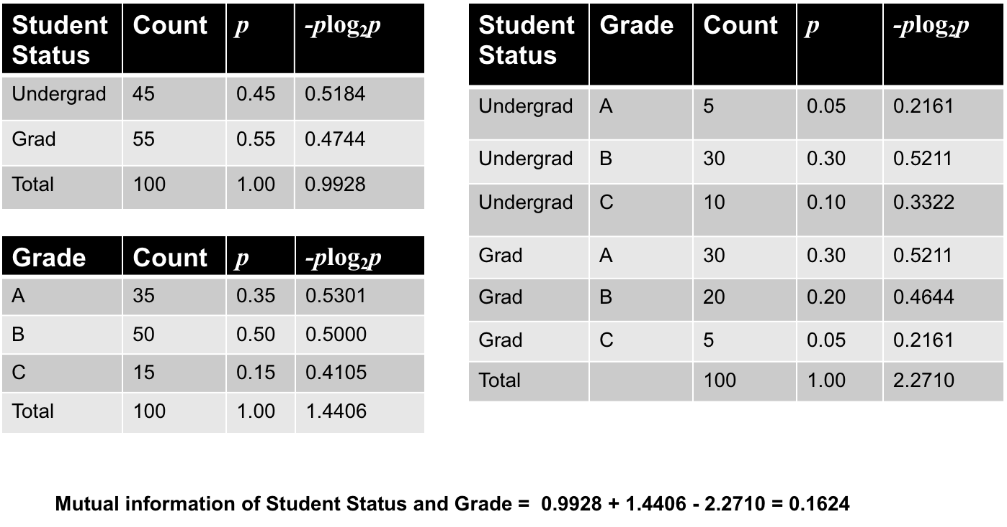
Mutual Information: Example

Slide 25
How to interpret MI value?
Calculate Normalized Mutual Information (NMI)
MI(X, Y) = H(X) + H(Y) - H(X, Y)
NMI(X, Y) = MI(X, Y) / sqrt(H(X) * H(Y))
NMI ranges from 0 (no association) to 1 (perfect association). A higher NMI suggests stronger association or dependence.

Slide 26
How to evaluate the statistical significance of MI
To determine if the MI or NMI is significantly different from zero (i.e., whether the joint entropy is significantly lower than the sum of the individual entropies):
Permutation Test: In a permutation test, you randomly shuffle one of the variables (while keeping the other fixed) many times to create a distribution of MI or NMI values under the null hypothesis of independence. You then compare the observed MI or NMI to this null distribution to determine if it is statistically significant.

Slide 27
Estimating Mutual Information
For discrete variables, mutual information can be directly computed
For continuous variables, discretization is needed
Possible approaches:
  Inspect the distribution of each variable, discretize accordingly
  For every pair of variables, find the binning that maximizes mutual information => Maximum Information Coefficient

Slide 28
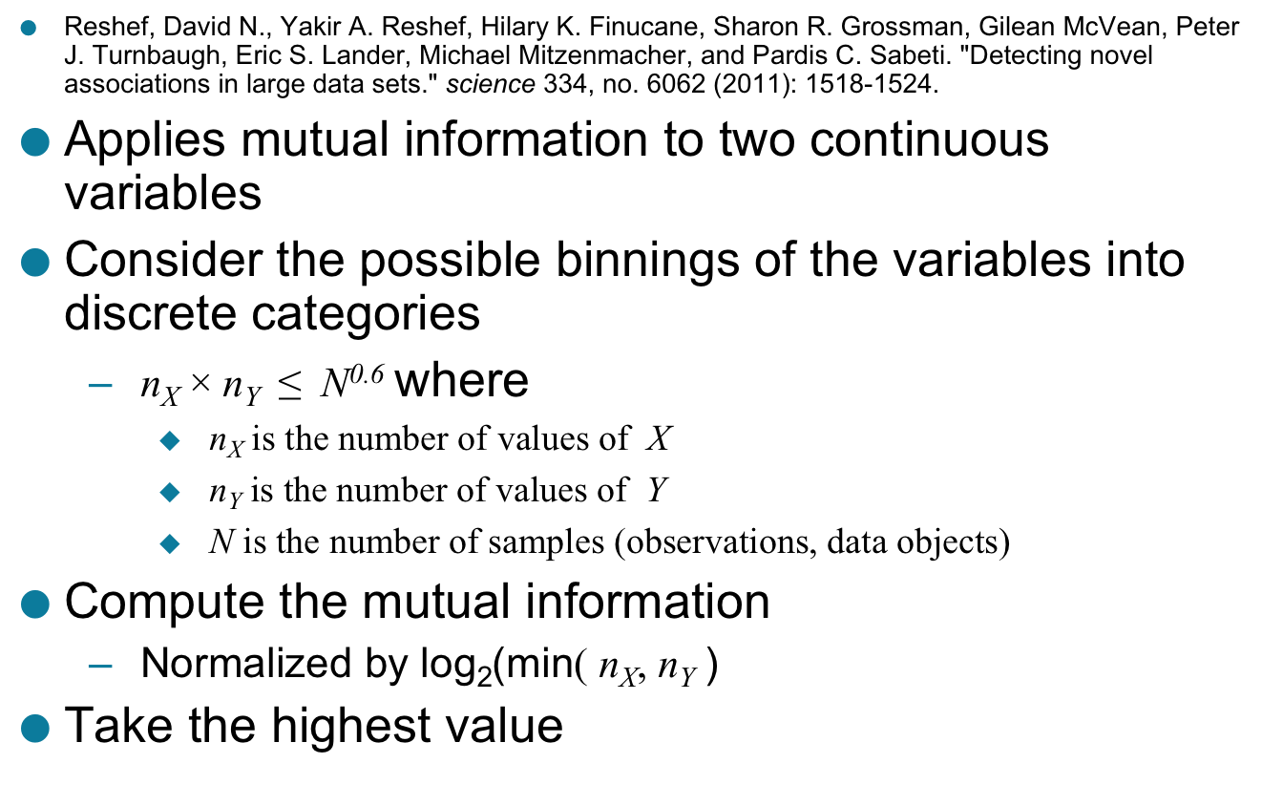
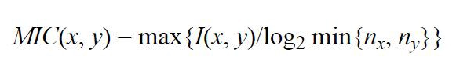
Maximal Information Coefficient (MIC)
the percent of a variable Y that can be explained by a variable X.
so the range is 0 to 1.
Does not the direction of relationship.

Slide 29
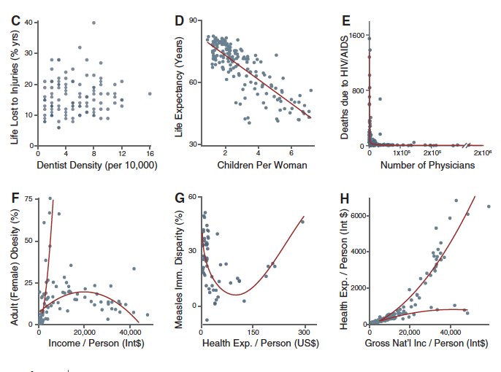
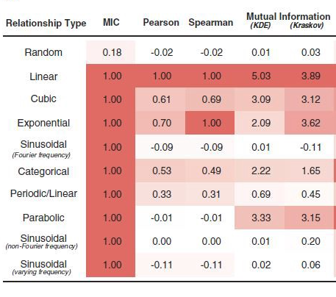
MIC: Motivation: The association between two variables can be quite complex

Slide 30
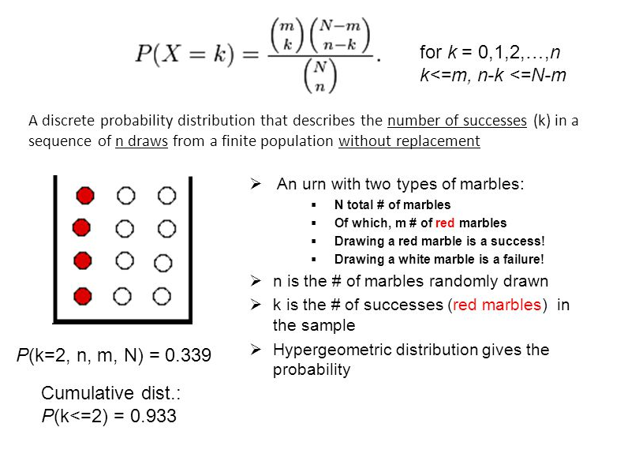
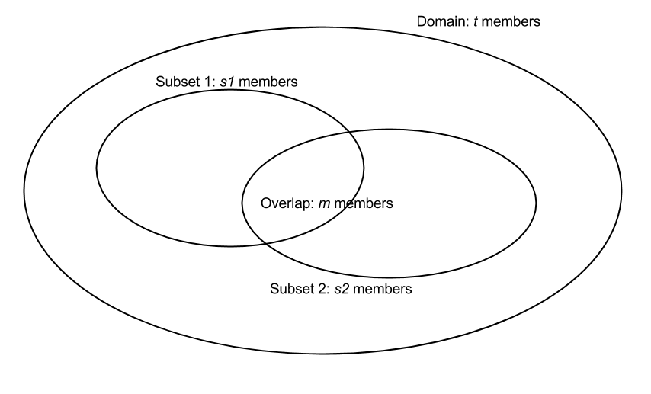
Hypergeometric Distribution
What is the significance of the overlap?

Slide 31

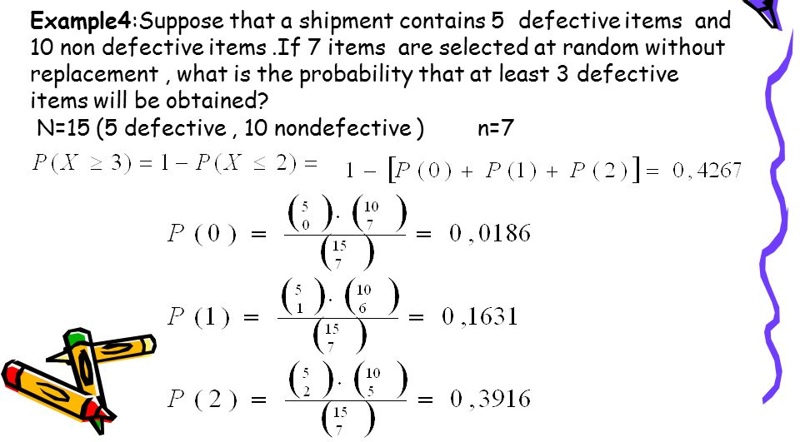
Hypergeometric Distribution : Example
15
Total number of marbles N =
Number of red Marbles m =
Number of drawn n =
Number of red marbles drawn k =
5
7
More than 3

Slide 32
Hypergeometric Distribution : Example
Suppose we have 10000 refugee and 170 of them have blond hairs. The neighboring country accepted 250 refugees. Among the accepted refugees 120 have blonde hairs. Is the neighboring countries biased toward the hair color of refugees?
Total number of marbles N =
Number of red Marbles m =
Number of drawn n =
Number of red marbles drawn k =
10000
170
250
120

Slide 33
Hypergeometric Distribution : Example
Suppose we have 17,980 genes detected in a Microarray study and 57 genes were differentially expressed. Among the differentially expressed genes, 28 are annotated to be in the Insulin secretion pathway that has 54 genes. Is this set significantly associated to the Insulin?
Total number of marbles N =
Number of red Marbles m =
Number of drawn n =
Number of red marbles drawn k =
17980
54
57
28

Slide 34
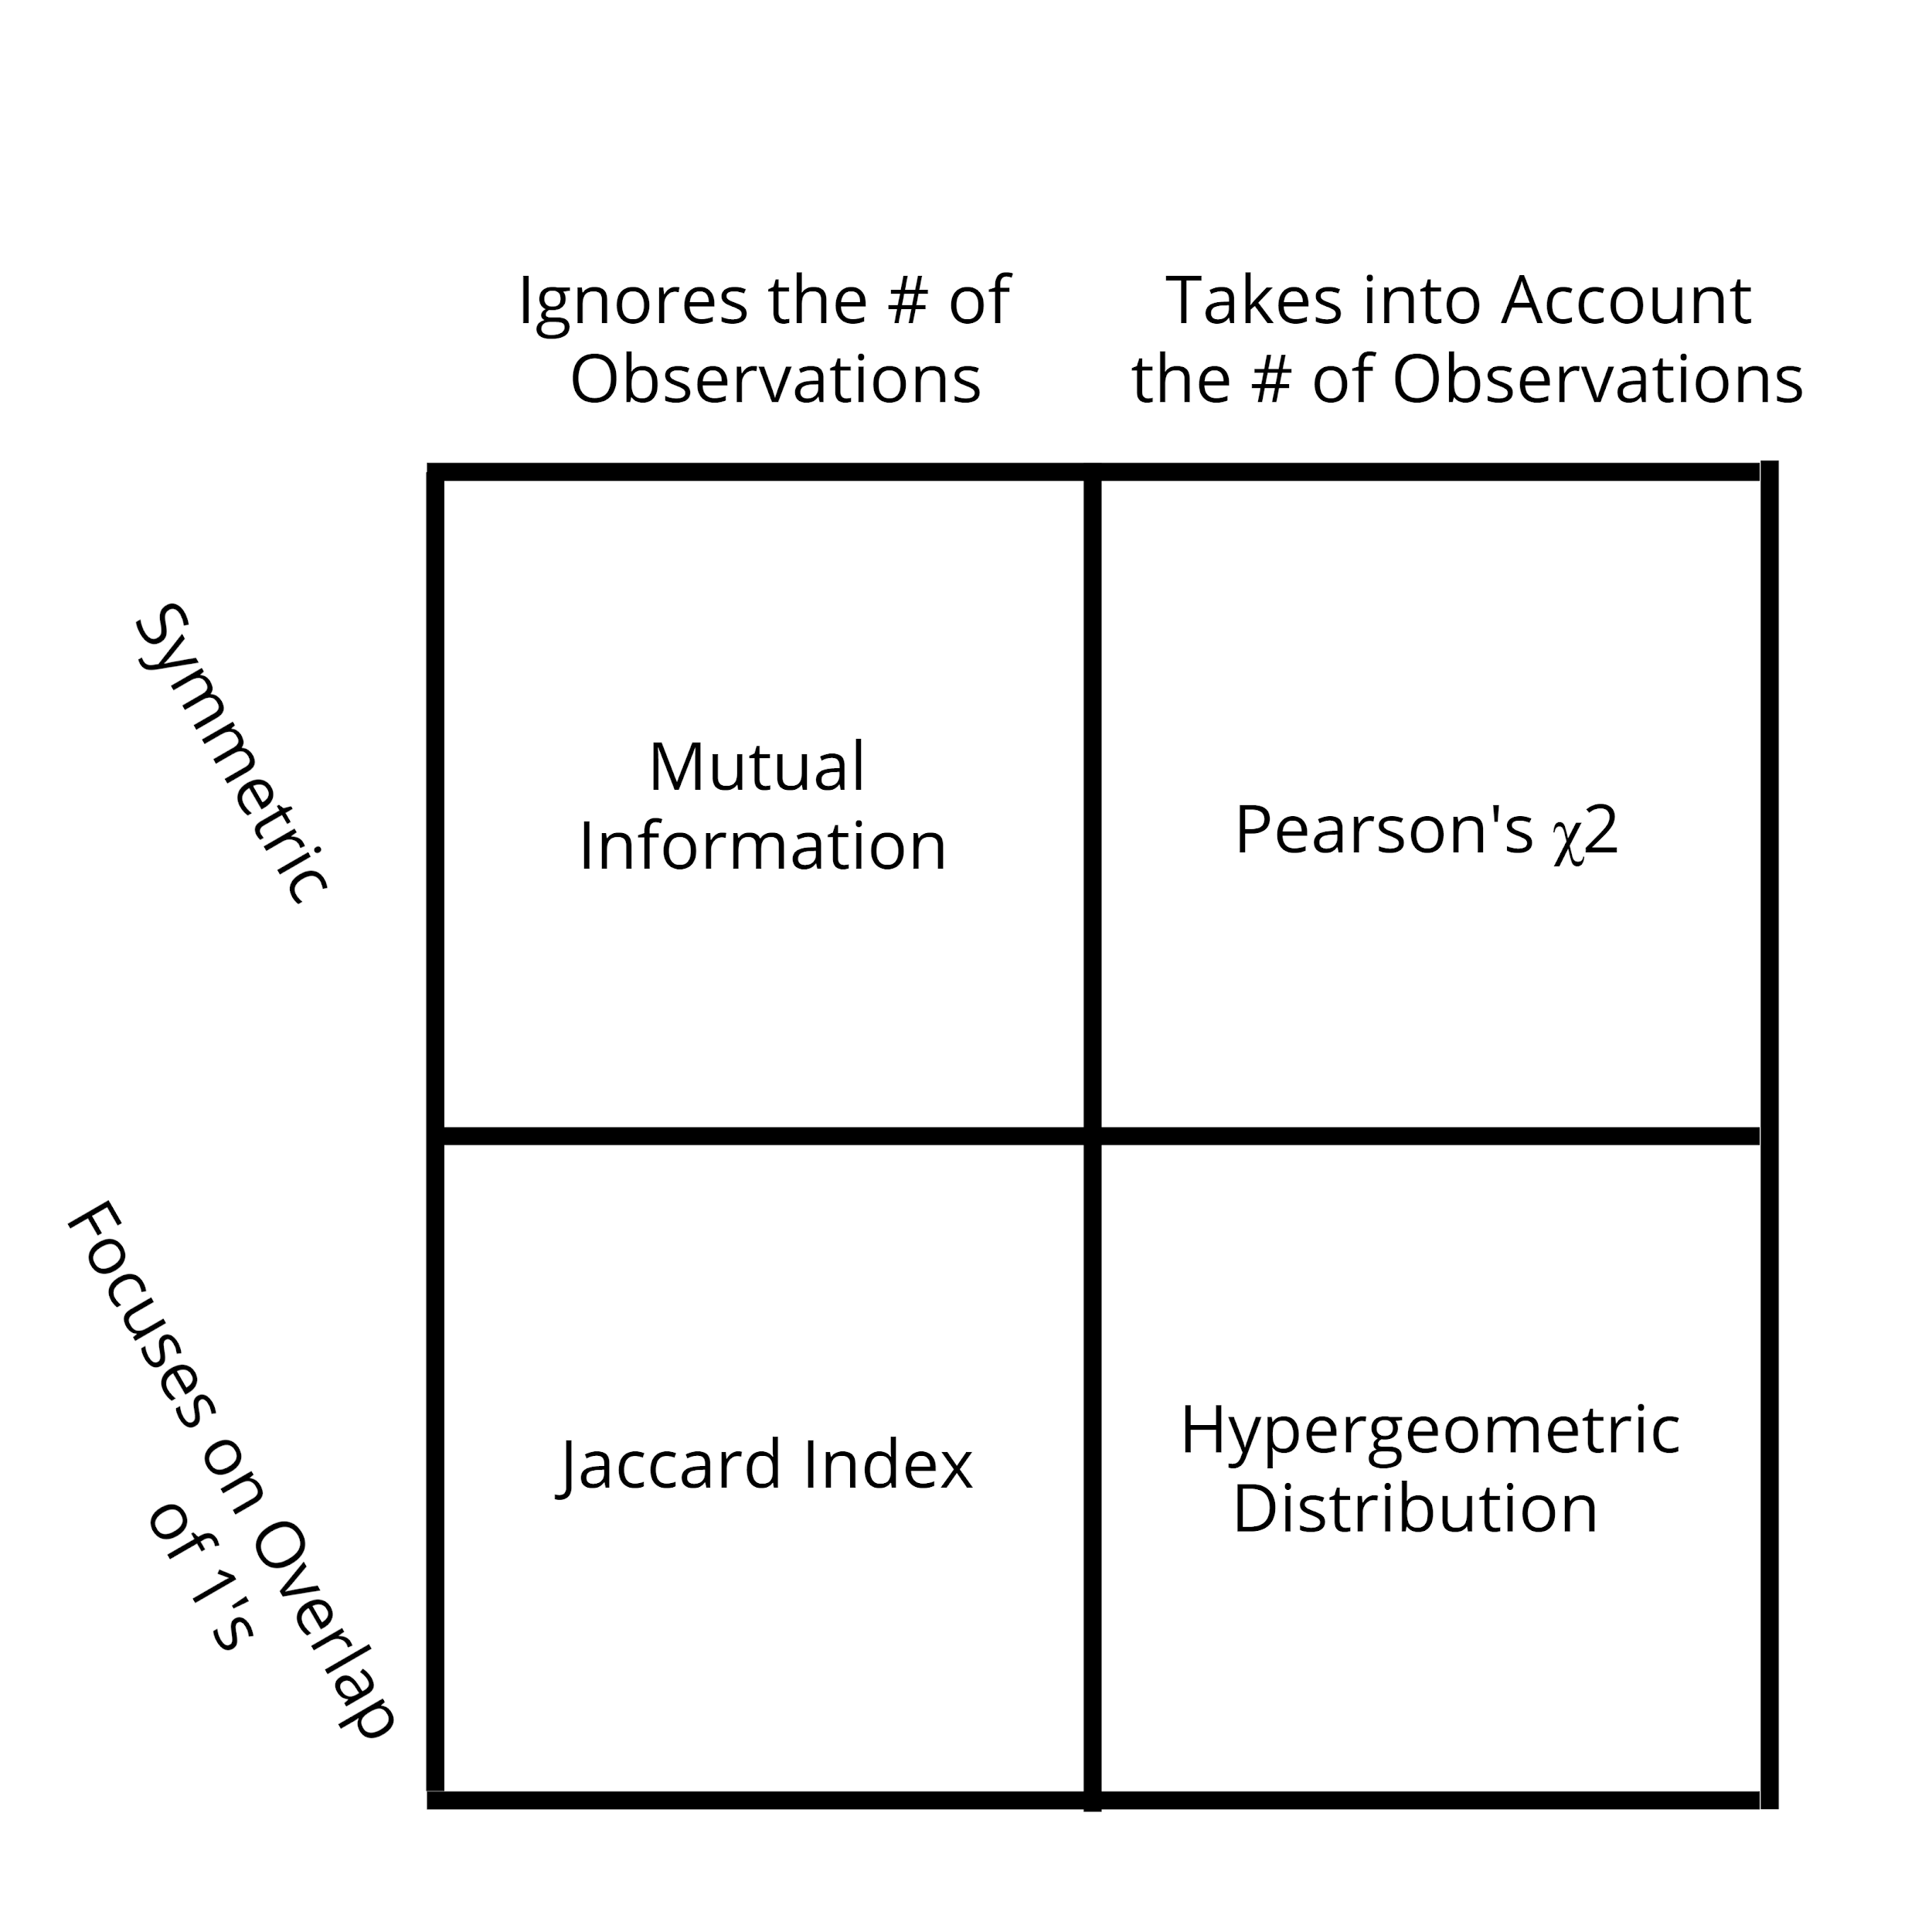
Chi-Square
Notes:
Helpful Square

Slide 35
Kahoot Quizz

