Slide 1
<Project Name>
Otito Mbelu
Rodrigo Almeida
Supervisor:
Dr. Damien Costello

Slide 2
Context & Objectives
Describe the context of the problem domain here. One or two sentences should be enough to explain what you are doing and why you are doing it.
Explain why the problem domain is of interest.
Write out the key objectives of the project as bullet points.
Each objective should be clear, realizable and measurable / testable, i.e. the success of your project is determined by the degree to which these are realized.

Slide 3
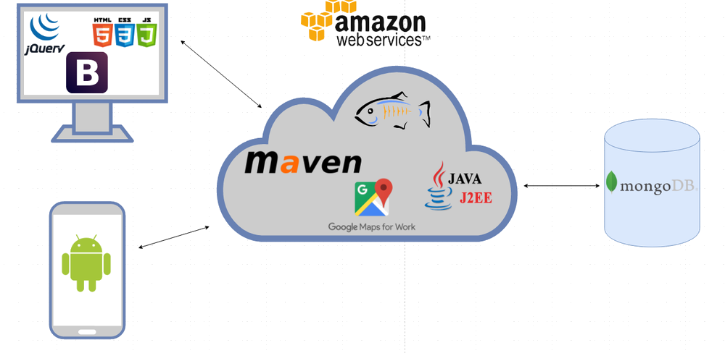
Technologies & System Architecture
Explain the technologies you are using and why you selected them.
Show a diagram of your system architecture and how the high-level components interact.

Slide 4
Development & Deployment
List any objectives that have already been implemented.
Show a screen grab of your project working and its GitHub repo and commit history.
Give a 1-minute live demo or a 1-minute video of skeleton application in its deployed environment, e.g. Amazon, JVM, Unity.
Group projects should show who worked on, is working on, will work on what...

Slide 5
Work Plan
Show a Gantt Chart of the set of remaining activities.
Don’t forget to include your dissertation document and any other deliverables.

