Slide 1
Tor Fingerprint Attack (TorFA)

Slide 2
Results
Test | Website | Match | KL-Divergence | Match
1 | Facebook | facebook | 0.02912 | yes
2 | Facebook | facebook | 0.00708 | yes
3 | Facebook | facebook | 0.01343 | yes
4 | ask.com | ask.com | 0.00256 | yes
5 | ask.com | ask.com | 0.00800 | yes
6 | ask.com | ask.com | 0.00363 | yes
7 | meebo | meebo | 0.00593 | yes
8 | tsquare | tsquare | 0.10467 | yes
9 | tsqaure | yahoo | 0.02075 | no
10 | wikipedia main page | NONE | ---- | yes

Slide 3
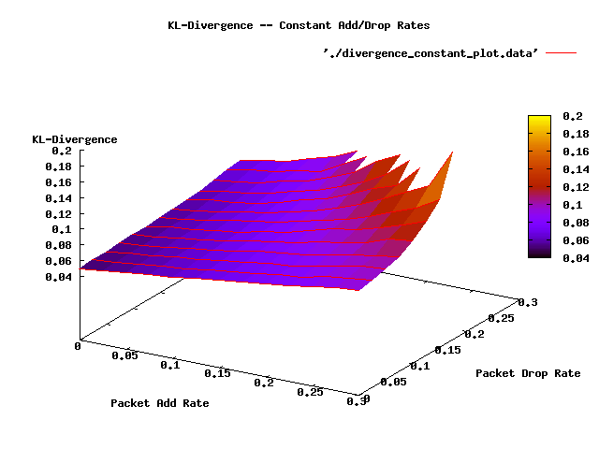
Results

Slide 4
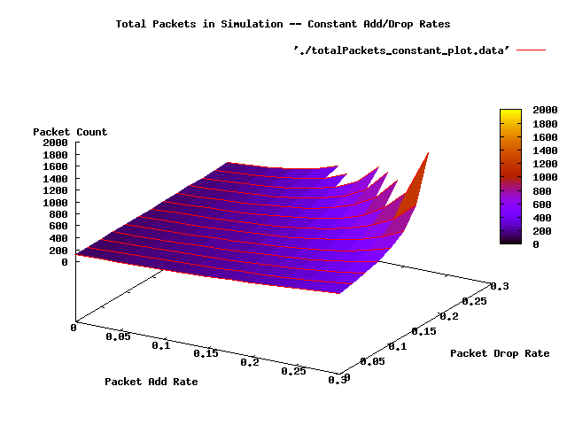
Results

Slide 5
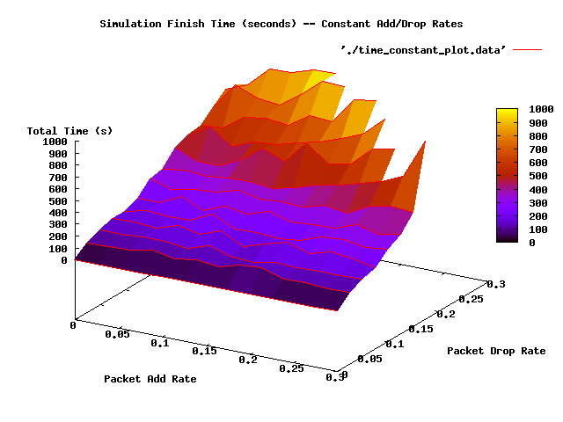
Results

Slide 6
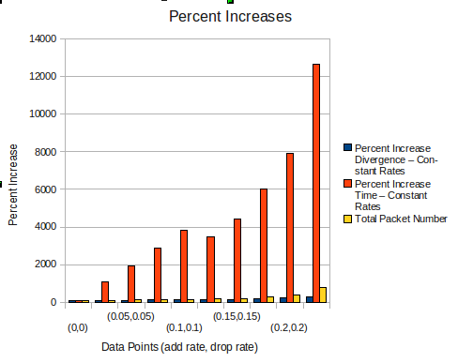
Results

Slide 7
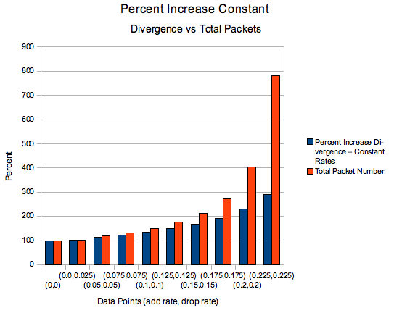
Results

