Slide 1
Public Investment
Evidence
Unstructured reviews for public-project analysis
CIS 509 Team 4
John Wheeler, Ryan Wolff, Cameron Anthony
01
Notes:
00:00–00:30. Opening: A public official has a practical question: if we build a project here, what kind of local activity might follow per dollar? We built two connected workflows: inspect completed projects, then explore a proposal using a measured local baseline. The unstructured-data contribution turns review text into both targeted place evidence and learned topic features.
Sources: data/derived/project_evidence.json; data/derived/project_model.json; data/derived/advanced_text.json. Build versions: project-evidence-v1, project-ce-v2, tfidf-bigram-nmf5-v1.

Slide 2
The goal: a better-informed project proposal
“If we build a project here, what local activity
might follow per dollar?”
Completed projects
Proposed projects
Inspect outcomes, review language,
coverage and source assumptions.
Enter local conditions, compare cases
and examine an experimental estimate.
Current outcome: growth-adjusted Yelp review activity per $1 million of reported cost
02
Notes:
00:30–01:15. State the goal in the official's language. For completed projects, the product explains footprint, cost, local activity and review language. For proposals, a user enters budget and measured baseline conditions, inspects comparable cases and exports an analysis record. Project type filters comparable evidence today; it does not identify a type-specific treatment effect. The current outcome is a Yelp activity proxy. The product vision can later expand to stronger public-value measures.
Sources: web/projects.html; web/model.html; docs/product-improvement-plan.md.

Slide 3
Large text coverage, small prediction sample
1.06M
11
10
unique reviews scored
projects across 7 cities
eligible project outcomes
Learned-topic analysis uses 23,691 sampled reviews
10,971 baseline reviews fit the descriptive vocabulary and topics.
The archive describes historical business-review activity.
Yelp archive vintage: January 2022. Reviews overlap across some project catchments.
03
Notes:
01:15–01:55. Do not conflate review volume with the number of independent project outcomes. We processed 1,063,956 unique reviews for 11 projects across seven cities. Ten projects meet the baseline support rule. Shared catchments create 292,924 shared review IDs. The topic layer uses 23,691 distinct sampled nearby pre/post reviews, with 10,971 baseline reviews fitting the descriptive basis. Data vintage is January 2022.
Sources: data/derived/project_evidence.json; data/derived/project_model.json; data/derived/advanced_text.json. Build versions: project-evidence-v1, project-ce-v2, tfidf-bigram-nmf5-v1.

Slide 4
Review text becomes place-specific evidence
“The only unfavorable part was the sidewalk seating since the city hadn’t picked up the garbage.”
Topic
Cleanliness / maintenance
Target
Surrounding area
Clause polarity
Negative
Illustrative Rail Park review excerpt. Rule labels remain provisional pending human validation.
04
Notes:
01:55–02:40. Read the excerpt. Topic alone is insufficient: garbage could describe a restaurant interior or the street. Target-aware clause rules distinguish area, business and unclear targets, and preserve whole-review sentiment separately. The example is an illustrative actual excerpt from near Rail Park in the post period. It is not a representative public consultation. Provisional VADER and barrier rules lack independent human accuracy estimates. 731 blank annotation tasks are prepared.
Source: data/derived/project_evidence.json, Rail Park excerpts; src/project_text.py; docs/advanced-text-method.md.

Slide 5
Learned topics expose what reviews discuss
TF-IDF unigrams and bigrams with five NMF topics
Dilworth Park: 1,200 sampled reviews per period. Mean normalized topic weight.
05
Notes:
02:40–03:30. TF-IDF converts unigrams and bigrams into weighted features. Five NMF components learn recurring language. We show leading terms rather than assign unverified civic labels. For Dilworth, 1,200 sampled reviews per period produce these mean normalized topic weights. They are mixtures, not the share of reviews assigned to exactly one topic. Descriptive topics use baseline text only; post text is transformed through the frozen basis. Entropy and lexical features add further structure. The food/service emphasis is a finding about Yelp coverage.
Source: data/derived/advanced_text.json, descriptive topics and dilworth-park pre/post. Predictive topic basis is separate.

Slide 6
Raw growth can trail the comparison area
Sun Link review counts | Reviews
Nearby baseline, 2010–2011 | 3,807
Nearby post, 2015–2016 | 10,943
Expected post from comparison growth | 13,150.3
−11.2
adjusted reviews
per $1M
CE = (observed nearby post − expected nearby post) ÷ cost in $M
Descriptive comparison. Other neighborhood changes can influence review activity.
06
Notes:
03:30–04:15. This example makes the metric concrete. Sun Link nearby reviews rose from 3,807 to 10,943. The farther-area growth benchmark implies 13,150.34 expected nearby reviews. The difference is minus 2,207.34 reviews. Divide by reported cost of 196.5 million to obtain minus 11.23. This is slower relative review growth, not declining raw activity or evidence of project failure. Nearby means within 500 m of footprint. Comparison is 1.5–8 km. Baseline 2010/11 and post 2015/16.
Source: data/derived/project_evidence.json, sun-link primary and periods.

Slide 7
Advanced text did not improve the forecast
Text adds interpretable evidence. It did not improve prediction in this sample.
Mean absolute error in adjusted reviews / $1M. Ten eligible project outcomes.
07
Notes:
04:15–05:10. Compare models on the same ten project outcomes. Lower mean absolute error is better. Holding out a city is more demanding than leaving out one neighboring project. Baseline uses reported cost, baseline reviewed businesses, and reviews per reviewed business. Learned text adds five NMF mixtures, entropy, log length and lexical diversity. TF-IDF/NMF is fitted again inside all 17 project/city folds, with no held-out shared IDs. Two folds require training-only feature imputation. Advanced text has project MAE 53.04 and city MAE 46.67, versus baseline 49.33 and 45.61. Text is still a valuable analysis layer and a substantive tested result. Selection uses the same small held-out comparisons, not an independent final test.
Source: data/derived/project_model.json candidates and advanced_text.fold_audit.

Slide 8
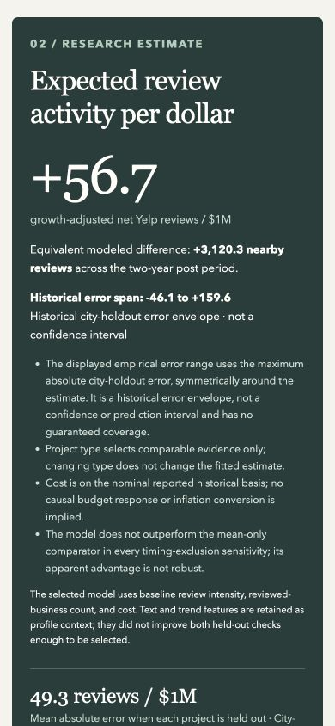
Live demo: from a project record to a proposal
1 Inspect the historical evidence
Dilworth outcome, geometry and learned review topics
2 Test a documented scenario
Change the budget, inspect support, then export
Live demonstration: 3 minutes
08
Notes:
05:10–08:10. Three-minute live demo. Start the server before the talk and open Dilworth Park. For the first 25 seconds, show observed capital efficiency of +60.0 and the near/comparison counts. Until 01:00, inspect learned topics and briefly open text-method details. From 01:00 to 01:55, use the proposal example, change cost from $55M to $80M, and reset. The fitted estimate changes from +56.7 to +53.2 reviews/$1M. This is an association, not a causal return from additional spending. From 01:55 to 02:35, show historical error, challenger results and timing sensitivity. Export the analysis by 02:50. If time remains, show Water Works: seven baseline-reviewed businesses, so the estimate is withheld. If the browser fails, use the captured screens in the deck and narrate recorded results. Do not debug live.
Sources: web/projects.html; web/model.html; docs/demo-runbook.md; docs/qa/validation.md. Screenshot: docs/qa/proposal-mobile.png.

Slide 9
The current estimate needs stronger evidence
City-held-out MAE | Model | Mean
All 10 projects | 45.6 | 58.5
Exclude pandemic windows, 8 cases | 60.3 | 59.5
Also exclude construction overlap, 7 cases | 70.2 | 61.6
The predictive advantage does not survive these timing exclusions.
Five geometry proxies remain. Current proposals need fresh local measurements.
09
Notes:
08:10–09:15. This is the key boundary of the product claim. Excluding Rail and Gateway pandemic post windows removes the baseline advantage over a mean predictor. Removing Indianapolis construction overlap also worsens transfer error. Do not hide this. Five center proxies, nominal mixed-scope costs, historical Yelp participation, and unvalidated aspect labels further limit deployment. The useful product today is an inspectable evidence and scenario workflow.
Source: data/derived/project_model.json sensitivity; docs/project-source-audit.md.

Slide 10
A usable foundation for public-project planning
Review language becomes evidence
that an official can inspect.
Today: compare historical projects and explore assumptions.
Next: pilot one measured proposal, then validate
with more projects and independently labeled text.
10
Notes:
09:15–10:00. Close with value and goal. We built an operational workflow that connects project records, unstructuredtext and comparable estimates, with assumptions exposed. The analysis is useful before the forecast is decision-grade. The next step is a focused pilot with one public official and a measured proposal profile, paired with broader project coverage, human aspect validation, and stronger outcome validation. The ask is to evaluate the workflow and evidence needs, not authorize a budget from this score.
Sources: docs/product-improvement-plan.md; docs/demo-runbook.md; docs/advanced-text-method.md.

Slide 11
Appendix: model comparisons and inputs
Predictor | Project MAE | City MAE
Mean benchmark | 61.62 | 58.48
Review activity + cost | 49.33 | 45.61
Plus rule text | 53.10 | 48.19
Plus earlier trend | 51.52 | 46.26
Plus learned text | 53.04 | 46.67
Baseline inputs: cost, reviewed businesses and reviews per reviewed business
All errors use adjusted reviews / $1M. Evaluation remains exploratory.
11
Notes:
Backup for model questions. All candidates use the same ten eligible project outcomes. The baseline uses log-transformed reported cost, baseline-reviewed businesses and reviews per reviewed business. Rule-text features add place-discussion, access-friction and public-realm complaint shares. The earlier-trend challenger adds the relative near/far change between early and baseline windows. Learned text adds five NMF topic weights, normalized topic entropy, mean log review length and lexical diversity. Ridge uses alpha 10, with scaling fitted inside each fold. Project type filters comparable cases and is not a model predictor.
Source: data/derived/project_model.json, feature_schema, candidates and validation.

Slide 12
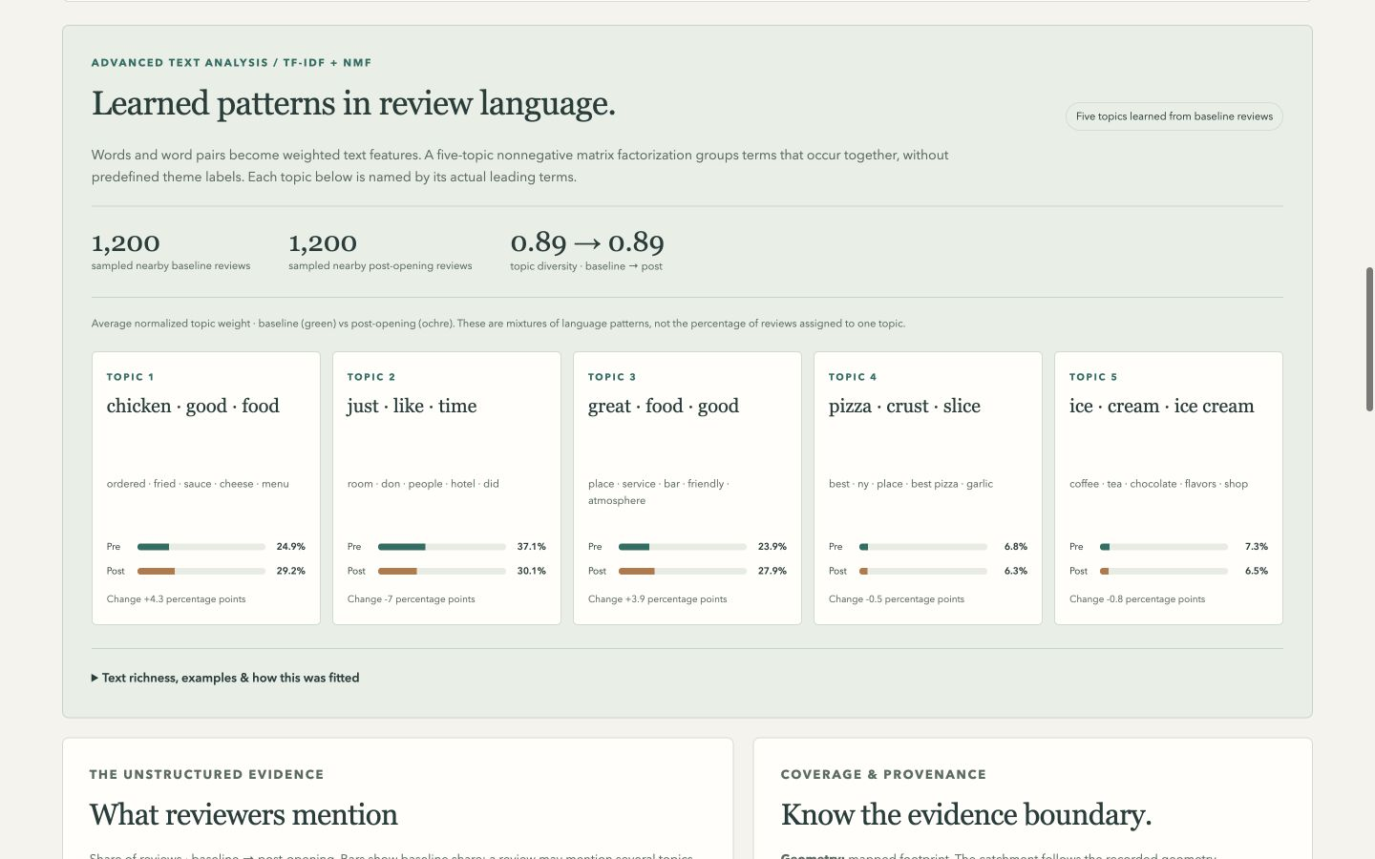
Appendix: learned-text demo fallback
12
Notes:
Use only if the live browser fails or someone requests detail. This is a captured Dilworth Park project page. Point out baseline and post-opening mixtures, actual leading terms, sample sizes and topic diversity. The dominance of food/service language explains why whole-review sentiment cannot automatically represent public-space experience. The disclosure contains lexical measures and method detail. The screenshot records a tested state rather than a new live calculation.
Sources: docs/qa/advanced-text-desktop.png and data/derived/advanced_text.json.

Slide 13
Appendix: validation and remaining work
Implemented
Still needed
Baseline-only topic fitting
Fold-specific vocabulary and NMF
Shared-review exclusion
Versioned profile import and export
Independent human text labels
Verified historical footprints
Current, broader project coverage
Independent forecast validation
The historical error span is empirical, with no calibrated coverage guarantee.
13
Notes:
Backup for method questions. Descriptive NLP fits 10,971 baseline reviews and projects post-opening reviews through the frozen basis. Predictive NLP uses its own sample of up to 500 reviews per project and fits vocabulary and NMF separately in 17 project/city folds. There is zero held-out review-ID overlap in text training. In two folds, strict overlap exclusion removes all sampled text from a training project, so that project's text features use the other training projects' means. Exact basis fingerprints guard profile imports. The full 1,063,956-review rule extraction is separate from sampled NMF analysis. The 731 annotation tasks contain blank labels and await independent human scoring. Site QA records 47 Python tests, three Node test files and desktop/mobile workflow checks.
Sources: docs/advanced-text-method.md; data/derived/project_model.json, advanced_text; docs/qa/validation.md.

