Slide 1
Variable Density

Slide 2
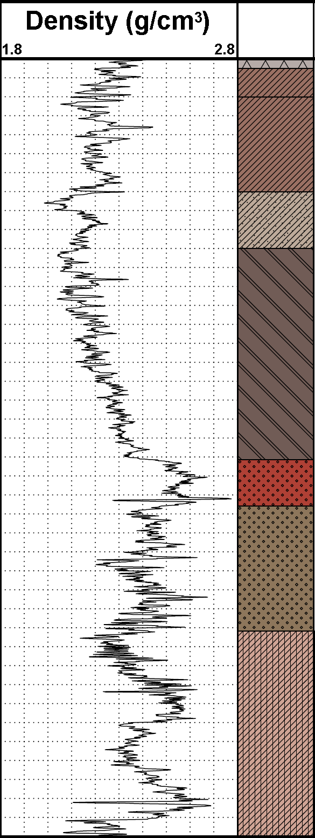
Variable Density
The density of basin sediments may vary as a function of depth (below surface)
  However, variable density is not simply some variation of density as a function of ‘z’
  Typically it is also a function of (x, y) … due to topography

Slide 3
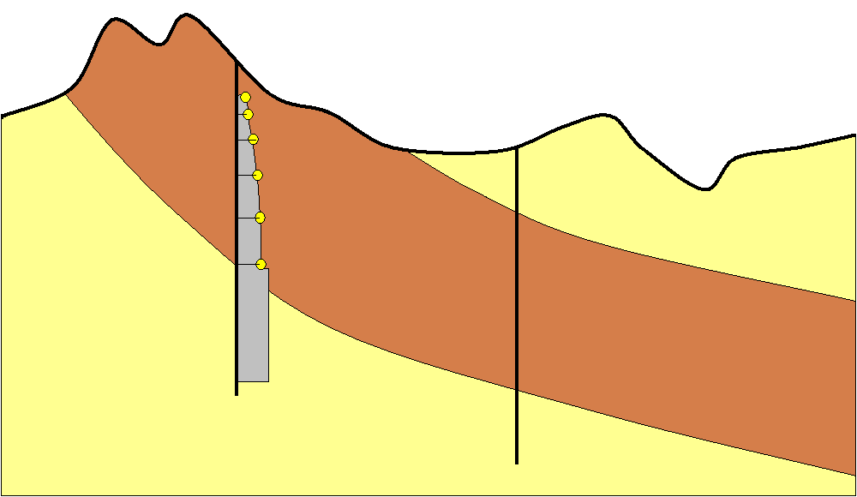
Variable Density
The density at (x₁, y₁, z₁) differs from (x₂, y₂, z₁)
… density is a function of (x, y) as well as ‘z
Topographic Surface
Location (x₁, y₁, z₁,) has density ρ₁
Location (x₂, y₂, z₁,) has density ρ₂

Slide 4
Variable Density
  Density variations at depth do not reflect the sharp changes that we observe in topography
Topographic Surface
Constant density at this constant depth?
… unlikely!

Slide 5
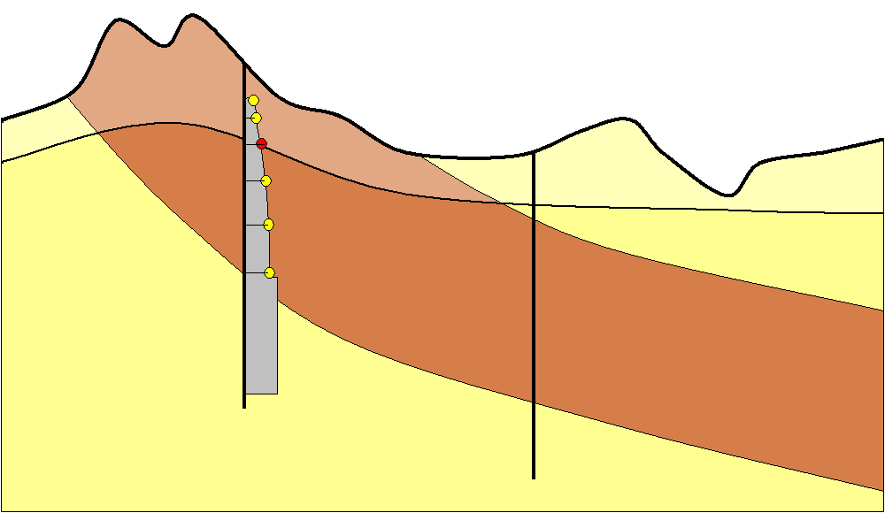
Variable Density
  We consider the variable density of a unit to vary relative to a (smooth) reference surface located some distance below the topography
Lower density weathered bedrock and cover
Topographic Surface
Reference Surface
Reference Depth (z₀)
  The reference surface could be a smoothed version of the topography, displaced to an appropriate depth

Slide 6
How do we record the 3D variation of the density of a formation?

Slide 7
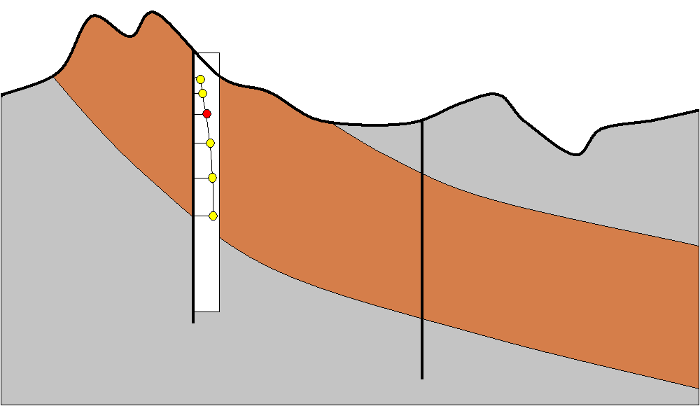

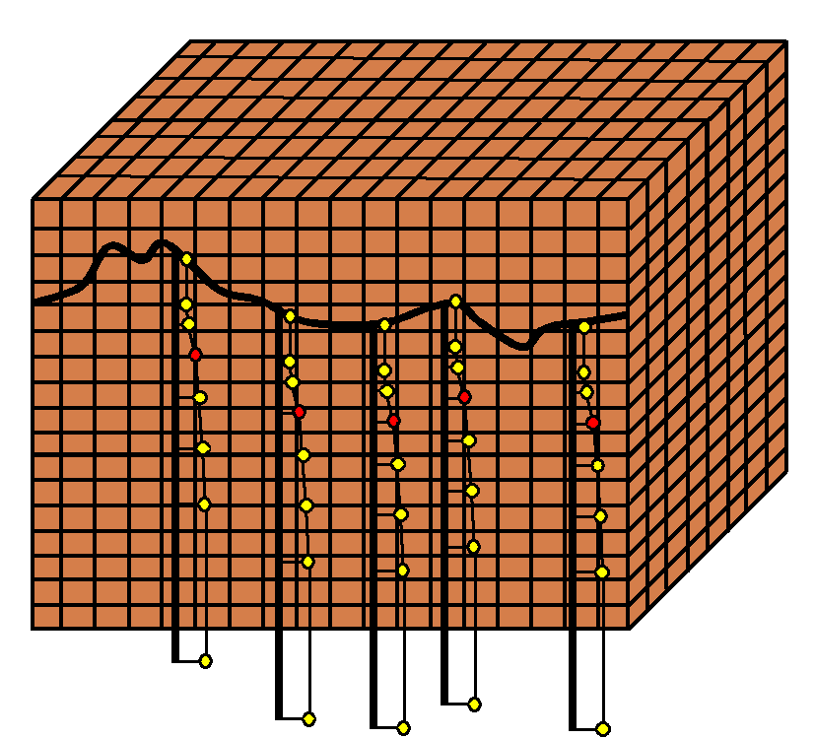
Variable Density – Density Voxet
We use a voxet to record the 3D variation of density of a given geology formation
For a specific lithology unit (UnitX) …
  The recorded data values are the density of UnitX at each voxel-centroid location (x, y, z)
  A value for density of UnitX is recorded throughout the whole of the voxet volume
  One of the property fields of the voxet stores the density data for UnitX
Unit ‘X’

Slide 8
Variable Density – Density Voxet
A density voxet must be spatially identical to the lithology voxet used in GeoModeller forward modelling or inversion
  same overall size, dimension, position and voxel size and number of voxels
Thus – in inversion – whenever any voxel of the lithology model is assigned to be the lithology ‘UnitX’, the correct density value for that (x, y, z) location can be read from the corresponding voxel of the (UnitX) density property of the density voxet
If several formations have variable density, the density data for each lithology must be recorded in separate property fields of the density voxet

Slide 9
How do we create a density voxet?

Slide 10
Create a Density Voxet?
Some organisations will already have datasets that describe the 3D variation of density for specific formations – typically derived from density logs, 3D seismic interpretation and velocity analysis
  These need to be written out to a voxet of appropriate dimension – and can then be directly used in GeoModeller forward modelling and inversion
Alternatively … use CreateDepthFunction

Slide 11


CreateDepthFunction
Typically our knowledge of variable density is derived from a density log in a drillhole … from which we would choose a set of (depth, density) pairs …
CreateDepthFunction references these (depth, density) data to the topographic surface … to generate a density voxet for a specific formation

Slide 12
CreateDepthFunction - Details
The CreateDepthFunction operation uses a list of two or more (depth,density) pairs to generate a piece-wise linear spline function
Reference Surface is the topography
Reference Depth is 0m
For each ‘column’ of voxels, the spline function is ‘referenced to’ the Reference Surface (i.e. topography) at that column location (x, y), and density values are interpolated at the required elevations of each voxel-centroid
The (depth,density) pairs can be in any order (they will be sorted by depth prior to splining). Where voxels extend above or below the limits of the supplied (depth, density) data pairs, the top or bottom supplied density value is used

Slide 13
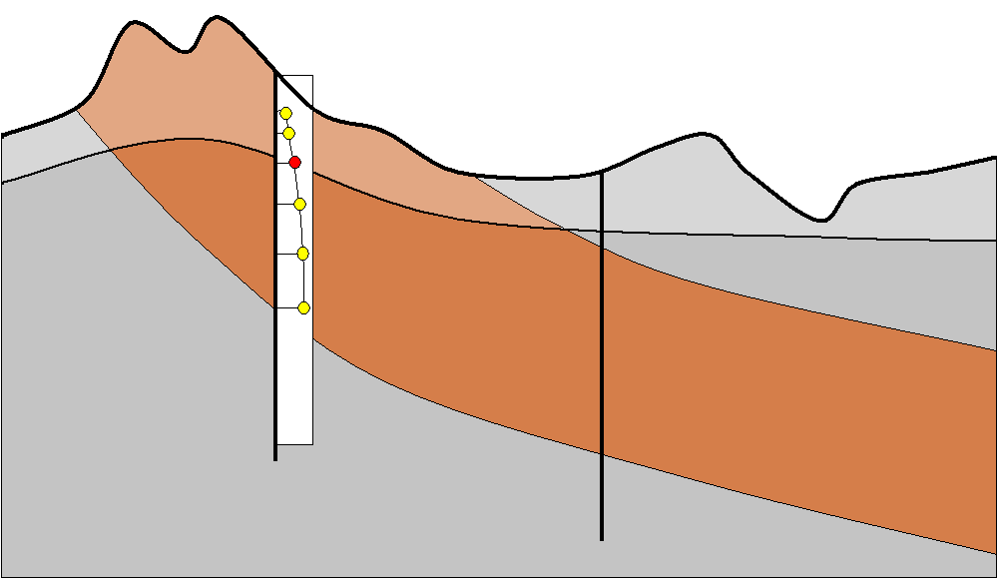
CreateDepthFunction - Ideal
Depth-Density Pairs (z₁,ρ₁, z₂,ρ₂, etc.) from a drillhole density log
Topographic Surface
Reference Surface
Reference Depth (z₀)

Slide 14
CreateDepthFunction - Current
Depth-Density Pairs (z₁,ρ₁, z₂,ρ₂, etc.) from a drillhole density log
Reference Surface
Reference Depth (z₀)
Topographic Surface

Slide 15
CreateDepthFunction - Command
The arguments to the CreateDepthFunction command are …
  F(d1,v1,...,di,vi,...) - a list of depth-density pairs
  <Output Voxet> - the name of the output voxet
  <Output Field> - a name for the density property field
CreateDepthFunction Command …
call %DoTask% %CaseXML% CreateDepthFunction F(200,2.5,1000,4.9) ^ %ToResultsDIR%\%Case%\DensityDepth_BigCubeFormation.vo BigCubeDensity

Slide 16
CreateDepthFunction - Workaround
To generate a density voxet for the ideal case
  Generate a grid of your preferred Reference Surface (e.g. smooth a topography grid, and subtract, say, 50m)
  Create a temporary GeoModeller Project using this surface as ‘the topography’
  Using this Project, create an inversion Case
  Revise the ‘depths’ of the (depth, density) pairs such that density at ‘true 50m’ temporarily corresponds to ‘adjusted 0m’ i.e. the ‘adjusted topography’
  Use the CreateDepthFunction to generate the required density voxet (and delete all temp. files!)

Slide 17
How do we use a density voxet?

Slide 18
Variable Density: SetLaw Density
A variation to the CaseControl SetLaw command is used to assign a specified field of a specified voxet to supply density values for a particular formation
The density voxet must match the Case voxet in terms of voxel size and voxet extents
The voxet may be generated via the CreateDepthFunction, or can be generated by third-party software
CaseControl SetLaw Command …
call %DoTask% %CaseXML% CaseControl SetLaw ^
Tertiary Density "Normal(2.67,0.01,100,XYZ,%Case%\DepthDensity_Tertiary.vo,TertiaryDensity)" ^
Palaeozoic Density Normal(2.55,0.01,100) ^
Basement Density Normal(2.65,0.01,100)

Slide 19
Variable Density: SetLaw (Detail)
Tertiary Density "Normal(2.67,0.01,100,XYZ,%Case%\DepthDensity_Tertiary.vo,TertiaryDensity)" ^
Note the “” and (). Warning – no spaces within the ()
Tertiary Name of the geology formation
Density Keyword – this SetLaw command sets the density property
Normal Keyword – in this case specifying a ‘normal’ density distribution
2.67 Mean density value – not used – but you must enter a number here
0.01 Standard deviation of the (normal) density distribution
100 Percentage of formation with this density value
XYZ Keyword, signifying that (mean) density to be read from a voxet
%Case%\DepthDensity_Tertiary.vo Name of the density voxet
TertiaryDensity) Name of property field (of the voxet) containing formation density
^ The ‘continuation character’ for Windows ‘command scripts’

