Slide 1
GeoModeller
AEM - 1D and 2D Inversion
1D & 2D Forward and Inverse EM modelling is fully integrated with the GeoModeller 3D geology modelling package.
AEM Time and Freq. Domain for most current systems.
Includes a fast approximate Apparent Conductivity calculation (by channel).
1D inversion developed by Jovan Silic.
2D methods based on AMIRA/CSIRO code ArjunAir; with new forward and inversion solver and other improvements implemented by Jovan.
Both 1D & 2D are parallelised using MPI.
GeoModeller also provides 3D Grav/Mag forward and stochastic inverse modelling (single or joint) with full tensor capabilities.

Slide 2
GeoModeller
AEM - 1D and 2D Inversion
Features
Supports TEMPEST, AEROTEM, GEOTEM, HeliGEOTEM, QUESTEM, SPECTREM, VTEM, VTEM Plus, SkyTEM, DigHEM RESOLVE, DigHEM
Example Waveform and configuration defaults are supplied for each system.
Measurement units are standardised internally on data load.
Direct GDB support – no reformatting required
Automatic generation of sections for each EM Flight line
Intuitive and Simplified interface

Slide 3
GeoModeller Core Design Specs
Builds complex 3D models (faults, folds, overturned strata, intrusions)
Incorporates digital terrain model
Implicit potential field method geological interpolators
Rule-based modelling; onlap / erode relationships in stratigraphic pile
Handles sparse data well;
Supports drillhole lithology, assay and rock properties
Quickly add / revise data, re-compute & re-build the model; new drilling
2D/3D IDW and Kriging interpolators for gridding assay & property data
3D Gravity and Magnetic voxel based forward and stochastic inverse modelling (single or joint) with full tensor capabilities.
1D/2D AEM forward modelling & inversion.

Slide 4
GeoModeller
AEM - 1D and 2D Inversion
Unique Features
A completely rewritten Inversion Solver based upon an L2 norm objective function which also includes the misfit to the reference model and a model smoothness function.
The solver uses a Generalized Single Value Decomposition (GSVD) method where generalized singular values of the sensitivity and model norm matrices are used as weights in determining changes in the cell conductivities at each iteration.
An adaptive Tikhonov regularization scheme is used to solve for changes in the conductivity model at each iteration. An RSVT (Relative Singular Value Truncation) parameter allows dampening of changes in non-sensitive cell conductivities for each data point during the initial stages of the solution.

Slide 5
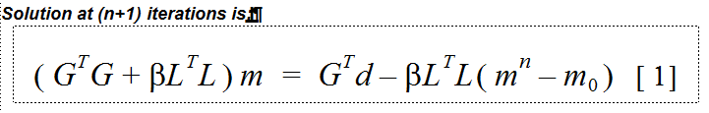
GeoModeller AEM - 1D and 2D Inversion
Algorithmic Improvements - Comparisons
G = Sensitivity matrix; L = Model Roughness matrix
β = Regularisation parameter; d = observed data
m₀ = Reference model; m^{n} = Model at the n^{th} iteration
We solve equation [1] using the GSVD method.
Unlike most commonly applied algorithms, the inversion solver implemented in GeoModeller uses special properties of matrix L^{T}L and applies the GSVD method to matrices G and L, so that the regularisation parameter is chosen automatically and changed adaptively at each iteration as the model, the sensitivity and the roughness matrices are changing.

Slide 6
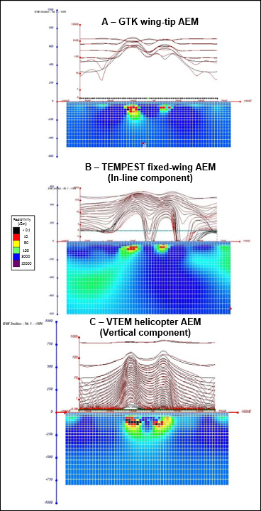
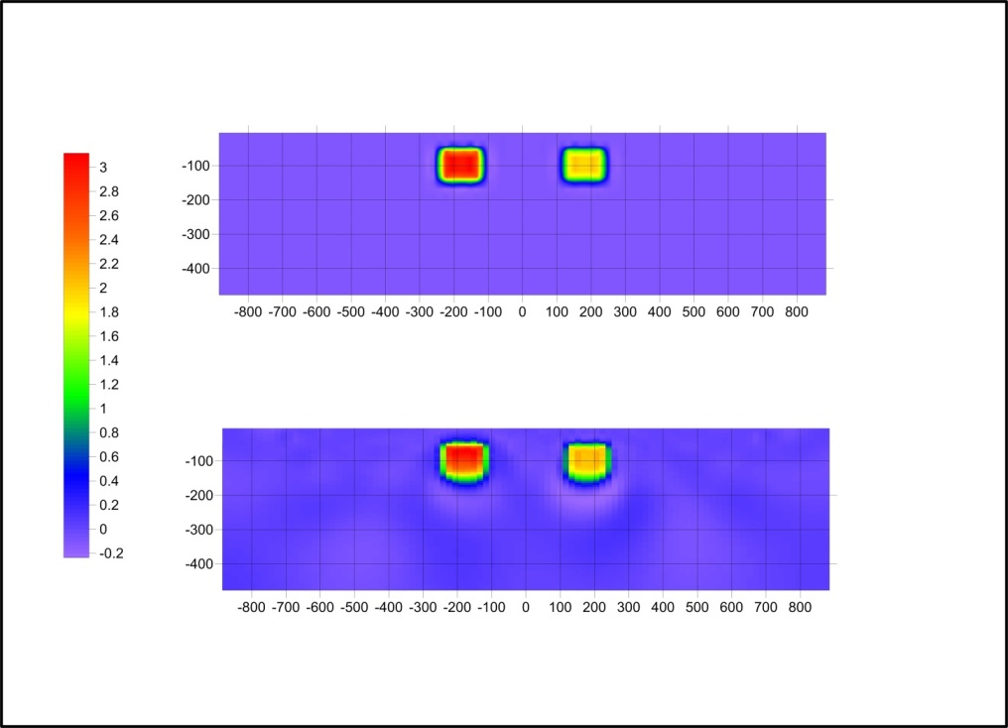
GeoModeller AEM - 1D and 2D Inversion
Algorithmic Improvements - Comparisons
Published CSIRO modelling results
Equivalent CSIRO Model
Using the new methods
Synthetic model
Predicted inverted
mS/m

Slide 7
GeoModeller AEM - 1D and 2D Inversion
Competitive Advantages
Fully Integrated with an implicit 3D Geology model builder
Builds geology models with associated resistivity properties from sparse geological or geophysical data
i.e. from a prior EM 1D Inversion or actual observed data.
Preliminary geology/property models can be used in:
2D forward for AEM system evaluation.
2D inversion as starting models or reference models for improved inversion accuracy and convergence speed.
2D Inversion has the ability to fix or stiffen well constrained parts of the reference model during inversion.
SkyTEM 1D Inversion jointly inverts measurements for both transmitters taking full advantage of High Moment data.

Slide 8
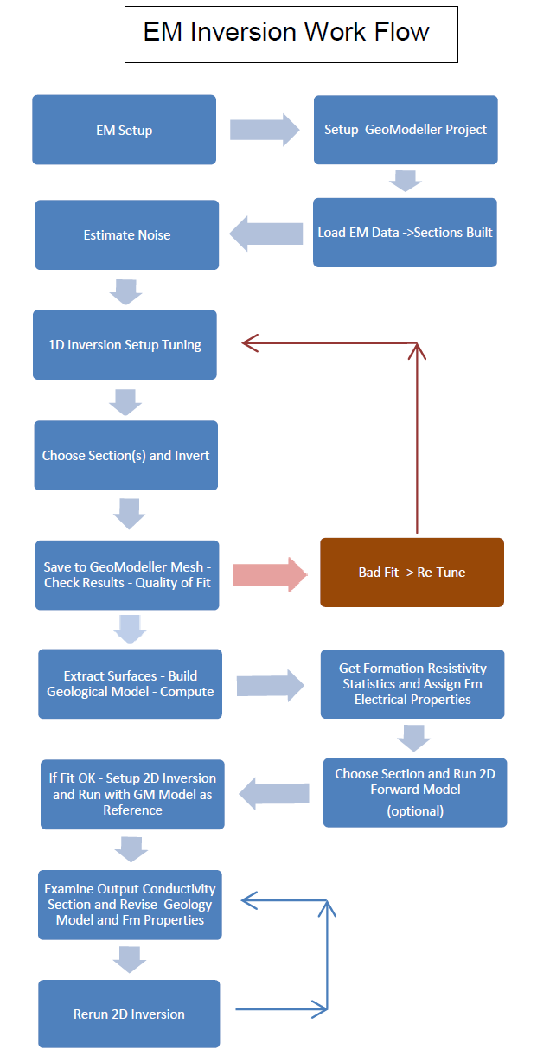
An Example Workflow:
Progress from 1D to 2D geology/property constrained inversion

Slide 9
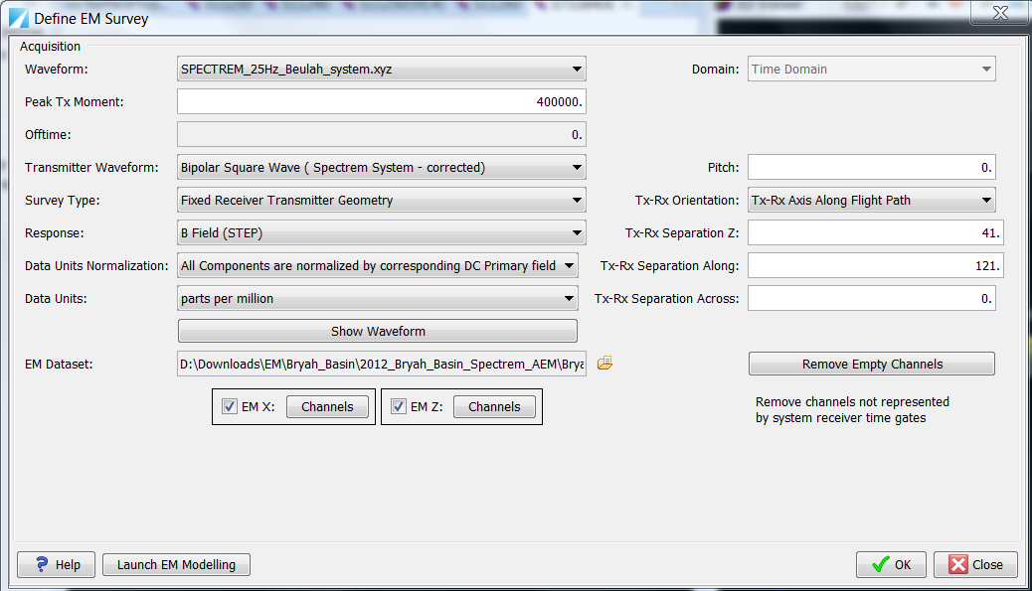
GeoModeller AEM - 1D and 2D Inversion
GUI - Work Flow
Set up new GeoModeller Project – need coord limits & DTM
Startup MPI daemon
Prepare EM system file.
Select Geophysics->EM Modelling->Define Survey Properties

Slide 10
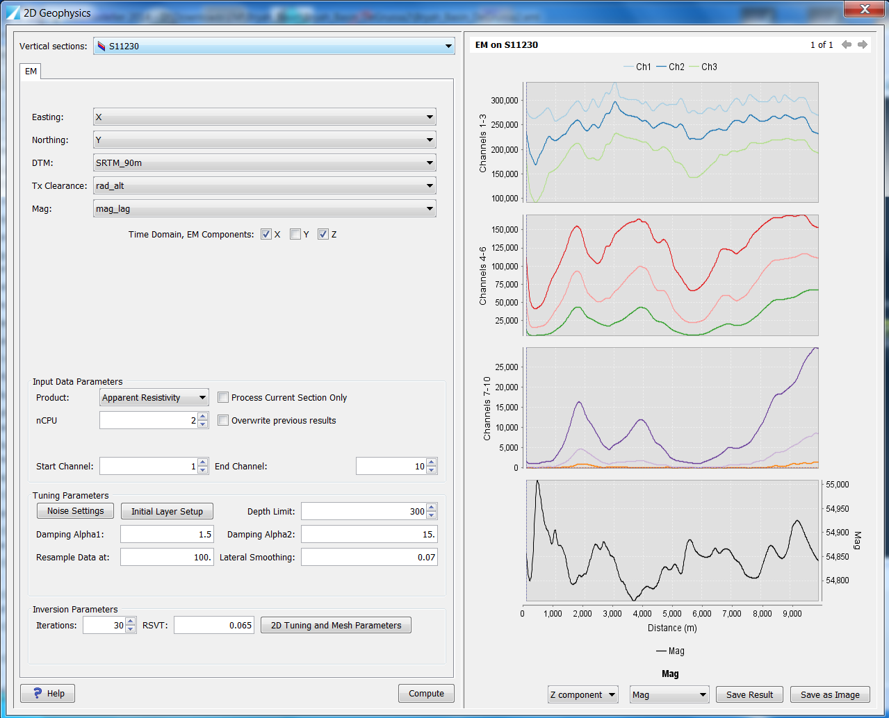
GeoModeller AEM - 1D and 2D Inversion
GUI - Work Flow
When done click Launch Compute EM button.
Select required supporting channels: East, North, DTM, Tx Clearance.
Choose method
Setup parameters
Click Compute …..
Review results and misfits in profile panel.
Save Results to GM Mesh grid tree

Slide 11
GeoModeller AEM - 1D and 2D Inversion
GUI - Work Flow
Estimating System Noise
Calc
Calculate the StdDev of each channel (time gate) for both X and Z components within a polygon drawn - with pen tool - around an area of low signal on the Surface Topography section. Use a contractor delivered apparent conductivity grid or a late time channel point plot loaded into the mesh grid environment and displayed on the Topo section to identify the area of low signal.
Set Decay Reference
Choose the earliest of the late time channels where you are confident that signal is all noise and compute a multiplier sqrt(ts/tn) where ts = time since turnoff for the chosen channel and tn = time since turnoff for the channel we are calculating. The NoiseX or NoiseZ value for the chosen channel is then set constant for all X or Z channels in the group. When computing noise for inversion the value NoiseX*MultipleX*Peak Moment is the noise value applied to each component channel.

Slide 12
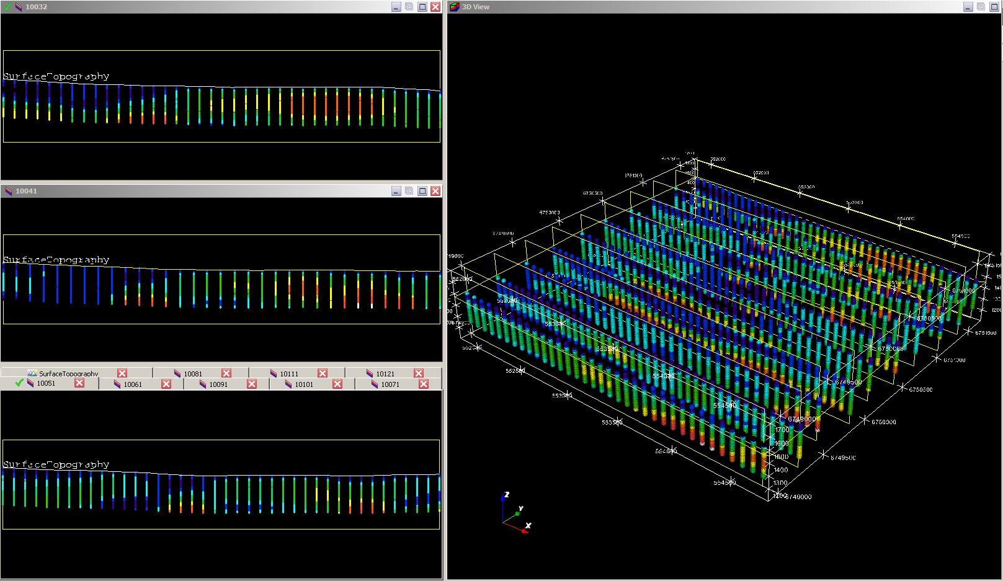
Save results into GeoModeller mesh grid and visualise on 2D sections and in 3D Viewer

Slide 13
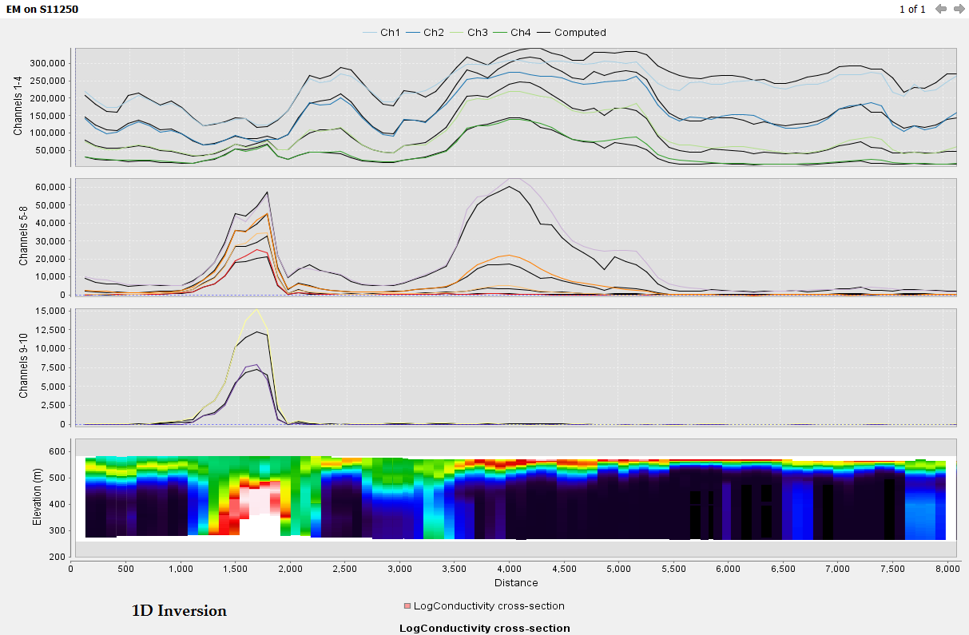
Checking 1D inversion misfit – black profiles
SPECTREM – Z Component Profiles and
Log Conductivity Section

Slide 14
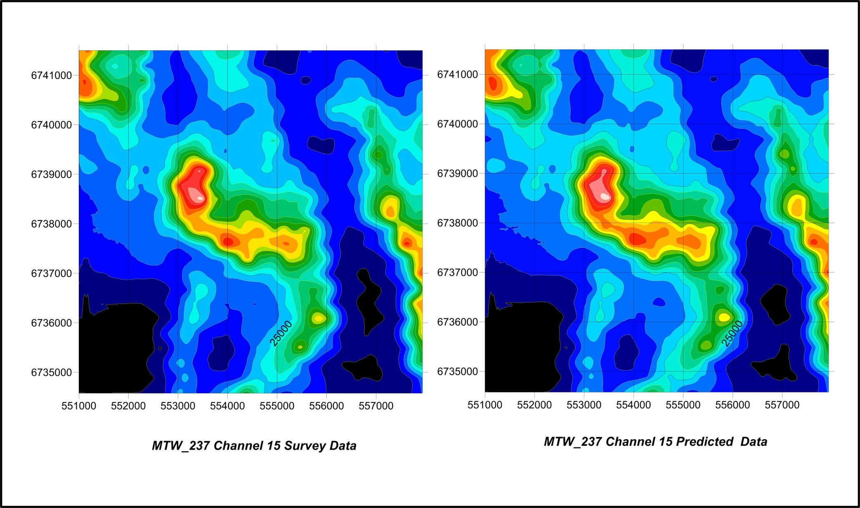
Checking the 1D inversion misfit – grid individual observed and computed inversion channels
Check individual channel (15) inversion misfits

Slide 15
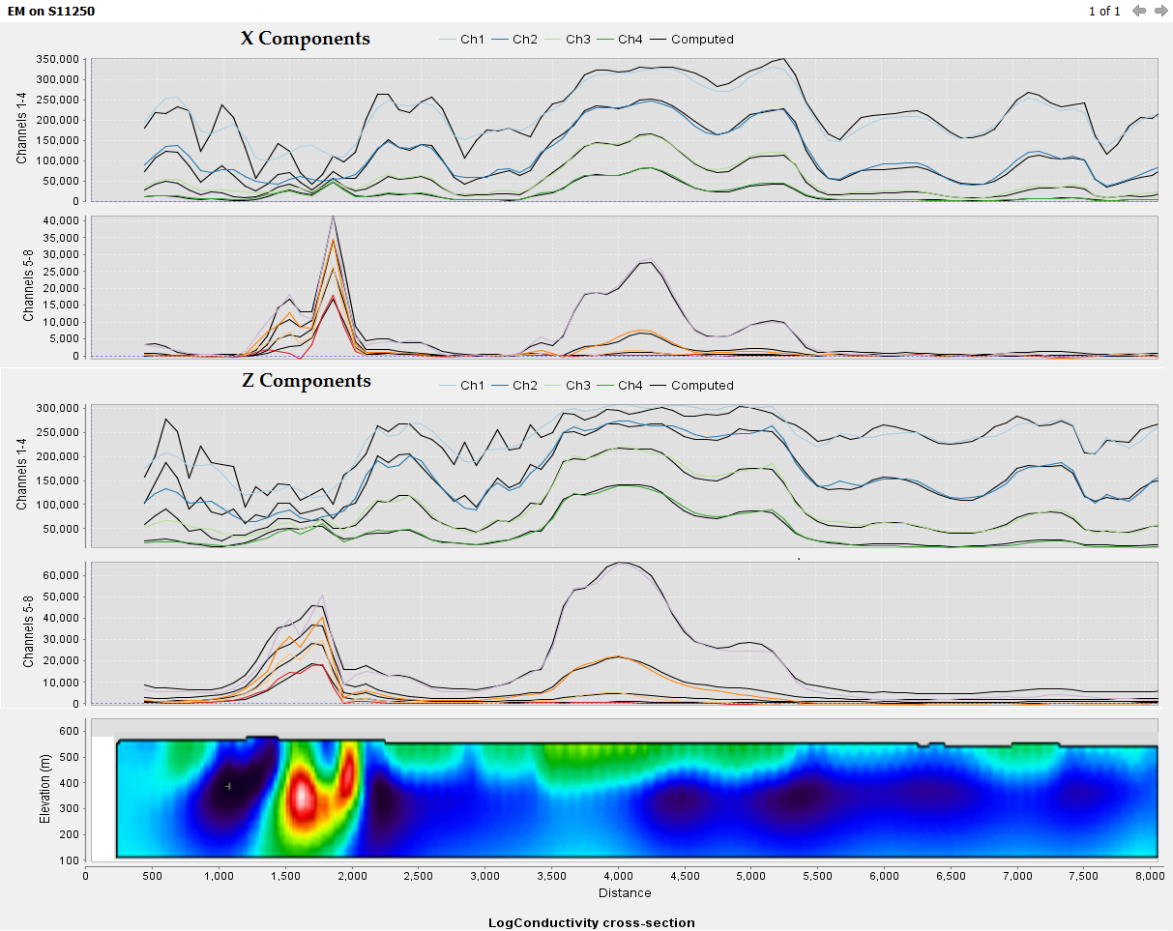
Checking 2D inversion misfits – black profiles
X Component
Z Component
SPECTREM – 2D Inversion X & Z Component Profiles and Conductivity Section

Slide 16
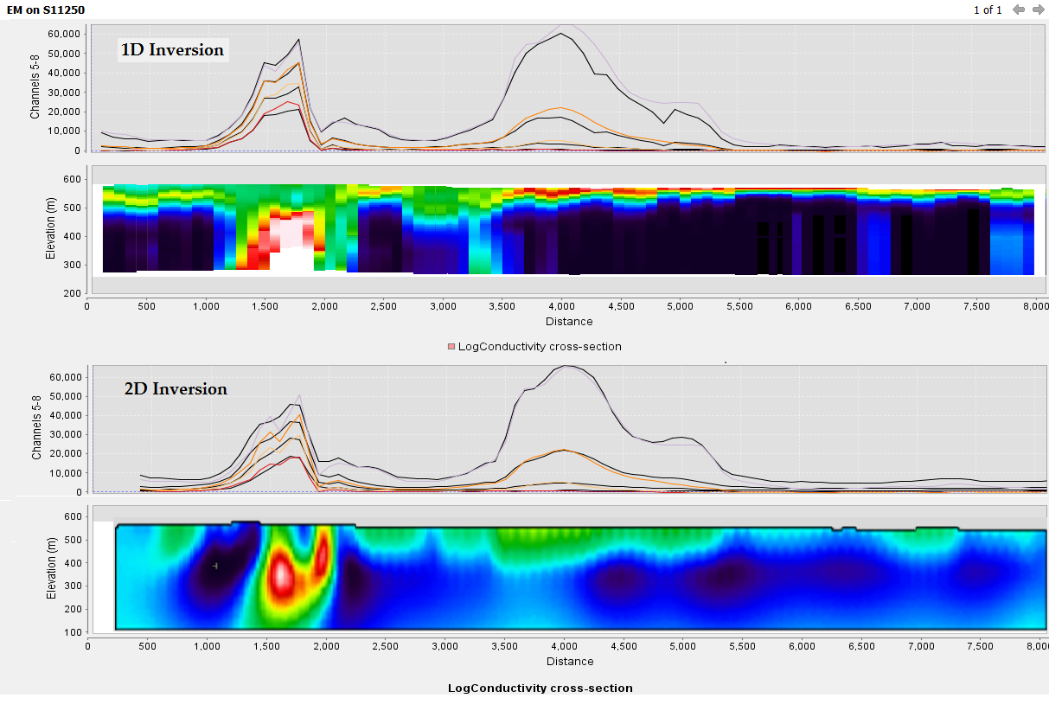
1D and 2D inversion Comparison – Z component
SPECTREM – 1D and 2D Inversion Z Component Ch6 to Ch8 Profiles and Conductivity Sections

Slide 17
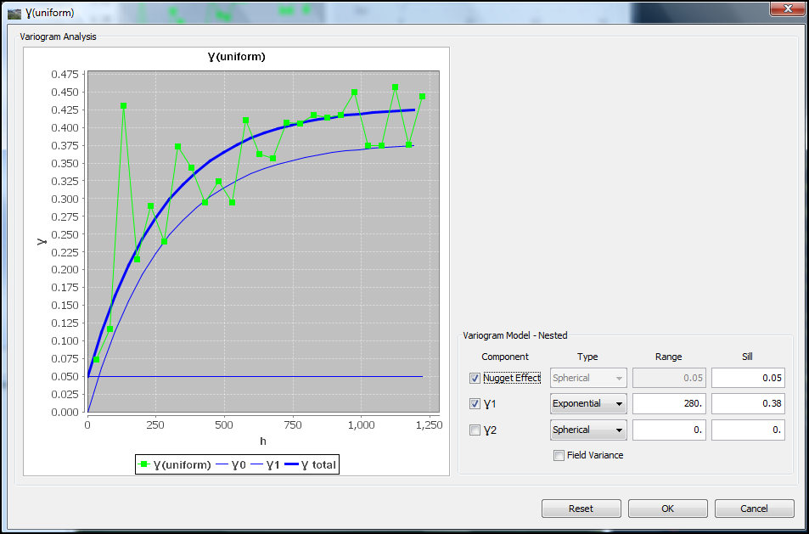
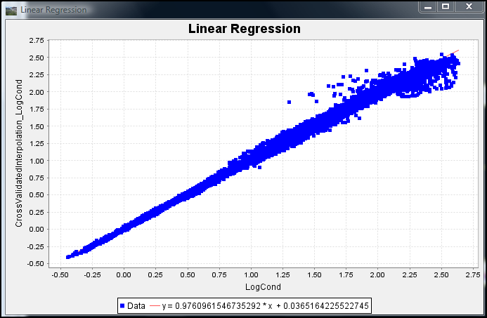
GeoModeller EM Inversion
Post Processing
Compute variogram for 1D LogCond and Cross Validate.

Slide 18
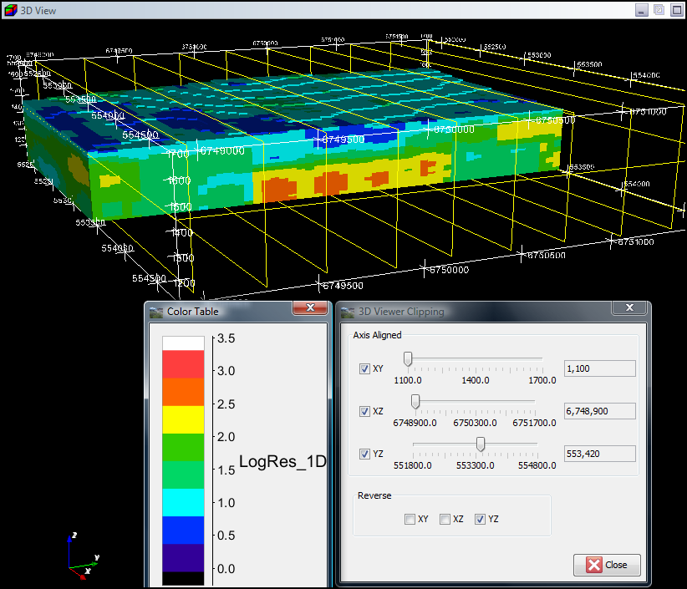
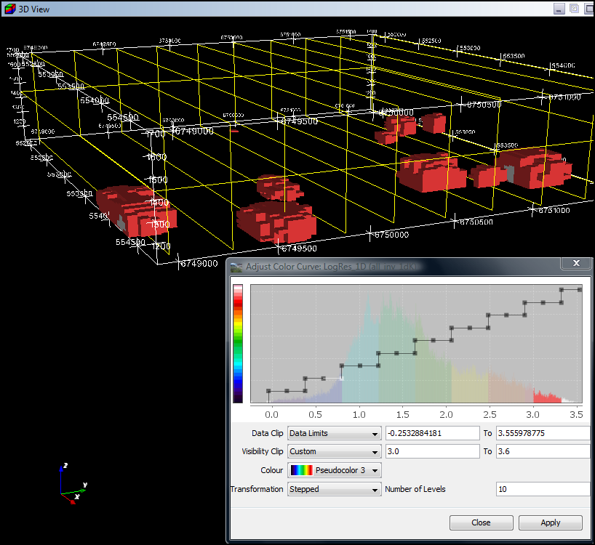
GeoModeller EM Inversion
Post Processing
Run kriging, create 3D voxet and visualise in 2D and 3D
Show LogRes >3.0
Resistivity Units

Slide 19
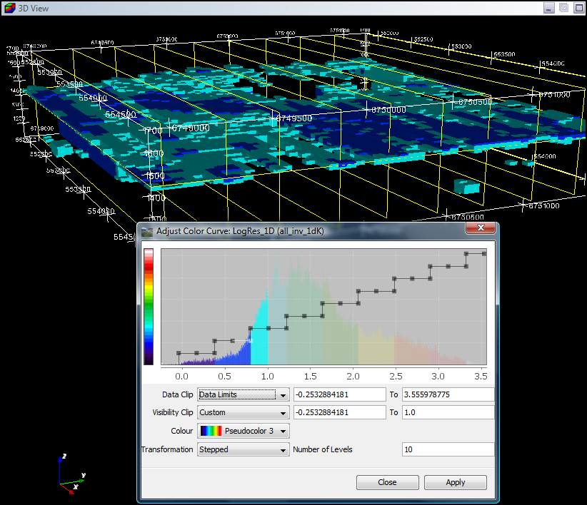
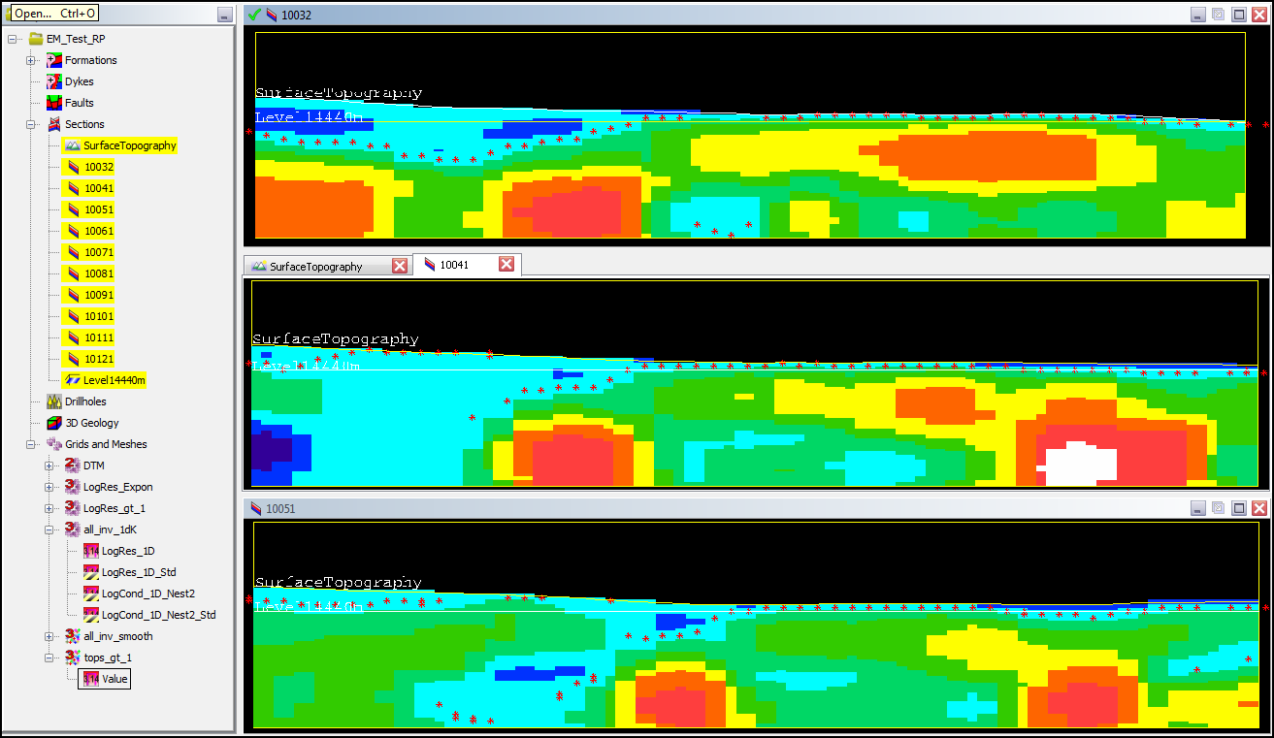
GeoModeller EM Inversion
Post Processing – Build Geology and Property Model
Run “Export surface shells” using log resistivity or conductivity and the range option to create surfaces (csv points) or triangulated shells.
Import CSV point surfaces or shells and use to create the GeoModeller section model formation boundaries.
Extract Surface at base of Conductive Cover; Top of Fm with LogRes > 1.0

Slide 20
GeoModeller EM Inversion
Future Plans
Implement Geological and Property constraints in 1D Inversion.
Add ability to fix (drillholes) or stiffen model elements from the GUI in 2D Inversion.
Add 3D Inversion support
Add support for MT and ZTEM.
Improve Inversion Speed and Memory management.

