Slide 1

Using jQuery
Dr. Charles Severance
www.wa4e.com
http://www.wa4e.com/code/jquery-01.zip

Slide 2


Time
Browser
Web Server
Database Server
DOM
Send
Request
Apache
MySql
Parse
Response
PHP
ind.php
PDO
JavaScript
JQuery
http://www.wa4e.com/code/rrc/

Slide 3
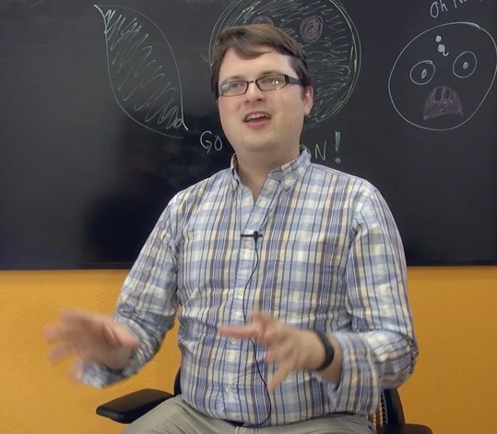
John Resig
Started jQuery in 2005 to make his web development projects easier
  - Elegant way to select DOM elements
  - Clean way to register events
Released in 2006
Works at Khan Academy as the “Dean of Computer Science”

Slide 4
jQuery Documentation
The web is a wonderful source of jQuery documentation.
    http://docs.jquery.com/Main_Page
    http://api.jquery.com/
    http://jqueryui.com/demos/
This lecture will only cover the basic elements of low-level JQuery.

Slide 5
<html>
<head>
</head>
<body>
<p>Here is some awesome page content</p>
<script type="text/javascript" src="jquery.min.js">
</script>
<script type="text/javascript">
$(document).ready(function(){
alert("Hello jQuery World!");
window.console && console.log('Hello jQuery..');
});
</script>
</body>
jquery-01/hello.php

Slide 6
jquery-01/resize.php
<html>
<head>
</head>
<body>
<script type="text/javascript" src="jquery.min.js">
</script>
<script type="text/javascript">
$(window).resize(function() {
console.log('.resize() called. width='+
$(window).width()+' height='+$(window).height());
});
</script>
<p>Here is some awesome page content</p>
</body>
http://api.jquery.com/resize/

Slide 7
jquery-01/toggle.php
<p id="para">Where is the spinner?
<img id="spinner" src="spinner.gif" height="25"
style="vertical-align: middle; display:none;">
</p>
<a href="#" onclick="$('#spinner').toggle();
return false;">Toggle</a>
<a href="#" onclick="$('#para').css('background-color', 'red');
return false;">Red</a>
<a href="#" onclick="$('#para').css('background-color', 'green');
return false;">Green</a>

Slide 8
Forms and jQuery

Slide 9
Time
Browser
Web Server
Database Server
DOM
Send
Request
Apache
MySql
Parse
Response
PHP
ind.php
PDO
JavaScript
JQuery
http://www.wa4e.com/code/rrc/

Slide 10
jquery-01/autoecho.php
<?php
sleep(5);
echo('You sent: '.$_POST['val']);
jquery-01/autopost.php
<form id="target">
<input type="text" name="one" value="Hello there"
style="vertical-align: middle;"/>
<img id="spinner" src="spinner.gif" height="25"
style="vertical-align: middle; display:none;">
</form>
<div id="result"></div>
...

Slide 11
<script type="text/javascript">
$('#target').change(function(event) {
$('#spinner').show();
var form = $('#target');
var txt = form.find('input[name="one"]').val();
window.console && console.log('Sending POST');
$.post( 'autoecho.php', { 'val': txt },
function( data ) {
window.console && console.log(data);
$('#result').empty().append(data);
$('#spinner').hide();
}
).error( function() {
$('#target').css('background-color', 'red');
alert("Dang!"); });
});
</script>
jquery-01/autopost.php

Slide 12
Summary
This focused on the mechanics of low-level JQuery.
  - Initialization setup
  - Event handling
  - DOM selection
  - DOM manipulation
  - Handling form data
Next we will look at how use JSON to read data from the server.

Slide 13
Acknowledgements / Contributions
These slides are Copyright 2010- Charles R. Severance (www.dr-chuck.com) as part of www.wa4e.com and made available under a Creative Commons Attribution 4.0 License. Please maintain this last slide in all copies of the document to comply with the attribution requirements of the license. If you make a change, feel free to add your name and organization to the list of contributors on this page as you republish the materials.
Initial Development: Charles Severance, University of Michigan School of Information
Insert new Contributors and Translators here including names and dates
Continue new Contributors and Translators here
Notes:
Note from Chuck. Please retain and maintain this page as you remix and republish these materials. Please add any of your own improvements or contributions.

Slide 14
Additional Source Information
Image of John Resig Copyright Charles R. Severance and licensed as CC-BY

