Slide 1



Temporal data with tsibble and fable
Oskar Krafft
Justus v. Samson-Himmelstjerna

Slide 2


Outlook
tsibble: tidy data analysis workflow for time series data
tidy data frames combined with temporal data
fable: forecasting for time series datain a table format
Provide forecasts with time distributions, not intervals.
Specify
Tidy
Visualise
Estimate
Forecast
Evaluate

Slide 3
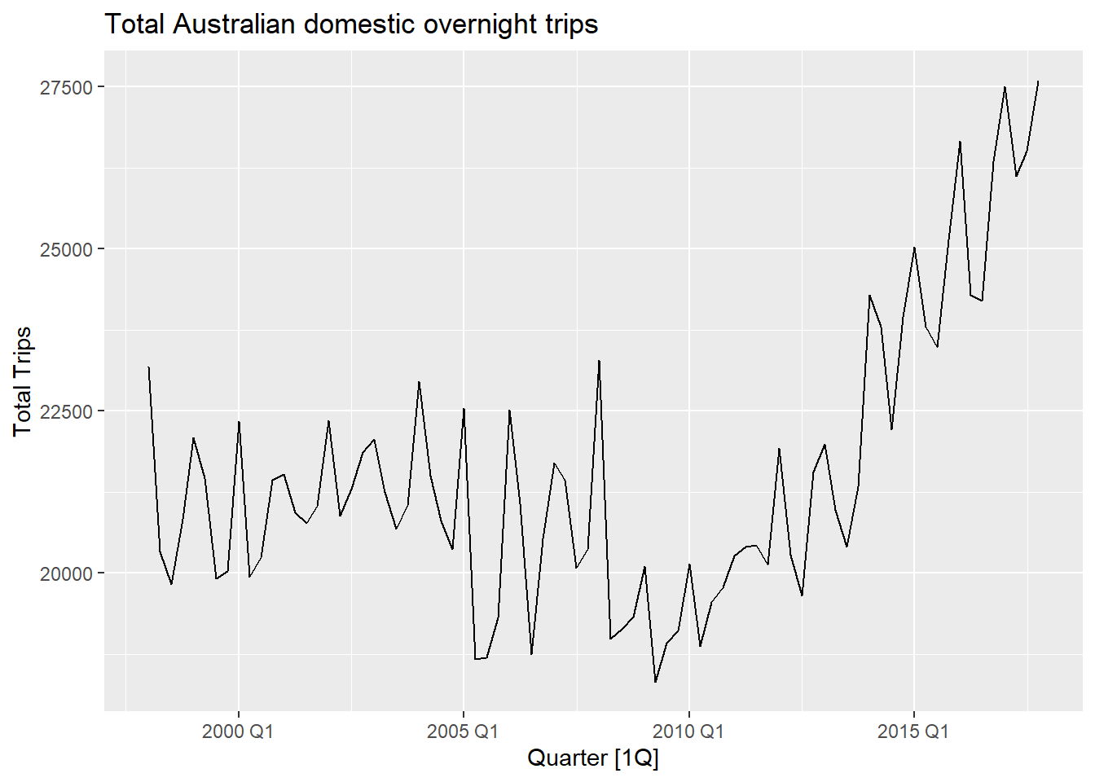
Vocabulary for time series analysis
Trends
Long-term overall increase or decrease in the Data
Does not have to be linear
Seasonal
Data affected by seasonal factors
Seasonality has fixed periods
Cyclic
Rises and falls of unknown frequency
For example economic cycles

Slide 4
Grammar of tsibble
Index is a variable with inherent ordering from past to present.
Key is a set of variables that define observational units over time.
Each observation should be uniquely identified by index and key.
Interval computed from index, ranging from year to nanosecond, from numerics to ordered factors.
Intervals can be Regular as well as Irregular
Interval | Class
Annual | integer/double
Quarterly | yearquarter
Monthly | yearmonth
Weekly | yearweek
Daily | Date/difftime
Subdaily | POSIXt/difftime/hms

Slide 5
Common verbs used in tsibble
as_tsibble() → Coerce Data to a tsibble object
count_gaps() → Count implicit gaps
fill_gaps() → Turn implicit missing values into explicit missing values
has_gaps() → Show if a tsibble has implicit gaps
filter_index() → filtering time index for a tsibble
index_by() → Group by time index and collapse with summarise()
group_by_key(). → Group by key variables

Slide 6
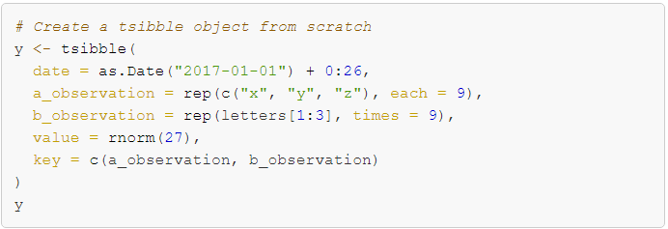
Data preparation and manipulation (tsibble)

Slide 7
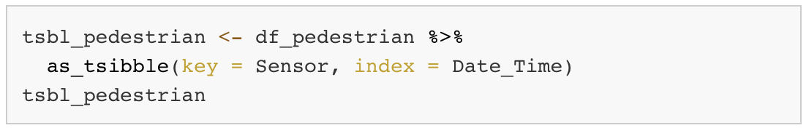
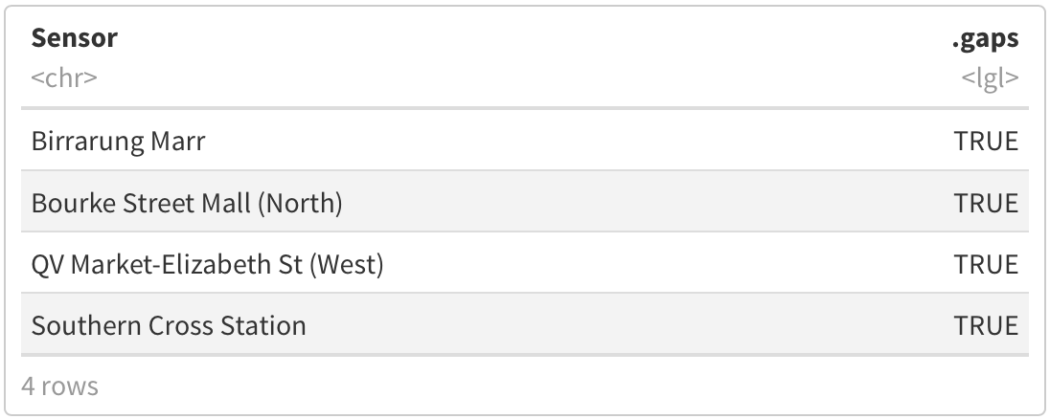
Data preparation and manipulation (tsibble)

Slide 8
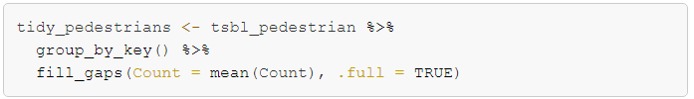
Data preparation and manipulation (tsibble)

Slide 9
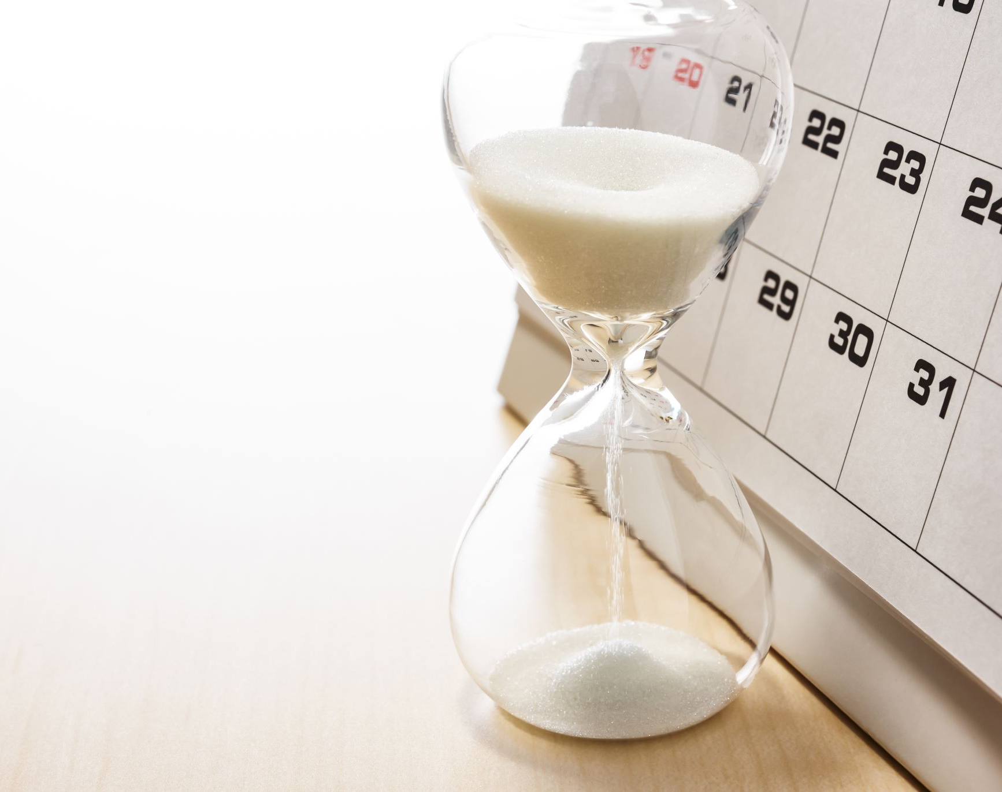
A forecasting workflow for time series data
Data preparation and manipulation
Model specification and estimation
Forecasting and choosing the best Model

Slide 10
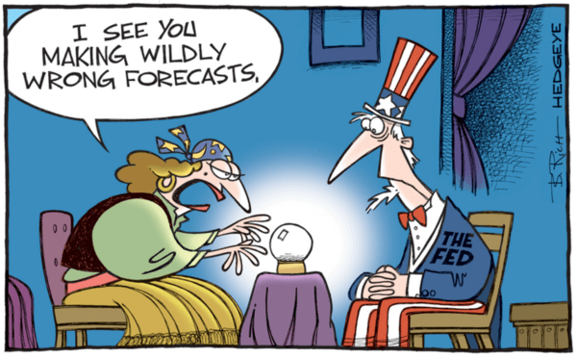
What even is Forecasting?
Image Source (last access: 16.11.2022

Slide 11
What even is Forecasting?
"Forecasting is about predicting the future as accurately as possible, given all of the information available, including historical data and knowledge of any future events that might impact the forecasts.“
The predictability of an event or a quantity depends on several factors including:
how well we understand the factors that contribute to it;
how much data is available;
how similar the future is to the past;
whether the forecasts can affect the thing we are trying to forecast.
Source: Hyndman, R.J., & Athanasopoulos, G. (2021)

Slide 12
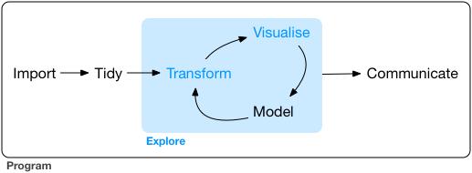
Fable in the Tidy Workflow
Specify
Tidy
Visualise
Estimate
Forecast
Evaluate

Slide 13
The tidy model syntax of fable
R> Transform(y) ~ {model specification}
Left Hand Side - Response | Right Hand Side - Specials
Defines the response variable from the Data | Model specific special functions
Specification of transformations (which are automatically back-transformed) | Several models at the same time possible

Slide 14
Common fable verbs and models
Model() → Model specification using models such as:
ETS() → Exponential smoothing
ARIMA() → Autoregressive integrated moving average model
TSLM() → Linear model with time series components
forecast() → Forecast Data using the specified model
glance() → Construct a single row summary of the model
Evaluation metrics e.g. accuracy() → Summarise the performance of the model using accuracy measures

Slide 15
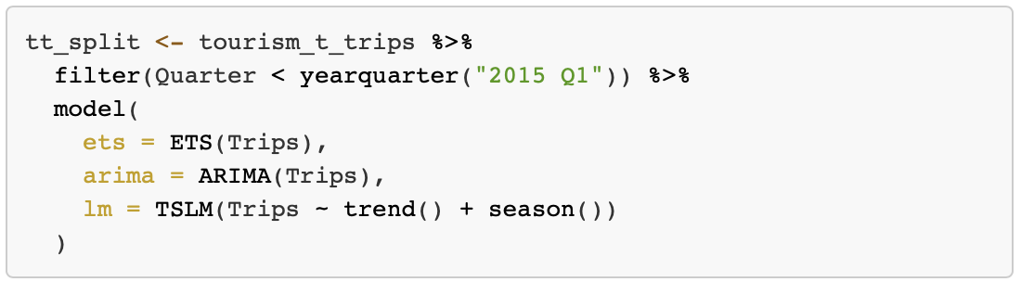
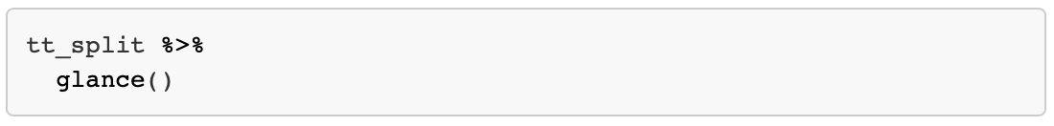
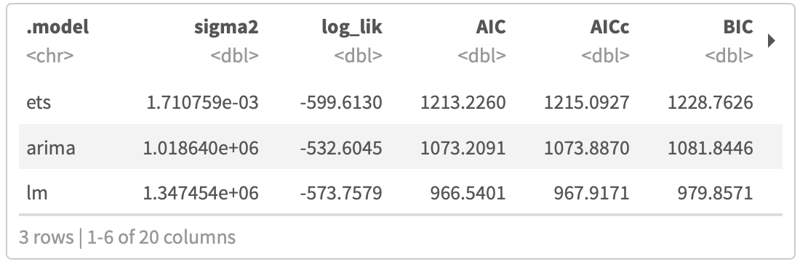
Model specification and forcasting (fable)

Slide 16
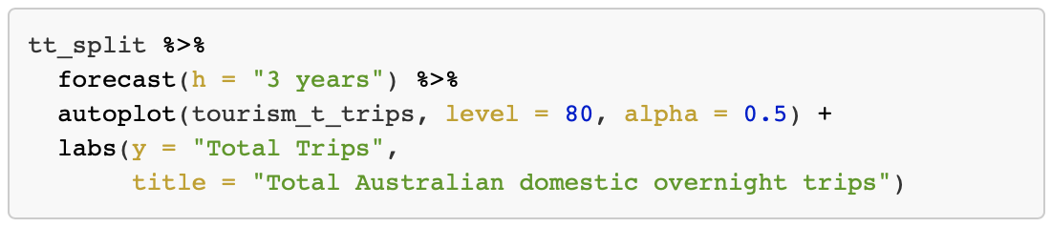
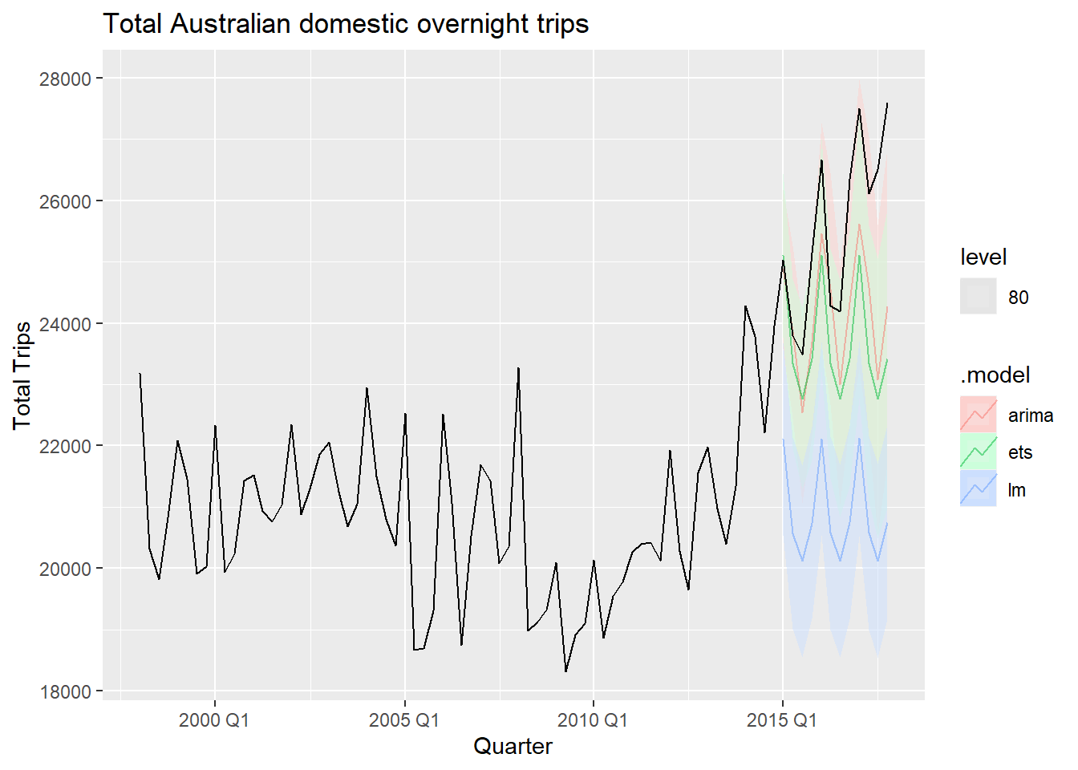
Producing forecasts

Slide 17
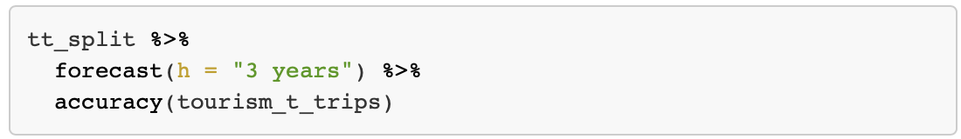
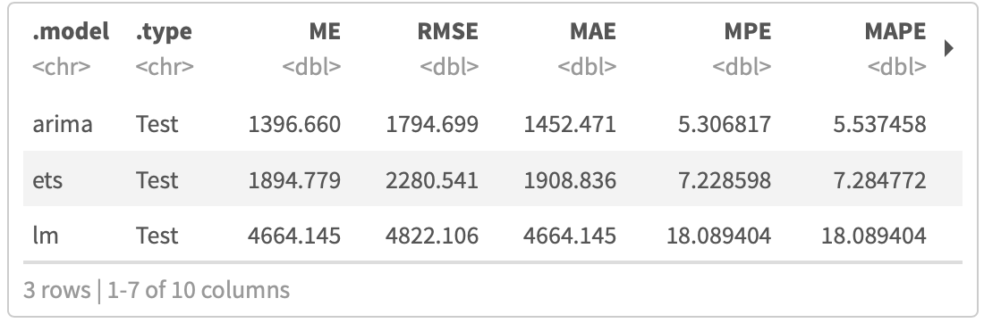
Producing forecasts

Slide 18
What have we learned today?
Time series can be described by Trends, Seasonality, and Cycles.
The tsibble package provides a data class to represent tidy temporal data.
A tsibble consists of a time index, key, and other measured variables in a data-centric format.
Further packages are building upon tsibble to further analyse and visualise temporal data.
Fable helps forecasting for time series data in a table format.
Keeping with the tidyverse models in fable define the response variable on the left hand side and model specific functions on the right hand side.
Fable can be used to produce forecasts and asses how well different models perform.

Slide 19
Further Reading
Tidyverse Webpage for tsibble: https://tsibble.tidyverts.org
Tidyverse Webpage for fable: https://fable.tidyverts.org
Cran Webpage by the tsibble creator:
http://cran.nexr.com/web/packages/tsibble/vignettes/intro-tsibble.html
Cran package description for tsibble:
https://cran.r-project.org/web/packages/tsibble/tsibble.pdf
Cran package description for fable:
https://cran.r-project.org/web/packages/fable/fable.pdf
Introduction to fable by package creator:
https://www.mitchelloharawild.com/blog/fable/
Book by Rob J Hyndman on forecasting principles:
https://otexts.com/fpp3/

Slide 20
