Slide 1
CSE 326: Data Structures
Lecture #3
Analysis of Recursive Algorithms
Alon Halevy
Fall Quarter 2000

Slide 2
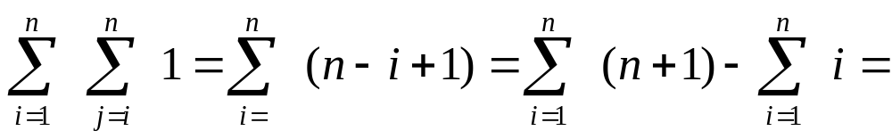
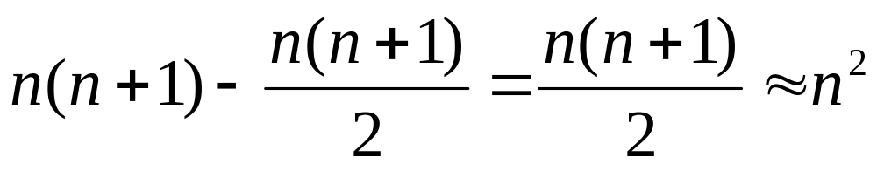
Nested Dependent Loops
for i = 1 to n do
for j = i to n do
sum = sum + 1
Notes:
There’s a little twist here. J goes from I to N, not 1 to N.
So, let’s do the sums
inside is constant.
Next loop is sum I to N of 1 which equals N - I + 1
Outer loop is sum 1 to N of N - I + 1
That’s the same as
sum N to 1 of I
or N(N+1)/2
or O(N^2)

Slide 3
Recursion
A recursive procedure can often be analyzed by solving a recursive equation
Basic form:
  T(n) = if (base case) then some constant
  else ( time to solve subproblems +
  time to combine solutions )
Result depends upon
  how many subproblems
  how much smaller are subproblems
  how costly to combine solutions (coefficients)
Notes:
You may want to take notes on this slide as it just vaguely resembles a homework problem!
Here’s a function defined in terms of itself. You see this a lot with recursion. This one is a lot like the profile for factorial.
WORK THROUGH
Answer: O(n)

Slide 4
Example: Sum of Integer Queue
sum_queue(Q){
if (Q.length == 0 ) return 0;
else return Q.dequeue() +
sum_queue(Q); }
  One subproblem
  Linear reduction in size (decrease by 1)
  Combining: constant c (+), 1×subproblem
Equation: T(0) ≤ b
T(n) ≤ c + T(n – 1) for n>0
Notes:
Here’s a function defined in terms of itself. You see this a lot with recursion. This one is a lot like the profile for factorial.
WORK THROUGH
Answer: O(n)

Slide 5
Sum, Continued
Equation: T(0) ≤ b
T(n) ≤ c + T(n – 1) for n>0
Solution:
T(n) ≤ c + c + T(n-2)
≤ c + c + c + T(n-3)
≤ kc + T(n-k) for all k
≤ nc + T(0) for k=n
≤ cn + b = O(n)

Slide 6
Example: Binary Search
7
12
30
35
75
83
87
90
97
99
One subproblem, half as large
Equation: T(1) ≤ b
T(n) ≤ T(n/2) + c for n>1
Solution:
T(n) ≤ T(n/2) + c
≤ T(n/4) + c + c
≤ T(n/8) + c + c + c
≤ T(n/2^{k}) + kc
≤ T(1) + c log n where k = log n
≤ b + c log n = O(log n)
Notes:
Generally, then, the strategy is to keep expanding these things out until you see a pattern. Then, write the general form. Finally, sub in for the series bounds to make T(?) come out to a known value and solve all the series.
Tip: Look for powers/multiples of the numbers that appear in the original equation.

Slide 7
Example: MergeSort
Split array in half, sort each half, merge together
  2 subproblems, each half as large
  linear amount of work to combine
T(1) ≤ b
T(n) ≤ 2T(n/2) + cn for n>1
T(n) ≤ 2T(n/2)+cn ≤ 2(2(T(n/4)+cn/2)+cn
= 4T(n/4) +cn +cn ≤ 4(2(T(n/8)+c(n/4))+cn+cn
= 8T(n/8)+cn+cn+cn ≤ 2kT(n/2k)+kcn
2kT(1) + cn log n where k = log n
= O(n log n)
Notes:
This is the same sort of analysis as last slide.
Here’s a function defined in terms of itself.
WORK THROUGH
Answer: O(n log n)
Generally, then, the strategy is to keep expanding these things out until you see a pattern. Then, write the general form. Finally, sub in for the series bounds to make T(?) come out to a known value and solve all the series.
Tip: Look for powers/multiples of the numbers that appear in the original equation.

Slide 8
Example: Recursive Fibonacci
Recursive Fibonacci:
int Fib(n){
if (n == 0 or n == 1) return 1 ;
else return Fib(n - 1) + Fib(n - 2); }
Running time: Lower bound analysis
T(0), T(1) ≥ 1
T(n) ≥ T(n - 1) + T(n - 2) + c if n > 1
Note: T(n) ≥ Fib(n)
Fact: Fib(n) ≥ (3/2)^{n}
O( (3/2)^{n} ) Why?
Notes:
This is the same sort of analysis as last slide.
Here’s a function defined in terms of itself.
WORK THROUGH
Answer: O(log n)
Generally, then, the strategy is to keep expanding these things out until you see a pattern. Then, write the general form. Finally, sub in for the series bounds to make T(?) come out to a known value and solve all the series.

Slide 9
Direct Proof of Recursive Fibonacci
Recursive Fibonacci:
int Fib(n)
if (n == 0 or n == 1) return 1
else return Fib(n - 1) + Fib(n - 2)
Lower bound analysis
T(0), T(1) >= b
T(n) >= T(n - 1) + T(n - 2) + c if n > 1
Analysis
let φ be (1 + √5)/2 which satisfies φ² = φ + 1
show by induction on n that T(n) >= bφ^{n - 1}
Notes:
This is the same sort of analysis as last slide.
Here’s a function defined in terms of itself.
WORK THROUGH
Answer: O(log n)
Generally, then, the strategy is to keep expanding these things out until you see a pattern. Then, write the general form. Finally, sub in for the series bounds to make T(?) come out to a known value and solve all the series.

Slide 10
Direct Proof Continued
Basis: T(0) ≥ b > bφ⁻¹ and T(1) ≥ b = bφ⁰
Inductive step: Assume T(m) ≥ bφ^{m - 1} for all m < n
T(n) ≥ T(n - 1) + T(n - 2) + c
≥ bφ^{n-2} + bφ^{n-3} + c
≥ bφ^{n-3}(φ + 1) + c
= bφ^{n-3}φ² + c
≥ bφ^{n-1}

Slide 11
Fibonacci Call Tree
5
3
4
3
2
1
2
1
2
0
1
0
1
0
1

Slide 12
Learning from Analysis
To avoid recursive calls
  store all basis values in a table
  each time you calculate an answer, store it in the table
  before performing any calculation for a value n
    check if a valid answer for n is in the table
    if so, return it
Memoization
  a form of dynamic programming
How much time does memoized version take?

Slide 13
Kinds of Analysis
So far we have considered worst case analysis
We may want to know how an algorithm performs “on average”
Several distinct senses of “on average”
  amortized
    average time per operation over a sequence of operations
  average case
    average time over a random distribution of inputs
  expected case
    average time for a randomized algorithm over different random seeds for any input

Slide 14
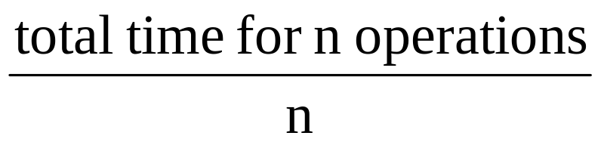
Amortized Analysis
Consider any sequence of operations applied to a data structure
  your worst enemy could choose the sequence!
Some operations may be fast, others slow
Goal: show that the average time per operation is still good

Slide 15
Stack ADT
A
E D C B A
B
C
D
E
F
F
Stack operations
  push
  pop
  is_empty
Stack property: if x is on the stack before y is pushed, then x will be popped after y is popped
  What is biggest problem with an array implementation?

Slide 16
Stretchy Stack Implementation
int data[];
int maxsize;
int top;
Push(e){
if (top == maxsize){
temp = new int[2*maxsize];
copy data into temp;
deallocate data;
data = temp; }
else { data[++top] = e; }
Best case Push = O( )
Worst case Push = O( )

Slide 17
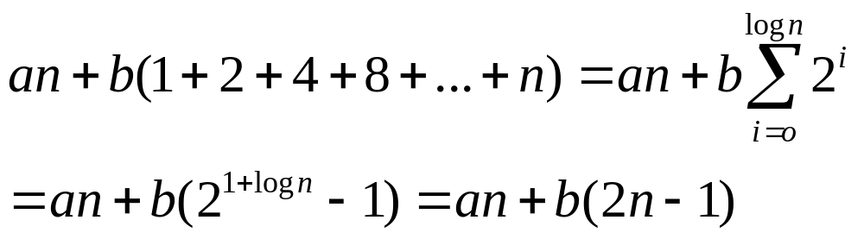
Stretchy Stack Amortized Analysis
Consider sequence of n operations
  push(3); push(19); push(2); …
What is the max number of stretches?
What is the total time?
  let’s say a regular push takes time a, and stretching an array contain k elements takes time kb, for some constants a and b.
Amortized time = (an+b(2n-1))/n = O(1)
log n

Slide 18
Wrapup
Having math fun?
Homework #1 out wednesday – due in one week
Programming assignment #1 handed out.
Next week: linked lists

