Slide 1
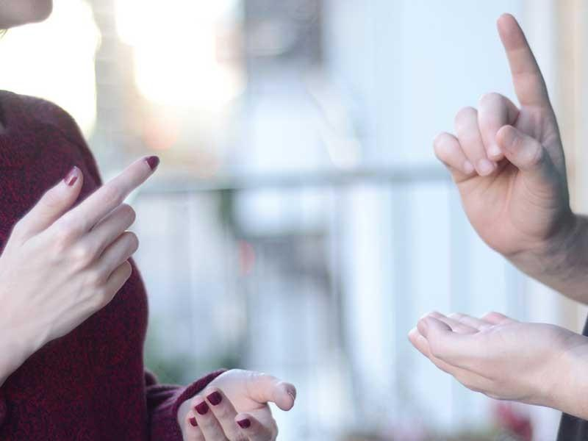
SIGN LANGUAGE DETECTION
Using Machine Learning
Group ID : G13

Slide 2

RAJKIYA ENGINEERING COLLEGE BIJNOR
(Affiliated to Dr. A.P.J Abdul Kalam Technical University, Lucknow)
SIGN LANGUAGE DETECTION
PROJECT
MENTORS:
Dr. ISHAN BHARDWAJ
(HOD - IT Dept)
Prof. SUDHIR GOSWAMI
(Ass. Prof - IT Dept)
MEMBERS:
KUMAR SHANU (1773513025)
MUSKAN MAHESHWARI (1773513032)
RAHUL (1773513037)
VISHAL (1773513061)

Slide 3
Work done till 7th semester
Collected dataset of American sign language (ASL)
Preprocessing of dataset
Load dataset and analyse the data
Build a basic model
Check accuracy
Plan to improve accuracy of model with CNN (Convolutional Neural Network)

Slide 4
CONTENTS
Collecting dataset
Preprocessing of data
Split dataset in to train and valid
Build a basic model
Training of model
Convolutional Neural Network (CNN)
Build model with CNN
Data Augmentation
Train the model and check final accuracy
Deployment of model

Slide 5
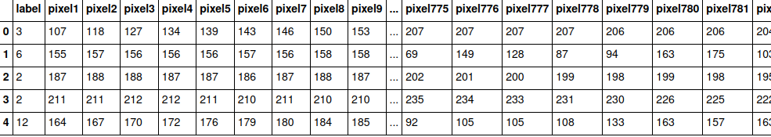
Collecting Dataset
This dataset is available from the website Kaggle, which is a fantastic place to find datasets and other deep learning resources. In addition to providing resources like datasets and "kernels" that are like these notebooks, Kaggle hosts competitions that you can take part in, competing with others in training highly accurate models.

Slide 6
Preprocessing of Dataset
Exploring the Data
Let's take a look at our data. We can use the “head” method to print the first few rows of the DataFrame. Each row is an image which has a label column, and also, 784 values representing each pixel value in the image, just like with the MNIST dataset. Note that the labels currently are numerical values, not letters of the alphabet.
Extracting the Labels
we would like to store our training and validation labels in y_train and y_valid variables. Here we create those variables and then delete the labels from our original data frames where they are no longer needed.

Slide 7
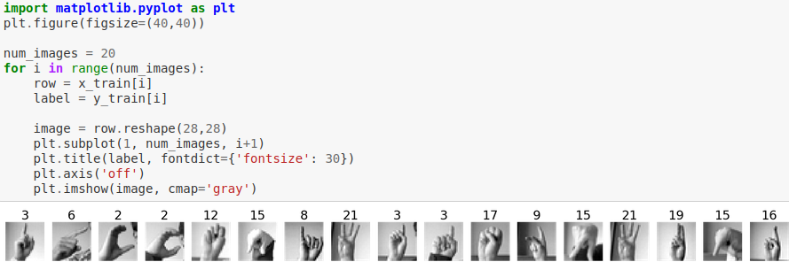
Preprocessing of Dataset
Visualizing the Data
To visualize the images, we will again use the Matplotlib library. We don't need to worry about the details of this visualization, but if interested, you can learn more about “matplotlib”at a later time.

Slide 8
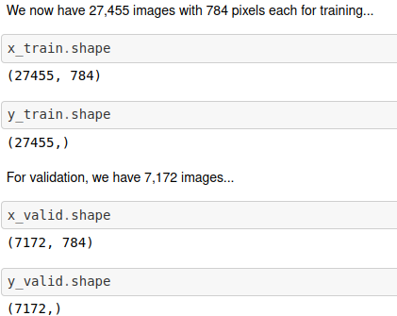
Splitting of Dataset in to train and valid
Train dataset: Used to fit the machine learning model
Valid dataset: Used to evaluate the fit machine learning model
Train dataset contains about 80 % data for fit the model and remaining 20 % data in valid for evaluation

Slide 9
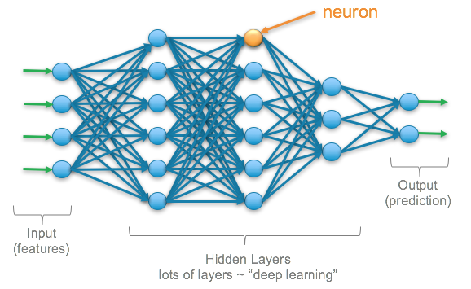
Build a basic model
We are going to build a sequential model:
Has a dense input layer. This layer should contain 512 neurons, use the relu activation function, and expect input images with a shape of (784,)
Has a second dense layer with 512 neurons which uses the relu activation function
Has a dense output layer with neurons equal to the number of classes, using the softmax activation function

Slide 10
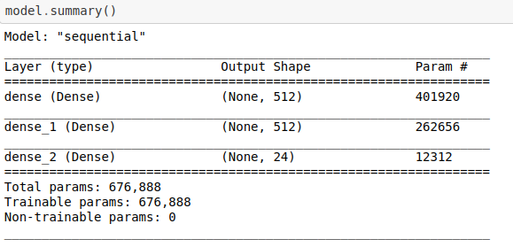
Build a basic model
We have to import some libraries like :
TensorFlow and Keras
Summarising the model: Using “summary” function.

Slide 11
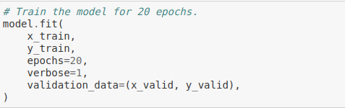
Training of model
Use the model's fit method to train it for 20 epochs using the training and validation
An epoch is a term used in machine learning and indicates the number of passes of the entire training dataset the machine learning algorithm has completed.

Slide 12
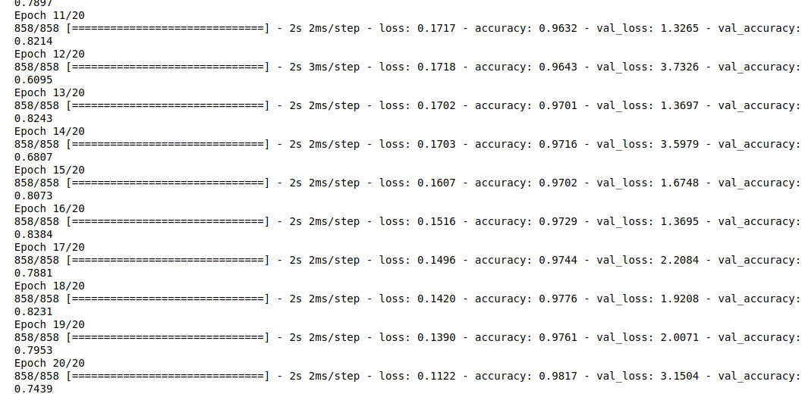
Training of model
As we can see in above model valid accuracy is less than accuracy and loss is slightly high.
So now we have applied CNN (Convolutional Neural Network) for better performance.

Slide 13
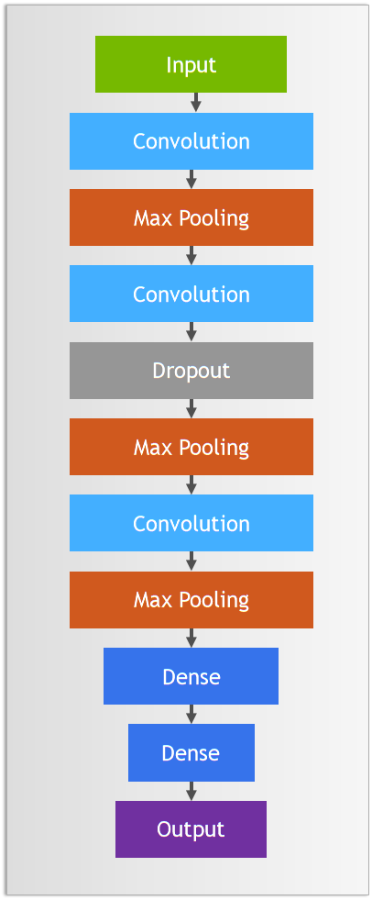
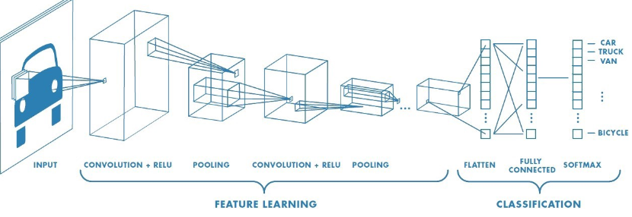
Convolutional Neural Network (CNN)
A Convolutional Neural Network (CNN) is a Deep Learning algorithm which can take in an input image, assign importance to various aspects in the image and be able to differentiate one from the other.

Slide 14
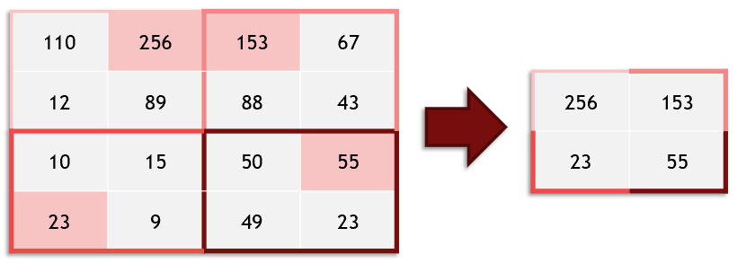
Convolutional Neural Network (CNN)
Batch Normalization Like normalizing our inputs, batch normalization scales the values in the hidden layers to improve training.
Maxpool2D: Max pooling takes an image and essentially shrinks it to a lower resolution. It does this to help the model be robust to translation (objects moving side to side), and also makes our model faster.

Slide 15
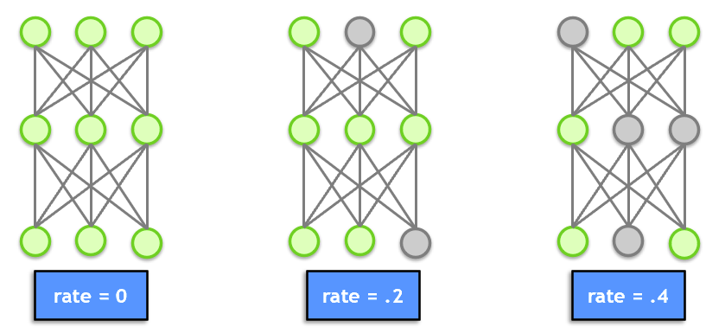
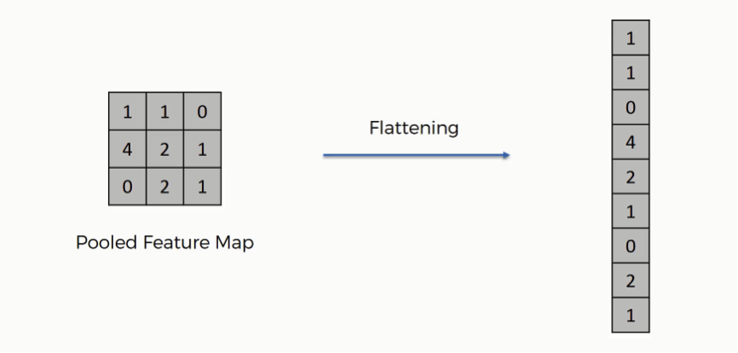
Dropout: Dropout is a technique for preventing overfitting. Dropout randomly selects a subset of neurons and turns them off, so that they do not participate in forward or backward propagation in that particular pass. This helps to make sure that the network is robust and redundant, and does not rely on any one area to come up with answers.
Flatten: Flatten takes the output of one layer which is multidimensional, and flattens it into a one-dimensional array. The output is called a feature vector and will be connected to the final classification layer.

Slide 16
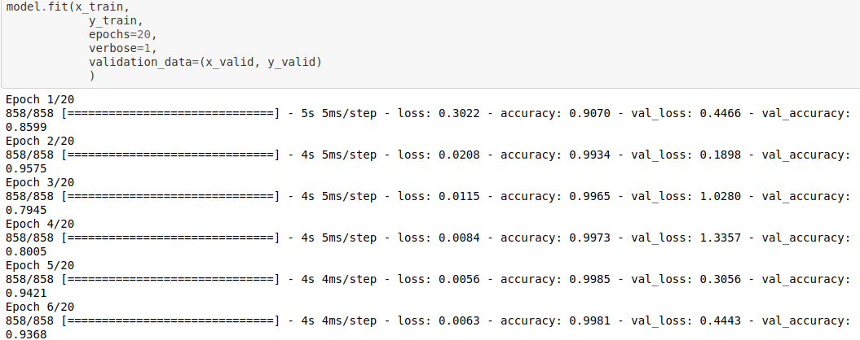
Build model with CNN
After building the model with Convolutional Neural Network, we are going to train the model:
As we can see from epoch 2 to epoch 3 val_accuracy is drastically down and it happens in many more epochs.
So we apply Data Augmentation technique.

Slide 17
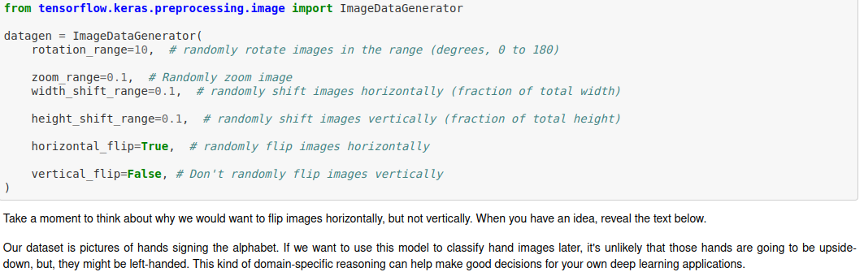
Data Augmentation
Data augmentation is a technique to artificially create new training data from existing training data. This means, variations of the training set images that are likely to be seen by the model.
The increase in size gives the model more images to learn from while training. The increase in variance helps the model ignore unimportant features and select only the features that are truly important in classification, allowing it to generalize better.

Slide 18
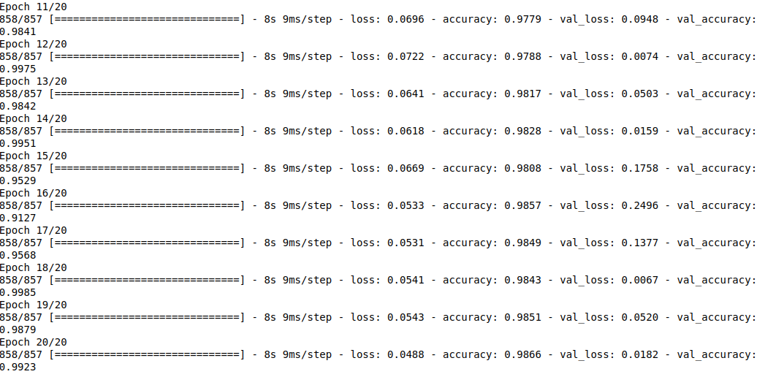
Data Augmentation
Training the model with Augmentation:
When using an image data generator with Keras, a model trains a bit differently: instead of just passing the x_train and y_train datasets into the model, we pass the generator in, calling the generator's flow method.

Slide 19
Training the model and check final accuracy
As we can see, model accuracy with CNN and Data Augmentation is higher and more consistent.
This means that our model is no longer overfitting in the way it was; it generalizes better, making better predictions on new data.
In epoch 20 val_accuracy is 98.223 and accuracy is 96.66 and loss is 0.0488, Now we can say model gives accurate result.
Save the model and move to predicting the model

Slide 20
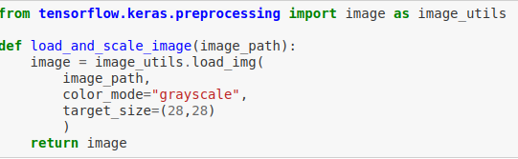
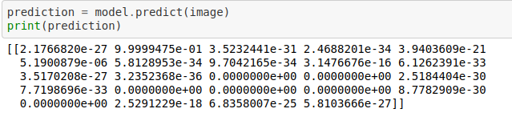
Deployment of model
Prepare function to load and scale image data:
Making prediction:
It gives result in 24 length array having probability.

Slide 21
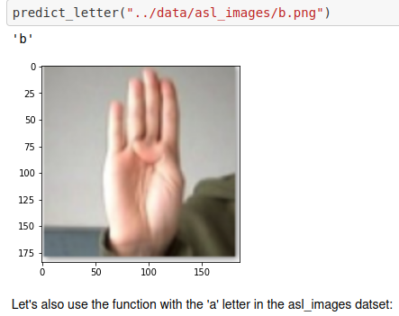
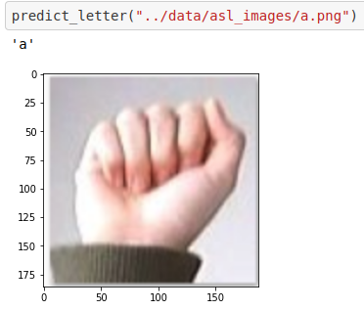
Deployment of model
We make a dictionary with keys and values for better understanding and desired prediction.
Keys: { 0,1,2,3,4………….24}
Values: { a,b,c,d….i,k,l……….y}
We pass sign image of “a” and “b” in model, it gives accurate result.

Slide 22
Any Question ?

Slide 23

Thank you !

