Slide 1

RAJKIYA ENGINEERING COLLEGE BIJNOR
(Affiliated to Dr. A.P.J Abdul Kalam Technical University)
SESSION 2020-21
MACHINE LEARNING
PROJECT:
WINE QUALITY TEST
Submitted By-
RAHUL
1773513037
Submitted To-
Mr. Santosh Kumar (Assistant Professor) (Information Technology)

Slide 2
What is machine learning?
“Machine learning focuses on applications that learn from experience and improve their decision-making or predictive accuracy over time. “
Machine learning is a branch of Artificial Intelligence focused on building applications that learn from data and improve their accuracy over time without being programmed to do so.
Machine Learning is a subset of Artificial Intelligence. Machine Learning is the study of making machines more human-like in their behaviour and decisions by giving them the ability to learn and develop their own programs.
1

Slide 3


INDUSTRIAL TRAINING CERTIFICATE
V
tr
INTERNSHALA TRAININGS
Certificate of Training
Rahul
from Rajkiya Engineering College Bijnor has successfully completed a six weeks online training on Machine Learning. The training consisted of Introduction to Machine Learning, Python for Machine Learning, Machine Learning Life Cycle, Data Exploration and Manipulation, Build Your First Model, Evaluation Metrics, k-NN, Selecting the Right Model, Linear Regression, Logistic Regression, Decision Trees, Feature Engineering, Basics of Ensemble Models, Random Forest and Clustering modules. Rahul scored 99% marks in the final assessment and is a top performer in the training. We wish Rahul all the
best for the future.
Sarvesh Agrawal
Founder & CEO, Internshala
Date of certification: 2020-08-12
Certificate no.: E48FEFEE-344D-3208-2CCB-F266D9208E98
For certificate authentication, please visit https://trainings.internshala.com/verify_certificate
2

Slide 4
PROJECT
WINE QUALITY TEST PROJEC
]
(using Machine Learning with Python)
First I have done some exploration on the data using matplotlib and seaborn. Then, I use different
3

Slide 5
classifier models to predict the quality of the wine.
1. Random Forest Classifier
2. Stochastic Gradient Descent Classifier
3. Support Vector Classifier(SVC)
Then I use cross validation evaluation technique to optimize the model performance.
1. Grid Search CV
2. Cross Validation Score
1. IMPLEMENTATION
Importing required packages:
import pandas as pd
4

Slide 6
import seaborn as sns import matplotlib.pyplot as plt
from sklearn.ensemble import RandomForestClassifier
from sklearn.svm import SVC
from sklearn.linear_model import SGDClassifier
from sklearn.metrics import confusion_matrix, classification_report
from sklearn.preprocessing import StandardScaler, LabelEncoder
from sklearn.model_selection import train_test_split, GridSearchCV, cross_val_score
%matplotlib inline
Loading dataset:
wine = pd.read_csv('../input/winequality-red.csv')
#How data is distributed wine.head()
 | fixed acidity | volatile acidity | citric acid | residual sugar | chlorides | free sulfur dioxide | total sulfur dioxide | density | PH | sulphates | alco
0 | 7.4 | 0.70 | 0.00 | 1.9 | 0.076 | 11.0 | 34.0 | 0.9978 | 3.51 | 0.56 | 9.4
1 | 7.8 | 0.88 | 0.00 | 2.6 | 0.098 | 25.0 | 67.0 | 0.9968 | 3.20 | 0.68 | 9.8
2 | 7.8 | 0.75 | 0.04 | 2.3 | 0.092 | 15.0 | 54.0 | 0.9970 | 3.26 | 0.65 | 9.8
3 | 11.2 | 0.28 | 0.56 | 1.9 | 0.075 | 17.0 | 60.0 | 0.9980 | 3.16 | 0.58 | 9.8
4 | 7.4 | 0.70 | 0.00 | 1.9 | 0.076 | 11.0 | 34.0 | 0.9978 | 3.51 | 0.56 | 9.4
#Information about the data columns wine.info()
5

Slide 7
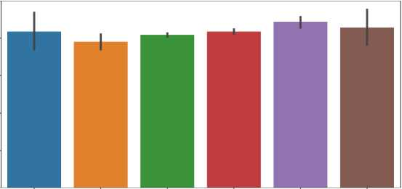
<class 'pandas.core.frame.DataFrame'> Rangelndex: 1599 entries, 0 to 1598 Data columns (total 12 columns):
fixed acidity | 1599 | non-null | float64
volatile acidity | 1599 | non-null | float64
citric acid | 1599 | non-null | float64
residual sugar | 1599 | non-null | float64
chlorides | 1599 | non-null | float64
free sulfur dioxide | 1599 | non-null | float64
total sulfur dioxide | 1599 | non-null | float64
density | 1599 | non-null | float64
pH | 1599 | non-null | float64
sulphates | 1599 | non-null | float64
alcohol | 1599 | non-null | float64
quality | 1599 | non-null | int64
dtypes: float64(11), int64(l) memory usage: 150.0 KB
#Plotting to know how data column are distributed
fig = plt.figure(figsize = (10,6)) sns.barplot(x = 'quality', y = 'fixed acidity', data = wine)
fig = plt.figure(figsize = (10,6))
sns.barplot(x = 'quality', y = 'volatile acidity', data = wine)
6

Slide 8
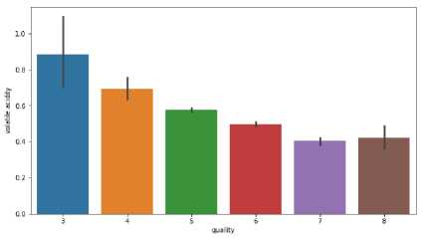
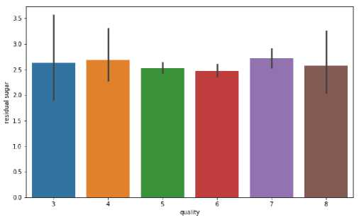
#Composition of citric acid go higher as we go higher in the quality of the wine fig = plt.figure(figsize = (10,6))
sns.barplot(x = 'quality', y = 'residual sugar', data = wine)
fig = plt.figure(figsize = (10,6))
sns.barplot(x = 'quality', y = 'chlorides', data = wine)
7

Slide 9
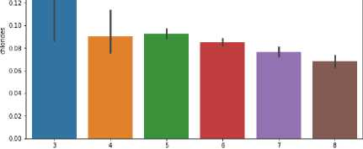
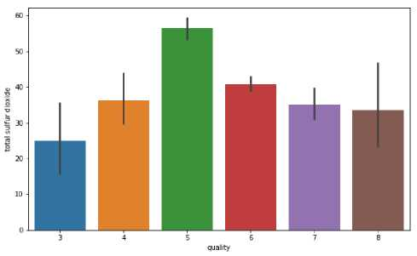
fig = plt.figure(figsize = (10,6))
sns.barplot(x = 'quality', y = 'total sulfur dioxide', data = wine)
fig = plt.figure(figsize = (10,6))
sns.barplot(x = 'quality', y = 'sulphates', data = wine)
8

Slide 10
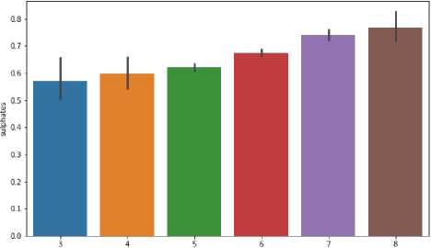
quality
Preprocessing Data for performing Machine learning algorithms
#Making binary classificaion for the response variable.
#Dividing wine as good and bad by giving the limit for the quality
bins = (2, 6.5, 8) group_names = ['bad', 'good']
wine['quality'] = pd.cut(wine['quality'], bins = bins, labels = group_names) label_quality = LabelEncoder()
wine['quality'] = label_quality.fit_transform(wine['quality']) wine['quality'].value_counts()
9

Slide 11
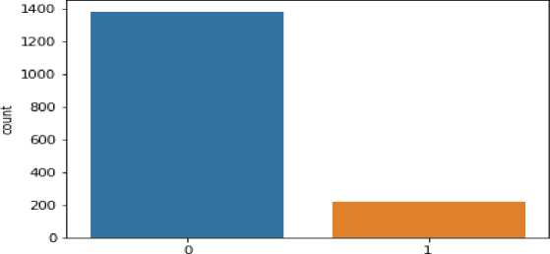
0 1382
1 217
Name: quality, dtype: int64
sns.countplot(wine['quality'])
#Now seperate the dataset as response variable and feature variabes X = wine.drop('quality', axis = 1) y = wine['quality']
#Train and Test splitting of data
X_train, X_test, y_train, y_test = train_test_split(X, y, test_size = 0.2, random_state = 42)
#Applying Standard scaling to get optimized result sc = StandardScaler()
10

Slide 12
X_tra in = sc.fit_transform(X_train) X_test = sc.fit_transform(X_test)
Our training and testing data is ready now to perform machine learning algorithm
Random Forest Classifier
rfc = RandomForestClassifier(n_estimators=200) rfc.fit(X_train, y_train) pred_rfc = rfc.predict(X_test)
print(classification_report(y_test, pred_rfc))
 | precision | recall | fl-score | support
0 | 0.90 | 0.96 | 0.93 | 273
1 | 0.66 | 0.40 | 0.50 | 47
avg / total | 0.87 | 0.88 | 0.87 | 320
Random forest gives the accuracy of 87%
#Confusion matrix for the random forest classification print(confusion_matrix(y_test, pred_rfc))
11

Slide 13
[[263 10]
[28 19]]
Stochastic Gradient Descent Classifier
sgd = SGDClassifier(penalty=None) sgd.fit(X_train, y_train) pred_sgd = sgd.predict(X_test)
print(classification_report(y_test, pred_sgd))
 | precision | recall | f1-score | support
0 | 0.91 | 0.89 | 0.90 | 273
1 | 0.44 | 0,51 | 0.47 | 47
avg / total | 0.84 | 0.83 | 0.84 | 320
84% accuracy using stochastic gradient descent classifier
print(confusion_matrix(y_test, pred_sgd))
12

Slide 14
[ [242 31 ]
[ 23 24]]
Support Vector Classifier
svc = SVC() svc.fit(X_train, y_train) pred_svc = svc.predict(X_test)
print(classification_report(y_test, pred_svc))
 | precision | recall | fl-score | support
0 | 0.88 | 0,98 | 0.93 | 273
1 | 0,71 | 0.26 | 0.37 | 47
avg / total | 0.86 | 0,88 | 0.85 | 320
Support vector classifier gets 86%
Let's try to increase our accuracy of models Grid Search CV
#Finding best parameters for our SVC model
13

Slide 15
param = {
'C': [0.1,0.8,0.9,1,1.1,1.2,1.3,1.4],
'kernel':['linear', 'rbf'],
'gamma' :[0.1,0.8,0.9,1,1.1,1.2,1.3,1.4]
}
grid_svc = GridSearchCV(svc, param_grid=param, scoring='accuracy', cv=10) grid_svc.fit(X_train, y_train)
GridSearchCV(cv=10, error_score='raise’,
estimator=SVC(C=1.0, cache_size=200, class_weight=None, coef0=0.
0,
decision_function_shape='ovr' , degree=3, gamma='auto’ , kernel=* rbf', max_iter=-1, probability=False, random_state=None, shrinking=True, tol=0.001. verbose=False),
fit_params=None, iid=True, n_jobs-1_{f}
param_grid={*C*: [0.1, 0.8, 0.9, 1, 1.1, 1.2, 1.3, 1.4], ’kernel
' : [’linea r’ , *rbf' ]. 'gamma[0.1, 0.8. 0.9. 1. 1.1. 1.2. 1.3. 1 .4]>,
pre_dispatch='2*n_jobs’, refit=True, return_train.score='warn', scoring=’accuracy', verbose=0)
#Best parameters for our svc model grid svc.best params
#Let's run our SVC again with the best parameters. svc2 = SVC(C = 1.2, gamma = 0.9, kernel= 'rbf') svc2.fit(X_train, y_train) pred_svc2 = svc2.predict(X_test) print(classification_report(y_test, pred_svc2))
14

Slide 16
 | precision | recall | fl-score | support
0 | 0.90 | 0,99 | 0,94 | 273
1 | 0.89 | 0,34 | 0.49 | 47
avg / total | 0.90 | 0.90 | 0.88 | 320
SVC improves from 86% to 90% using Grid Search CV
#Now lets try to do some evaluation for random forest model using cross validation. rfc_eval = cross_val_score(estimator = rfc, X = X_train, y = y_train, cv = 10) rfc_eval.mean()
0.91166338582677164
Random forest accuracy increases from 87% to 91 % using cross validation score
15

Slide 17
CONCLUSION
During my industrial training, there are many changes from the point of learning environments and discussion among colleagues. It can directly increase the dedication and rational attitude toward myself.
However, there are still some weaknesses that can be improved in the future. Therefore I conclude that the industrial
training program has provided many benefits to students even if there are minor flaws that are somewhat disfiguring , so that
this weakness can be rectified in the future.
I can conclude that this industry is through training I received a lot of exposure in the computing world. I would also like to thank the INTERNSHALA for their own experience with having Industrial Training like this.
16

Slide 18
Signature: Name: RAHUL Roll: 1773513037
17

