Slide 1


RAJKIYA ENGINEERING COLLEGE, CHANDPUR BIJNOR
(Affiliated to Dr A P J Abdul Kalam Technical University, Lucknow)
SEMINAR (RIT851)

Slide 2
WINE QUALITY TEST PROJECT
SEMINAR (RIT851)
(using Machine Learning with Python)
By:
Rahul (1773513037) TO:
Kumar Shanu (1773513025) MISS. HIMANSHI MA’AM
(IT-DEPT.)

Slide 3
CONTENTS
Collecting data set
Importing python libraries and Load dataset
Preprocessing of data set
Analysis, Visualisation
Prepare dataset for building model
Build model by Apply machine learning algorithms
Improve accuracy with another model

Slide 4
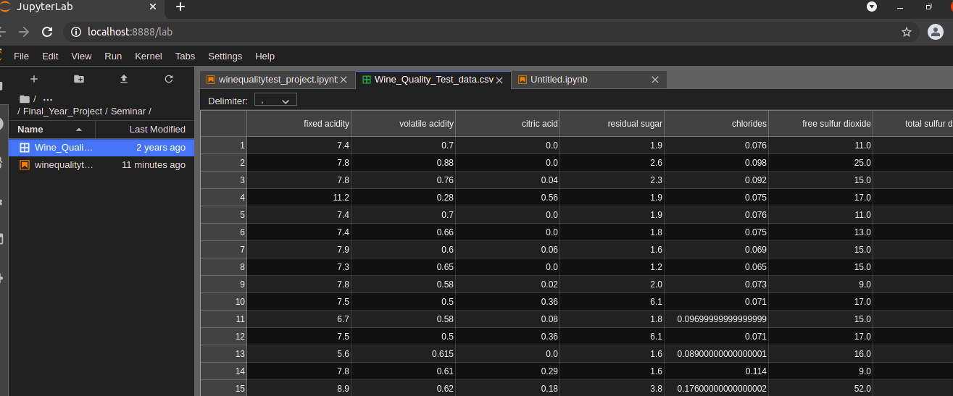
COLLECTING DATASET
This dataset is available from the website Kaggle, which is a fantastic place to find datasets and other deep learning resources. In addition to providing resources like datasets and "kernels" that are like these notebooks, Kaggle hosts competitions that you can take part in, competing with others in training highly accurate models.
Basic information of dataset - using JUPYTERLAB

Slide 5
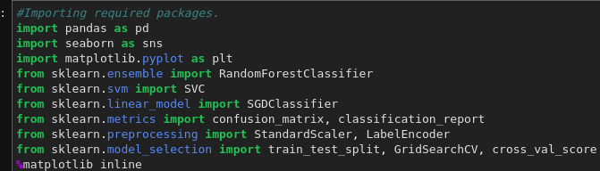
IMPORT PYTHON LIBRARIES
Pandas : It is used for load and analysis of dataset having csv file.
Matplotlib: It’s a plotting library of python, for data visualisation and graphical
interface of dataset.
Seaborn : It’s also used for plotting graph.

Slide 6
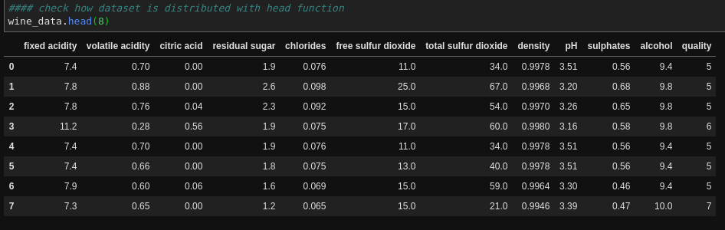
LOAD DATASET
Load data with pandas library:
Dataset basic information

Slide 7
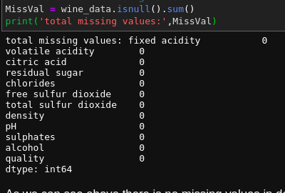
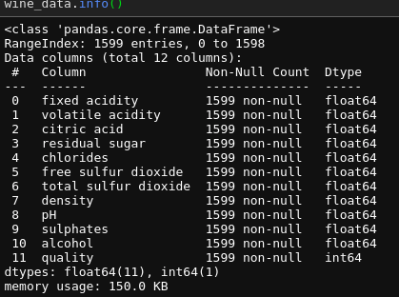
Preprocessing of dataset
As we can see there is no null values in dataset with the function.
If null values exists then it can be filled by some methods like:
Avg of that parameter, mean or select a particular value as appropriate for model
Information of data, #rows and column

Slide 8
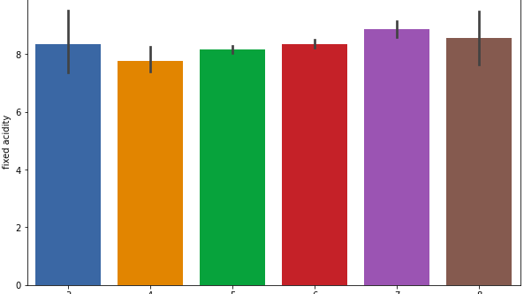
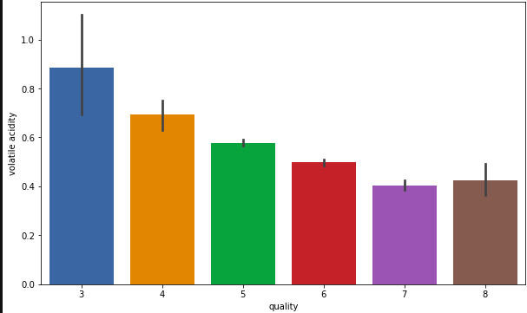
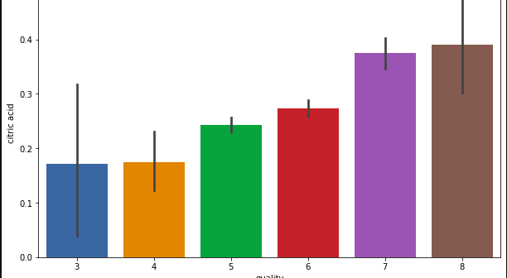
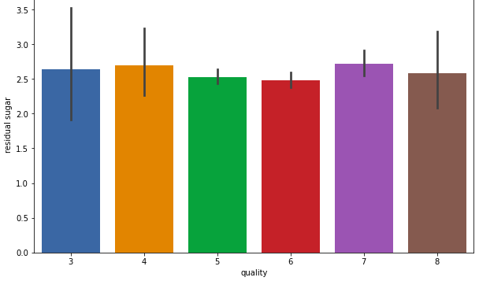
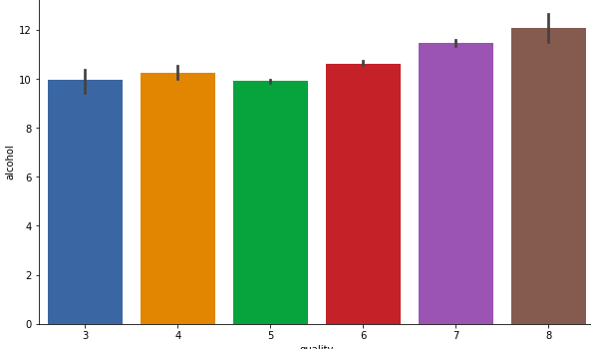
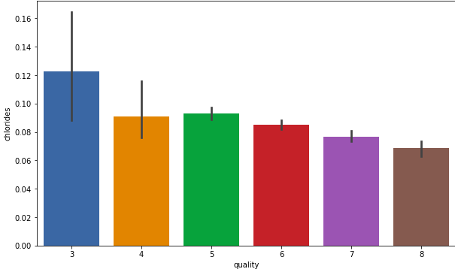
Visualisation of dataset
Plotting some bar graph between column(parameter that affect the quality of wine.
We will take quality value is 6 is good wine and less than 6 is bad wine.
Quality VS fixed_acidity volatile acidity VS Quality Quality VS citric acid
Quality VS residual sugar Quality VS chlorides Qality VS alchohal

Slide 9
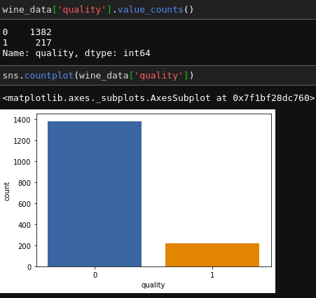
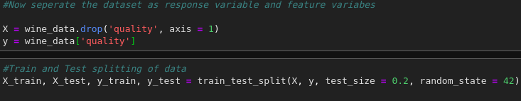
Prepare data for building model
There are 1302 rows having bad quality and 217 having good quality.
As we can show in graph also.
Now split the data in to train and test with 80% and 20% respectively.
And drop column quality in test part.

Slide 10
Build model
By Apply machine learning algorithms
Stochastic Gradient Descent Classifier
SGD Classifier is a linear classifier (SVM, logistic regression, a.o.) optimized by the SGD.
These are two different concepts. While SGD is an optimization method, Logistic Regression or linear Support Vector Machine is a machine learning algorithm/model.
You can think of that a machine learning model defines a loss function, and the optimization method minimizes/maximizes it.

Slide 11
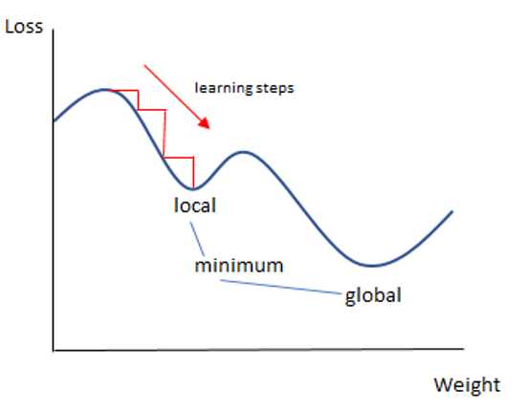
Stochastic gradient descent (SGD) computes the gradient using a single sample.

Slide 12
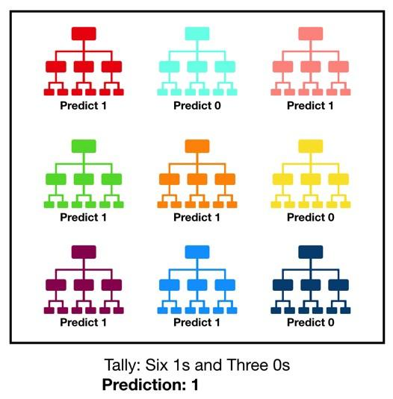
Random Forest Classifier
Random forest, like its name implies, consists of a large number of individual decision trees that operate as an ensemble.
Each individual tree in the random forest spits out a class prediction,
and the class with the most votes becomes our model’s prediction (see figure below).

Slide 13

Support Vector Classifier
Support Vector Machine or SVM is one of the most popular Supervised Learning algorithms, which is used for Classification as well as Regression problems.
However, primarily, it is used for Classification problems in Machine Learning.
There can be multiple lines/decision boundaries to segregate the classes in n-dimensional space, but we need to find out the best decision boundary that helps to classify the data points.
This best boundary is known as the hyperplane of SVM.

Slide 14
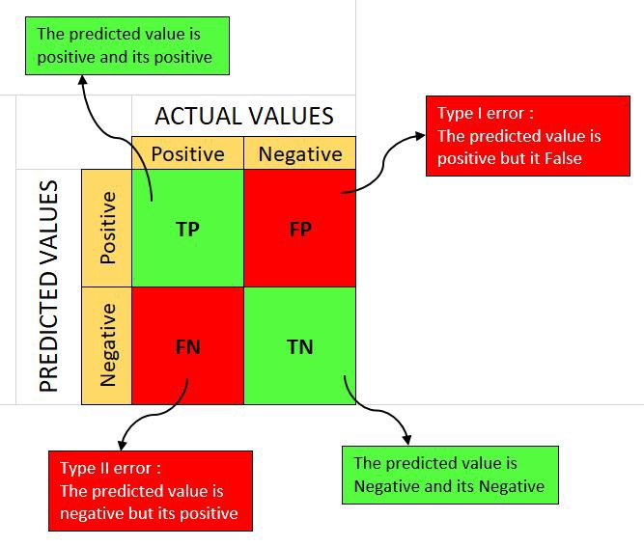
Confusion matrix
It is a performance measurement for machine learning classification problem where output can be two or more classes.
It is a table with 4 different combinations (2X2 matrix) of predicted and actual values.
True positive(TP): We predict positive, and it’s true.
False positive(FP): We predict positive, and it’s false,
this is type 1 error.
False negative(FN): We predict negative and it’s false,
this is type 2 error.
True Negative(TN): We predict negative, and it’s true.

Slide 15
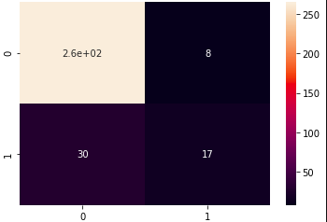
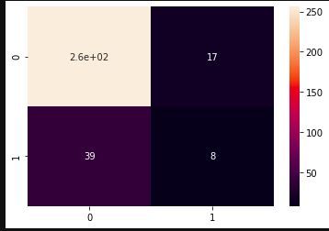
CONFUSION MATRIX
Random forest classifier Stochastic Gradient Descent Classifier
TP: 262
TN: 17
FP: 8
FN: 30
TP: 262
TN: 8
FP: 17
FN: 39

Slide 16



Precision: Precision is the ratio between the True Positives and all the Positives.
Precision quantifies the number of positive class predictions that actually belong to the
positive class.
Recall : The recall is the measure of our model correctly identifying True
Positives.Recall quantifies the number of positive class predictions made out of all positive examples in the dataset.
F1 Score :
F1 which is a function of Precision and Recall.

Slide 17
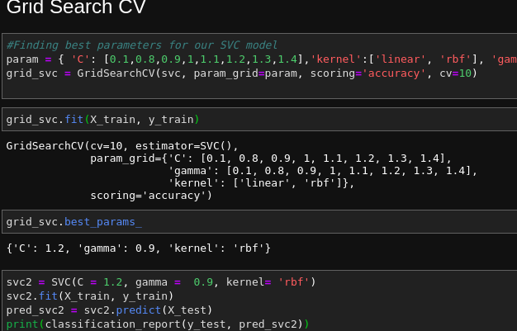
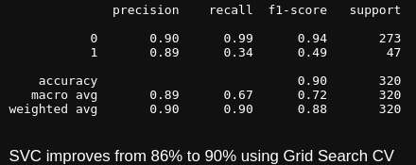
Let's try to increase our accuracy of models Grid Search CV
GridSearchCV is a library function that is a member of sklearn’s model_selection package. It helps to loop through predefined hyperparameters and fit your estimator (model) on your training set.

Slide 18
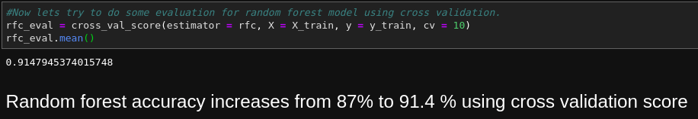
As we can see accuracy of model is 91.4 % .

Slide 19
Thank you

