Slide 1

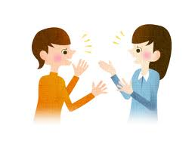
Consumer Assessment Identifying Language, Culture and Communication Styles

Slide 2
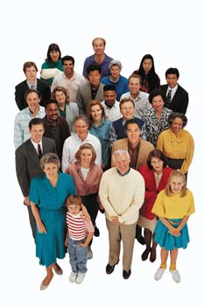
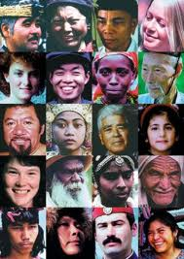
Demographics of the Deaf Community

Slide 3
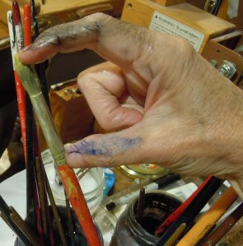
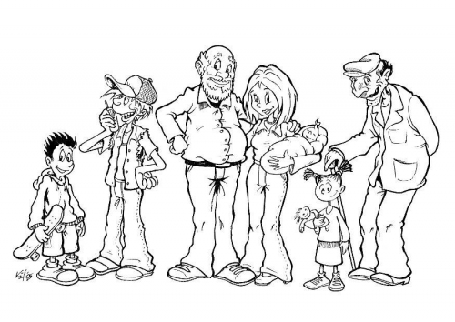
Demographics
Deaf people of all ages
cultural identities
desirable/preference
gender
Notes:
Desirable/preference: ex, theater, meetings

Slide 4
Demographics
Deaf people with mental illnesses
Deaf people with cognitive challenge

Slide 5
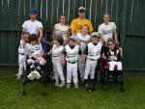
Demographics
Deaf people with physical challenge

Slide 6
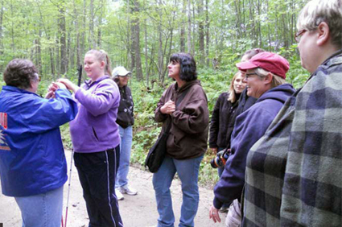
Demographics
Deafblind people

Slide 7
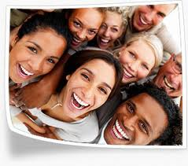
Demographics
Deaf Foreigners

Slide 8
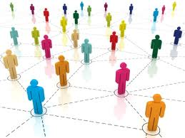
Demographics
What is Grassroots?
(Priscilla Moyers- 2006 Summer Symposium on Effective Practices in Interpreter Education)

Slide 9
Grassroots
Fluent in ASL registers
Awkward with using English spelling words to indicate some formal education
Comfortable with deaf culture identity

Slide 10
Demographics: Cultural Identities
Seven Identity Categories

Slide 11
Seven Identity Categories
balanced bicultural
deaf-dominant bicultural
hearing-dominant bicultural

Slide 12
Seven Identity Categories
culturally isolated
culturally marginal
culturally separate
culturally captive

Slide 13
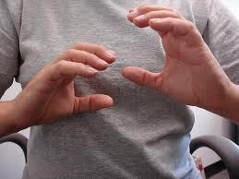
Language Foundations
Communication Modes

Slide 14
Communication Modes
Written English
ASL
Rochester Method
SEE
Signed English
“contact language”
Pidgin Sign English (PSE)

Slide 15
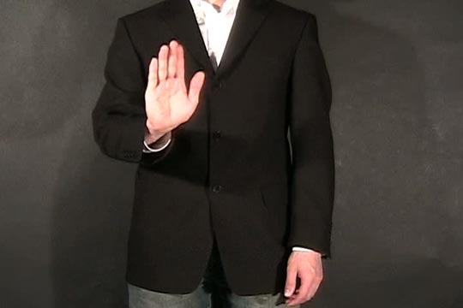
Language Foundations
What is Gesture?

Slide 16
Gesture
Form of communication
RICH in ways for individuals to express their feelings and thoughts
Some cultural groups use more gestures than other groups.

Slide 17
Groups of Gesture
Idiosyncratic non-standard signs or gestures
Some communication skills
Gestures used in a variety of regions, ethnic and age groups

Slide 18
Who uses Gesture?

Slide 19
Gesture
Foreign born
Immigrants
Non-Immigrants
Refugees
Isolated individuals

Slide 20
Language Foundations
Languages

Slide 21
Familiar with…
Signing styles (age, ethnic, education, local, regional and foreign
Discourse styles
Context/Topical knowledge

Slide 22
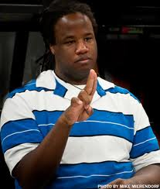
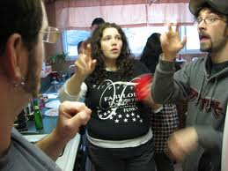
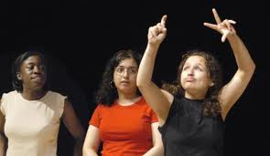
Communication Styles in the Deaf Community

Slide 23
Communication Styles in the Deaf Community
ASL Monolinguals
English dominant Bilinguals
ASL dominant Bilinguals
Balanced Bilinguals

Slide 24
Communication Styles in the Deaf Community
English Monolinguals
Home signs
Semi-linguals
Alingual

Slide 25
Interpreting Flow Chart

Slide 26
Interpreting Flow Chart

Slide 27
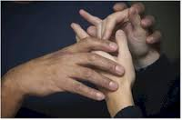
Forms of Deafblind’s Communication
Basic Tactile Sign
Tactile ASL
Tactile Signed English
Tactile Tracking ASL Fingerspelling
Tactile Fingerspelling

Slide 28
Forms of Deafblind’s Communication
Visual ASL (small space)
Visual Signed English (small space)
Visual Fingerspelling (small space)
Tadoma
Print-On-Palm (POP)
Tellatouch

Slide 29
Deaf Consumer’s Potential Communication Limitations
Experiential
Cognitive
Educational
Cultural
Physical

Slide 30
Meeting special communication challenges
idiosyncratic non-standard signs or gestures such as those commonly referred to as:
“home signs” which are unique to a family
a foreign sign language
minimal or limited communication skills
deaf-blind or deaf with limited vision

Slide 31
Meeting special communication challenges
signs particular to a given region, ethnic or age group
limited cognitive
multidisabilities
characteristics reflective of Deaf Culture not familiar to hearing interpreters.

Slide 32

Significance of Oppression in the Deaf Community

Slide 33
Understanding how oppression influenced us
Different forms of Oppression
(Charlotte baker-Shenk, “Characteristics of Oppressed and Oppressor People: Their Effect on the Interpreting Context on Interpreting: The Art of Cross Cultural Mediation, pp. 43-53; 4th Printed; 1993)

Slide 34
Forms of Oppression
Ambivalence
Passivity
Adaptation
Emotional dependence
Horizontal oppression

Slide 35
Oppression
Who are the Oppressed People?
Who are the Oppressors?

Slide 36
The Characteristics of Oppressed People
Ambivalence
Existential duality
Self depreciation
A basic distrust of oneself and one’s peer
Horizontal violence
Slave consciousness or fatalistic attitude

Slide 37
The Characteristics of Oppressed People
Slave consciousness or fatalistic attitude
Pervasive, magical belief in the power & invulnerability of the oppressor
Emotional dependence on the oppressor
Fear of freedom(loosing the dependence) of backlash (worse repression)

Slide 38
The Characteristics of Oppressor
Their way is the best way
Pejorative view of the oppressed
Automatic assumption the oppressed want to change and become like them
Take charge attitude

Slide 39
The Characteristics of Oppressor
Paternalism toward the oppressed
Strongly possessive consciousness
Desire for approval and gratitude from the oppressed
Fearful and angry reaction to attempts by the oppressed to become free

Slide 40
References
Charlotte baker-Shenk (1993), “Characteristics of Oppressed and Oppressor People:
Their Effect on the Interpreting Context on Interpreting: The Art of Cross Cultural
Mediation, pp. 43-53; 4th Printed
Holcomb, Thomas K. (1997) American Annals of the Deaf v 142 (April ‘97),
“Development of Deaf Bicultural Identity”. P89-93
Humphries, Janice & Alcorn, B. (2007) So You Want to be An Interpreter? (4th ed).
H & H Publishers CO, Amarillo, Texas
Solow, Sharon Neumann (2000) Sign Language Interpreting: a basic resource book
(revised ed). Linstok Press, Burtinsville, MD
Wilcox, Sherman (1989) American Deaf Culture: An Anthology, “Inside the Deaf
Community” by Barbara Kannapell, Linstok Press, Inc,
Burtinsville, MD
Deaf Interpreter Work Team, National Consortium of Interpreter Education Centers
(NCIEC)
Notes:
Add a few slides about high edu deaf people (Lillian, did we miss that, huh?)
Add NCIEC, not our names (we will add that during our Nov mtg and see what we can put in the footer part)
Copyright and revised/adapted to bottom of slide

