Slide 1

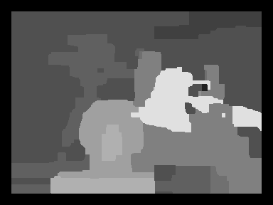
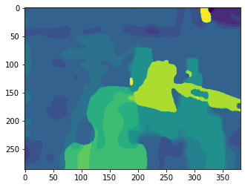
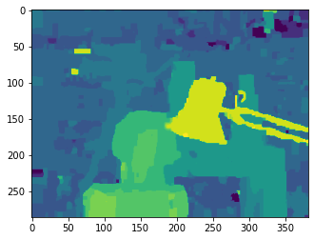
(a) Ground Truth
(b) Nghia Ho’s min sum
(c) Sum-product by mesilliac
(d) Min-sum algorithm (this work)

