Slide 1
Normalization
Normalization is a Database Technique that organize table in such a manner that will reduce redundancy & dependency of data
This Technique used to avoid insertion, updation & deletion anomaly.
Normalization divides larger table into smaller sets of table and relate then using Relationships.

Slide 2
Anomaly
Not NULL
Something that is not according to Standard or Normal
Id | Name | Address | Dept
1001 | Ravi | Hyderabad | Sales
1001 | Suraj | Bengaluru | Finance
1002 | Vicky | Pune | IT
1003 | Soma | Mumbai | Sales
1003 | Narendra | Hyderabad | Finance
Insert: This will not allow Null Values
Update: There is no Standard (1001 should be IT)
Delete: Even here there is no standard (1001 needs to deleted)

Slide 3
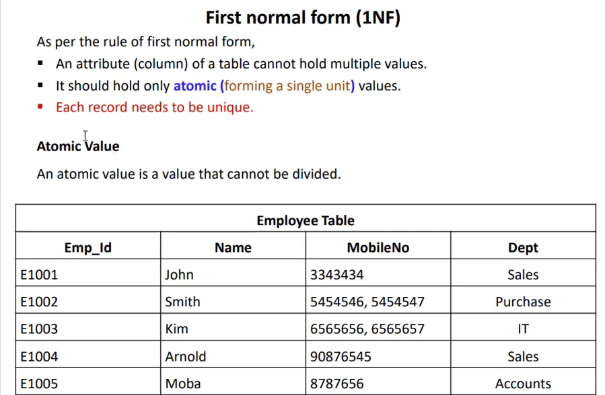

Slide 4
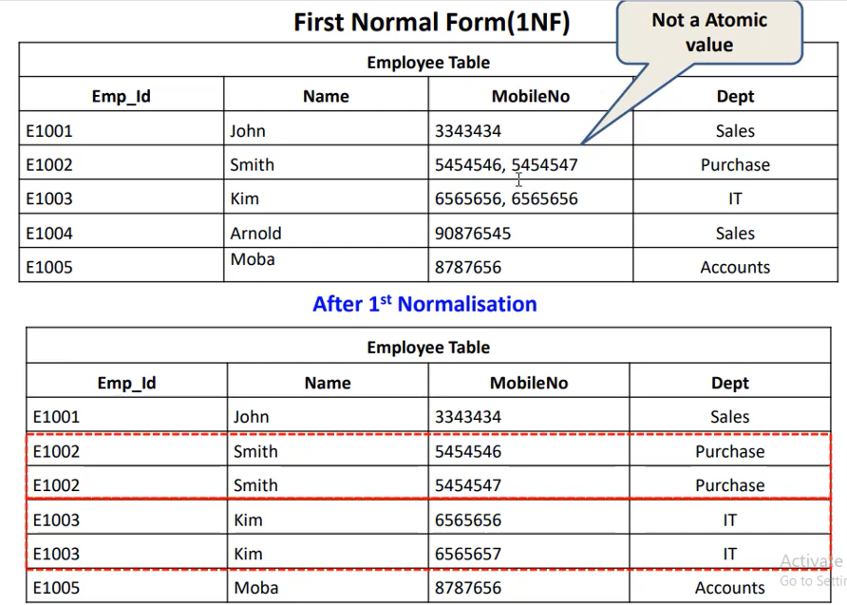

Slide 5
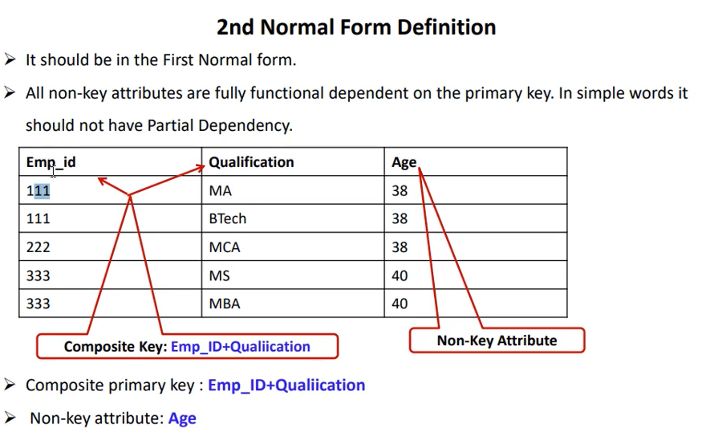

Slide 6
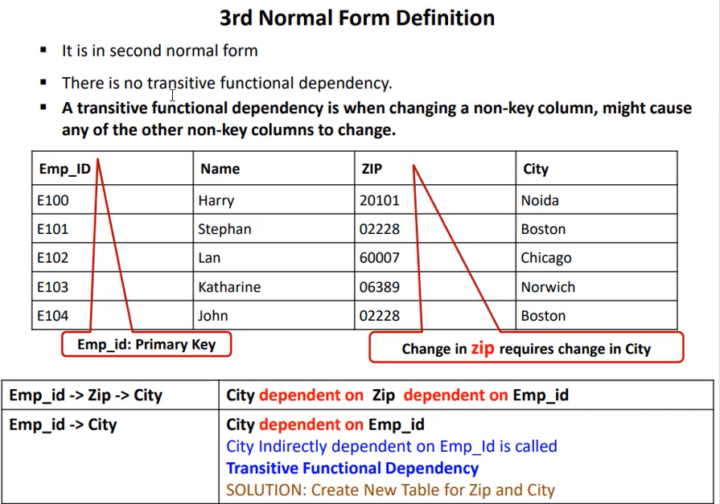

Slide 7
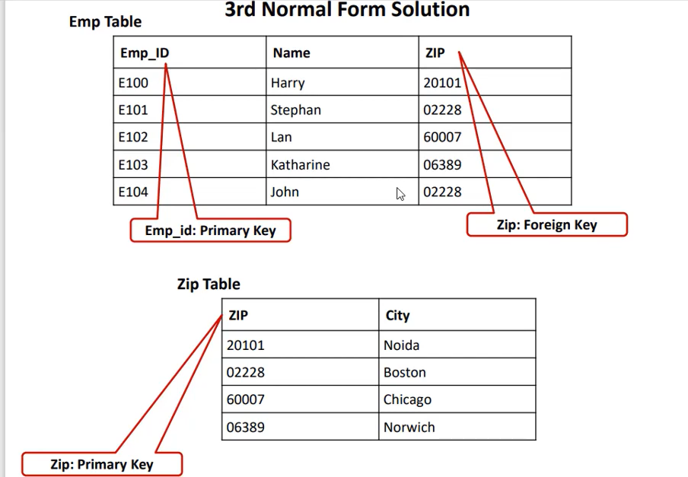

Slide 8
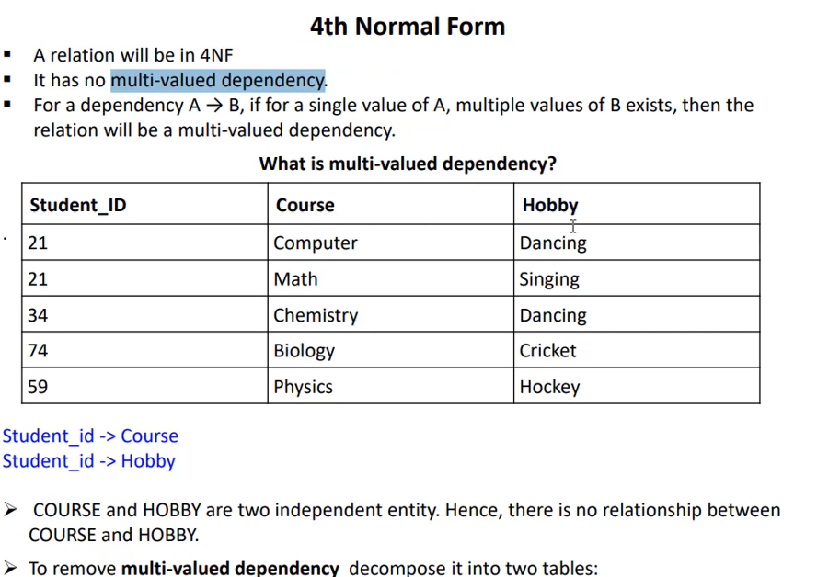

Slide 9
