Slide 1

AiOps – A vision of automation and control
CD-team
Dr. Christopher A. Tucker
1
Notes:
1

Slide 2
Agenda
What is AiOps?
Previous works: The belastingdienst misadventure
A new vision: Epic CD-3324
Pitfall! A crisis of reproducibility
A design proposal
Discussion
2

Slide 3
Let me take a moment…
3

Slide 4
What is AiOps: Beyond the hype
What is real verses what is expected
Aggregate data to discover operational patterns of a cluster and classify them (looking for rules)
Know when to use unstructured learning verses supervised learning
Leverage change-impact analysis
Has found suitability in the markets with testing
Low-hanging fruit
Tools verses new development
Quality of tools mixed and indeterminate
Is AI “in there” or are they just saying it is?
Backpropagation feedforward neural networks that can remember
4
Notes:
4

Slide 5
This has been tried before: The belastingdienst
Lessons learned
Don’t automatically trust the algorithm
Involve participants to determine post-mortem
Trust what is possible not what is theoretically possible
Changing course
Determine a mathematically-sound workflow
Model processes in a logical manner
Keep functionality simple
Orient the process toward increasing optimization
5
Notes:
5

Slide 6
A new vision: Epic CD-3324
Smart automation
An executable runtime having the ability to remember changes in system variables differentiating in time can be tailored to perform complex tasks. Coupled to a feedback mechanism, it will discover the operational equilibrium of any system it is tasked within.
If a program can reliably analyze patterns of time-series events over a window of data by paying attention to the causal patterns that are chosen for it to observe and with access to requisite remedies, it will apply its analysis of the best performance metric to the system it is tasked within.
If a modal is trained to understand the relationship between causal events over a length of temporal data and the consequences of actions taken by the program, it can supervise it by tuning its neural network toward achieving systematic equilibrium.
A focus on metrics and balanced behaviour in the cluster by applying an attention-focused machine-learning program that generates code and publishes (Helm charts) to OpenShift.
Relevant points and features
What are the metrics the team is most concerned about keeping in check?
Can we state we know what is the ideal metric for a given resource?
Can we accept a solution that is arrived-at by computation?
Training is performed as a build step.
Output charts can be tested before they are deployed.
Output charts can be interrupted (reviewed) as a part of the testing (confidence-building) step.
Error/failure handling: If the agent experiences errors that it cannot solve, an option is to call a human reviewer, as notifications, generally, are undesirable.
6
Notes:
6

Slide 7
Pitfall! A crisis of reproducibility
Too often these methods are not done well
One design to suit many kinds of purposes
Division in machine-learning elements: Separation is key
Follow where the predictive mathematical solutions lead
Collaborate
Don’t get intimidated by the complexity – an unavoidable feature
Establish fitness and create trust
Keep supervision tasks until (the feeling is) it is ready
Remember: Despite the flowery language...it is (piecewise) linear algebra...well...except for curved solutions...
7
Notes:
7

Slide 8
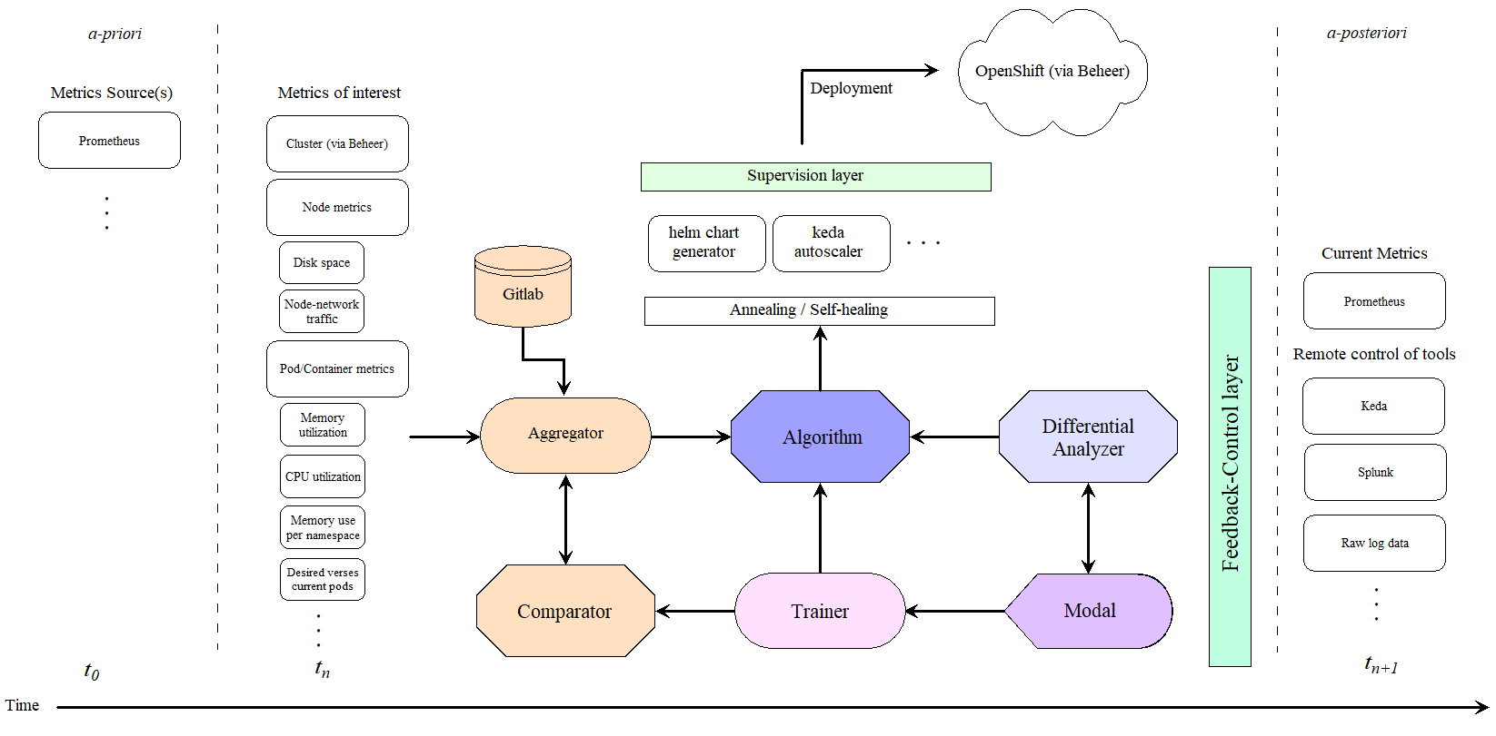
Design proposal
8
Notes:
8

Slide 9
Discussion points
Is AI trustworthy?
Can this idea be replicated to perform other kinds of tasks?
A containerized deployment of an application?
When is the moment we “let go” and set the algorithm free?
Other points?
9
Notes:
9

