Slide 1
1:n Links and Grouping Problem

Slide 2
The Problem
Dekanat-App allows linking tables to others in a partial functional relationship (row x→ row y) => n:1
We would like to view these links backwards (“show me all rows that point to this row”), in a 1:n view
“Normal” join with foreign key:
… FROM table_x LEFT JOIN table_y ON table_x.foreign_key=table_y._id
“Backwards” join:
… FROM table_y LEFT JOIN table_x ON table_y._id=table_x.foreign_key

Slide 3
Scenario
Tables: Organe (institutes), Personen, Räume (rooms)
Links:
Personen → Organe (“Works at institute”)
Räume → Organe (“Room belongs to institute”)
The Organe table should show an institute along with all persons working there and all rooms that belong to it

Slide 4
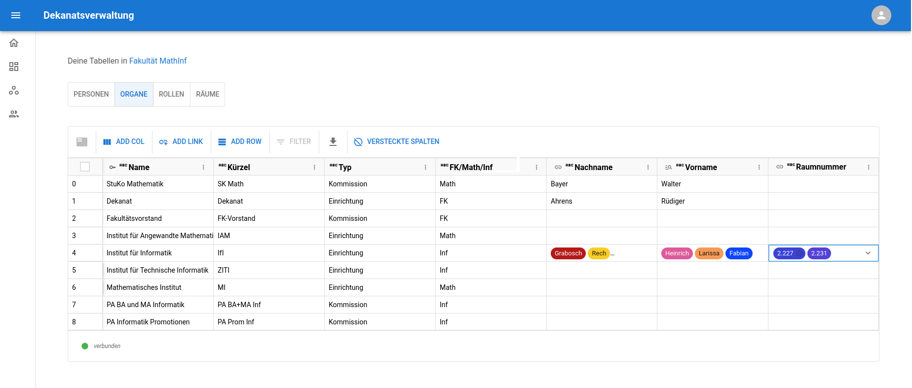
Desired Result
Institut für Informatik shows all linked persons and rooms

Slide 5
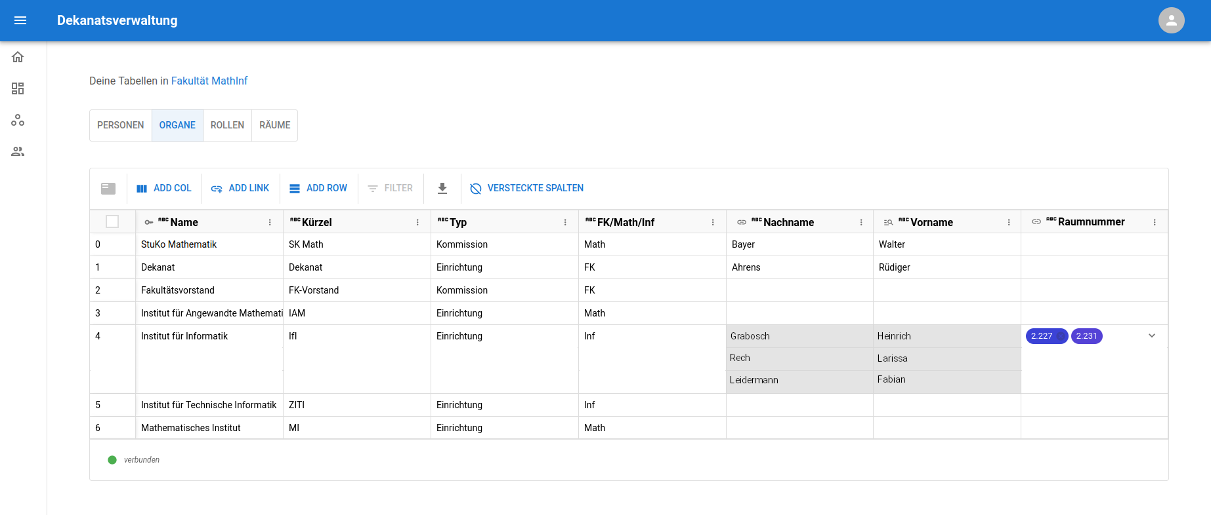
Expand Group
Expand the group to see which Nachname (last name) and Vorname (first name) go together

Slide 6
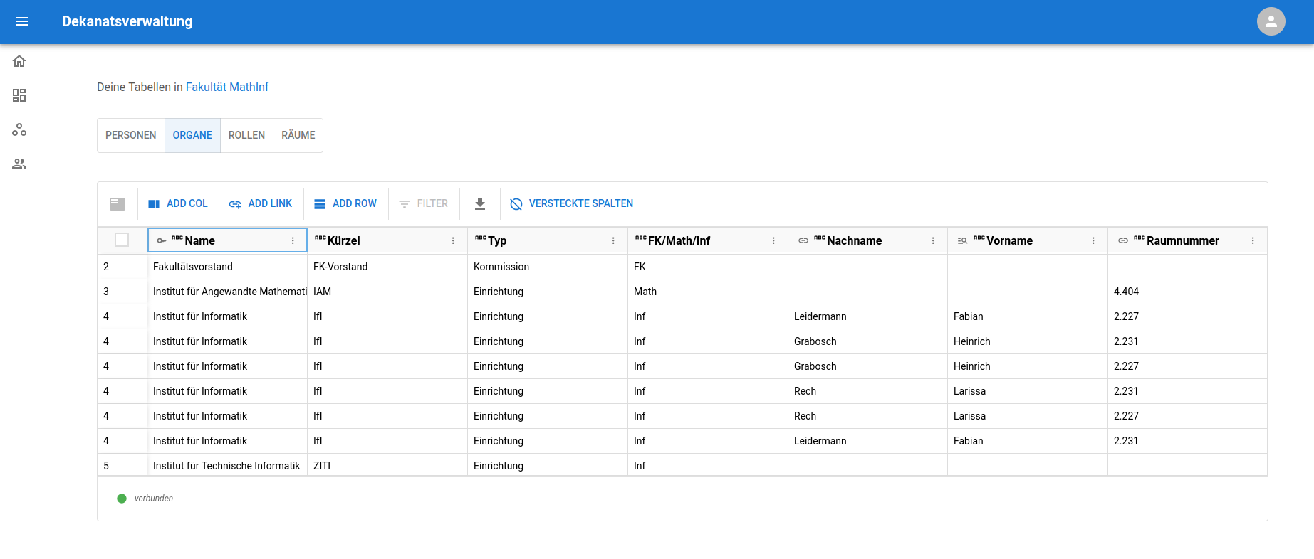
Actual Result of Naive Join
Row is duplicated six times!

Slide 7
Why Does This Happen?
JOIN creates all possible pairings of rows where keys match
organe LEFT JOIN personen ON organe._id=personen.organe_fk
X =?
_id | Institut
1 | Mathematisches Institut
2 | Institut für Informatik
Nachname | Vorname | organe_fk
Grabosch | Heinrich | 2
Rech | Larissa | 2
Leidermann | Fabian | 2

Slide 8
Why Does This Happen?
JOIN creates all possible pairings of rows where keys match
organe LEFT JOIN personen ON organe._id=personen.organe_fk
(Row with _id=1 left out, because it is not relevant to the join)
_id | Institut | Nachname | Vorname
2 | Institut für Informatik | Grabosch | Heinrich
2 | Institut für Informatik | Rech | Larissa
2 | Institut für Informatik | Leidermann | Fabian

Slide 9
Why Does This Happen?
How do we get rid of the duplicates of “Institut für Informatik”?
→ grouping
SELECT _id, institut, array_agg(nachname), array_agg(vorname)
FROM organe LEFT JOIN personen ON organe._id=personen.organe_fk
GROUP BY organe._id;
_id | Institut | Nachname | Vorname
2 | Institut für Informatik | { Grabosch, Rech, Leidermann} | {Heinrich, Larissa, Fabian}

Slide 10
Grouping with Multiple Joins
Now let us try to solve our two-join problem with grouping:
SELECT o._id, o.institut, array_agg(p.nachname), array_agg(p.vorname), array_agg(r.raumnummer
FROM organe AS o
LEFT JOIN personen AS p ON o._id=p.organe_fk
LEFT JOIN raeume AS r ON o._id=r.organe_fk
GROUP BY o._id;

Slide 11
Grouping With Multiple Joins
_id | Institut | Nachname | Vorname | Raumnummer
2 | Institut für Informatik | {Grabosch, Rech, Leidermann, Grabosch, Rech, Leidermann} | {Heinrich, Larissa, Fabian, Heinrich, Larissa, Fabian} | {2.227, 2.231, 2.227, 2.231, 2.227, 2.231}

Slide 12
Grouping with Multiple Joins
Joins are an algebraic operation on relations
organe LEFT JOIN personen LEFT JOIN raeume
<=> (organe LEFT JOIN personen) LEFT JOIN raeume
X =?
_id | Institut | Nachname | Vorname
2 | Institut für Informatik | Grabosch | Heinrich
2 | Institut für Informatik | Rech | Larissa
2 | Institut für Informatik | Leidermann | Fabian
Raumnummer | organe_fk
2.227 | 2
2.231 | 2

Slide 13
Grouping with Multiple Joins
We get all possible combinations!
Grouping can only accumulate the duplicates, not filter them out
_id | Institut | Nachname | Vorname | Raumnummer
2 | Institut für Informatik | Grabosch | Heinrich | 2.227
2 | Institut für Informatik | Rech | Larissa | 2.231
2 | Institut für Informatik | Leidermann | Fabian | 2.227
2 | Institut für Informatik | Grabosch | Heinrich | 2.231
2 | Institut für Informatik | Rech | Larissa | 2.227
2 | Institut für Informatik | Leidermann | Fabian | 2.231

Slide 14
Grouping with Multiple Joins
We get all possible combinations!
Grouping can only accumulate the duplicates, not filter them out
_id | Institut | Nachname | Vorname | Raumnummer
2 | Institut für Informatik | {Grabosch, Rech, Leidermann, Grabosch, Rech, Leidermann} | {Heinrich, Larissa, Fabian, Heinrich, Larissa, Fabian} | {2.227, 2.231, 2.227, 2.231, 2.227, 2.231}

Slide 15
How to Solve?
Observation: As long as the left relation has no duplicates before the join, grouping can still correct the result as intended:
X
_id | Institut | Nachname | Vorname
2 | Institut für Informatik | { Grabosch, Rech, Leidermann} | {Heinrich, Larissa, Fabian}
Raumnummer | organe_fk
2.227 | 2
2.231 | 2

Slide 16
How to Solve?
Observation: As long as the left relation has no duplicates before the join, grouping can still correct the result as intended:
_id | Institut | Nachname | Vorname | Raumnummer
2 | Institut für Informatik | { Grabosch, Rech, Leidermann} | {Heinrich, Larissa, Fabian} | 2.227
2 | Institut für Informatik | { Grabosch, Rech, Leidermann} | {Heinrich, Larissa, Fabian} | 2.231
group by (_id, institut, nachname, vorname)
_id | Institut | Nachname | Vorname | Raumnummer
2 | Institut für Informatik | { Grabosch, Rech, Leidermann} | {Heinrich, Larissa, Fabian} | {2.227, 2.231}

Slide 17
Easy in SQL! ...right?
Query required to achieve this:
For every additional join, we need to newly group and therefore we need another layer of subquery!
SELECT left._id, left.institut, left.nachname, left.vorname, ARRAY_AGG(r.raumnummer) AS raumnummer
FROM (
SELECT o._id, o.name AS institut, ARRAY_AGG(p.nachname) as nachname,
ARRAY_AGG(p.vorname) as vorname
FROM organe o
LEFT JOIN personen p ON o._id=p.organe_fk
GROUP BY o._id
) AS left
LEFT JOIN raeume AS r ON left._id=r.organe_fk
GROUP BY (left._id, left.institut, left.nachname, left.vorname);

Slide 18
Approaches - Summary
1. Pre-group left table (previous slides)
2. Fetch tables individually and assemble in JS
3. Fetch other tables as aggregated subqueries
4. Pre-group right tables

Slide 19
Pre-Grouping Left Table
lazy-views plugin only allows grouping at the top level of a view, after all joins have happened
Solution 1: client code creates a hierarchy of views, one for each join
Pro: Changes are made where they are needed, probably not too hard to explain in documentation
Con: A table is now no longer “a table and a view”, but “a table and a variable-length hierarchy of views”
complex and bug-prone
dekanat-app-plugin would need extensive changes to accommodate new architecture

Slide 20
Pre-Grouping Left Table
lazy-views plugin only allows grouping at the top level of a view, after all joins have happened
Solution 2: augment lazy-views plugin with a “group before join” option
Pro: Appropriate abstraction level
Pro: Changes contained in LV plugin, no need to change GUI
Con: Adds to already mind-bending query builder code in LV
Con: What does “group before join” mean? In what order should joining and grouping happen? Semantics of connection with other abilities of the LV plugin also unclear

Slide 21
Fetch Tables and Assemble in JS
Solution 3: The tables are left as they are, the client code in the GUI fetches each and assembles them “manually”
Pro: for-loops are easier to understand and implement than SQL joins
Pro: likely least bug-prone approach
Con: Would have to add hidden columns and empty joins that symbolize the links, thus duplicating part of LV’s abilities manually
Con: Filters on linked columns have to be implemented (partially) by hand, instead of being handled by LV

Slide 22
Aggregated subquery
Solution 4: SQL allows a subquery that returns exactly one row and column inline:
Pro: Least confusing approach
Con: Multiple columns from a single joined table each need their own subquery
→ no way of ensuring the aggregated arrays are in the same order, required for “Expand group” option from slide 5 (deal breaker!)
SELECT o._id AS id, o.name AS institut,
(SELECT ARRAY_AGG(r.name) FROM p1_raeume AS r WHERE r.organe_fk=o._id
) AS raumnummer,
(SELECT ARRAY_AGG(p.nachname) AS nachname FROM personen AS p WHERE p.organe_fk=o._id
) AS nachname
FROM organe AS o;

Slide 23
Pre-Grouping Right Tables
Observation: If the right table is pre-grouped on its foreign key, then there will be only one matching row on each side:
X
=
(Row with _id=1 left out again)
_id | Institut
1 | Mathematisches Institut
2 | Institut für Informatik
Nachname | Vorname | organe_fk
{Grabosch, Rech, Leidermann} | {Heinrich, Larissa, Fabian} | 2
_id | Institut | Nachname | Vorname
2 | Institut für Informatik | { Grabosch, Rech, Leidermann} | {Heinrich, Larissa, Fabian}

Slide 24
Pre-Grouping Right Tables
Query looks complex at first:
However, only requires substituting the subquery for the right table – SELECT statement and join condition can stay the same!
SELECT o.id AS id, o.name AS institut, p.nachname, p.vorname
FROM organe AS o
LEFT JOIN (SELECT p.organe_fk AS fk, ARRAY_AGG(p.nachname) AS nachname, ARRAY_AGG(p.vorname) AS vorname
FROM personen AS p GROUP BY p.organe_fk
) AS P ON o.id=p.fk
LEFT JOIN (SELECT r.organe_fk AS fk, ARRAY_AGG(r.name) AS raumnummer
FROM raeume AS r GROUP BY r.organe_fk
) AS raeume ON o._id=raeume.fk;
← substituted for reference to table personen
← substituted for reference to table raeume

Slide 25
Pre-Grouping Right Tables
Pro: all the pros of approach 2:
Contained in LV, maintains the same API and structure of result set
Uses SQL, compatible with existing filters and sorting, etc.
Pro: clear semantics: right operand in join is grouped before joining, grouping column is the foreign key
Con: Still adds to the complexity of LV query building
However, only adds one level of nesting at a time, while left-grouping approach requires n levels of nesting (one for each join)

