Slide 1
The Lean Startup Process
May 2021

Slide 2
Eric Ries Lean Startup Video
Soul Cycle Podcast
The Lean Product Playbook by Dan Olsen (Video)

Slide 3
How is entrepreneurship like management?
How does Eric Ries define entrepreneurship?
If building good software is not a problem, why do so many startups fail?
What is broken about the waterfall approach to building software?
Why did IMVU fail?
Where do each of these things fall in the feedback loop?
Ideas
Data
Code
Outline the process of innovation accounting
What tips does Eric give Google for using Lean Startup principles to encourage validated learning?

Slide 4
Lean Startup Principles
Entrepreneurs are everywhere
“A startup is a human institution designed to deliver a new product or service under conditions of extreme uncertainty.”
This has nothing to do with the size of the company, sector of the economy or industry
Startups are about running experiments
Entrepreneurship is management

Slide 5
Lean Startup Principles
Entrepreneurship is management:
Our goal is to create an institution, not just a product
We however cannot use traditional management practices. We need practices and principles geared to the startup context of extreme uncertainty
Validated learning (Build-Measure-Learn)
Innovation Accounting is at the core (good metrics vs vanity metrics)

Slide 6
The Pivot
What do successful startups have in common:
They started out as digital cash for PDAs but evolved into online payments for eBay
They started building BASIC interpreters, but evolved into the world’s largest operating systems monopoly
They were shocked to discover their online games company was actually a photo-sharing site
The one thing they do well is that they PIVOT: They change directions but stay grounded in what they've learned.
We do not want to celebrate failure, we celebrate successful pivoting!

Slide 7
We need to move fast
If we can reduce the time between pivots
We can increase our odds of success
Before we run out of money (or time)

Slide 8
Validated learning: Achieving Failure
If we are building something nobody wants, what does it matter if we accomplish it:
On time?
On budget?
With high quality?
With beautiful design?
Achieving failure is basically successfully executing a bad plan

Slide 9
Build-Measure-Learn
Ideas
Build
Code
Measure
Learn
Data

Slide 10
Innovation Accounting: The Three Learning Milestones
Establish the baseline
Build a Minimum Viable Product (MVP)
Measure how customers behave right now
Tune the engine
Experiment to see if we can improve metrics from the baseline towards the ideal
Pivot or persevere
When experiments reach diminishing returns, it’s time to pivot

Slide 11
Lean Product Methodology

Slide 12
What causes a company’s success/ failure?
The caliber of the startup team
The quality of product
The size of the market

Slide 13
PRODUCT – MARKET FIT

Slide 14
Think about the products you have used for the last year
How many of those do you love?
How many did you hate?
How many can you even remember?
Customers love very few products. It is extremely hard to build products that customers love, and that is why most products fail

Slide 15

Why then do products fail?
Product – Market Fit
Coined by Mark Andersen in his famous blog post the only thing that matters.
The main reason products fail is because they don't meet customer needs in a way that is better than other alternatives

Slide 16
The Product-Market Fit Pyramid
UX
Underserved Needs
Target Customer
Product-Market Fit
Feature Set
Value Proposition
PRODUCT
MARKET
Notes:
the Product-Market Fit Pyramid, breaks product-market fit down into five key components: your target customer, your customer's underserved needs, your value proposition, your feature set, and your user experience (UX). Each of these is actually a testable hypothesis, and they relate to each other logically. Within the product and market sections, each layer depends on the layer immediately beneath it. Product-market fit lies between the top and bottom sections of the pyramid.

Slide 17
1. The Market
A market consists of all the existing and potential customers that share a particular customer need or set of related needs.
You can describe the size of a market by the total number of customers in the market or the total revenue generated by those customers. For either of those two measures, you can refer to the current size or the potential future size of the market.
Different customers within a market choose different solutions to meet their needs.
Within a given market, you can analyze the market share of each competing product—that is, what percentage of the market each product has. This is what is called Market Share
UX
Underserved Needs
Target Customer
Product-Market Fit
Feature Set
Value Proposition
PRODUCT
MARKET
Notes:
- Describe different markets for the different business ideas in the class

Slide 18
1. What is the size of the mobile network services market in Kenya? 2. What is the market share for each of the mobile network operators in Kenya?

Slide 19
The Market (contn’d)
The needs layer is above the target customers layer in the model because it's their needs that are relevant to achieving product-market fit.
As you try to create value for customers, you want to identify the specific needs that correspond to a good market opportunity. For example, you probably don't want to enter a market where customers are extremely happy with how the existing solutions meet their needs. When you develop a new product or improve an existing product, you want to address customer needs that aren't adequately met.
Customers will measure your product against the alternatives that they have in the market
UX
Underserved Needs
Target Customer
Product-Market Fit
Feature Set
Value Proposition
PRODUCT
MARKET

Slide 20
2. The Product
A product is a specific offering intended to meet a set of customer needs. From this definition, it's clear that the concept of product-market fit applies to services as well as products.
The typical distinction between a product and service is that a product is a physical good while a service is intangible.
However, with products delivered via the web and mobile devices, the distinction between product and service has been blurred, as indicated by the popular term software as a service (SaaS)
UX
Underserved Needs
Target Customer
Product-Market Fit
Feature Set
Value Proposition
PRODUCT
MARKET

Slide 21
The Product (contn’d)
For software, the product itself is intangible code, often running on servers that the customer never sees. The real-world manifestation of software products that customers see and use is the user experience (UX). The UX is what brings a product's functionality to life for the user.
The functionality that a product provides consists of multiple features, each built to meet a customer need. Taken together, they form the product's feature set.
To decide which features to build, you need to identify the specific customer needs your product should address. In doing so, you want to determine how your product will be better than the others in the market. This is the essence of product strategy. The set of needs that you aspire to meet with your product forms your value proposition
UX
Underserved Needs
Target Customer
Product-Market Fit
Feature Set
Value Proposition
PRODUCT
MARKET
Notes:
Your value proposition is also the layer just above customer needs, and fundamentally determines how well the needs addressed by your product match up with the customer's.

Slide 22
Therefore, Product-Market fit is how….
UX
Feature Set
PRODUCT
Value Proposition
Fits into…
Underserved Needs
MARKET
Target Customer
Notes:
Your goal in creating customer value is to make the product and the market fit nicely – and this is where customer value is created.

Slide 23
Who determines whether you have Product-Market Fit
Your customers

Slide 24

The Quicken Story
By the time they got into the market, there were 46 personal finance products in the market
Scott Cook and Tom Proulx conducted market research and concluded that none of the products had perfected Product-Market Fit. The products didn't meet customer needs and were difficult to use.
The cofounders had a hypothesis that a checkbook-based design would do well, since everyone at the time was familiar with writing checks.
Their hypothesis proved right: the UX they built using the checkbook conceptual design resonated with customers and Quicken rapidly became the leading personal finance software.

Slide 25
The Quicken Story
The company pioneered the use of customer research and user testing to inform software development.
They routinely conducted usability testing of each version before launching it and organized public betas years before those ideas became mainstream.
They invented the “follow me home” concept, where Intuit employees would go to retail stores, wait for customers to buy a copy of Quicken, and then ask to follow them home to see how they used the software. This helped immensely in understanding the customer's initial impressions of the product.
Notes:
Let's assess Quicken using the Product-Market Fit Pyramid. There were many customers in its market, and the product definitely addressed real customer needs: People needed help balancing their checkbook, tracking their balances, and seeing where their money was going. Computer software was well suited to help on that front, but despite 46 products in the market, customer needs were still underserved. By talking with customers, the cofounders ensured Quicken's feature set addressed those needs. Their design insights led to an innovative UX that customers found much easier to use. This dramatic improvement in ease of use was, in fact, the main differentiator in Quicken's value proposition.

Slide 26
You achieve this through the Lean Product Process
UX
Underserved Needs
Target Customer
Product-Market Fit
Feature Set
Value Proposition
TEST WITH CUSTOMERS
PRODUCT
MARKET

Slide 27
The Lean Product Process has 6 steps
Determine your target customers
Identify underserved customer needs
Define your value proposition
Specify your minimum viable product (MVP) feature set
Create your MVP prototype
Test your MVP with customers
Notes:
The last three steps reference the important Lean concept of a minimum viable product (MVP) - the minimum amount of functionality that your target customer considers viable, that is, providing enough value. When you are building a new product, you want to avoid building more than is required to test your hypotheses with customers. The term MVP clearly applies when you're building a completely new version 1 product (v1 for short)

Slide 28
PROBLEM SPACE versus SOLUTION SPACE

Slide 29
Solution Space
Problem Space
In contrast, there is no product or design that exists in problem space.
Instead, problem space is where all the customer needs that you'd like your product to deliver live.
You shouldn't interpret the word “needs” too narrowly: Whether it's a customer pain point, a desire, a job to be done, or a user story, it lives in problem space.
Any product that you actually build exists in solution space, as do any product designs that you create—such as mockups, wireframes, or prototypes.
Solution space includes any product or representation of a product that is used by or intended for use by a customer. It is the opposite of a blank slate.
When you build a product, you have chosen a specific implementation. Whether you've done so explicitly or not, you've determined how the product looks, what it does, and how it works.

Slide 30

Lessons from “The Space Pen Story”
Avoid the risk of jumping into the solution space prematurely – instead, start in the problem space.
If we constrain our thinking to “a pen that works in zero gravity,” we may not consider creative, less-expensive solutions such as a pencil.
In contrast, having a clear understanding of the problem space (devoid of any solution space ideas), allows for a wider range of creative solutions that potentially offer a higher return-on-investment.
Notes:
My favorite story to illustrate the concept of problem space versus solution space is the space pen. When NASA was preparing to send astronauts into space, they knew that ballpoint pens would not work because they rely on gravity in order for the ink to flow. One of NASA's contractors, Fisher Pen Company, decided to pursue a research and development program to create a pen that would work in the zero gravity of space. After spending $1 million of his own money, the company's president, Paul Fisher, invented the Space Pen in 1965: a wonderful piece of technology that works great in zero gravity.
Faced with the same challenge, the Russian space agency equipped their astronauts with pencils. You can actually buy a “Russian space pen” (which is just a cleverly packaged red pencil).
This story shows the risk of jumping into the solution space prematurely and the advantage of starting in the problem space. If we constrain our thinking to “a pen that works in zero gravity,” we may not consider creative, less-expensive solutions such as a pencil. In contrast, having a clear understanding of the problem space (devoid of any solution space ideas), allows for a wider range of creative solutions that potentially offer a higher return-on-investment. If the pencil and space pen were equally adequate solutions, then avoiding one million dollars of research and development cost would clearly be the preferable alternative.

Slide 31
Ways we can rephrase the problem to avoid being anchored on the pen
“A writing instrument that works in zero gravity”
Or better still…
“a way to record notes in zero gravity for later reference that is easy to use.”
Considering out-of-the-box solution ideas can help you refine your problem space definition, even if they aren't feasible.
Notes:
The first is still anchored on a “writing instrument”
The second allows for solutions such as audio recording
In this case, a voice recorder would probably not be as good a solution as a Space Pen. It would need a power source and would require playback to refer to the notes again, which would be less convenient than being able to scan and read them. But undergoing this thought exercise would allow us to further refine our problem space definition to: “a way to record notes in zero gravity for convenient reference later on that is easy to use, is inexpensive, and does not require an external power source.”

Slide 32
Problems define markets
When thinking about your competitors, do not just think about other tech providers – this shows that you are not thinking in the Problem Space, but are anchored in the Solution Space.
A market is not tied to any specific solutions that meet those needs. It is purely about a set of related customer needs.
Focus on “What” the product needs to accomplish, before getting into the “How”
“What” - the benefits that the product should give the customer—what the product will accomplish for the user or allow the user to accomplish
“How” - is the way in which the product delivers the “what” to the customer. The “how” is the design of the product and the specific technology used to implement the product.
“What” is problem space and “how” is solution space
Notes:
Who are the competitors for the house hunting business idea?

Slide 33
Should we listen to customers?
Customers are not likely to identify the next breakthrough solution in your product category. They are not product designers, product managers, or technologists.
However, a good understanding of customer needs and preferences helps product teams explore new potential solutions and estimate how valuable customers are likely to find each one to be
Notes:
We are saying that the solution should be problem centered, yet we say that customers do not know what they want.

Slide 34
Customers will not always talk about their problems
So how do we get to the Problem Space?
Contextual Inquiry or Customer Discovery –You can observe what pain points they run into even if they don't explicitly mention them to you. You can ask them what they like and don't like about the current solutions. As you form hypotheses about the customer needs and their relative importance, you can validate and improve your hypotheses using these techniques.
The reality is that customers are much better at giving you feedback in the solution space. If you show them a new product or design, they can tell you what they like and don't like. They can compare it to other solutions and identify pros and cons.

Slide 35
Where does the Problem Space and Solution Space Lie in the Product-Market Fit Pyramid
UX
Underserved Needs
Target Customer
Product-Market Fit
Feature Set
Value Proposition
Solution Space
PRODUCT
Problem
Space
MARKET
Notes:
Your product's feature set and UX live in solution space—they're what customers can see and react to. The other three layers of the pyramid live in problem space. The important interface between problem space and solution space occurs between your value proposition and your feature set. It is, of course, within your control to change your feature set and UX as you like. Unlike customers and their needs, which you can target but can't change, value proposition is the problem space layer over which you have the most control.

Slide 36
“Customers don't care about your solution. They care about their problems.” – Dave Mc Clure (500 Startups)

Slide 37

Describe your Problem Space (in writing).

Slide 38
THE LEAN PRODUCT PROCESS
STEP 1: DETERMINING YOUR TARGET MARKET

Slide 39
Determining who will connect with your product is a bit like fishing
Different customers will have different needs—and even those who have the same needs can have distinct views on their relative importance.
You may end up with a different customer from who you first identified. You can develop hypotheses about your target market, but you won't truly know who your customers actually are until you throw your hook into the water and see what kind of fish bite.
Once you have a product or a prototype to show customers, then you can gain clarity about the target market you're attracting.
Notes:
Quicken was designed so that individual consumers could easily manage their household finances. But it was so easy to use that small business owners started using it to manage their companies' finances. To the Quicken team's surprise, they had caught a second type of fish with the same bait. Through customer research, Intuit discovered that almost a third of Quicken users were using it to track the finances for their business. So Intuit developed a new Quicken Home and Business version of their software to better address the distinct needs of small business owners. This discovery about their target market also led Intuit to launch QuickBooks, an accounting software application designed exclusively for managing business finances.

Slide 40
How to segment your target market
Demographic Segmentation: Demographics are quantifiable statistics of a group of people, such as age, gender, marital status, income, and education level. Say you were developing an app for moms to easily share photos of their babies with friends and family. You could describe your target customers demographically as women 20 to 40 years old who have one or more children under the age of three.
If you are targeting businesses, you'll use firmographics instead; these are to organizations what demographics are to people, and include traits such as company size and industry.
Notes:
You define your target customer by capturing all of the relevant customer attributes that identify someone as being in your target market. These attributes can be demographic, psychographic, behavioral, or based on needs. Dividing a broad market into specific subsets based on attributes is called market segmentation.

Slide 41
How to segment your target market
Psychographic Segmentation: Psychographics are statistics that classify a group of people according to psychological variables such as attitudes, opinions, values, and interests. For the same app, you might describe your target customers as moms who enjoy using social media and like sharing pictures of their babies with friends and family. Looking back on the demographic description, you'll see that it didn't say anything about whether or not the 20- to 40-year-old women wanted to share photos or not.
Psychographic attributes are more useful than demographics for many products. Rather than being the primary reason why someone is in your target market, demographics are often incidental. In this case, your app is targeted at moms with babies who want to share pictures. The fact that you're targeting moms drives the “women” part, and the statistical data on the age at which women give birth determines the “20 to 40 years old” range.

Slide 42
How to segment your target market
Behavioral Segmentation: You can also use relevant behavioral attributes to describe your target customer: whether or not someone takes a particular action or how frequently they do. You might define your target market as moms who currently share an average of three or more baby pictures per week on social media (e.g., Facebook, Instagram, etc.). If you were working on a stock trading app for active investors, you might define your target market as investors who place 10 or more stock trades per week.

Slide 43
How to segment your target market
Needs-Based Segmentation: With this approach, you divide the market into customer segments that each have distinct needs. One product, say a security camera could be used for different things by security companies, busy parents, pet owners, home owners etc. Understanding each segment determines how you will then develop the product and market it to each of the segments.
Users versus Buyers: For business-to-business products especially, the customer who will use your product (the user) is not the same person who makes the decision to buy it. In such cases, it is useful to distinguish the economic buyer—the decision-maker who controls the budget and writes the check—from the other stakeholders involved in the decision-making process. The others are often potential “blockers” who have the ability to veto your product if they object to unmet requirements. The buyer often has distinct needs from the end user that need to be addressed to achieve product-market fit, and you should define your target buyer in addition to your target customer when warranted.

Slide 44
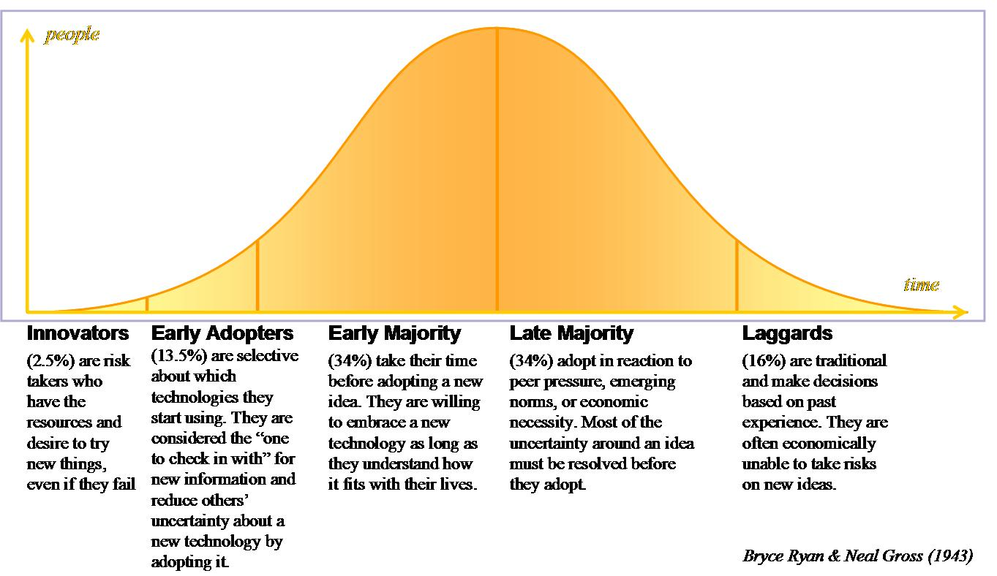
Technology adoption life cycle
Notes:
Early Adopters are visionaries who want to exploit new innovations to gain an advantage over the status quo. Unlike innovators, their interest in being first is not driven by an intrinsic love of technology but rather the opportunity to gain an edge
The Early Majority are pragmatists that have no interest in technology for its own sake. These individuals adopt new products only after a proven track record of delivering value.
The Late Majority are risk-averse conservatives who are doubtful that innovations will deliver value and only adopt them when pressured to do so, for example, for financial reasons, due to competitive threats, or for fear of being reliant on an older, dying technology that will no longer be supported

Slide 45
Technology adoption life cycle
You may initially target innovators for a new market, since they embrace new solutions, are willing to pay a premium to have them, and are willing to overlook product shortcomings outside the core area of innovation.
As you try to gain adoption by additional segments over time, you will discover that they have different needs and preferences—such as increased ease of use, higher reliability, and lower price—that require you to change your product before they will adopt it.

Slide 46
Personas
This is a hypothetical archetype of your actual users and not real people.
A persona is used to capture your hypotheses about your target customer and help to ensure that everyone in your team that is involved in the product process is building for the same customer.

Slide 47
Use of Personas to describe the customer
Alan Cooper championed the use of personas as part of his “Goal-Directed Design” process. In his book The Inmates are Running the Asylum, he describes personas as “a precise definition of our user and what he wishes to accomplish.” Cooper explains, “personas are not real people” but rather “hypothetical archetypes of actual users.”
Personas also help to ensure that everyone in your company who's involved with the product is aligned on the same customer. As with most endeavors involving a large number of people, if you don't write it down, share it, and discuss it, chances are that everyone won't be on the same page. At the end of the day, personas help people on the product team make decisions about which features are important and about how to design the user experience. A good persona empowers everyone on the team with the same solid foundation of information and reasoning.

Slide 48
Information a persona should provide
Name
Representative photograph
Quote that conveys what they most care about
Job title
Demographics
Needs/goals
Relevant motivations and attitudes
Related tasks and behaviors
Frustrations/pain points with current solution
Level of expertise/knowledge (in the relevant domain, e.g., level of computer savvy)
Product usage context/environment (e.g., laptop in a loud, busy office or tablet on the couch at home)
Technology adoption life cycle segment (for your product category)
Any other salient attributes

Slide 49
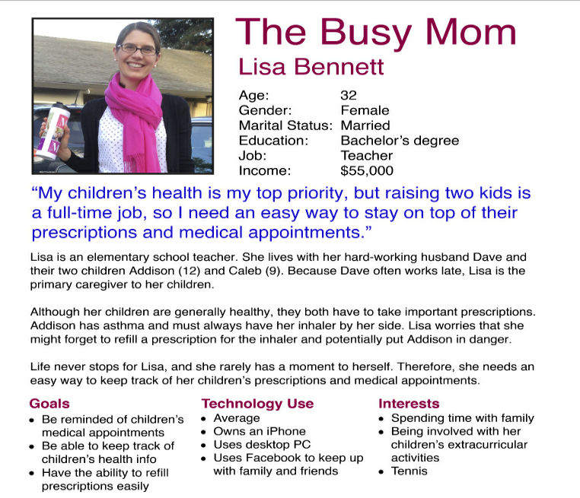
Customer Persona Example

Slide 50
How to create personas
You can gather information by doing customer interviews and surveys. Talking to customers in one-on-one interviews is the best way to build this knowledge. Once you know the right questions to ask, surveys can help you collect data from many customers at once.
When you use survey data, it is critical that you not use averages of the collected data to populate your persona. You want your persona to represent a real person and should not design your product for some nonexistent “average” customer. You can use the aggregate survey data to help ensure your persona represents a meaningful portion of your customer base. Reading through the individual survey responses from people who match your target customer profile can be enlightening.
if you are launching a new product or trying to expand to a new target market, you won't have existing customers. You can always use your judgment to make initial hypotheses about your target customer's attributes, and then test those hypotheses by talking to prospective customers who match that profile.
As you talk with more customers, you learn more and revise your persona to make it more accurate and robust. Your goal is to iterate until you feel confident that you have identified a target customer with an underserved customer need that you believe you can address.

Slide 51
The problem with personas
Weak personas can lack key information, be poorly written, or be based purely on speculation versus grounded in real customer data. At the other extreme are personas that contain too many superfluous details that don't add value. To be useful, a persona should be pragmatic and provide useful information that can help inform product design decisions.
Developing a persona should not slow down your product process, and you should not spend an inordinate amount of time trying to perfect your initial persona. Instead, you should view it as a first draft that you will revise as you iterate through the process.
Even if a persona is well written, the rest of the product team might ignore it. They should be referring to the persona as they make various design decisions and evaluate proposed designs. If your team members aren't using the persona, you should try providing some education about personas, the benefits they provide, and how the team should use them.

Slide 53
Do a market segmentation and customer persona for your problem space.

Slide 54
The Lean Product Process has 6 steps
Determine your target customers
Identify underserved customer needs
Define your value proposition
Specify your minimum viable product (MVP) feature set
Create your MVP prototype
Test your MVP with customers
Notes:
The last three steps reference the important Lean concept of a minimum viable product (MVP) - the minimum amount of functionality that your target customer considers viable, that is, providing enough value. When you are building a new product, you want to avoid building more than is required to test your hypotheses with customers. The term MVP clearly applies when you're building a completely new version 1 product (v1 for short)

