Slide 1

G2M case study
virtual internship
Oct-20-2022

Slide 2

Agenda
Background
EDA
Data visualization
Recommendations

Slide 3
Background
XYZ is a private firm in US. Due to remarkable growth in the Cab Industry in last few years and multiple key players in the market, it is planning for an investment in Cab industry and as per their Go-to-Market(G2M) strategy they want to understand the market before taking final decision.
Goals : Provide actionable insights to help XYZ firm make proper investment.

Slide 4
Background – Data
Data were stored into 4 main .csv files, all of which are collected from 31/01/2016 to 31/12/2018.
Cab_Data.csv – this file includes details of transaction for 2 cab companies
Customer_ID.csv – this is a mapping table that contains a unique identifier which links the customer’s demographic details
Transaction_ID.csv – this is a mapping table that contains transaction to customer mapping and payment mode
City.csv – this file contains list of US cities, their population and number of cab users

Slide 5
EDA
Cab
Customer
Data
EDA
Feature Engineering
Visualization
Transaction
City

Slide 6
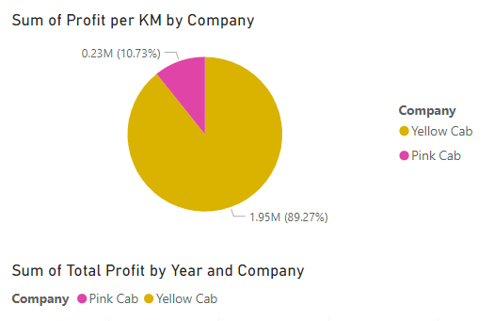
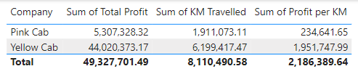
Data visualization – Profit by Company

Slide 7
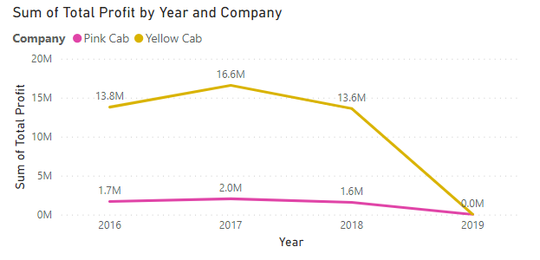
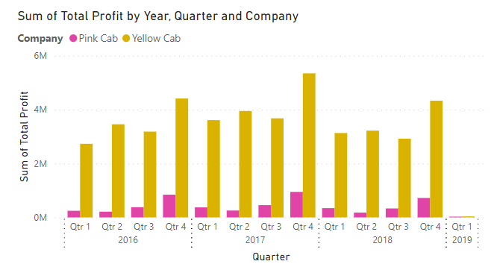
Data visualization – Profit by Year and Company

Slide 8
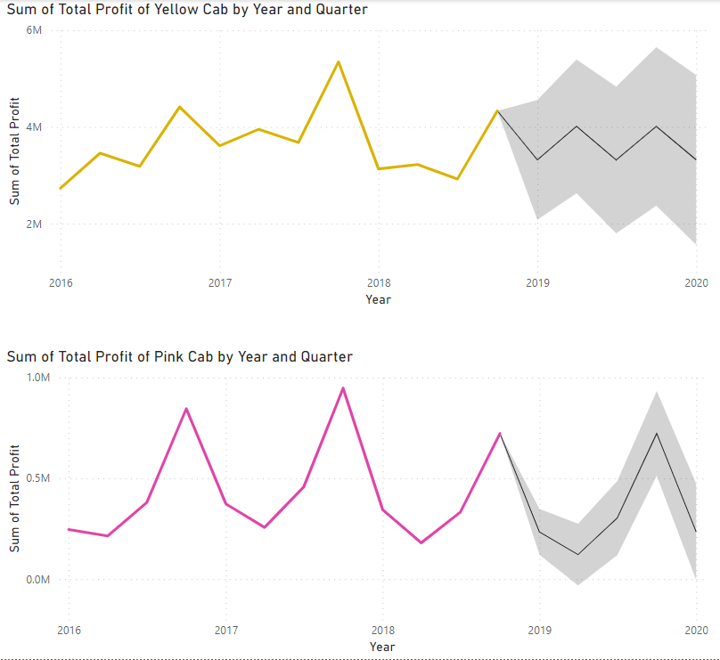
Data visualization – Profit Prediction by Company

Slide 9
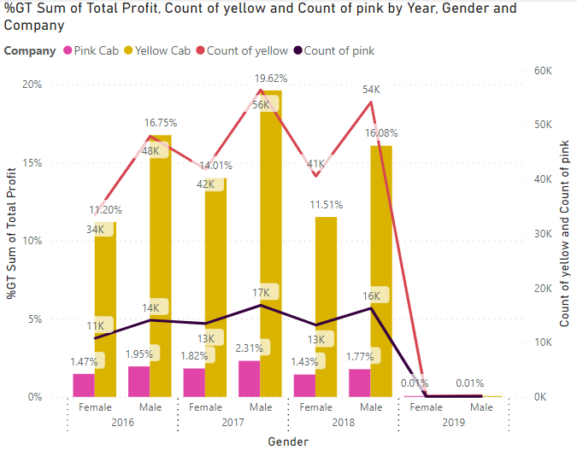
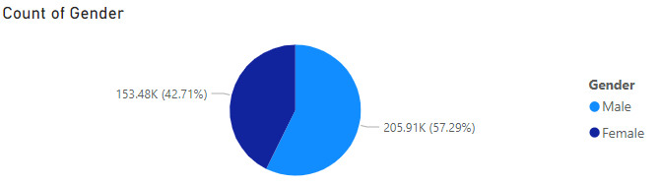
Data visualization – Gender analysis

Slide 10
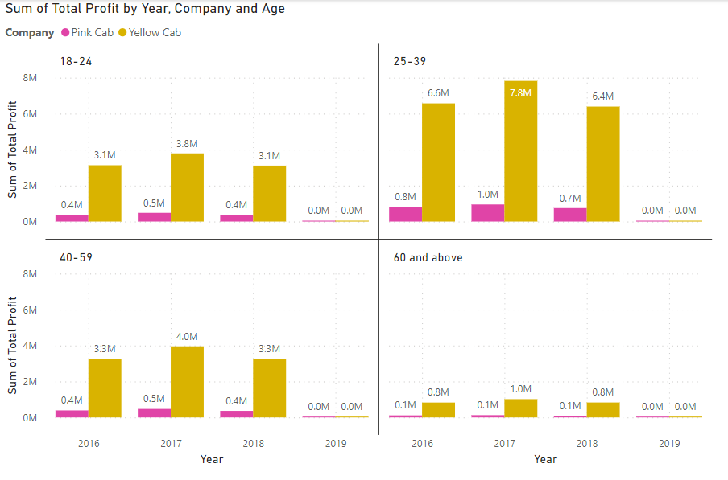
Data visualization – Age analysis

Slide 11
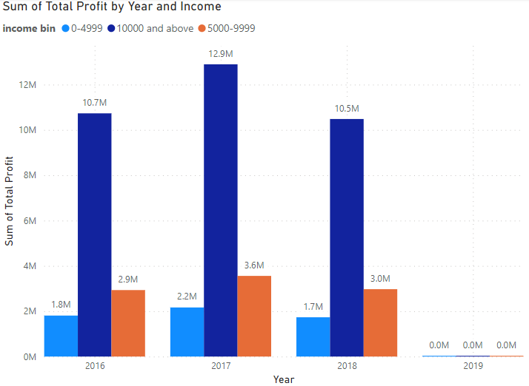
Data visualization – Income analysis

Slide 12
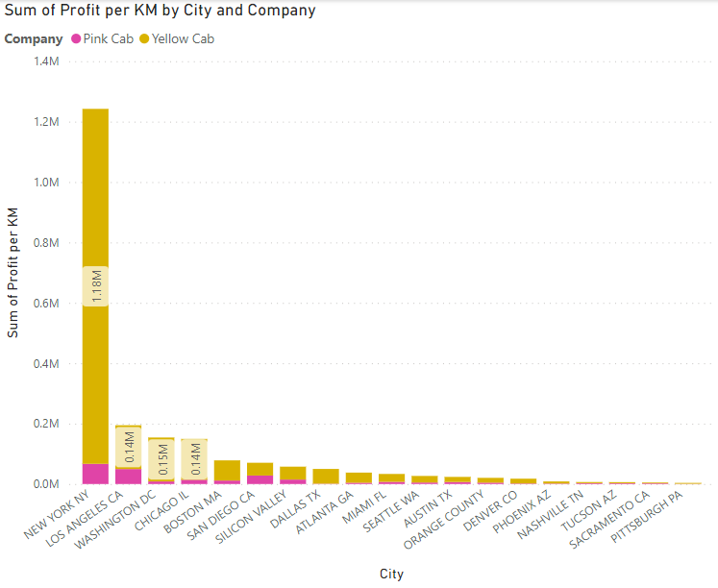
Data visualization – City analysis

Slide 13
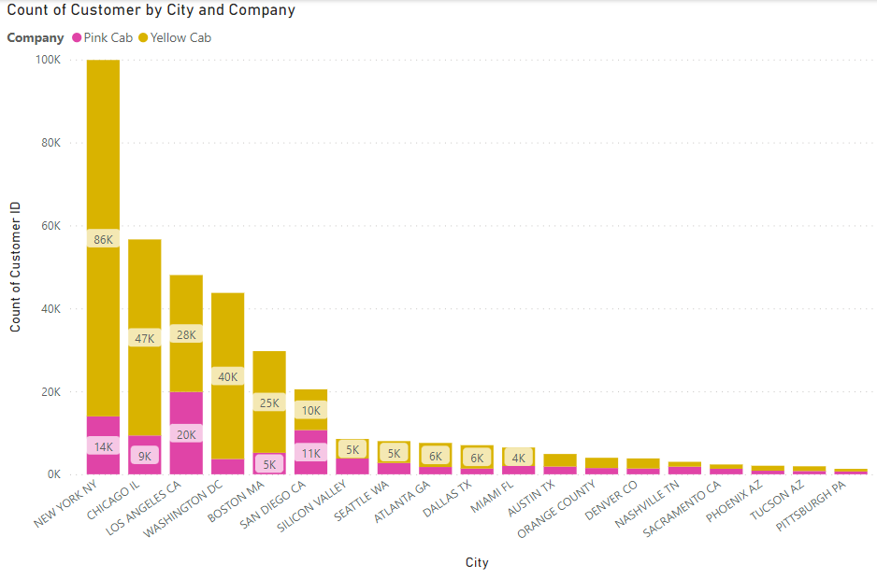
Data visualization – City analysis

Slide 14
Recommendations
The recommendations are from various aspects based on the data visualization.
Profit – Yellow cab is more profitable than Pink cab and the future profitability of Yellow cab is more stable than Pink cab.
Gender – Males use cabs more frequently than females which means that there is a huge potential market for females. XYZ should create some customized services such as carpool to make them users safe.
Age – People who age from 25 to 39 are the dominant users. 18-24 and 40-59 groups should be given some promotions to use cab services.
Income – The higher income of users, the more frequent uses of cab services
City – Big cities such as YN, LA, CHI have more user bases. XYZ should prioritize the investment for those cities.

Slide 15
Thank You

