Slide 1

OOP Project #4
Team 14
Team Member
20200009 김동영
20200699 박혜인
20200479 정수용

Slide 2

Contents
Descript the program
Explain how to operate
Show our program

Slide 3
Descript
the Program
Our program is…
Vending Machine that we can see everywhere
This Vending Machine supports two modes

Slide 4
Descript
the Program
Consumer mode
You have to insert the coin to buy some goods
Choose the good that you want to buy
You can see the information of the good
The amount of the coin is decreased by the price of the good
You have to press clear button to return remaining coin

Slide 5
Descript
the program
Manager mode
You can edit information of the goods
Name, price, inventory, and image
You also add new goods
Of course, you can delete goods

Slide 6
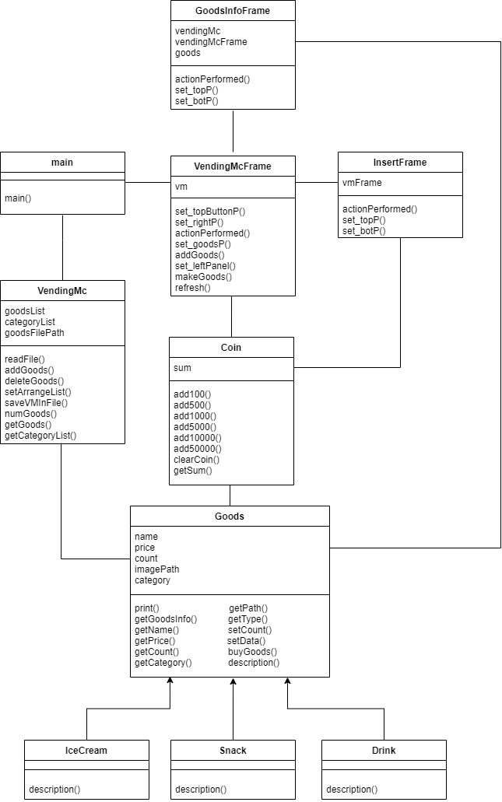
Explain
How to Operate

Slide 7
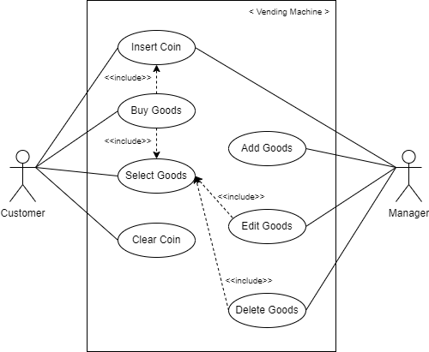
Explain
How to Operate

Slide 8
Show
Our Program
Let’s execute our program!

Slide 9
Thank you for listening!

