Slide 1
tableView
QnA

Slide 2
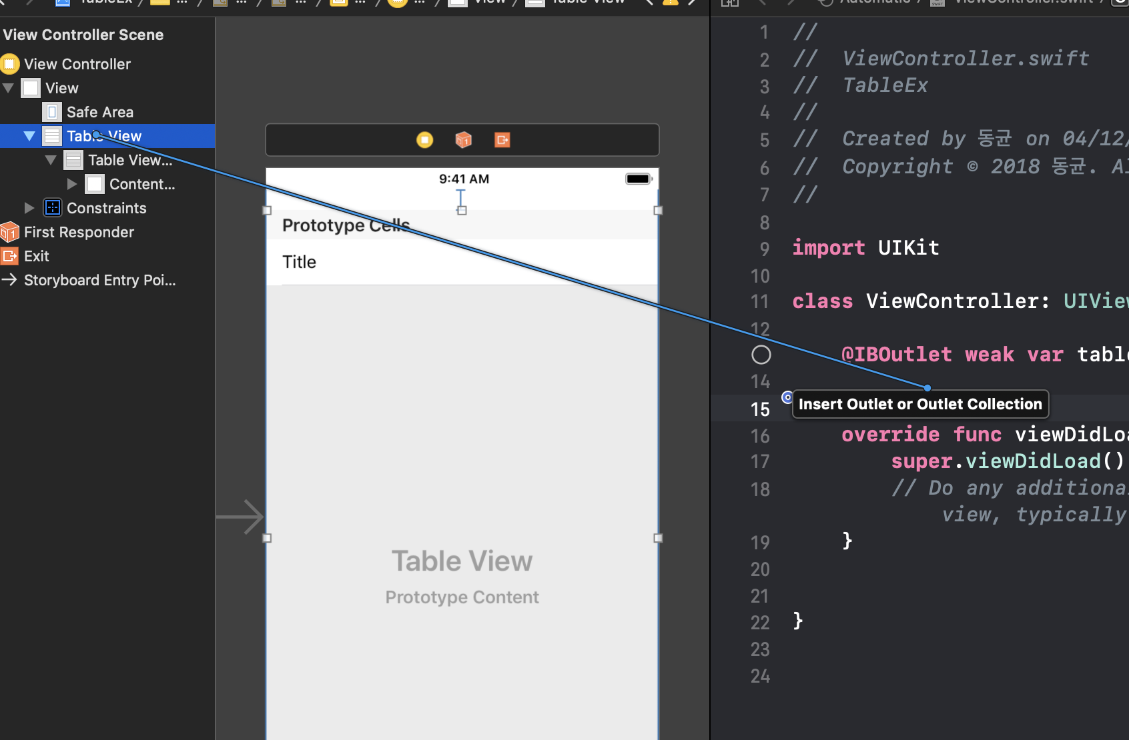
아울렛 지정

Slide 3
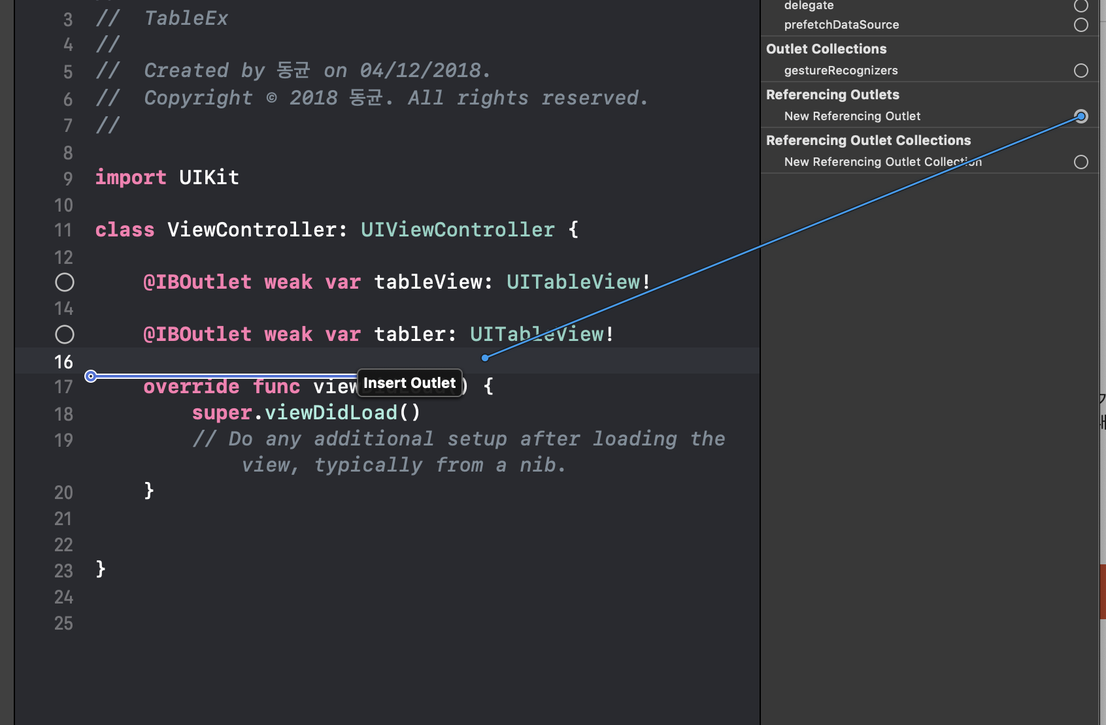
아울렛 지정

Slide 4
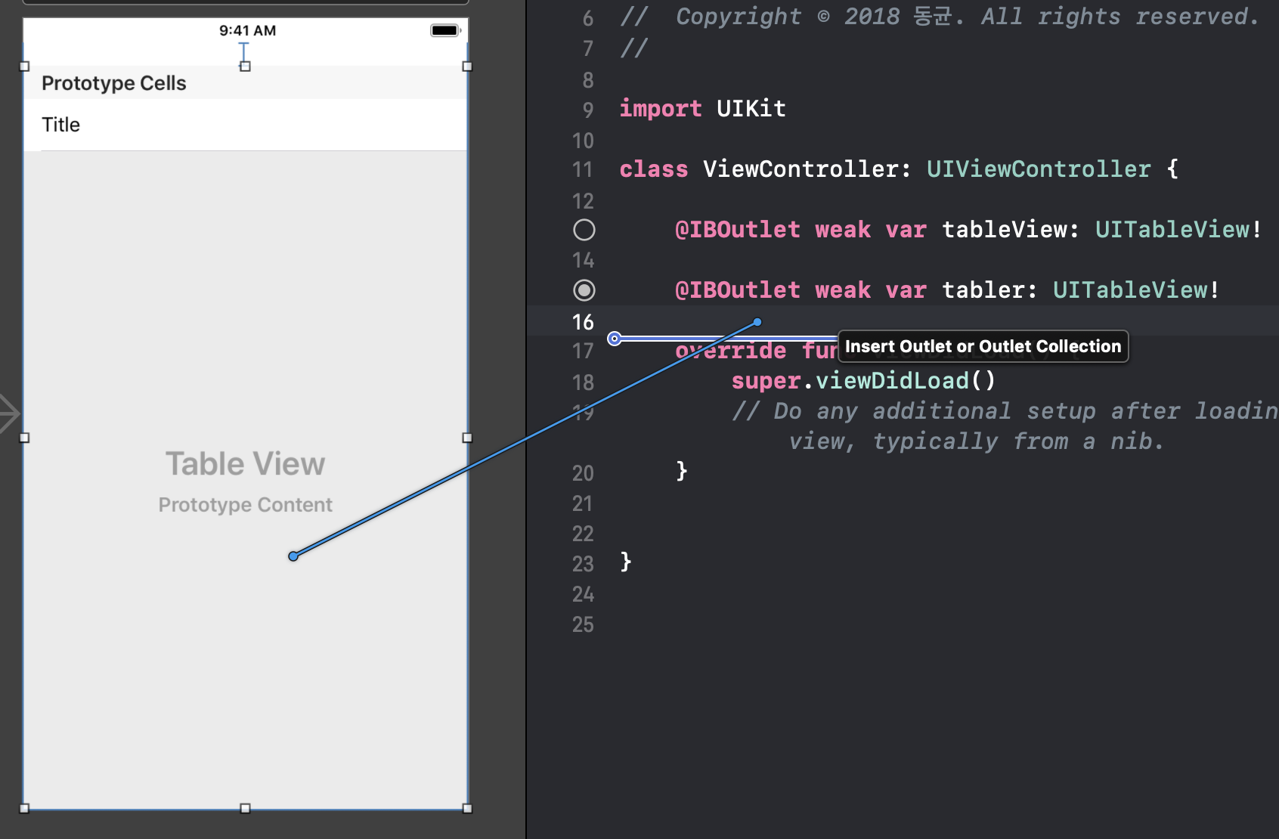
아울렛 지정

Slide 5
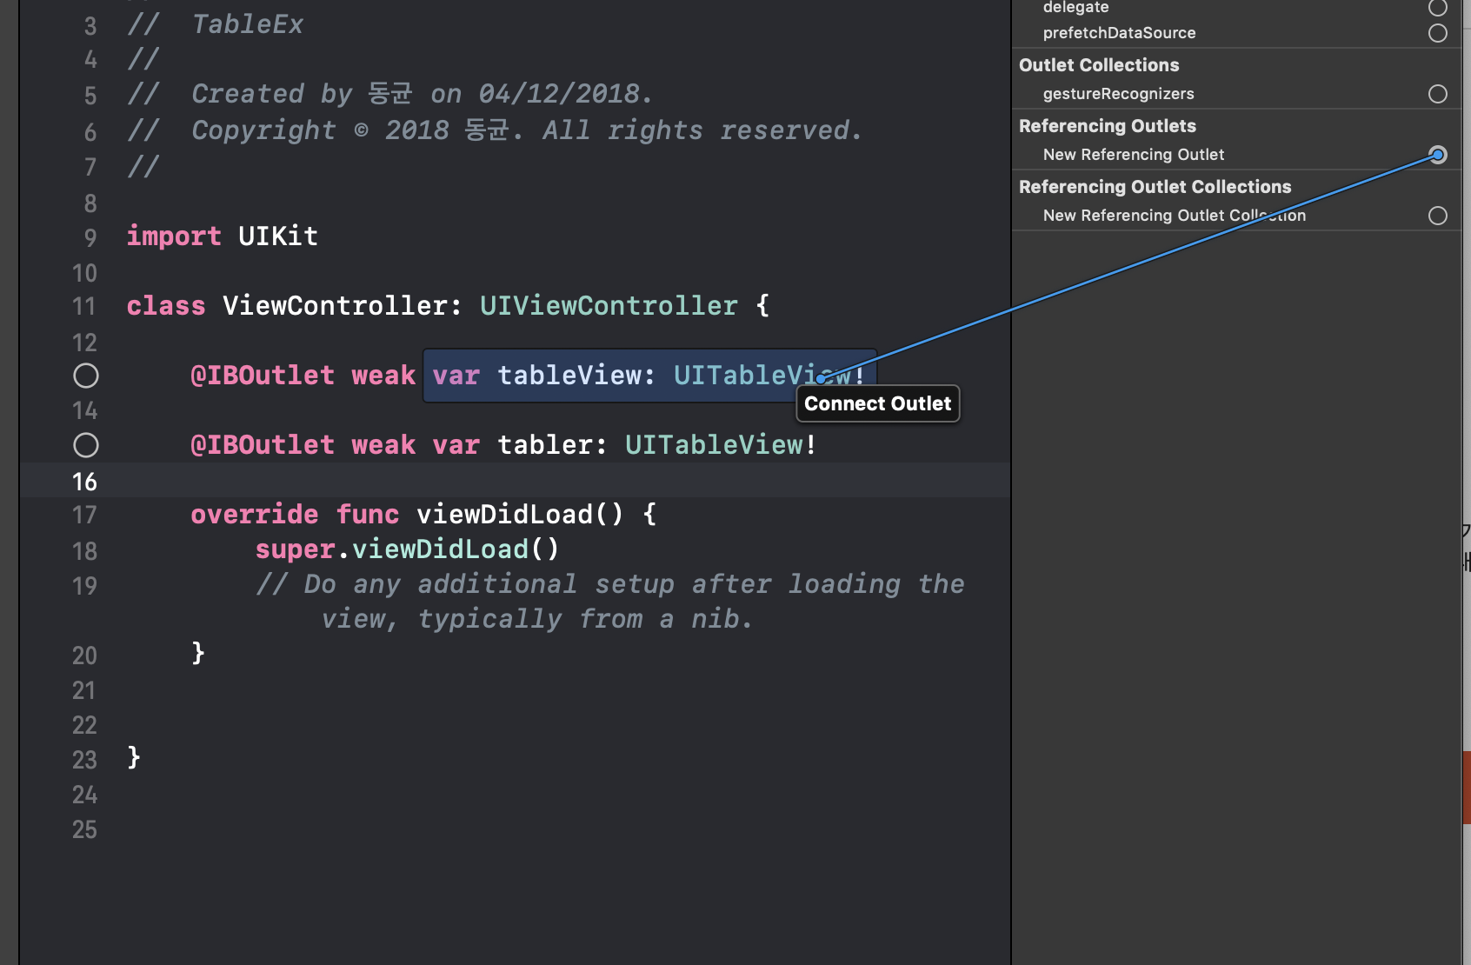
아울렛 지정

Slide 6
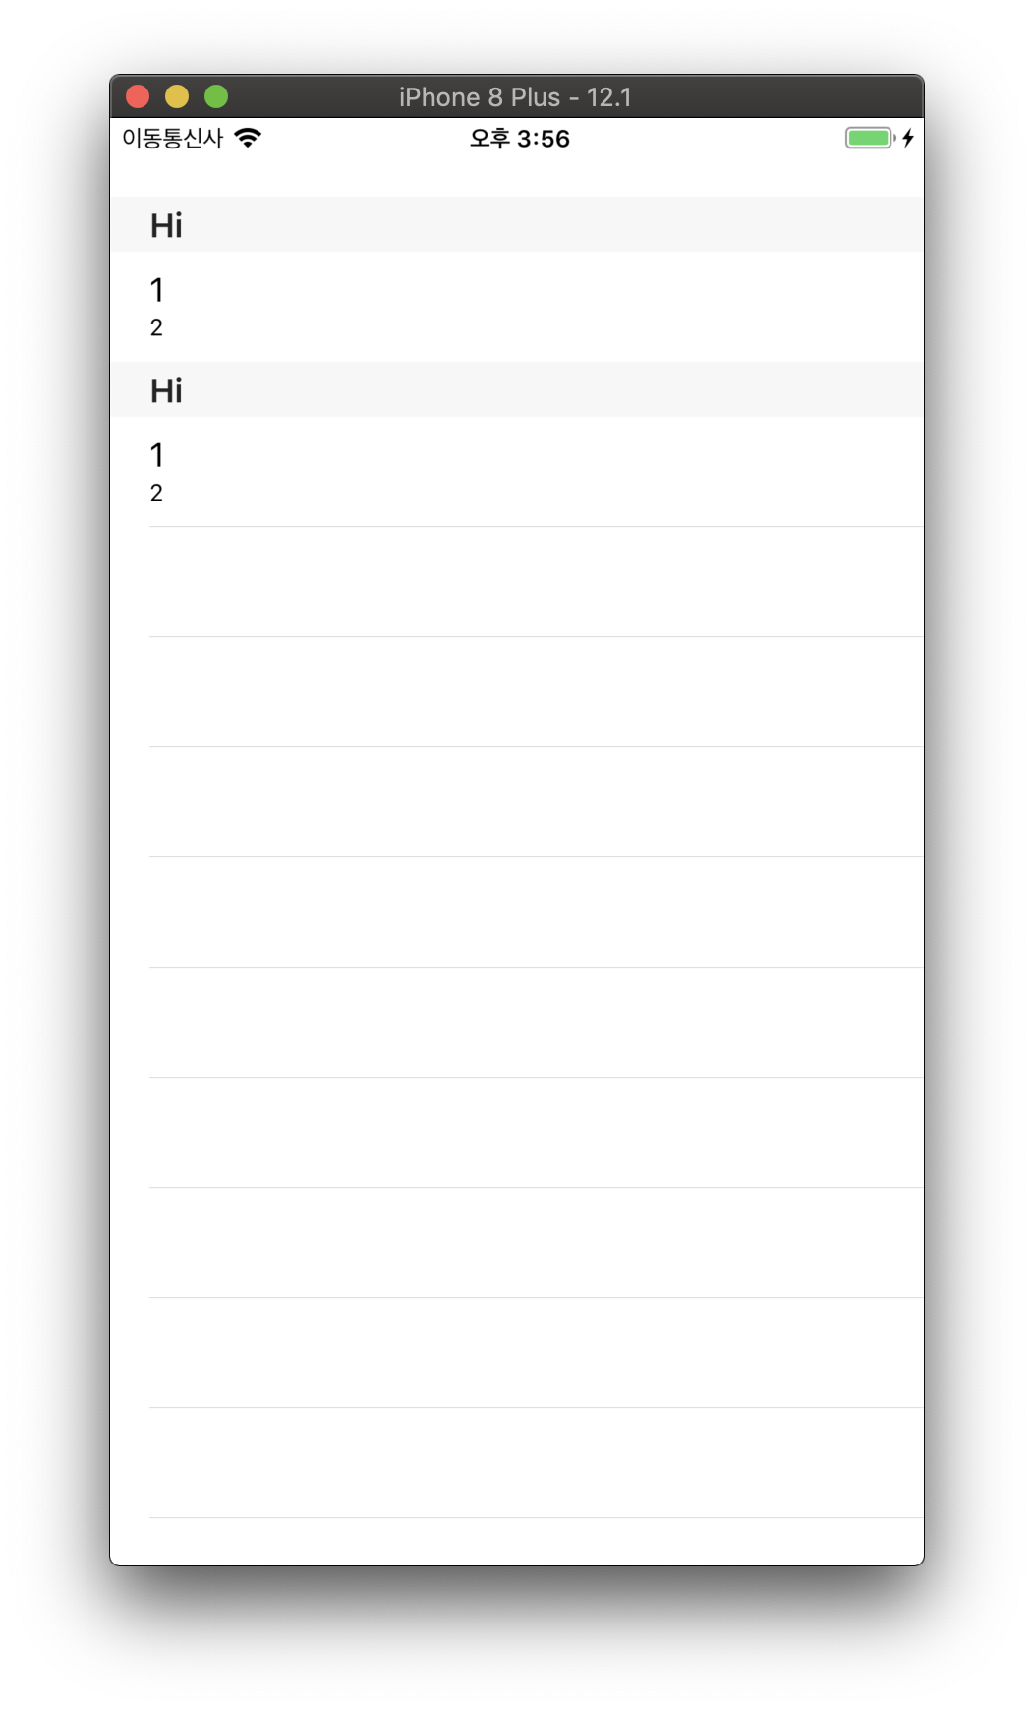
Section
func numberOfSections(in tableView: UITableView) -> Int {
}
func tableView(_ tableView: UITableView, titleForHeaderInSection section: Int) -> String? {
}

Slide 7
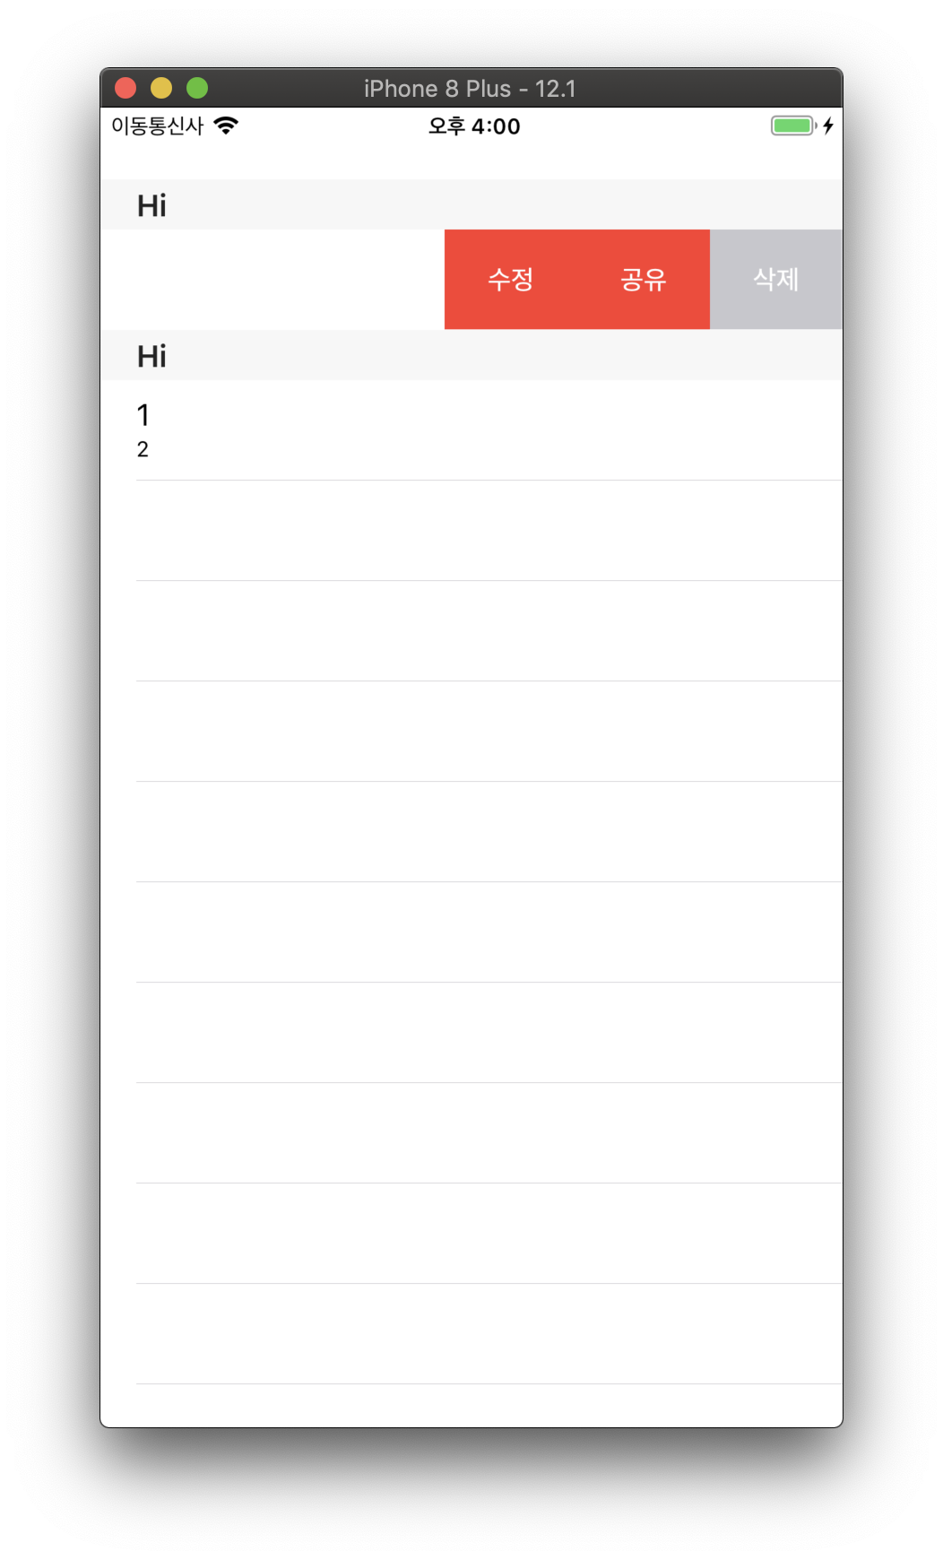
스와이프. 예전버전 새로운버전
https://zeddios.tistory.com/335?category=682195
func tableView(_ tableView: UITableView, editActionsForRowAt indexPath: IndexPath) -> [UITableViewRowAction]? {
let deleteAction = UITableViewRowAction(style: .destructive, title: "삭제") { action, index in
//하고싶은 작업
}
let share = UITableViewRowAction(style: .normal, title: "공유") { action, index in
//하고싶은 작업
}
return [deleteAction,share]
}

Slide 8
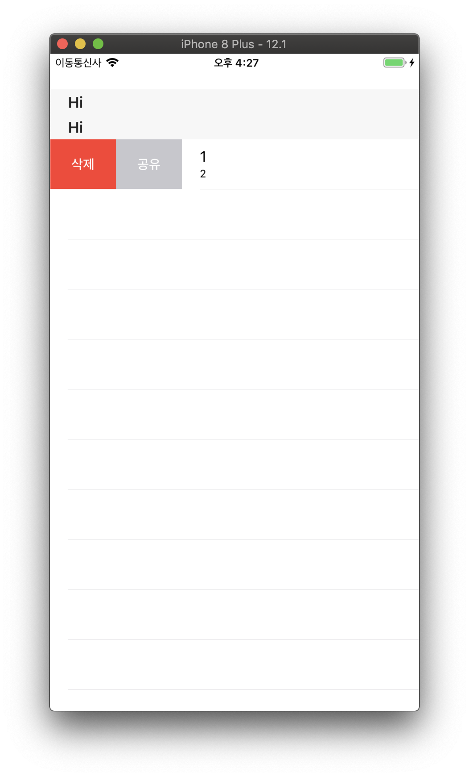
스와이프. 새로운버전
// 왼 -> 오 스와이프
func tableView(_ tableView: UITableView, leadingSwipeActionsConfigurationForRowAt indexPath: IndexPath) -> UISwipeActionsConfiguration? {
//code
}
// 왼 -> 오 스와이프
func tableView(_ tableView: UITableView, trailingSwipeActionsConfigurationForRowAt indexPath: IndexPath) -> UISwipeActionsConfiguration? {
//code
}

