Slide 1
zeplin
code

Slide 2
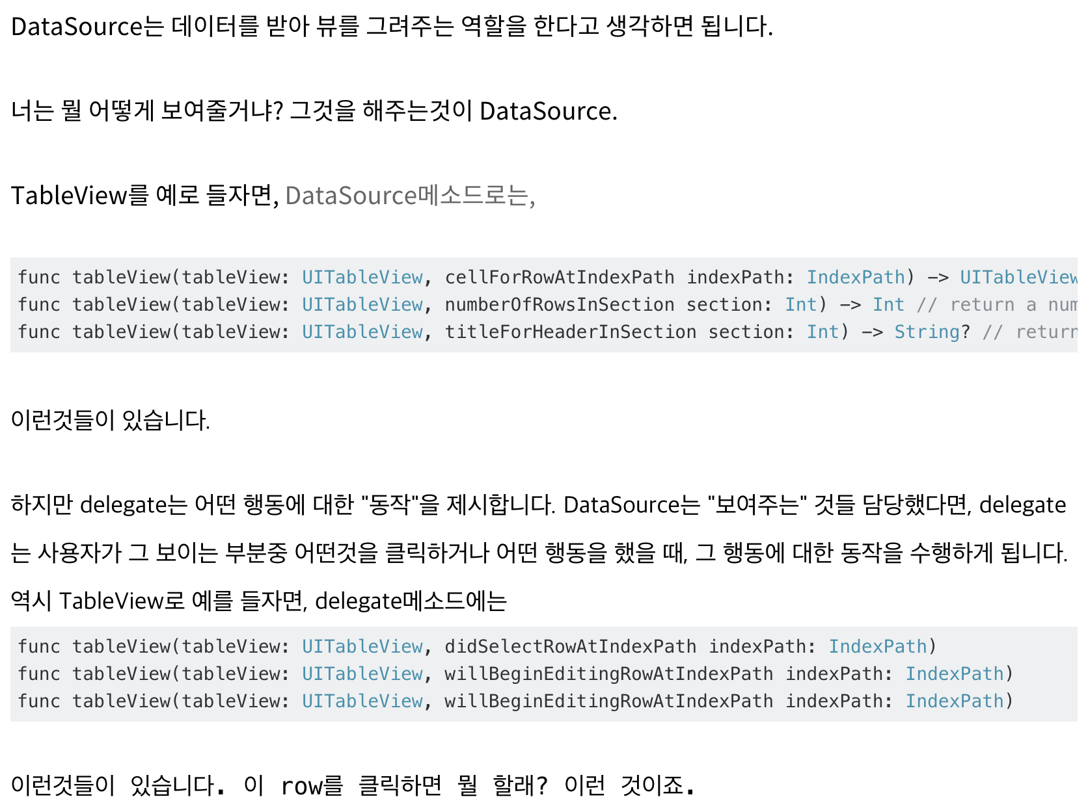

Slide 3
Zeplin
http://zeplin.io

Slide 4
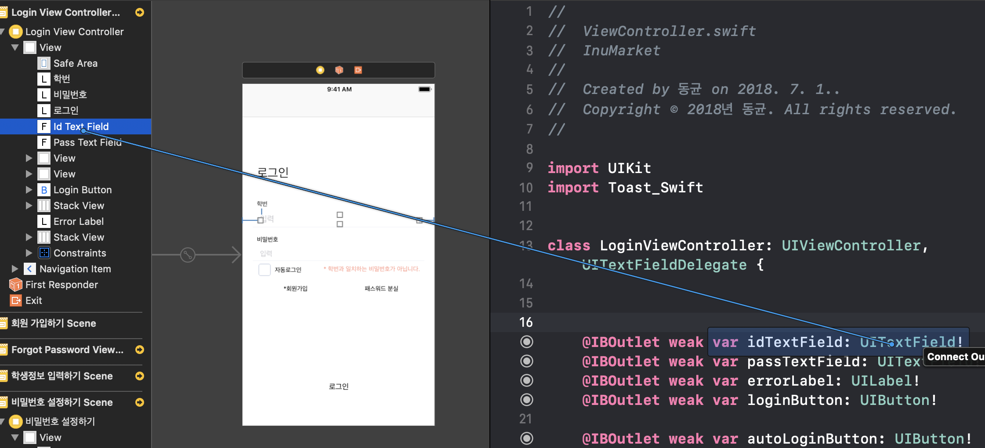
@IBOutlet weak var dayLabel: UILabel!
@IBOutlet weak var locationLabel: UILabel!
@IBOutlet weak var loginButton: UIButton!
@IBAction func URLButton(_ sender: Any) {
}

Slide 5
