Slide 1
CS 1520: Recitation 2
DOM and Events

Slide 2
DOM – Document Object Model
Created by the browser when a webpage is loaded
We use JS to read or change the DOM

Slide 3
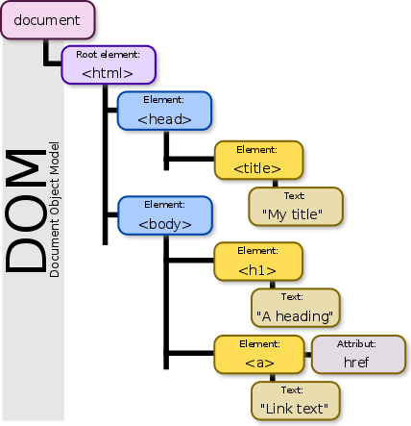
Graphically, a tree of elements/nodes

Slide 4
Interacting with the DOM
Edit HTML elements on the page
Change element attributes, styles
Inserting new HTML elements to the page
Attach event listeners to elements

Slide 5
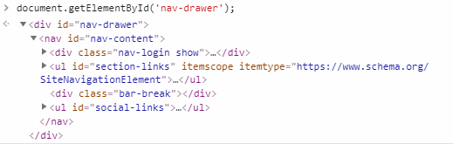
Get Element By ID
document.getElementById(‘Id_name’)
Example (from https://www.starwars.com/)

Slide 6
Get Elements By Class Name or Tag
document.getElementsByClassName(“Class_Name”)
document.getElementsByTagName(“Tag_Name”)
Returns a HTMLCollection of elements with the class name and tag name passed as parameter respectively
NOT an array
Traverse using a for loop (not by using forEach)

Slide 7
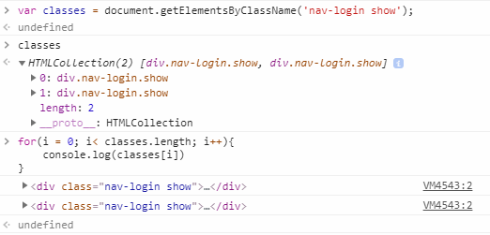

Slide 8
Query Selector
element = document.querySelector(selectors);
selectors are valid CSS selector strings
elements = document.querySelectorAll(selectors);
Returns all elements with the matching selectors

Slide 9
Examples
<div id = “book-list”>
<ul>
<li> <span class = “name”> book 1 </span> </li>
<li> <span class = “name”> book 2 </span> </li>
</ul>
</div>
Query Selector to select the 2nd book?
Query Selector to select all the books?

Slide 10
Examples
<div id = “book-list”>
<ul>
<li> <span class = “name”> Goblet of Fire </span> </li>
<li> <span class = “name”> Deathly Hallows </span> </li>
</ul>
</div>
Query Selector to select the 2nd book?
document.querySelector(#book-list li:nth-child(2) .name)

Slide 11
Examples
<div id = “book-list”>
<ul>
<li> <span class = “name”> Goblet of Fire </span> </li>
<li> <span class = “name”> Deathly Hallows </span> </li>
</ul>
</div>
Query Selector to select all the books?
document.querySelectorAll(#book-list li .name)

Slide 12
DOM Events
List of DOM Events
https://www.w3schools.com/jsref/dom_obj_event.asp
element.addEventListener(‘click’, function(e){})

Slide 13
Event Bubbling and Capturing
Bubbling Phase
Bottom up event trigger
Capture Phase
Top down event trigger
element.addEventListener(‘click’, function(e){}, userCapture)

Slide 14
Event Bubbling
Bubbling Phase
Bottom up event trigger
Capture Phase
Top down event trigger
element.addEventListener(‘click’, function(e){}, userCapture)
true => Event executed in the capture phase
false => Event executed in the bubbling phase

Slide 15
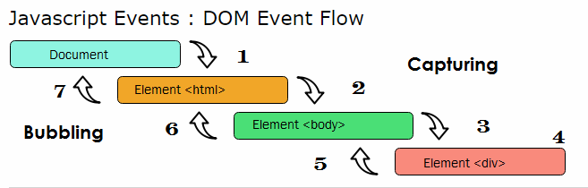

Slide 16
Exercise 1 ( See Rec2-ex1.html)
What is the output in the console when
the child button is clicked?
the other button is clicked?
Output
child clicked
parent clicked

Slide 17
Exercise 1.1(See Rec2-ex1_1.html)
What is the output when child button is clicked?
Output
parent clicked
child clicked

Slide 18
Exercise 2 (Rec2_exercise2.html)
What alerts will be produced (and in what order) if a user clicks on `fuz`?
What alerts will be produced (and in what order) if a user clicks on `baz`?
If possible, write Javascript to replace the comment in the source code (`// YOUR CODE WOULD GO HERE`) such that clicking on `foo` will cause `Alert4` to be produced as the first alert without altering the other EventListeners. If this is not possible, explain why not.
How would you target <td> foo </td> without using getElementsByClassName, getElementById(), getElementsByTagName()?

Slide 19
Exercise 2 (Rec2_exercise2.html)
What alerts will be produced (and in what order) if a user clicks on `fuz`?
Alert 1, Alert 2

Slide 20
Exercise 2 (Rec2_exercise2.html)
What alerts will be produced (and in what order) if a user clicks on `baz`?
Alert 1, Alert 3, Alert 2

Slide 21
Exercise 2 (Rec2_exercise2.html)
If possible, write Javascript to replace the comment in the source code (`// YOUR CODE WOULD GO HERE`) such that clicking on `foo` will cause `Alert4` to be produced as the first alert without altering the other EventListeners. If this is not possible, explain why not.
Can't do it unless you set capture to false on actionTable eventlistener. (If assigning eventlistener to the `<td>foo</td>`). Because actionTable eventlistener takes priority.

Slide 22
Exercise 2 (Rec2_exercise2.html)
How would you target <td> foo </td> without using getElementsByClassName, getElementById(), getElementsByTagName()?
document.querySelector(#action-row td);

Slide 23
References
https://www.w3.org/TR/DOM-Level-3-Events/#event-flow
https://www.youtube.com/watch?v=sfKDOOJgbSI
https://www.youtube.com/playlist?list=PL4cUxeGkcC9gfoKa5la9dsdCNpuey2s-V
http://www.tutorialspark.com/javascript/JavaScript_Event_Flow.php

