Slide 1
CS 1520
Recitation 1

Slide 2
Assignment 1
Join Slack: Introduce yourself as required
Create a GitHub repo following the classroom repo invite link provided in CourseWeb.
Create index.html to introduce yourself

Slide 3
index.html
Apply CSS to override the default presentation of the HTML document in the browser
Don’t Use inline CSS styles like
<p style = “color:red:”>…</p>
Do use class and id attributes on HTML elements of your page

Slide 4
index.html
class attribute
Not Unique
Can use same class on multiple elements
Can use multiple classes on same element

Slide 5
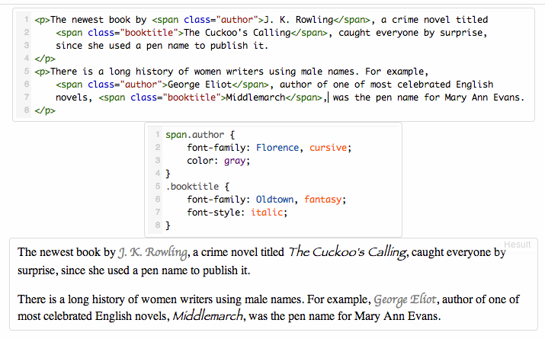

Slide 6
index.html
id attribute
Unique
Each element can have only one id
Each page can have only one element with that id
Has higher specificity (priority) compared to class attribute

Slide 7
<p class="message" id="introduction"> MarkSheet is a free HTML and CSS tutorial. </p>
.message{ color: green;}
#introduction{ color: red;}
What is the color of the paragraph?

Slide 8
index.html
Don’t use <style></style> block in HTML
Refer to an external CSS file using the link element
<head> <link rel="stylesheet" type="text/css" href="mystyle.css"> </head>
Avoid Failed references
Include a Readme.md file for my convenience

