Slide 1

Artificial Intelligence
Module Number: 2.1
Segment Name: Game Playing
Version Code:AI3
Released Date:1-Apr-2020

Slide 2

Contents:
AI and game playing
History and Overview
Games As Search Problems
Imperfect Decision
Min Max Search Strategy
Alpha-Beta Pruning
Algorithm for Nondeterministic and Deterministic Games
Summary

Slide 3

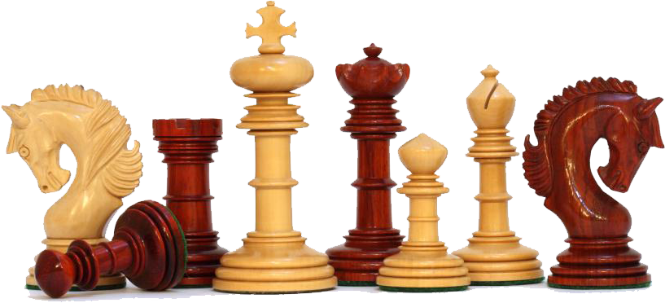
Game Playing
Why study games

Slide 4

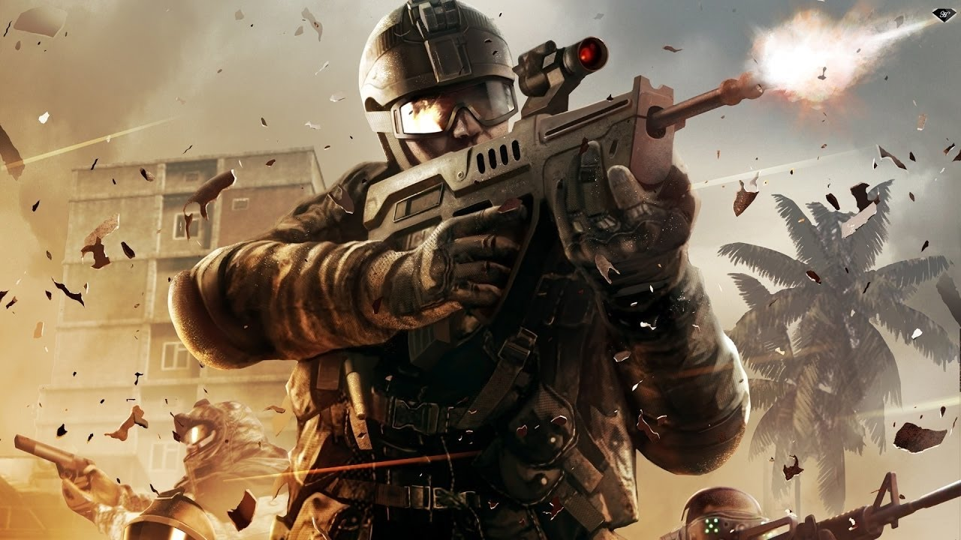
Game Playing
Definition
Game artificial intelligence refers to techniques used in computer and video games to produce the illusion of intelligence in the behavior of non-player characters (NPCs)
Hacks and cheats are acceptable and, in many cases, the computer abilities must be toned down to give human players a sense of fairness
E.g racing and shooting
Emphasis of game AI is on developing rational agents to match or exceed human performance

Slide 5
Game Playing
AI and game playing
Game playing (especially chess and checkers) was the first test application of AI
It involves a different type of search problem than we have considered up to now
A solution is not a path, but simply the next move
The best move depends on what the opponent might do (adversary search)
Games are well-defined problems that are generally interpreted as requiring intelligence to play well

Slide 6
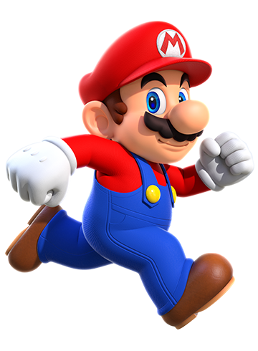
Game Playing
Computer Games Types
Strategy Games
Real-Time Strategy (RTS)
Turn-Based Strategy (TBS)
Helicopter view
Role-Playing Games (RPG)
Single-Player
Multi-Player (MMORPG: Massive multiplayer role playing Game)
Action Games
First-Person Shooters (FPS)
First-Person Sneakers
4. Sports Games
5. Simulations
6. Adventure Games
7. Puzzle Games

Slide 7

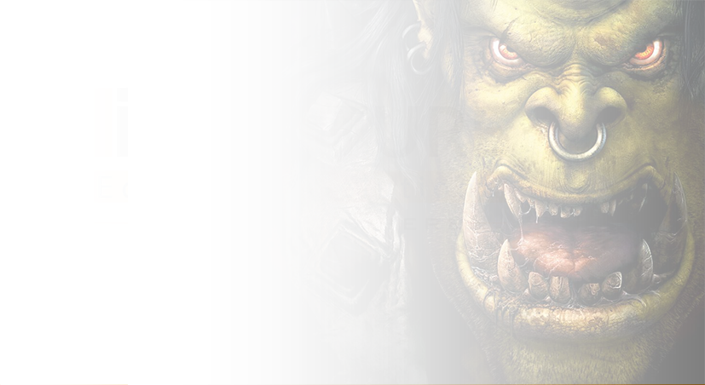
Game Playing
More Complicated Games
Most card games (e.g. Hearts, Bridge, etc.) and Scrabble
Non-deterministic
Lacking in perfect information
Cooperative games
Real-time strategy games (lack alternating moves). e.g. Warcraft
Deterministic
Chance
Perfect information
Chess, Checkers, Go, Othello
Backgammon monopoly
Impact information
Bridge, Poker, Srabble, nuclear war

Slide 8
Game Playing
The Functionalism Of Game AI
Turing test
Simulated behaviour
Believability
Human-like or plausible robot/alien
Fidelity
Non-cheating
Fiction - not (to much) autonomy!
Pseudo-autonomy: limited knowledge, ‘personal’ goals etc.

Slide 9
Game Playing
History and Overview

Slide 10
Game Playing
History and overview
Minimax
Developed by John von Neumann in 1928
This algorithm is used extensively in game theory
Samuel’s learning program (1959)
The program learns through the manipulation of the summation of heuristics
If the program wins, it raises high heuristic values and lowers low ones. If it loses, it does the opposite
1960s
Progress and success in Game AI
Creating a successful AI meant coming up with the right rules for it to follow

Slide 11
Game Playing
4. 1970s-1980s
Transition to games as entertainment
Using search based AI to emulate entertaining characters would be unnatural and clumsy
Game play is based more on skill than on rules
5. Early 1990s
Increased realism becomes the primary focus of the game industry
A rift develops between the developers of popular games and AI researchers

Slide 12
Game Playing
Techniques / Technologies used
Machine Learning – Also known as ML, is a field of artificial intelligence which focuses on developing algorithms that can learn to predict, classify, control, or solve problems.
Waypoint Graph - Is a collection of waypoints linked up to form the information about what areas of a level can be traversed by an actor during path finding.
Semantic Markup – The process of annotating raw information with meta-data that explains its meaning to the AI.
Reinforcement Learning - Taking past data that the AI has recorded and using it to
influence behavior and choices made in the future.

Slide 13
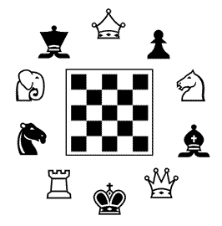
Game Playing
Games As Search Problems
Games have a state space search
Each potential board or game position is a state
Each possible move is an operation to another state
For chess:
-Branching factor: 35(35 legal moves possible)
-Depth: 50 moves each player
-Search tree: 35100 nodes (~1040 legal positions)
Game playing is a search problem Defined by
Initial state
Successor function
Goal test
Path cost / utility / payoff function

Slide 14
Game Playing
Characteristics Of Game Playing
Unpredictable” opponent
Solution is a strategy specifying a move for every possible opponent reply
Time limits: Unlikely to find goal, must approximate

Slide 15
Game Playing
Two-Player Games
Search tree for each player remains the same
Even levels i are moves of player A
Odd levels i+1 are moves of player B
Each player searches for a goal (different for each) at their level
Each player evaluates the states according to their heuristic function
A’s best move brings B to the worst state
A searches for its best move assuming B will also search for its best move
Two players: Max and MinMin must reach a terminal state with the lowest utility

Slide 16
Game Playing
Objective of both Max and Min to optimize winnings
Max must reach a terminal state with the highest utility
Min must reach a terminal state with the lowest utility
8. Game ends when either Max and Min have reached a terminal state
9. Upon reaching a terminal state points maybe awarded or sometimes deducted

Slide 17
Game Playing
Conventionally, in discussion of minimax, have two players “MAX” and “MIN”
The utility function is taken to be the utility for MAX
Larger values are better for MAX”
1
MIN
MIN
MIN
MAX
MAX
MAX
1
7
1
1
6-1
5-2
4-3
0
1
0
1
5-1-1
4-2-1
3-2-2
3-3-1
1
3-2-1-1
2-2-2-1
0
0
4-1-1-1
0
2-2-1-1-1
1
3-1-1-1-1
2-1-1-1-1-1
0
Loss for MAX

Slide 18


TELL ME MORE…
Perfect Decision in Two-Person Games | Russell S., Norvig P. Artificial intelligence- a modern approach (2ed,PH,2003) | 6 | 162-165 | https://www.google.co.in/url?sa=t&rct=j&q=&esrc=s&source=web&cd=1&cad=rja&uact=8&ved=0ahUKEwjgpsaLyu_XAhWG4iYKHSYSCoEQFggrMAA&url=http%3A%2F%2Fweb.cecs.pdx.edu%2F~mperkows%2FCLASS_479%2F2017_ZZ_00%2F02__GOOD_Russel%3DNorvig%3DArtificial%2520Intelligence%2520A%2520Modern%2520Approach%2520(3rd%2520Edition).pdf&usg=AOvVaw29pYJLt7AUiY08MWrTSMH
 | M. Tim Jones Artificial Intelligence A Systems | 4 | 89-92 | http://www.yarbis.yildiz.edu.tr/web/userCourseMaterials/okur_9ed08014291a6b42450d7f262021dee6.pdf

Slide 19
Imperfect Decisions
Searching through the whole game tree is too inefficient for any realistic game
Moves must be made in a reasonable amount of time
One has to cut off the generation of the game tree to some depth and the absolute terminal node values are replaced by heuristic estimates
Game positions are rated according to how good they appear to be (with respect to reaching a goal state)
A basic requirement for a heuristic evaluation function is that it orders the terminal states in the same way as the true utility function
Of course, evaluation of game positions may not be too inefficient and the evaluation function should be strongly correlated with the actual chances of winning

Slide 20
Most evaluation functions work by calculating features of the state
E.g., in chess the number of pawns possessed by each side could be one feature
As game positions are mapped to the values of the chosen features, different states may look equivalent, even though some of them lead to wins, some to draws, and some to losses
For such an equivalence class of states, we can compute the expected end result
If, e.g., 72% of the states encountered in the category lead to a win (utility +1), 20% to a loss (0) and 8% to a draw (½), then the expected value of a game continuing from this category is: (0,72 × 1) + (0,20 × 0) + (0,08 × ½) = 0,76
Because the number of features and their possible values is usually high, the method based on categories is only rarely usable

Slide 21
Adding up the values of the features involves the strong assumption about the independence of the features
However, e.g., in chess bishops are more powerful in the endgame, when they have a lot of space to maneuver
For this reason, current programs for chess and other games also use nonlinear combinations
For example, a pair of bishops might be worth slightly more than twice the value of a single bishop, and a bishop is worth more in the endgame than in the beginning
If different features and weights do not have centuries of experience behind them like in chess, the weights of the evaluation function can be estimated by machine learning techniques

Slide 22

TELL ME MORE…
Imperfect Decisions | Russell S., Norvig P. Artificial intelligence- a modern approach (2ed,PH,2003) | 6 | 171-173 | https://www.google.co.in/url?sa=t&rct=j&q=&esrc=s&source=web&cd=1&cad=rja&uact=8&ved=0ahUKEwjgpsaLyu_XAhWG4iYKHSYSCoEQFggrMAA&url=http%3A%2F%2Fweb.cecs.pdx.edu%2F~mperkows%2FCLASS_479%2F2017_ZZ_00%2F02__GOOD_Russel%3DNorvig%3DArtificial%2520Intelligence%2520A%2520Modern%2520Approach%2520(3rd%2520Edition).pdf&usg=AOvVaw29pYJLt7AUiY08MWrTSMXH
 | Decision theory With imperfect Information by Rafik A Aliev Oleg H Huseynov | 1 | 1-35 | http://bok.org/s/?q=Decision+Theory+with+Imperfect+Information+Kindle+Edition+by+Rafik+A+Aliev+%28Author%29%2C%E2%80%8E+Oleg+H+Huseynov+&yearFrom=&yearTo=&language=&extension=&t=0
Imperfect Decisions | https://www.youtube.com/watch?v=w90x9VGQXQI | Explains what algorithms did game use and how do they work

Slide 23
Game Playing
Min Max Search Strategy
MiniMax rule: Decision Making in Multi-agent Systems Perfect play for deterministic, perfect-information games
Idea: make the move for player MAX which has the most benefit assuming that MIN makes the best move for MIN in response
This is computed by a recursive process
The backed-up value of each node in the tree is determined by the values of its children
For a MAX node, the backed-up value is the maximum of the values of its children (i.e. the best for MAX)
For a MIN node, the backed-up value is the minimum of the values of its children (i.e. the best for MIN)

Slide 24
Game Playing
Minimax Procedure
Consider a 2-ply (two step) game:
Max want’s largest outcome --- Min want’s smallest
Start with the current position as a MAX node
Expand the game tree a fixed number of ply (half-moves)
Apply the evaluation function to the leaf positions
Calculate back-up up values bottom-up
Pick the move which was chosen to give the MAX value at the root

Slide 25
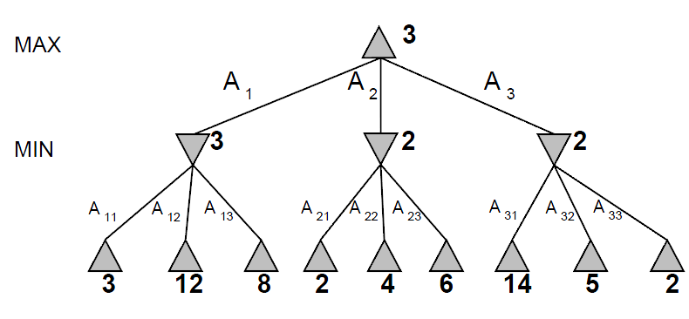
Game Playing

Slide 26
Game Playing
Min Max – Overview
Min-Max the heart of almost every computer board game Applies to games where:
Players take turns
Underlying assumption
Opponent acts rationally
Have perfect information
Chess, Checkers, Tactics
But can work for games without perfect information or chance e.g Poker, Monopoly, Dice
Can work in real-time (i.e- not turn based) with timer (iterative deepening, later)

Slide 27
Game Playing
Properties Of Minimax
Complete? Yes (if tree is finite)
Optimal? Yes (against an optimal opponent)
Time complexity? O(bm)
Space complexity? O(bm) (depth-first exploration)
For chess, b ≈ 35, m ≈100 for "reasonable" games exact solution completely infeasible
The average branching factor for chess is 35. A game may involve 50 moves per player, so the search tree has 35 100 nodes.
Even eliminating duplicates, there are 10 40 unique legal states! Assuming successors can be generated in 33 nanoseconds, it would take 10 22 centuries to do an exhaustive search!

Slide 28
Game Playing
Game Playing – Bounded Minimax
For real games, search trees are much bigger and deeper than Nim
Cannot possibly evaluate the entire tree
Have to put a bound on the depth of the search
The terminal states are no longer a definite win/loss
They are really a definite win/draw/loss but with reasonable computer resources
Cannot determine which Have to heuristically/approximately evaluate the quality of the positions of the states
Evaluation of the utility function is expensive if it is not a clear win or loss

Slide 29
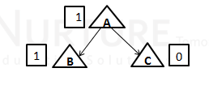
Game Playing
5. Artificial example of minimax bounded Evaluate “terminal position” after all possible moves by MAX (The numbers are invented, and just to illustrate the working of minimax)
=Terminal Position
=Agent
=Opponent

Slide 30
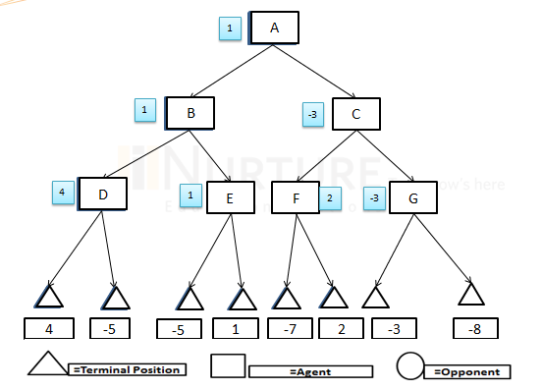
Game Playing
6. Evaluate “terminal position” after all possible moves in the order:
1. MAX (a.k.a “agent”)
2. MIN (a.k.a. “opponent”)
3. MAX
7. (The numbers are invented, and just to illustrate the working of minimax) Assuming MX plays first, complete the MIN/MAX tree
MAX
MN
MAX

Slide 31
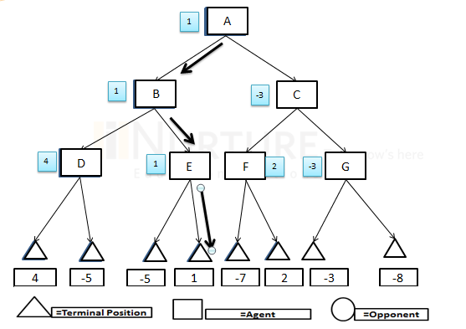
Game Playing
8. If both players play their best moves, then which “line” does the play follow?

Slide 32
Game Playing
Pruning
Discards parts of the search tree
guaranteed not to contain good moves
guarantee that the solution is not in that branch or sub-tree
if both players make optimal decisions, they will never end up in that part of the search tree
sub-optimal moves by the opponent may lead into that part
may increase the amount of calculations for the player, but does not change the outcome of the game
Results in substantial time and space savings
as a consequence, longer sequences of moves can be explored
the leftover part of the task may still be exponential, however

Slide 33
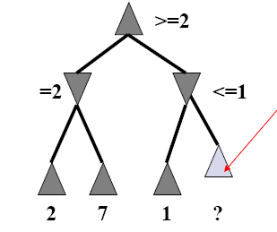
Game Playing
Alpha-Beta Pruning
Eliminating a branch without consideration is called pruning
Want to visit as many board states as possible (Can be used for entire search or cutoff search)
Want to avoid whole branches (prune them)
Because they can’t possibly lead to a good score
A way to improve the performance of the Minimax Procedure
We don’t need to compute the value at this node
No matter what it is it can’t effect the value of the root node. (branch cannot produce better score than a node you have already evaluated

Slide 34
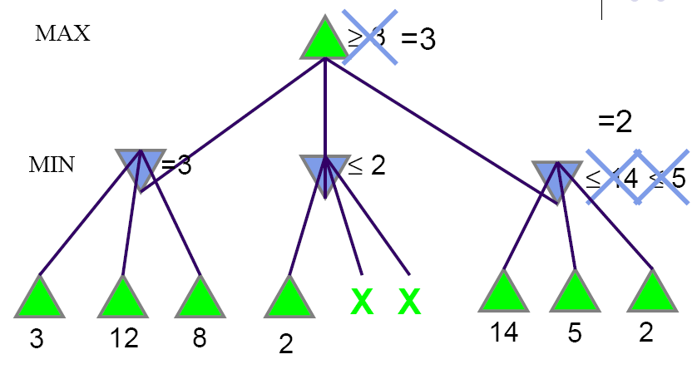
Game Playing
Alpha-Beta Pruning

Slide 35
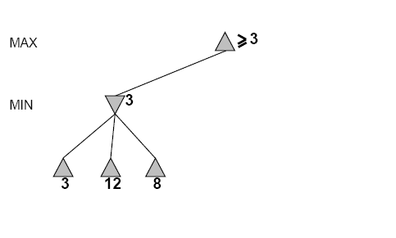
Game Playing

Slide 36
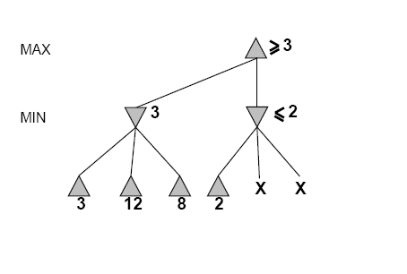
Game Playing

Slide 37
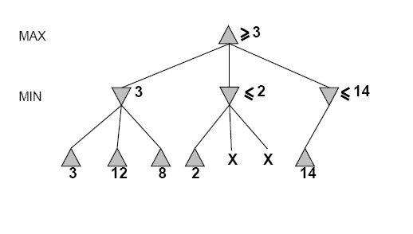
Game Playing

Slide 38
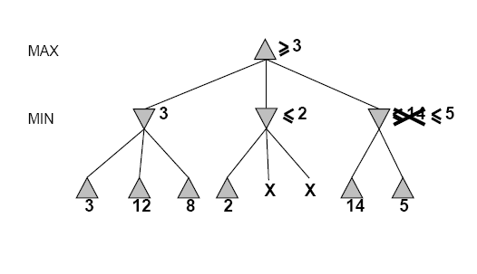
Game Playing

Slide 39
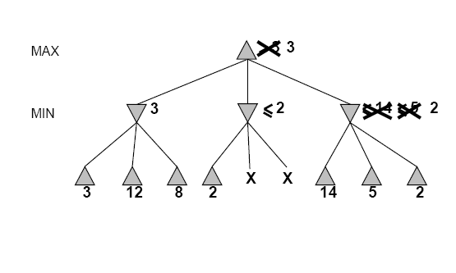
Game Playing

Slide 40
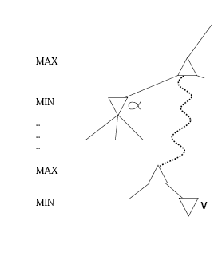
Game Playing
α - is the best value (to MAX) found so far off the current path
If value x of some node below V is known to be less than a, then value of V is known to be at most x, i.e., less than a,
therefore MAX will avoid node V
Consequence
No need to expand further nodes below V

Slide 41
Game Playing
Alpha-Beta Pruning
Traverse the search tree in depth-first order
For each MAX node n, α(n)=maximum child value found so far
Starts with – ¥
Increases if a child returns a value greater than the current α(n)
Lower-bound on the final value
For each MIN node n, β(n)=minimum child value found so far
Starts with + ¥
Decreases if a child returns a value less than the current β(n)
Upper-bound on the final value

Slide 42
Game Playing
4. MAX cutoff rule: At a MAX node n, cut off search if α(n)>=β(n)
5. MIN cutoff rule: At a MIN node n, cut off search if β(n)<=α(n)
6. Carry α and β values down in search

Slide 43
Game Playing
Alpha-Beta Algorithm 1
MAX Play
function ALPHA-BETA-SEARCH(state) returns an action
inputs: state, current state in game
v ← MAX-VALUE(state , - ∞ , +∞)
r e t u r n the action in SUCCESSORS(state ) with value v
function MAX-VALUE(state, a , b) returns a utility value
if TERMINAL-TEST(state) then return UTILITY(state)
v ¬ - ∞
f o r a,s in SUCCESSORS(state ) d o
v ←MAX(v ,MIN-VALUE(s , a , b))
if v ≥ b t h e n r e t u r n v
a ¬ MAX(a ,v)
r e t u r n v

Slide 44
Game Playing
Alpha-Beta Algorithm 2
MIN Play
function MIN-VALUE(state, a , b) returns a utility value
if TERMINAL-TEST(state) then return UTILITY(state)
v ←+ ∞
f o r a,s in SUCCESSORS(state ) d o
v ←MIN(v ,MAX-VALUE(s , a , b))
if v ≤ a t h e n r e t u r n v
b ¬ MIN(b ,v)
r e t u r n v

Slide 45
Game Playing
Properties | Effectiveness
Pruning does not affect final Result | Guaranteed to compute same root value as Mini-max
Good move ordering improves effectiveness of pruning | Worst case: no pruning, same as Mini-max (O(bd))
With "perfect ordering," time complexity = O(bm/2) →doubles depth of search | Best case: when each player’s best move is the first option examined, you examine only O(bd/2) nodes, allowing you to search twice as deep!
A simple example of the value of reasoning about which computations are relevant (a form of meta reasoning) | For Deep Blue, alpha-beta pruning reduced the average branching factor from 35-40 to 6.

Slide 46
TELL ME MORE…
Alpha-Beta Pruning | Russell S., Norvig P. Artificial intelligence- a modern approach (2ed,PH,2003) | 6 | 167 | https://www.google.co.in/url?sa=t&rct=j&q=&esrc=s&source=web&cd=1&cad=rja&uact=8&ved=0ahUKEwjgpsaLyu_XAhWG4iYKHSYSCoEQFggrMAA&url=http%3A%2F%2Fweb.cecs.pdx.edu%2F~mperkows%2FCLASS_479%2F2017_ZZ_00%2F02__GOOD_Russel%3DNorvig%3DArtificial%2520Intelligence%2520A%2520Modern%2520Approach%2520(3rd%2520Edition).pdf&usg=AOvVaw29pYJLt7AUiY08MWrTSMXH
 | Artificial Intelligence illuminated | 6 | 153-155 | https://www.google.co.in/url?sa=t&rct=j&q=&esrc=s&source=web&cd=1&cad=rja&uact=8&ved=0ahUKEwiIytyWr73YAhXIvo8KHRwGCVUQFggtMAA&url=http%3A%2F%2Fcoltech.vnu.edu.vn%2F~sonpb%2FAI%2FAIIlluminated.pdf&usg=AOvVaw0BSz05AH3m3Zc9ar7Zq94D
Alpha-Beta Pruning | https://www.youtube.com/watch?v=xBXHtz4Gbdo | Step by Step explanation of Alpha Beta Pruning
 | https://www.youtube.com/watch?v=Ewh-rF7KSEg | Additional example of how alpha-beta pruning works.

Slide 47


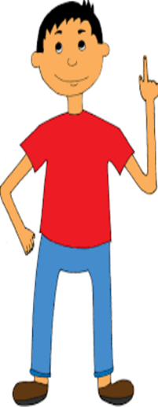
Alpha-Beta Pruning | http://blog.hackerearth.com/minimax-algorithm-alpha-beta-pruning | Summarize the recursive algorithm for optimizing the solution
 | https://www.google.co.in/url?sa=t&rct=j&q=&esrc=s&source=web&cd=1&cad=rja&uact=8&ved=0ahUKEwjh3cne47vYAhXMQI8KHTG6AZYQFggoMAA&url=http%3A%2F%2Fpeople.cs.pitt.edu%2F~litman%2Fcourses%2Fcs2710%2Flectures%2FpruningReview.pdf&usg=AOvVaw3-PjpdV7mkm3IcrYCLQQIq | Explain about adversarial search algorithm

Slide 48
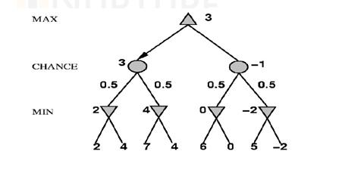
Game Playing
Mini-max For Non-Deterministic Games
For min node, compute min of children
2. For chance node, compute weighted average of children
3. For max node, compute max of children

Slide 49
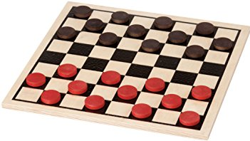
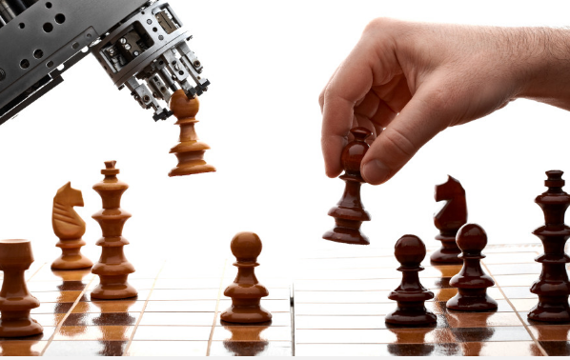
Game Playing
Deterministic Games in Practice
Checkers:
Chinook ended 40-year-reign of human world champion Marion Tinsley in 1994
Used an endgame database defining perfect play for all positions involving 8 or fewer pieces on the board, a total of 443,748,401,247 positions
Chess:
Deep Blue defeated human world champion Gary Kasparov in a six-game match in 1997
Deep Blue searches 200 million positions per second, uses very sophisticated evaluation, and undisclosed methods for extending some lines of search up to 40 ply

Slide 50
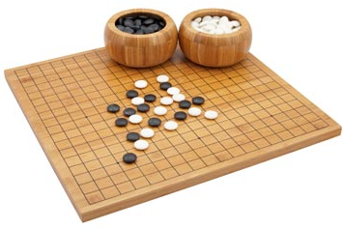
Game Playing
Deterministic Games in Practice
Go:
Human champions refuse to compete against computers, who are too bad.
In go, b 300, so most programs use pattern knowledge bases to suggest plausible moves

Slide 51
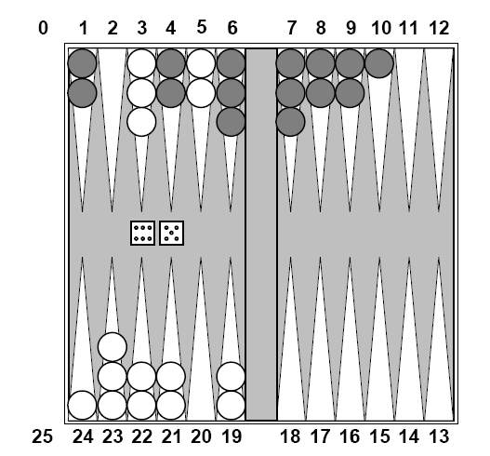
Game Playing
Nondeterministic Games: Backgammon

Slide 52
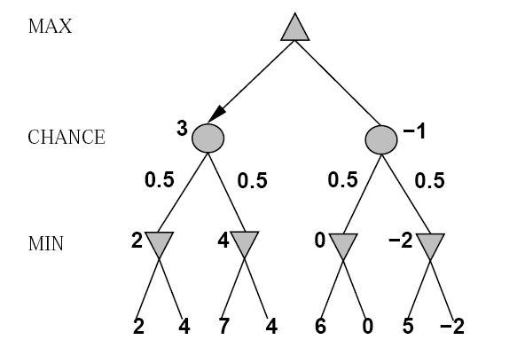
Game Playing
Non-Deterministic Games in General
Chance introduced by dice, card-shuffling, etc.
Simplified example with coin-flipping

Slide 53
Game Playing
Algorithm for Nondeterministic Games
EXPECT MINIMAX gives perfect play:
If state is a MAX node then return the highest EXPECTMINIMAX value of SUCCESSORS(state)
If state is a MIN node then return the lowest EXPECTIMINIMAX value of SUCCESSORS(state)
If state is a chance node then return average of EXPECTMINIMAX value of SUCCESSORS(state)

Slide 54
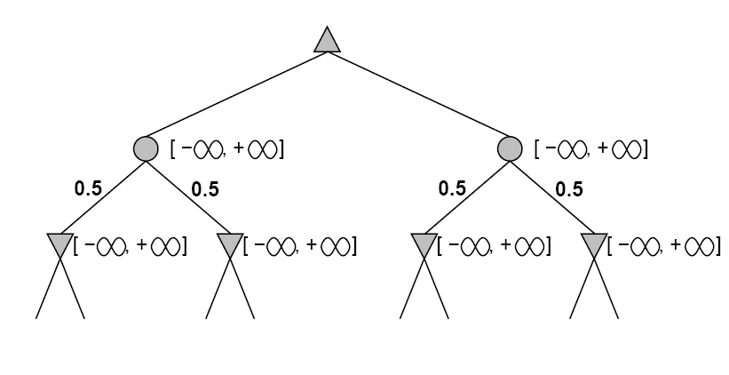
Game Playing
Pruning in Nondeterministic Game Trees

Slide 55
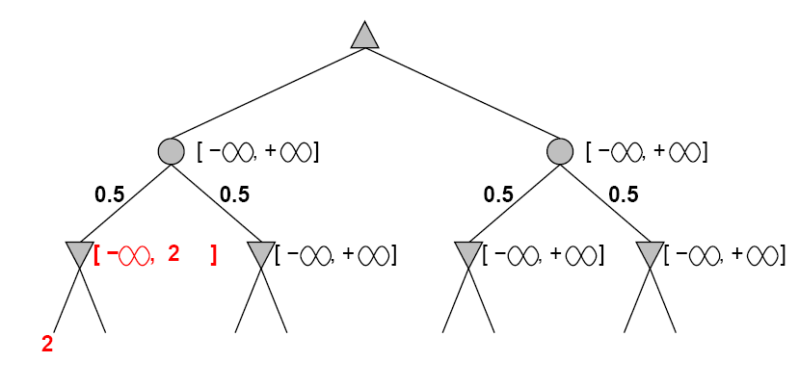
Game Playing

Slide 56
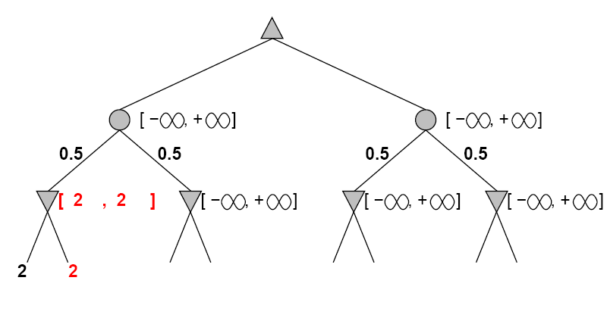
Game Playing

Slide 57
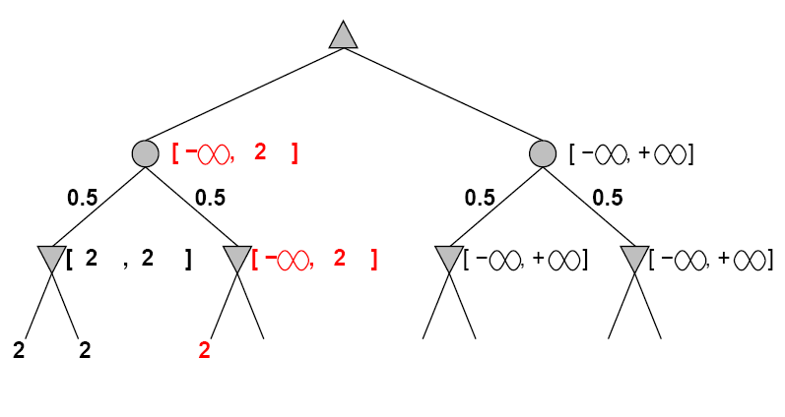
Game Playing

Slide 58
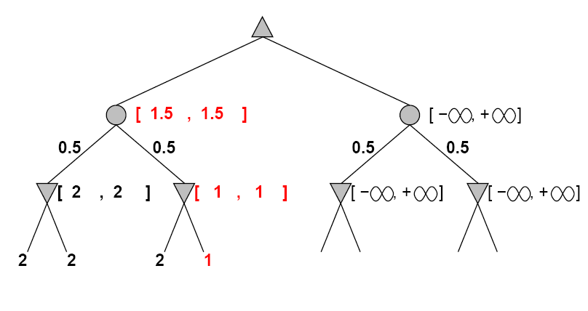
Game Playing

Slide 59
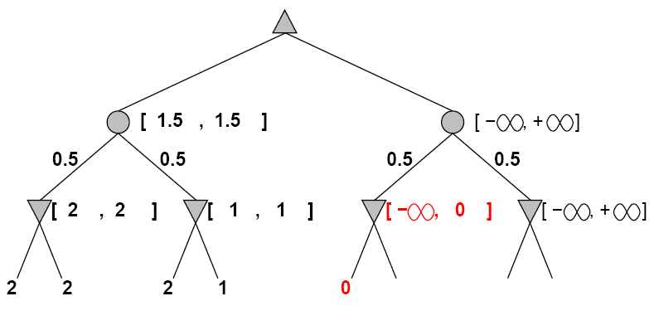
Game Playing

Slide 60
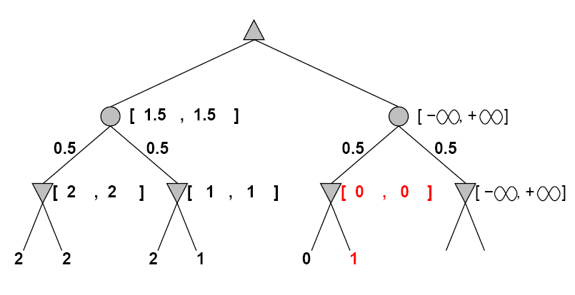
Game Playing

Slide 61
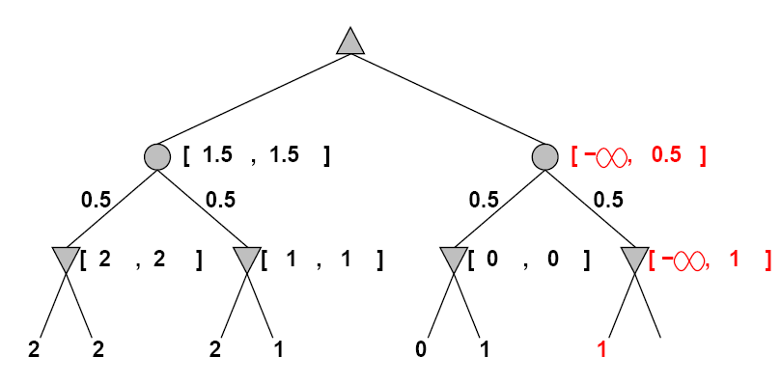
Game Playing

Slide 62
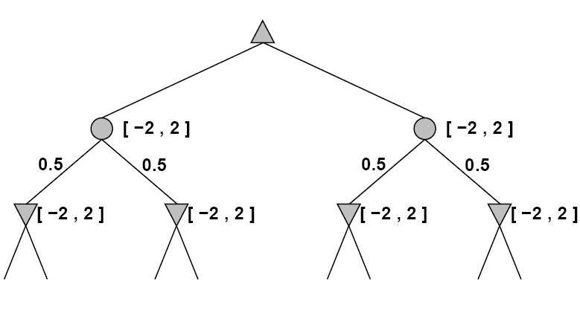
Game Playing
More pruning occurs if we can bound the leaf values

Slide 63
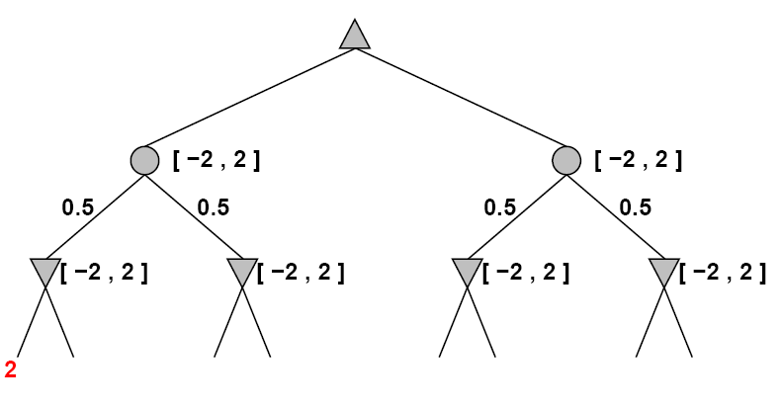
Game Playing

Slide 64
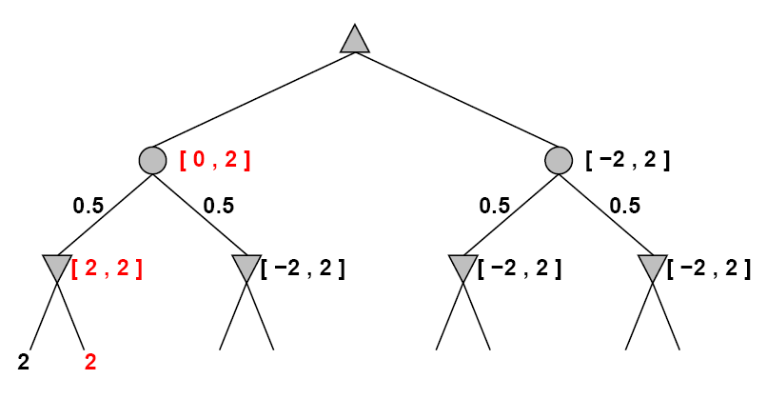
Game Playing

Slide 65
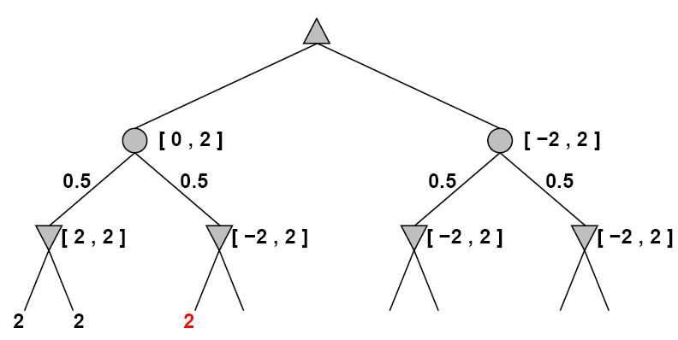
Game Playing

Slide 66
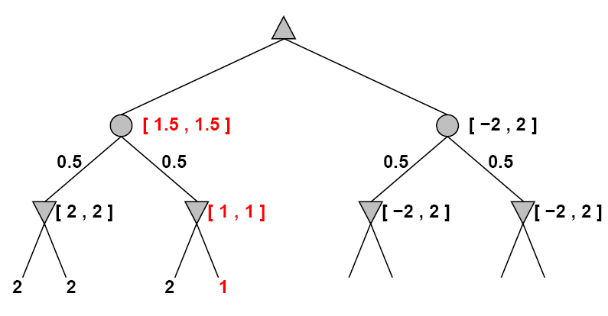
Game Playing

Slide 67
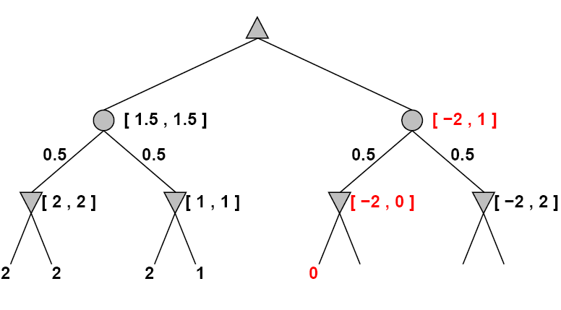
Game Playing

Slide 68

Game Playing
Nondeterministic Games in Practice
Problem
a-b pruning is much less effective
Dice rolls increase b
21 possible rolls with 2 dice
Backgammon
20 legal moves
TDGAMMON
Uses depth-2 search + very good EVAL world-champion level

Slide 69
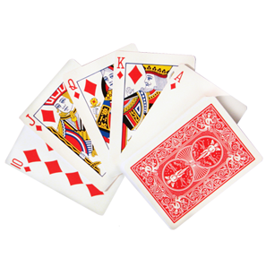
Game Playing
Games of Imperfect Information
Typical examples
Card games: Bridge, poker, skat, etc.
Note
Like having one big dice roll at the beginning of the game

Slide 70
Game Playing
3. Idea for computing best action
Compute the mini-max value of each action in each deal, then choose the action with highest expected value over all deals
Requires information on probability the different deals
4. Special case
If an action is optimal for all deals, it’s optimal.
5. Bridge
GIB, current best bridge program, approximates this idea by
generating 100 deals consistent with bidding information
picking the action that wins most tricks on average

Slide 71
Game Playing
Summary
Games are to AI as grand prix racing is to automobile design
Defined the game in terms of a search.
Optimizations using alpha-beta pruning to arrive at the same conclusion as mini-max would have.
They illustrate several important points about AI
Perfection is unattainable, must approximate
It is a good idea to think about what to think about
Uncertainty constrains the assignment of values to states

Slide 72
Game Playing
Bibliography
Peterson, Ivars. “Silicon Champions of the Game.”
Wookcock, Steve. “Game AI: The State of the Industry”
“AI in Gaming” Generation5.org. http://www.generation5.org/app_game.shtml.
McCarthy, John. “Arthur Samuel: Pioneer in Machine Learning.” Stanford Computer Science Computer History
Laird, John and Michael van Lent. “Human-level AI’s Killer Application: Interactive Computer Games.”
Laird, John. “Bridging the Gap Between Developers and Researchers.”
Johnson, Steven. “Wild Things.”
from http://www.aigamedev.com
Game Artificial Intelligence. Wikipedia, the free Encyclopedia

Slide 73
U
I
Z
Q
M
E
T
I

Slide 74
1. General games involves a) Single-agent b) Multi-agent c) Neither Single-agent nor Multi-agent d) Only Single-agent and Multi-agent
4. Zero sum games are the one in which there are two agents whose actions must alternate and in which the utility values at the end of the game are always the same.
a) True
b) False
2. Adversarial search problems uses
a) Competitive Environment
b) Cooperative Environment
c) Neither Competitive nor Cooperative Environment
d) Only Competitive and Cooperative Environment
5. Zero sum game has to be a ______ game.
a) Single player
b) Two player
c) Multiplayer
d) Three player
3. Mathematical game theory, a branch of economics, views any multi-agent environment as a game provided that the impact of each agent on the others is “significant,” regardless of whether the agents are cooperative or competitive.
a) True
b) False
6. A game can be formally defined as a kind of search problem with the following components:
a) Initial State
b) Successor Function
c) Terminal Test
d) All of the mentioned

Slide 75
7. The initial state and the legal moves for each side define the __________ for the game.
a) Search Tree
b) Game Tree
c) State Space Search
d) Forest
10. The complexity of minimax algorithm is
a) Same as of DFS
b) Space – bm and time – bm
c) Time – bm and space – bm
d) Same as BFS
8. General algorithm applied on game tree for making decision of win/lose is ____________
a) DFS/BFS Search Algorithms
b) Heuristic Search Algorithms
c) Greedy Search Algorithms
d) MIN/MAX Algorithms
11. Which search is equal to minimax search but eliminates the branches that can’t influence the final decision?
a) Depth-first search
b) Breadth-first search
c) Alpha-beta pruning
d) None of the mentioned
9. The minimax algorithm (Figure 6.3) computes the minimax decision from the current state. It uses a simple recursive computation of the minimax values of each successor state, directly implementing the defining equations. The recursion proceeds all the way down to the leaves of the tree, and then the minimax values are backed up through the tree as the recursion unwinds.
a) True
b) False
12. Which values are independent in minimax search algorithm?
a) Pruned leaves x and y
b) Every states are dependent
c) Root is independent
d) None of the mentioned

Slide 76
13. To which depth does the alpha-beta pruning can be applied?
a) 10 states
b) 8 States
c) 6 States
d) Any depth
16. Where does the values of alpha-beta search get updated?
a) Along the path of search
b) Initial state itself
c) At the end
d) None of the mentioned
17. How the effectiveness of the alpha-beta pruning gets increased?
a) Depends on the nodes
b) Depends on the order in which they are executed
c) All of the mentioned
d) None of the mentioned
14. Which search is similar to minimax search?
a) Hill-climbing search
b) Depth-first search
c) Breadth-first search
d) All of the mentioned
15. Which value is assigned to alpha and beta in the alpha-beta pruning?
a) Alpha = max
b) Beta = min
c) Beta = max
d) Both Alpha = max & Beta = min
18. What is called as transposition table?
a) Hash table of next seen positions
b) Hash table of previously seen positions
c) Next value in the search
d) None of the mentioned

Slide 77
20. Which function is used to calculate the feasibility of whole game tree?
a) Evaluation function
b) Transposition
c) Alpha-beta pruning
d) All of the mentioned
19. Which is identical to the closed list in Graph search?
a) Hill climbing search algorithm
b) Depth-first search
c) Transposition table
d) None of the mentioned

Slide 78

Question Number | Answer
1 | D
2 | A
3 | A
4 | B
5 | C
6 | D
7 | B
8 | D
9 | A
10 | A
11 | C
12 | A
ANSWER’S

Slide 79
Question Number | Answer
13 | D
14 | B
15 | D
16 | A
17 | A
18 | B
19 | C
20 | A
ANSWER’S

Slide 80



Slide 81
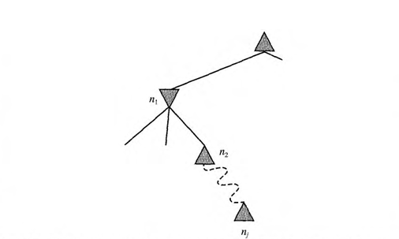
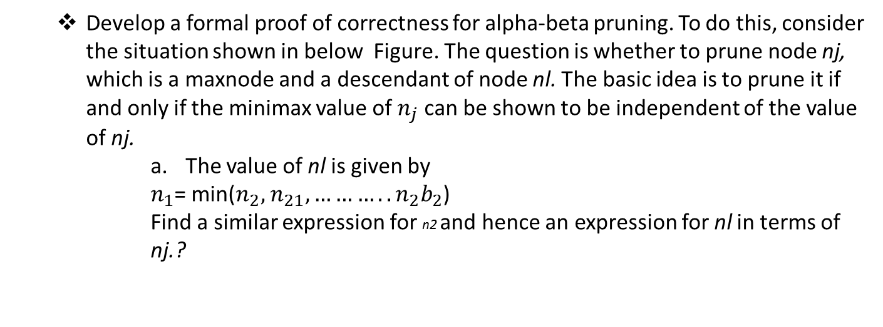
Search Strategies
Develop a formal proof of correctness for alpha-beta pruning. To do this, consider the situation shown in below Figure. The question is whether to prune node nj, which is a maxnode and a descendant of node nl. The basic idea is to prune it if and only if the minimax value of $n_{j}$ can be shown to be independent of the value of nj.
The value of nl is given by
$n_{1}$= min($n_{2},$ $n_{21}, ………..n_{2}b_{2}$)
Find a similar expression for n2 and hence an expression for nl in terms of nj.?

Slide 82
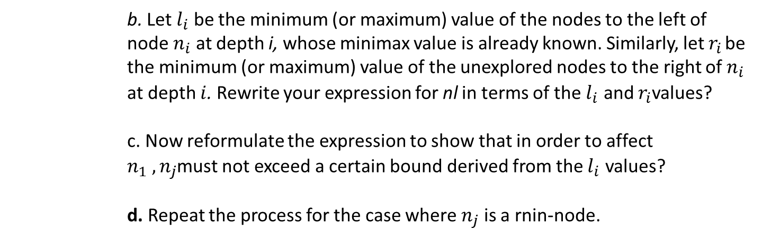
b. Let $l_{i}$ be the minimum (or maximum) value of the nodes to the left of node $n_{i}$ at depth i, whose minimax value is already known. Similarly, let $r_{i}$ be the minimum (or maximum) value of the unexplored nodes to the right of $n_{i}$ at depth $i$. Rewrite your expression for nl in terms of the $l_{i}$ and $r_{i}$values?
c. Now reformulate the expression to show that in order to affect $n_{1} ,n_{j}$must not exceed a certain bound derived from the $l_{i}$ values?
d. Repeat the process for the case where $n_{j}$ is a rnin-node.

Slide 83
Prove the following assertion: for every game tree, the utility obtained by MAX using
minimax decisions against a suboptimal MIN will be never be lower than the utility obtained playing against an optimal MIN. Can you come up with a game tree in which MAX can do still better using a suboptimal strategy against a suboptimal MIN?

Slide 84
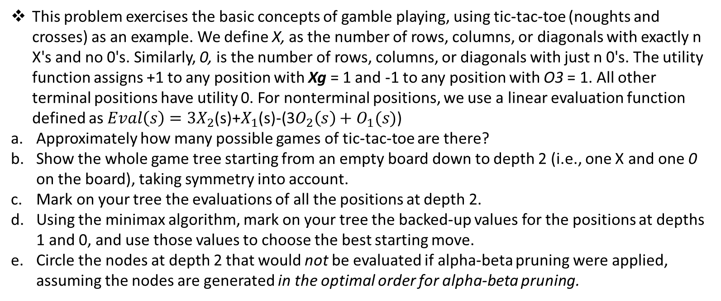
This problem exercises the basic concepts of gamble playing, using tic-tac-toe (noughts and crosses) as an example. We define X, as the number of rows, columns, or diagonals with exactly n X's and no 0's. Similarly, 0, is the number of rows, columns, or diagonals with just n 0's. The utility function assigns +1 to any position with Xg = 1 and -1 to any position with O3 = 1. All other terminal positions have utility 0. For nonterminal positions, we use a linear evaluation function defined as $Eval\left(s\right)=3X_{2}$(s)+$X_{1}$(s)-(3$O_{2}\left(s\right)+O_{1}(s)$)
Approximately how many possible games of tic-tac-toe are there?
Show the whole game tree starting from an empty board down to depth 2 (i.e., one X and one 0 on the board), taking symmetry into account.
Mark on your tree the evaluations of all the positions at depth 2.
Using the minimax algorithm, mark on your tree the backed-up values for the positions at depths 1 and 0, and use those values to choose the best starting move.
Circle the nodes at depth 2 that would not be evaluated if alpha-beta pruning were applied, assuming the nodes are generated in the optimal order for alpha-beta pruning.

