Slide 1

Artificial Intelligence
Module Number: 2.2
Segment Name: Logical Agent
Version Code:AI3
Released Date:1-Apr-2020

Slide 2

Content
Knowledge-based agents
Wumpus world
Logic in general - models and entailment
Propositional (Boolean) logic
Equivalence, validity, satisfiability
Inference rules and theorem proving
forward chaining
backward chaining
resolution

Slide 3
Logical Agent
How the machines understands what we are talking about?
How they are Understanding natural language?

Slide 4
Logical Agent
How machine are able to accept new tasks in the form of explicitly described goals?

Slide 5
Logical Agent
Knowledge-Based Agents

Slide 6
Logical Agent
Introduction
The representation of knowledge and the reasoning processes that bring knowledge to life are central to entire field of artificial intelligence
Knowledge and reasoning are important to artificial agents because they enable successful behaviours that would be very hard to achieve otherwise (no piece in chess can be on two different squares at the same time)
Knowledge and reasoning also play a crucial role in dealing with partially observable environments (inferring hidden states in diagnosing diseases, natural language understanding)
Knowledge also allows flexibility

Slide 7
Logical Agent
Computer can know “things” and “reason” like human
Representation: How are the things stored?
Reasoning: How is the knowledge used?
To solve a problem…
To generate more knowledge…

Slide 8
Logical Agent
Deciding what to do????
How Do You make decision???
Gather data from observing the situation
Compare that to the facts that you know
make a decision based on the balance of evidence

Slide 9

Logical Agent
Patient Vs Doctor
Doctor Am Having Fever Sure…
You don’t have fever!!!!!

Slide 10
Logical Agent
Who we will Trust More??
Doctor or the boy??
Doctor Am Having Fever Sure…
You don’t have fever!!!!!

Slide 11
Logical Agent
DOCTOR WINS!!
Doctor Am Having Fever Sure…
You don’t have fever!!!!!

Slide 12
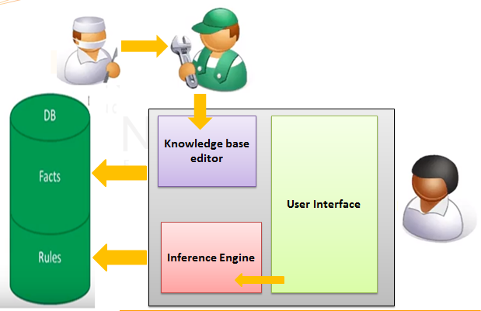
Logical Agent
Knowledge based systems
Aim: Replace human with a computer that contains all the relevant knowledge from a particular domain.
If the computer is in the possession of the fact then computer can make decision on how to solve the problem

Slide 13
Logical Agent
Knowledge base = set of sentences in a formal language
Each sentence is expressed in a knowledge representation language and represents some assertions about the world
There should be a way to add new sentence to Knowledge Base(KB), and to query what is known
Declarative approach to building an agent (or other system)
TELL it what it needs to know
Then it can ASK itself what to do-answer should follow from the KB
Both tasks may involve inference – deriving new sentences from old
In logical agents – when one ASKs a question to KB, the answer should follow from what has been TOLD

Slide 14
Logical Agent
7. Agents can be viewed at the knowledge level
i.e., what they know, regardless of how implemented
8. Or at the implementation level
i.e., data structures in KB and algorithms that manipulate them
Inference Engine
Domain-Independent algorithm
Knowledge Base
Domain-specific content

Slide 15
Logical Agent
A Simple knowledge-Based Agent
KB : Maintain the background knowledge
Each time the agent program is called it does three things
TELLs the KB what it perceives
ASK the KB what action it should perform
TELL the KB that the action is executed
The agent must be able to:
Represent states, actions, etc.
Incorporate new percepts
Update internal representations of the world
Deduce hidden properties of the world
Deduce appropriate actions
Function KB- Agent(percept) return an action
Static: KB a knowledge base
T, a counter, initially 0, indicating time
TELL(KB,MAKE-PERCEPT-SENTENCE(percept, t))
Action← Ask(KB,MAKE –ACTION-QUERY(t))
TELL(KB,MAKE-ACTION-SENTENCE(action ,t ))
T←t+1
Return action

Slide 16
Logical Agent
Applications Of Knowledge Based System
Credit Checks
Credit card transaction checking(Fraud)
Medical diagnosis
Chemical Analysis
Drilling advisor
HR management

Slide 17
Logical Agent
Limitations Of Knowledge Based System
Need to identify the “tricks” used by an expert
What if the knowledge engineer doesn’t ask the right question?
What if the knowledge changes???
What if there is some unexpected data not accounted for?

Slide 18
Logical Agent
Wumpus World

Slide 19
Logical Agent
Wumpus World Envirnoment
The Wumpus computer game
The agent explores a cave consisting of rooms connected by passageways
Lurking somewhere in the cave is the Wumpus, a beast that eats any agent that enters its room
Some rooms contain bottomless pits that trap any agent that wanders into the room
Occasionally, there is a heap of gold in a room
The goal is:
To collect the gold and
Exit the world
Without being eaten

Slide 20
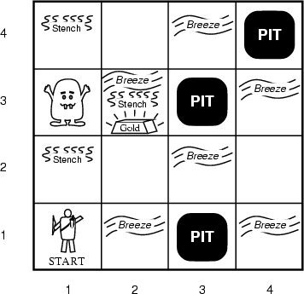
Logical Agent
A Typical Wumpus World
The agent always starts in the field [1,1]
The task of the agent is to find the gold, return to the field [1,1] and climb out of the cave

Slide 21
Logical Agent
Agent in a Wumpus world: Precepts
The agent perceives
a stench in the square containing the wumpus and in the adjacent squares (not diagonally)
a breeze in the squares adjacent to a pit
a glitter in the square where the gold is
a bump, if it walks into a wall
a woeful scream everywhere in the cave, if the wumpus is killed
The precepts will be given as a five-symbol list:
If there is a stench, and a breeze, but no glitter, no bump, and no scream, the percept is
[Stench, Breeze, None, None, None]
The agent can not perceive its own location

Slide 22
Logical Agent
The Actions Of The Agent In Wumpus Game
Go forward
Turn right 90 degrees
Turn left 90 degrees
Grab means pick up an object that is in the same square as the agent
Shoot means fire an arrow in a straight line in the direction the agent is looking
The arrow continues until it either hits and kills the wumpus or hits the wall
The agent has only one arrow
Only the first shot has any effect
Climb is used to leave the cave
Only effective in start field
Die, if the agent enters a square with a pit or a live wumpus
(No take-backs!)

Slide 23
Logical Agent
The Agent’s Goal
The agent’s goal is to find the gold and bring it back to the start as quickly as possible, without getting killed
1000 points reward for climbing out of the cave with the gold
1 point deducted for every action taken
10000 points penalty for getting killed

Slide 24
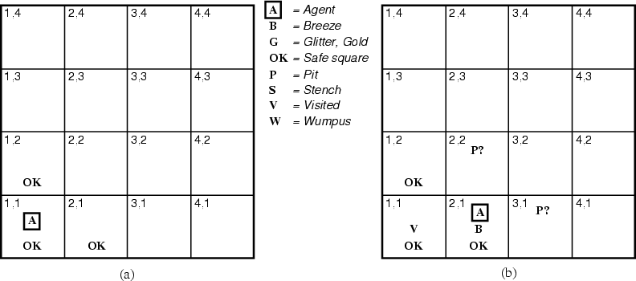
Logical Agent
The Wumpus Agent’s First Step

Slide 25
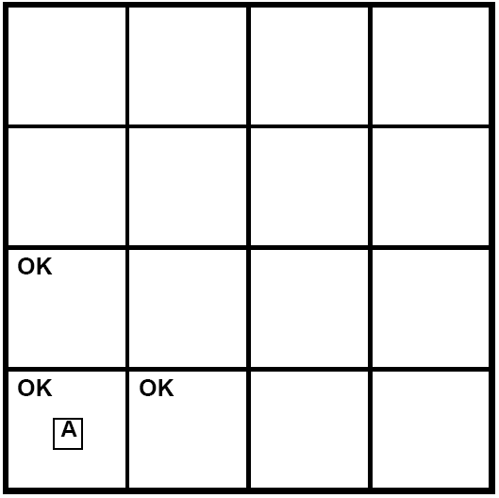
Logical Agent
Wumpus World

Slide 26
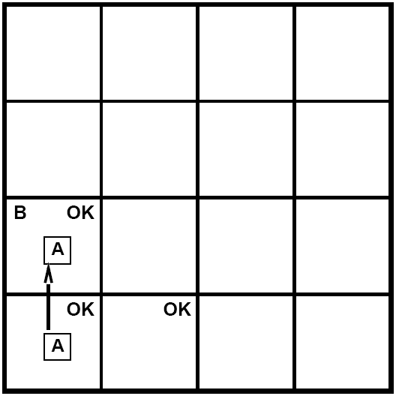
Logical Agent

Slide 27
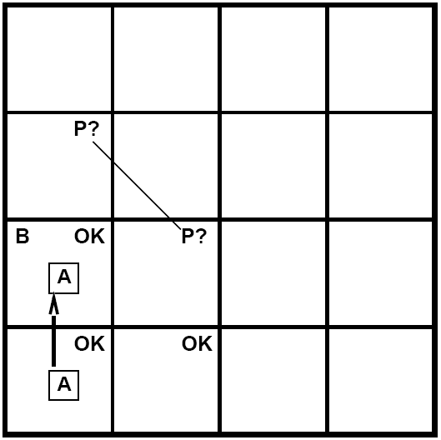
Logical Agent

Slide 28
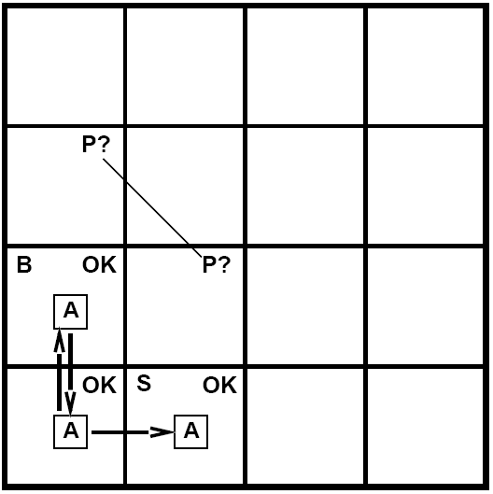
Logical Agent

Slide 29
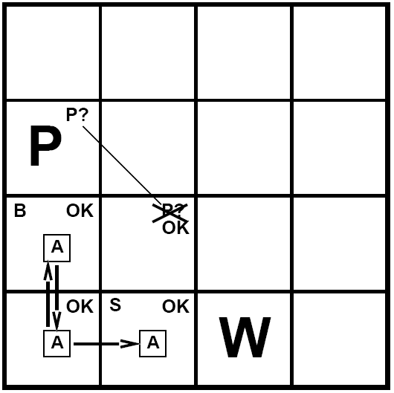
Logical Agent

Slide 30
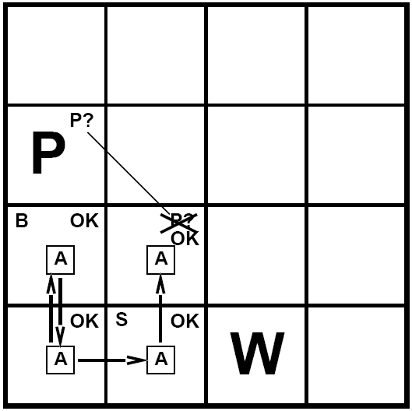
Logical Agent

Slide 31
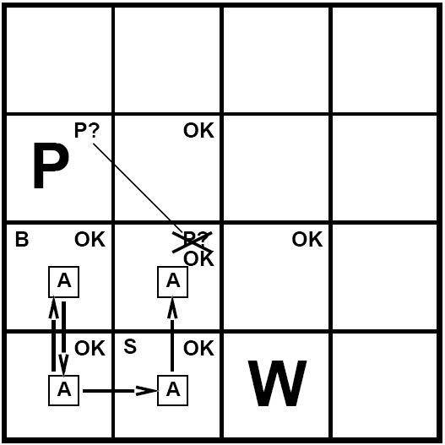
Logical Agent

Slide 32
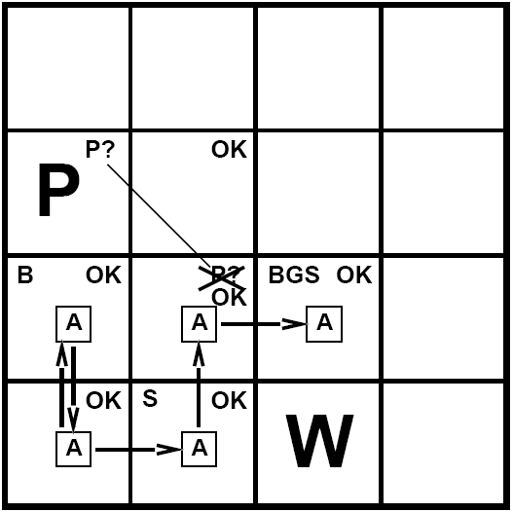
Logical Agent

Slide 33
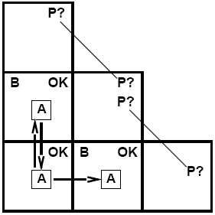
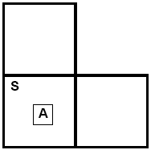
Logical Agent
Other Sticky Situations
Breeze in (1,2) and (2,1)
No safe actions
Smell in (1,1)
Cannot move

Slide 34
Logical Agent
Logic

Slide 35
Logical Agent
Logic
Knowledge bases consist of sentences in a formal language
Syntax
Sentences are well formed
Semantics
The “meaning” of the sentence The truth of each sentence with respect to each possible world (model)
Example:
x + 2 >= y is a sentence
x2 + y > is not a sentence
x + 2 >= y is true iff x + 2 is no less than y
x + 2 >= y is true in a world where x = 7, y=1
x + 2 >= y is false in world where x = 0, y =6

Slide 36
Logical Agent
3. Entailment means that one thing follows logically from another
a |= b
4. a |= b iff in every model in which a is true, b is also true
5. if a is true, then b must be true
the truth of b is “contained” in the truth of a
A model is a formally structured world with respect to which truth can be evaluated
M is a model of sentence a if a is true in m
Then KB |= a if M(KB)  M(a)
M(α)
x
x x x x x x x x xx
x x x x x x x x
x x x x x x x x x
xxx x x xx x x x
xxx x x x x x x x x
M(KB)
x x x x
x x x x
x x x
x

Slide 37
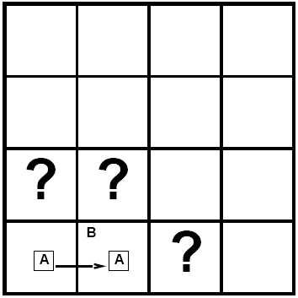
Logical Agent
9. Entailment in Wumpus World
10. Situation after detecting nothing in [1,1], moving right, breeze in [2,1]
11. Consider possible models for ? assuming only pits
12. 3 Boolean choices => 8 possible models

Slide 38
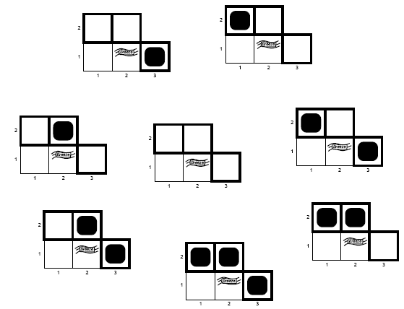
Logical Agent

Slide 39
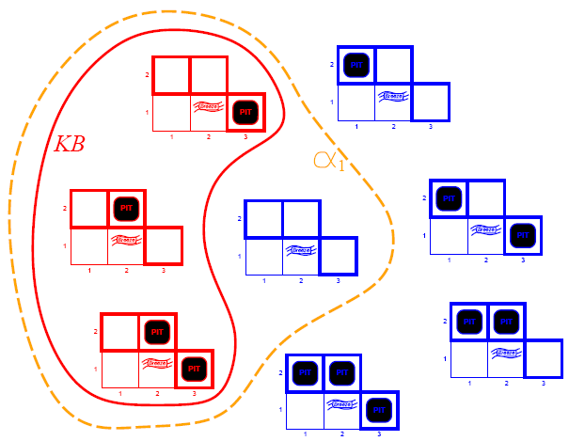
Logical Agent
KB = wumpus world rules + observations
a₁ = “[1,2] is safe”, KB |= a₁, proved by model checking

Slide 40
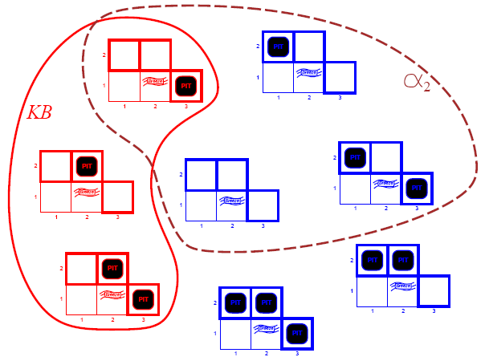
Logical Agent
KB = wumpus world rules + observations
α₂ = “[2,2] is safe”, KB ¬|= α₂ proved by model checking

Slide 41
Logical Agent
Inference is the process of deriving a specific sentence from a KB (where the sentence must be entailed by the KB)
KB |-i a = sentence a can be derived from KB by procedure I
2. “KB’s are a haystack”
Entailment = needle in haystack
Inference = finding it
3. Soundness
i is sound if…
whenever KB |-i a is true, KB |= a is true
4. Completeness
i is complete if
whenever KB |= a is true, KB |-i a is true
5. If KB is true in the real world, then any sentence a derived from KB by a sound inference procedure is also true in the real world

Slide 42
Logical Agent
Propositional Logic

Slide 43
Logical Agent
Propositional Logic
AKA Boolean Logic
False and True
Proposition symbols P1, P2, etc. are sentences
NOT: If S1 is a sentence, then ¬S1 is a sentence (negation)
AND: If S1, S2 are sentences, then S1  S2 is a sentence (conjunction)
OR: If S1, S2 are sentences, then S1  S2 is a sentence (disjunction)
IMPLIES: If S1, S2 are sentences, then S1  S2 is a sentence (implication)(¬S1∨S2)
IFF: If S1, S2 are sentences, then S1  S2 is a sentence (biconditional)

Slide 44
Logical Agent
P | Q | ¬P | P∧Q | P∨Q | P⇒Q | P⇔Q
False | False | True | False | False | True | True
False | True | True | False | True | True | False
True | False | False | False | True | False | False
True | True | False | True | True | True | True

Slide 45
Logical Agent
Wumpus World Sentences
Let Pi, j be True if there is a pit in [i, j]
Let Bi, j be True if there is a breeze in [i, j]
¬P1,1
¬ B1,1
B2,1
“Pits cause breezes in adjacent squares”
B1,1  (P1,2  P2,1)
B2,1  (P1,1  P2,1  P3,1)
A square is breezy if and only if there is an adjacent pit

Slide 46
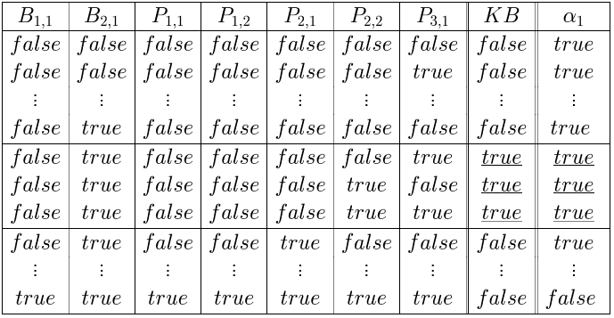
Logical Agent
A Simple Knowledge Base
R1: ¬P1,1
R2: B1,1  (P1,2  P2,1)
R3: B2,1 (P1,1  P2,2  P3,1)
R4: ¬ B1,1
R5: B2,1
KB consists of sentences R1 thru R5
R1  R2  R3  R4  R5

Slide 47
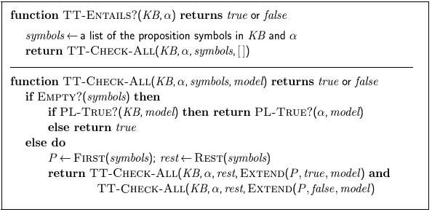
Logical Agent
Every known inference algorithm for propositional logic has a worst-case complexity that is exponential in the size of the input. (co-NP complete)

Slide 48
Logical Agent
Equivalence, Validity, Satisfiability

Slide 49
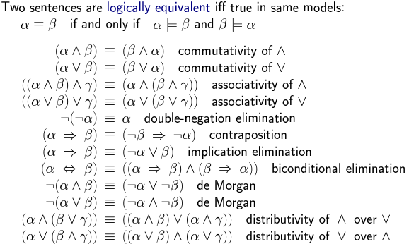
Logical Agent
Equivalence, Validity, Satisfiability

Slide 50
Logical Agent
A sentence if valid if it is true in all models
e.g. True, A  ¬A, A  A, (A  (A  B)  B
Validity is connected to inference via the Deduction Theorem
KB |- a iff (KB  a) is valid
A sentence is satisfiable if it is True in some model
e.g. A  B,
C
A sentence is unstatisfiable if it is True in no models
e.g. A  ¬A
Satisfiability is connected to inference via the following
KB |= a iff (KB  ¬a) is unsatisfiable
proof by contradiction

Slide 51
Logical Agent
Reasoning Patterns
Inference Rules
Patterns of inference that can be applied to derive chains of conclusions that lead to the desired goal
Modus Ponens
Given: S1  S2 and S1, derive S2
And-Elimination
Given: S1  S2, derive S1
Given: S1  S2, derive S2
DeMorgan’s Law
Given: ➢( A  B) derive ➢A  ➢B
Given: ➢( A  B) derive ➢A  ➢

Slide 52
Logical Agent
And Elimination
From a conjunction, any of the conjuncts can be inferred
(WumpusAhead  WumpusAlive), WumpusAlive can be inferred
Modus Ponens
Whenever sentences of the form a  b and a are given, then sentence b can be inferred
(WumpusAhead  WumpusAlive)  Shoot and (WumpusAhead  WumpusAlive), Shoot can be inferred

Slide 53
Logical Agent
Example Proof By Deduction
Knowledge
S1: B22  ( P21  P23  P12  P32 ) rule
S2: ➢B22 observation
Inferences
S3: (B22  (P21  P23  P12  P32 )) ((P21  P23  P12  P32 )  B22) [S1,bi elim]
S4: ((P21  P23  P12  P32 )  B22) [S3, and elim]
S5: (➢B22  ➢( P21  P23  P12  P32 )) [contrapos]
S6: ➢(P21  P23  P12  P32 ) [S2,S6, MP]
S7: ➢P21  ➢P23  ➢P12  ➢P32 [S6, DeMorg]

Slide 54
Logical Agent
Evaluation of Deductive Inference
Sound
Yes, because the inference rules themselves are sound. (This can be proven using a truth table argument)
Complete
If we allow all possible inference rules, we’re searching in an infinite space, hence not complete
If we limit inference rules, we run the risk of leaving out the necessary one…
Monotonic
If we have a proof, adding information to the DB will not invalidate the proof

Slide 55
Logical Agent
Resolution
Resolution allows a complete inference mechanism (search-based) using only one rule of inference
Resolution rule:
Given: P1  P2  P3 … Pn, and ➢P1  Q1 … Qm
Conclude: P2  P3 … Pn  Q1 … Qm Complementary literals P1 and ➢P1 “cancel out”
Why it works:
Consider 2 cases: P1 is true, and P1 is false

Slide 56
Logical Agent
Resolution in Wumpus World
There is a pit at 2,1 or 2,3 or 1,2 or 3,2
P21  P23  P12  P32
There is no pit at 2,1
➢P21
Therefore (by resolution) the pit must be at 2,3 or 1,2 or 3,2
P23  P12  P32

Slide 57
Logical Agent
Proof using Resolution
To prove a fact P, repeatedly apply resolution until either:
No new clauses can be added, (KB does not entail P)
The empty clause is derived (KB does entail P)
This is proof by contradiction: if we prove that KB  ➢P derives a contradiction (empty clause) and we know KB is true, then ➢P must be false, so P must be true!
To apply resolution mechanically, facts need to be in Conjunctive Normal Form (CNF)
To carry out the proof, need a search mechanism that will enumerate all possible resolutions

Slide 58
Logical Agent
CNF Example
B22  ( P21  P23  P12  P32 )
Eliminate  , replacing with two implications (B22  ( P21  P23  P12  P32 ))  ((P21  P23  P12  P32 )  B22)
Replace implication (A  B) by ➢A  B
(➢B22  ( P21  P23  P12  P32 ))  (➢(P21  P23  P12  P32 )  B22)
Move ➢ “inwards” (unnecessary parens removed)
(➢B22  P21  P23  P12  P32 )  ( (➢P21  ➢P23  ➢P12  ➢P32 )  B22)
Distributive Law
(➢B22  P21  P23  P12  P32 )  (➢P21  B22)  (➢P23  B22)  (➢P12  B22)  (➢P32  B22)
(Final result has 5 clauses)

Slide 59
Logical Agent
Horn Clauses
A Horn Clause is a CNF clause with exactly one positive literal
The positive literal is called the head
The negative literals are called the body
Prolog: head:- body1, body2, body3 …
English: “To prove the head, prove body1, …”
Implication: If (body1, body2 …) then head
Horn Clauses form the basis of forward and backward chaining
The Prolog language is based on Horn Clauses
Deciding entailment with Horn Clauses is linear in the size of the knowledge base

Slide 60
Logical Agent
Reasoning with Horn Clauses
Forward Chaining
For each new piece of data, generate all new facts, until the desired fact is generated
Data-directed reasoning
Backward Chaining
To prove the goal, find a clause that contains the goal as its head, and prove the body recursively
(Backtrack when you chose the wrong clause)
Goal-directed reasoning

Slide 61
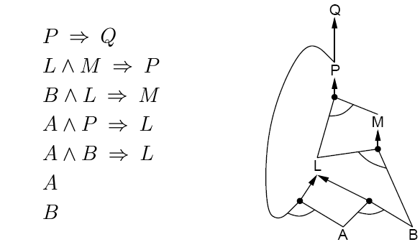
Logical Agent
Forward Chaining
Fire any rule whose premises are satisfied in the KB
Add its conclusion to the KB until the query is found

Slide 62
Logical Agent
AND-OR Graph
multiple links joined by an arc indicate conjunction – every link must be proved
multiple links without an arc indicate disjunction – any link can be proved

Slide 63
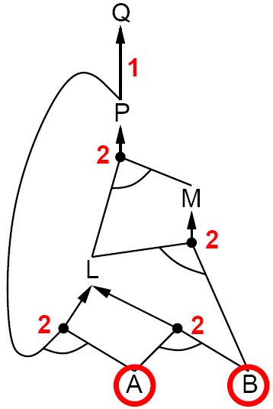
Logical Agent

Slide 64
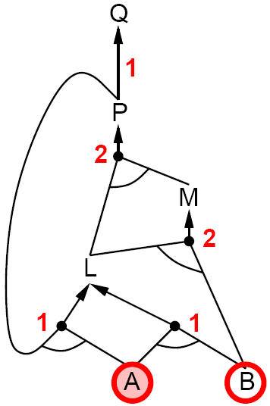
Logical Agent

Slide 65
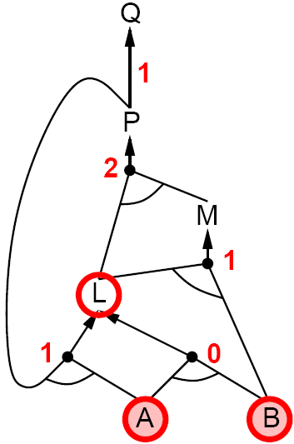
Logical Agent

Slide 66
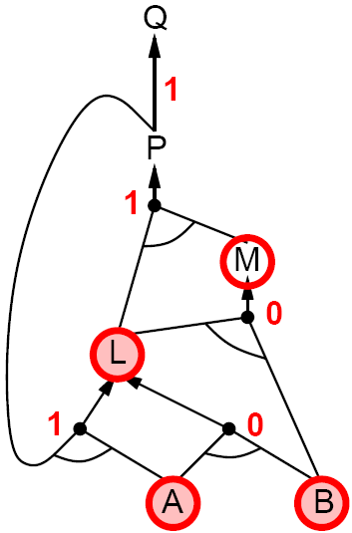
Logical Agent

Slide 67
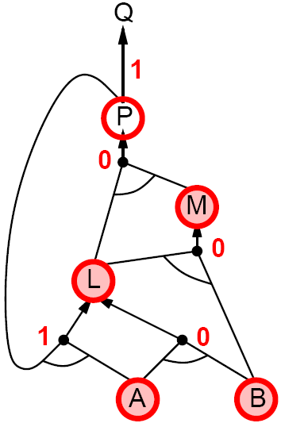
Logical Agent

Slide 68
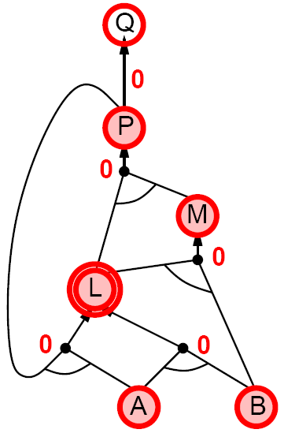
Logical Agent

Slide 69
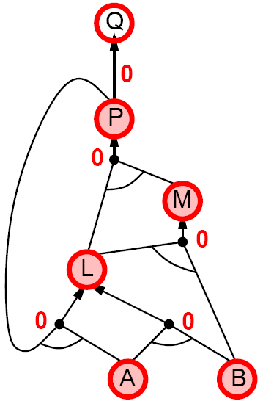
Logical Agent

Slide 70
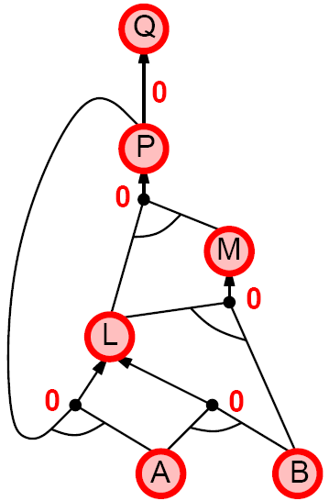
Logical Agent

Slide 71
Logical Agent
Backward Chaining
Idea: work backwards from the query q:
To prove q by BC,
Check if q is known already, or
Prove by BC all premises of some rule concluding q
Avoid loops
Check if new subgoal is already on the goal stack
Avoid repeated work: check if new subgoal
Has already been proved true, or
Has already failed

Slide 72
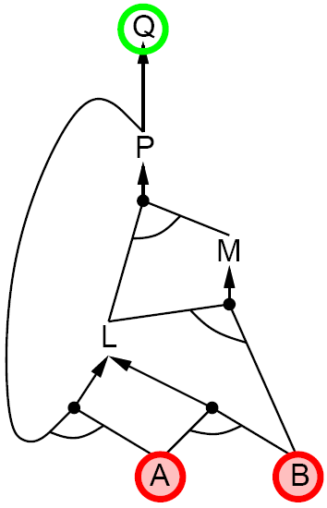
Logical Agent

Slide 73
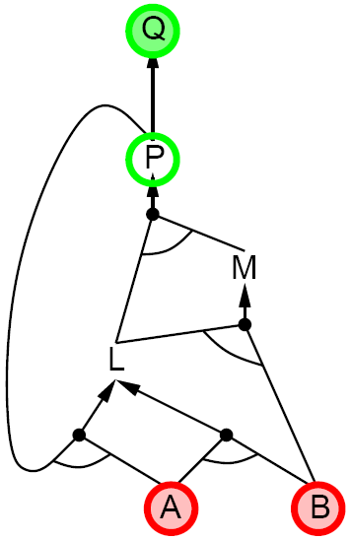
Logical Agent

Slide 74
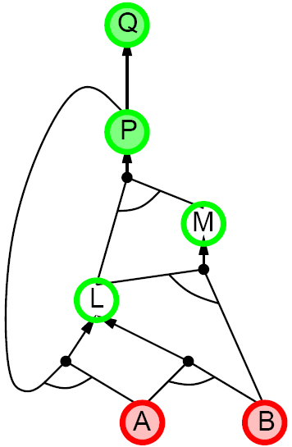
Logical Agent

Slide 75
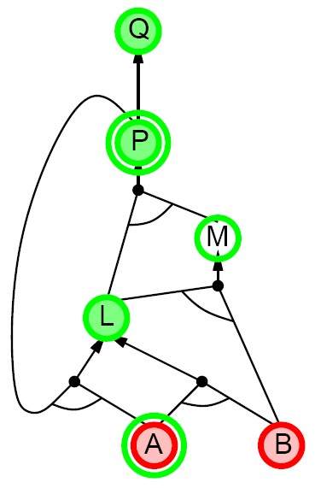
Logical Agent

Slide 76
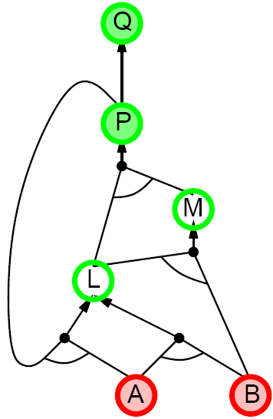
Logical Agent

Slide 77
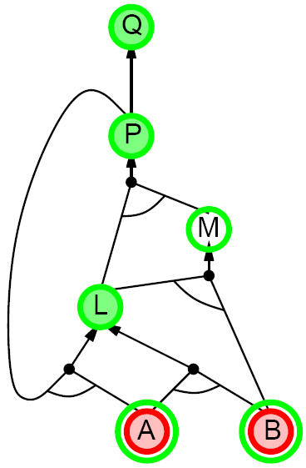
Logical Agent

Slide 78
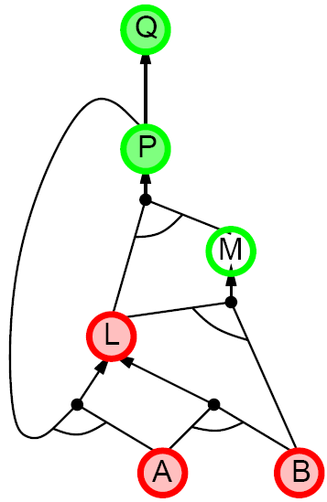
Logical Agent

Slide 79
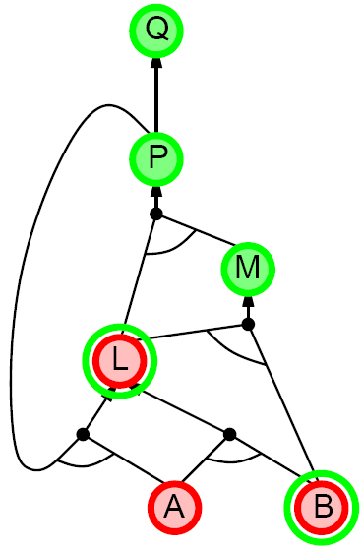
Logical Agent

Slide 80
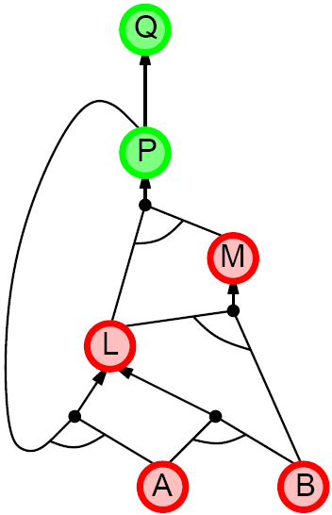
Logical Agent

Slide 81
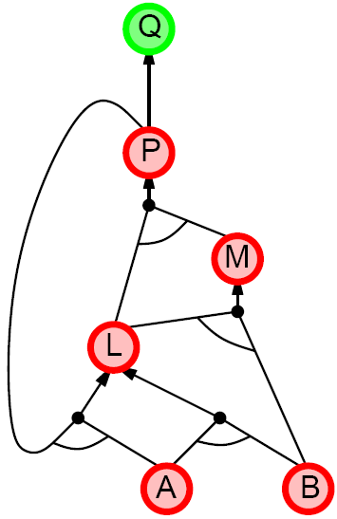
Logical Agent

Slide 82
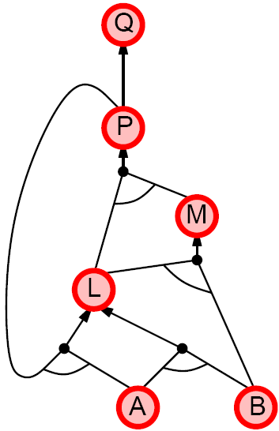
Logical Agent

Slide 83
Logical Agent
Forward Chaining vs. Backward Chaining
Forward Chaining is data driven
Automatic, unconscious processing
E.g. object recognition, routine decisions
May do lots of work that is irrelevant to the goal
Backward Chaining is goal driven
Appropriate for problem solving
E.g. “Where are my keys?”, “How do I start the car?”
The complexity of BC can be much less than linear in size of the KB

Slide 84
Logical Agent
Summary
Logical agents apply inference to a knowledge base to derive new information and make decisions
Basic concepts of logic
Wumpus world requires the ability to represent partial and negated information, reason by cases, etc.
Resolution is complete for propositional logic Forward, backward chaining are linear-time, complete for Horn clauses

Slide 85
Self Assessment Questions
1. Which algorithm will work backward from the goal to solve a problem?
a) Forward chaining b) Backward chaining c) Hill-climb algorithm d) None of the mentioned
Answer: b

Slide 86
Self Assessment Questions
2. Which is mainly used for automated reasoning?
a) Backward chaining b) Forward chaining c) Logic programming d) Parallel programming
Answer: c

Slide 87
Self Assessment Questions
3. What will backward chaining algorithm will return?
a) Additional statements b) Substitutes matching the query c) Logical statement d) All of the mentioned
Answer: b

Slide 88
Self Assessment Questions
4. How can be the goal is thought of in backward chaining algorithm?
a) Queue b) List c) Vector d) Stack
Answer: d

Slide 89
Self Assessment Questions
5. What are used in backward chaining algorithm?
a) Conjucts b) Substitution c) Composition of substitution d) None of the mentioned
Answer: c

Slide 90
Self Assessment Questions
6. Which algorithms are in more similar to backward chaining algorithm?
a) Depth-first search algorithm b) Breadth-first search algorithm c) Hill-climbing search algorithm d) All of the mentioned
Answer: a

Slide 91
Self Assessment Questions
7. Which problem can frequently occur in backward chaining algorithm?
a) Repeated states b) Incompleteness c) Complexity d) Both Repeated states & Incompleteness
Answer: d

Slide 92
Self Assessment Questions
8. How the logic programming can be constructed?
a) Variables b) Expressing knowledge in a formal language c) Graph d) All of the mentioned
Answer: b

Slide 93
Self Assessment Questions
9. What form of negation does the prolog allows?
a) Negation as failure b) Proposition c) Substitution d) Negation as success
Answer: a

Slide 94
Self Assessment Questions
10. Which is omitted in prolog unification algorithm?
a) Variable check b) Occur check c) Proposition check d) Both Occur & Proposition check
Answer: b

Slide 95
Self Assessment Questions
11. Which condition is used to cease the growth of forward chaining?
a) Atomic sentences b) Complex sentences c) No further inference d) All of the mentioned
Answer: c

Slide 96
Self Assessment Questions
12. Which closely resembles propositional definite clause?
a) Resolution b) Inference c) Conjuction d) First-order definite clauses
Answer: d

Slide 97
Self Assessment Questions
13. What is the condition of variables in first-order literals?
a) Existentially quantified b) Universally quantified c) Both Existentially & Universally quantified d) None of the mentioned
Answer: b

Slide 98
Self Assessment Questions
14. Which are more suitable normal form to be used with definite clause?
a) Positive literal b) Negative literal c) Generalized modus ponens d) Neutral literal
Answer: c

Slide 99
Self Assessment Questions
15. Which will be the instance of the class datalog knowledge bases?
a) Variables b) No function symbols c) First-order definite clauses d) None of the mentioned
Answer: b

Slide 100
Self Assessment Questions
16. Which knowledge base is called as fixed point?
a) First-order definite clause are similar to propositional forward chaining b) First-order definite clause are mismatch to propositional forward chaining c) All of the mentioned d) None of the mentioned
Answer: b

Slide 101
Self Assessment Questions
17. How to eliminate the redundant rule matching attempts in the forward chaining?
a) Decremental forward chaining b) Incremental forward chaining c) Data complexity d) None of the mentioned
Answer: b

Slide 102
Self Assessment Questions
18. From where did the new fact inferred on new iteration is derived?
a) Old fact b) NaNew rrow fact c) fact d) All of the mentioned
Answer: c

Slide 103
Self Assessment Questions
19. Which will solve the conjuncts of the rule so that the total cost is minimized?
a) Constraint variable b) Conjunct ordering c) Data complexity d) All of the mentioned
Answer: b

Slide 104
Self Assessment Questions
20. How many possible sources of complexity are there in forward chaining?
a) 1 b) 2 c) 3 d) 4
Answer: c

Slide 105
Self Assessment Questions
21. Which is created by using single propositional symbol?
a) Complex sentences b) Atomic sentences c) Composition sentences d) None of the mentioned
Answer: b

Slide 106
Self Assessment Questions
22. Which is used to construct the complex sentences?
a) Symbols b) Connectives c) Logical connectives d) All of the mentioned
Answer: c

Slide 107
Self Assessment Questions
23. How many proposition symbols are there in artificial intelligence?
a) 1 b) 2 c) 3 d) 4
Answer: b

Slide 108
Self Assessment Questions
24. How many logical connectives are there in artificial intelligence?
a) 2 b) 3 c) 4 d) 5
Answer: d

Slide 109
Self Assessment Questions
25. Which is used to compute the truth of any sentence?
a) Semantics of propositional logic b) Alpha-beta pruning c) First-order logic d) Both Semantics of propositional logic & Alpha-beta pruning
Answer: a

Slide 110
Self Assessment Questions
26. Which are needed to compute the logical inference algorithm?
a) Logical equivalence b) Validity c) Satisfiability d) All of the mentioned
Answer: d

Slide 111
Self Assessment Questions
27. From which rule does the modus ponens are derived?
a) Inference rule b) Module rule c) Both Inference & Module rule d) None of the mentioned
Answer: a

Slide 112
Self Assessment Questions
28. Which is also called single inference rule?
a) Reference b) Resolution c) Reform d) None of the mentioned
Answer: b

Slide 113
Self Assessment Questions
29. Which form is called as conjunction of disjunction of literals?
a) Conjunctive normal form b) Disjunctive normal form c) Normal form d) All of the mentioned
Answer: a

Slide 114
Self Assessment Questions
30. What can be viewed as single leteral of disjunction?
a) Multiple clause b) Combine clause c) Unit clause d) None of the mentioned
Answer: c

Slide 115
Self Assessment Questions
31. Knowledge and reasoning also play a crucial role in dealing with __________________ environment.
a) Completely Observable b) Partially Observable c) Neither Completely nor Partially Observable d) Only Completely and Partially Observable
Answer: b

Slide 116
Self Assessment Questions
32. Treatment chosen by doctor for a patient for a disease is based on
a) Only current symptoms b) Current symptoms plus some knowledge from the textbooks c) Current symptoms plus some knowledge from the textbooks plus experience d) All of the mentioned
Answer: c

Slide 117
Self Assessment Questions
33. A knowledge-based agent can combine general knowledge with current percepts to infer hidden aspects of the current state prior to selecting actions. State whether True or False.
a) True b) False
Answer: a

Slide 118
Self Assessment Questions
34. A) Knowledge base (KB) is consists of set of statements. B) Inference is deriving a new sentence from the KB.
Choose the correct option.
a) A is true, B is true b) A is false, B is false c) A is true, B is false d) A is false, B is true
Answer: a

Slide 119
Self Assessment Questions
35. Wumpus World is a classic problem, best example of _______.
a) Single player Game b) Two player Game c) Reasoning with Knowledge d) Knowledge based Game
Answer: c

Slide 120
Self Assessment Questions
36. ‘α |= β ‘(to mean that the sentence α entails the sentence β) if and only if, in every model in which α is _____ β is also _____
a) True, true b) True, false c) False, true d) False, false
Answer: a

Slide 121
Self Assessment Questions
37. Which is not a property of representation of knowledge?
a) Representational Verification b) Representational Adequacy c) Inferential Adequacy d) Inferential Efficiency
Answer: a

Slide 122
Self Assessment Questions
38. Which is not Familiar Connectives in First Order Logic?
a) and b) iff c) or d) not
Answer: d

Slide 123
Self Assessment Questions
39. Inference algorithm is complete only if,
a) It can derive any sentence b) It can derive any sentence that is an entailed version c) It is truth preserving d) It can derive any sentence that is an entailed version & It is truth preserving
Answer: d

Slide 124
Self Assessment Questions
40. An inference algorithm that derives only entailed sentences is called sound or truth-preserving.
a) True b) False
Answer: a

Slide 125
Assignment
General Instructions: You need to explain below sets of problem. These problem statement are meant to discussed in detailed explanations. There are series of questions associated with the main problem statement. You can submit your solution in 6-8 A4 sheets paper for further evaluation or as per faculty suggestions.
1. Consider the problem of deciding whether a propositional logic sentence is true in a given model.
Write a recursive algorithm PL-True?(s,m) that returns true if and only if the sentence s is true in the model m (where m assigns a truth value for every symbol in s). The algorithm should run in time linear in the size of the sentence.
Give three examples of sentences that can be determined to be true or false in a partial model that does not specify a truth value for some of the symbols.
Show that the truth value (if any) of a sentence in a partial model cannot be determined efficiently in general.

Slide 126
Assignment
2. Discuss what is meant by optimal behavior in the wumpus world. Show that our definition of the PL-WUMPUS-AGENisT n ot optimal, and suggest ways to improve it.
3. Extend PL-WUMPUS-AGENsTo that it keeps track of all relevant facts within the knowledge base.
4. How long does it take to prove KB )= a using DPLL when a is a literal already contained in KB? Explain.

Slide 127
Assignment
5. A logical knowledge base represents the world using a set of sentences with no explicit structure. An analogical representation, on the other hand, has physical structure that corresponds directly to the structure of the thing represented. Consider a road map of your country as an analogical representation of facts about the country. The two-dimensional structure of the map corresponds to the two-dimensional surface of the area.
Give five examples of symbols in the map language.
An explicit sentence is a sentence that the creator of the representation actually writes down. An implicit sentence is a sentence that results from explicit sentences because of properties of the analogical representation. Give three examples each of implicit an explicit sentences in the map language.
c. Give three examples of facts about the physical structure of your country that cannot be represented in the map language.
d. Give two examples of facts that are much easier to express in the map language than in first-order logic.
e. Give two other examples of useful analogical representations. What are the advantages and disadvantages of each of these languages?

Slide 128
Assignment
6. Represent the following sentences in first-order logic, using a consistent vocabulary (which you must define):
Some students took French in spring 2001.
Every student who takes French passes it.
Only one student took Greek in spring 2001.
The best score in Greek is always higher than the best score in French.
Every person who buys a policy is smart.
No person buys an expensive policy.
There is an agent who sells policies only to people who are not insured.
There is a barber who shaves all men in town who do not shave themselves.

Slide 129
Document Link
Forward chaining Backward Chaining | http://artint.info/html/ArtInt_316.html https://faculty.washington.edu/smcohen/120/Chapter12.pdf www.cs.uni.edu/~wallingf/teaching/161/sessions/session12.pdf | Explain new facts from what you know in order to solve problems or make decisions

Slide 130
Video Link
SUB TOPIC | VIDEO LINK | NOTES
Introduction Games as Search Problems | https://www.youtube.com/watch?v=Xhec39dVGDE https://www.youtube.com/watch?v=MHS-htjGgSY | The link explains Game evolution along with Artificial intelligences that play abstract, strategic board games have come a long way, but how do their "brains" work? Explains about game theory and give an idea on how a Game theory is looking at human interactions through the lens of mathematics.
Perfect Decision in Two-Person Games | https://www.youtube.com/watch?v=hwM7VfUjW6g https://www.youtube.com/watch?v=xvDdrswAj8M | Link explains A brief example of minimax searching algorithm. Explains introduction to game theory, pure strategy games, mixed strategy games, the concept of dominance in two player zero-sum games.

Slide 131
Video Link
SUB TOPIC | VIDEO LINK | NOTES
Propositional Logic | https://www.youtube.com/watch?v=qV4htTfow-E https://www.youtube.com/watch?v=73AUBVOW-sM | This is the introduction to a video series that teaches basic concepts of propositional logic. Explains Introduction, concepts, definitions and the general idea of propositional logic.
Knowledge Based Agent | https://www.youtube.com/watch?v=KVIshSocUzo https://www.youtube.com/watch?v=zOCTxedhf_c | Fundamental process of knowledge agent. Small introduction to knowledge agents and convoluted explanation of entailment.

Slide 132
E Book
Sub-Topic | E-book name | Chapter No | Page Number | URL
Introduction Games as Search Problems | M. Tim Jones Artificial Intelligence A Systems | 4 | 89-92 | http://www.yarbis.yildiz.edu.tr/web/userCourseMaterials/okur_9ed08014291a6b42450d7f262021dee6.pdf
 | Artificial Intelligence and Games by Georgios N. Yannakakis and Julian Togelius | Chapter1 Section : 1.3 | 15 | https://www.google.co.in/url?sa=t&rct=j&q=&esrc=s&source=web&cd=1&cad=rja&uact=8&ved=0ahUKEwirkqfStr3YAhVERyYKHX7bAMkQFggoMAA&url=http%3A%2F%2Fgameaibook.org%2Fbook.pdf&usg=AOvVaw1eJ4gbulU0Qmm42Cb2ob9A

