Slide 1

Artificial Intelligence
Module Number: 2.3
Segment Name: First-Order Logic
Version Code:AI3
Released Date:1-Apr-2020

Slide 2

Contents:
Propositional Logic Review
Why First Order Logic (FOL)?
Syntax and semantics of First-Order Logic
Using First-Order Logic
Wumpus world in First-Order Logic
Knowledge engineering in First-Order Logic

Slide 3

First-Order Logic
IS THIS A ROBOT ??
YES
NO

Slide 4

First-Order Logic
IS THIS A ROBOT ??
YES
NO

Slide 5
First-Order Logic
PROPOSITIONAL LOGIC
Proposition : A proposition is classified as a declarative sentence which is either true or false
Eg :Is this a robot?
Logic is a great knowledge representation language for many AI problems
Logical constants: true, false
Propositional symbols: P, Q,... (atomic sentences)
Wrapping parentheses: ( … )

Slide 6
First-Order Logic
Sentences are combined by connectives:
Literal: atomic sentence or negated atomic sentence
P, ➢ P
∧ | and | [conjunction]
∨ | or | [disjunction]
⇒ | implies | [implication / conditional]
⇔ | is equivalent | [biconditional]
¬ | not | [negation]

Slide 7
First-Order Logic
Examples Of PL Sentences
P means “It is hot.” Q means “It is humid.” R means “It is raining.”
(P  Q)  R
“If it is hot and humid, then it is raining”
Q  P
“If it is humid, then it is hot”
We’re free to choose better symbols, btw:
Ho = “It is hot”
Hu = “It is humid”
R = “It is raining”

Slide 8
First-Order Logic
Propositional Logic (PL)
A simple language useful for showing key ideas and definitions
User defines a set of propositional symbols, like P and Q.
User defines the semantics of each propositional symbol:
P means “It is hot”
Q means “It is humid”
R means “It is raining”
A sentence (well formed formula) is defined as follows:
A symbol is a sentence
If S is a sentence, then ➢S is a sentence
If S is a sentence, then (S) is a sentence
If S and T are sentences, then (S  T), (S  T), (S  T), and (S ↔ T) are sentences
A sentence results from a finite number of applications of the above rules

Slide 9
First-Order Logic
Some Terms
The meaning or semantics of a sentence determines its interpretation
Given the truth values of all symbols in a sentence, it can be “evaluated” to determine its truth value (True or False).
A model for a KB is a “possible world” (assignment of truth values to propositional symbols) in which each sentence in the KB is True

Slide 10
First-Order Logic
More Terms
A valid sentence or tautology is a sentence that is True under all interpretations, no matter what the world is actually like or how the semantics are defined
Example: “It’s raining or it’s not raining.”
An inconsistent sentence or contradiction is a sentence that is False under all interpretations
The world is never like what it describes, as in “It’s raining and it’s not raining.”
P entails Q, written P |= Q, means that whenever P is True, so is Q. In other words, all models of P are also models of Q

Slide 11
First-Order Logic
Laws of Algebra of Propositions
Idempotent
p V p ≡ p p Λ p ≡ p
Commutative
p V q ≡ q V p p Λ q ≡ q Λ p
Complement
p V ~p ≡ T p Λ ~p ≡ F
Double Negation
~(~p) ≡ p
Associative:
p V (q V r) ≡ (p V q) V r
p Λ (q Λ r) ≡ (p Λ q) Λ r

Slide 12
First-Order Logic
6. Distributive:
p V (q Λ r) ≡ (p V q) Λ (p V r)
p Λ (q V r) ≡ (p Λ q) V (p Λ r)
7. Absorbtion:
p V (p Λ q) ≡ p
p Λ (p V q) ≡ p
8. Identity:
p V T ≡ T p Λ T ≡ p
p V F ≡ p p Λ F ≡ F 8

Slide 13
First-Order Logic
9. De Morgan’s
~(p V q) ≡ ~p Λ ~q
~(p Λ q) ≡ ~p V ~q
10. Equivalence of Contrapositive:
p → q ≡ ~q → ~p
11. Others:
p → q ≡ ~p V q
p ↔ q ≡ (p → q) Λ (q → p)

Slide 14
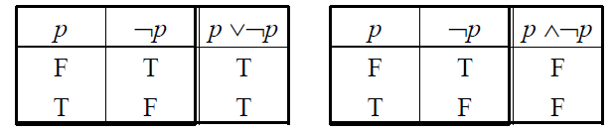
First-Order Logic
Tautologies and Contradictions
A tautology is a sentence that is True under all interpretations
An contradiction is a sentence that is False under all interpretations

Slide 15
First-Order Logic
Tautology By Truth Table
p | q | ¬p | pVq | ¬pΛ(p V q) | [ ¬pΛ(p V q)] → q
T | T | F | T | F | T
T | F | F | T | F | T
F | T | T | T | T | T
F | F | T | F | F | T

Slide 16
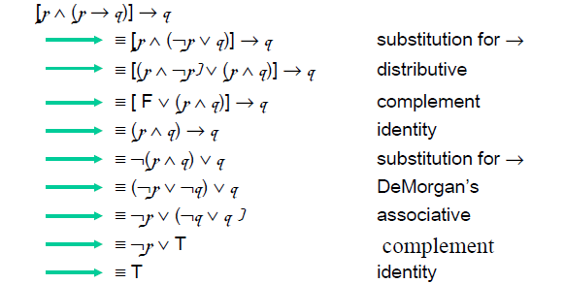
First-Order Logic
Propositional Logic - one last proof
Show that [p ☹ (p → q)] → q is a tautology
We use  to show that [p ☹ (p → q)] → q  T

Slide 17
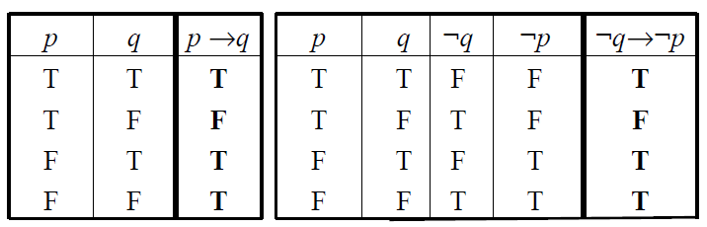
First-Order Logic
Logical Equivalence of Conditional and Contrapositive
The easiest way to check for logical equivalence is to see if the truth tables of both variants have
Identical last columns:

Slide 18
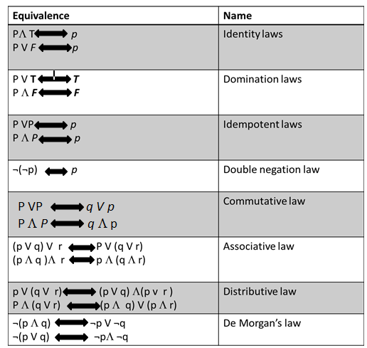
First-Order Logic
Identity laws
Like adding 0
Domination laws
Like multiplying by 0
Idempotent laws
Delete redundancies
Double negation
“I don’t like you, not”
Commutativity
Like “x+y = y+x”
Associativity
Like “(x+y)+z = y+(x+z)”
Distributivity
Like “(x+y)z = xz+yz”

Slide 19
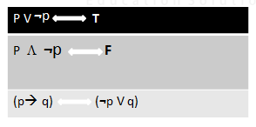
First-Order Logic
Table of Logical Equivalences
Excluded middle
Negating creates opposite
Definition of implication in terms of Not and Or

Slide 20
First-Order Logic
Inference Rules
Logical inference is used to create new sentences that logically follow from a given set of predicate calculus sentences (KB)

Slide 21
First-Order Logic
Sound rules of inference
Here are some examples of sound rules of inference
A rule is sound if its conclusion is true whenever the premise is true
Each can be shown to be sound using a truth table
RULE | PREMISE | CONCLUSION
Modus Ponens | A, A→ B | B
And Introduction / Conjunction | A, B | A Λ B
And Elimination / Simplification | A Λ B | A
Double Negation | ¬ ¬ A | A
Unit Resolution | A V B, B | A
Resolution | A V B , ¬B V C | A V C

Slide 22
First-Order Logic
Soundness Of Modus Ponens
A | B | A→ B | OK?
True | True | True | √
True | False | False | √
False | True | True | √
False | False | True | √

Slide 23
First-Order Logic
Proving things
A proof is a sequence of sentences, where each sentence is either a premise or a sentence derived from earlier sentences in the proof by one of the rules of inference
The last sentence is the theorem (also called goal or query) that we want to prove
Example for the “weather problem”
Hu | Premise | It is Humid
Hu→ Ho | premise | If it is humid, it is hot
Ho | Modus Ponens | It is hot
(Ho Λ Hu) → R | premise | If it is hot and humid it is raining
Ho Λ Hu | And Introduction | It is hot and humid
R | Modus Ponens | It is raining

Slide 24
First-Order Logic
Propositional Logic: Pro & Cons

Slide 25
First-Order Logic
Propositional logic: pro and con
Advantages
Simple KR language sufficient for some problems Lays the foundation for higher logics (e.g., FOL)
Reasoning is decidable, though NP complete, and efficient techniques exist for many problems
Disadvantages
Not expressive enough for most problems Even when it is, it can very “un-concise”

Slide 26
First-Order Logic
Propositional logic is a weak language
Hard to identify “individuals”
Can’t directly talk about properties of individuals or relations between individuals
Generalizations, patterns, regularities can’t easily be represented (e.g., “all triangles have 3 sides”)
First-Order Logic (abbreviated FOL or FOPC) is expressive enough to concisely represent this kind of information
FOL adds relations, variables, and quantifiers, e.g.,
“Every elephant is gray”  x (elephant(x) → gray(x))
“There is a white alligator” x (alligator(X) ^ white(X))

Slide 27
First-Order Logic
PL Example
Consider the problem of representing the following information:
How can these sentences be represented so that we can infer the third sentence from the first two?
Every person is mortal
Confucius is a person
Confucius is mortal

Slide 28
First-Order Logic
Solution: PL Example
In PL we have to create propositional symbols to stand for all or part of each sentence, e.g.:
P = “person”; Q = “mortal”; R = “Confucius”
The above 3 sentences are represented as:
P  Q; R  P; R  Q
The 3rd sentence is entailed by the first two, but we need an explicit symbol, R, to represent an individual, Confucius, who is a member of the classes person and mortal
Representing other individuals requires introducing separate symbols for each, with some way to represent the fact that all individuals who are “people” are also “mortal”

Slide 29
First-Order Logic
Propositional logic summary

Slide 30
First-Order Logic
Inference is the process of deriving new sentences from old
Sound inference derives true conclusions given true premises
Complete inference derives all true conclusions from a set of premises
A valid sentence is true in all worlds under all interpretations
If an implication sentence can be shown to be valid, then—given its premise—its consequent can be derived
Different logics make different commitments about what the world is made of and what kind of beliefs we can have
Propositional logic commits only to the existence of facts that may or may not be the case in the world being represented
Simple syntax and semantics suffices to illustrate the process of inference
Propositional logic can become impractical, even for very small worlds

Slide 31
First-Order Logic
First-Order Logic

Slide 32
First-Order Logic
Introduction
Propositional logic assumes the world contains facts
First-order logic (like natural language) assumes the world contains
Objects: people, houses, numbers, colors, baseball games, wars, …etc
Relations: red, round, prime, brother of, bigger than, part of, comes between, …etc
Functions: father of, best friend, one more than, plus, …etc.
First-order logic (FOL) models the world in terms of
Objects, which are things with individual identities
Properties of objects that distinguish them from other objects
Relations that hold among sets of objects
Functions, which are a subset of relations where there is only one “value” for any given “input”

Slide 33
First-Order Logic
4. Examples:
Objects: Students, lectures, companies, cars ..etc
Relations: Brother-of, bigger-than, outside, part-of, has-color, occurs-after, owns, visits, precedes…etc
Properties: blue, oval, even, large, ...
Functions: father-of, best-friend, second-half, one-more-than ...

Slide 34
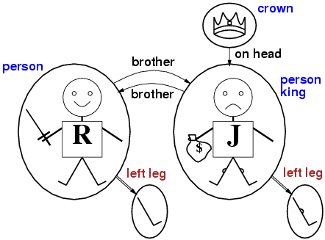
First-Order Logic
Models for FOL: Graphical Example

Slide 35
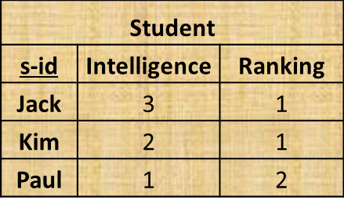
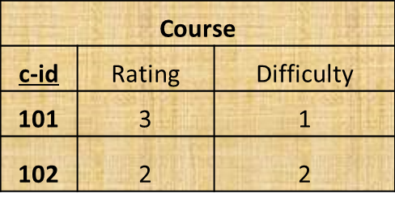
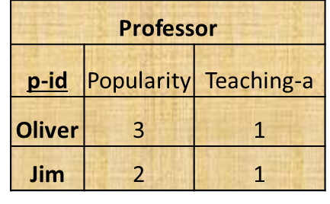
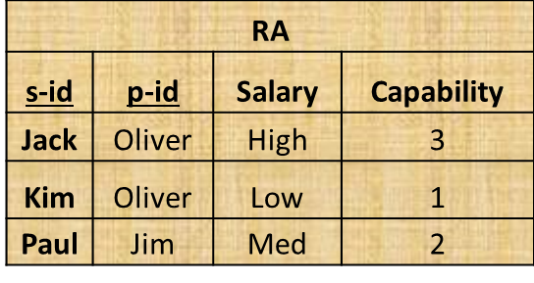
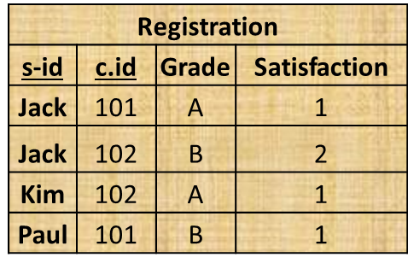
First-Order Logic
Tabular Representation
A FOL model is basically equivalent to a relational database instance
Historically, the relational data model comes from FOL

Slide 36
First-Order Logic
User provides
Constant symbols, which represent individuals in the world
Mary
3
Green
Function symbols, which map individuals to individuals
Father-of(Mary) = John
Color-of(Sky) = Blue
Predicate symbols, which map individuals to truth values
Green(Grass)
Color(Grass, Green)

Slide 37
First-Order Logic
FOL Provides:
Variable symbols
E.g., x, y, foo
Connectives
Same as in PL: not (➢), and ( ☹), or ( V ), implies ( → ),
if and only if ( )
Quantifiers
Universal x or (Ax)
Existential x or (Ex)

Slide 38
First-Order Logic
Syntax of FOL: Basic Elements
Constants | KingJohn, 2, NUS,...
Predicates | Brother, >,...
Functions | Sqrt, LeftLegOf,...
Variables | x, y, a, b,...
Connectives | ¬ , Λ, V,
Equality | =
Quantifiers | ∀, ∃

Slide 39

First-Order Logic
Examples
King John and Richard the Lion heart are brothers
Brother(KingJohn, RichardTheLionheart)
The length of left leg of Richard is greater than the length of left leg of King John
>(Length(LeftLegOf(Richard)),
Length(LeftLegOf(KingJohn)))
John Richard

Slide 40
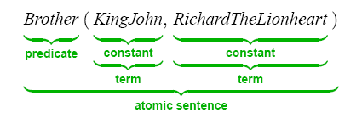
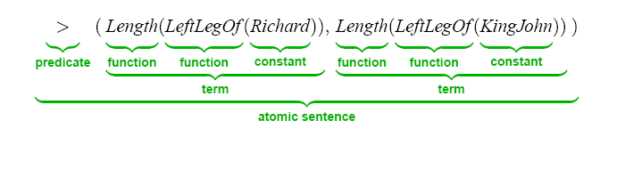
First-Order Logic
Atomic Sentence

Slide 41

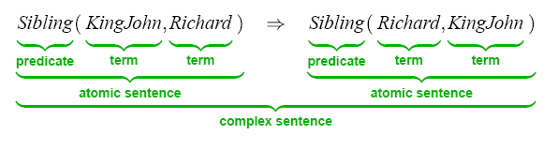
First-Order Logic
Complex Sentence
Complex sentences are made from atomic sentences using connectives:
Example
Sibling(King John ,Richard )  Sibling(Richard , King John)

Slide 42

First-Order Logic
FOL Illustrated
Five objects-
Richard the Lionheart
2. Evil King John
3. Left leg of Richard
4. Left leg of John
5. The crown

Slide 43
First-Order Logic
Objects are related with Relations
For example, King John and Richard are related with Brother relationship
This relationship can be denoted by (Richard, John), (John, Richard)

Slide 44
First-Order Logic
Again, the crown and King John are related with On Head Relationship- On Head (Crown, John)
Brother and On Head are binary relations as they relate couple of objects

Slide 45
First-Order Logic
Properties are relations that are unary
In this case, Person can be such property acting upon both Richard and John Person (Richard) Person (John)
Again, king can be acted only upon John King (John)

Slide 46
First-Order Logic
Certain relationships are best performed when expressed as functions.
Means one object is related with exactly one object.
Richard -> Richard’s left leg
John -> John’s left leg

Slide 47
First-Order Logic
Universal quantification
<variables> <sentence> x P(x)
Translated into the English language, the expression is understood
as:
"For all x, P(x) holds",
"for each x, P(x) holds" or
“for every x, P(x) holds“
"All cars have wheels" could be transformed into the propositional form, "x P(x)
P(x) is the predicate denoting: x has wheels, and
the universe of discourse is only populated by cars

Slide 48
First-Order Logic
4. If all the elements in the universe of discourse can be listed then the universal quantification "x P(x) is equivalent to the conjunction:
P(x1) ☹ P(x2) ☹ P(x3) ….. ☹ P(xn)
5. For example, in the above example of "x P(x), if knew that there were only 4 cars in our universe of discourse (c1, c2, c3 and c4) then we could also translate the statement as:
P(c1) ☹ P(c2) ☹ P(c3) ☹ P(c4)

Slide 49
First-Order Logic
Consider the five objects in the example and replace them with a variable x-
x ―›Richard the Lionheart
x ―› Evil King John
x ―› Left leg of Richard
x ―› Left leg of John
x ―› The crown

Slide 50
First-Order Logic
Consider the five objects in the example and replace them with a variable x-
Now, for the quantified sentence
x King (x)  Person (x)
Richard is king  Richard is Person
John is king  John is person
Richard’s left leg is king  Richard’s left leg is person
John’s left leg is king  John’s left leg is person
The crown is king  the crown is person

Slide 51
First-Order Logic
Consider the five objects in the example and replace them with a variable x-
Now, for the quantified sentence
x King (x)  Person (x)
Richard is king  Richard is Person
John is king  John is person
Richard’s left leg is king  Richard’s left leg is person
John’s left leg is king  John’s left leg is person
The crown is king  the crown is person

Slide 52
First-Order Logic
Existential quantification
 <variables> <sentence>
Translated into the English language, the expression is understood as:
"There exists an x such that P(x)"
"There is at least one x such that P(x)"
"Someone loves you" could be transformed into the propositional form,  x P(x)
P(x) is the predicate meaning: x loves you,
The universe of discourse contains (but is not limited to) all living creatures

Slide 53
First-Order Logic
Existential quantification
If all the elements in the universe of discourse can be listed, then the existential quantification x P(x) is equivalent to the disjunction:
P(x1) P(x2) P(x3)  ...P(xn)
For example, in the above example of  x P(x), if there were only 5 living creatures in our universe of discourse (say: me, he, she, rex and fluff) then the statement can be written as:
P(me) P(he) P(she) P(rex) P(fluff)

Slide 54
First-Order Logic
Order of application of quantifiers
When more than one variables are quantified in a wff such as
 y x P( x, y )
They are applied from the inside, that is, the one closest to the atomic formula is applied first
Thus  y x P( x, y ) reads  y[  x P( x, y )], and we say "there exists a y such that for every x, P( x, y ) holds " or " for some y, P( x, y ) holds for every xevery
The positions of the same type of quantifiers can be switched without affecting the truth value as long as there are no quantifiers of the other type between the ones to be interchanged.
For example
 x y  y x z P(x, y , z), etc.
It is the same for the universal quantifier

Slide 55
First-Order Logic
4. However, the positions of different types of quantifiers can not be switched.
5. For example x  y P( x, y ) is not equivalent to
yx P( x, y )
6.  x  y x < y
“for every number x, there is a number y that is greater than x ”
7.  y  xx < y
“there is a number -that is greater than every (any) number ”

Slide 56
First-Order Logic
Properties of quantifiers
x y is the same as y x
x y is the same as y x
x y is not the same as y  x
Quantifier duality: Each can be expressed using the other
x Likes(x,IceCream) is equivalent to
➢x ➢Likes(x,IceCream)
x Likes(x,Broccoli) is equivalent to
➢x ➢Likes(x,Broccoli)

Slide 57
First-Order Logic
Equivalences:
 x P is equivalent to ➢x ➢P
 ➢x ➢P is equivalent to x P
 x ➢P is equivalent to ➢x P
 ➢x P is equivalent to x ➢P

Slide 58
First-Order Logic
References
Artificial Intelligence: A Modern Approach (2nd Edition) by Russell and Norvig Chapter 8
http://www.cs.odu.edu/~toida/nerzic/content/logic/pred

Slide 59
Self Assessment Questions
1. There exist only two types of quantifiers, Universal Quantification and Existential Quantification. State whether True or False.
a) True
b) False
Answer: a

Slide 60
Self Assessment Questions
2. Translate the following statement into FOL.
“For every a, if a is a philosopher, then a is a scholar”
a) ∀ a philosopher(a) scholar(a)
b) ∃ a philosopher(a) scholar(a)
c) All of the mentioned
d) None of the mentioned
Answer: a

Slide 61
Self Assessment Questions
3. A _________ is used to demonstrate, on a purely syntactic basis, that one formula is a logical consequence of another formula.
a) Deductive Systems
b) Inductive Systems
c) Reasoning with Knowledge Based Systems
d) Search Based Systems
Answer: a

Slide 62
Self Assessment Questions
4. The statement comprising the limitations of FOL is/are
a) Expressiveness
b) Formalizing Natural Languages
c) Many-sorted Logic
d) All of the mentioned
Answer: d

Slide 63
Self Assessment Questions
5. A Term is either an individual constant (a 0-ary function), or a variable, or an n-ary function applied to n terms: F(t1 t2 ..tn). State whether True or False.
a) True
b) False
Answer: a

Slide 64
Self Assessment Questions
6. First Order Logic is also known as ___________.
a) First Order Predicate Calculus
b) Quantification Theory
c) Lower Order Calculus
d) All of the mentioned
Answer: d

Slide 65
Self Assessment Questions
7. The adjective “first-order” distinguishes first-order logic from ___________ in which there are predicates having predicates or functions as arguments, or in which one or both of predicate quantifiers or function quantifiers are permitted.
a) Representational Verification
b) Representational Adequacy
c) Higher Order Logic
d) Inferential Efficiency
Answer: c

Slide 66
Assignment
General Instructions: You need to explain below sets of problem. These problem statement are meant to discussed in detailed explanations. You can submit your solution in 6-8 A4 sheets paper for further evaluation or as per faculty suggestions.
Explain the advantages and disadvantages of Propositional Logic.
Write the Syntax of First-Order-Logic for Basic Elements.
Write the properties of Quantifiers.
Explain application of quantifiers with examples.

Slide 67
Document Link
Topics | URL | NOTES
Reasoning and Logic a. Propositional Logic | https://www.iep.utm.edu/prop-log/ | Describes propositions using logical connectives
 | https://www.google.co.in/url?sa=t&rct=j&q=&esrc=s&source=web&cd=2&cad=rja&uact=8&ved=0ahUKEwiRnret5rvYAhUM5GMKHbdAC_oQFggtMAE&url=http%3A%2F%2Fwww1.spms.ntu.edu.sg%2F~frederique%2Fdm2.pdf&usg=AOvVaw2Erj20gZnlMmJf7-FlhKSB | Explains rules and techniques to formalize statements, to make them precise.

Slide 68
Document Link
Topics | URL | NOTES
Knowledge Engineering | https://www.investopedia.com/terms/k/knowledge-engineering.asp | Defines rules and reasoning mechanisms to provide solutions to real-world problems
 | www.cs.vu.nl/~guus/papers/Schreiber07a.pdf | Discuss about diagnosis, trouble-shooting, and solving issues
Inference Rules involving Quantifiers | www.sdsc.edu/~tbailey/teaching/cse151/lectures/chap09a.html | Explains logical form of a function which takes premises, analyses their syntax, and returns a conclusion.
 |  | Outline the functions by applying the inference rule.

Slide 69
Video Link
SUB TOPIC | VIDEO LINK | NOTES
Knowledge Engineering | https://www.youtube.com/watch?v=8mwwGJGK-Zg https://www.youtube.com/watch?v=0OQJhyQMY8E | 1. Explains about the basic concept of knowledge engineering. 2. Video summarizing the creation, applications and limitations of knowledge based (expert) systems
Inference Rules involving Quantifiers | https://www.youtube.com/watch?v=__QMuFGENO8 | 1. Equivalence, Validity, Satisfiability, Modus ponens, And-elimination, Bi-directional elimination, Law of contraposition

Slide 70
Video Link
SUB TOPIC | VIDEO LINK | NOTES
Forward Chaining. | https://www.youtube.com/watch?v=EZJs6w2YFRM https://www.youtube.com/watch?v=KwhO2nZHeQg | This is a brief description of the different kinds of logic that may be used in determining the solution to a problem.
Backward chaining | https://www.youtube.com/watch?v=EZJs6w2YFRM https://www.youtube.com/watch?v=KwhO2nZHeQg | 2. This is a brief description of the different kinds of logic that may be used in determining the solution to a problem.

Slide 71
e Book
Sub-Topic | E-book name | Chapter No | Page Number | URL
Forward Chaining. | Russell S., Norvig P. Artificial intelligence- a modern approach (2ed,PH,2003) | 9 | 280-283 | http://www.eng.uerj.br/~fariasol/disciplinas/Topicos_B/AGENTS/books/Stuart%20Russell,%20Peter%20Norvig-Artificial%20Intelligence_%20A%20Modern%20Approach-Prentice%20Hall%20(2002)-2nd-ed.pdf
Backward Chaining. | Russell S., Norvig P. Artificial intelligence- a modern approach (2ed,PH,2003) | 9 | 287-294 | http://www.eng.uerj.br/~fariasol/disciplinas/Topicos_B/AGENTS/books/Stuart%20Russell,%20Peter%20Norvig-Artificial%20Intelligence_%20A%20Modern%20Approach-Prentice%20Hall%20(2002)-2nd-ed.pdf

