Slide 1
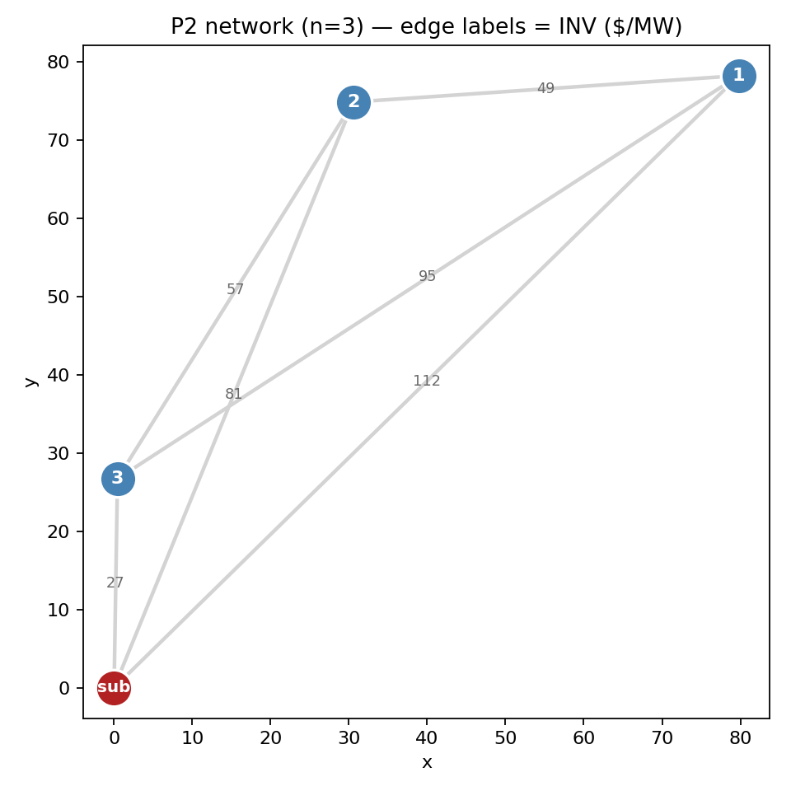
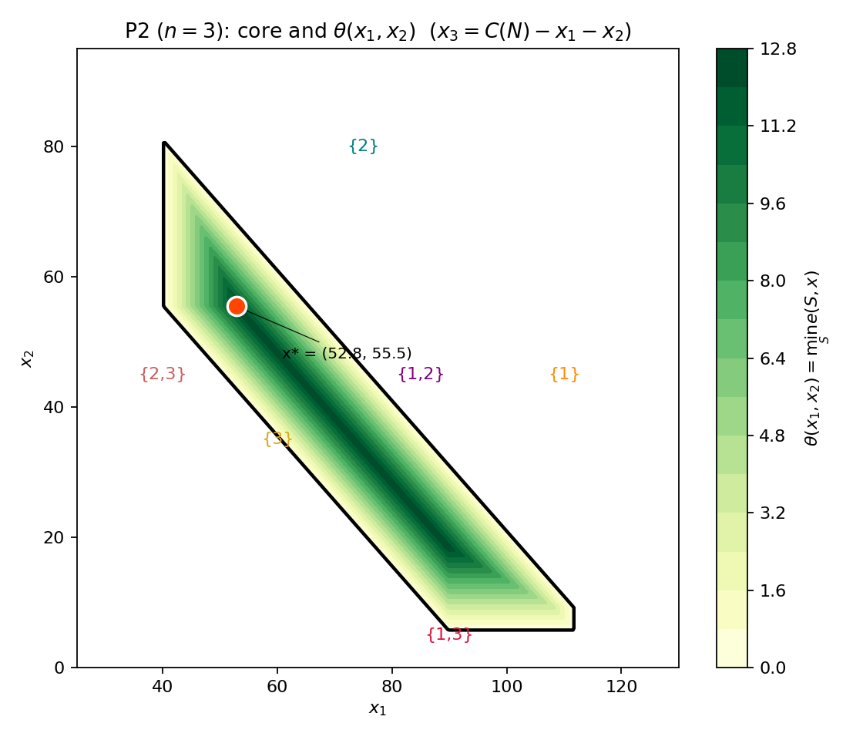
Problem 2 (n=3): Nucleolus Geometry & Cost Function Validation
8 coalitions · perfect anti-correlation · seed=238 · C(N)=122.28
s | C(s) | gain | excess
{1} | 111.72 | 0.00 | 58.91
{2} | 80.82 | 0.00 | 25.37
{3} | 26.70 | 0.00 | 12.69
{1,2} | 120.95 | 71.60 | 12.69
{1,3} | 116.51 | 21.91 | 49.69
{2,3} | 82.15 | 25.37 | 12.69
{N} | 122.28 | 96.96 | —
Nucleolus x* (sum = C(N) = 122.28)
x₁ = 52.81 (43.2%) x₂ = 55.45 (45.3%) x₃ = 14.01 (11.5%)
Sequential LP iterations
iter 1 | ε* = 12.69 | 3 tight ({3}, {1,2}, {2,3})
iter 2 | ε* = 25.37 | 1 tight ({2})
iter 3 | ε* = 49.69 | 1 tight ({1,3}; {1} non-binding e=58.91)
Takeaways
Cost LP correct: C({i}) = INV(0,i) for all singletons (direct line is optimal).
Anti-correlation savings: ΣC({i}) − C(N) = 96.96.
Core-stable: every coalition's excess ≥ ε*₁ = 12.69; x* lies at the deepest θ in the core.
gain = ΣC({i}) − C(s) | excess = C(s) − x*(s) | red = tight at ε*₁

Slide 2
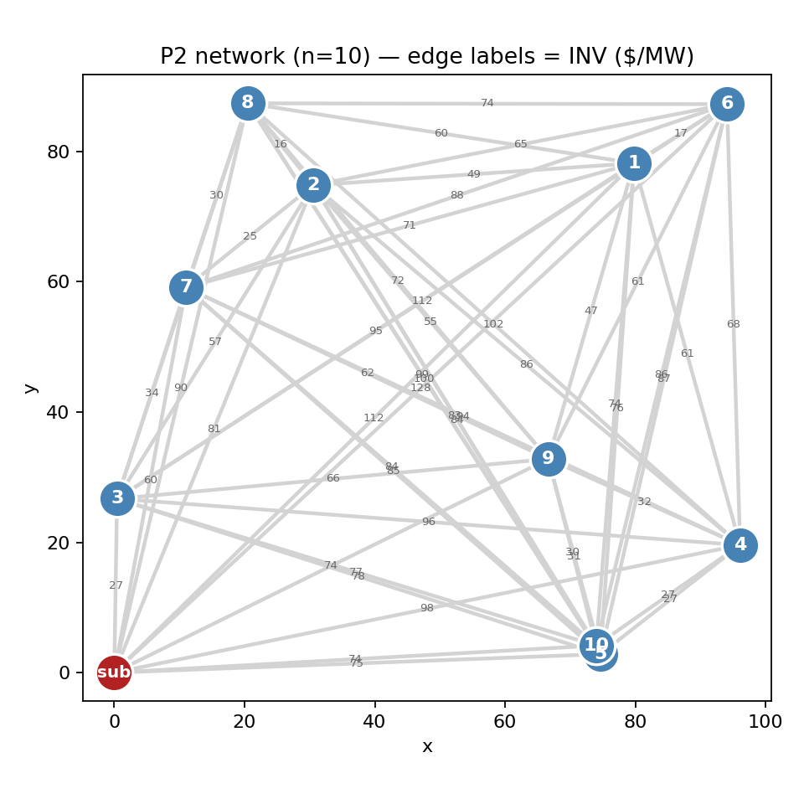
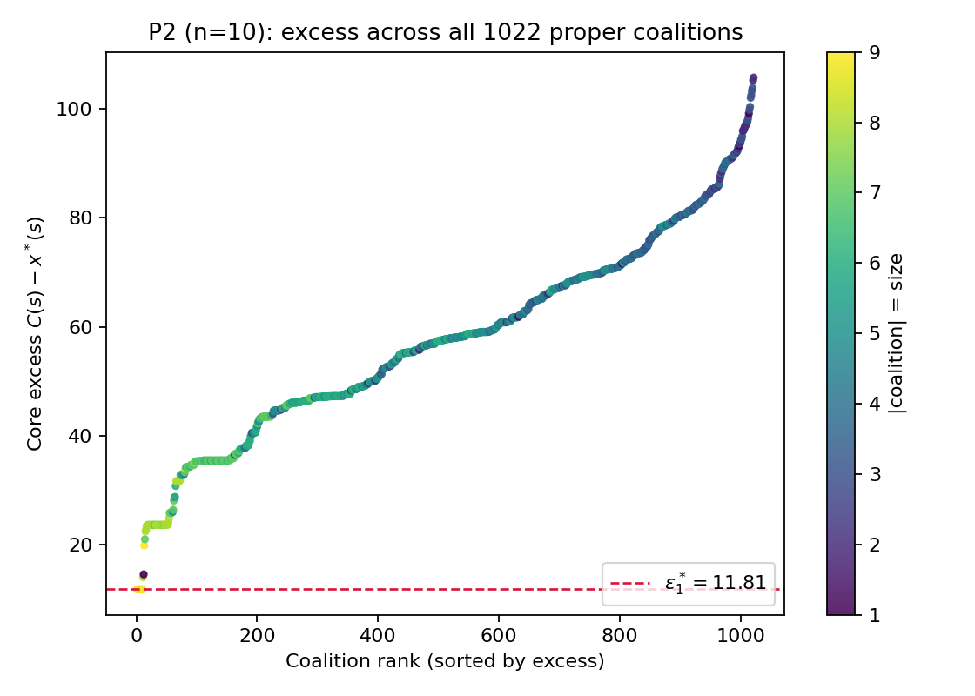
Problem 2 (n=10): Nucleolus across 1024 Coalitions
11 nodes · 55 lines · 1022 proper coalitions · C(N)=184.50
Nucleolus x* (sum = C(N) = 184.50, sorted by share)
p6 35.16 (19.1%) p4 26.45 (14.3%) p9 24.58 (13.3%) p8 22.24 (12.1%)
p2 14.60 ( 7.9%) p5 12.67 ( 6.9%) p1 12.58 ( 6.8%) p10 12.25 ( 6.6%)
p3 12.15 ( 6.6%) p7 11.81 ( 6.4%)
Sequential LP iterations & takeaways
it1: ε*=11.81 (10 tight — all singletons bind first)
it2..9: ε climbs 14.03 → 23.53 (1 coalition / step)
it10: ε*=23.63 (33 tight; 971 non-binding remain)
Anti-correlation savings: ΣC({i}) − C(N) = 634.08.
Peripheral nodes (6,4,9,8) pay most; nodes near substation (3,7,10) pay least.

