Slide 1
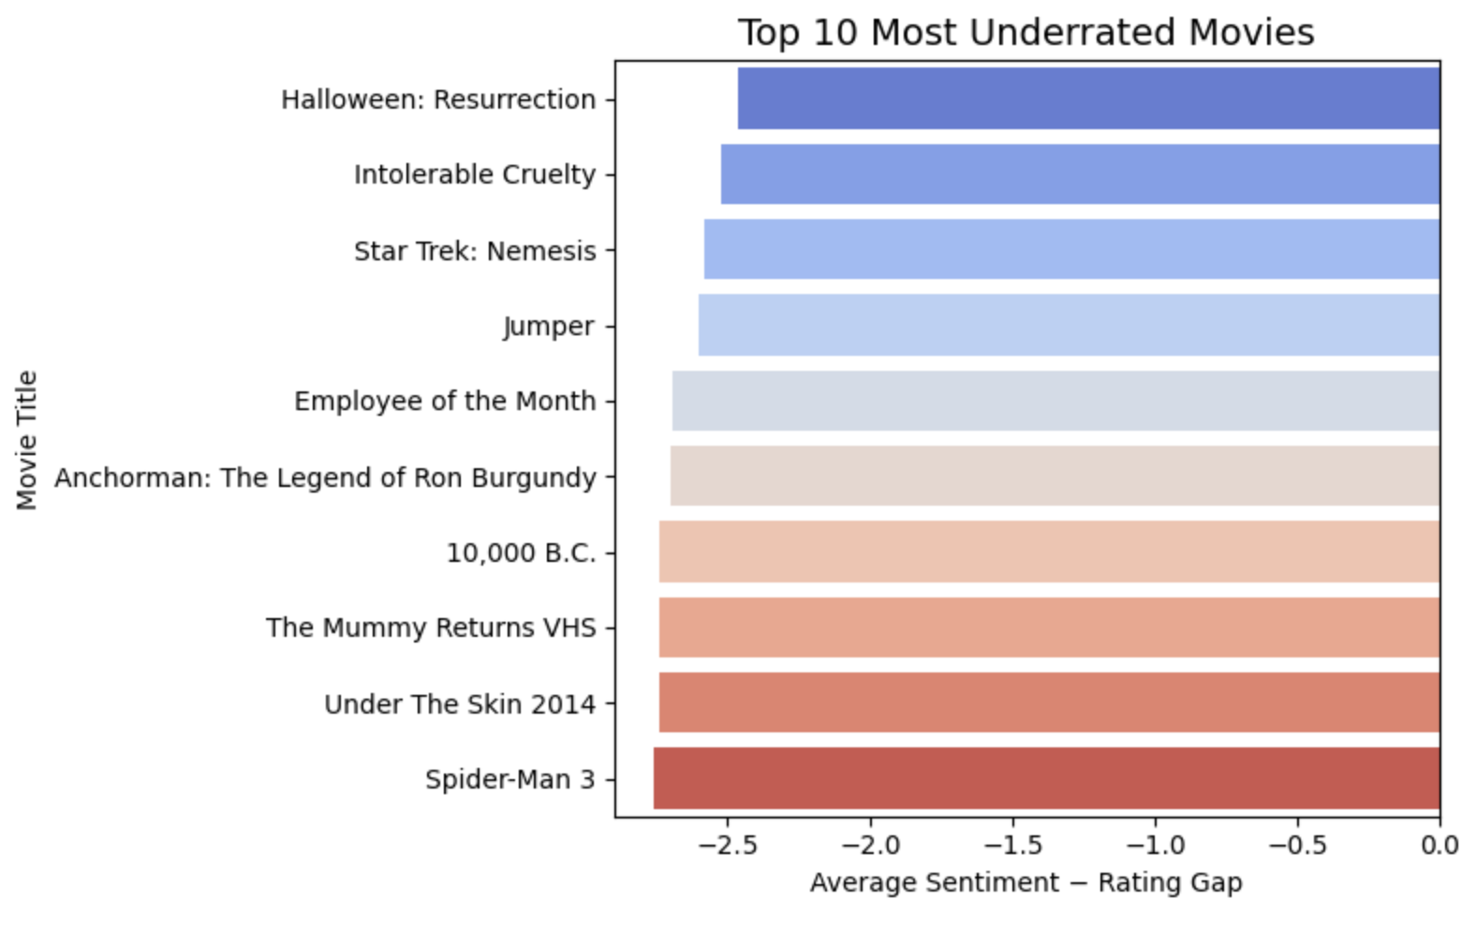
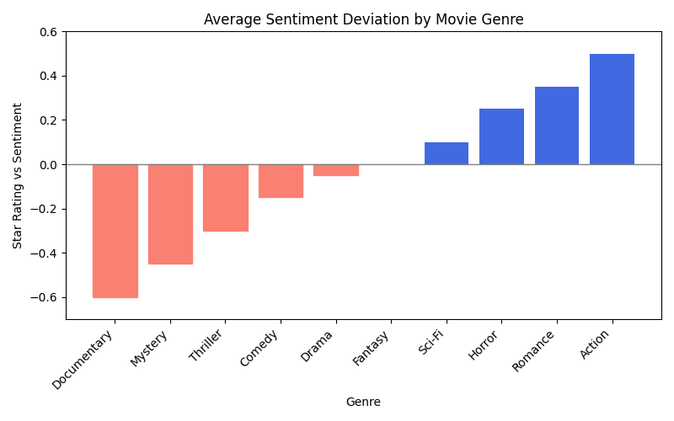
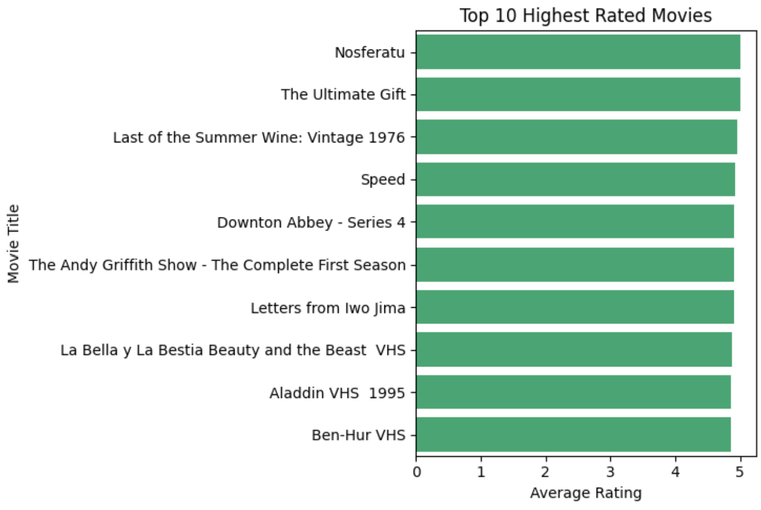
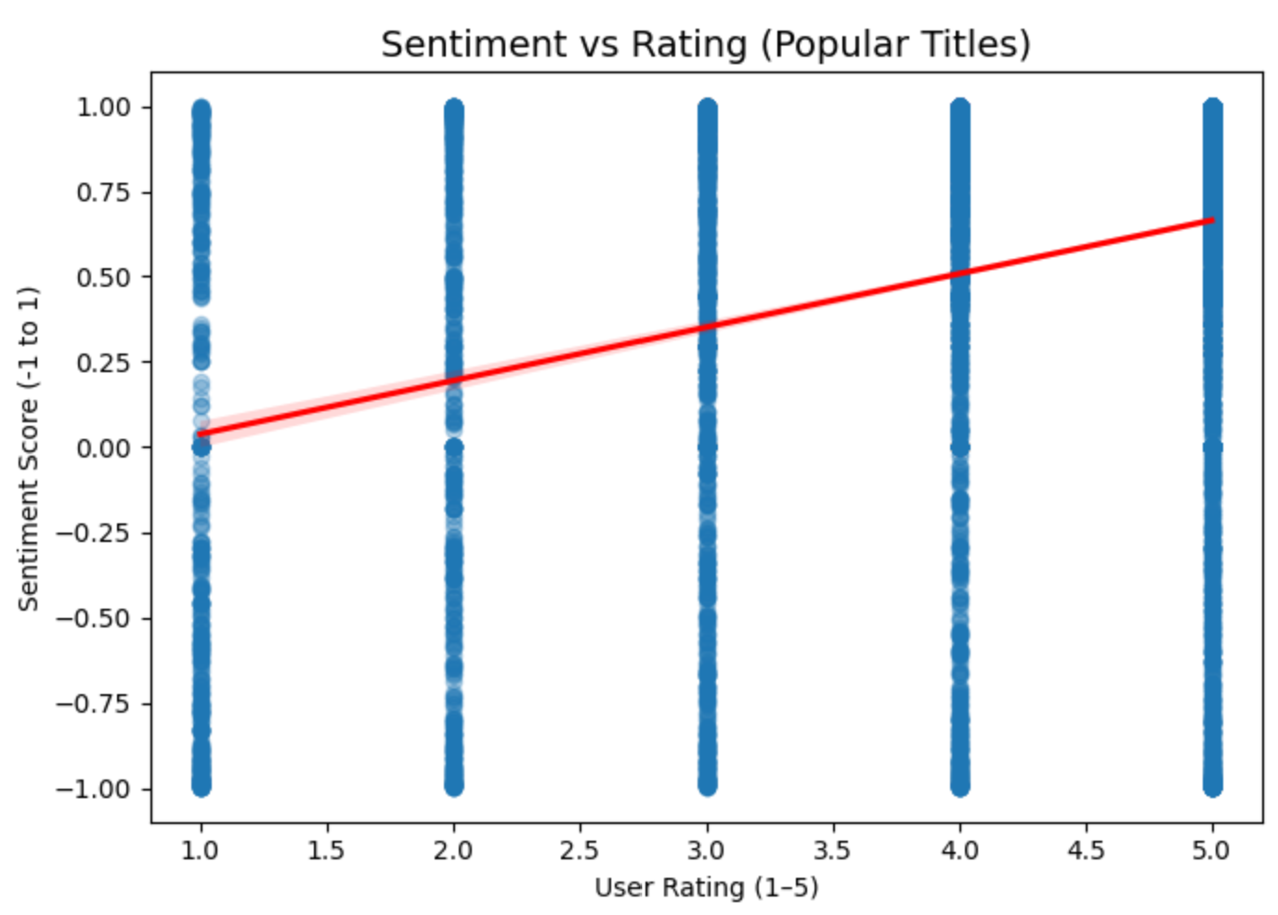
Comparison of Different Movie Review Methods
Micah Gifford and Jacob Limerick
Introduction and Problem
Conclusions
We are both fans of movies of all genres, but often find a fundamental flaw in the traditional movie ranking system: rankings based on a star system often disproportionately see 2-star and 3-star (and sometimes even 4-star) ratings underutilized in comparison to their true feelings about a film. A written review is often more nuanced and reveals much more detail about a consumer’s understanding than a star-based ranking, but can be much more difficult to consume efficiently or in aggregate.
We seek to expose this delta between easy-to-use star rankings and detailed individual written reviews by performing sentiment analysis with the VADER tool on written reviews and comparing this to traditional reviews to find under- and over-appreciated films.
We found a strong, but not perfect correlation between star ratings and written review sentiment (r=0.81)
The most consistently underrated genre was documentaries, while the most overrated was action movies
There was little to no correlation (r=0.21) between a movie’s release year and it’s rating (star, sentiment, or delta)
Spider-Man 3 was found to be the most underrated movie
Sequels were consistently rated lower than the originals, but re-releases or re-masters often scored much higher
Our tool was able to recommend underrated movies, accomplishing the main goal
Pull 9 million+ IMDb and Amazon movie ratings
Filter out titles with less than 50 reviews
Use the VADER tool to perform sentiment analysis on written reviews
Compare normalized sentiment scores with actual reviews to identify underrated films
Create a hybrid ranking using a weighted combination of the two review methods to identify top overall films
Compare correlation of the two rating systems, identify trends in genres and release year using linear regression
Method & Process

